Slide 1
Goals
BNL Director’s Review: 4/9-11, 2019
Update budget
MVTX TPC: $5.49M → <$5M
Revisit major high cost items - carbon structures etc
Contingency: 30% now for all, some could be lower?
Move some tasks to WBS 2.x

Slide 2
MVTX detector in sPHENIX
MVTX detector with service cylinder
Support brackets for TPC and INTT
TPC volume, length 2,160.0 mm
INTT detector, 2 layers

Slide 3
INTT Consideration

Slide 4
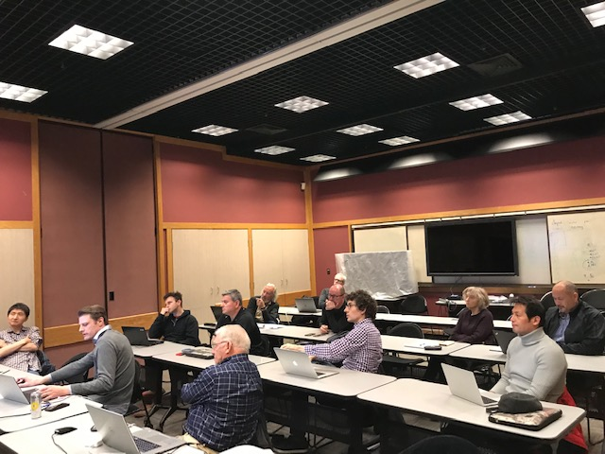
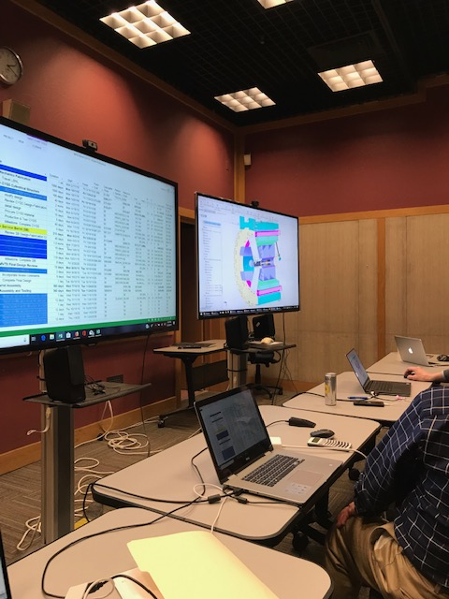
Friday Mechanical System Discussions

Slide 5
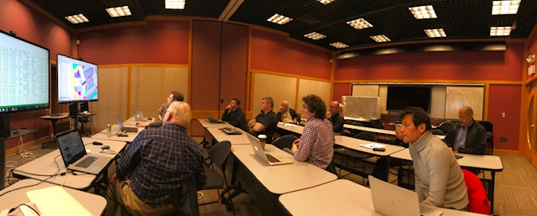

Slide 6
Notes from Friday Discussions
Power system
Update the cost - Yuan
Cost in US $ for CAEN, from LANL LDRD – Ming
sPHENIX LV PS?
Carbon structures
Service barrel – new $$, less by ~$100K
Existing mold, R = 126mm, could be used for MVTX
CYSS – new cost, less
INTT feedback – cones become disk OK, if far away from IP
End wheels – new cost, more, ~40% contingency for some
Total cost for CYSS + End wheels, ~$1.6M
Avoid conical structures if possible, they are expensive!
Carbon structure production schedule - best by 2020 (Eric)
One sPHENIX order, MVTX+INTT – cost saving
PHENIX FVTX carbon strucutre cost ~$950K
Integration – reasonable cost, ~$700K

Slide 7
New Schedule
Stave production @CERN
May 2019- May 2020, 84 staves
4-stave/week
Stave acceptance test @LBNL
MOSAIC system, 9/2019 – 5/2020
Final mechanical design work
May 2019 – $$ available ?
CYSS, End wheels
Service barrel and interface
MVTX detector assembly at LBNL
LBNL ALICE ML stave production ends ~12/2019, a total of 60 ML staves
Start MVTX detector assembly ~ end of 2019, after the completion of ALICE ML?
MVTX half-barrel full test @LBNL
Starts ~mid of 2021
Using full readout system if ready: 24RU + 12PU + 3FELIX/2 servers ()

Slide 8
MVTX Schedules and Milestones, in progress (3/2019)
sPHENIX: CD1/3a PD2/3
Installation
1st collisions
CY-2018 | 2019 | 2020 | 2021 | 2022 | 2023
MVTX
Stave & RU
production
FELIX
production
Detector mechanics design & production, global interface to sPHENIX
End Wheels
CYSS
Global integration
/interface design?
Service barrel
design & production
Ready for beam;
sPHENIX day-1 run
Barrel Assembly & Testing @LBNL
Install half barrels
@sPHENIX IR
Half barrel #1
Power system
production
Half barrel #2
Half barrels
arrive @BNL
design & procure
interface to
sPHENIX rails
Design & procure
sPHENIX rails
MVTX installation & commissioning @BNL
RU, FELIX, PS, cables etc.

Slide 9
Possible New Test Beam @Fermilab with INTT + TPC: 6/10-20
INTT DAQ needs more support
After PD-2 review, 5/29-31, 2019
TPC TB, 6/12 – 7/7. (7/8/2019, beam turned off)

Slide 11
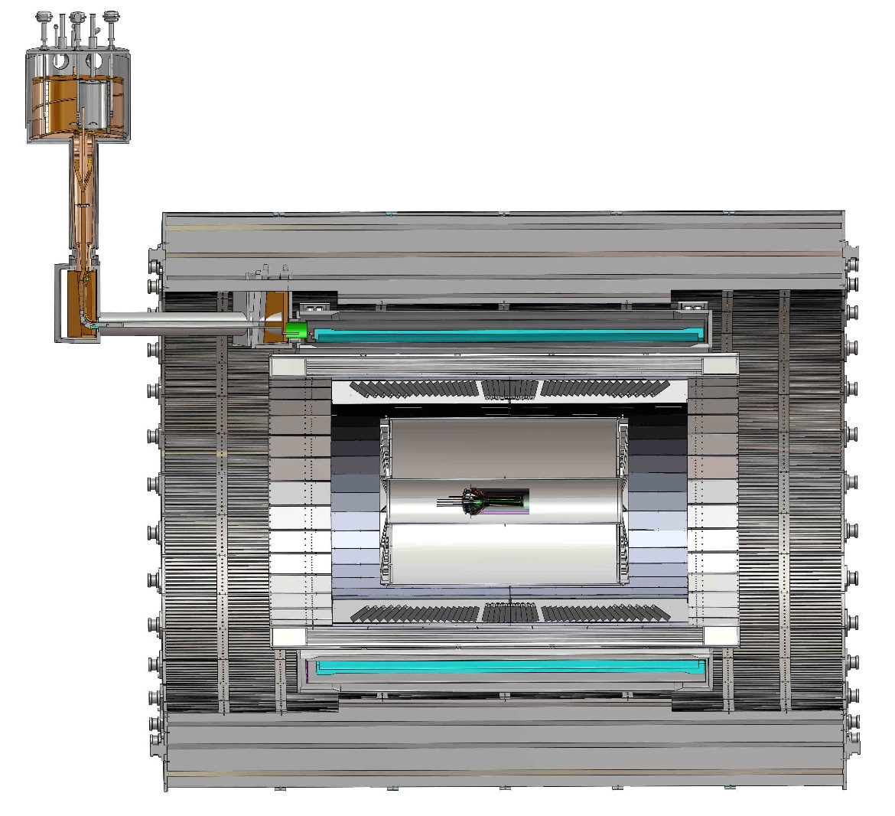
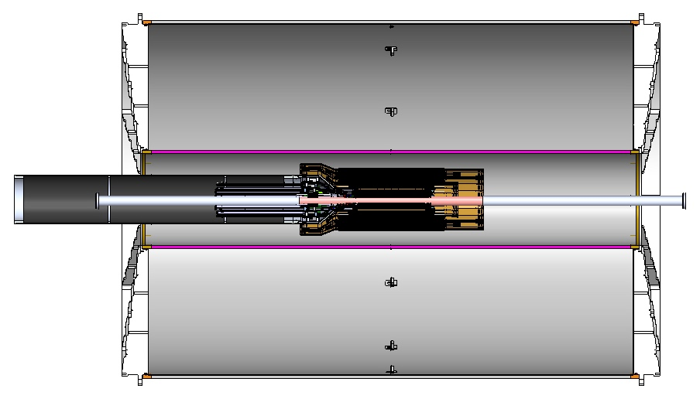
MVTX Global Mechanical System Integration
MVTX service barrel preliminary design, with two parts:
Part-1: from MVTX to PP-1b, all power PCB, 40cm
Part-2: length TBD later, from PP-1b to PP-2
iHCal/Support
Service Barrel
TPC
TPC
INTT
MVTX
PP-1a:
short signal cables
PP-2:
Signal and power cables
R= 209.6cm
PP-1b:
power cables
L = 350.0 cm

Slide 12
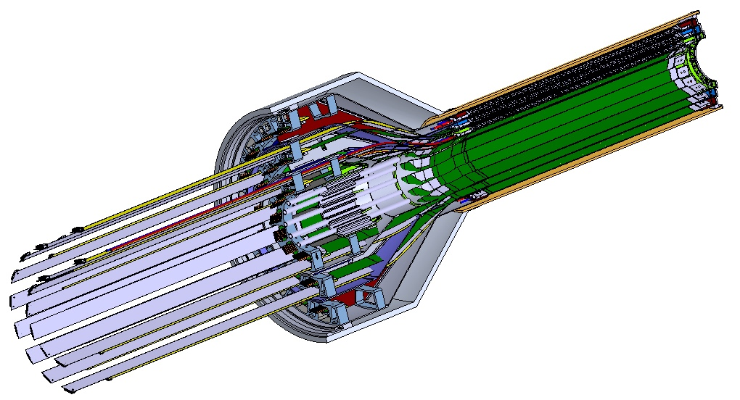
Detector Mechanical System Design
a new MVTX stave design with 40cm extended power FPC

Slide 13
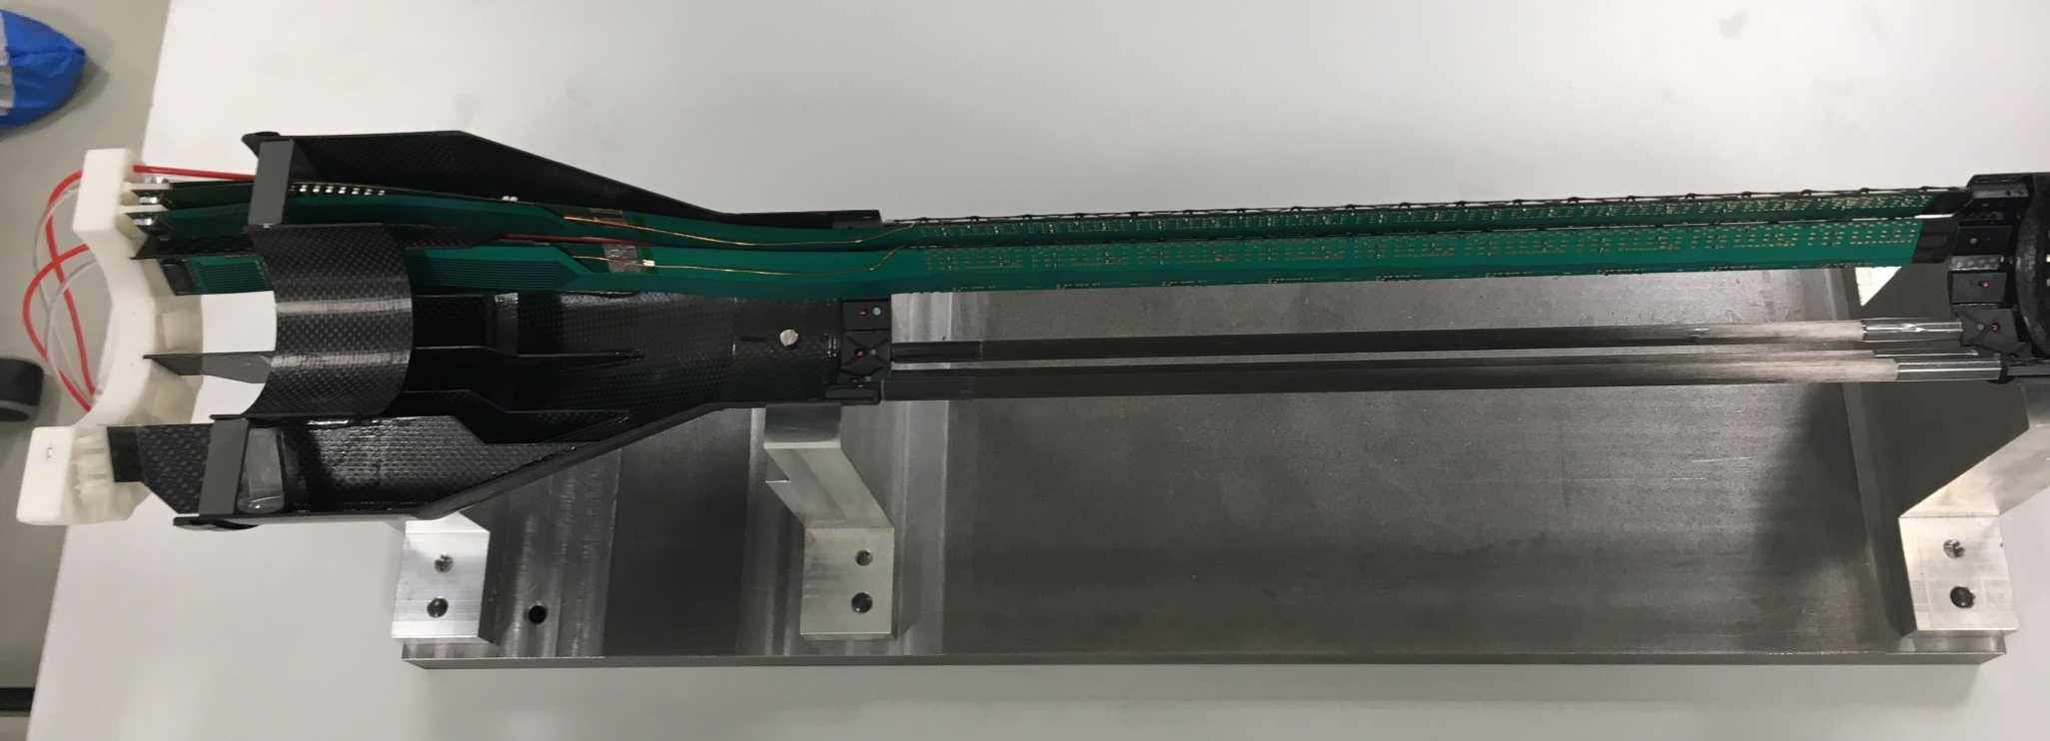
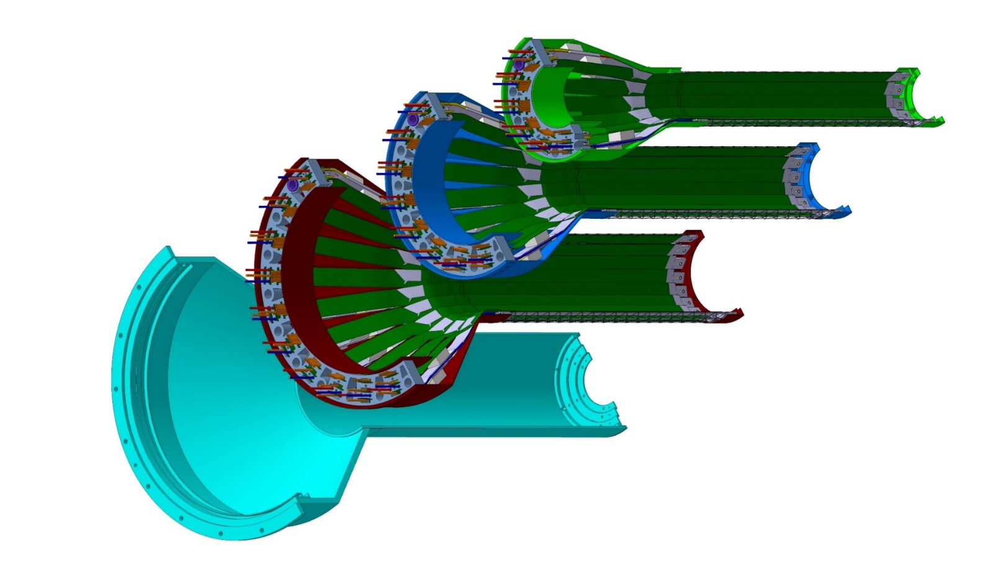
Detector Assembly
staves
Precision positioning and installation of staves on end-wheels
dummies
ALICE 1st half inner layer being assembled
6/2018@CERN
Layer 0
Layer 1
Follow ALICE IB assembly procedures to build half-detectors for MVTX
QA records in DB, travelers
Modified jigs for MVTX
Build two full half-barrel detector with the service structures
Layer 2
IB CYSS
Install SamTec & power cables during half-barrel assembly with the service barrel at LBNL

Slide 14
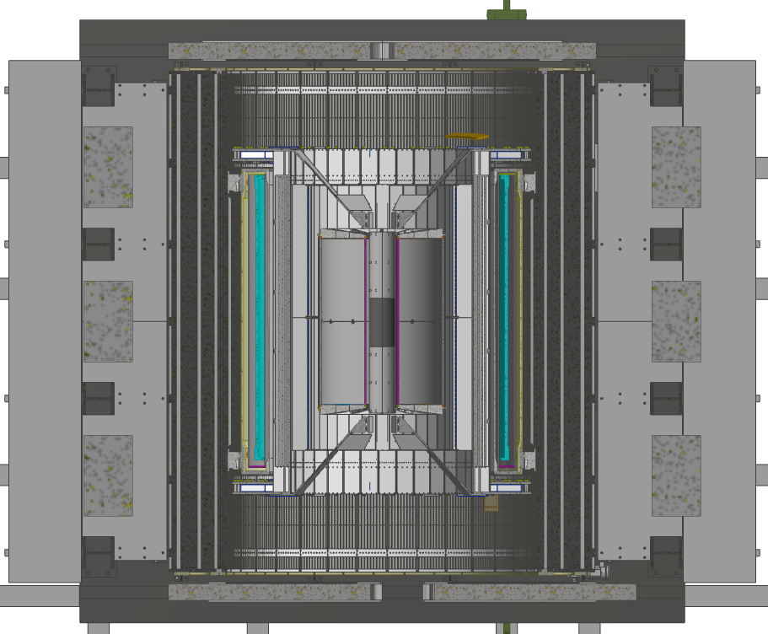
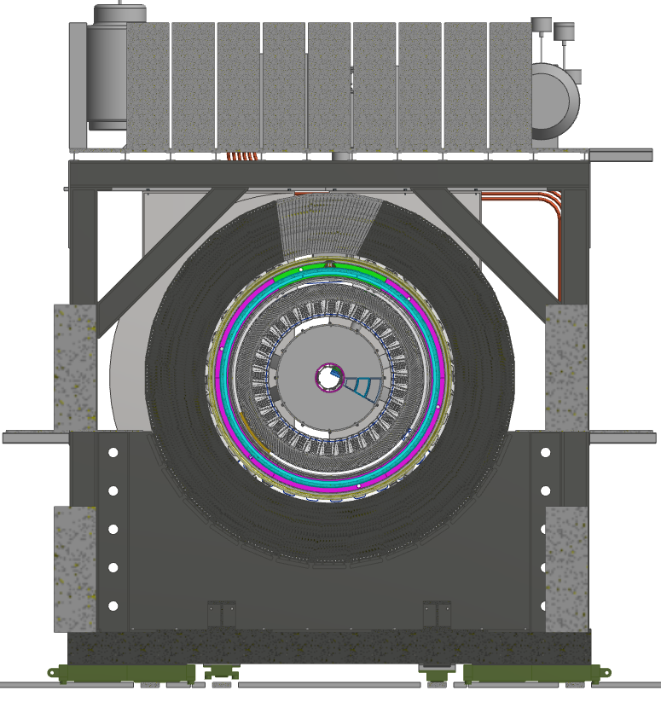
MVTX Cable Route
2E3
West
East
2E1
1.4 m
6.5 m
4.7 m

Slide 15
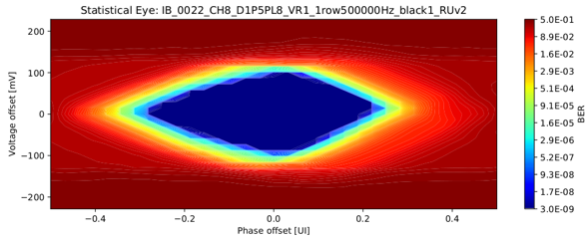
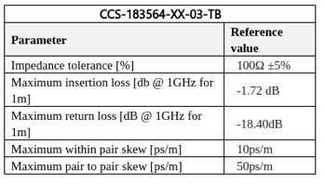
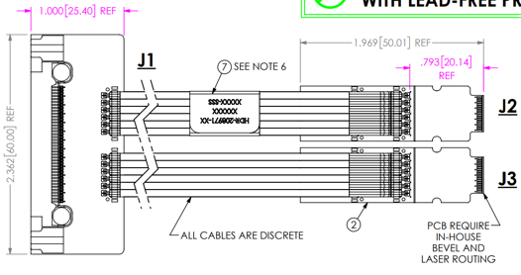
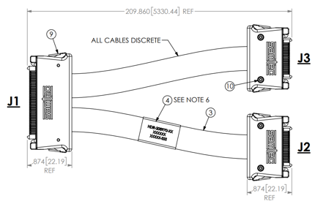
Signal cable design
The Samtec twinax cables carry clock (40 MHz), control (40 Mbps bidirectional), data (9x1.2 Gbps)
ALICE is using halogen-free cables (32 AWG, LDPE dielectric) due to CERN LSZH requirement; 2.65 + 5.3 m cables have been tested and are now in production
RU
RU
Stave
Stave

Slide 16
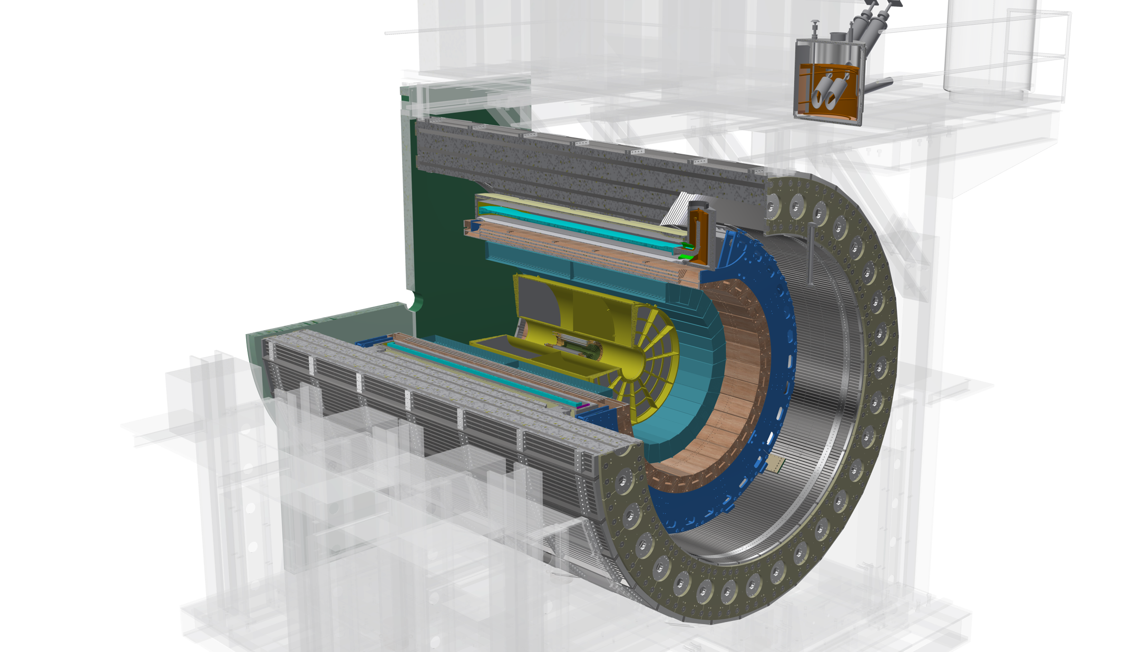
The sPHENIX Detector Design
Outer HCal
SC Magnet
Inner HCal
EMCal
TPC
INTT
MVTX
Φ ~ 5m
15 kHz trigger
>10 GB/s data
Notes:
15kHz matched to collision rate.

