Slide 1
MVTX Cost & Schedule
(WBS 3.2)
Dave Lee/Ming Liu, LANL
April 9-11, 2019
BNL

Slide 2
MVTX C & S - Assumptions
Integrated into the sPHENIX schedule (P6)
Self contained project, funding from BNL
Technically driven schedule
Built-in resource hourly rates, fully burdened with escalation
Will implement Risk Based Contingency
Schedule not smoothed, ~6 months contingency in P6 prior to sPHENIX installation
Electronics ready for production on day-1 due to the successful LDRD effort, cost based on as built experience, FELIX and RU service boards, power system etc.
Staves and Readout Units (RU) not in P6, separate cost
LANL 04/10/19
2

Slide 3
MVTX in sPHENIX P6 (fully Burd. & Esca.)
TPC: $4.3M

Slide 4
MVTX Schedules and Milestones
sPHENIX: CD1/3a PD2/3
Installation
1st collisions
CY-2018 | 2019 | 2020 | 2021 | 2022 | 2023
Generic R&D
Sensors for RHIC
Stave & RU production @CERN
MVTX
Construction
Detector mechanics design & production, global interface to sPHENIX
Detector & interface design
MVTX final
review
Feb. 2019, in P6
End Wheels
CYSS
Service barrel &
global system design
SB & global mech
sys production
Stave testing, half-barrel assembly @LBNL
Half barrel #1
6/15 Half barrels
arrive @BNL
FELIX production
Half barrel #2
IR installation
8/25 Installed
Ready for commissioning
sPHENIX interface & global support design
cooling & safety
system @BNL
Power system
production
Full detector
system test @BNL Lab
Pre-installation commissioning @BNL
RU, FELIX, PS, cables etc.
Ready for beam;
sPHENIX day-1 run
Today

Slide 5
Milestones
Milestone | Date
Start Construction | 3rd Qtr FY 2019
MVTX Final Design Review | 1st Qtr FY 2021
Half Barrels Assembled | 3rd Qtr FY 2021
Installation Finished | 4th Qtr FY 2022
Ready for Beam | 1st Qtr FY 2023

Slide 6
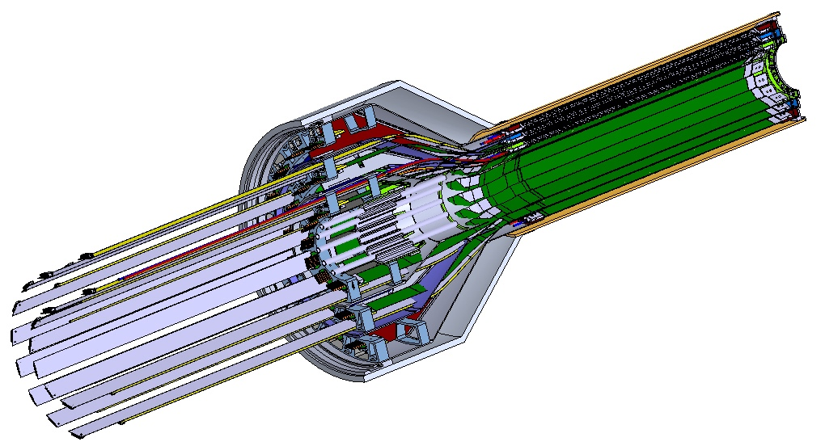
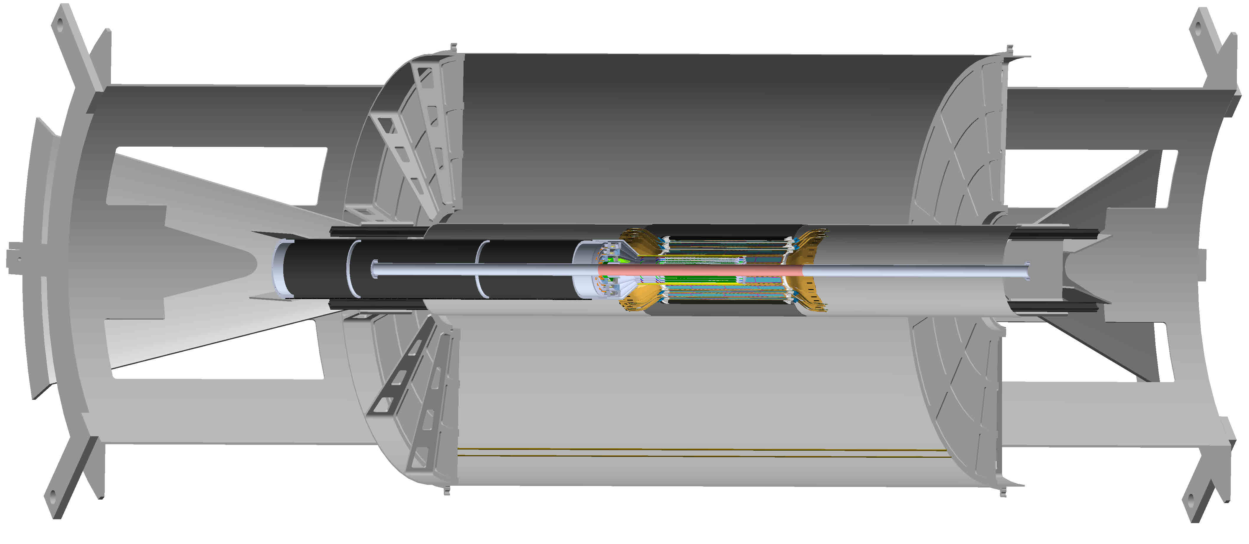
Schedule Drivers
Budget availability
  Final engineering design of the mechanical system
  Production of support structures
Mechanical structures
  Detector and interface system design
  Carbon structure fabrication
Detector assembly and test
  Assembly jigs design and fabrication
  Detector assembly & QA
  Metrology
Final installation in IR
  Last detector to be installed

Slide 7
Cost Drivers
Mechanical design and fabrication
CYSS
End wheels
Service barrel
Global interface

Slide 8
Basis of Estimate & Resource-Loaded Schedules
Electronics: production
  FELIX: ATLAS/sPHENIX production, LANL/LDRD
  RU services, cables: ALICE/ITS production, LANL/LDRD
  Power boards: ALICE/ITS production , LANL/LDRD
  CAEN bulk PS: Quotes from CAEN, ALICE/ITS production, LANL/LDRD
Mechanics & Integration: design and production
  CYSS, End wheels, Service barrel: ALICE/ITS
  Integrations: Recent experience at RHIC, HFT/STAR, FVTX/PHENIX
MVTX BoE Doc
FELIX
Labor, M&S
Carbon Structures
Labor, M&S

Slide 9
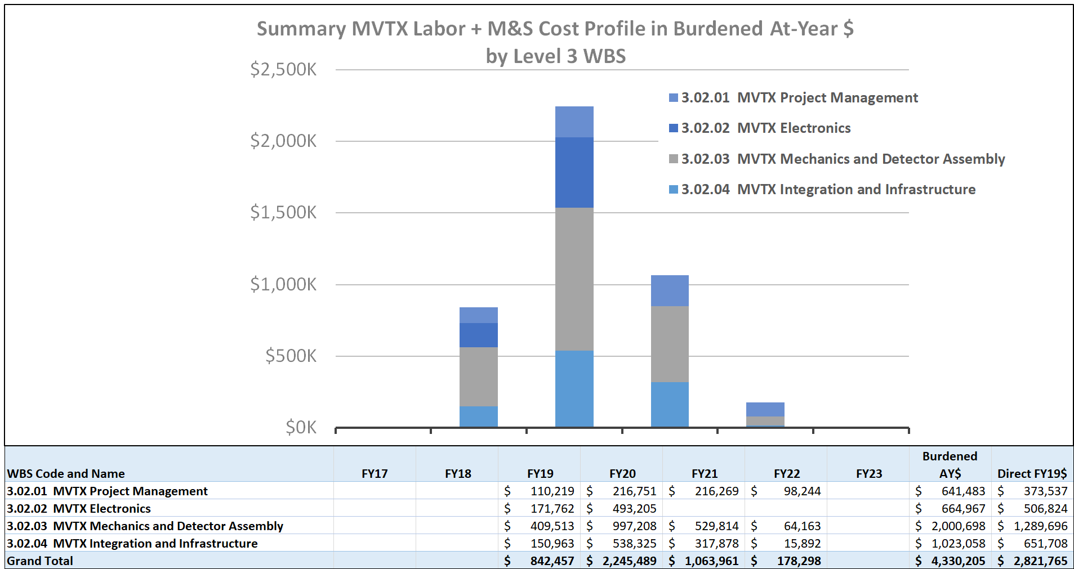
Resource Distribution
TPC: $4.3M
FY19 FY20 FY21 FY22

Slide 10
Major Cost Items
WBS | Task Name | Cost (K)
3.2.3.2.2 | End Wheels (EW) | $165
3.2.3.2.3.2 | Cylindrical Structure(CYSS) | $465
3.2.3.2.3.3 | Service Barrel (SB) | $428
3.2.2.2 | RU Services | $186
3.2.2.3 | FELIX | $122
3.2.2.4 | Power System (PS) | $357

Slide 11
Electronics
Examples of low contingency
 | WBS | Cost (K) | Contingency | Basis
RU Services | 3.2.2.2 | $186 | 25% | As Built*
FELIX | 3.2.2.3 | $122 | 25% | As Built*
Power Board | 3.2.2.4.1 | $219 | 25% | As Built*
Power Supply | 3.2.2.4.2 | $138 | 25% | CAEN
Total Cost = $665 K
“As Built” means item is a production unit

Slide 12
Carbon Structures
Examples of high contingency
 | WBS | Cost (K) | Contingency | Basis
End Wheels | 3.2.3.2.2 | $165 | 45% | Previous experience
Cylindrical Structure | 3.2.3.2.3.2 | $465 | 45% | Previous experience
Service Barrel | 3.2.3.2.3.3 | $428 | 45% | Previous experience
Total Cost = $ 1,058 K

Slide 13
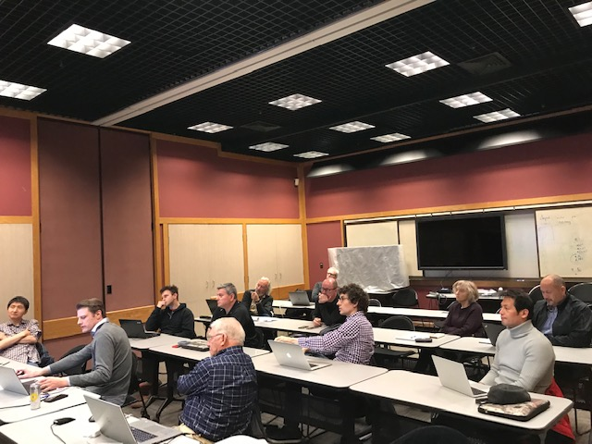
Status and Highlights
MVTX integrated into P6 (2/2019)
  TPC $4.3M
Latest Cost & Schedule update - following MVTX workshop at LBNL in 3/2019
  Carbon structures
    Design
    Production
    Schedule
  Power system
  Contingency
    Electronics
    Mechanics design
    Mechanics fabrication
  Rebalance work load among collaborators
    LANL, MIT, LBNL, UT-A, BNL et al
MVTX TPC updated, under review
  Identified potential cost saving, ~$600K
  OPC, TEC assigned
MVTX Workshop @LBNL, 2/28-3/2,2019
Mechanical System Discussion Session:
- Discussed and updated major carbon structures’
design & production cost & schedule, risks etc.
- LANL, MIT, BNL and LBNL engineers and physicists

Slide 14
Issues and Concerns
Budget availability
  Final mechanical system design work, at MIT, LANL and LBNL
  Early R&D required to reduce the high production contingency
Carbon structure production cost & schedule
  LBNL, other production plan/ATLAS
  Exploring other companies in Italy, France, Korea …
  High contingency in design and production cost ~45%
Global mechanical system integration
  Inner volume design is good progress, in ceonuputal
  High contingency in design and production, ~ 50%

Slide 15
Summary
TPC in P6, $4.3M, w/ burden and escalation
About 6 months contingency in schedule
Implemented Risk Based Contingency
Recent scrubbing exercise, possible cost saving ~$600K
Plan to update P6 after this review
Mechanical engineering design in progress
  Need budget now for the final engineering design work
Collaboration institutions ready to receive the project fund

Slide 16
backup

Slide 17
MVTX Scope
Mechanical structure design
  Design & FEA, LANL/MIT
  End Wheels
  Cylindrical structure shells
  Detector service half barrels
  Service patch panels
  Global interface
Mechanical structure fabrication
  Composite structures, LBNL
  Non-composite structures, MIT
  Installation tooling etc., MIT/LANL/LBNL/BNL
Ancillary systems – “adopt” ALICE/ITS
  Cooling plant, MIT/BNL
  Slow control & monitoring etc., MIT/GSU
MVTX electronics
  Backend FELIX and cables
  Integration into sPHENIX DAQ
  Power system
Detector assembly & test
  Stave QA & half detector assembly @LBNL
  System test & integration @LBNL/BNL
Installation & commissioning, by all
  Pre-installation commissioning @BNL
  Installation @IR
Early generic R&D accomplished through LANL LDRD
- Readout integration
- Detector conceptual design

Slide 18
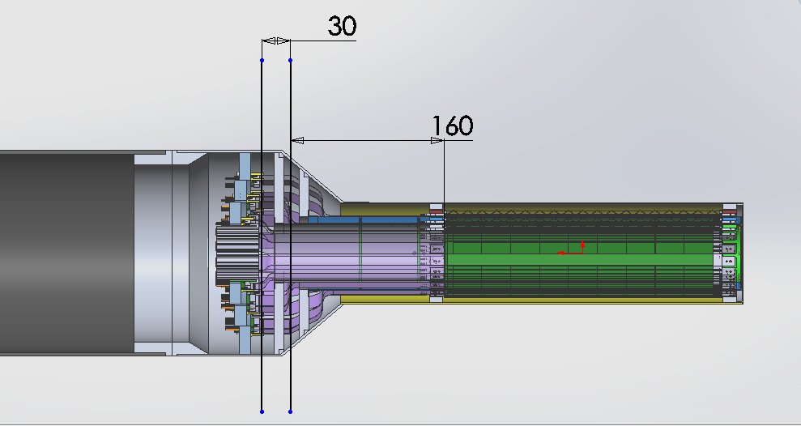
Carbon Structures – Work in Progress
Ross’ talk
Conical sectors are expensive!
A new design under development to avoid the conical structures, MIT/LANL

Slide 19
Half Barrel

Slide 20
MVTX Detector in sPHENIX
Ross’ talk
MVTX detector with service cylinder
TPC volume:
Length = 216 cm
Radius = 800 cm
Support brackets for TPC and INTT
INTT detector

Slide 21
MVTX in P6: 1/11

Slide 22
MVTX in P6: 2/11

Slide 23
MVTX in P6: 3/11

Slide 24
MVTX in P6: 4/11

Slide 25
MVTX in P6: 5/11

Slide 26
MVTX in P6: 6/11

Slide 27
MVTX in P6: 7/11

Slide 28
MVTX in P6: 8/11

Slide 29
MVTX in P6: 9/11

Slide 30
MVTX in P6: 10/11

Slide 31
MVTX in P6: 11/11

