Slide 1
MVTX Cost & Schedule (WBS 3.2)
Dave Lee/Ming Liu
April 9-11, 2019
BNL

Slide 2
MVTX C & S - Assumptions
Integrated into the sPHENIX schedule (P6)
Self contained project, funding from BNL
Technically driven schedule
Built in resource hourly rates fully burdened with escalation
Electronics ready for production on day one due to LDRD effort, cost based on as built experience, FELIX and RU support boards
Schedule not smoothed, ~5 month contingency in P6 prior to sPHENIX installation
Will implement Risk Based Contingency
Staves and Readout Units (RU) not in P6, separate cost
LANL 04/10/19
2

Slide 3
MVTX Schedules and Milestones
sPHENIX: CD1/3a PD2/3
Installation
1st collisions
CY-2018 | 2019 | 2020 | 2021 | 2022 | 2023
Generic R&D
Sensors for RHIC
Stave & RU production @CERN
MVTX
Construction
Detector mechanics design & production, global interface to sPHENIX
Detector & interface design
MVTX final
review
Feb. 2019, in P6
End Wheels
CYSS
Ready for beam;
sPHENIX day-1 run
Service barrel &
global system design
SB & global mech
sys production
Stave testing, half-barrel assembly @LBNL
Half barrel #1
6/15 Half barrels
arrive @BNL
FELIX production
Half barrel #2
IR installation
8/25 Installed
Ready for commissioning
sPHENIX interface & global support design
cooling & safety
System @BNL
Power system
production
Full detector
system test @BNL Lab
Pre-installation commissioning @BNL
RU, FELIX, PS, cables etc.
Today

Slide 4
Milestones
Milestone | Date
Start Construction | 3rd Qtr FY 2019
MVTX Final Design Review | 1st Qtr FY 2021
Half Barrels Assembled | 3rd Qtr FY 2021
Installation Finished | 4th Qtr FY 2022
Ready for Beam | 1st Qtr FY 2023

Slide 5
Cost Drivers
Mechanical design and fabrication
CYSS
End wheels
Service barrel
Global interface

Slide 6
Basis of Estimate
Electronics: production & LDRD experience
FELIX: ATLAS/sPHENIX production, LANL/LDRD
RU services, cables: ALICE/ITS production, LANL/LDRD
Power boards: ALICE/ITS production , LANL/LDRD
CAEN bulk PS: Quote from CAEN, ALICE/ITS production, LANL/LDRD
Mechanics & Integration: design and production
CYSS, End wheels, Service barrel: ALICE/ITS
Integrations: Recent experience at RHIC upgrades, HFT/STAR, FVTX/PHENIX

Slide 7
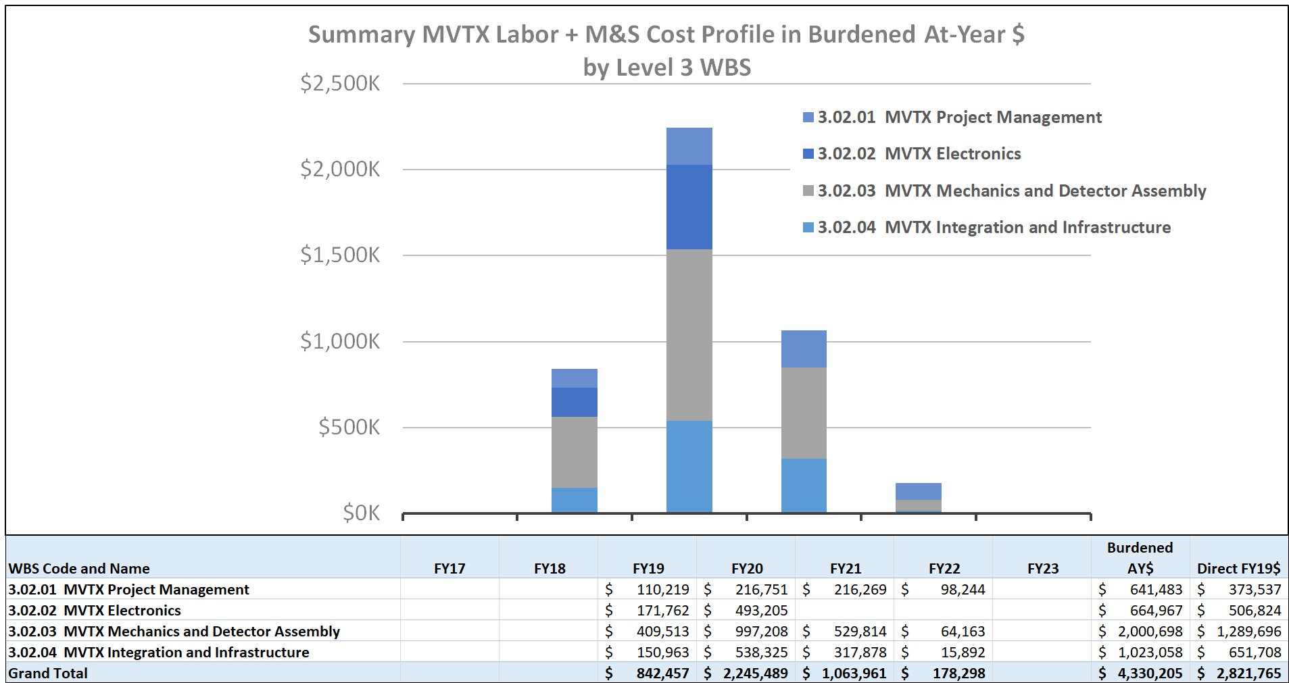
Resource Distribution
FY19 FY20 FY21 FY22

Slide 8
Major Cost Items
WBS | Task Name | Cost (K)
3.2.3.2.2 | End Wheels (EW) | $165
3.2.3.2.3.2 | Cylindrical Structure(CYSS) | $465
3.2.3.2.3.3 | Service Barrel (SB) | $428
3.2.2.4 | Power System (PS) | $357

Slide 9
Electronics Examples of low contingency
 | WBS | Cost (K) | Contingency | Basis
RU Services | 3.2.2.2 | $186 | 25% | As Built*
FELIX | 3.2.2.3 | $122 | 25% | As Built*
Power Board | 3.2.2.4.1 | $219 | 25% | As Built*
Power Supply | 3.2.2.4.2 | $138 | 25% | CAEN
As Built means item is a production unit
Total Cost = $665 K

Slide 10
Carbon Structures Examples of high contingency
 | WBS | Cost (K) | Contingency | Basis
End Wheels | 3.2.3.2.2 | $165 | 45% | Previous experience
Cylindrical Structure | 3.2.3.2.3.2 | $465 | 45% | Previous experience
Service Barrel | 3.2.3.2.3.3 | $428 | 45% | Previous experience
Total Cost = $ 1,058 K

Slide 11
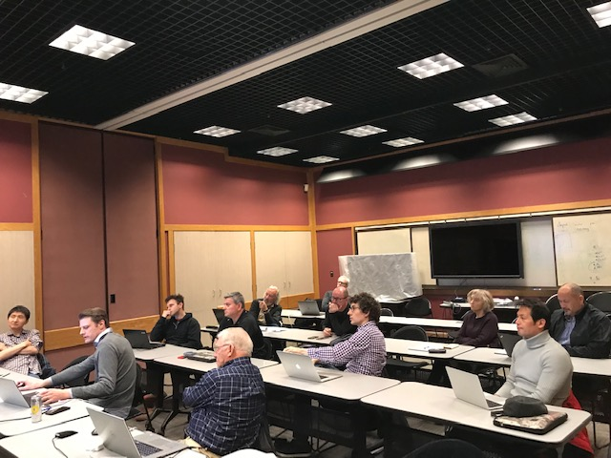
Status and Highlights
Updated Cost & Schedule following MVTX workshop at LBNL, 3/2019
Carbon structures
Design
Production
Schedule
Power system
Contingency
Electronics
Mechanics
Rebalance work load
LANL, MIT, UT-A
TPC updated
$4.3M (P6)
Identified potential $600K cost saving
OPC, TEC assigned
MVTX Workshop @LBNL, 2/28-3/2,2019
updated major carbon structures’
design & production cost, line by line

Slide 12
Issues and Concerns
Budget availability
Final mechanical system design work, at MIT, LANL and LBNL
Early R&D required to reduce the high production contingency
Carbon structure production cost & schedule
LBNL, other production plan/ATLAS
Investiagin Other companies
Expect high contingency for this ~50%
Global mechanical integration
Inner volume design is good progress, in ceonuputal
High contingency, ~ 50%

Slide 13
Summary
TPC, $4.3M, w/ burden and escalation
Recent scrubbing exercise, possible cost saving ~$600K
Plan to update P6 after the review
Design engineering in progress
Collaboration institutions ready to receive the project fund

Slide 14
backup

Slide 15
Resource Distribution
To be updated with Jan. version
Skip --- not tied to P6
Get on e from P6

Slide 16
Funding Profile
2/2019, pre-LBNL C&S

Slide 17
Cost and Schedule

Slide 18
MVTX Schedules and Milestones
Post-LBNL workshop version, 4/2019; NOT in P6 yet
sPHENIX: CD1/3a PD2/3
Installation
1st collisions
CY-2018 | 2019 | 2020 | 2021 | 2022 | 2023
MVTX
Stave & RU
production
FELIX
production
Construction
Detector mechanics design & production, global interface to sPHENIX
Detector & interface design
MVTX Review
End Wheels
CYSS
Ready for beam;
sPHENIX day-1 run
Service barrel
design & production
Stave testing, half-barrel assembly @LBNL
Half barrel #1
Half barrels
arrive @BNL
Power system
production
Half barrel #2
Procure & assemble
cooling system
Installed 2 half-barrels
@sPHENIX IR;
Design & procure
support structure
Complete detector
system test @BNL Lab
Procure insertion
sys to sPHENIX rails
MVTX pre- installation @BNL
RU, FELIX, PS, cables etc.
Today
MVTX pre- installation @BNL
RU, FELIX, PS, cables etc.

Slide 23
Guidance

Slide 24
L3 Technical Overview
Emphasize any technical issues that still need to be resolved. If all has been decided put it on the slide.

Slide 25
L3 Scope
What are you building?
Where you fit in the L2

Slide 26
L3 Collaborators

Slide 27
Schedule Drivers

Slide 28
Cost Drivers

Slide 29
Status and Highlights
Recent technical accomplishments

Slide 30
Issues and Concerns

Slide 31
Back Up

