Slide 1
MVTX Status
Ming Liu
For the MVTX Group
7/13/2019

Slide 2
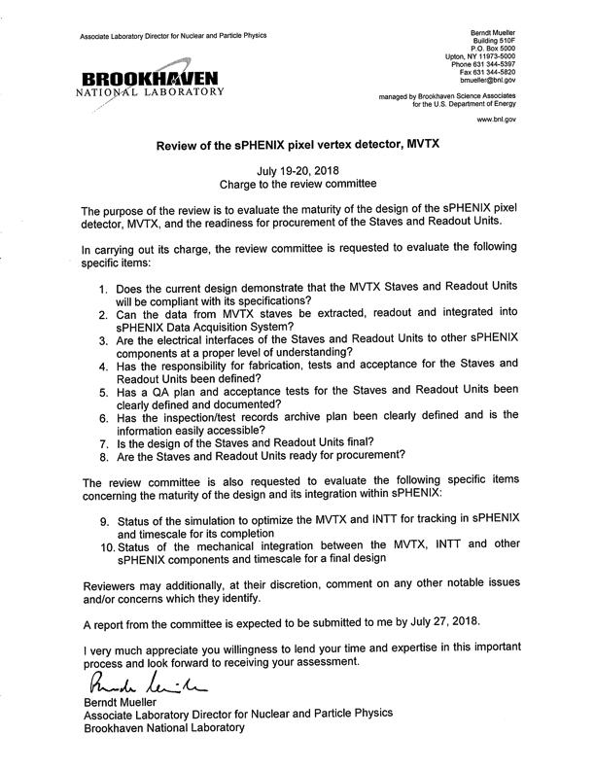
MVTX Director’s Review: 7/19-20, 2018 @BNL
sPHENIX overview – Dave/Gunther
  Compelling science
MVTX overview –Ming
  Status and highlights
Readout integration – Alex/Sho
  #1, 2, 3
Staves – Leo/Grazyna
  #1, 3, 4, 5, 6, 7, 8
Readout Units – Jo
  #1, 3, 4, 5, 6, 7, 8
INTT overview – Rachid
  Important for tracking
Mechanical integration – Walt/Dan
  #10
Tracking simulation – Tony
  #9
Summary – Ming
  YES, we are ready, #1, 8

Slide 3
Scope of the MVTX Project
MAPS Staves & Electronics
  Readout Integration R&D (LANL LDRD)
    Frontend: ALICE/ITS, RU
    Backend: ATLAS FELIX
    Reprogram RU & FELIX for sPHENIX
  Production:
    84 ALICE/ITS-IB staves from CERN
      Acceptance test @LBNL
      48+spares(36)
    58 ALICE/ITS-RU from CERN
      Acceptance test @UT-Austin, 48+spares(10)
    Reproduce 8 ATLAS/FELIX
      Acceptance @LANL
    Final assembly and test in US
      LBNL and BNL
  Ancillary systems, “adopt” ALICE system
Mechanics & Cooling
  Some changes to ALICE/ITS inner tracker mechanical structures,
    End Wheels
    Cylindrical structure shells
    Detector half barrels
    Detector and Service half barrels
  Mechanical Integration,
    Conceptual design by LANL LDRD
    Prototype by sPHENIX R&D, MIT/LANL
    Design integration frames
    Carbon frames etc., LBNL
    Installation tooling etc.
  Adopt ALICE cooling plant design
    Minor modification to fit sPHENIX
    Smaller heat load than ALICE ITS
Alex & Sho
Walt
Leo
Walt & Dan
Jo
- Early R&D by LANL LDRD, $5M, FY17-19, readout, mechanical design and physics
- Established LANL-ALICE MoU in 12/2016 for joint R&D for MVTX

Slide 4
Schedules and Milestones
sPHENIX: CD1 CD2
Installation
1st collisions
2018 | 2019 | 2020 | 2021 | 2022 | 2023
MVTX
ALICE IB stave done;
Facilities available for
sPHENIX production;
Window of opportunity
Stave & RU
production
FELIX
production
Detector mechanics design & production, global interface to sPHENIX
End Wheels
CYSS
Service barrel
design & production
Ready for beam;
sPHENIX day-1 run
MVTX final
design review
Barrel Assembly & Testing
Install half barrel
#1, 2@sPHENIX IR;
Half barrel #1
Half barrel #2
Test half barrels
#1, 2@BNL
Power system
production
MVTX installation & commissioning @BNL
RU, FELIX, PS, cables etc.

Slide 5
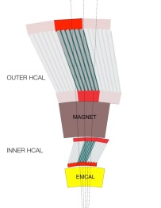
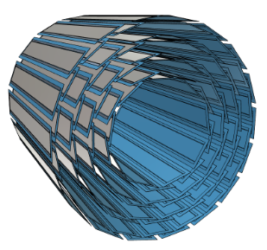
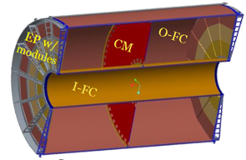
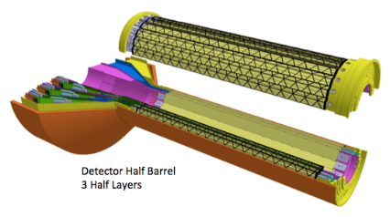
sPHENIX DAQ Architecture
Event Builder
FEM
DCM
DCM2
DCM
DCM
DCM
DCM
Network
Switch
Buffer Box
FEM
DCM
SEB
ATP
DCM
DCM
DCM2
DCM
DCM
ATP
DCM
Buffer Box
FEM
DCM
SEB
ATP
DCM
DCM
DCM
DCM2
ATP
Buffer Box
Calorimeters,
INTT, MBD
DCM
SEB
DCM
To the
RACF/HPSS
DCM
ATP
ATP
Buffer Box
FEE
ATP
DCM
DCM
FELIX
EBDC
ATP
TPC
MVTX
DCM
Buffer Box
FEE
ATP
DCM
DCM
FELIX
EBDC
ATP
Buffer Box
DCM
FEE
ATP
DCM
FELIX
EBDC
DCM
ATP
Buffer Box
DCM
Rack Room
SEB Sub-Event Buffer
EBDC Event Buffer and Data Compressor
ATP Assembles events and compresses data
Buffer Box data interim storage before sending data to the computing center

Slide 6
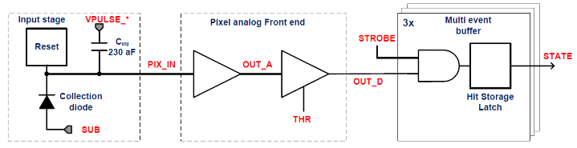
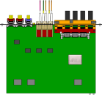

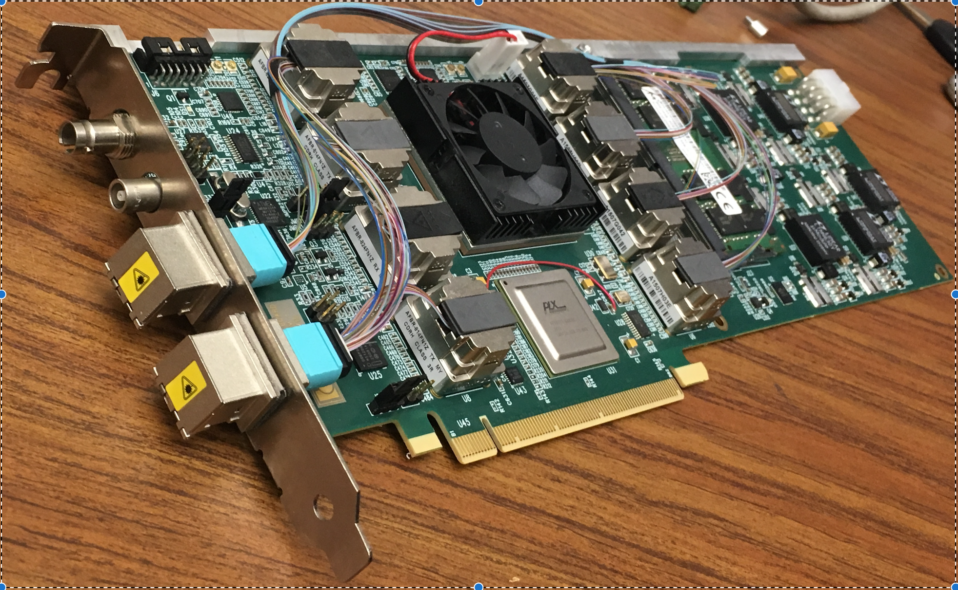
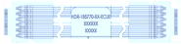
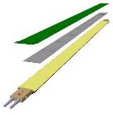

MVTX Readout, Power and Controls
Alex,Sho, Jo, Leo
#1,2,3
CAN bus
DCS
Trigger & Clock
Readout Unit
Front End
GBT Optical Links
one pixel
9 Data (1.2Gbps)
1 Clock, 1 Control/Trigger
Control
Data (9.6 Gb/s max)
Trigger
9-sensor Stave
Samtec Twinax “FireFly”
FELIX
Back End
FPC
Power
ATLAS Front-End Link eXchange (FELIX):
sPHENIX Data Aggregation Module (DAM)
Alpide Sensors
Power
Filtering Capacitors
regulators
Power supplies
Cold Plate
Regulated Power
ALPIDE pixel:
Shaping
Digitization
Zero-suppression
3x buffer
Power Board
Interaction Region
Experimental Hall
Counting House
MVTX Detector Electronics consists of three parts
Sensor-Stave (9 ALPIDE chips) | Front End-Readout Unit | Back End-FELIX/DAM

Slide 7
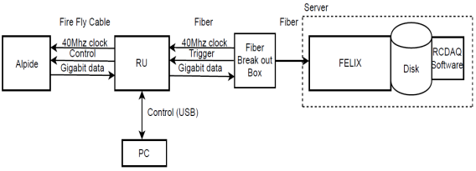
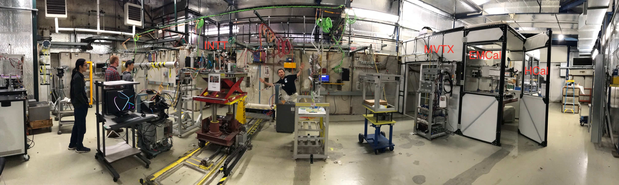
MVTX Full Readout Chain Demonstrated
Alex & Sho
#1,2,3
4-MAPS
telescope
Tracking spatial resolution
achieved: <5 um
Fermilab Test Beam: Feb-Mar, 2018
120 GeV proton
beam
4-hit track
4-MAPS telescope

Slide 8
Projected Radiation Level after 5-year Runs
sPH-TRG-2018-001
Leo
#1
Projected sPHENIX integrated luminosities after 5-year operation
  AuAu: Lum. = 214 nb⁻¹
  pp+pAu: Lum. = 1340 pb⁻¹
PHENIX study
arXiv: 0710.2676 [nucl-ex]
Projected sPHENIX MVTX L0 fluence:
Outer layers:
L1 = 0.6 x L0; L2 = 0.4 x L0
TID = 1060 krad
NIEL = 6x10¹² N_{eq}/cm²
Sensors tested to full MVTX NIEL and ~1/2 TID @ALICE

Slide 9
Stave and RU Production QA Plan
Leo & Jo
#4,5,6,7,8
Staves
Purchase 84 staves from ALICE production
  48 + 28(spares for 2 inner layers) + 8 spares
  Production following the completion of ALICE ITS/IB
  Starting ~Oct. 2018, last 6-12 months
  Fully tested at CERN before shipping to US
    All Gold/Silver staves (same ~ALICE IB standard)
    A LANL postdoc (Dr. Yasser Morales) oversees production QA at CERN
Acceptance QA at LBNL
  Full test and QA
    Electrical
    Mechanical
  Detector assembly at LBNL
Readout Units
Purchase 58 RUs from ALICE
  48 + 10 spares(20%)
  To be part of ALICE production
    Cost saving
    Minimize technical risks
  Initial test at CERN
QA at UT-Austin
  Full test
  LANL as the 2nd test site

Slide 10
#5, Has a QA plan and acceptance tests for the Staves and Readout Units been defined?
Leo & Jo
Yes!
  Both stave and RU QAP documents are available.

Slide 11
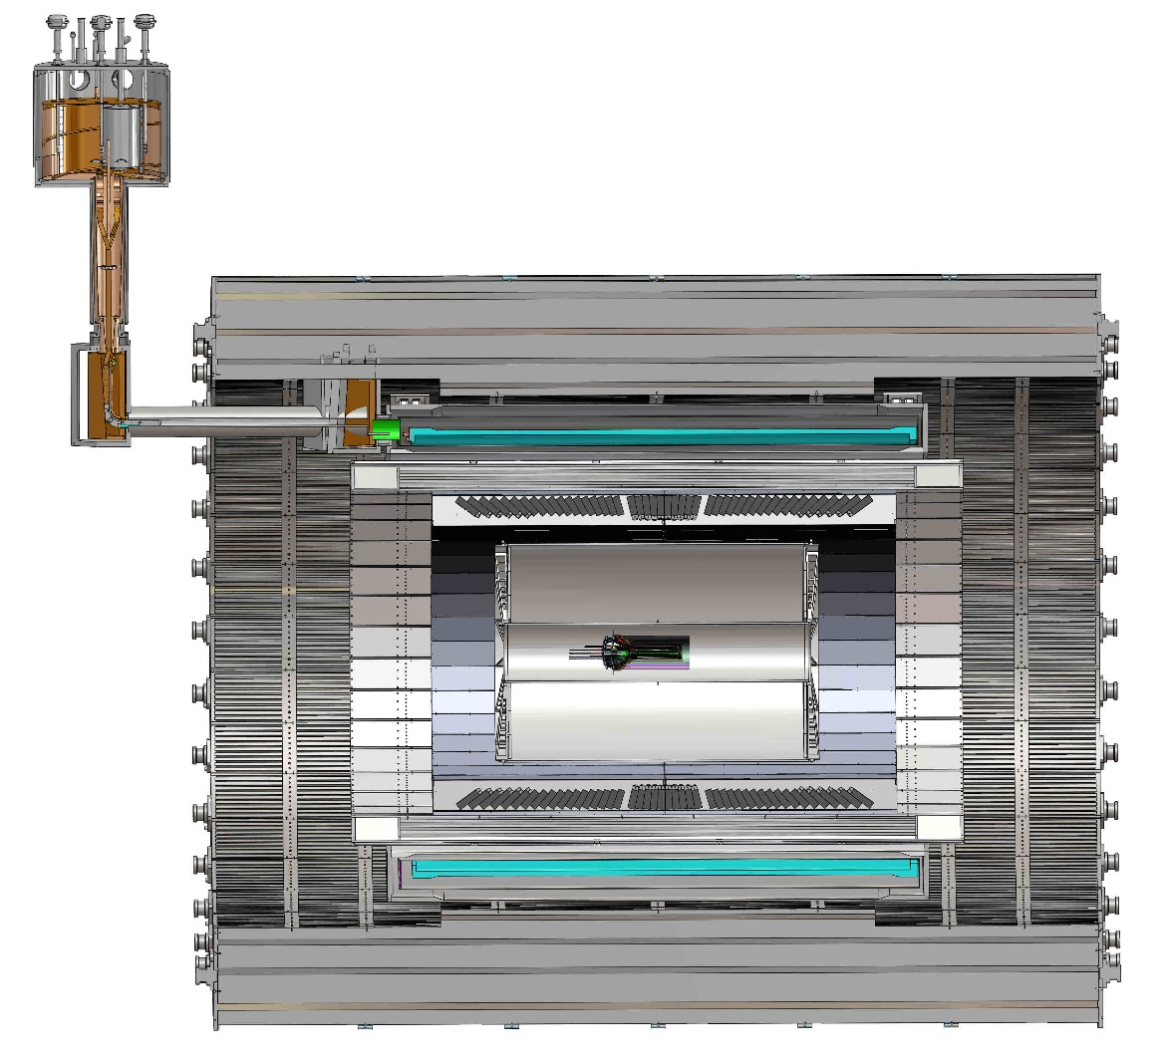
Mechanical Integration
MVTX, INTT and TPC
  MVTX detector design modified
  Global interface being developed
Walt & Dan
#10
TPC
TPC
INTT
MVTX
R= 209.6cm
L = 350.0 cm

Slide 12
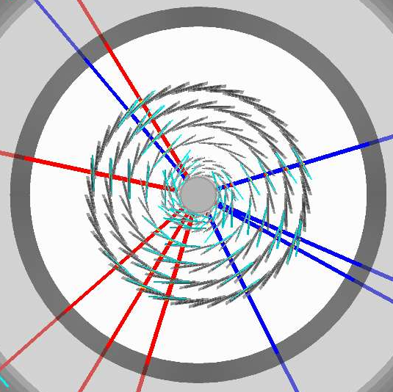
Simulations for Optimization
Tony & Rachid
#9, 10
Task force formed
  Goals and deadline defined
  Evaluate tracking with different INTT layers & geometry
Complementary roles in global tracking:
  MVTX:
    Precision DCA and vertexing
  INTT:
    Matching in-time hits of MVTX and TPC
    Important for p+p and p+A, pileups

Slide 13
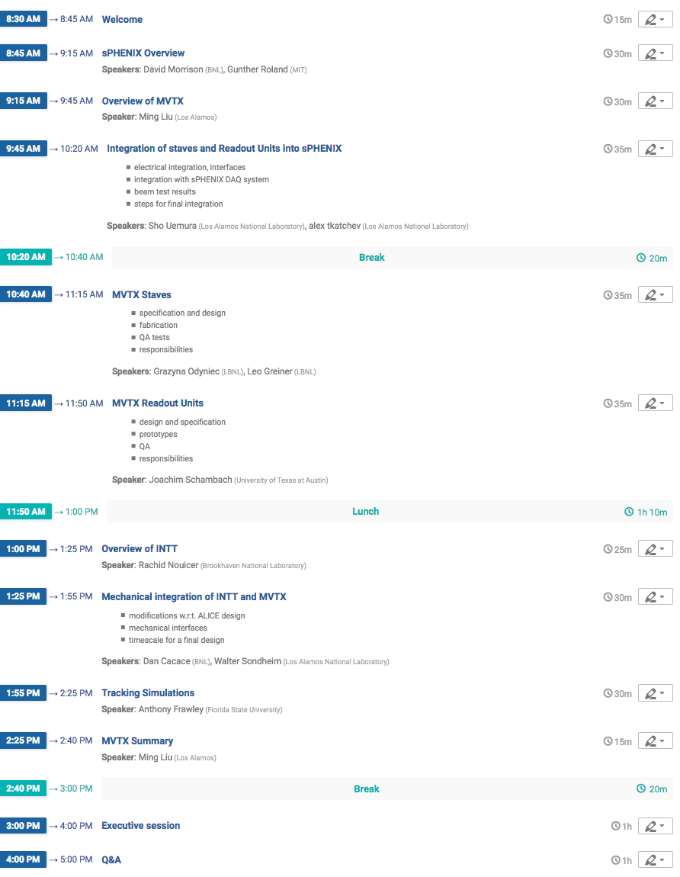
MVTX Review Agenda Page:
https://indico.bnl.gov/event/4729/
- Presentation slides
- RU QA plan document
Stave QA plan document
All practice review slides & QA documents
https://indico.bnl.gov/event/4806/
Send your comments/suggestions

