Slide 1
MVTX Proposal Status and Plan
Ming Liu
LANL
1/26/2018
sPHENIX General Meeting
Proposal submission plan
Funding path

Slide 2
MVTX Proposal Status & Plan
Received extensive and very good comments and suggestions from the collaboration, thanks!
  MVTX group has been updating the proposal since 1/16/2018.
  Plan is to complete the full proposal by early next week.
    Address the comments received from the collaboration
    Final edit, Jan 26 ~ Jan 30
    Send it to ALD ~Jan 31, 2018
Propose to submit a modified version of this proposal (remove most of the cost & schedule discussions) to arXiv for record and future reference
  Collaboration review of modified proposal, ~March?
  Submission: ~March/April 2018?
Comments & responses summary doc:
https://docs.google.com/document/d/1CruOsS4g4U2VWMVbF8F2IkDP2H2WSqjR818_OIhVynI/edit#heading=h.s87340nqkunh
MVTX full proposal link:
https://www.overleaf.com/10919417bwssgrhhgryc#/41088600/

Slide 3
MVTX Funding News
Email from Gunther and Dave to collaboration on 1/21/2018,
Dear Colleagues,
Last weekend the project and co-spokespeople were notified by the ALD Berndt Mueller about a recent communication from the DOE office of nuclear science in response to the MVTX pre-proposal submitted last year. We met with the ALD last Wednesday, and discussed what we learned with the MVTX management team on Thursday and Friday. A summary can be found in a presentation prepared for Friday's biweekly MVTX meeting:
https://indico.bnl.gov/conferenceDisplay.py?confId=4114
The message from DOE is that while they "appreciate the compelling science this instrument could enable and why it is considered very important to the sPHENIX experiment by the collaboration" they unfortunately "do not foresee at this time that we would be able to identify new DOE funding for the purpose of implementing the MVTX". DOE "very much appreciate and encourage efforts to secure" international contributions to sPHENIX to implement elements of the detector that can not be funded with the RHIC budget constraints.
Please see the presentation for further details and first thoughts on how to proceed.
As before, we remain fully committed to building a detector that delivers the full sPHENIX physics program. While the DOE budget developments narrow our path to achieving this goal, there are other options available, in particular in regards to non-US sPHENIX institutions able and willing to contribute to the MVTX project. We will have further discussions involving project and BNL management in the near future. We will also have a brainstorming session at next week's general meeting, and are planning to call an EC meeting for further discussion.
Best,
Gunther and Dave

Slide 4
Active follow up discussions on alternative funding path and project planning
MVTX project weekly meeting 1/23/2018, Maria, Bob, Grazyna and Ming
  Discussed inputs from Berndt:
    Berndt has requested to have the proposal by the end of January;
    Even if no additional funds expected from DOE at this time, DOE would allow us to proceed with the construction of the MVTX if financially feasible as the scientific case is compelling
    Actively seek non-DOE contributions
  Agreed to complete MVTX full proposal as planned, and send it to ALD by 1/31.
    Try to have all comments/updates implemented by Monday
  MVTX group actively working with sPHENIX and BNL management to develop “Plan-B”
A meeting to discuss possible foreign contributions and “Plan-B”, 1/25/2018, Gunther, Dave, Nu and Ming
  Foreign contributions, direct and indirect ones to generate cash for MVTX
    Chinese consortium on EMcal contribution, CCNU to work on stave production and assembly etc.
    CCNU can provide “free” student/technician/engineer labors and lab space, and cover travels but hard to pay for materials
  Possible savings from sPHENIX baseline contingency, HCal steel procurement etc.
  Further exploring cost reduction options for MVTX
  Physics priority – in 2016 de-scoping exercise, the collaboration determined keeping MVTX physics in the program is more important than to recover other de-scoped subsystems.

Slide 5
MVTX Major Cost Items
Major Items | Cost w/ 35%Cont. ($M) | Schedule
Staves (WBS 1.5.3.1) | 1.3 | 8/2018-5/2019
Readout & Controls (WBS 1.5.2) | 1.3 | 1/2019-6/2019
Mechanics & Detector Assembly (WBS 1.5.3) | 1.8 | 2019-2022, TBO
Integration (WBS 1.5.4) | 1.0 | 2021-2022, TBO
Project Management | 1.0 | 8/2018-1/2023

Slide 6
Time Sensitive Items: ~1.5M
Stave production @CERN: 1.3M (w/ 35% contin.)
  0.97M(quote from ALICE, $11.5K/stave x84)
  Cost & technical risk reduction
  Two-step in procurement?
    48+20%, in FY18/19 (700K)
    Rest comes later (300K)
Readout Unit: 0.66M
  0.48M (best estimate, paid for RUv1.0, 58RUs)
  Cost reduction (~50%) through ALICE mass production
Saving from sPHENIX contingency? Non-DOE contribution?
MVTX has a large schedule contingency: > 1 year
  New funds could come in later … Foreign, non-DOE/US and DOE
sPHENIX
Run
2023
Major Items | Cost ($M) | Schedule
Staves (WBS 1.5.3.1) | 1.3 | 8/2018-5/2019
Readout & Controls (WBS 1.5.2) | 1.3 | 1/2019-6/2019
Mechanics & Detector Assembly (WBS 1.5.3) | 1.8 | 2019-2022, TBO
Integration (WBS 1.5.4) | 1.0 | 2021-2022, TBO
Project Management | 1.0 | 8/2018-1/2023
CCNU?

Slide 7
Labor Cost Profile in the Current Proposal
Physicists and students/postdocs are not costed
Engineers & Technicians are costed in the project
  Could some covered by institution’s base program?
  More “in kind” contribution to reduce project management cost (Engineers & Physicists)

Slide 8
Project file: 11/29/2017
11/29/2017
M&S
Labor

Slide 9
M&S
Labor

Slide 10
M&S
Labor

Slide 11
M&S
Labor

Slide 12
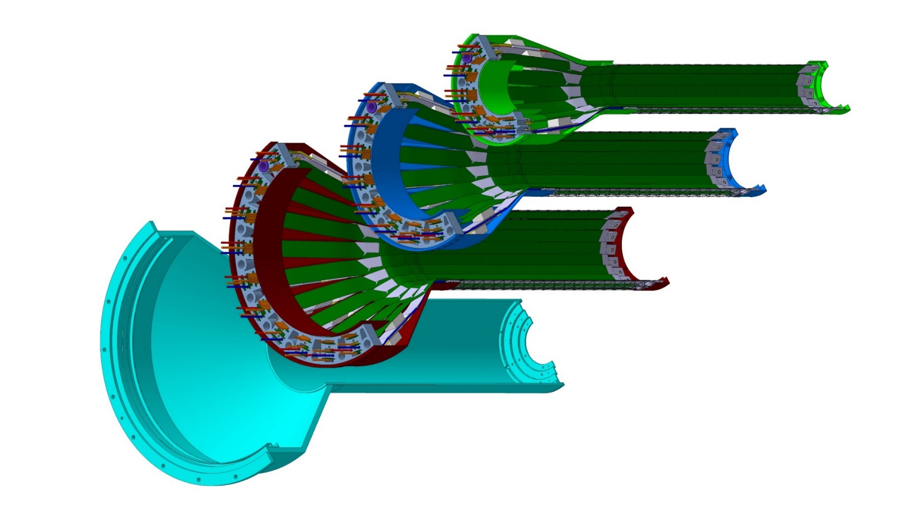
Detector Assembly @LBNL/CCNU?
Layer 0
Layer 1
Layer 2
IB CYSS

Slide 13
Possible Path Forward
– follow up on the discussions from today’s meeting
Plan-B1
  sPHENIX savings from contingency
  Foreign contributions
    direct (such as CCNU on stave production/assembly)
    indirect (such as EMCal) to generate cash saving from sPHENIX baseline
Plan-B2
  NSF funding through Universities .. $4M cap
  sPHENIX savings from contingency
Reduce the total cost of MVTX is critical
  Carbon structures
  Readout electronics
  Labor cost – more “in kind” contributions

