Slide 1
Report from MVTX Workfest at MIT
Ming Liu
Los Alamos

Slide 2
MVTX-HF Workfest @MIT 4/30-5/1
Primary goals: discuss and refine a roadmap for MVTX realization
~20 people attended, MVTX, INTT experts and sPHENIX management and project offices;
defined near term action items for MVTX/INTT integration in sPHENIX
A mini-sPHENIX integration review proposed, ~last week of June
Monday April 30:
a series of presentations & discussions of current considerations on budget & schedule and possible cost reduction measures, and MVTX+INTT integration
Tuesday May 1:
mostly follow up on day-1 discussions, near term R&D, MVTX + INTT
Workfest indico page: https://indico.bnl.gov/event/4380/

Slide 3
Topics discussed
News from sPHENIX workshop in China;
Involvement in MVTX project from Chinese Consortium;
1) stave production, test and simulations;
2) possible joint R&D and/or production of carbon structures
MVTX project status and plan:
Working on early procurement of Readout Units and Staves from ALICE/CERN, EIC R&D proposal to DOE
Highlight from Fermilab test beam
MVTX integration in sPHENIX
Project schedule and funding profile smoothing to fit projected sPHENIX cash flow
Near term R&D for MVTX and INTT
New development in physics and simulations
ALD asked to have a mini-review of sPHENIX tracking integration ASAP (MVTX+INTT+TPC + …)
the week of June 25th or early July, TBD
Carry out critical integration R&D MVTX, INTT..
A joint MVTX+INTT test beam at Fermilab, Jan-Feb 2019
Full subsystem test
INTT ~1.2m extension bus
MVTX, full staves with possibly extended FPC

Slide 4
A Broad Physics Program
Xin & Jin

Slide 5
Simulations
Haiwang & Jin

Slide 6
RU Production Plan
Plan-A
To be part of ALICE ITS production
Timeline:
Production starts ~May 2018, available by ~end of 2018, fully tested
Need to make commitment “NOW”
BNL management actively working on funding RU through RHIC $
Plan-B
Produce RU later, ~2019 as funding allows?
Procure GBT chips from CERN
Production & test in US, UT-Austin, LANL et al.
Higher cost, 2x
Higher technical and schedule risks

Slide 7
Stave Production Plan
Plan-A
Produce staves following the completion of ALICE IB at CERN, using ALICE facility
Timeline:
Starting as early as Aug/Sep 2018 +, last about 6 months for production and test
All 84 staves produced and tested at CERN
BNL management actively working with DOE to build staves at CERN
Plan –B
Produce full staves at CCNU later as funding allows, ~2019?
Earliest starting date - May 2019 + , ~12 months (could be shorter)
Higher technical and schedule risks
Impact on cost, TBD

Slide 8
Carbon Structure Design and Fabrication
Mechanical system design
MIT + LANL + LBNL + BNL
Production
LBNL
Alternative path for fabrication being explored
Europe (France & Italy, used for ITS Upgrade)
Asia (Korea, China)

Slide 9
Dave Lee
Current Profile (Cost): Funding Profile Smoothing, FY20-22
No Contingency and Passthru
Staves and RU in FY2018
Installation June 2022
FY2018 | FY2019 | FY20 | FY21 | FY22
1449 | 1645 | 1223 | 364 | 46
k$

Slide 10
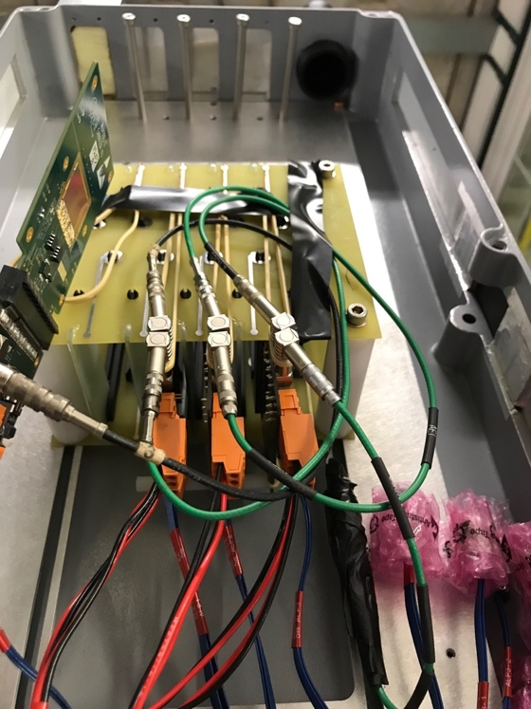
MVTX Test Beam at Fermilab 02/20-03/10, 2018
Goals:
Test full readout chain
Evaluate ALPIDE sensor performance
Experimental setup
A 4-sensor telescope
Full readout chain: MAPS+RU+FELIX+RCDAQ
120 GeV
proton
Parasitic with INTT run
Very productive & collaborative
4-sensor
Telescope

Slide 11
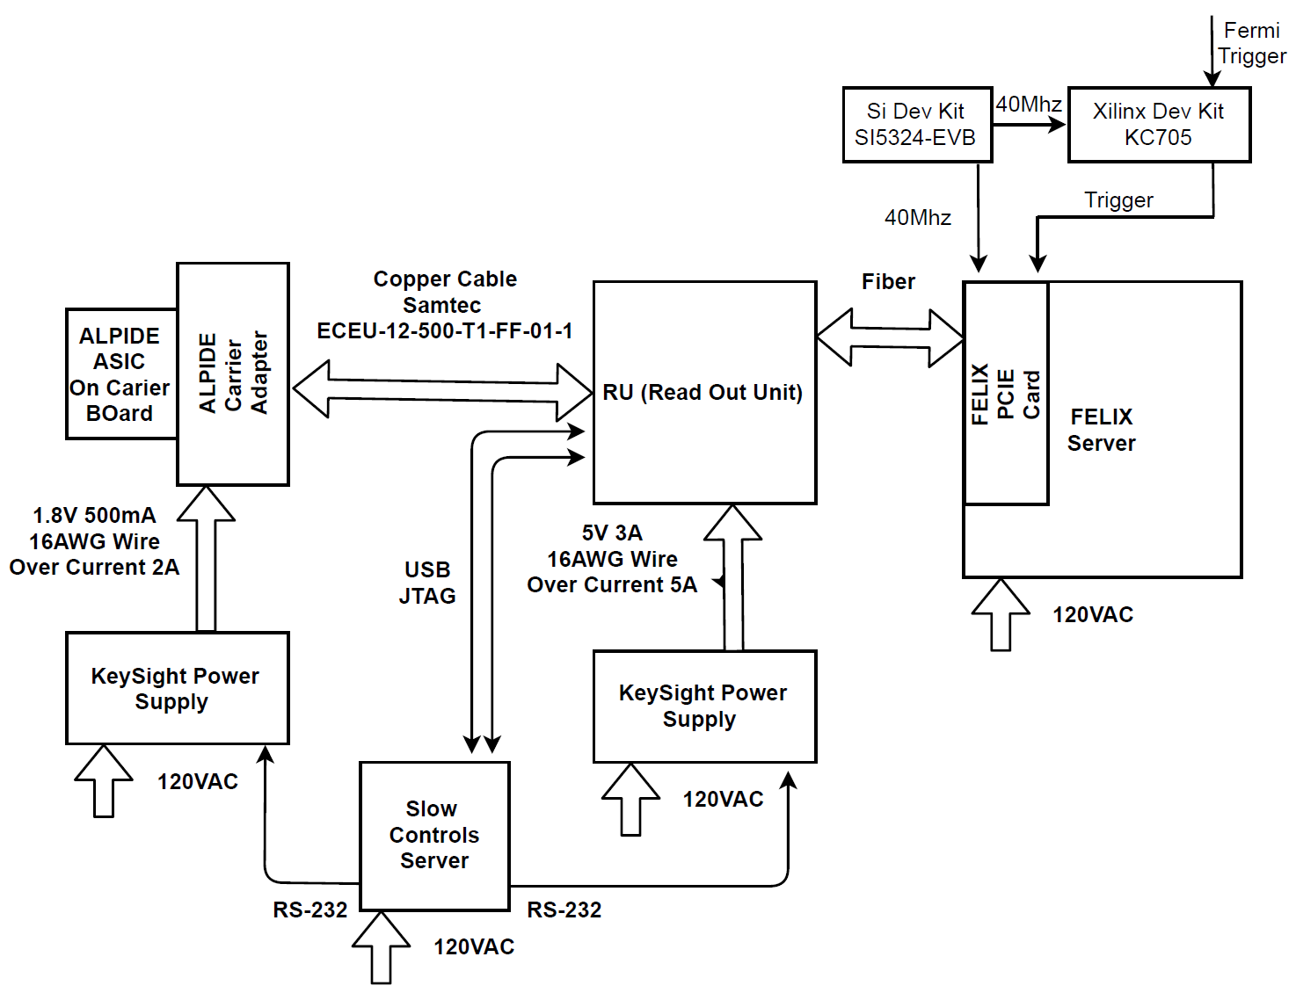
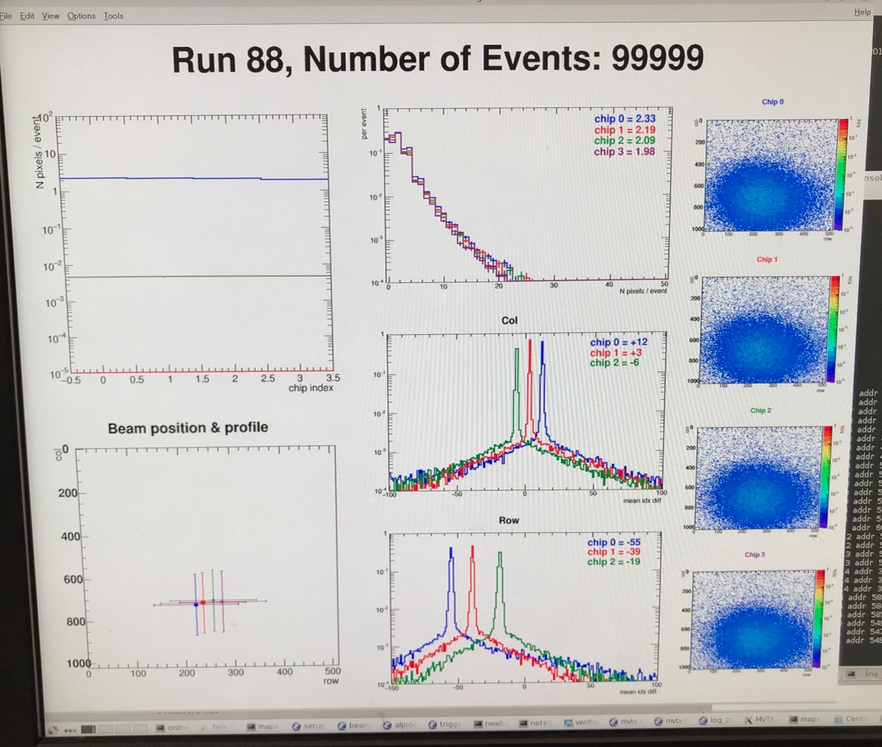
LHC 40MHz
mockup
Fermilab Test Beam Setup 03/2018
4-ALPIDE Telescope + 4-SamTec cables + 1 RU + 1 FELIX(“CRU”)
Amazing work by Sho, Alex et al
4-ALPIDE Telescope
4 5-m SamTec Cables, 1.2Gbps
CLK recovered from
FELIX through GBT link;
Trigger from FELIX
FELIX (“CRU”)
Online Display

Slide 12
Fermilab Test Beam Results (I)
4-hit track
120 GeV proton beam
4-sensor telescope
Mostly single tracks
Cluster size: 2.1 ~ 2.4
# of tracks per event
Cluster size
Beautiful analysis done by Sanghoon and Darren et al

Slide 13
Fermilab Test Beam Results (II)
Hit Spatial Resolution: < 5 um
Hit Efficiency > 99.5%
Pixel size (~28um)

Slide 14
Rachid
Latest design of INTT support from Dan Cacace

Slide 15
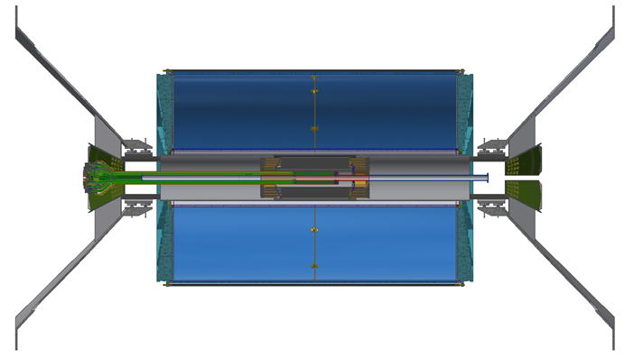
MVTX/INTT Integration Review: ~last week of June (TBD)
w/ ~50cm FPC power extension
@LANL, voltage drop, noise pickup
MVTX conical structure modification, reduced radius
w/ 10cm extension FPC – Plan A
INTT layout, “cables” and supporting structures
Final extension bus ~1.2m, INTT, summer 18
MVTX conical structure modification
10cm HS signal simulation now ..
Early R&D possible? right now, ~Sept 2018 @CERN
Mechanical mockup: MVTX+INTT + .. , @BNL, LANL
w/o FPC extension – Plan B
Revisit INTT layout, cables and supporting structures
Final 1.2m bus, summer 18
MVTX conical structure modification
INTT/MVTX simulations
New INTT postdoc, INTT optimization, including supporting structure
Resources
MIT engineers Jim/Jason ?
Walt, Dan, Mike L, Hubert, Chris …,
new $$ from non-MIE BNL project? New engineers? Under discussion

Slide 17
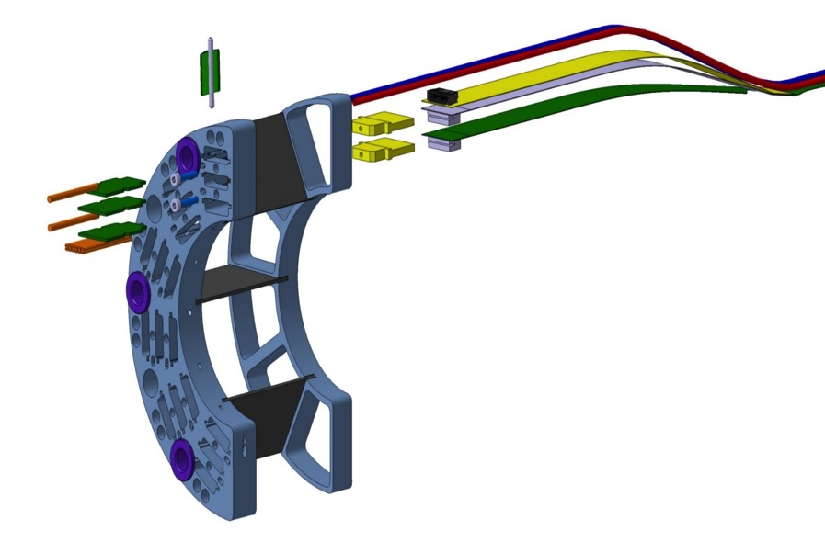
MVTX Flexible Printed Circuit (FPC) Extend MVTX Service Cables? Maximum +10cm for HS signal, TBD through R&D
Extend FPC/signal path by ~10cm
506.2 mm
Extend by ~10cm
16 mm
16.15 mm
41.9 mm
Power connection
Signal connection
signal
Also Impacting
SamTec
Cable length:
5~7m
Power cable
Extension ~50cm

Slide 18
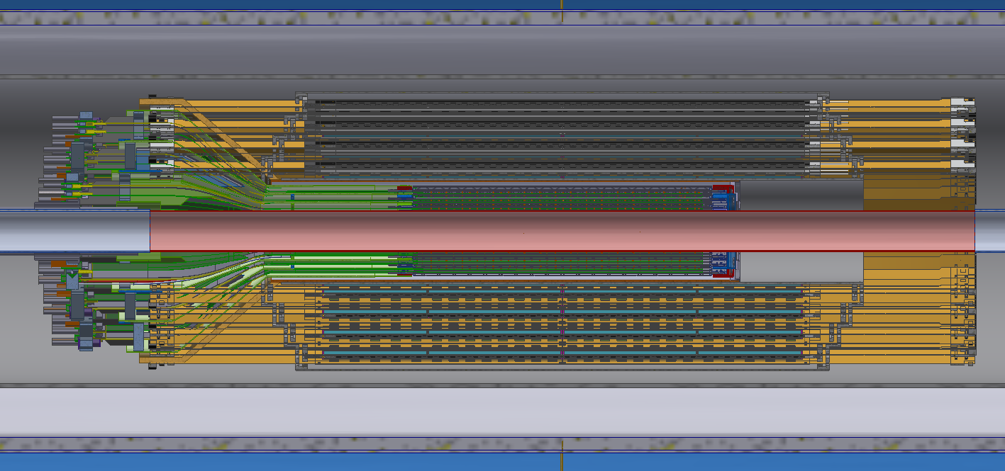
Work in Progress
Mickey, Dan, Walt, Rachid et al
Major conflict of INTT HDI connectors w/ MVTX
HDI (flexible)
HDI connector (rigid)
Space reserved for support rail
MVTX Outer Cone
TPC inner
Edge (r=20cm)
LADDER (rigid)
INTT Support Structure

