Slide 1
MVTX Proposal Status & Plan
Ming Liu
For MVTX Group
1/12/2018

Slide 3
MVTX Full Proposal under Collaboration Review 1/3-15, 2018
Thanks many people’s countless effort!
Please send in your feedback by next Monday 1/15!
Full proposal page:
https://www.overleaf.com/10919417bwssgrhhgryc#/41088600/
Major updates:
Executive summary
More theory inputs
Detector performance simulations
Readout integration
Mechanical system integration
Cost & Schedule
Matches sPHENIX baseline schedule, day-1

Slide 5
MVTX Proposal Submission Timeline
sPHENIX collaboration feedback – by 1/15, next Monday!
MVTX group updates proposal: 1/16-19
Send to ALD for feedback: 1/19 (Fri)- 1/26 (Fri)
MVTX group updates proposal: 1/27-31
Send the proposal to ALD for DOE submission: ~1/31(Wed)
DOE budget meetings: ~2/20 (BNL?), 2/22(LANL)
Our goal: early funding in FY18 for stave production at CERN
MVTX stave production starts ~9/2018, following ALICE ITS/IB production ~8/2018

Slide 6
MVTX+INTT Integration Model of MVTX with INTT inside TPC with the addition of two concentric composite cylinders;
Location of conflat flange on beam-pipe
Location in Z where the inner-hcal ends (see control drawing) Z=2175.0 mm

Slide 7
MVTX-INTT-TPC updated model, Dan Cacace & Walter Sondheim 1/5/2018
TPC
MVTX service/installation barrel
INTT ROC cards
INTT
INTT ROC cards
MVTX interface,
patch panel
MVTX

Slide 8
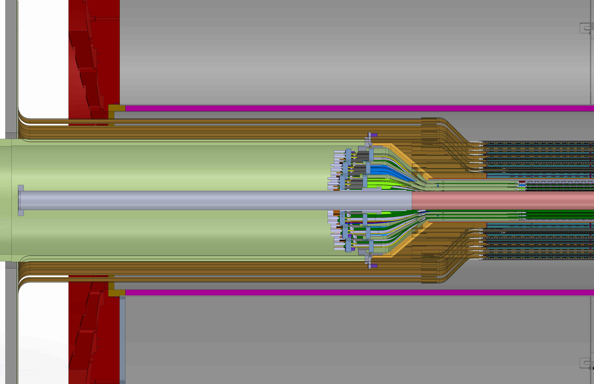
MVTX-INTT-TPC model continue;
Added extension cables to end of MVTX detector staves to conical patch panel, added length 20.0 cm

Slide 9
LDRD Telescope and Test Beam at Fermilab
Participate in sPHENIX test beam at Fermilab
A 3~4 sensor-layers telescope with full readout chain
3~4 sensor + one RUv1.0 + one FELIX v1.5 + RC DAQ
Test full readout chain
Study sensor and electronics performance
Preliminary tracking study
Schedule
Setup at Fermilab: 2/20-23, 2018
Parasitic run with INTT: 3/5-9, 2018

Slide 10
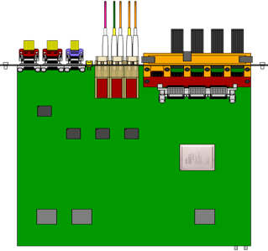
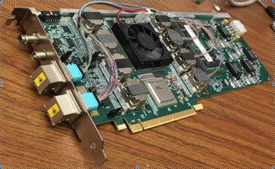
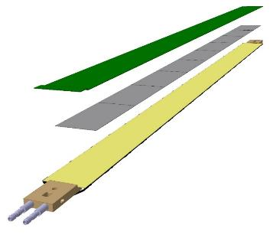
MVTX Readout and Control R&D
sPHENIX GL-1 & GTM
Front End Electronics
Readout Unit/ALICE
CAN bus
DCS
5-10 m
Trigger & Clock
GBT Optical Links
9-sensor Stave
9 Data (1.2Gbps)
1 Clock, 1 Control/Trigger
Control
Data (9.6 Gb/s max)
Trigger
Samtec Twinax “FireFly”
Back End Electronics
FELIX/ATLAS
FPC
Power
Alpide Sensors
Power
Filtering Capacitors
regulators
Power supplies
Cold Plate
Regulated Power
Power Board/ALICE
Interaction Region
Experimental Hall
Counting House

