Slide 1
MVTX Update
Ming Liu
10/19/2018
sPHENIX General Meeting

Slide 2
MVTX Plan - WBS 3.2 (renumbered)
MS Project being updated, now moved into P6
  Stave and RU production through ALICE, moved out of the scope
  The rest of tasks, being optimize for cash flow
Early procurements of staves and readout units (RU) through US-Alice
  DOE and BNL agree, DOE directly pays UTK/US-ALICE
  Received signed letter from CERN on the cost of 60 RUs and 84 Stave, ~$1.36M
  Paperwork in progress, aim to complete by ~ mid November, 2018
About $5M to be added to the sPHENIX Management Portfolio
  Open MVTX accounts in coming weeks
  As a separated project from the MIE, for the rest of MVTX tasks
    Monthly report to sPHENIX and BNL upper management
  Will NOT be part of CD-2/3 DOE review
  Update baseline cost and schedule by January 2019

Slide 3
Near Term Schedule Update
RU production through ALICE: 60 RUs
  Being started at CERN, first batch of full production ~ Dec., 2018
  sPHENIX RUs available: ~Summer 2019
  Acceptance test and QA at UT-Austin: starting ~summer 2019
    Good opportunity for training and contribution
Stave production through ALICE: 84 staves (ALICE Gold/Silver QA)
  sPHENIX sensor production ~Dec. 2018
    3 months (wafer production) + 1 month (dicing & testing)
    Stave assembly starts @CERN, ~ April 2016, will take ~12 months to finish
    Training & contribution at CERN, Stave test and QA
  Acceptance test and QA at LBNL, ~Summer 2019
    Hand-carrying staves to LBNL, ~4 trips, ~20 staves each trip

Slide 4
Updated Schedules and Milestones
sPHENIX: CD1/3a CD2
Installation
1st collisions
CY-2018 | 2019 | 2020 | 2021 | 2022 | 2023
MVTX
ALICE IB stave done;
Facilities available for
sPHENIX production;
A window of opportunity:
Low technical risk
Cost saving
Stave & RU
production
FELIX
production
Detector mechanics design & production, global interface to sPHENIX
End Wheels
CYSS
Global integration
/interface design?
Service barrel
design & production
Ready for beam;
sPHENIX day-1 run
Barrel Assembly & Testing @LBNL
Install half barrels
@sPHENIX IR
Half barrel #1
Power system
production
Half barrel #2
Half barrels
arrive @BNL
To be updated
design & procure
interface to
sPHENIX rails
Design & procure
sPHENIX rails
MVTX installation & commissioning @BNL
RU, FELIX, PS, cables etc.

Slide 5
Recent Progress Highlights
Completed sensor/HIC/stave evaluations at CERN
  Built and tested two HICs with 40cm and 60cm long power FPC
    Confirmed sensor performance comparable with the ALICE default configuration
  Sensors irradiated up to 2.7MRad, no problem (updated 9/18/2018).
  Confirmed low magnetic field in RU/PU racks, <50Gauss; RU/PU designed for 0.5T
  Addressed all recommendations on stave/sensor R&D and RU from recent BNL review
MVTX/INTT mechanical integration
  Mechanical design being updated and built 3-D mockups
    no MVTX/INTT interference any more!
  Inner tracking simulation task force, good progress
  SamTec cables
    ALICE confirmed signal performance with 8m long readout cables
    This eases mechanical integration and layout of the services
Final documentation to address July MVTX Director’s Review recommendations
  MVTX/INTT mechanical integration, draft available
  Inner tracking optimization near final, optimal INTT layers, ~next week
https://docs.google.com/document/d/1vsm_G7ZLgqv-kBZqK0jF69T_Nx2Uwk0Zxv86jRVxybw/edit?usp=sharing

Slide 6
Sensor Irradiation Test
BNL Director’s Review: July 19-20, 2018
Recently (in 9/2018) ALICE carried out irradiation test up to 2.7MRad:
Sensor can still function well with high efficiency and low noise

Slide 7
Sensor Radiation Hardness – OK at 2.7MRad
Continuous effort by ALICE (@NPI, Czech)
BNL review recommendation: test sensor up to 1MRad
MVTX Operation Window
https://indico.cern.ch/event/758048/

Slide 8
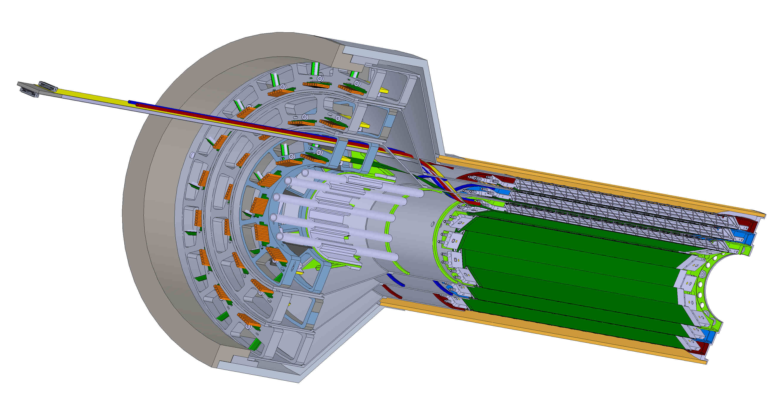
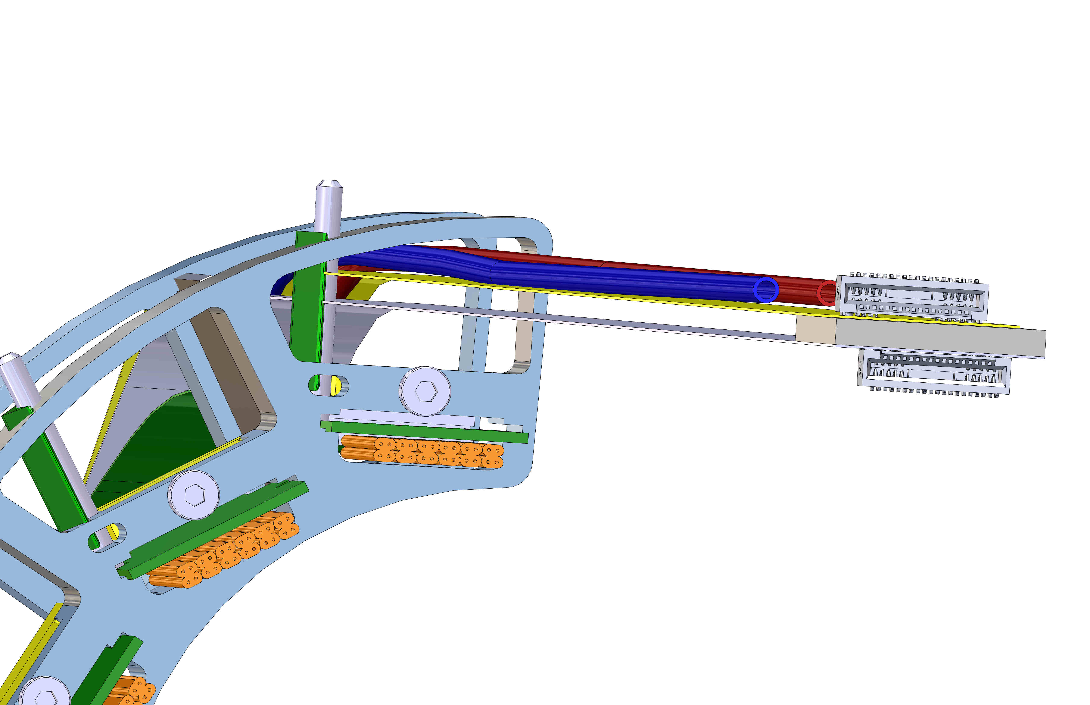
MVTX Detector Mechanical Structure
Signal cables
Digital power
Analogy power
Cooling tubes

Slide 9
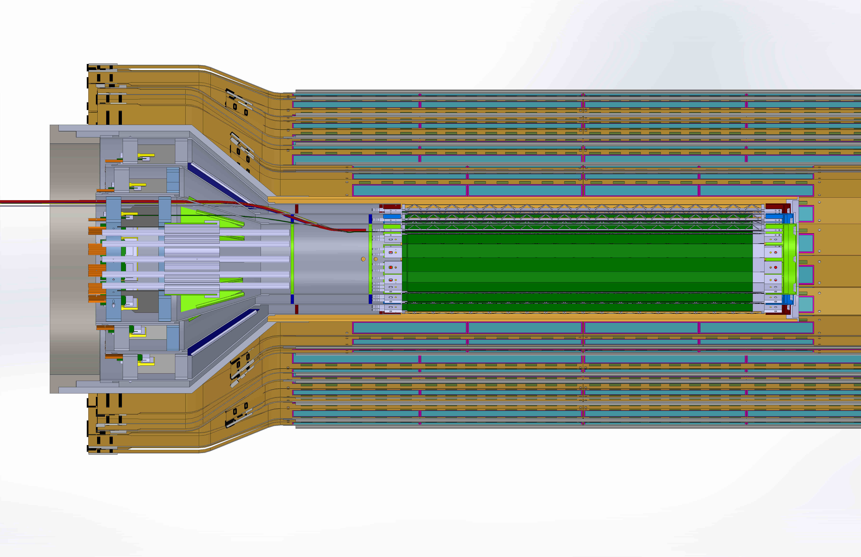
MVTX + INTT

Slide 10
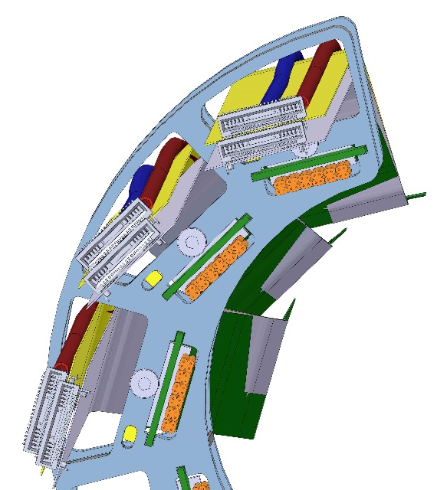
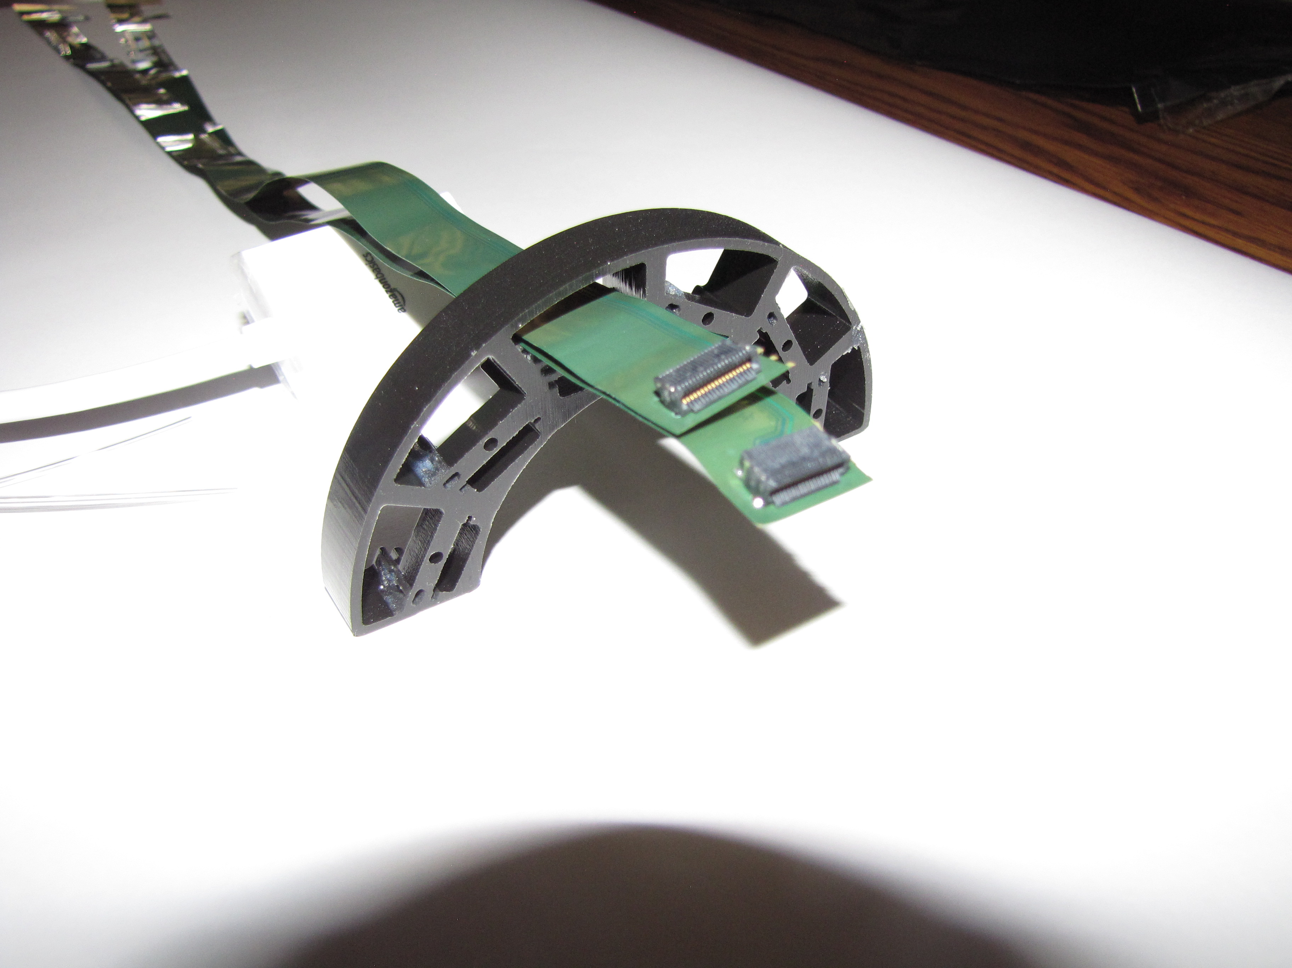
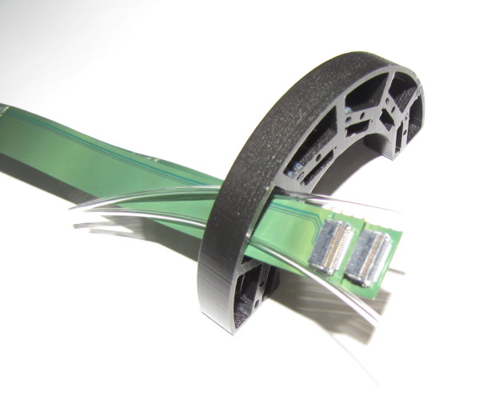
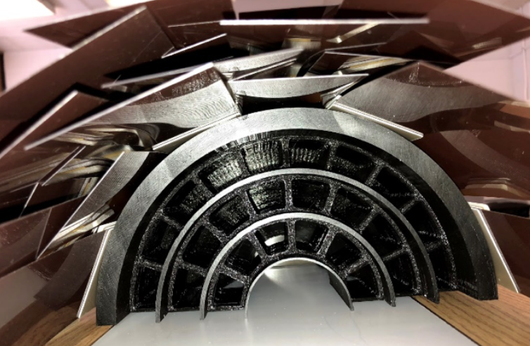
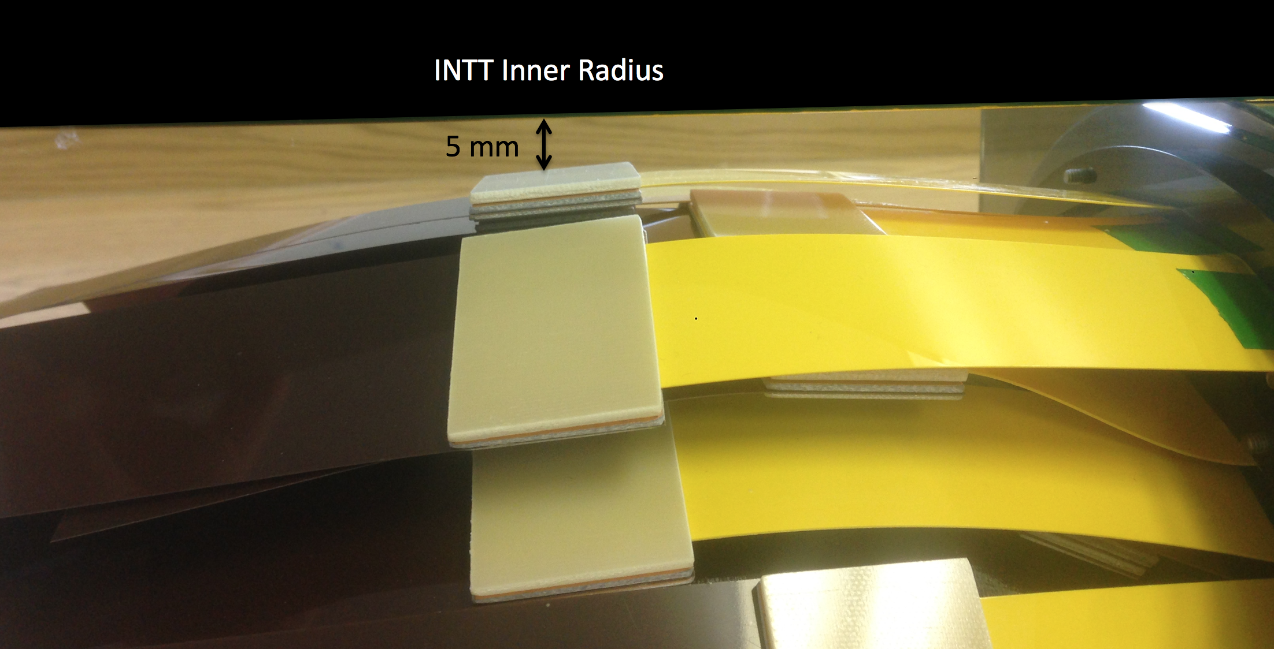
INTT/MVTX interference solved!
  Much love to the group: Dan, Walt, Rachid, Mike, Ross, etc.
From Mickey
3D mockups:
MVTX+INTT

Slide 11
SamTec Cables Tested and Finalized for ITS: ~8m!
Two cables per IB stave: 2.65m + 5.30m
HDR-203194 (Type B)
HDR-206142 (Type A)
RUs
PP2
Staves
L: 5300 mm
L: 2650 mm

Slide 12
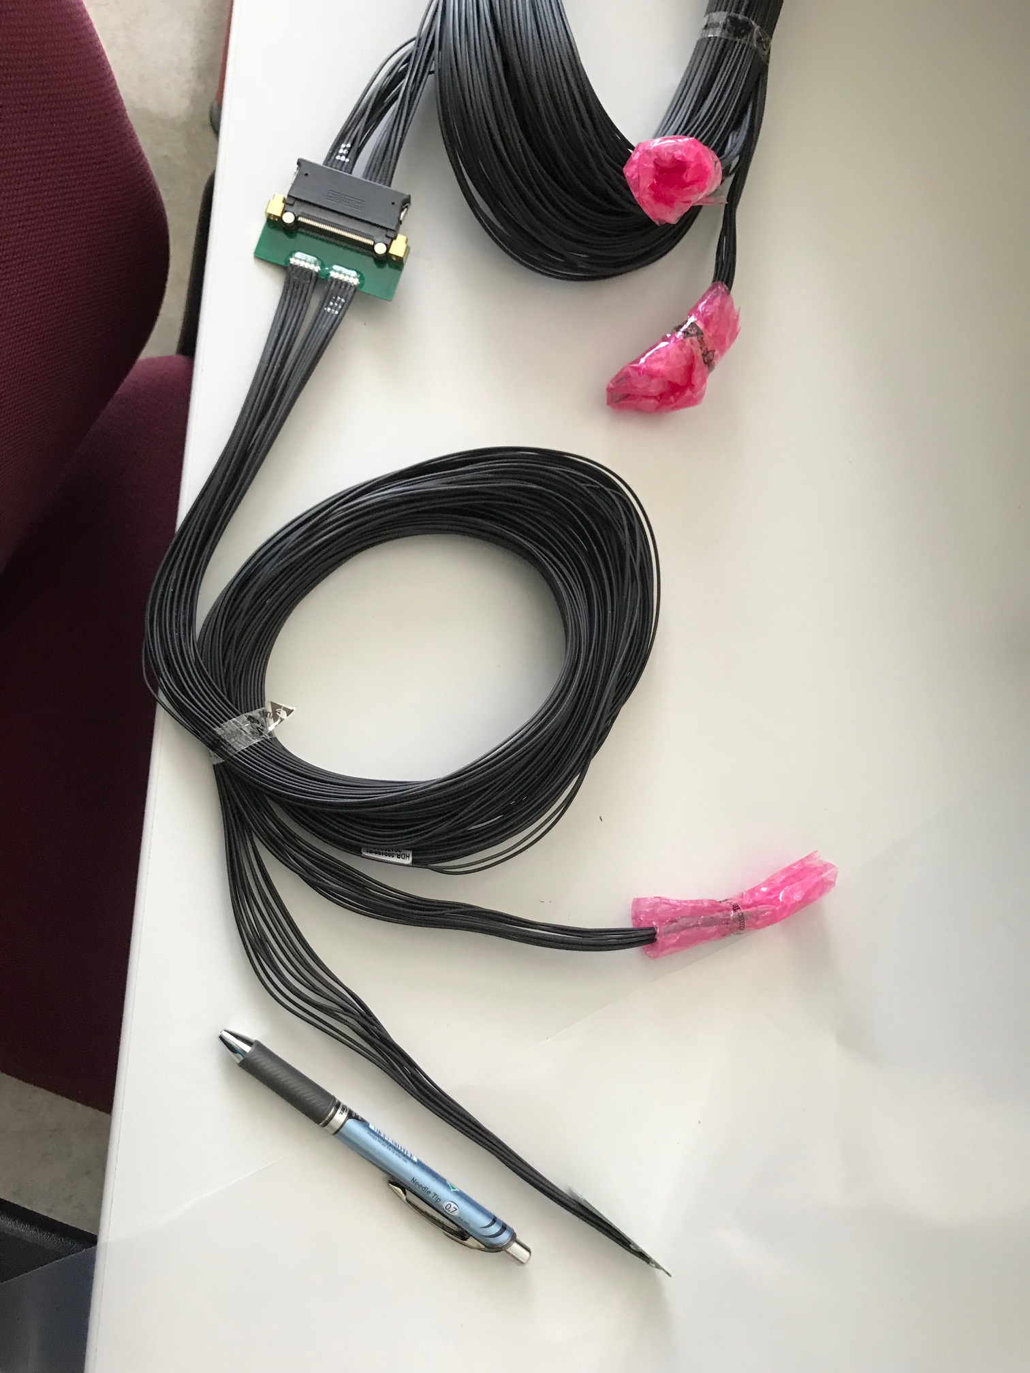
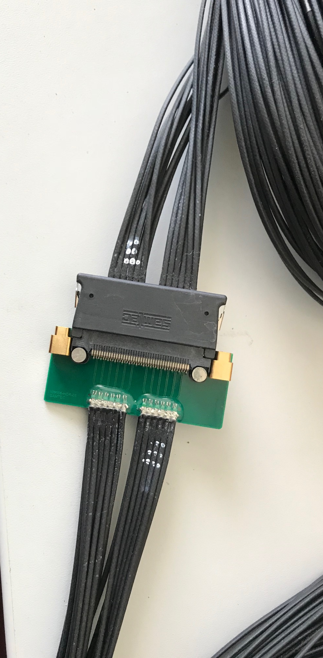
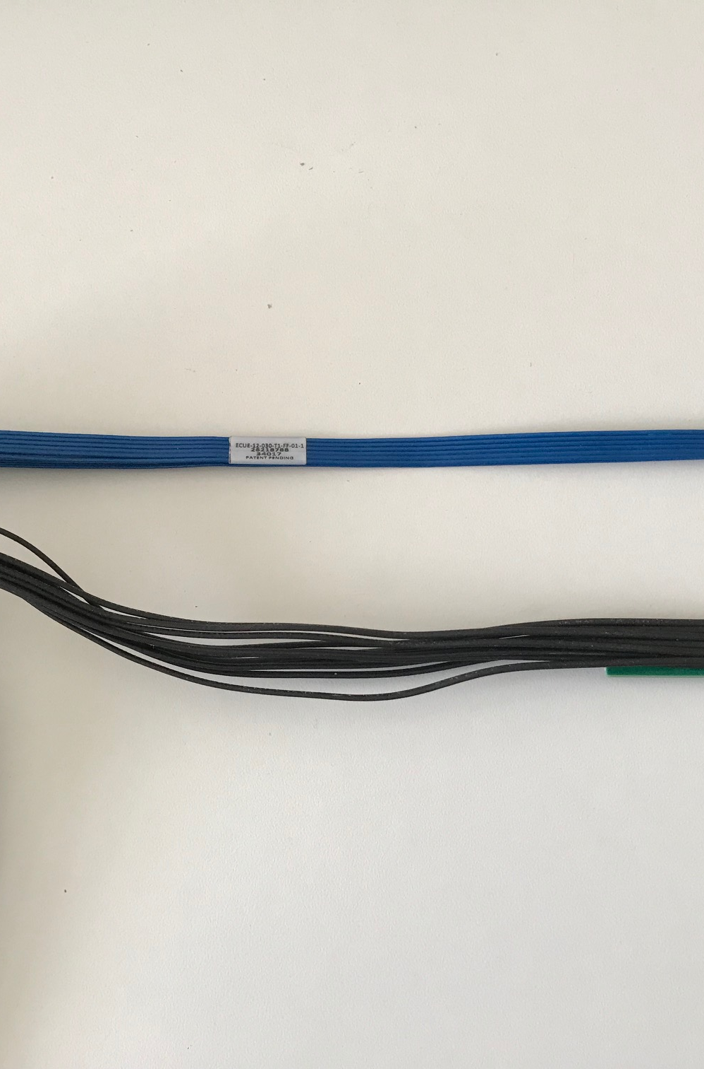
Type-A
Type-B
Type-A

Slide 13
Current thoughts on outstanding mechanical issues MVTX & sPHENIX:
From Walt
MVTX
  Envelope currently meets BNL/sPHENIX requirements to be compatible with INTT and sPHENIX beam-pipe.
  Details on conical section for all three layers and outer shell still need to be worked out;
    Interface with analog cable (Samtec) at patch-panel, pin and spring clip used in ALICE
    Making all three layer’s patch-panels similar for construction/fabrication
    Verify the interconnection/locking of the shells from layer to layer is consistent with the ALICE concept
    There is a locking pin in each shell – how does this function in the ALICE assembly
    New analog cable patch-panels have been 3D modeled verification of power cable passing through

Slide 14
Integration issues:
MVTX and INTT
  Unsettled design for the INTT – depending on simulation discussions and conclusion, hopefully by the end of October, number of layers, length of staves, radial position of layers.
  MVTX interface with extension tube to bring out services from detector.
  Mounting MVTX assembly
  sPHENIX beam-pipe, flange removal, placed further out from IP.

Slide 15
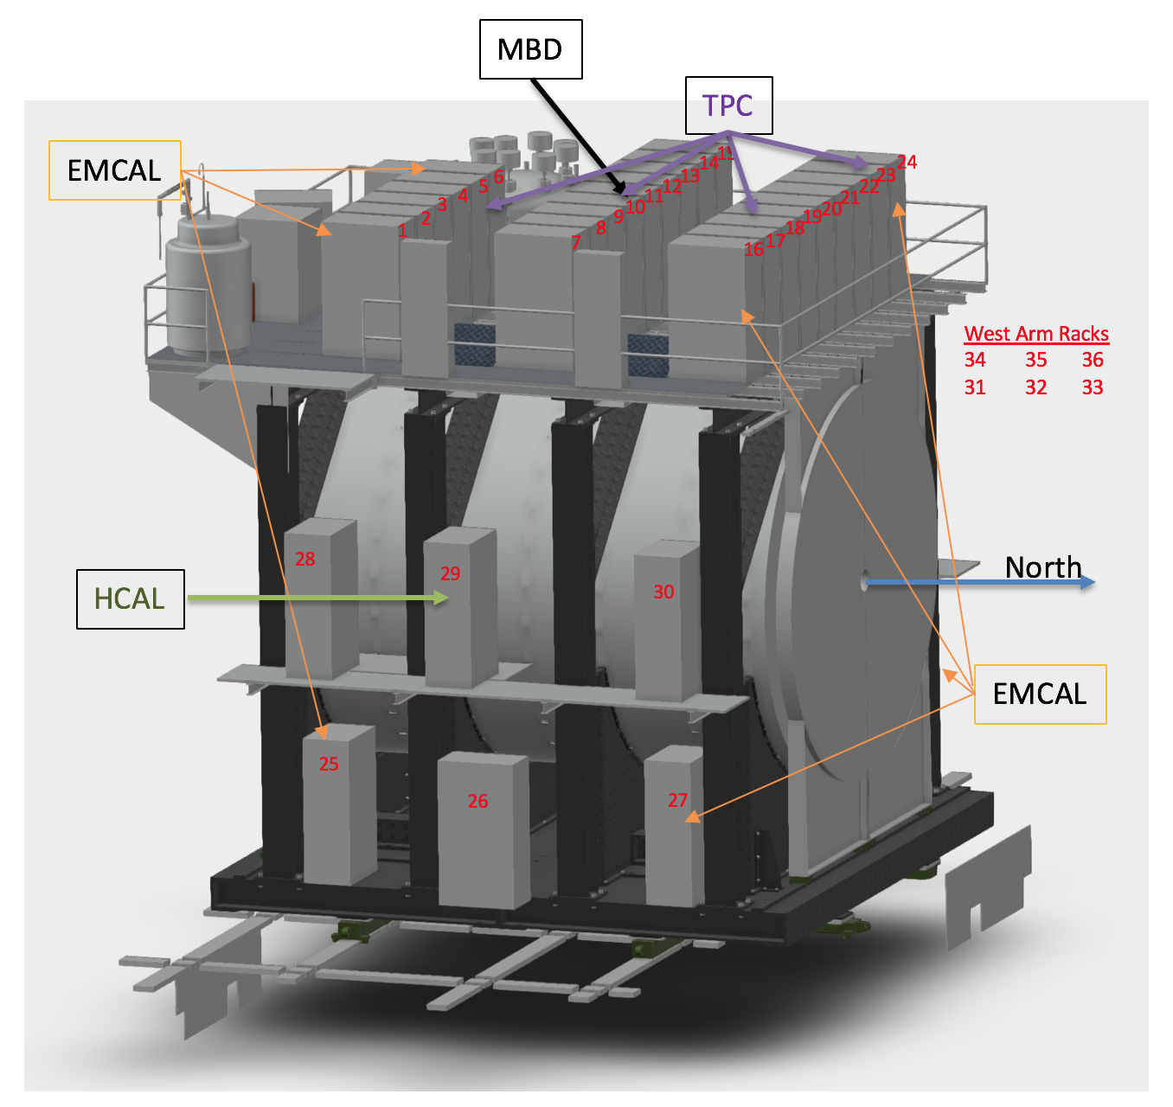
Next Activities
From Mickey
Next OSI Meeting Friday 10/26
  Cable Routes
  Grounding Scheme
  ICD Finalization?
  Beampipe?

Slide 16
Proposal: 2-day MVTX-Tracking Workfest, @FSU sPHENIX Collaboration Meeting (12/6-8),
Dates TBD: Tue-Wed (12/4-5) or Sat-Sun(12/8-9)
Doodle - https://doodle.com/poll/z73e4y2hpahqf4x3
Joint meetings with HF-Jet, INTT,
Tracking and Simulation groups
Update project cost and schedule
  Tasks and resources
  Smoothing funding profile for the cash flow
Discuss and update each institution’s role
  Task list
  Resources
  Manpower and schedule
Inner tracking task force
Mechanical system integration
Latest detector and physics simulations

Slide 17
backup

Slide 18
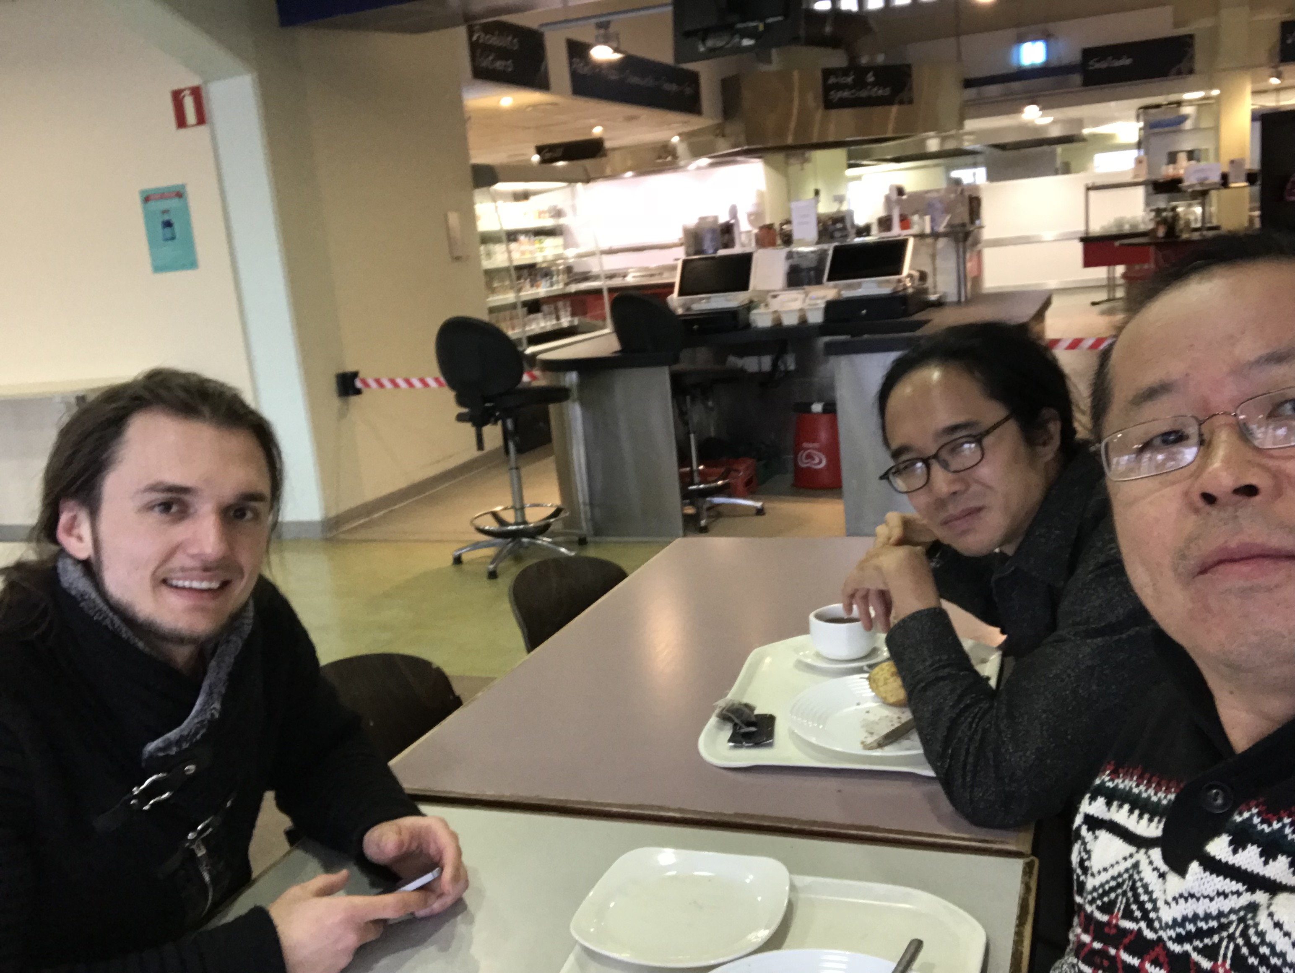
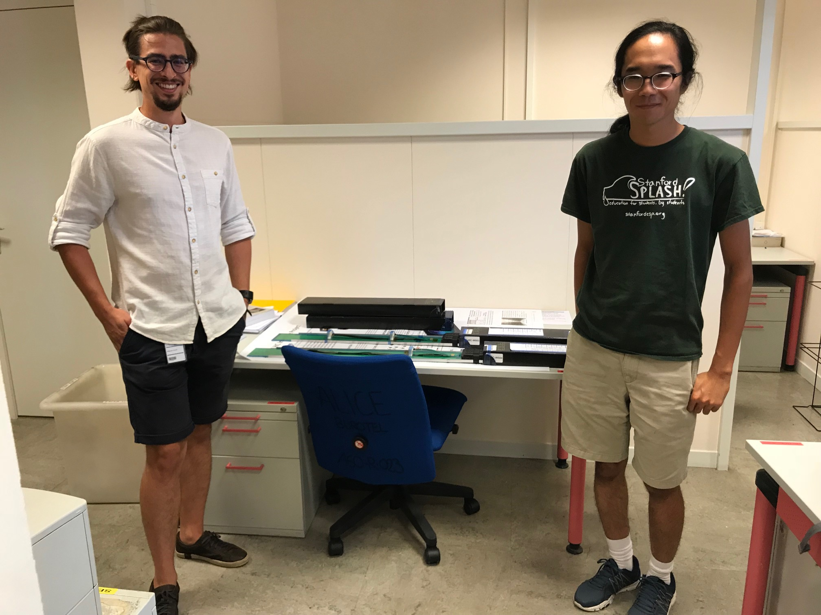
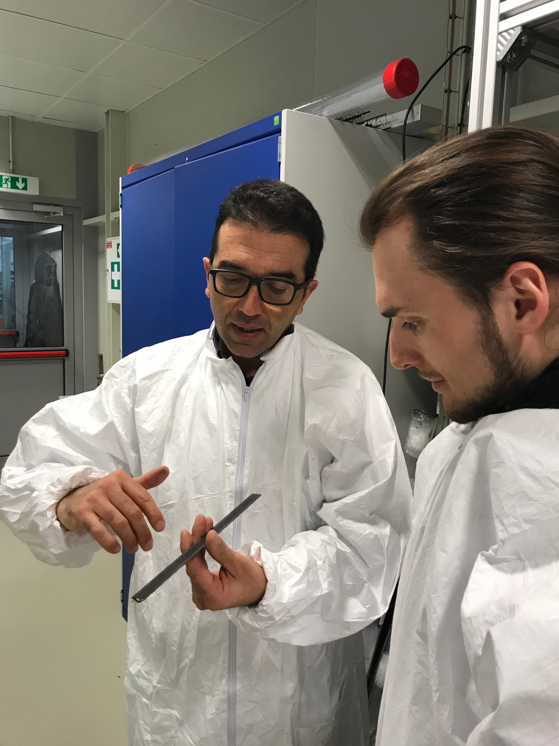
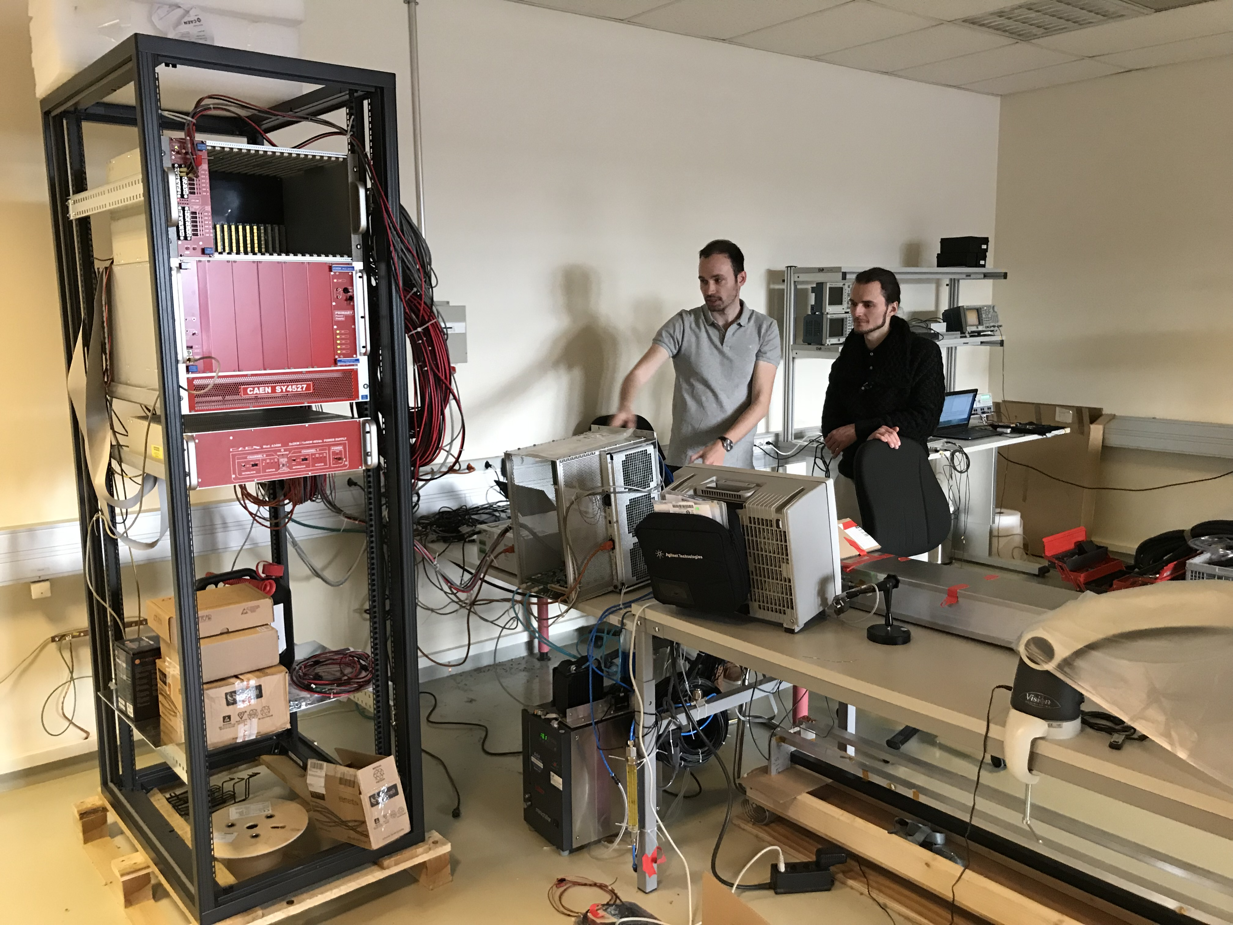
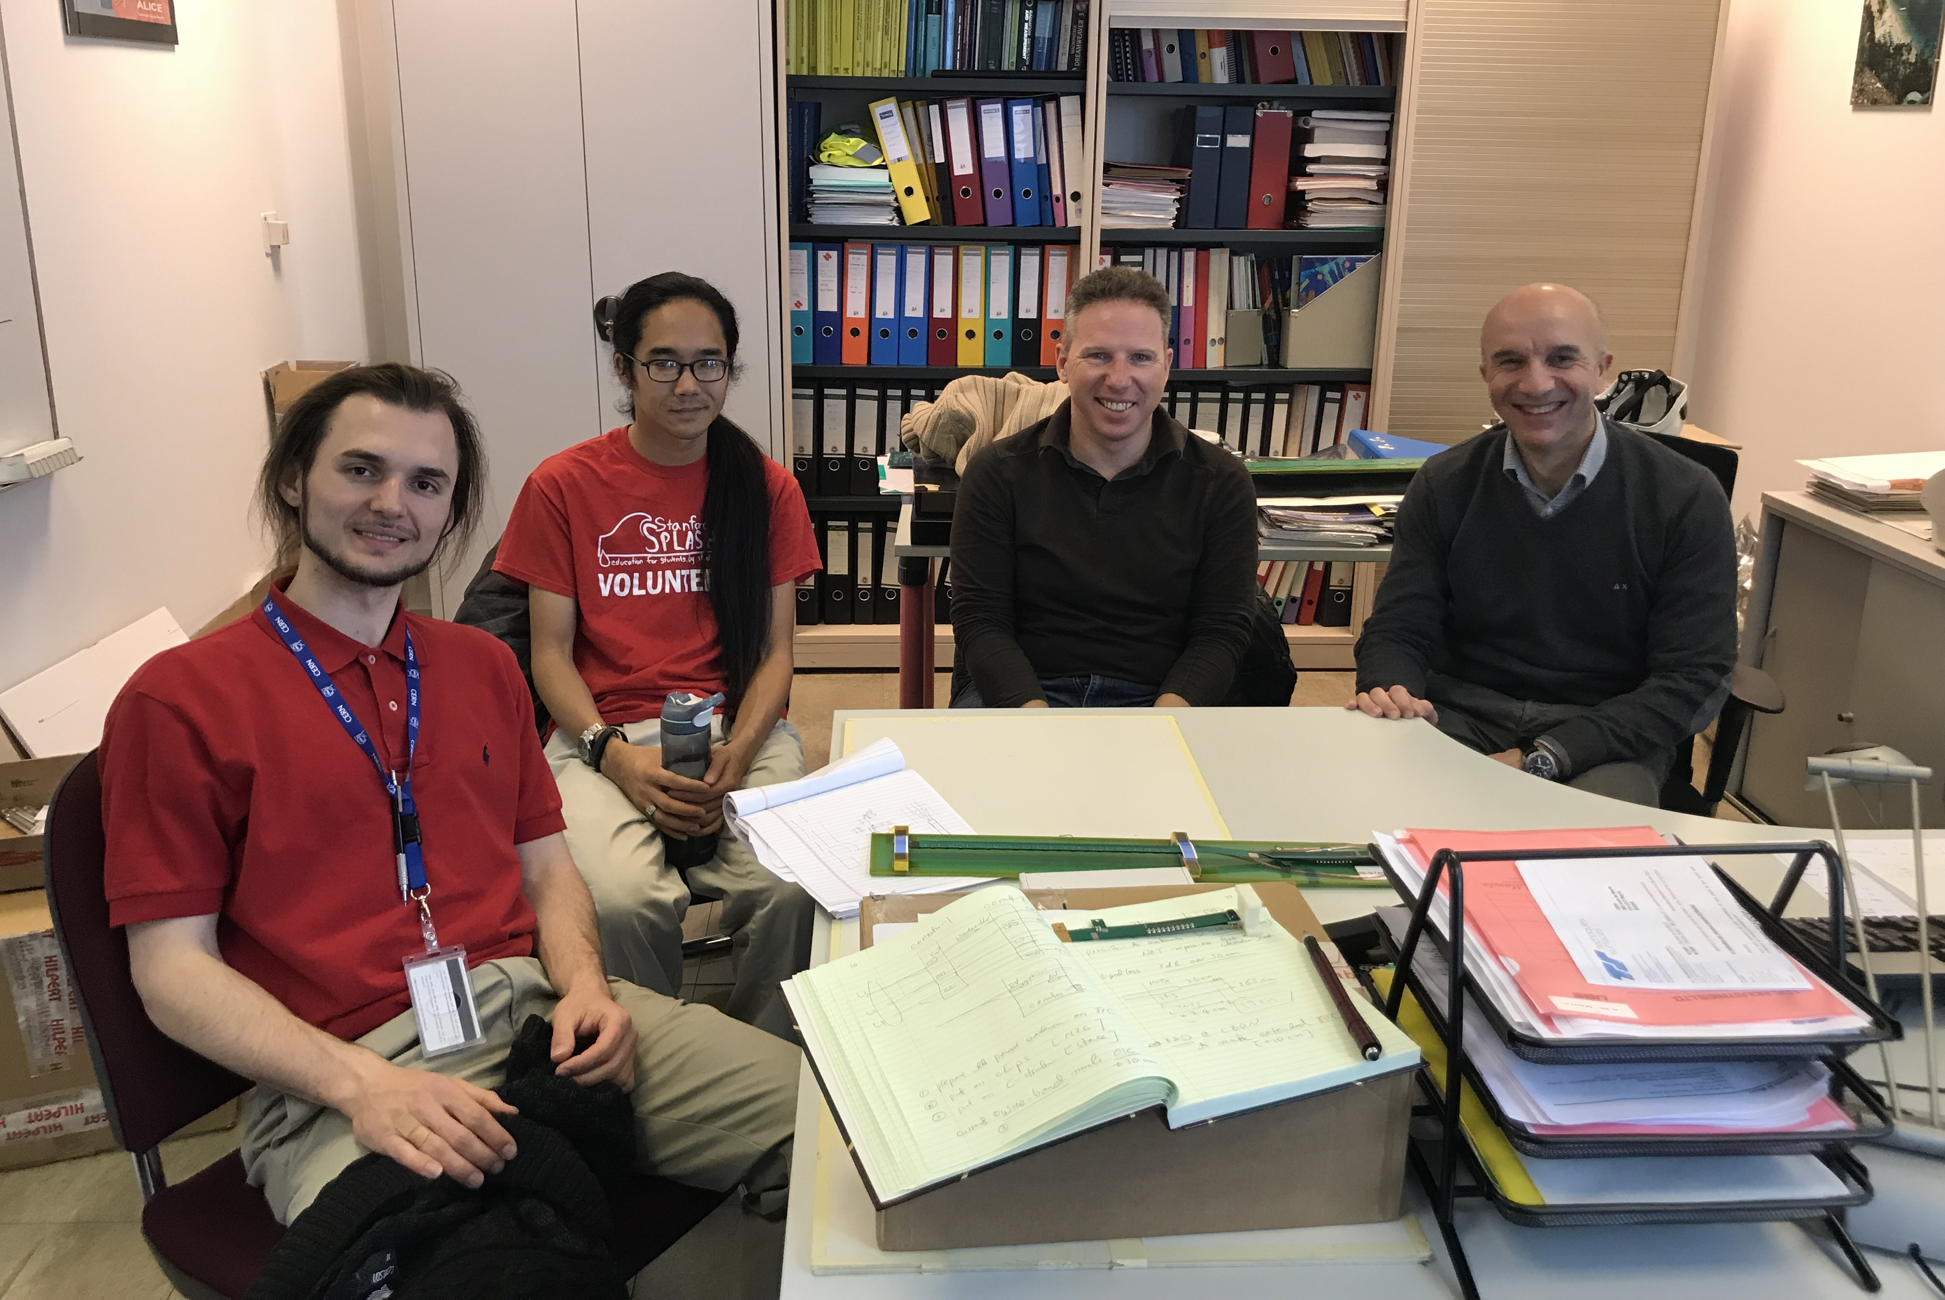
Actions @CERN
Many thanks to CERN colleagues!
Many are not shown here!
Miko
Sho
Corrado
Sho
Alex
Ming
Felix
Antoine
Antonello

Slide 19
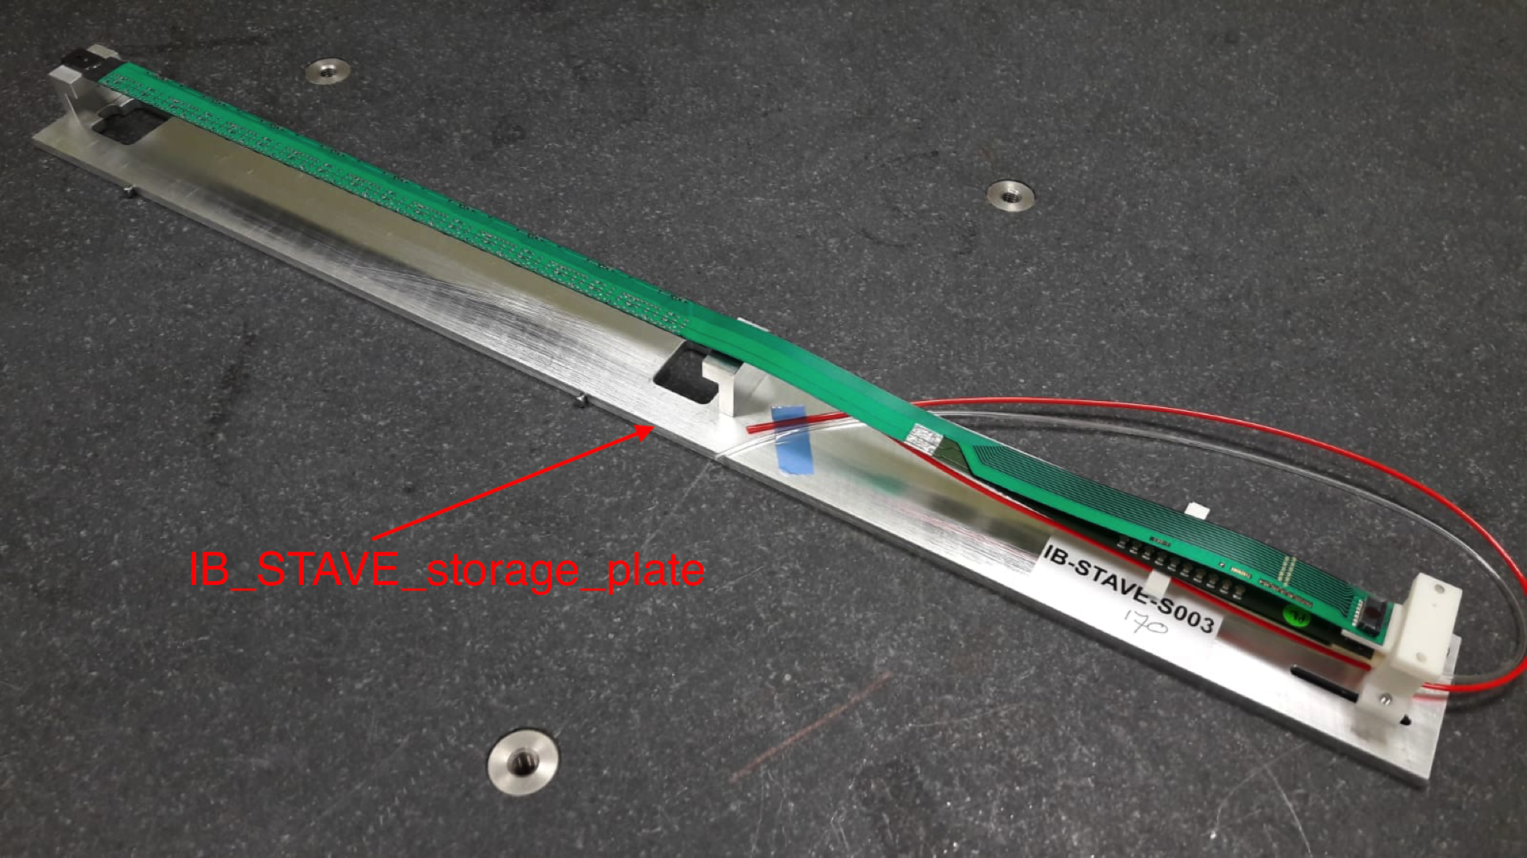
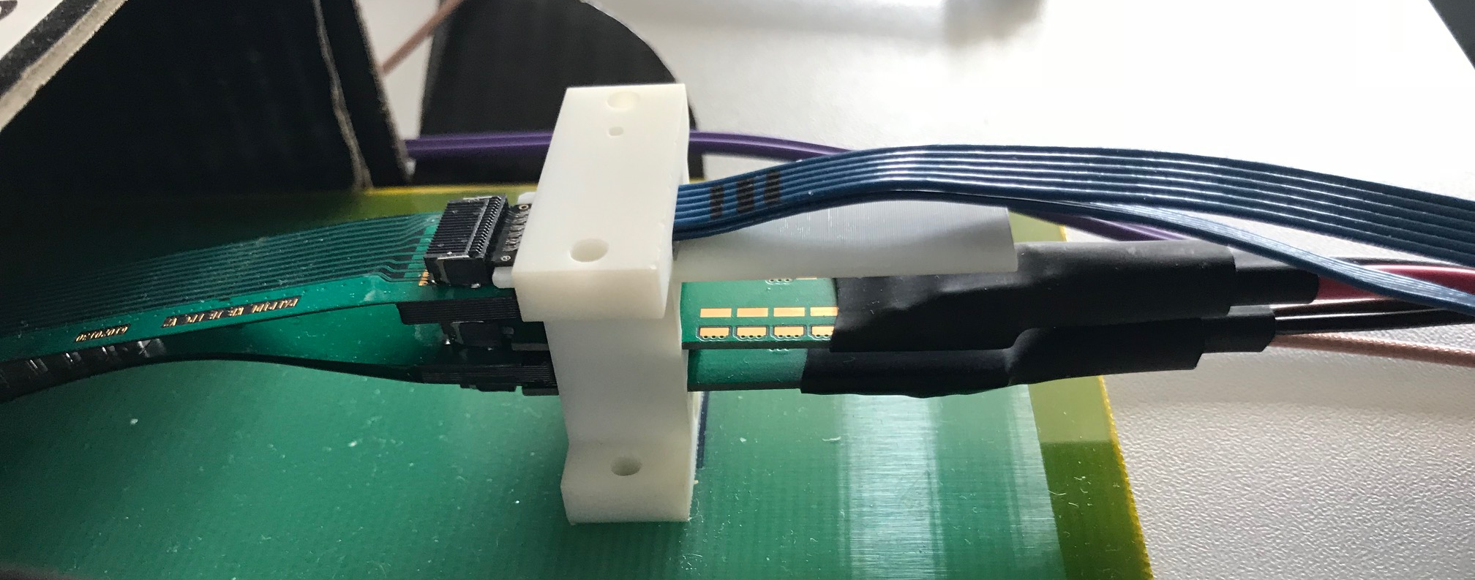
9 sensors
Flexible Printed Circuit (FPC) for
9 HS Signals, CLK, CTRL
Flexible power extension PCB
DVDD, AVDD and Bias V.
Soldered to FPC
- To be modified for sPHENIX
ALICE IB Stave

Slide 20
ALICE RU Production – Timeline
Presented at ITS Plenary Meeting, 9/24/2018
Both RUs and Data Cables are at the DAI. Goal is having 20 RUs before Christmas Break, as well as enough data cables to connect the whole IB (24 assemblies, equal to 40 data cables).
Jul
Aug
Sep
Oct
Nov
Dec
Jan
Feb
Mar
Apr
May
Data cables
TP
Tendering
DAI
Batch 1a (24 A+B)
Batch 1b
(46 A+B)
Batch 2 (90 A+B)
Batch 3 (90 A+B)
Batch 4 (90 A+B)
IB covered
Acpt.
48 Lnk
92 Lnk
180 Lnk
180 Lnk
180 Lnk
RUs
TP
Tendering
DAI
Ref.
Prototypes (20)
Batch 1 (140)
Batch 2 (150)
Acpt. (extensive)
Acpt. (40 b/w)
(standard)
Acpt. (40 b/w)
(standard)
Microsemi
140 RU
150 RU
Tendering
DAI
Lead time
(26)
Xilinx
→sPHENIX RU
production
Tendering
DAI
Lead time
2018
2019

