Slide 1
MVTX Status and Plan
Ming Liu
For the MVTX Detector Group
06/06/2018
sPHENIX Collaboration Meeting

Slide 2
Outline
Project Status
MVTX full proposal
R&D Highlights
Plan
Document: sPH-HF-2018-001
https://indico.bnl.gov/event/4072/

Slide 3
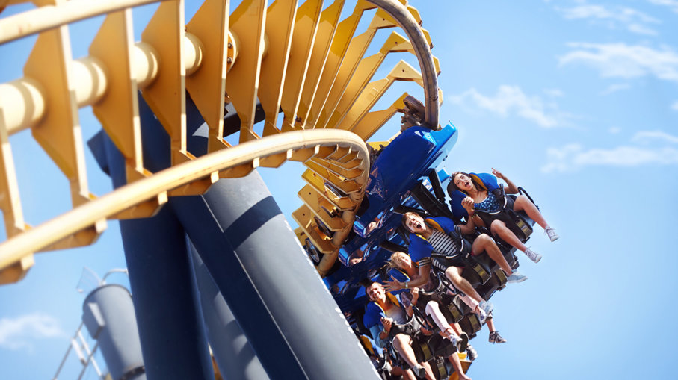
Toward Realizing MVTX …

Slide 4
A Short Summary …
From Dave & Gunther talk
Feb. 2018
sPHENIX workshop in China, 4/2018
Korean consortium under discussion, led by Prof. Y. Kown
Extensive discussion of integration @MIT
MVTX+INTT+TPC…
https://indico.bnl.gov/event/4380/

Slide 5
MVTX Status: Where do we stand?
BNL (w/ DOE) is actively exploring ways to secure funding for MVTX
  sPHENIX MIE at CD-2 (when baseline defined)
  Or a parallel project
BNL/MIT facilitating advanced funding for stave and RU production beginning Oct. 2018
  MVTX/INTT subsystem integration mini-review planned for 7/19/2018
  Procurement readiness review in September 2018

Slide 6
MVTX Full Proposal

Slide 7

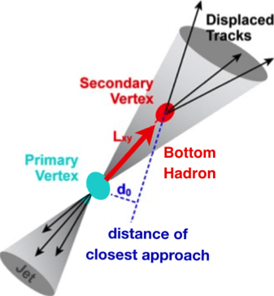

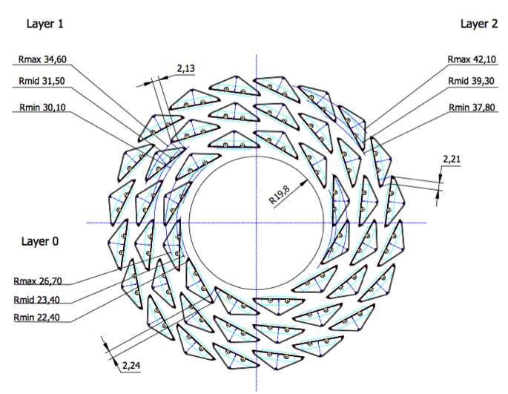
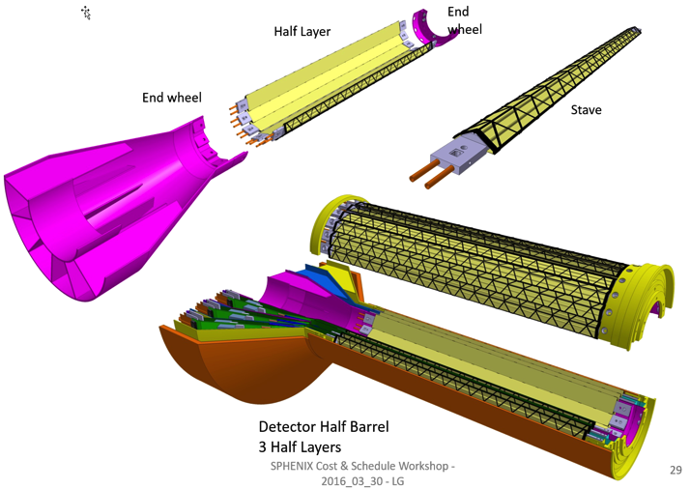
MVTX: Monolithic-Active-Pixel-Sensor-based VerTeX Detector
sPHENIX @RHIC
Key integration tasks:
Readout
Mechanics
ALICE ITS Upgrade @CERN;
Inner Tracker System (2021+)
sPHENIX Inner Tracking
“Adopt” ALICE/ITS
Mini. risk,
Max. physics
MVTX could also be a day-1 EIC detector

Slide 8
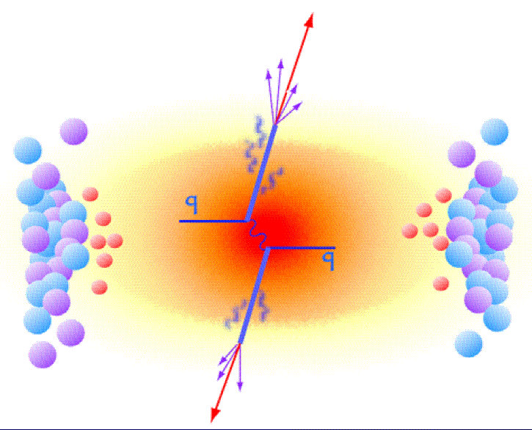
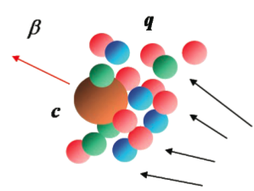
MVTX Enables the 3rd Science Pillar
Jin/Xin’s talk
Jets
Upsilons
Open Heavy Flavor
Bottom quarks are heavy (4.2 GeV)
Produced in initial collision, probe QGP evolution
Well controlled in pQCD
Provide access to fundamental transport properties

Slide 9

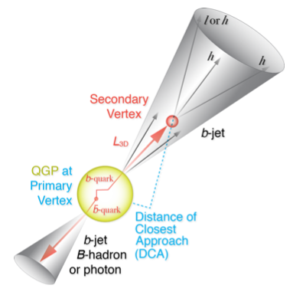
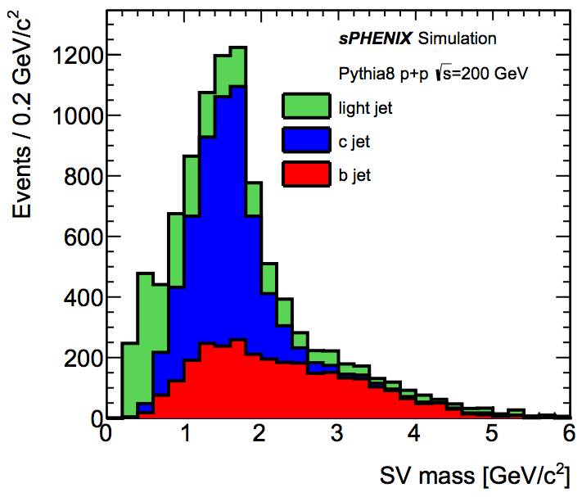
B-Hadron & b-Jet Tagging
Physics Reminder
Jin/Xin’s talks
Detected using the long lifetime of bottom quark hadrons:
  Displaced tracks
  Large 2nd vertex invariant mass
Need high precision tracking and vertex determination – MVTX!
Need excellent jet detection capabilities – sPHENIX!

Slide 10
MVTX Physics Highlights
Jin/Xin’s talk
“B meson and b-jet modification”
Heavy quarks – unique probe of QGP w/ new scales, m_{c}, m_{b}
  Study mass dependence
    Jet quenching & energy loss
    Flow – interaction with medium
  Access QGP properties
    Temperature, density, coupling, transport coefficients, viscosity etc.
“B meson and b-jet flow”
m_{u} m_{d}
m_{s}
Λ_{QCD}
m_{c}
m_{b}
MeV
1
10
10²
T_{c}
T_{QGP}
10³
10⁴

Slide 11
R&D Progress and Highlights

Slide 12
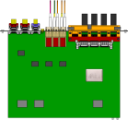

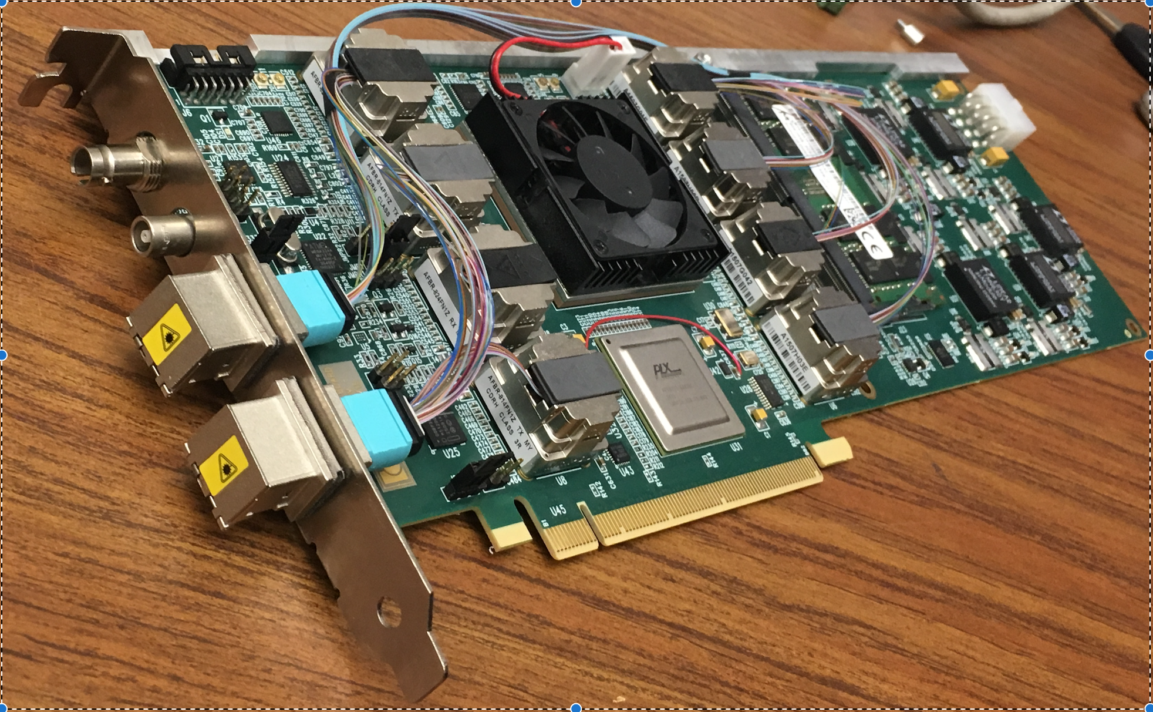
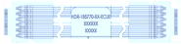
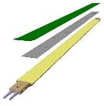

MVTX Electronics, Power and Controls
CAN bus
DCS
5-10 m
Trigger & Clock
Readout Unit
Front End
GBT Optical Links
9-sensor Stave
9 Data (1.2Gbps)
1 Clock, 1 Control/Trigger
Control
Data (9.6 Gb/s max)
Trigger
Samtec Twinax “FireFly”
FELIX
Back End
FPC
Power
Alpide Sensors
Power
Filtering Capacitors
regulators
Power supplies
Cold Plate
Regulated Power
Power Board
Interaction Region
Experimental Hall
Counting House
MVTX Detector Electronics consists of three parts
Sensor-Stave (9 ALPIDE chips) | Front End-Readout Unit | Back End-FELIX

Slide 13
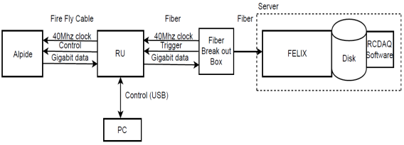
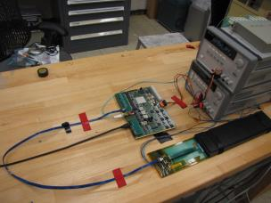
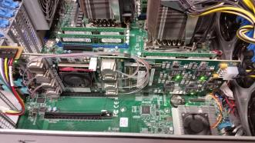
MVTX Full Readout Chain Demonstrated
Stave
Readout
Unit
FELIX
Readout Unit configures Stave using USB interface
FELIX distributes clock to Readout Unit
Readout Unit distributes clock to the Stave
Stave is triggered, sends data at 1.2Gb/s
Configured GBT link to recover clock from FELIX
Readout Unit receives the data and sends the data to FELIX over fiber using GBT link
FELIX packs data, stores it on disk using RCDAQ - the sPHENIX data format and software
Readout Unit + Stave
Server + FELIX

Slide 14
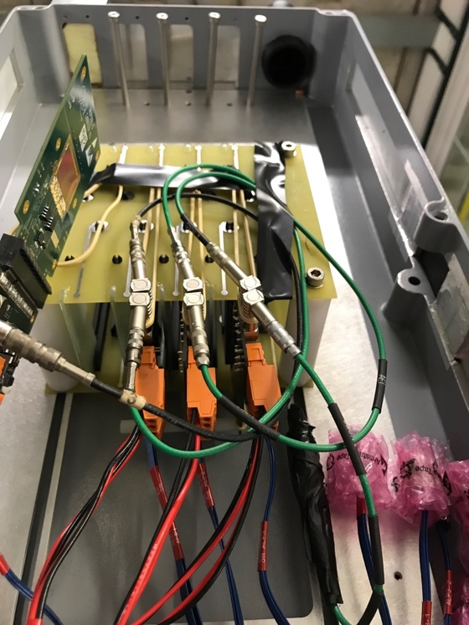
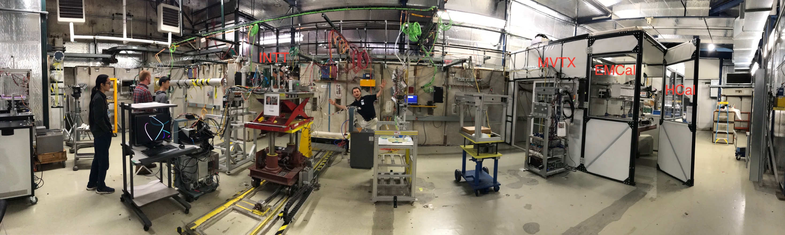
MVTX Test Beam at Fermilab 02/20-03/10, 2018
Goals:
  Test full readout chain
  Evaluate ALPIDE sensor performance
Experimental setup
  A 4-sensor telescope
  Full readout chain: MAPS+RU+FELIX+RCDAQ
120 GeV
proton
Parasitic with INTT run
Very productive & collaborative
4-sensor
Telescope

Slide 15
Fermilab Test Beam Results (I)
4-hit track
120 GeV proton beam
4-sensor telescope
Mostly single tracks
Cluster size: 2.1 ~ 2.4
# of tracks per triggered event
Cluster size

Slide 16
Fermilab Test Beam Results (II)
Hit Spatial Resolution: < 5 um
Hit Efficiency > 99.5%
Pixel size (~28um)

Slide 17
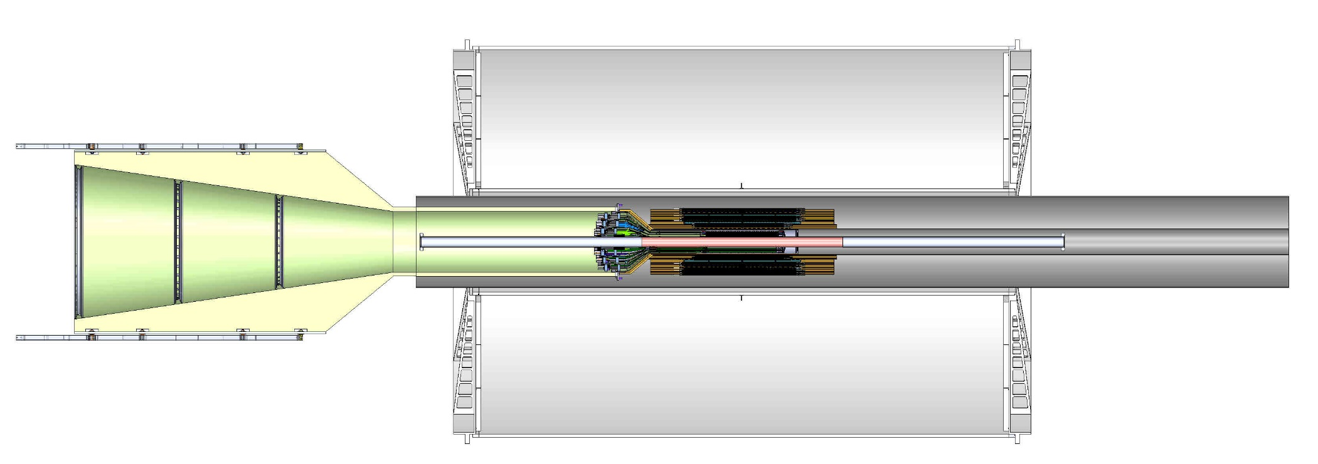
MVTX Detector Integration
Mickey/Walt’s talks
MVTX:
3 layers
48 staves
Electrical system
  Readout, power, controls
Mechanical system
  Support and cooling
Office of System Integration

Slide 18
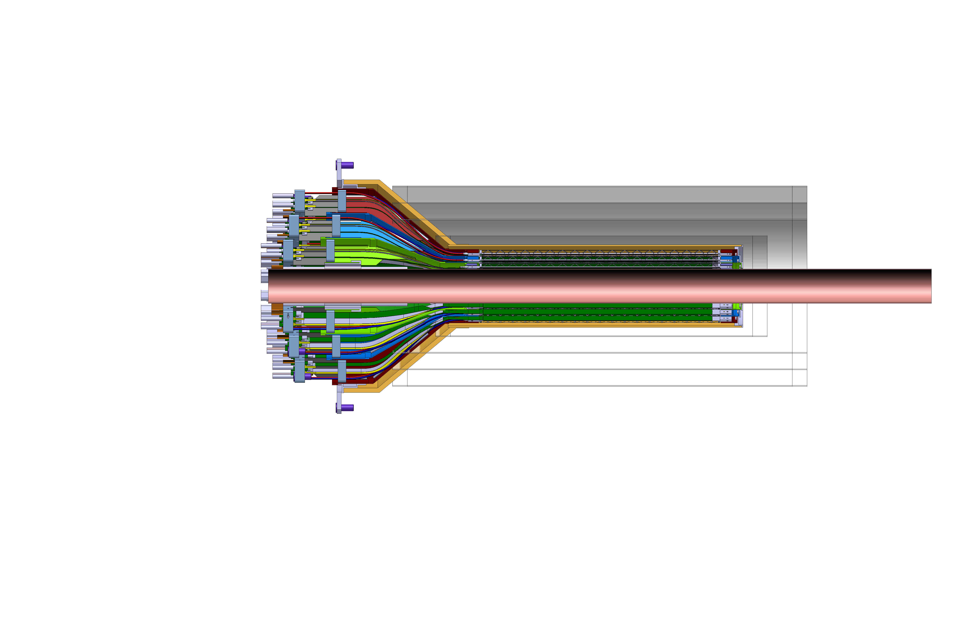
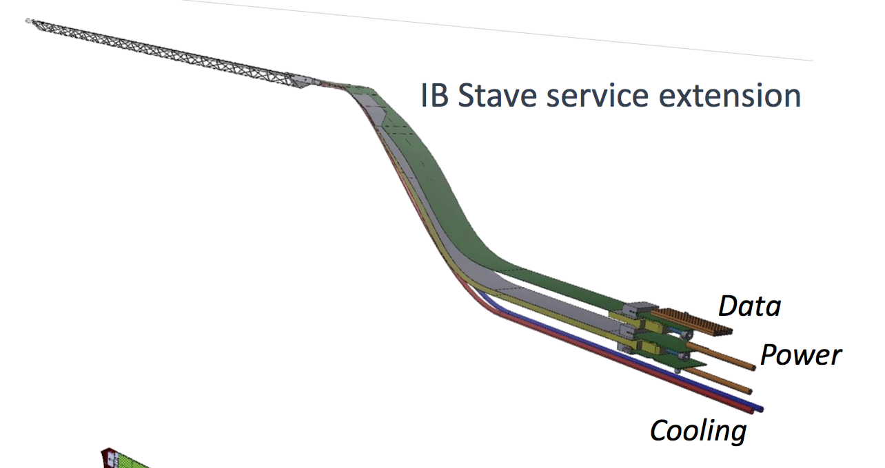
Toward INTT-MVTX Conflict Resolution
Walt/Mickey’s talks
INTT 4-layers
MVTX: Extend cables to move the conical structure further out in z-direction
FPC data cable is the HDI and can’t be easily extended
Make longer power extension ~50cm (current: 15cm)
Reduce angle of cone to free up space for INTT services
Redesign patch panel/cable connection shape and location
INTT: optimize detector layout and support for integration

Slide 19
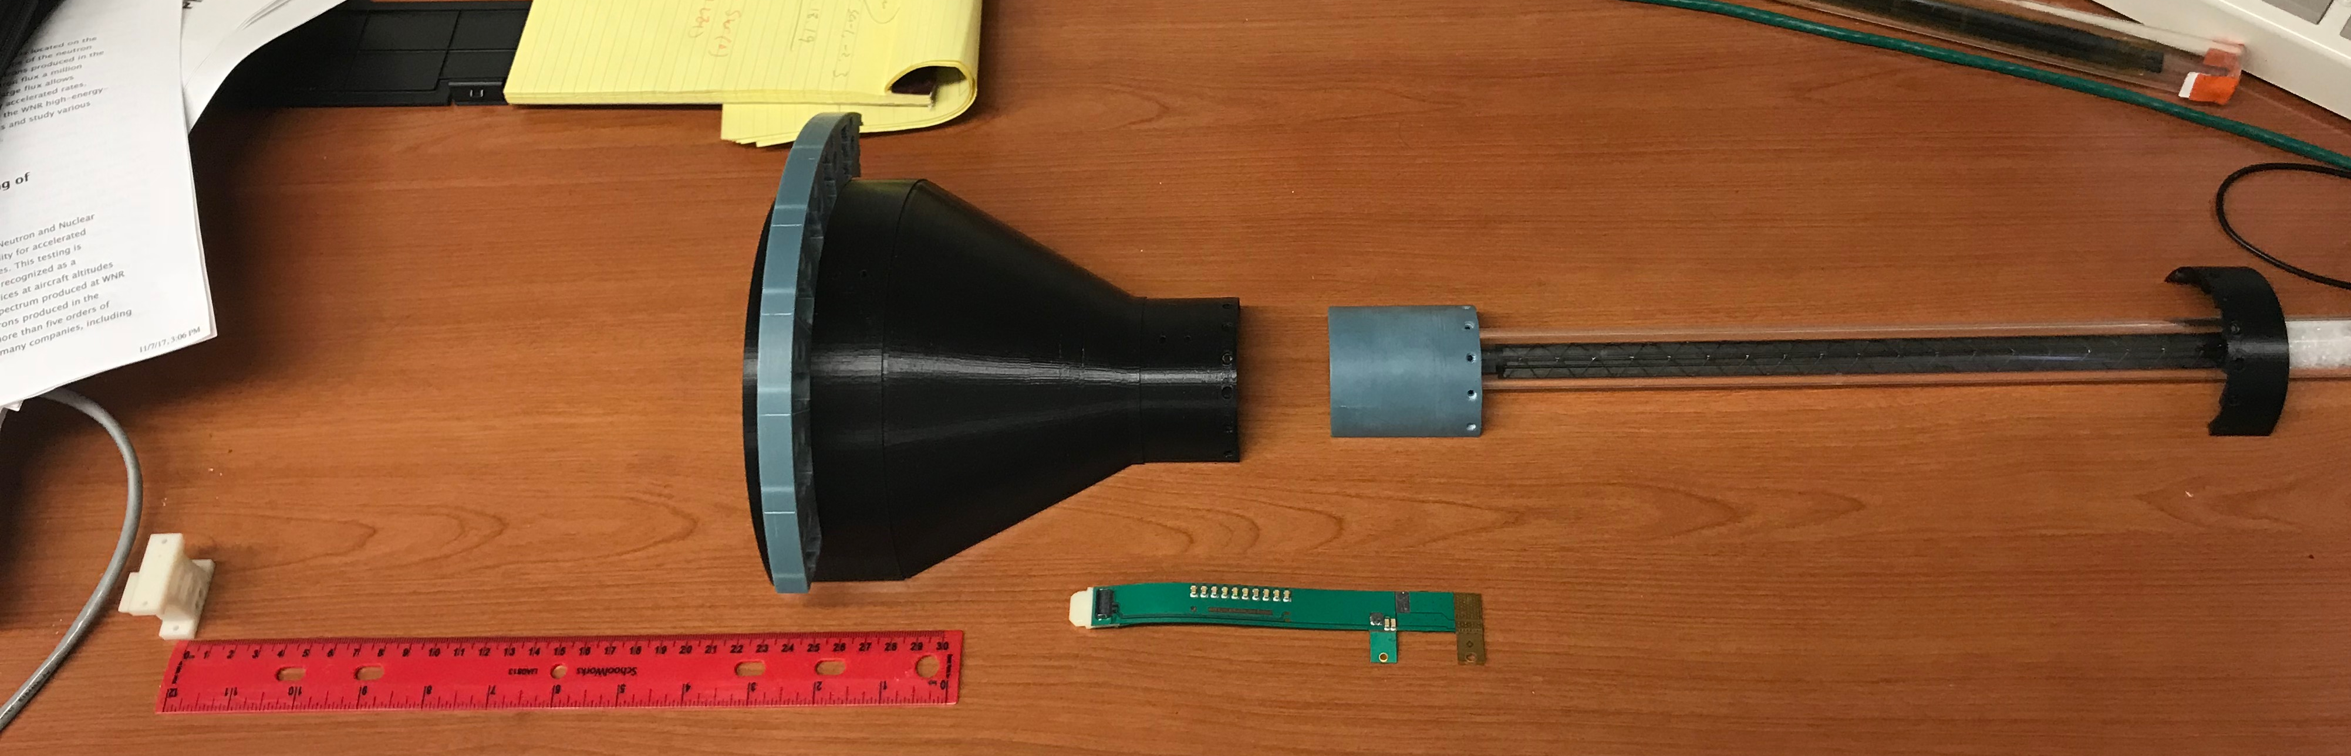
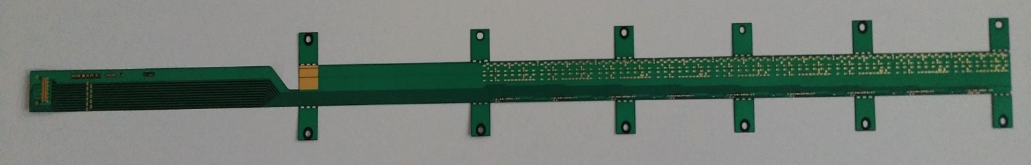
MVTX Mockup & FPC Extension R&D
PWR extension
L=15cm
Extend power cables to ~ 50cm
Extended power cables AVDD/DVDD:
L = ~50cm, and possibly with 2~3 different lengths, like 30cm and 40cm
Separate PWR and signal connections at different Z-locations.

Slide 20
Plan for next 6+ months
Detector simulation for integration: INTT + MVTX + TPC … urgent!
  TPC-INTT-MVTX tracking optimization for integration
  Physics performance study, 3 or 4-layer INTT etc.
Mini-review, July 19
  MVTX/INTT subsystem integration
  Technical readiness of stave and RU for production
Production readiness review in September
  Stave and RU production at CERN beginning 10/2018
  Advanced funding, BNL/MIT
  MVTX + INTT + rest sPHENIX integration
Near term R&D
  MVTX carbon structure and integration
    End wheels
    Service barrel
  Electrical system integration
    Readout
    Slow control & power
  MVTX+INTT joint test beam at Fermilab, ~Feb/Mar 2019
Budget profile & schedule smoothing
  RHIC operation budget and cash flow
  MVTX production schedule
  Prepare for CD-2 MIE integration

Slide 21
Summary
MVTX full proposal completed
  Expanded science
  sPHENIX baseline (CD-2)
  New collaborators, on physics/software and hardware
Cost and schedule being updated
  Major item cost and production plan
  Funding profile smoothing
  Advanced funding for staves and RU production at CERN
Excellent progress in R&D
  Full readout and controls proof-of-principle demonstrated
  Conceptual integrated mechanical system design developed
MVTX+INTT+TPC integration in progress
  Electrical and mechanical system
  sPHENIX wide coordination through Office of System Integration
To be ready for sPHENIX Day-1 Physics in 2023
  sPHENIX and later EIC possibility
Document: sPH-HF-2018-001
https://indico.bnl.gov/event/4072/

Slide 22
Backup slides

Slide 23


Monolithic-Active-Pixel-Sensors (MAPS)
ALPIDE: The next Generation State of the Art Pixel Sensor
Advantages of ALICE MAPS(ALPIDE):
  Very fine pitch (27x29 μm)
  High efficiency (>99%) and low noise (<10⁻⁶)
  Excellent time resolution, ~5 μs
  Ultra-thin/low mass, 50μm (~0.3% X₀)
  On-pixel digitization, low power dissipation
An ideal detector for sPHENIX and EIC physics!
FPC
9 Chips
Cooling plate
A 9-chip MAPS stave, 9 x (1.5 x 3 cm²)
ALPIDE design
50 μm
28 μm

Slide 24

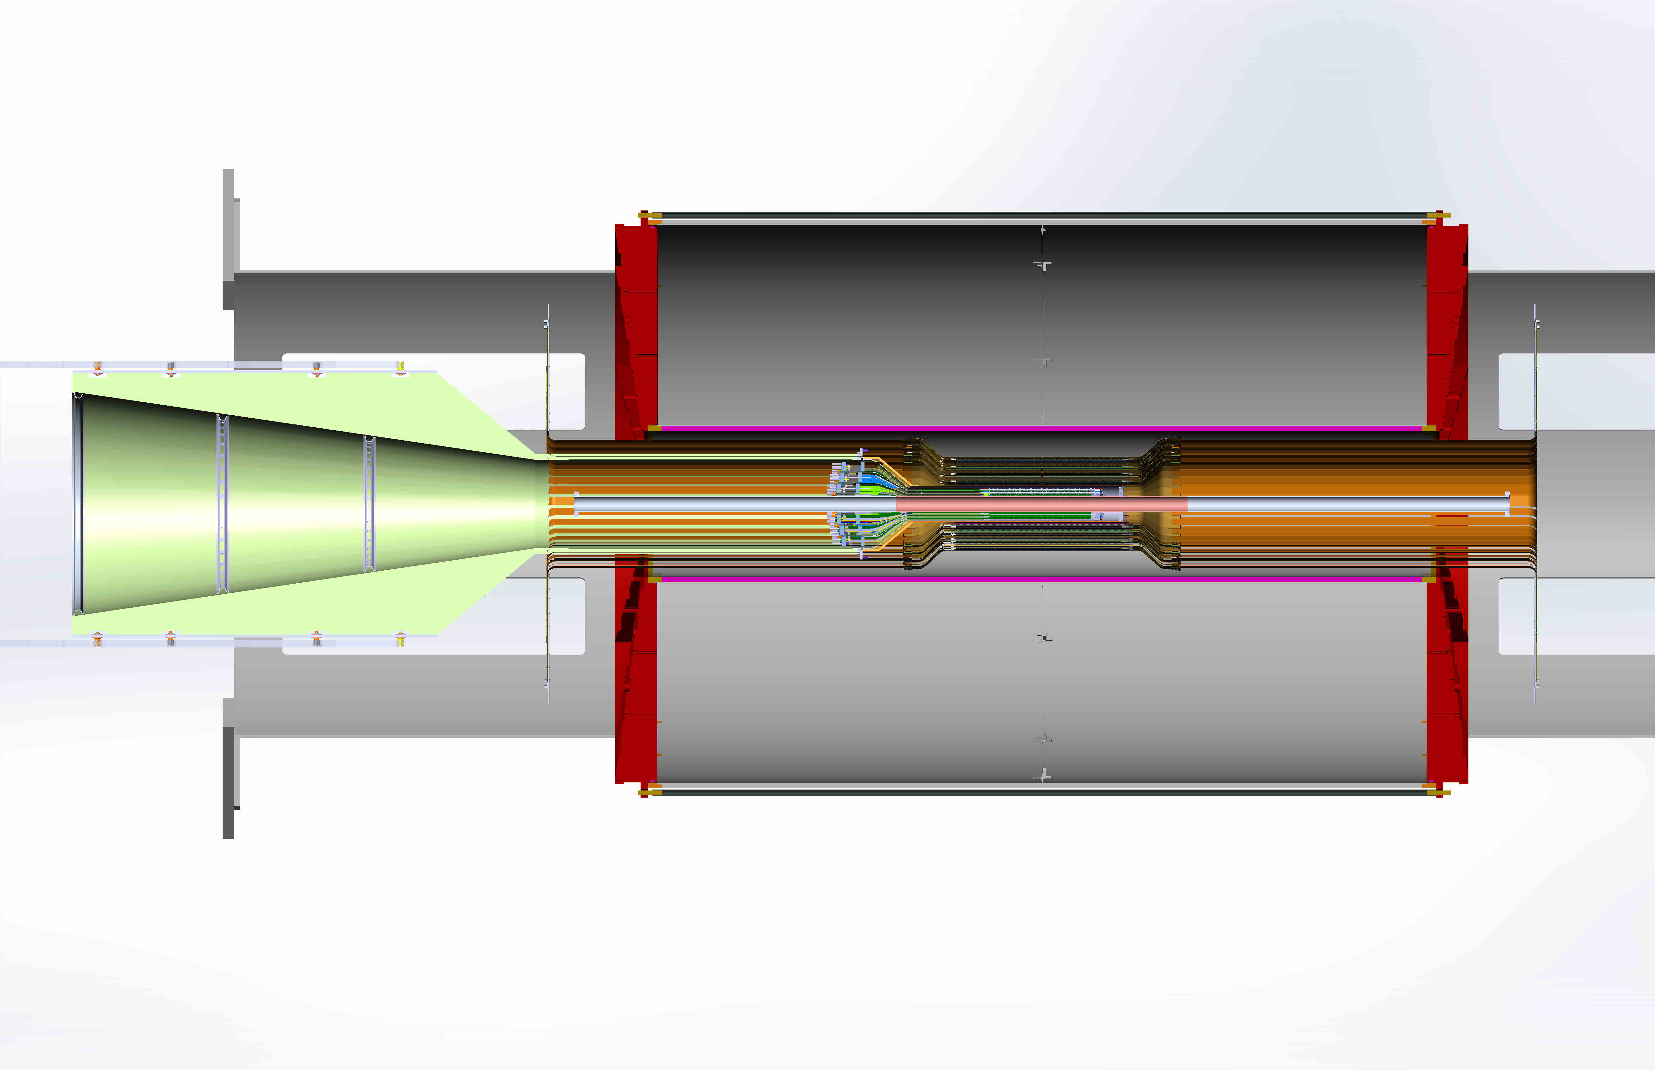
sPHENIX Tracking System
Excellent Tracking system:
  TPC: Time Projection Chamber
  INTT: Intermediate Silicon Strip Tracker
  MVTX
TPC:
R = 20-80cm
INTT:
R =6,8,10,12cm
MVTX:
R=2.3, 3.2, 3.9cm
TPC
INTT
MVTX
2m

Slide 25
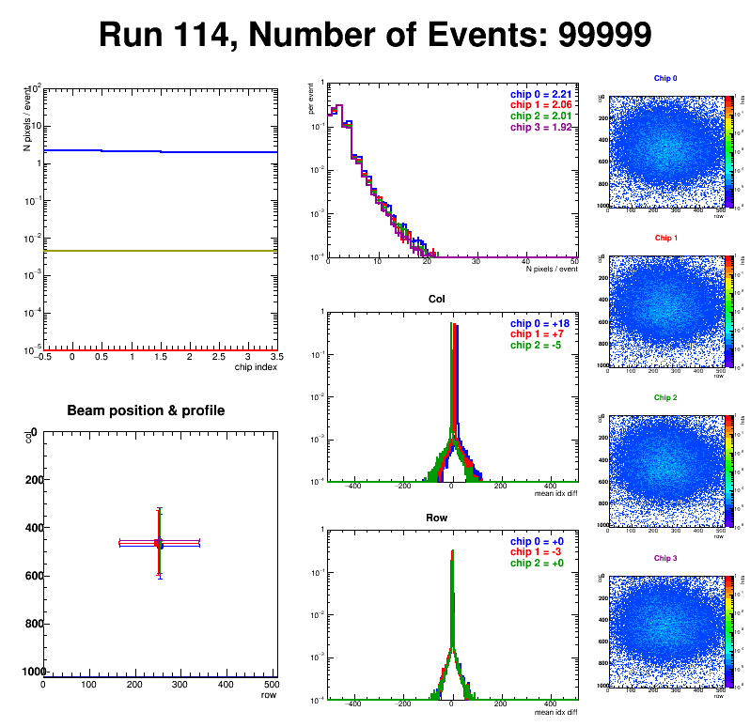
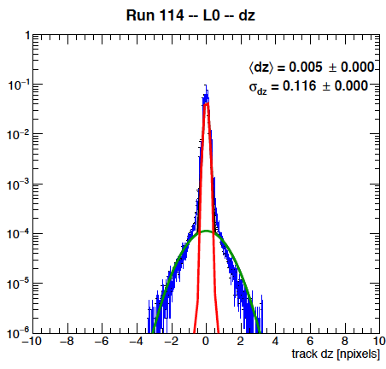
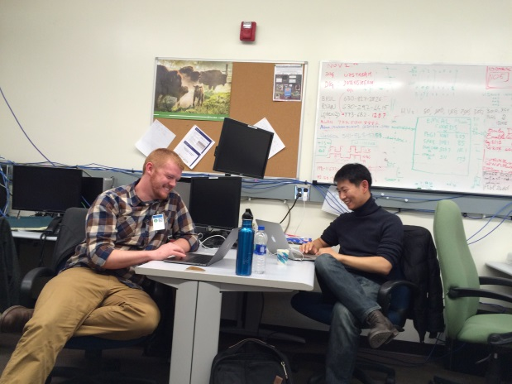
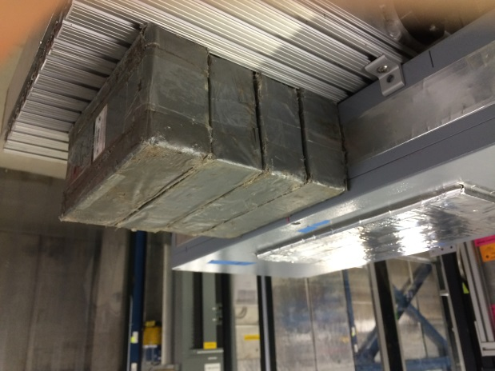
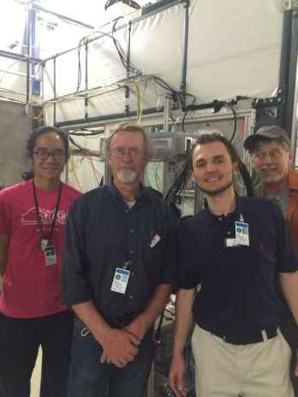
Fermilab Test Beam Summary
Successfully operated the full readout chain
  RU Configured and readout 4 ALPIDEs
  FELIX successfully integrated into RCDAQ
Sensor Performance
  Cluster Size
  Threshold parameters
  trigger delay
High multiplicity events
  ALPIDE occupancy runs with 10cm lead bricks
Online Monitoring
  Hit distribution, relative alignment
Analysis confirmed telescope performance
  Hit resolution < 5 um

Slide 26
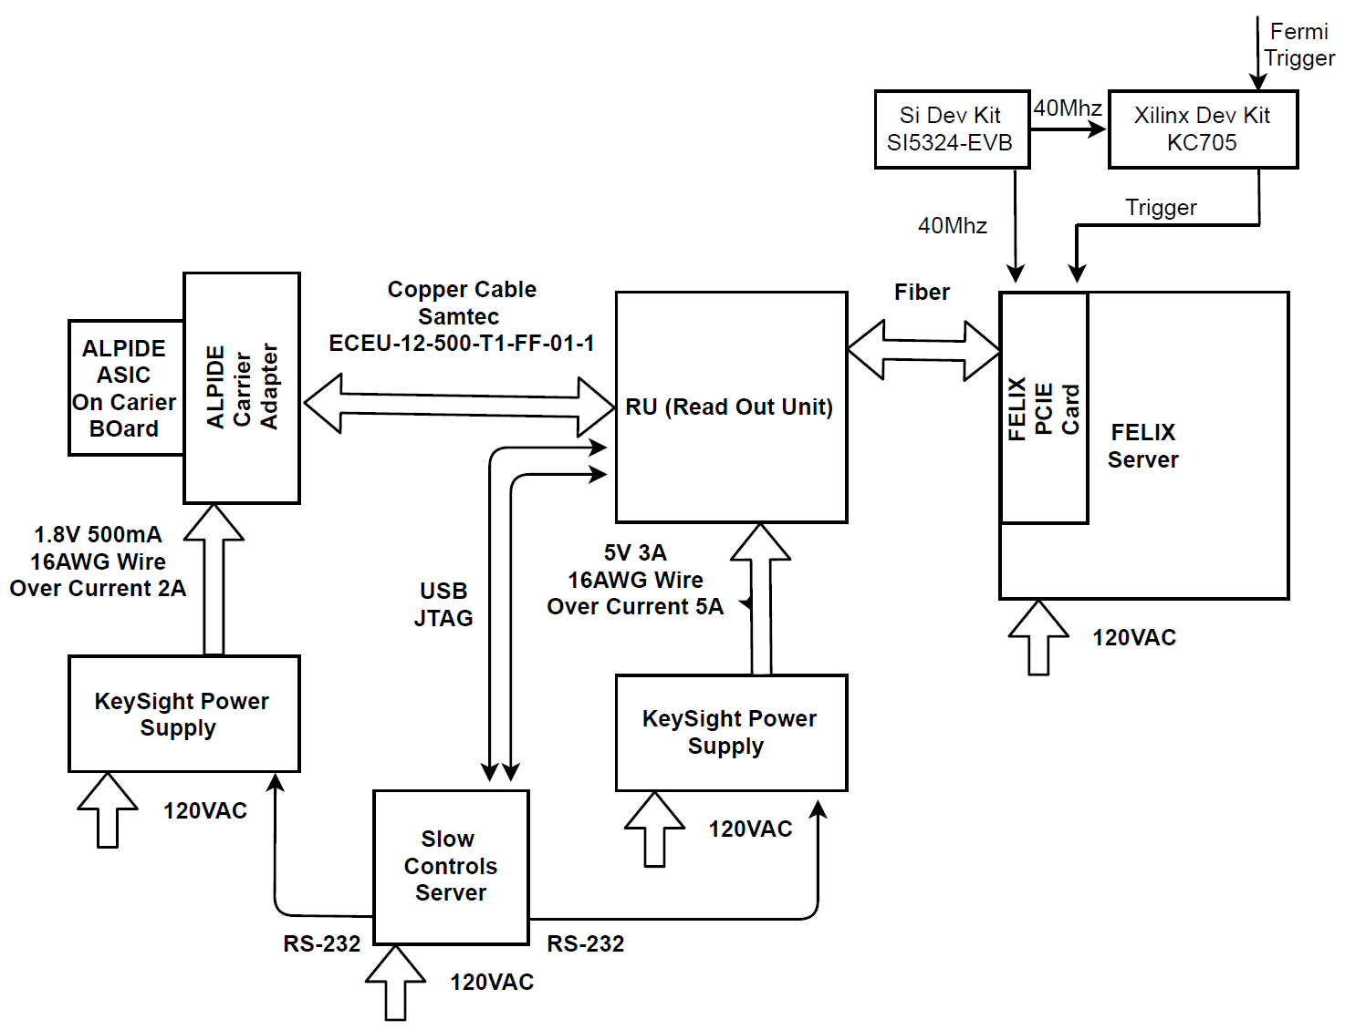
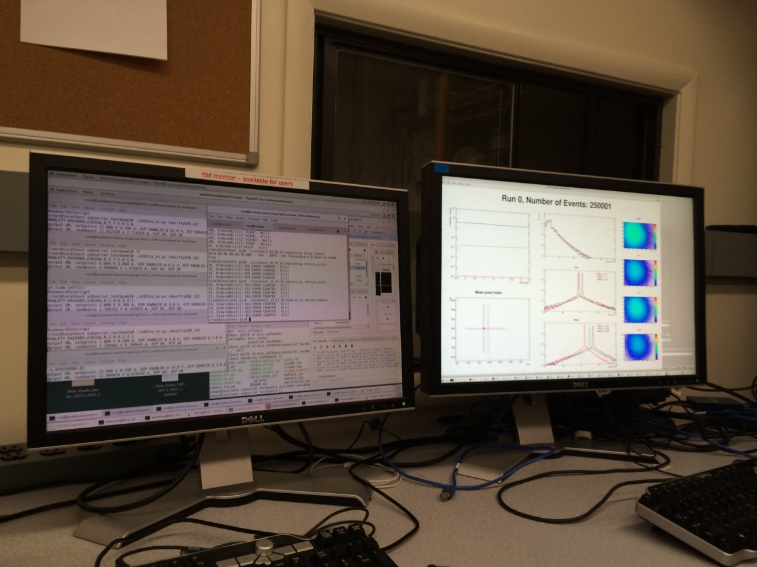
Fermilab Beam Test Block Diagram
4-ALPIDE Telescope
4 5m SamTec Cables, 1.2Gbps
CLK recovered from
FELIX through GBT link;
Trigger from FELIX

Slide 27
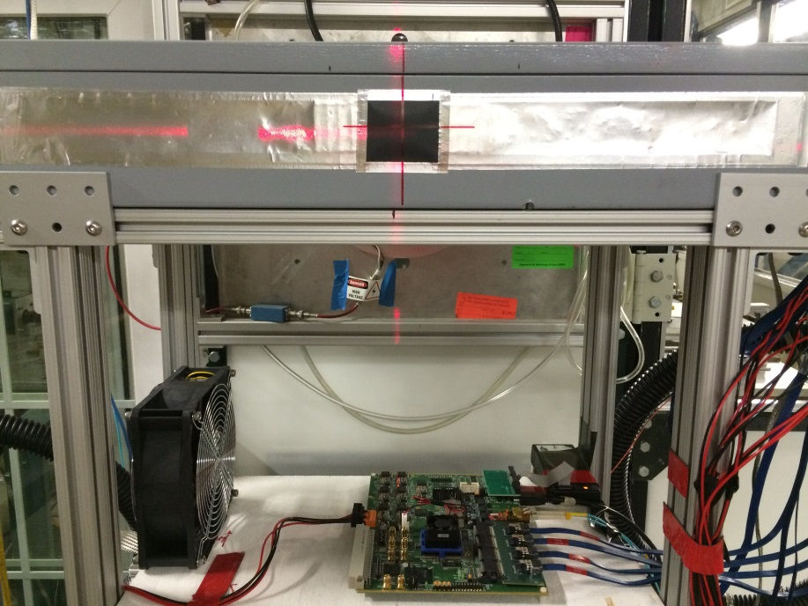
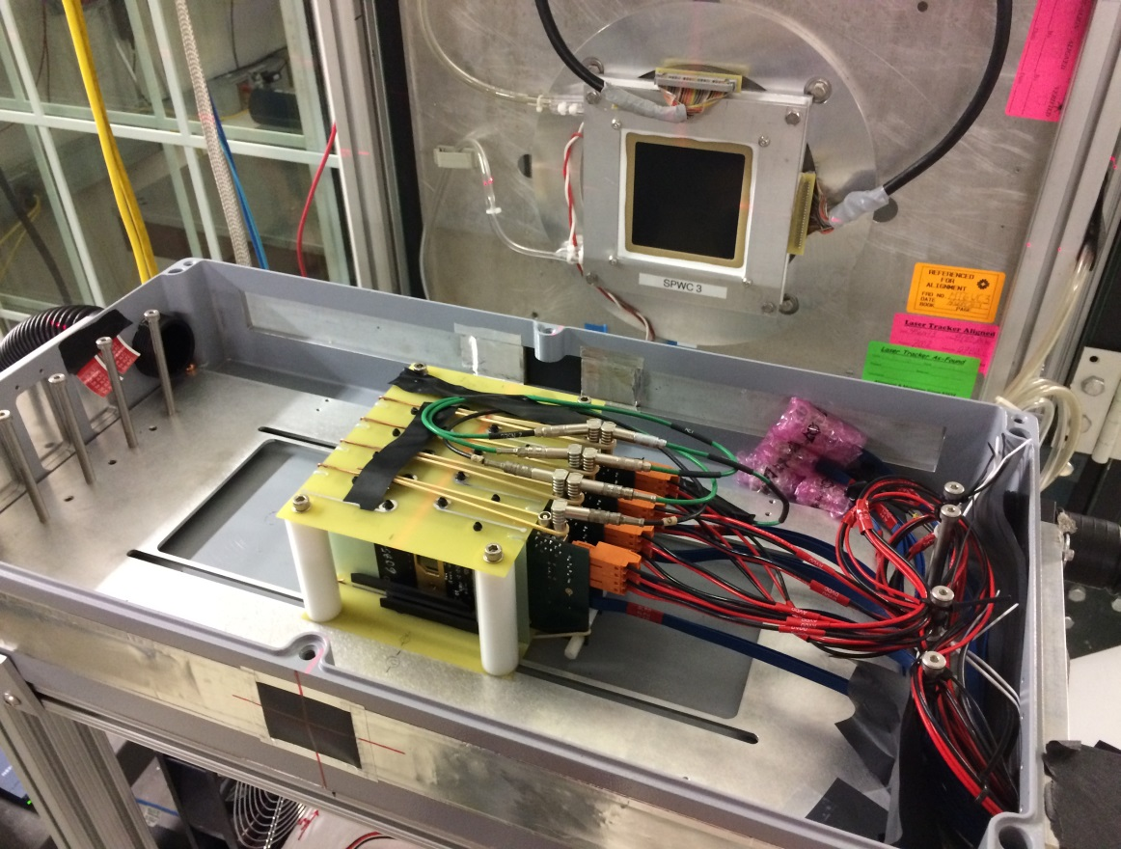
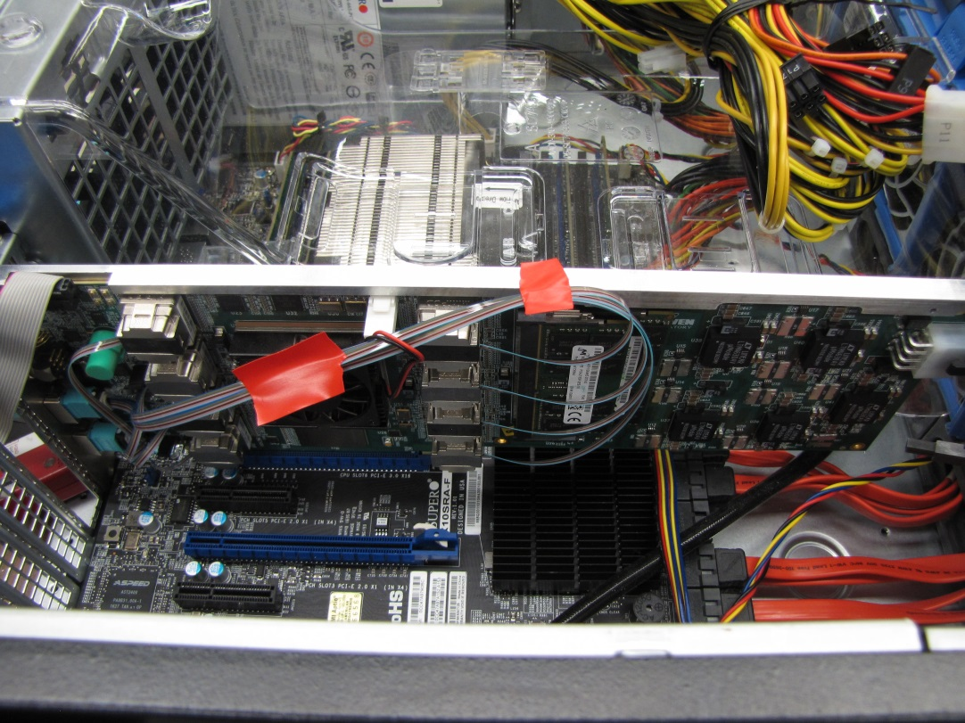
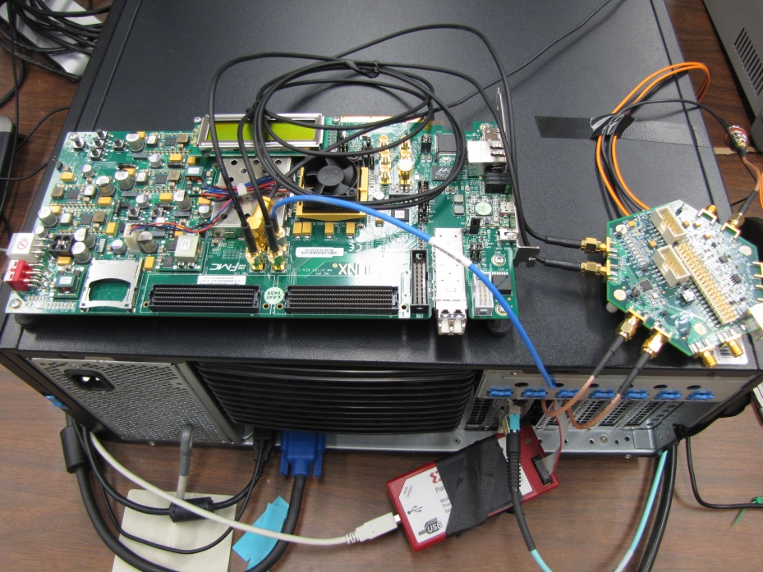
4 Sensor Telescope at Fermilab
RU
4-ALPIDE Telescope;
5m long SamTec cables
Si Time Kit
External Clock
KC705
External Trigger

Slide 28
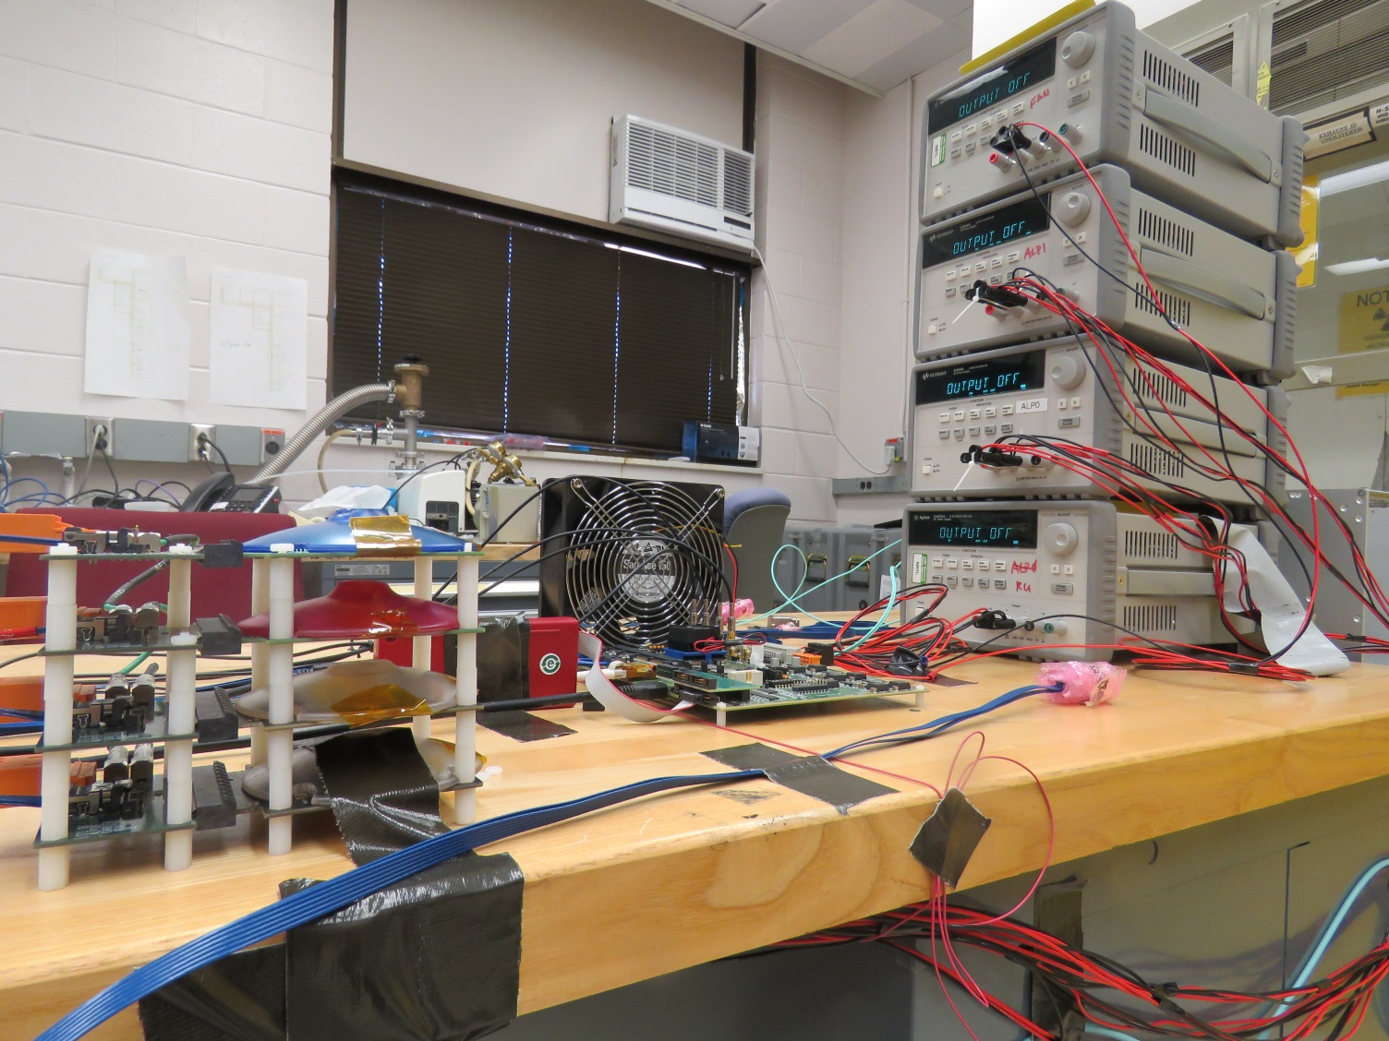
R&D Gameplan
ALPIDE Characterization
ALPIDE Triggered & Continuous Modes
Remote Readout Unit programming (over fiber)
Readout Unit Radiation Upset (Scrubbing) Firmware
FELIX programming (over PCIe).
RCDAQ (sPHENIX DAQ) finalization
Flex Cable Extension
System Optimization & Documentation

Slide 29
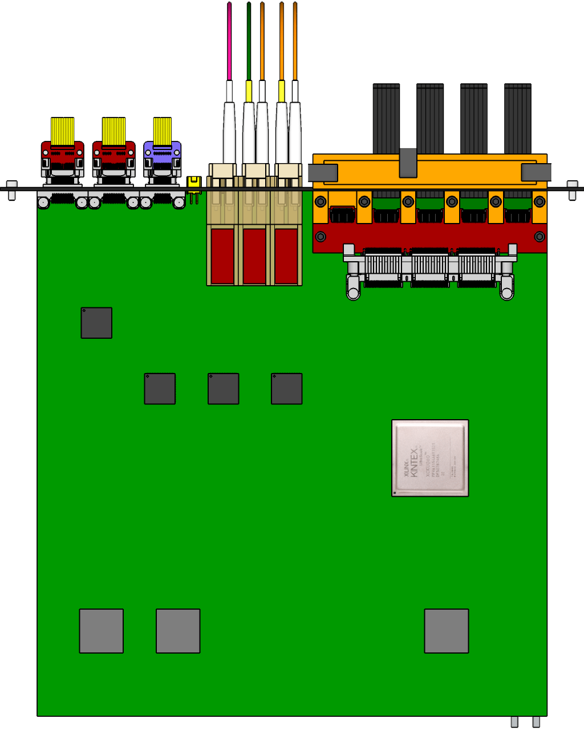
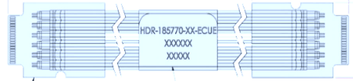

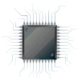
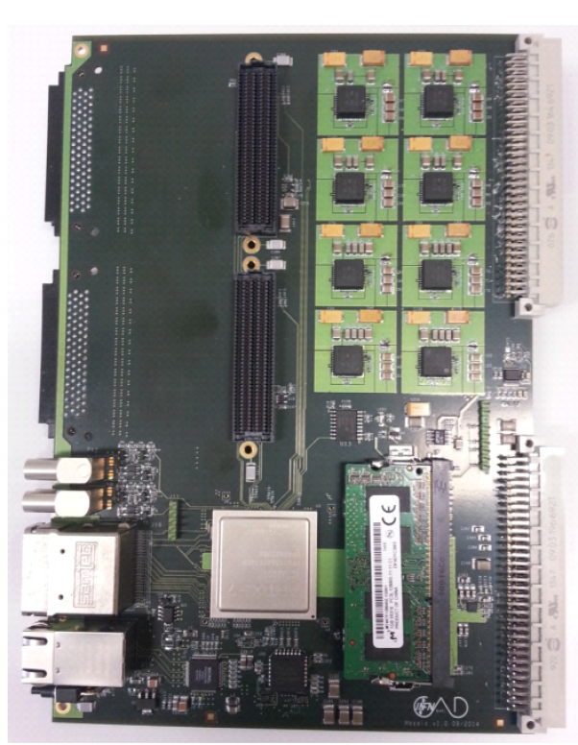
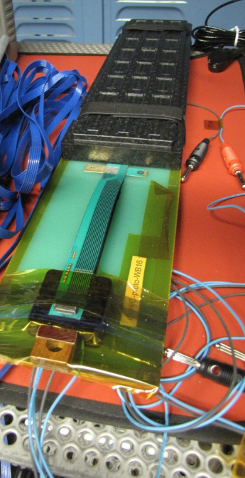
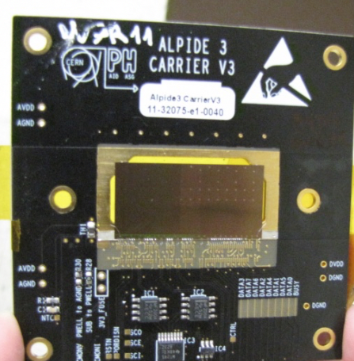
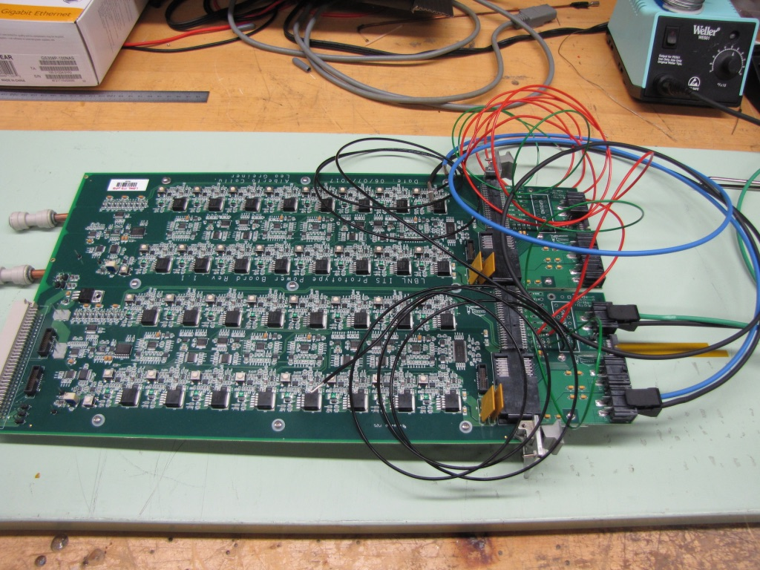
A Test Bench at LANL
5 m
Readout Unit
Optical Links
FELIX
9 Sensor Stave
9 Data (1.2Gbps)
1 Clock, 1 Control/Trigger
Control
Data (9.6 Gb/s max)
Trigger
Samtec Twinax “FireFly”
FPC
Power
Alpide Sensors
RCDAQ
Filtering Capacitors
regulators
Power Board
Cold Plate
Regulated Power
One HIC and 5+ individual ALPIDE chips.
MOSAIC miniDAQ
Power Board

Slide 30
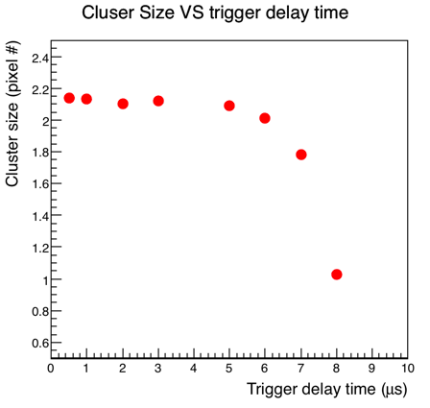
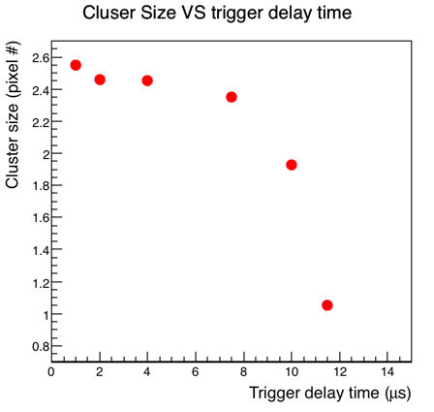
Trigger Latency and Signal Shaping Time Study
Lower the OUT_D threshold (IDB) increases the trigger duration time, but also increases the cluster size which might include more background hits.
In the continuous readout mode, “trigger/strobe” can start as early as ~1uS
Lower Threshold
(Lower the IDB)
Default set
sPHENIX
trigger
Nice work done by Xuan, Sho and Alex + others

Slide 31
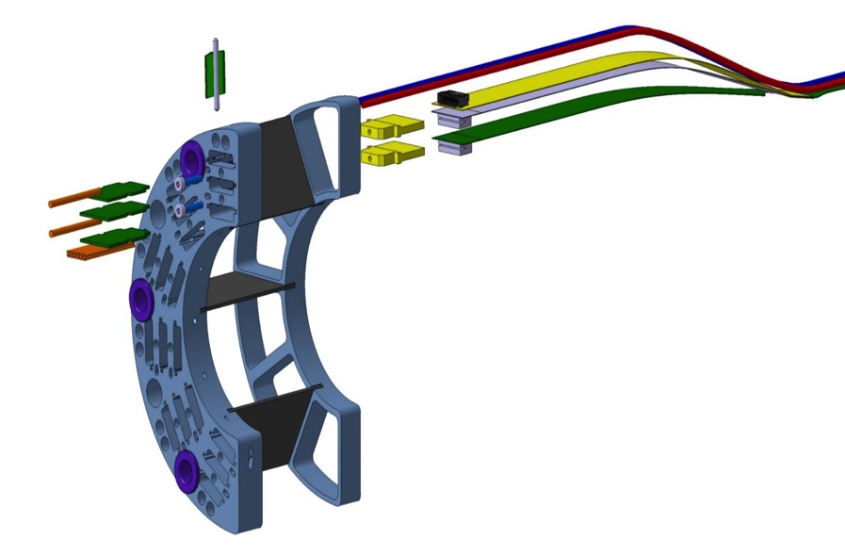
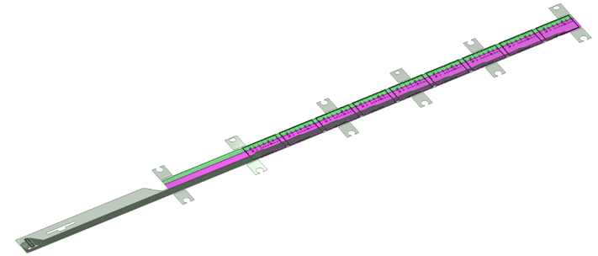
MVTX Flexible Printed Circuit (FPC)
Extend MVTX Service Cables?
Maximum ~60cm for HS signal, TBD through R&D
506.2 mm
16 mm
16.15 mm
41.9 mm
CHIP 9
……
CHIP 2
CHIP 1
Extend FPC/signal path by ~10cm – challenging!
The 9 silicon chips are read out in parallel: each chip sends its data stream to the end of Stave by a dedicated differential pair, 100 μm wide. Two additional differential pairs distribute the clock and configuration signals.

Slide 32
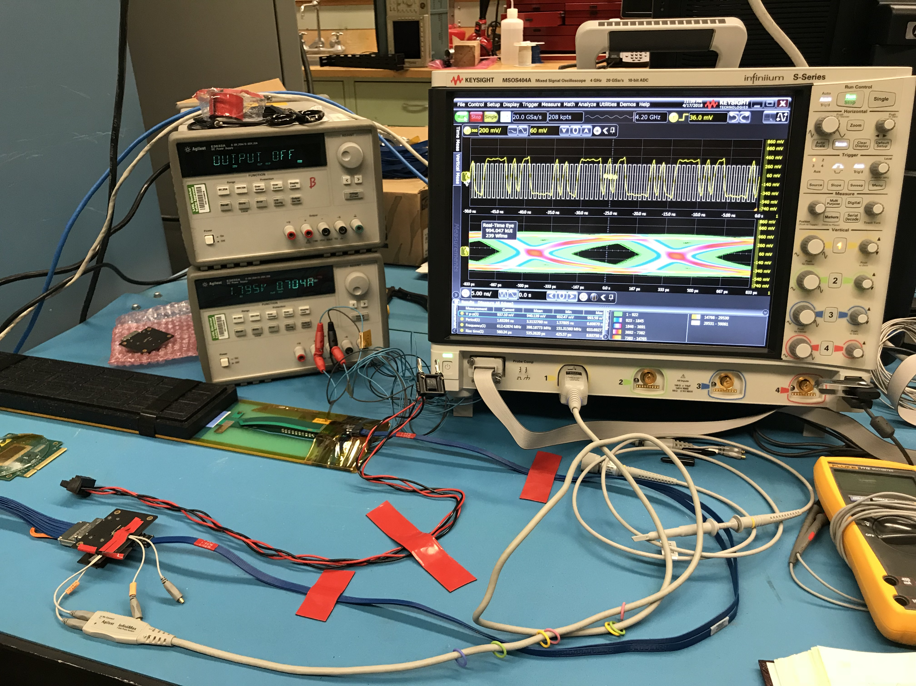
SamTec Cable and FPC Extension R&D

Slide 33
To Do List
FPC extension
  Power extension, ~50cm
SamTec cable length vs signal quality
  5~7m
  RU location, MVTX electrical system integration
Carbon structure and connector design
  FPC HS signal connectors
  FPC power extension connectors
  MVT Service barrel and mechanical system integration
  Installation procedure

Slide 34
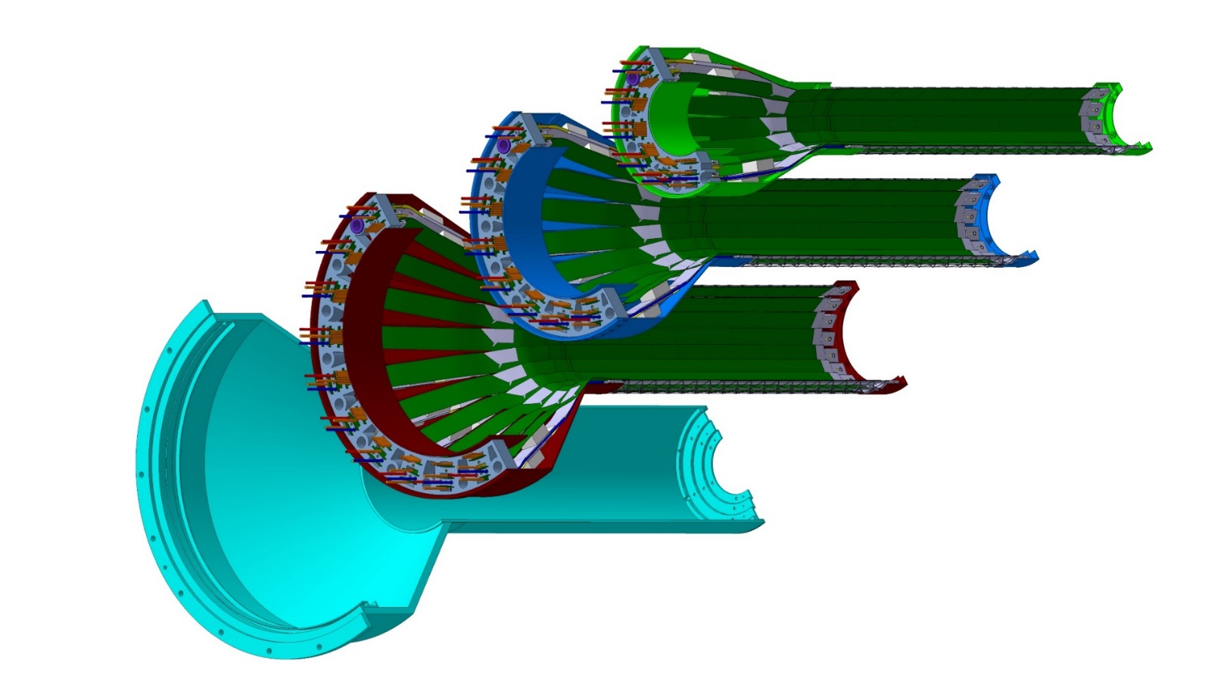
MVTX Carbon Structures
Carbon structures need modifications w.r.t. ALICE for installation in sPHENIX
Layer 0
Layer 1
Layer 2
IB CYSS
Detector carbon frames:
CYlindrical Support
Structure (CYSS)
- End Wheels

Slide 35
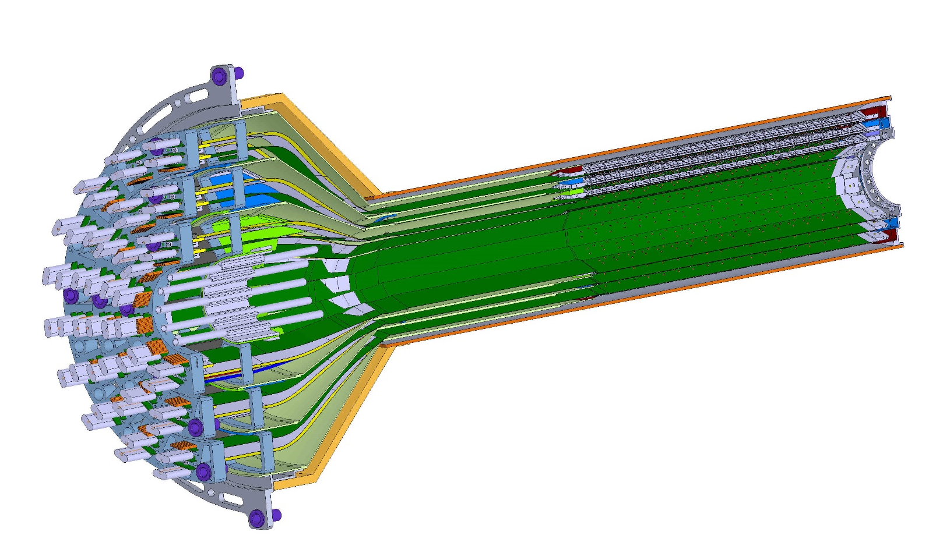
MVTX Mechanical Conceptual Design
View of MVTX half detector assembly with extended central barrel
Stave layout
Beam view
27cm
MVTX Staves
Layer 0
Needed extension for sPHENIX INTT integration, ~6cm possible
Layer 1
Layer 2
IB CYSS

Slide 36
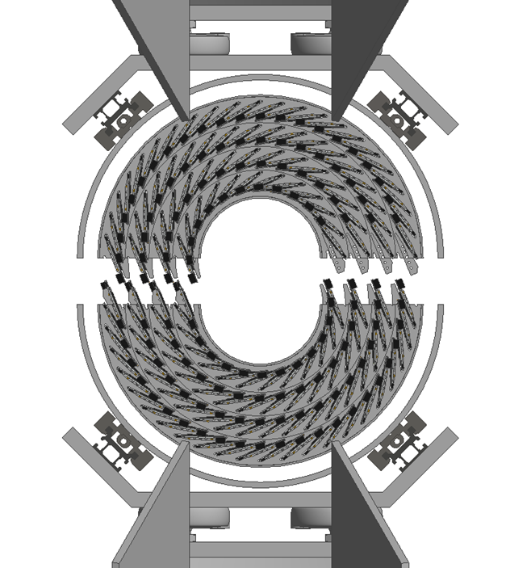

INTT Support Structure from Dan Cacace, 4/27/2018

