Slide 1
MVTX Status & Plan
Ming Liu
Los Alamos National Lab
for the MVTX Group
MVTX/HF Workfest @MIT

Slide 2
Outline
Project Status
MVTX full proposal
  Physics and Simulations
  Readout and Controls
  Mechanical Integration
  Budget and Schedule
R&D Highlights
Latest development
Document: sPH-HF-2018-001
https://indico.bnl.gov/event/4072/

Slide 3
MVTX Status: Where do we stand?
Full proposal submitted to BNL Associate Laboratory Director Dr. Berndt Mueller in Feb. 2018
March 27, a meeting of ALD, MVTX principals, co-SP and sPHENIX project office. Given improved DOE funding fiscal outlook, ALD recommended to bring MVTX into MIE baseline:
  This would be post-OPC/CD-1 Review(5/23-25, 2018), MIE baseline will be defined in the CD-2 (~summer 2019); MS Project -> P6 in progress
  Exploring advance-funding options to procure Readout Units ($250K, now) and staves from ALICE at CERN ($1.2M, fall 2018)
    Cost saving and reduce technical and schedule risks
  ALD seeks DOE agreement to proceed
MVTX workfest at MIT 4/30-5/1, 2018
  Refine MVTX roadmap – cost & schedule etc
  Prepare for sPHENIX integration mini review (~summer 18)
    MVTX+INTT+TPC…
    Both electrical and mechanical systems
https://indico.bnl.gov/event/4380/

Slide 4
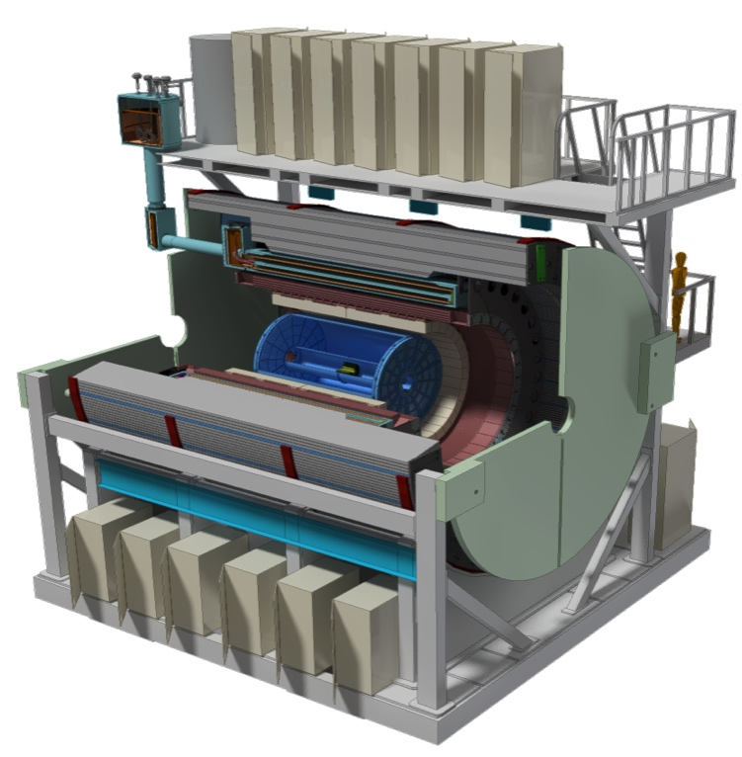
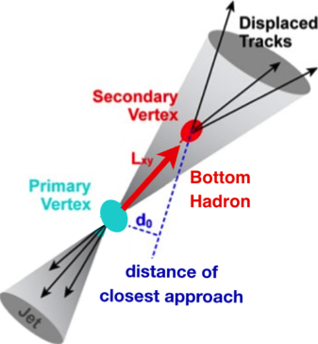
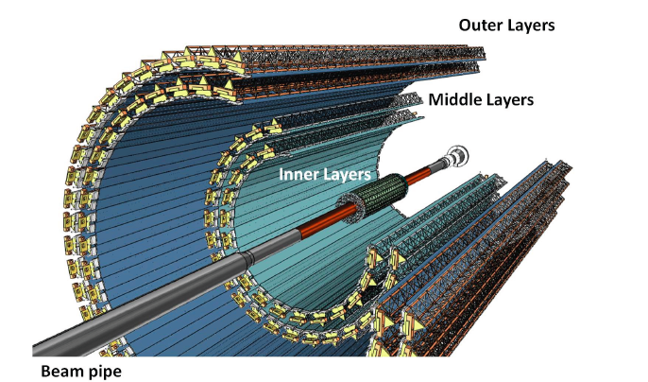
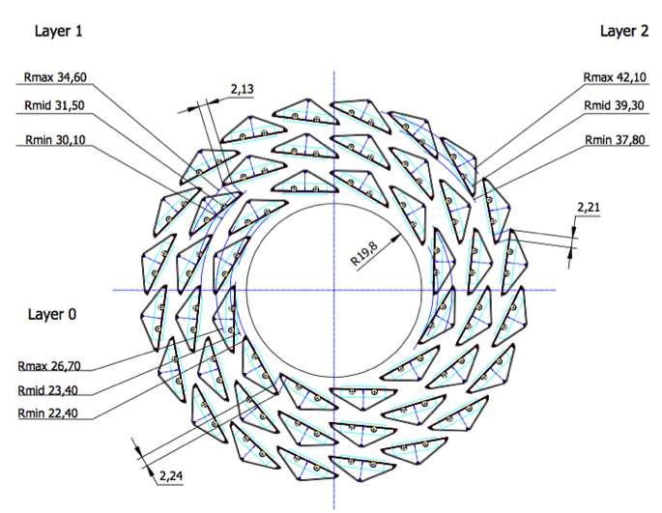
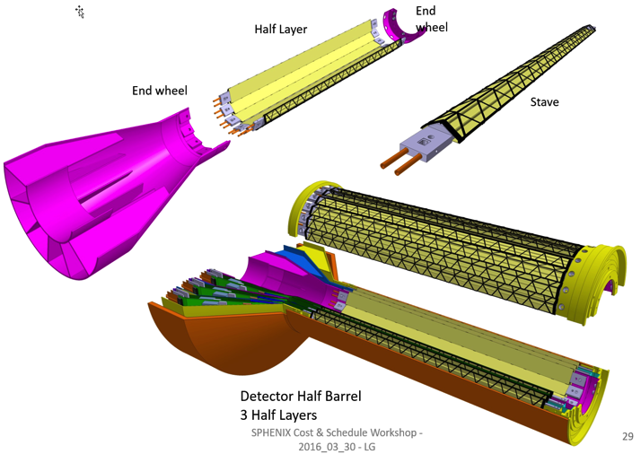
MVTX: Monolithic-Active-Pixel-Sensor-based VerTeX Detector
sPHENIX upgrade @RHIC
Key integration tasks:
Readout
Mechanics
ALICE ITS Upgrade @CERN;
Inner Tracker System (2021+)
sPHENIX Inner Tracking
“Adopt” ALICE/ITS
Mini. risk,
Max. physics
MVTX could also be a day-1 EIC detector

Slide 5
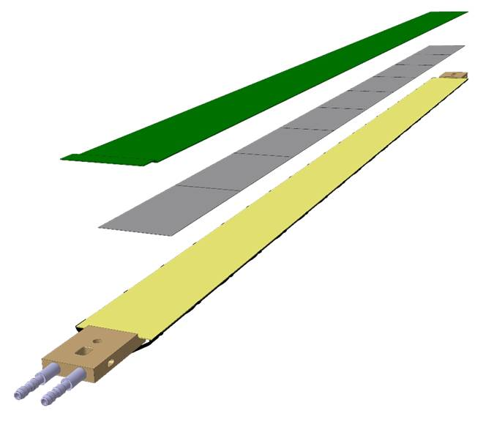
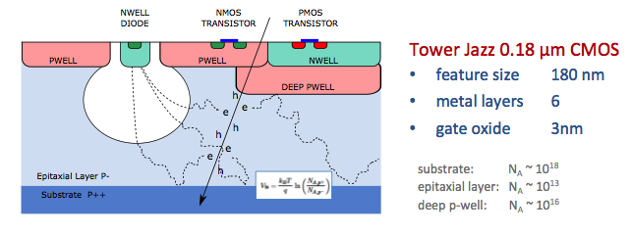
Monolithic-Active-Pixel-Sensors (MAPS)
ALPIDE: The next Generation State of the Art Pixel Sensor
Advantages of ALICE MAPS(ALPIDE):
  Very fine pitch (27x29 μm)
  High efficiency (>99%) and low noise (<10⁻⁶)
  Excellent time resolution, ~5 μs
  Ultra-thin/low mass, 50μm (~0.3% X₀)
  On-pixel digitization, low power dissipation
An ideal detector for sPHENIX and EIC physics!
FPC
9 Chips
Cooling plate
A 9-chip MAPS stave, 9 x (1.5 x 3 cm²)
ALPIDE design
50 μm
28 μm

Slide 6

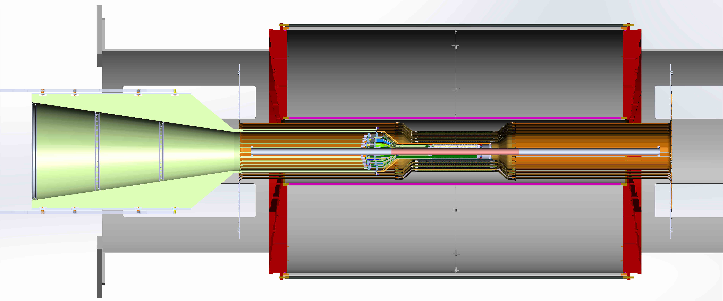
sPHENIX Tracking System
Excellent Tracking system:
  TPC: Time Projection Chamber
  INTT: Intermediate Silicon Strip Tracker
  MVTX
TPC:
R = 20-80cm
INTT:
R =6,8,10,12cm
MVTX:
R=2.3, 3.2, 3.9cm
TPC
INTT
MVTX
2m

Slide 7
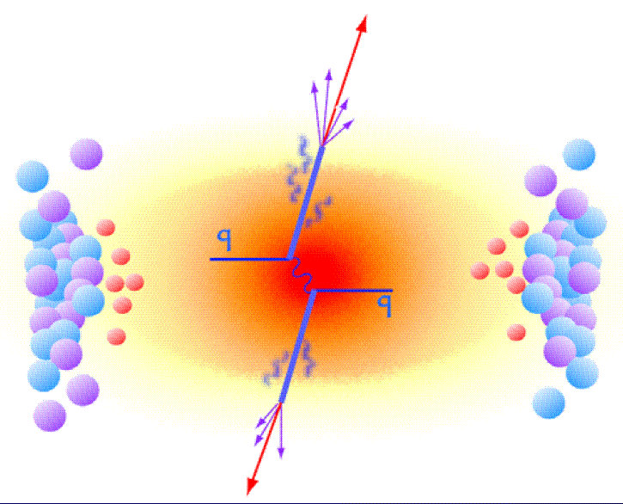
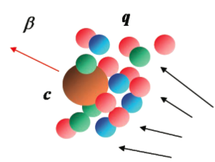
MVTX Enables the 3rd Science Pillar
Xin’s talk
Jets
Upsilons
Open Heavy Flavor
Bottom quarks are heavy (4.2 GeV)
Produced in initial collision, probe QGP evolution
Well controlled in pQCD
Provide access to fundamental transport properties

Slide 8

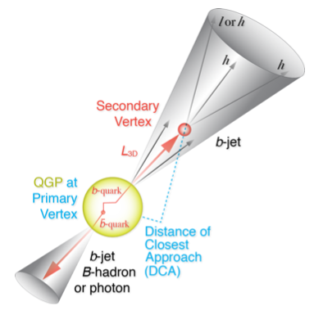
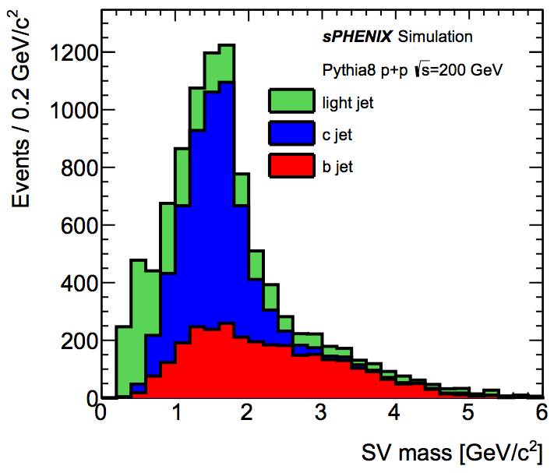
B-Hadron & b-Jet Tagging
Physics Reminder
Haiwang/Jin’s talks
Detected using the long lifetime of bottom quark hadrons:
  Displaced tracks
  Large 2nd vertex invariant mass
Need high precision tracking and vertex determination – MVTX!
Need excellent jet detection capabilities – sPHENIX!

Slide 9
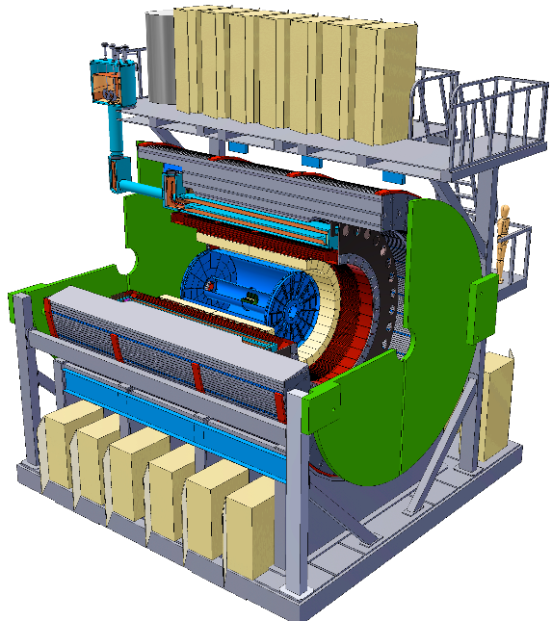
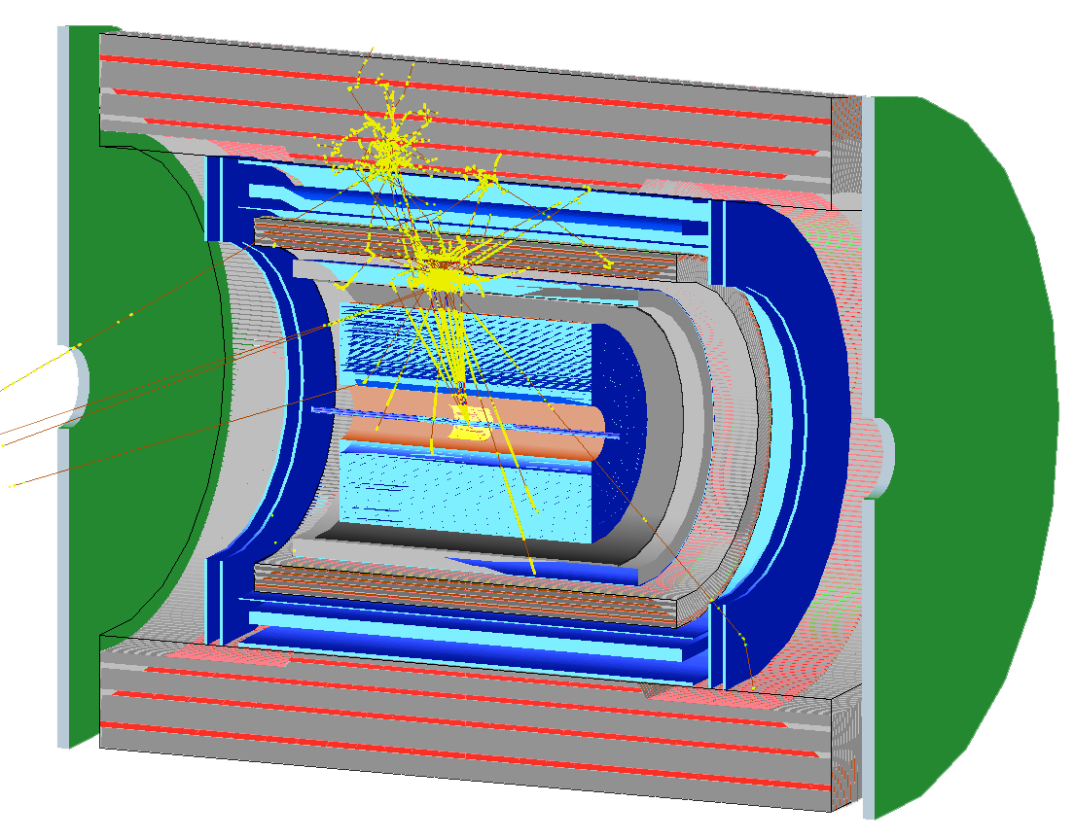
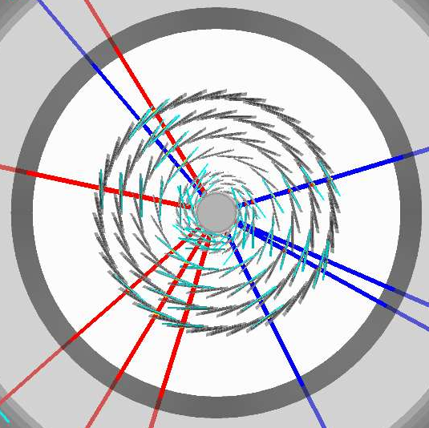
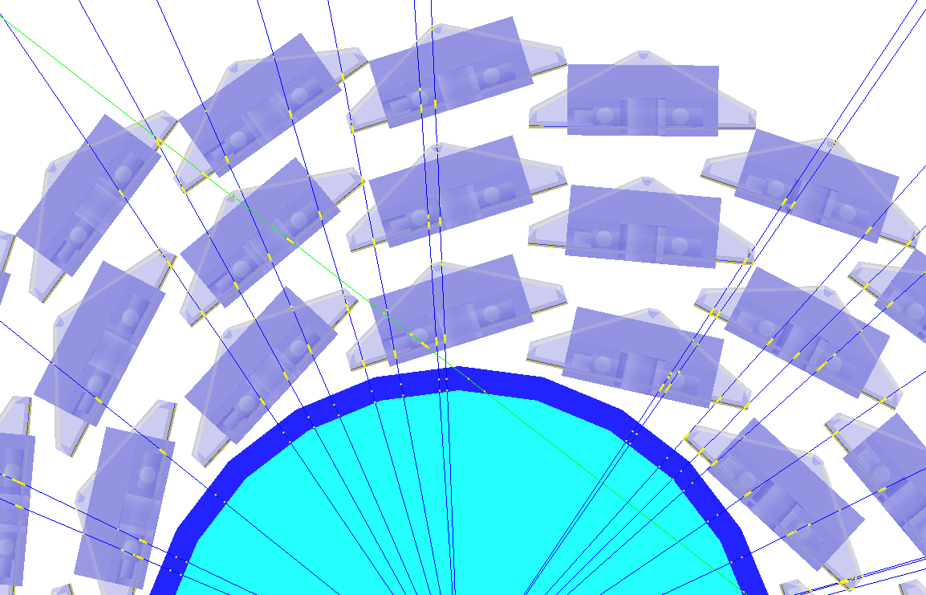
Simulation for b-jet and B-meson tagging
Haiwang’s talk
sPHENIX Geant4 display of p_{T}=30 GeV/c B⁺-hadron
Design to Simulation
MVTX and INTT _
_ MVTX Ladders modeled in details
MVTX sensors

Slide 10
MVTX Physics Highlights
Xin’s talk
“B meson and b-jet modification”
Heavy quarks – unique probe of QGP w/ new scales, m_{c}, m_{b}
  Study mass dependence
    Jet quenching & energy loss
    Flow – interaction with medium
  Access QGP properties
    Temperature, density, coupling, transport coefficients, viscosity etc.
“B meson and b-jet flow”
m_{u} m_{d}
m_{s}
Λ_{QCD}
m_{c}
m_{b}
MeV
1
10
10²
T_{c}
T_{QGP}
10³
10⁴

Slide 11
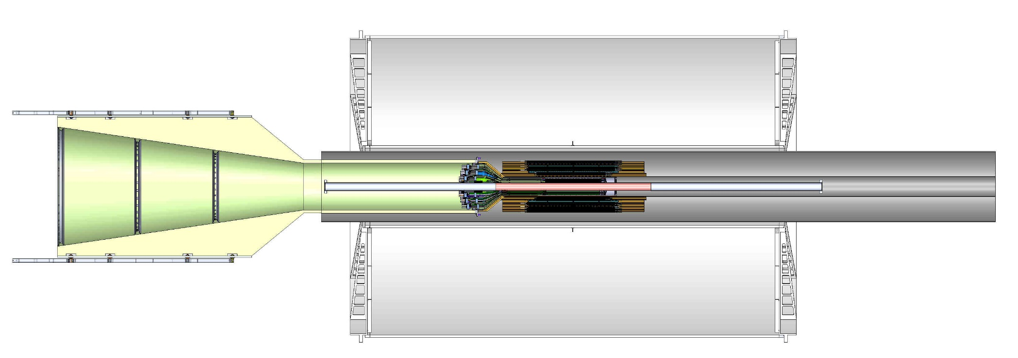
MVTX Detector Integration
Mickey/Walt’s talks
MVTX:
3 layers
48 staves
Electrical system
  Readout, power, controls
Mechanical system
  Support and cooling

Slide 12
Readout and Controls

Slide 13
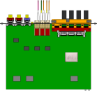
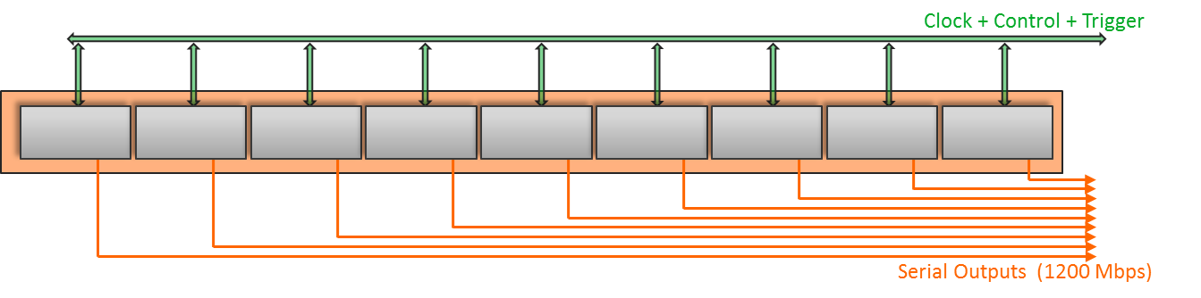
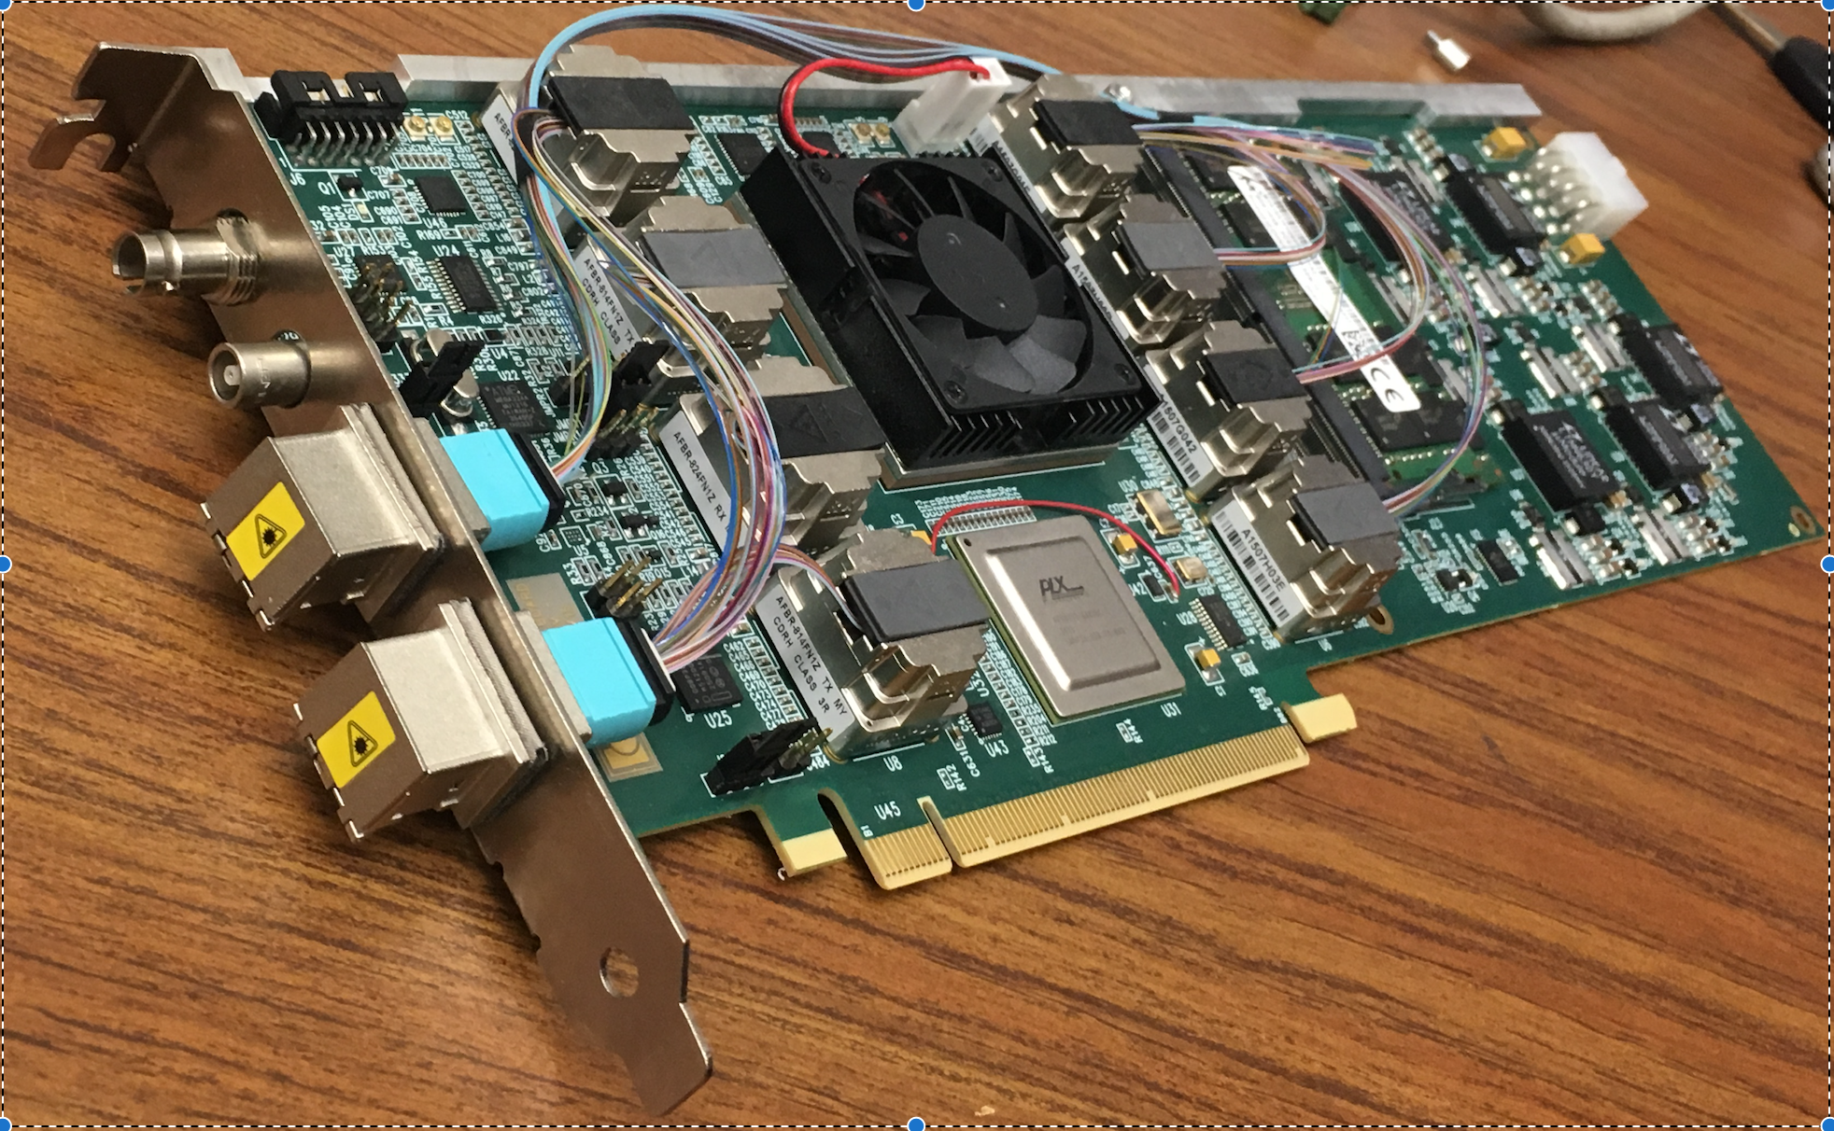
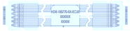
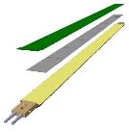

MVTX Electronics, Power and Controls
CAN bus
DCS
5-10 m
Trigger & Clock
Readout Unit
Front End
GBT Optical Links
9-sensor Stave
9 Data (1.2Gbps)
1 Clock, 1 Control/Trigger
Control
Data (9.6 Gb/s max)
Trigger
Samtec Twinax “FireFly”
FELIX
Back End
FPC
Power
Alpide Sensors
Power
Filtering Capacitors
regulators
Power supplies
Cold Plate
Regulated Power
Power Board
Interaction Region
Experimental Hall
Counting House
MVTX Detector Electronics consists of three parts
Sensor-Stave (9 ALPIDE chips) | Front End-Readout Unit | Back End-FELIX

Slide 14
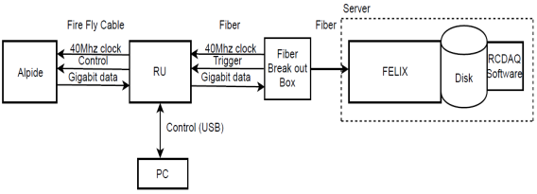
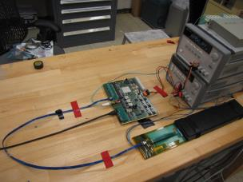
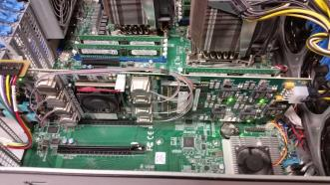
MVTX Full Readout Chain Demonstrated
Stave
Readout
Unit
FELIX
Readout Unit configures Stave using USB interface
FELIX distributes clock to Readout Unit
Readout Unit distributes clock to the Stave
Stave is triggered, sends data at 1.2Gb/s
Configured GBT link to recover clock from FELIX
Readout Unit receives the data and sends the data to FELIX over fiber using GBT link
FELIX packs data, stores it on disk using RCDAQ - the sPHENIX data format and software
Readout Unit + Stave
Server + FELIX
Amazing work done by Sho & Alex + LANL LDRD team!

Slide 15
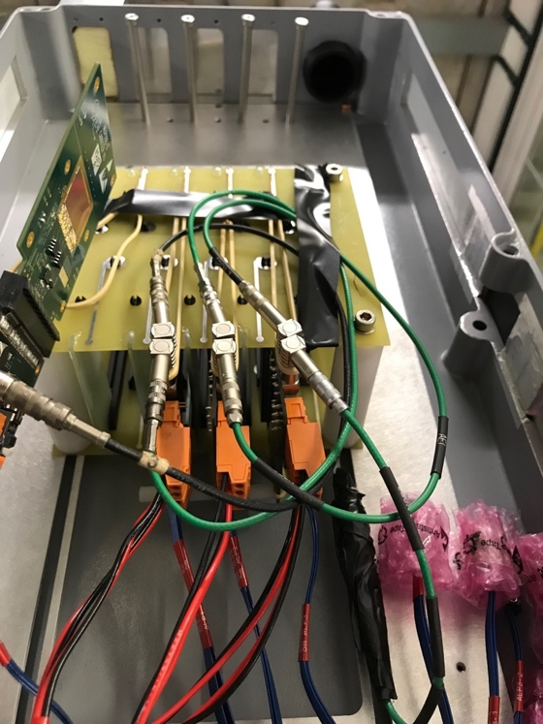
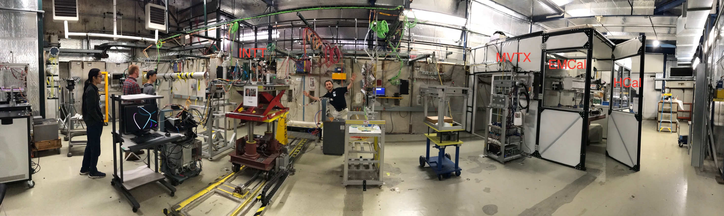
MVTX Test Beam at Fermilab 02/20-03/10, 2018
Goals:
  Test full readout chain
  Evaluate ALPIDE sensor performance
Experimental setup
  A 4-sensor telescope
  Full readout chain: MAPS+RU+FELIX+RCDAQ
120 GeV
proton
Parasitic with INTT run
Very productive & collaborative
4-sensor
Telescope

Slide 16
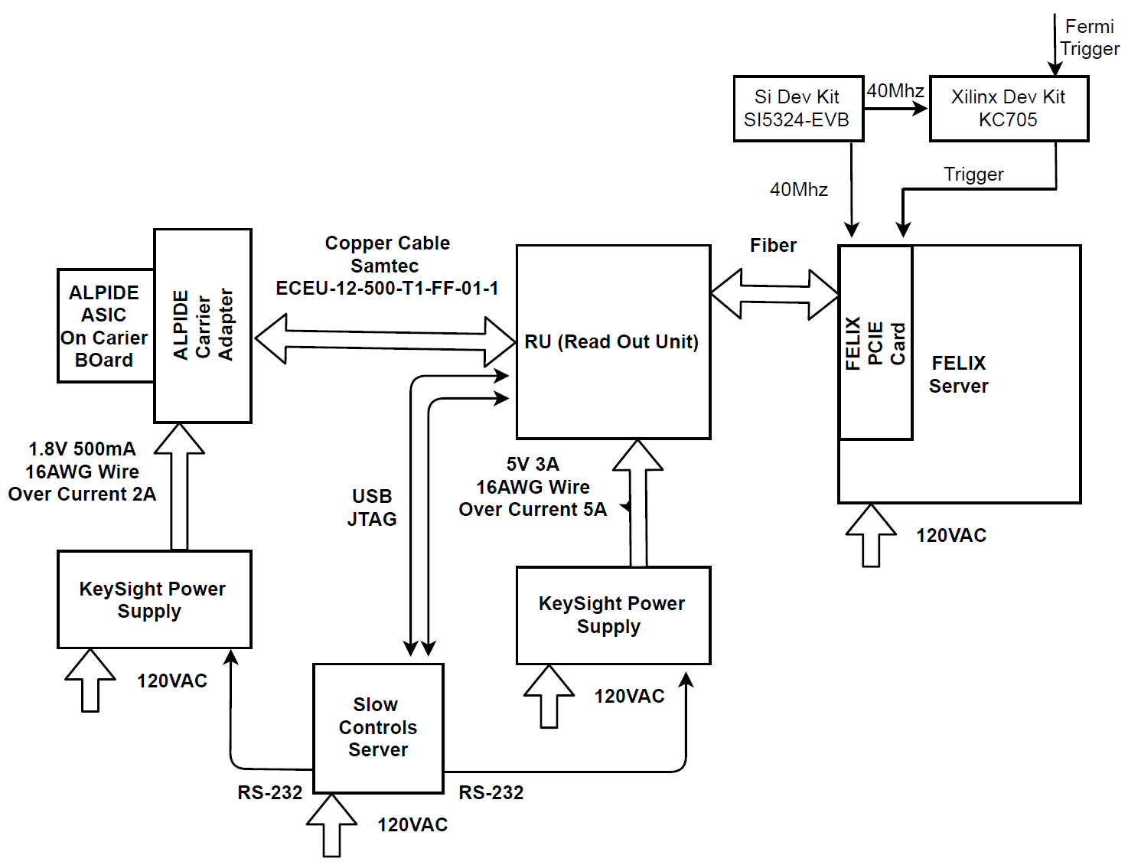
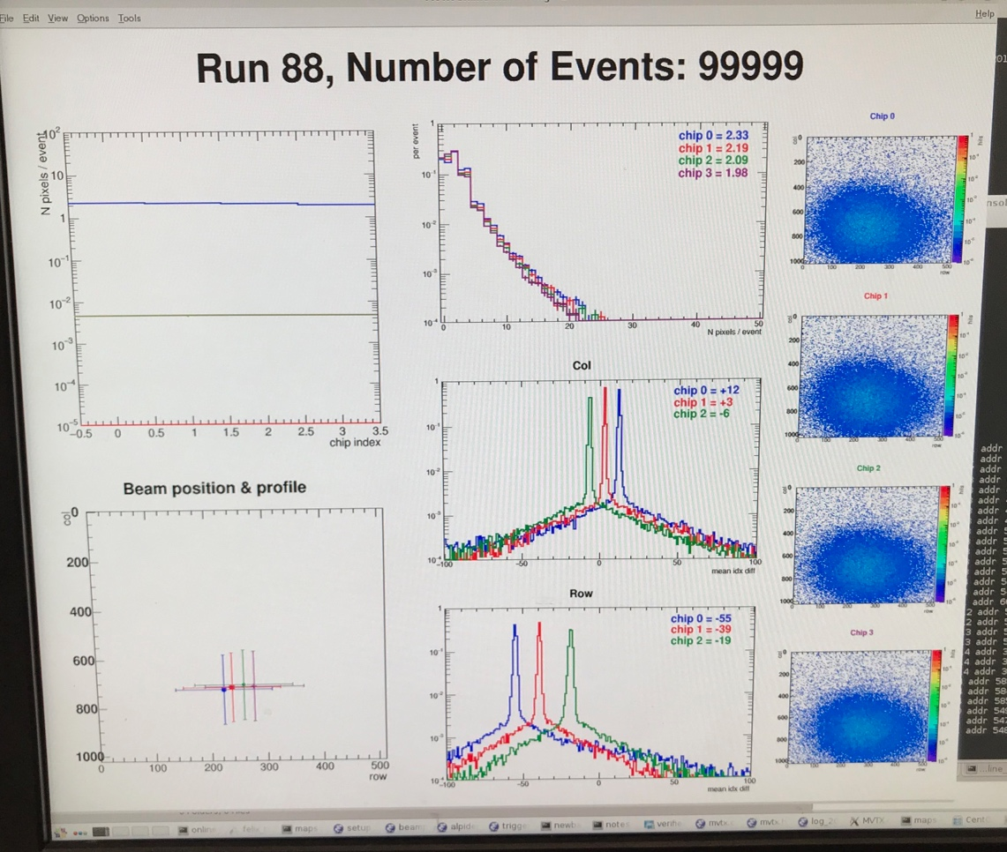
LHC 40MHz
mockup
LANL Fermilab Test Beam Setup 03/2018
4-ALPIDE Telescope + 4-SamTec cables + 1 RU + 1 FELIX(“CRU”)
4-ALPIDE Telescope
4 5-m SamTec Cables, 1.2Gbps
CLK recovered from
FELIX through GBT link;
Trigger from FELIX
FELIX (“CRU”)
Online Display

Slide 17
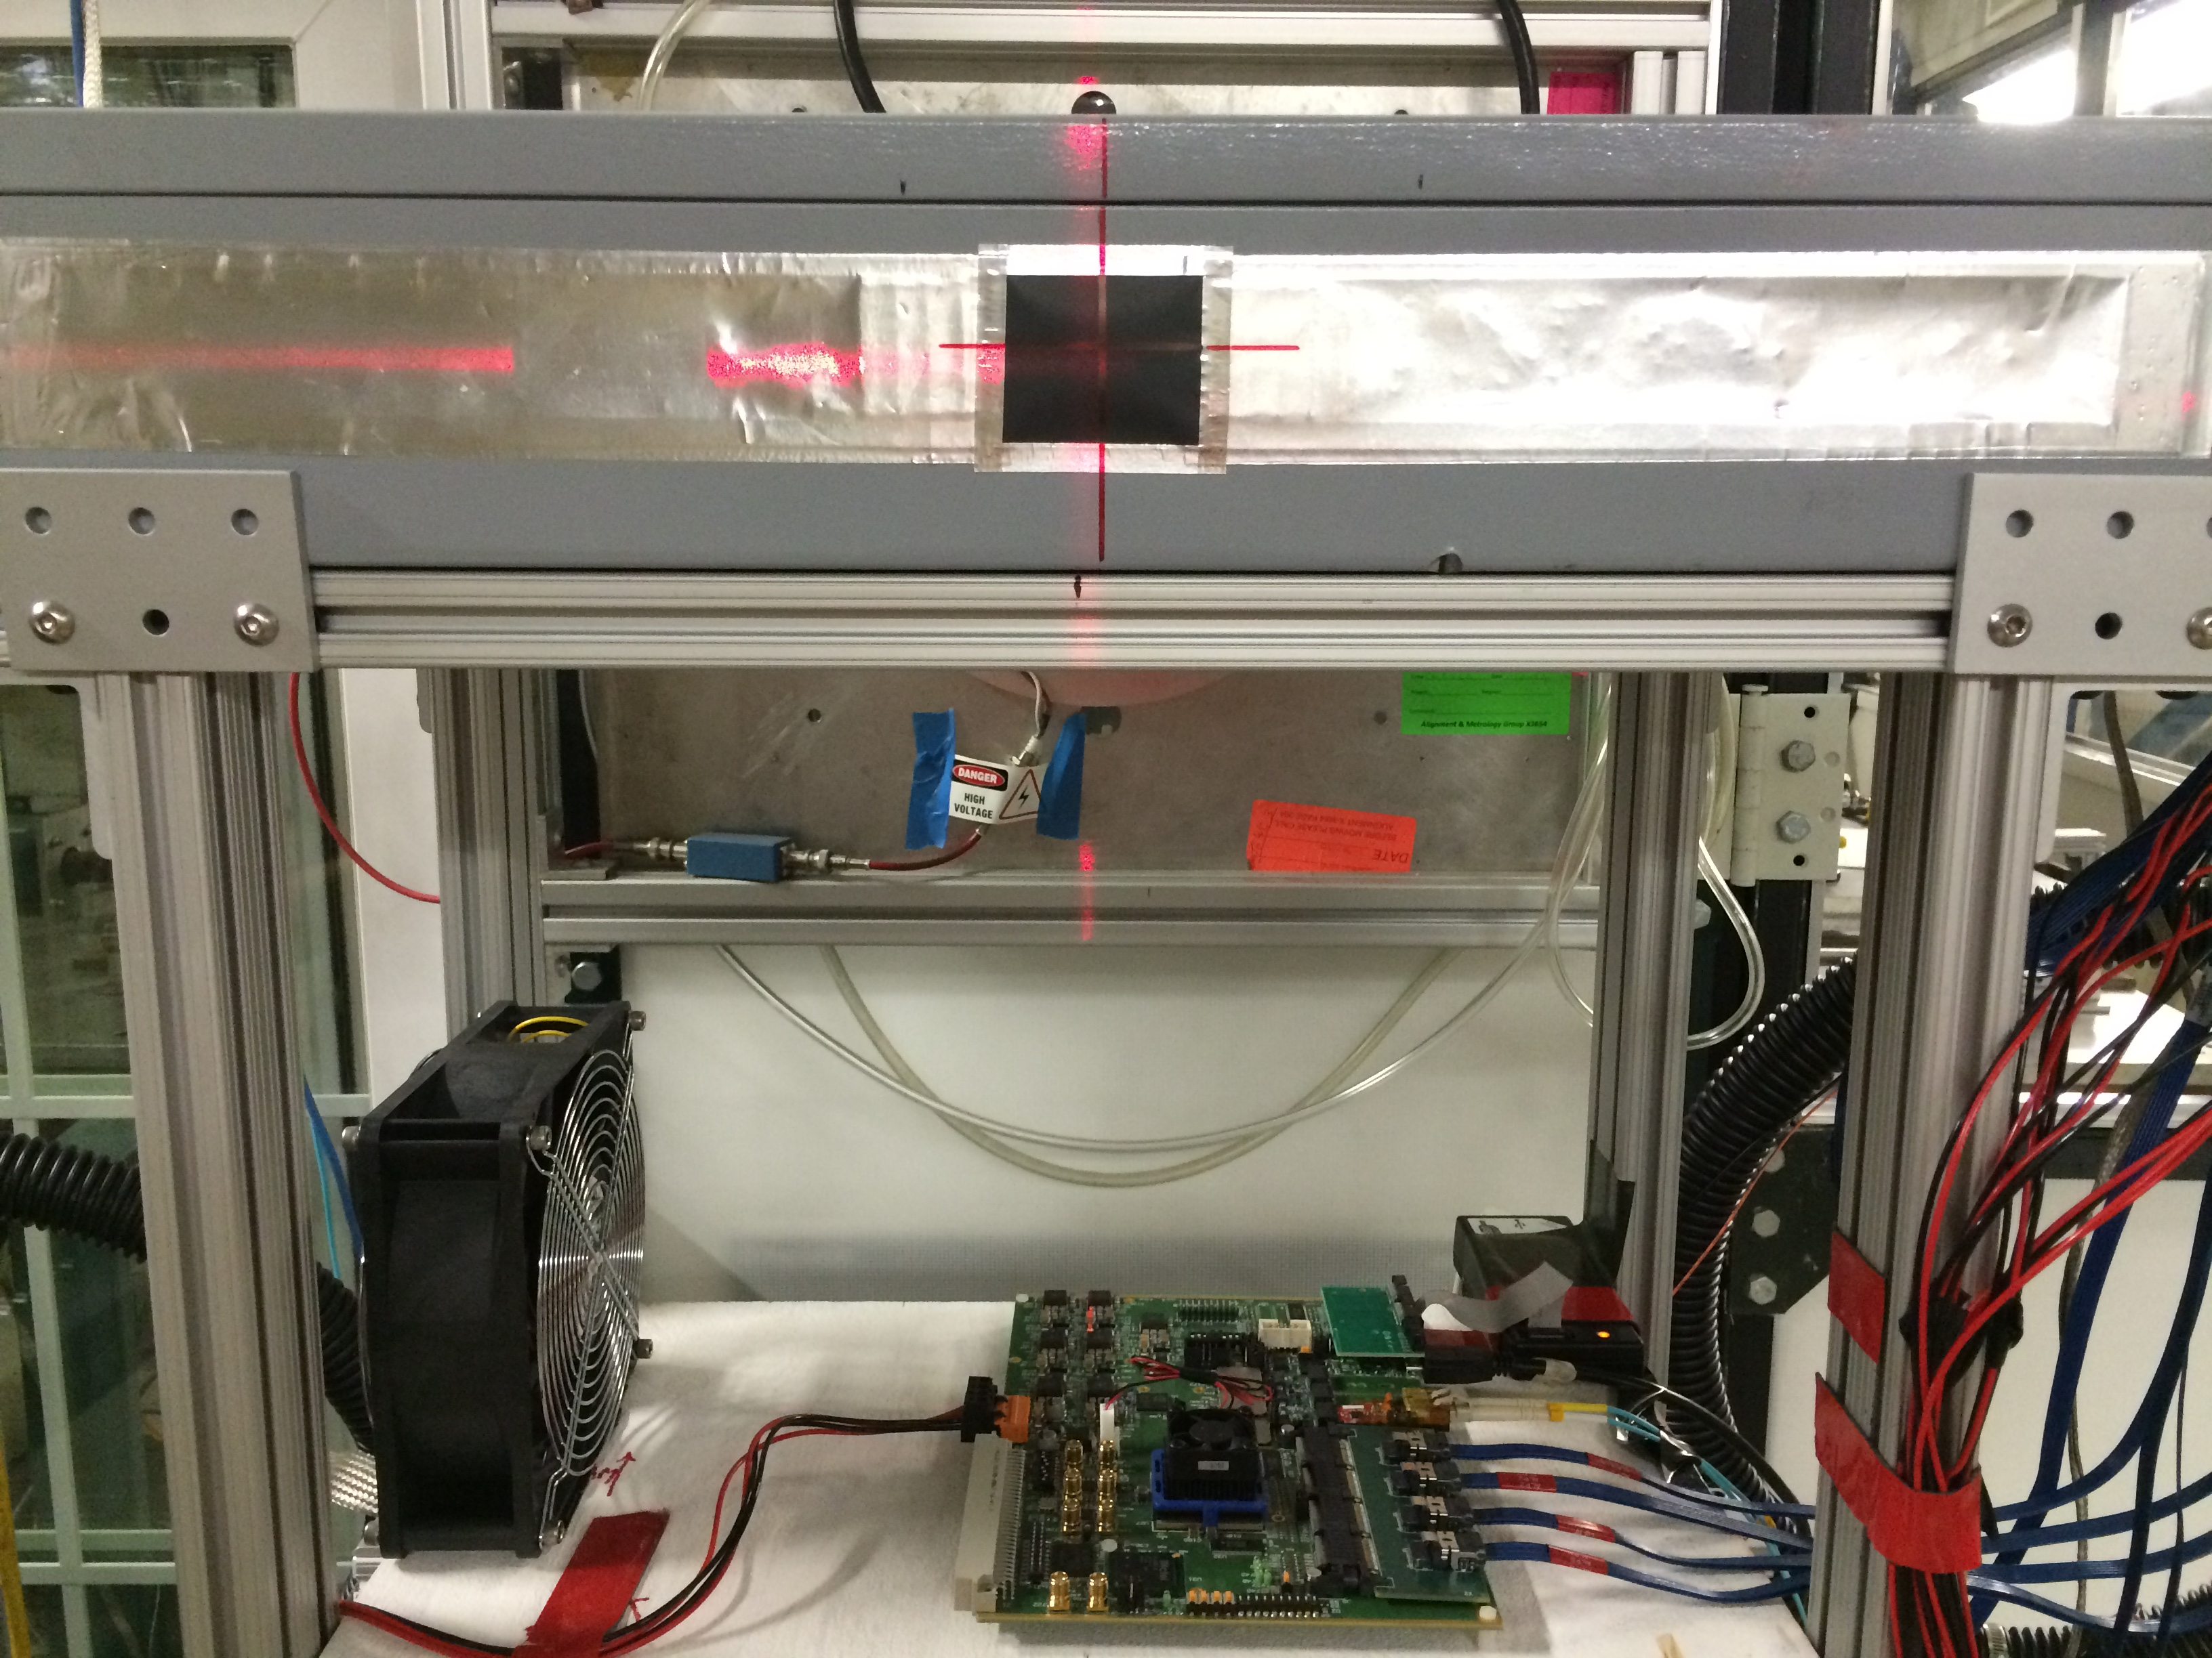
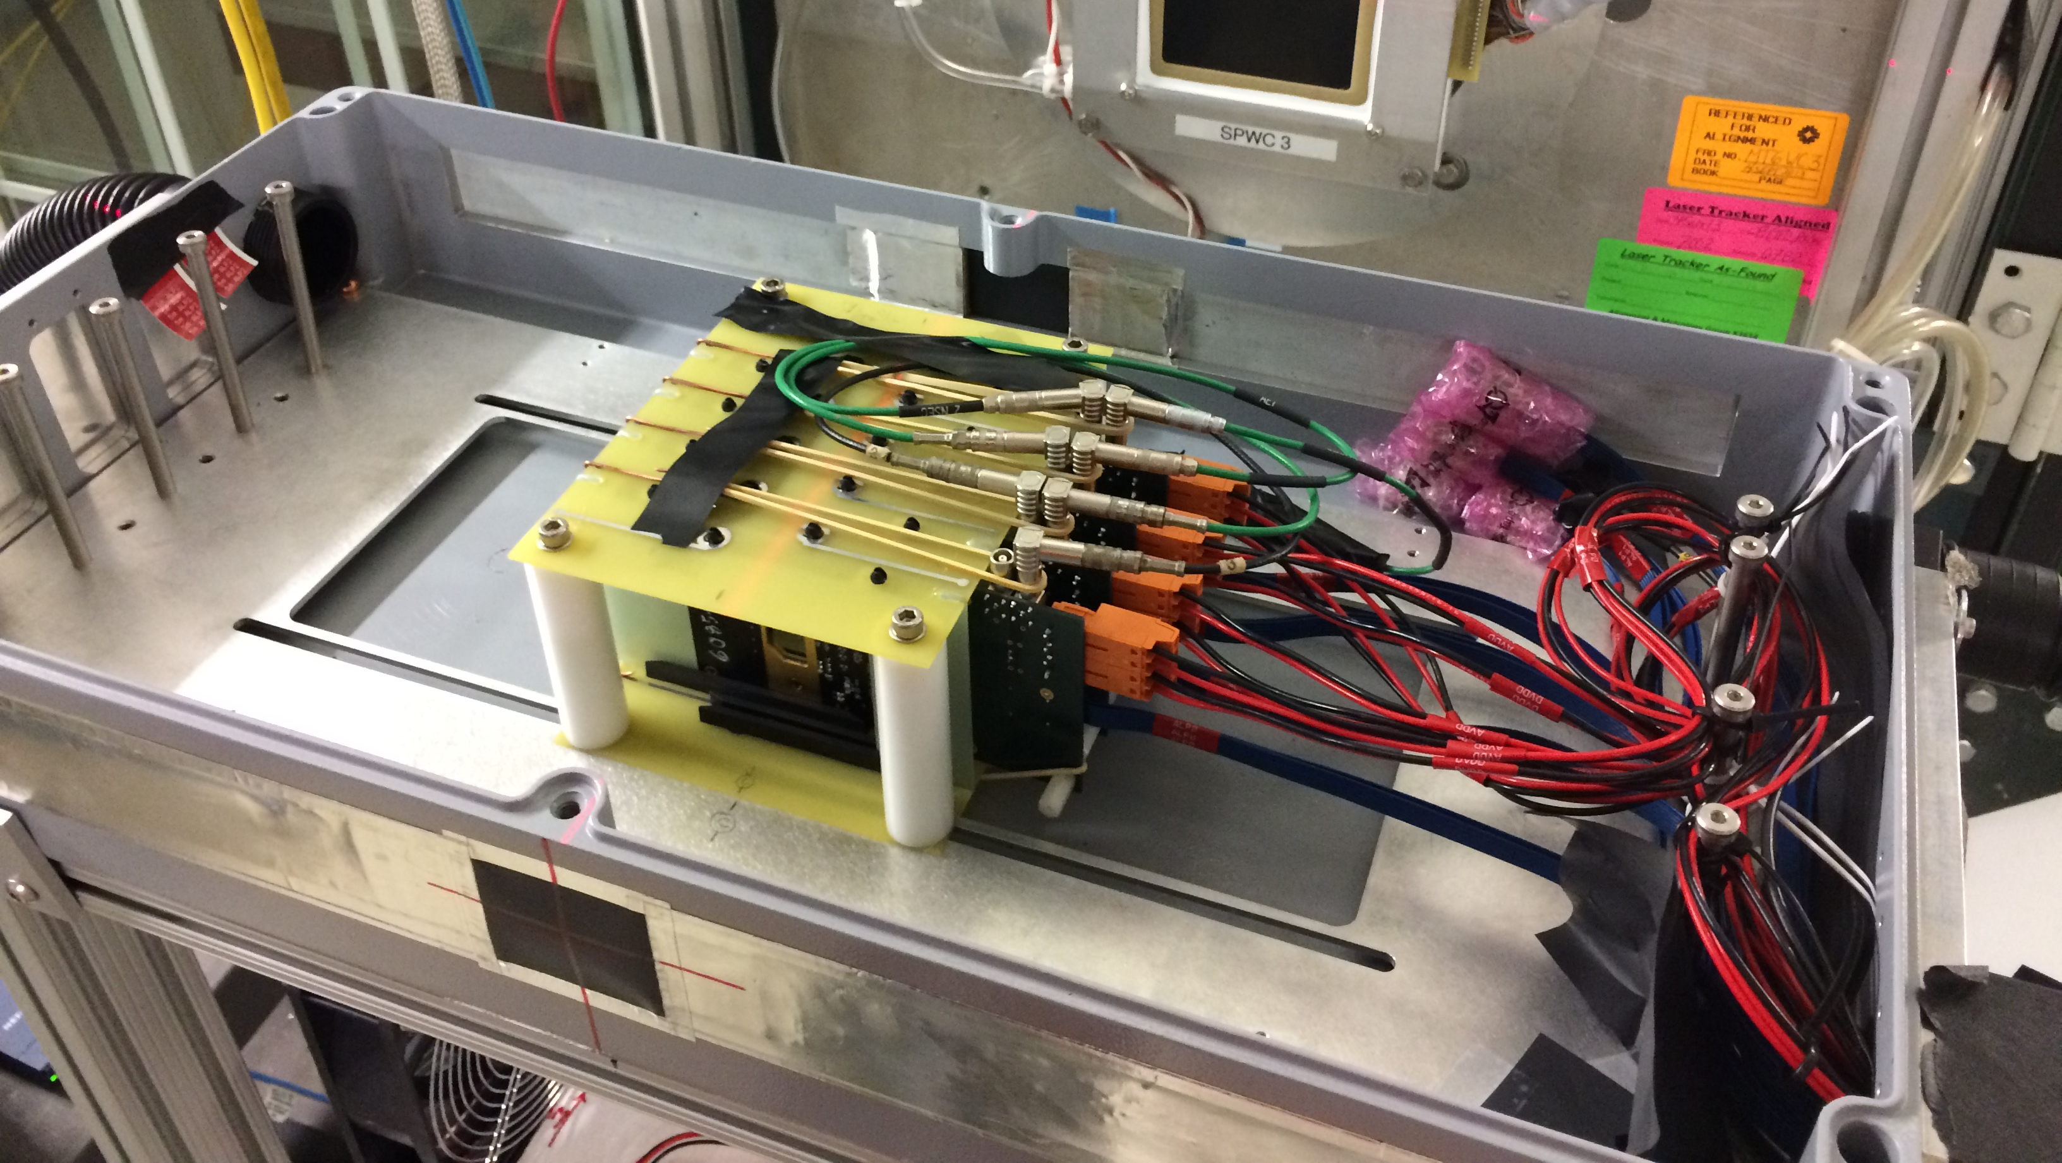
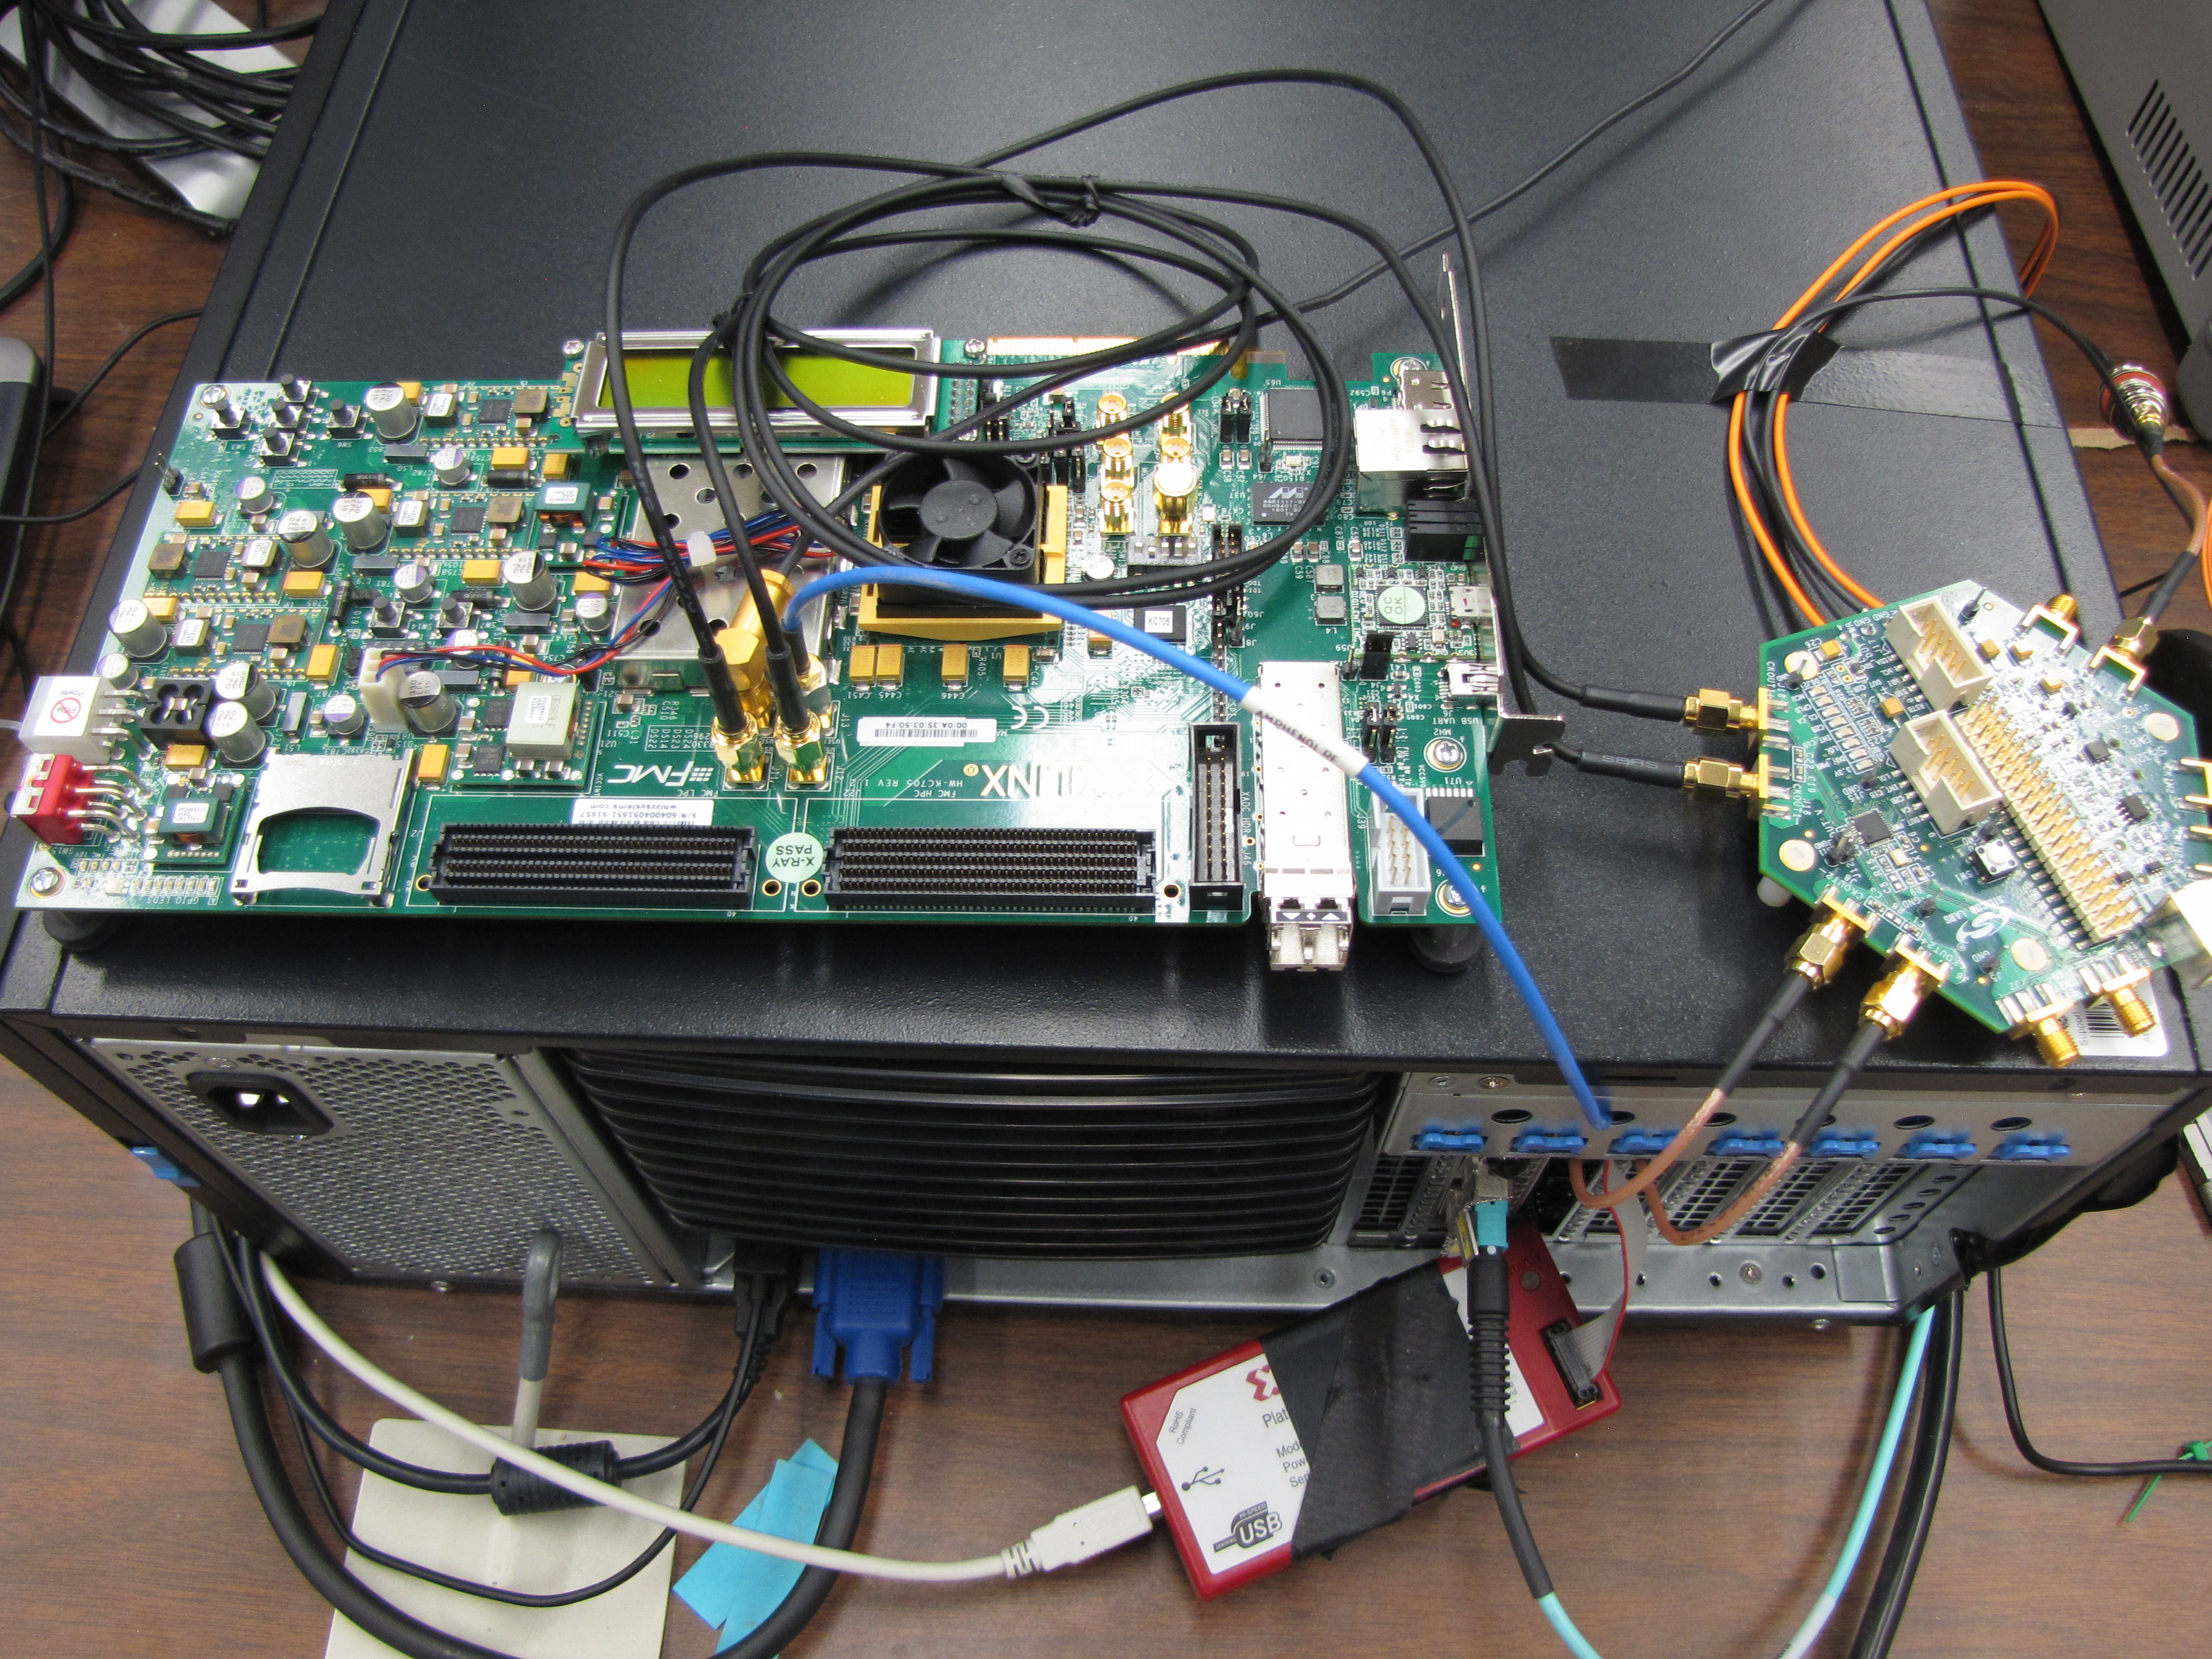
4-ALPIDE Telescope Setup at Fermilab Test Beam
4-ALPIDE Telescope;
5m long SamTec cables
RU
Summary:
Successfully operated the full readout chain
Confirmed all communications links and data path
Confirmed telescope performance
  Primarily 120GeV proton beam; also with low energy pion beams
  Beam trigger rate ~7kHz
  Tested High ALPIDE occupancy runs, with 10cm lead bricks in front of the sensors
FELIX(“CRU”) in Server
KC705
LHC 40MHz
Mockup
Nice work by Sho, Alex, Hubert, Chris + others

Slide 18
Fermilab Test Beam Results (I)
4-hit track
120 GeV proton beam
4-sensor telescope
Mostly single tracks
Cluster size: 2.1 ~ 2.4
# of tracks per event
Cluster size
Beautiful analysis done by Sanghoon and Darren + others

Slide 19
Fermilab Test Beam Results (II)
Hit Spatial Resolution: < 5 um
Hit Efficiency > 99.5%
Pixel size (~28um)

Slide 20
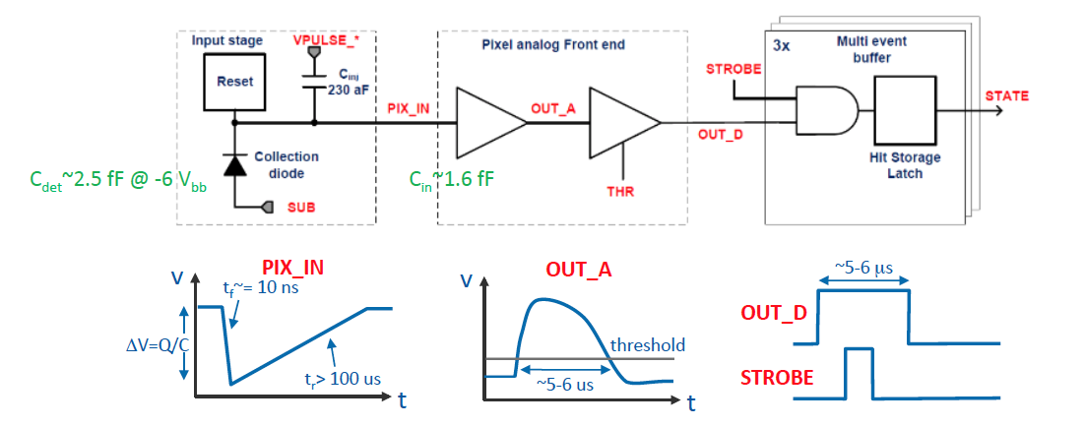
ALPIDE Readout Optimization and Trigger Latency Study
- Expected sPHENIX trigger latency 4~5 uS
- Two possible readout modes for MVTX: 1) Triggered (less data) and 2)Continuous
clipping point
OUT_A clipping: VCLIP. Decreasing VCLIP decreases clipping point.
OUT_A returns to baseline time: ITHR, VCLIP. Increasing ITHR decreases discharge time, and decreasing VCLIP decreases discharge time after clipping.
OUT_D return to baseline time: IDB. Increasing IDB increasing charging time hence decreasing pulse duration.

Slide 21
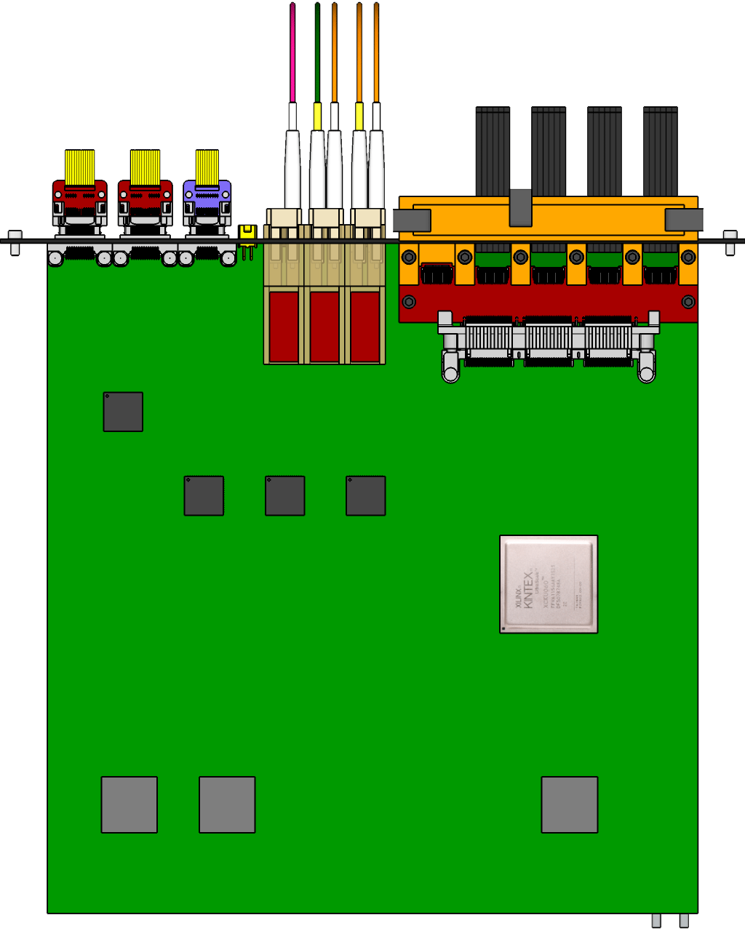
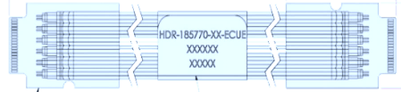

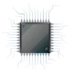
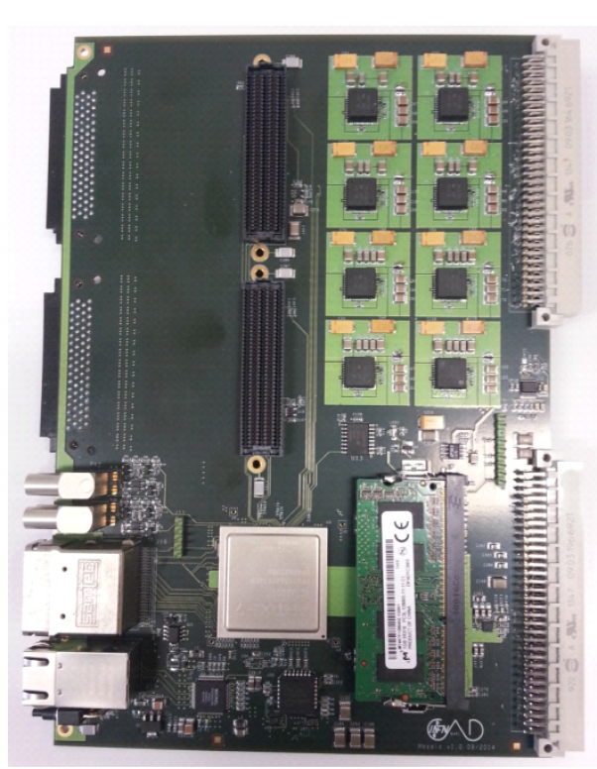
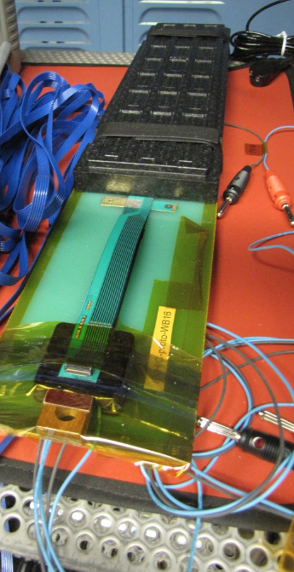
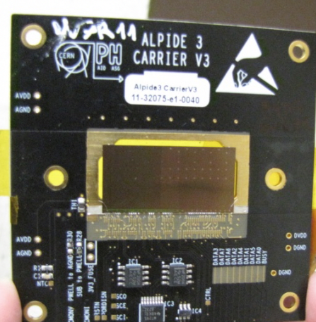
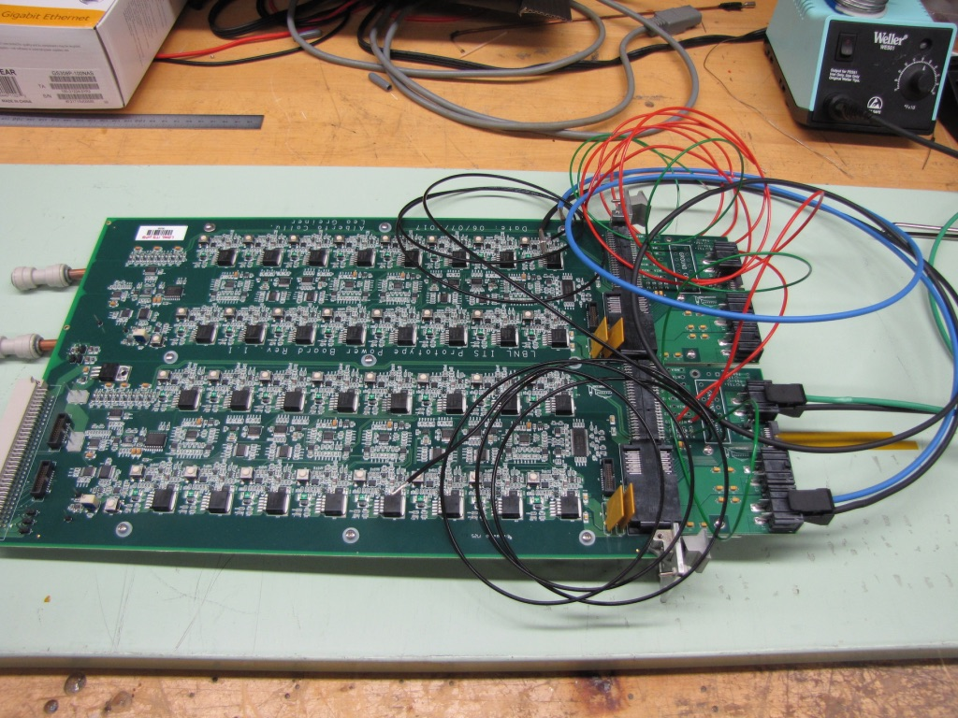
A Test Bench at LANL
5 m
Readout Unit
Optical Links
FELIX
9 Sensor Stave
9 Data (1.2Gbps)
1 Clock, 1 Control/Trigger
Control
Data (9.6 Gb/s max)
Trigger
Samtec Twinax “FireFly”
FPC
Power
Alpide Sensors
RCDAQ
Filtering Capacitors
regulators
Power Board
Cold Plate
Regulated Power
One HIC and 5+ individual ALPIDE chips.
MOSAIC miniDAQ
Power Board

Slide 22
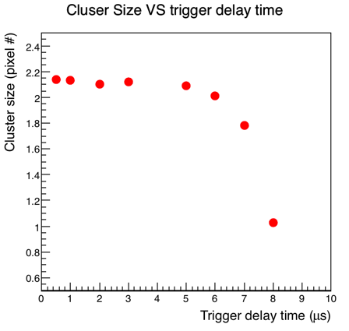
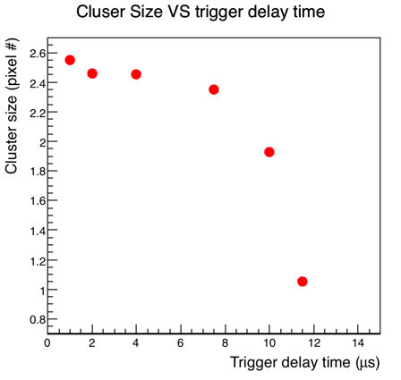
Trigger Latency and Signal Shaping Time Study
Lower the OUT_D threshold (IDB) increases the trigger duration time, but also increases the cluster size which might include more background hits.
In the continuous readout mode, “trigger/strobe” can start as early as ~1uS
Lower Threshold
(Lower the IDB)
Default set
sPHENIX
trigger
Nice work done by Xuan, Sho and Alex + others

Slide 23
To Do List
Update firmware, sync with latest ALICE firmware
  Scrubbing etc.
  Burn-in test, stability
Detector Control System (DCS) integration
  Power distribution and monitoring
  LV, “HV” and temperature
Sensor operation optimization
  Scan parameters for optimal operation
  Laser test bench setup at LANL
Multi-stave readout
  Up to 3 staves per RU
  Default: 1 stave per RU

Slide 24
sPHENIX System Integration

Slide 25
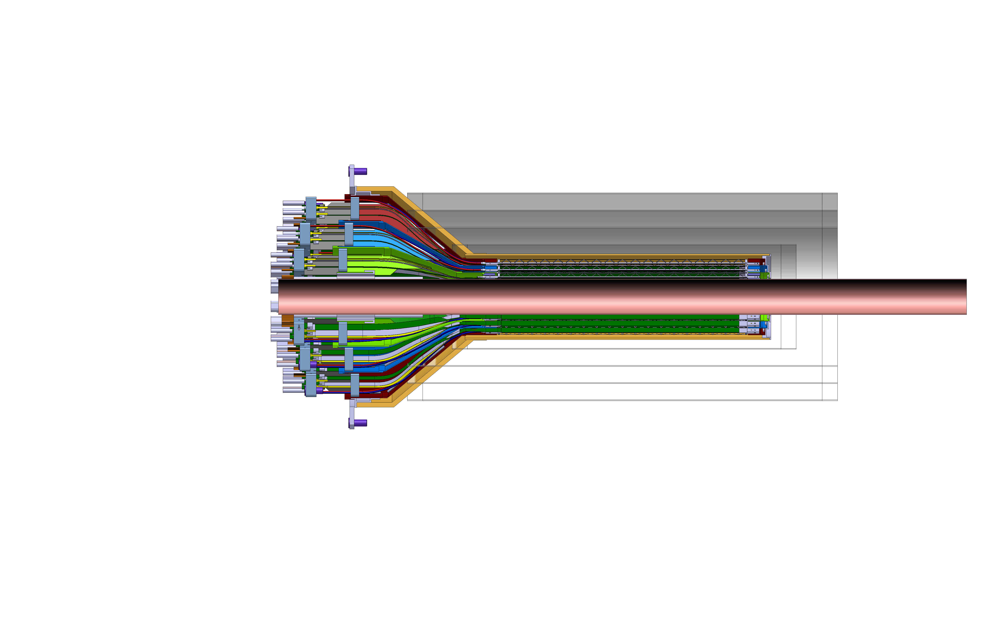
INTT-MVTX Space Conflict
Walt’s talk
INTT Acceptance
@ |z|=10
INTT 4-layers
|η|<0.95
|η|<1.09
|η|<1.28
|η|<1.12
Currently a clear conflict between the INTT and MVTX
  INTT only includes ladder, no connectors, cooling barbs, etc
R&D items:
Extend cables to move the conical structure further out in z-direction;
Design/optimize INTT layers to fit current MVTX geometry;
  FPC data cable can’t be easily extended (max additional ~10cm, machine limit)
  Reduce angle of cone – redesign C-structures and connectors

Slide 26
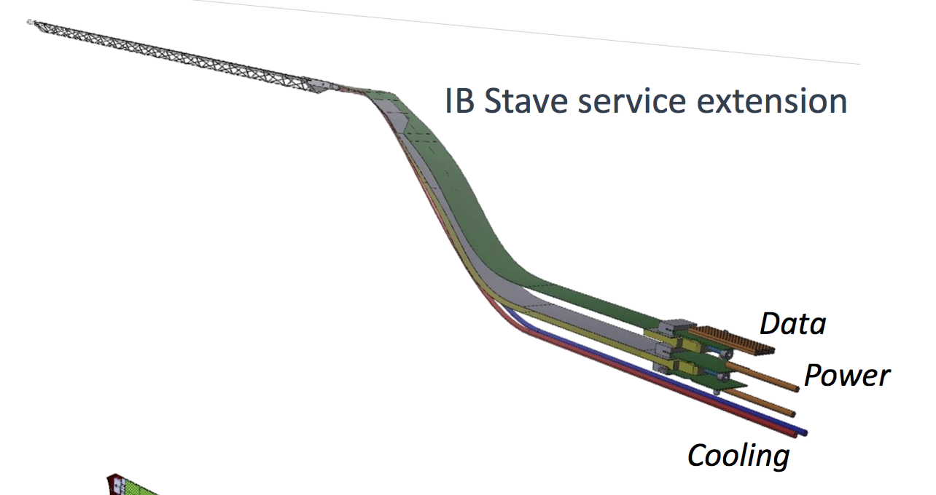
INTT-MVTX Conflict
Walt’s talk
INTT 4-layers
Extend cables to move the conical structure further out in z-direction
FPC data cable is the HDI and can’t be easily extended, CERN will produce extended 60cm long FPC prototype, ~Sept. 2019
Make long power extension ~50cm,
Reduce angle of cone to free up space for INTT services
Redesign patch panel/cable connection shape and location

Slide 27
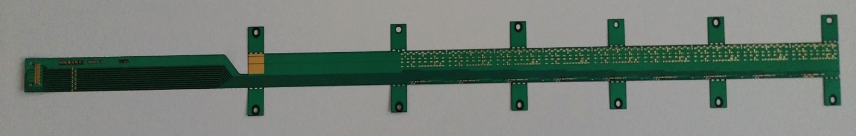
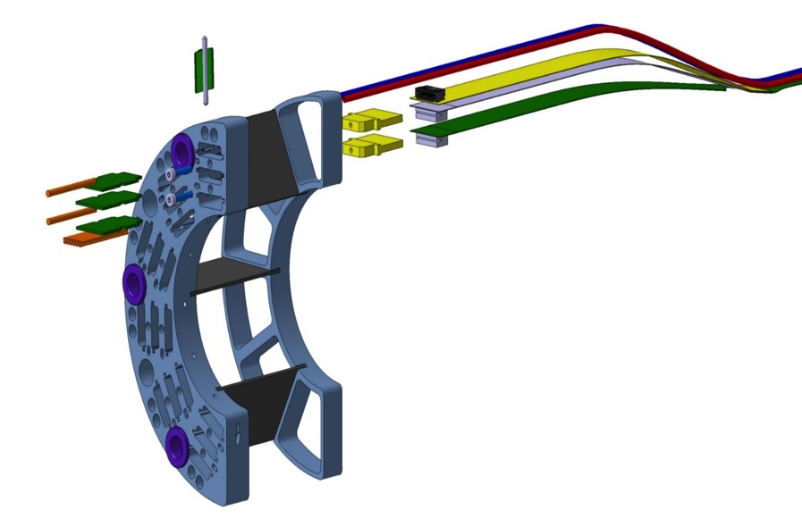
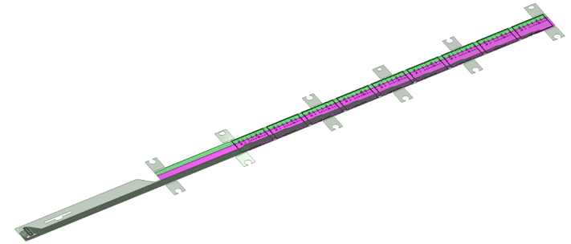
MVTX Flexible Printed Circuit (FPC)
Extend MVTX Service Cables?
Maximum ~60cm for HS signal, TBD through R&D
506.2 mm
16 mm
16.15 mm
41.9 mm
CHIP 9
……
CHIP 2
CHIP 1
Extend FPC/signal path by ~10cm
The 9 silicon chips are read out in parallel: each chip sends its data stream to the end of Stave by a dedicated differential pair, 100 μm wide. Two additional differential pairs distribute the clock and configuration signals.

Slide 28
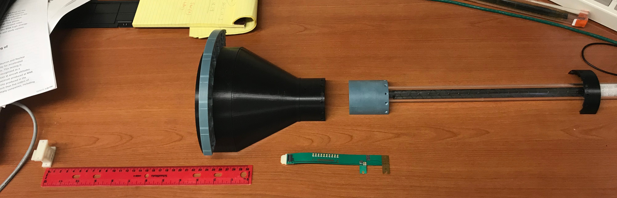
MVTX Mockup & FPC Extension R&D
PWR extension
L=15cm
Extend FPC/data
cable by ~10cm?, R&D
Extended power cables AVDD/DVDD:
L = ~50cm, and possibly with 2~3 different lengths, like 30cm and 40cm
Separate PWR and signal connections at different Z-locations.

Slide 29
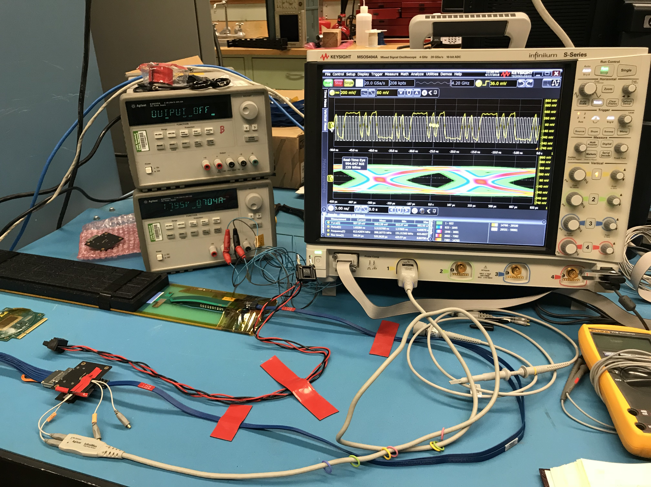
SamTec Cable and FPC Extension R&D

Slide 30
To Do List
FPC extension
  Signal path, +10cm
  Power extension, ~50cm
SamTec cable length vs signal quality
  5~7m
  RU location, MVTX electrical system integration
Carbon structure and connector design
  FPC HS signal connectors
  FPC power extension connectors
  MVT Service barrel and mechanical system integration
  Installation procedure

Slide 31
Carbon Structures

Slide 32
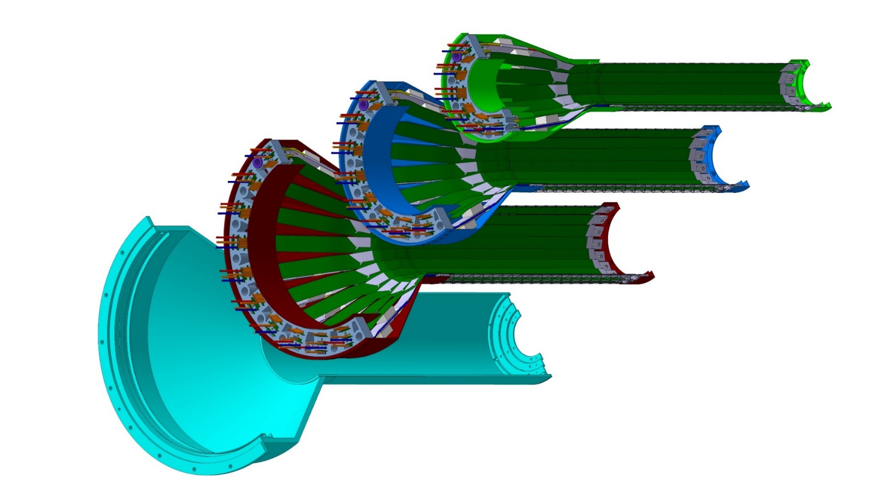
MVTX Carbon Structures
Carbon structures need modifications w.r.t. ALICE for installation in sPHENIX
Layer 0
Layer 1
Layer 2
IB CYSS
Detector carbon frames:
CYlindrical Support
Structure (CYSS)
- End Wheels

Slide 33

MVTX Mechanical Conceptual Design
View of MVTX half detector assembly with extended central barrel
Stave layout
Beam view
27cm
MVTX Staves
Layer 0
Needed extension for sPHENIX INTT integration
Layer 1
Layer 2
IB CYSS

Slide 34
sPHENIX Integration: MVTX + INTT + TPC

Slide 35

Another one: MVTX + INTT + TPC from Dan Cacace, 4/27/2018

Slide 36
Cost & Schedule

Slide 37
Updated Major Cost Items
Dave’s talk
Potential saving:
~$500K
$1.2M
$250K
1 CHF = 1.01 US $, 4/29/2018

Slide 38
Dave’s talk
FY18: Stave + RU production
FY19: Stave/RU QA & test; mechanical
design & carbon frame production
FY20: Carbon structure production
& detector assembly
FY21: Test and installation at BNL
Budget in full proposal
Proposed new early funding
Work in progress “smoothing”
MVTX installation:
Starts ~6/2022
 | FY2018 | FY2019 | FY2020 | FY2021 | FY2022
MVTX Cost | $1,436,825 | $1,911,749 | $2,610,068 | $501,407 | $63,152
New numbers:
$1.52M
$1.6M
RU units moved from FY19 to FY18
* 50% cost reduction due to joint production with ALICE
FY20-22: funding profile smoothing
Nice work by Dave, Maria + others

Slide 39
Possible Contributions from China?
Timeline
Offline detector and physics simulation
  sPHENIX
  EIC
FPC extension R&D at CERN, LANL
  MVTX+INTT+TPC integration
Electronics production test and QA
  Readout Units/CERN, FELIX/BNL
  Power boards and control system
Stave assembly, test and QA
  CERN, China, US
Slow control firmware/software development
  Online monitoring
  Safety controls
Carbon structure design and/or fabrication?
Detector assembly and test
  LBNL, half-barrel assembly, test, QA
  Final assembly & installation at BNL
Now
(MVTX & Heavy Flavor Topical Groups)
2018
2019
2020
2022

Slide 40
RU Production Plan
Plan-A
To be part of ALICE ITS production
Timeline:
  Production starts ~May 2018, available by ~end of 2018, fully tested
Need to make commitment “NOW”
  BNL management actively working on funding RU through RHIC $
Plan-B
Produce RU later, ~2019 as funding allows?
  Procure GBT chips from CERN
  Production & test in US, UT-Austin, LANL et al.
Higher cost, 2x
Higher technical and schedule risks

Slide 41
Stave Production Plan
Plan-A
Produce staves following the completion of ALICE IB at CERN, using ALICE facility
Timeline:
  Starting as early as Aug/Sep 2018 +, last about 6 months for production and test
All 84 staves produced and tested at CERN
BNL management actively working with DOE to build staves at CERN
Plan –B
Produce full staves at CCNU later as funding allows, ~2019?
Earliest starting date - May 2019 + , ~12 months (could be shorter)
Higher technical and schedule risks
Impact on cost, TBD

Slide 42
Following Slides from Yaping Wang/CCNU, 1st sPHENIX workshop in China

Slide 43
Expertise @CCNU

Slide 44
HIC Production @CCNU

Slide 45
Stave Production @CCNU

Slide 46
New: Also IHEP silicon group possibility

Slide 47
Carbon Structure Design and Fabrication
Mechanical system design
  MIT + LANL + LBNL + BNL
Production
  LBNL
Alternative path for fabrication being explored
  Europe (France & Italy, used for ITS Upgrade)
  Asia (Korea, China)

Slide 48
Quote on “CYSS” from Korea from Prof. Kwon/Yonsei Univ.
Layer 0
Layer 1
Layer 2
IB CYSS
Based on ALICE CYSS design AutoCAD:
~$3K, 5 weeks delivery
One of two IB CYSS shell only
Will follow up on this development,
also for the end-wheels/conical shells
MVTX Project:
CYSS: $424K (included review/design: $40K)
($103K_Material + 216K_Labor + 37%)

Slide 49

Institute of High Energy Physics in China (IHEP) - Silicon Group
IHEP is working on ATLAS MAPS detector R&D
  Carbon structure
  Sensor and readout
  Very interested in sPHENIX MVTX project
ATLAS MAPS Chips

Slide 50



Encouraged IHEP Silicon Group to join sPHENIX!
Carbon structure R&D
  A local institution, material science, in Hangzhou
FPC R&D
  A local company, can make up to ~100cm long “Copper FPC”, “Al” not clear

Slide 51
Summary and Outlook
MVTX full proposal completed
  Expanded science
  sPHENIX baseline
Cost and schedule update in progress
  Major item cost and production plan
  Funding profile smoothing
Excellent progress in R&D
  Readout and controls proof-of-principle demonstrated
  Conceptual mechanical system design being developed
  Possible new collaboration on carbon and FPC work
MVTX+INTT+TPC integration in progress
  Electrical and mechanical system
  sPHENIX wide coordination through Office of Integration
    Mini sPHENIX integration review in ~June 2018?
To be ready for sPHENIX Day-1 Physics in 2023
  sPHENIX and later EIC possibility
Document: sPH-HF-2018-001
https://indico.bnl.gov/event/4072/

Slide 52
Backup slides

Slide 53
Physics

Slide 54


RHIC Multi-Year Plan: sPHENIX 2023-2027+
Evolving
Precision B-tagging w/ MVTX:
  Tracking resolution better than 50um @pT=1GeV
  High multiplicity HI collisions
  Low multiplicity but high rate p+p collisions
  High efficiency and high purity
B hadrons/pT<15GeV: O(1M)
b-jets/pT>15GeV: O(100K)

Slide 55

Physics & Simulations: from sPHENIX to EIC
MVTX

Slide 56




B-hadron Tagging
Impact parameter (DCA) method to tag non-prompt D⁰ from B-meson decays
Inclusive and exclusive channels possible
Fully reco’d: B->D+pi
Partial reconstruction: B->D+x

Slide 57
b-jet Tagging in p+p and Au+Au
Fully implemented MVTX models used in performance projection
b-jet tagging projection evaluated with full tracking + calorimetry simulation
  Tagging work point has been stable (60% Purity 40% eff for pp)
  Central Au+Au Tagging work point has been stable (40% Purity 40% eff)
Performance has been stable using truth jet finding or calorimetry reconstructed jet finding
sPHENIX b-jet work point

Slide 58


B-jet tagging
Multi-tracks w/ large DCA
2nd vertex mass reco’d
CMS work-point, Phys. Rev. Lett. 113, 132301 (2014)

Slide 59
New Insight into QGP: HF-Jet Substructure
H. Li & I. Vitev (2018)
QCD Splitting function in QGP
f->f+g
g->f+fbar
Prompt c/b
Gluon splitting

Slide 60
New Insight into QGP: B v2
D-meson: v₂ scaling
observed at RHIC
Various new model calculations, PHSD, AMPT etc, for B-hadron v2:
Significant non-zero v2 suggested, but may NOT follow the scaling due to large b-mass!
Very active theoretical investigation:
LANL model
CUJET
Duke model
TAMU
UrQMD
AMPT
PHSD
Ads/CFT
BAMPS
HQ+EPOS2
JetScape
….
sPHENIX sensitivity
sPHENIX sensitivity

Slide 61
More Theoretical Inputs (II): B-meson R_AA
New calculations from PHSD for B-hadrons:
Potential significant anti-shadowing effects
Open b-bar in AuAu, very important baseline for Upsilon program!
EPS09
B prod.
x~0.05
@RHIC
Gluon
anti-shadowing
Q² ~100

Slide 62
sPHENIX Projected R_{AA} Sensitivity
Open questions to be answered: energy loss mechanisms and QGP medium properties
B-Mesons
B-jets

Slide 63

sPHENIX Project Elliptical Flow v₂
Open questions to be answered: nature of quasi-particles, medium interactions and transportation
B-Mesons
B-jets

Slide 64
More information

Slide 65
Summary: Major Remaining R&D
Mechanical/Electrical integration with INTT+TPC
  Carbon structure design
  FPC extension
Full electrical system control
  Power
  Safety
  Online monitoring & controls
  Integrate readout system firmware/software with slow controls

Slide 66
Mechanical Integration

Slide 67
sPHENIX Integration: MVTX + INTT + TPC

Slide 68
Stave Production @CCNU

Slide 69
INTT-MVTX Conflict
INTT Acceptance
@ |z|=10
INTT 4-layers
|η|<0.95
|η|<1.09
|η|<1.28
|η|<1.12
Currently a clear conflict between the INTT and MVTX
  INTT only includes ladder, no connectors, cooling barbs, etc
R&D items: 1) Extend cables to move the conical structure further out in z-direction; 2) Design/optimize INTT layers to fit current MVTX geometry;
  FPC data cable is the HDI and can’t be easily extended, short “firefly” cables possible?
  Reduce angle of cone – redesign C-structures and connectors

Slide 70
INTT-MVTX Conflict
INTT 4-layers
Extend cables to move the conical structure further out in z-direction
  FPC data cable is the HDI and can’t be easily extended
  Possibly add short “firefly” cables to hook up to patch panel, R&D needed
Reduce angle of cone – redesign

Slide 71
Signal and Power Extension for FPC

Slide 72
MVTX/INTT Integration
Extend MVTX Service Cables?
506.2 mm
16 mm
16.15 mm
41.9 mm
CHIP 9
……
CHIP 2
CHIP 1
The 9 silicon chips are read out in parallel: each chip sends its data stream to the end of Stave by a dedicated differential pair, 100 μm wide. Two additional differential pairs distribute the clock and configuration signals.

Slide 73

MVTX FPC R&D @CERN and LANL

Slide 75


Slide 76
End View of ALICE Patch Panel

Slide 77
PATCH PANEL
ESTIMATED TOTAL MASS HALF DETECTOR 1,100.0 grams
END WHEELS
CONICAL SECTION
MVTX half detector assembly

Slide 78
MVTX Detectors

Slide 79

MVTX and INTT Integration
– Work in Progress
It is clear from this detail view the conical region of the MVTX detector barrel with the INTT that the MVTX will need to translate in Z…

Slide 80


INTT Readouts from both North and South
ROC boards mount off inner EMCAL
Identical to FVTX Big Wheel
35cm
Bus Extender
ROC
Boards
Bus Extender
105 cm
η=1
ROC
Boards
η=0
The bus extender needs to run to ROC boards (reuse FVTX ROC) outside TPC.
Minimum length is 105cm – ladder length + distance to ROC board.

Slide 81
Mechanical Integration
Model of MVTX with INTT inside TPC with the addition of two concentric composite cylinders;
Location of conflat flange on beam-pipe
Location in Z where the inner-hcal ends (see control drawing) Z=2175.0 mm

Slide 82

Service Barrel: Design and Fabrication
DETECTOR SECTION
SERVICES, SUPPORT
SECTION
ALICE HALF-BARREL ASSY

Slide 83
ALICE Inner Tracker Rail Support
The MVTX plus INTT half barrel assemblies location position is provided by the engagement of 4 rollers on the half-barrel, which would be previously measured and aligned, into four precise inserts housed in the “cage-rail” assembly.
Rail guides for upper half assembly
Eccentric:
Adjustable roller +/- 1.0 mm, by steps of .25 mm
In sPHENIX we will not use a “service cone, rail system” anywhere near the size of that planned for the ALICE detector, but we will use their concept.

Slide 84
BNL control envelope drawing; Z location of the inner hcal is at 2175,0mm
Z=2175mm

Slide 85

INTT

Slide 86

INTT

Slide 87

INTT

Slide 88
MVTX + INTT + TPC

Slide 89

Cross-section view from CAD model of MVTX, INTT, TPC, beam-pipe, plus two composite conical shells:
MVTX radius are increased by 1.5mm to have a minimum 2mm gap between beam pipe and then inner MVTX structures

Slide 90
Gap between conical shell of MVTX and inner layer of INTT is 11.58 mm
Dist= R61.58 – R50
= 11.58mm

Slide 91
56.0 mm gap between INTT and inner radius of TPC
Gap= R200-R143.5
= 56mm

Slide 92
Earlier model for the INTT, chevron configuration, inner layer half ladders in width;
Number of ladders:
Layer 0 – 38 half ladders,
Layer 1 – 26
Layer 2 – 34
Layer 3 - 42

Slide 93
Offset from OD of beampipe and innermost component of the MVTX
New gap 2.025 mm

Slide 94
Offset needed to install split MVTX into run location around beampipe, passing over 2.75 in conflat flange
37.6mm

Slide 95
INTT stave design with HDI

Slide 96
Latest configuration of ladders in the INTT, 4 layers where each is made from two layers for hermeticity

Slide 97
New INTT model with HDI extensions;

Slide 98
Cost & Schedule

Slide 99
Cost and Schedule in the Full Proposal
Total budget: 6.5M
  Production
  Assembly
  Integration
About 9 months schedule float
Major Items | Cost ($M) | Schedule
Staves (WBS 1.5.3.1) | 1.3 | 8/2018-5/2019
Readout & Controls (WBS 1.5.2) | 1.3 | 1/2019-6/2019
Mechanics & Detector Assembly (WBS 1.5.3) | 1.8 | 2019-2022, TBO
Integration (WBS 1.5.4) | 1.0 | 2021-2022, TBO
Project Management | 1.0 | 8/2018-1/2023

Slide 100

MVTX labor profile in the full proposal
 | Escalation + Overhead + Contingency
Labor | $2.5M
M&S | $4M ($3.75M if RU produced in FY18)
Only engineers and Technical staff costed to the project

Slide 101
Early funding motivation for MVTX FY18,FY19
Buy 84 good staves from CERN following ALICE production, end FY18
  Includes: sensors, space frame, FPC, assembly and tests
  Very low technical risk
  CERN will deliver 100% working staves
Buy 58 Readout Units with the ALICE production in FY18 (was FY19)
  FPGA chips and GBT chips as part of the ALICE production
    GBT not commercially available product
  ~50% cost saving w.r.t. to estimated budget (exact number confirmed 04/18)
MVTX telescope Fermilab test beam confirmed the readout chain and sensor performance in early March 2018
  Sensors(ALPIDE) + RU(frontend) + FELIX(backend) + sPHENIX RCDAQ
To attract external funding & support for MVTX
  Foreign consortium, individual institution

Slide 102
M&S cost options & risks
Green: low risk / MVTX baseline budget
Red: High technical risk, low cost saving or increased cost
Staves:
  Oprion1: MVTX production following ALICE production at CERN, ~Aug 2018
    All material included and 100% working staves delivered
  Option2: Stave assembly at CCNU (China)
    MVTX project would still need to buy sensors, Flexible Printed Circuit (FPC) and space frames
    Wuhan could assembly sensor and FPC; assembly with space frame may be done elsewhere
    No experience assembly inner barrel → training required and hardware modified
    Potential saving on some labor assembly work
    Yield unknown -> schedule and cost uncertainty
Readout Units (radiation hard electronics):
  Option1: Produce with ALICE batch (FPGA & GBT chips) in FY18
    50% cost reduction w.r.t. budgeted cost
  Option2: MVTX produces its own batches→ cost increase/double and schedule impact
Carbon structures:
  Exploring cost-saving options, build carbon structures elsewhere (France, Italy, Korea, China?) instead of LBNL etc.
Reuse hardware from LDRD
  Electronics, Power System etc.

Slide 103
Electronics and Controls

Slide 104
MVTX Electronics Overview
CAN bus
DCS
5-10 m
Trigger & Clock
Readout Unit
Front End
GBT Optical Links
9-sensor Stave
9 Data (1.2Gbps)
1 Clock, 1 Control/Trigger
Control
Data (9.6 Gb/s max)
Trigger
Samtec Twinax “FireFly”
FELIX
Back End
FPC
Power
Alpide Sensors
Power
Filtering Capacitors
regulators
Power supplies
Cold Plate
Regulated Power
Power Board
Interaction Region
Experimental Hall
Counting House
MVTX Detector Electronics consists of three parts
Sensor-Stave (9 ALPIDE chips) | Front End-Readout Unit | Back End-FELIX

Slide 105

Sensor and Electronics R&D @LANL
ALPIDE evaluation and optimization
  MOSAIC + Single Chip/Stave
  Cosmic and source
  Laser system
Power unit tested
  PU + MOSAIC
  PU + RU
Full readout chain demonstrated
  ALPIDE + RUv1.0 + FELIX v1.5 + RCDAQ
  Full stave + RUv1.x + FELIX v2.0 + RCDAQ
Mechanical system integration
  Conceptual design developed
  MVTX+INTT integration
MVTX
ALPIDE chip
Scintillator
Collimator
Sr⁹⁰ source

Slide 106


First Full Chain Readout: Success!
LANL + Martin, JohnH et al
Successfully configured, triggered and readout single ALPIDE chip
  RU configures ALPIDE using python scripts interfacing the USB chip on RU
  Felix distributes clock to RU, the RU then distributes the clock to the ALPIDE
  ALPIDE is triggered on the control line, sends data at 1.2Ghz over copper
  The RU receives the data and sends the data to FELIX over fiber using GBT link
  FELIX packs the data and stores in on disk which is read out using RCDAQ
  Configured ALPIDE to accept triggers from FELIX using python software that came with the RU
  Configured GBT link to recover clock from FELIX and GT link (FGPA gigabit interface)
  8 RU’s emulated using 1 fiber link per RU on FELIX, 15kHz, 400 hits per RU
Currently working the implementation of the above using a Stave
RUv1.0

Slide 107
LHC 40MHz
mockup
LANL Fermilab Test Beam Setup 03/2018
4-ALPIDE Telescope + 4-SamTec cables + 1 RU + 1 FELIX(“CRU”)
4-ALPIDE Telescope
4 5m SamTec Cables, 1.2Gbps
CLK recovered from
FELIX through GBT link;
Trigger from FELIX
FELIX (“CRU”)

Slide 108

Achieved all goals and more!
Tested a new readout scheme
  4 sensors (~3 “staves”+1 Chip) per RU
    ALICE: 1 stave per RU for IB
Sensor performance evaluation
  Cluster size
  Threshold, signal shaping, trigger delay
System stress test
  High multiplicity events created via lead bricks “shower”
  With 5, 10, 20cm lead bricks
Analysis software developed
  Online monitor
    hit distribution, relative alignment etc.
  Offline reconstruction, alignment etc.
    Preliminary alignment, ~O(100um)
RU
4 sensors
Connected
to one RU
hits
Hits/sensor

Slide 109
Parallel Effort at UT-Austin
– Shared R&D

Slide 110


RC DAQ event Data Screen Shot
Rcdaq receiving events from FELIX using ddump utility
ffff0044ffffc0ff4ea0
a0 - Chip Header
4e - bunch counter
ff - IDLE
c0 - Region Header
40 00 - first Hit
Second screen shot showing end of one event (b0…, f000f000) and the beginning of another

Slide 111

LANL R&D: Single ALPIDE Chip Scan – Active Channel Fraction
Scanned the available chips and stave at the LANL lab through digital scan to verify the dead channel fraction: the bad channel fraction is <1%.
Similar results with different readout speeds.
Chip 1 test example
No. of 0 hits
777
Cold channel
1
Hot channel
0
Bad fraction
0.15%

Slide 112

Hit Pixel Cluster Distribution from Source Test (Sr⁹⁰)

Slide 113


Data Rate Calculations
 | Collision Rate
Au Au | 200kHz
P P | 10Mhz
  Assume 10us window and cluster size 3
 | Au Au | P P
# of collisions | 2 = 10us * 200kHz | 100 = 10us * 10Mhz
# of hits, hottest chip | 270 = 3 * 90 | 75 = 3 * 25
# of hits in a stave | 1983 = 3 * 661 | 543 = 3 * 181

Slide 114

Expected Data Rate (from the proposal)
Noise < 10^-5
@Fermilab test bean
~30 Gb/s max.

Slide 115
Project Organization

