Slide 1
MVTX R&D
Ming Liu
Los Alamos
Many inputs from Walt, Alex, Sho, Hubert,
Cesar, Xuan, Rachid, Itaru and the MVTX group

Slide 2
MVTX Detectors
Mechanical system integration
Electrical system integration

Slide 3
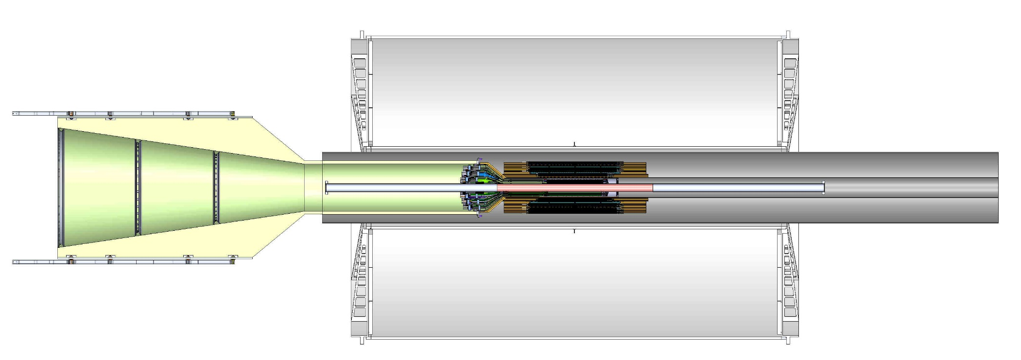
To Do List – Mechanical Integration
FPC extension
  Signal path, +10cm
  Power extension, ~50cm
SamTec cable length vs signal quality
  5~7m
  RU location, MVTX electrical system integration
Carbon structure and connector design
  FPC HS signal connectors
  FPC power extension connectors
  MVT Service barrel and mechanical system integration
  Installation procedure

Slide 4
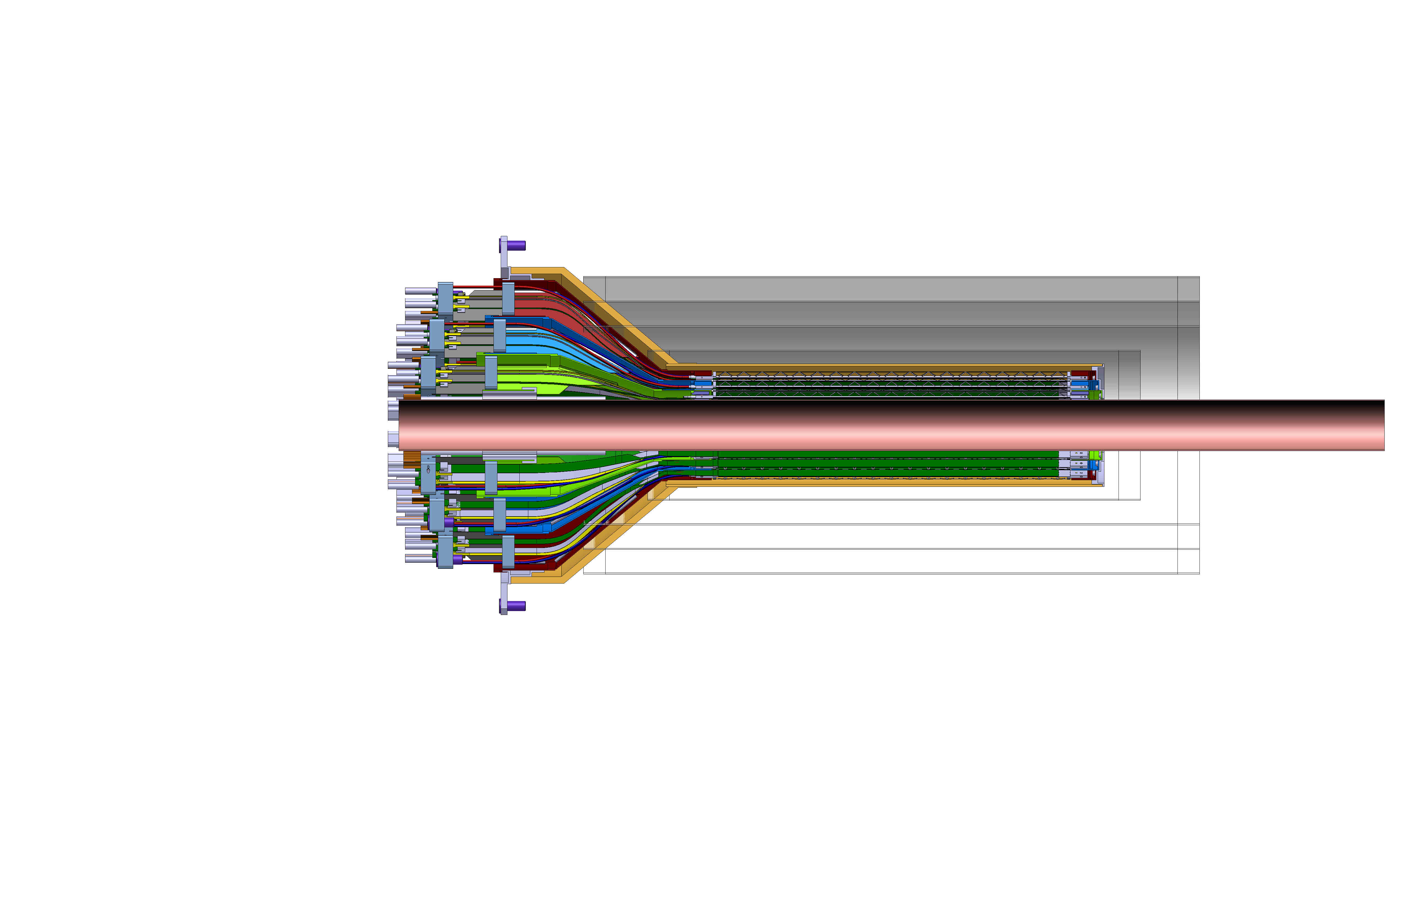
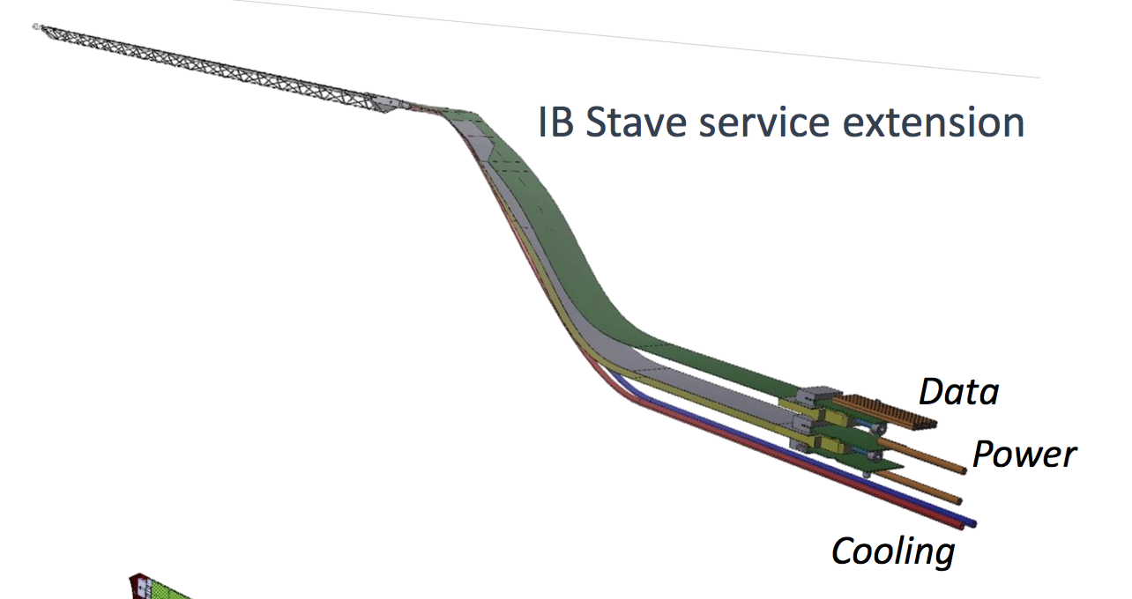
INTT-MVTX Conflict
INTT 4-layers
Extend cables to move the conical structure further out in z-direction
FPC data cable is the HDI and can’t be easily extended, CERN will produce a prototype FPC (add ~10cm) for testing, ~Sept. 2018
Make long power extension, ~50cm,
Reduce angle of cone to free up space for INTT services (how much is needed?)
Redesign patch panel/cable connection shape and location

Slide 5
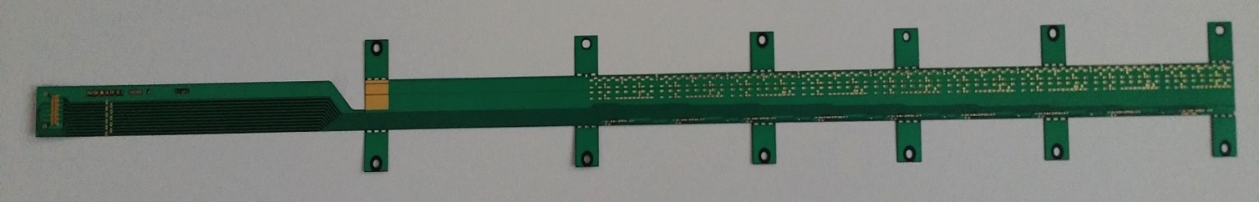
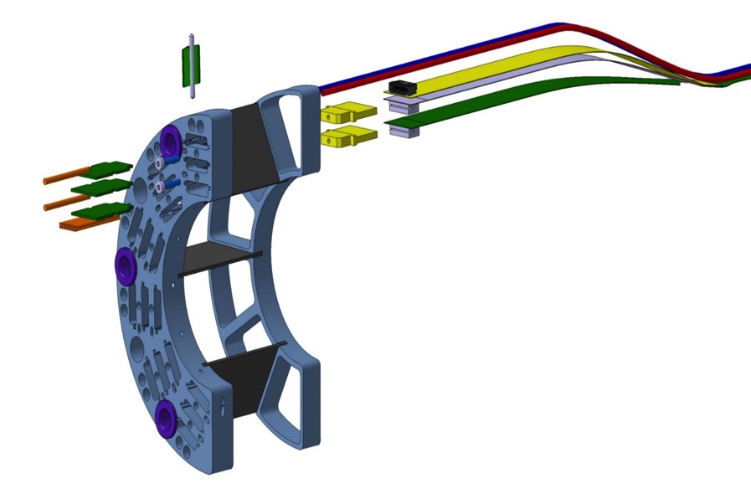
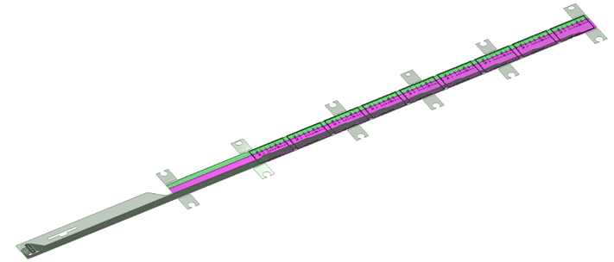
MVTX Flexible Printed Circuit (FPC)
Extend MVTX Service Cables?
Maximum +10cm for HS signal, TBD through R&D
506.2 mm
16 mm
16.15 mm
41.9 mm
CHIP 9
……
CHIP 2
CHIP 1
Extend FPC/signal path by ~10cm
The 9 silicon chips are read out in parallel: each chip sends its data stream to the end of Stave by a dedicated differential pair, 100 μm wide. Two additional differential pairs distribute the clock and configuration signals.

Slide 6
ITS/IB FPC, 50cm long;
CERN can make FPC up to 60cm long, but needs to be confirmed
Caps, resistors, connectors, etc

Slide 7
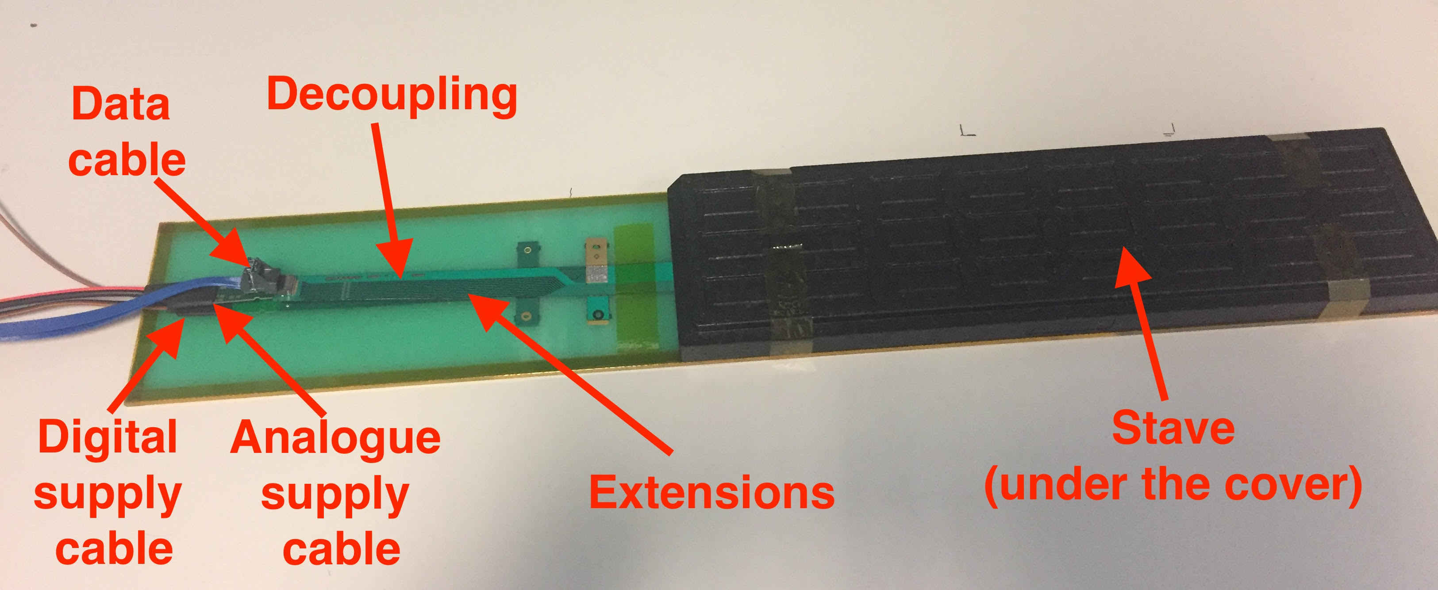
ALICE ITS/IB HIC: Signal, AVDD and DVDD

Slide 8
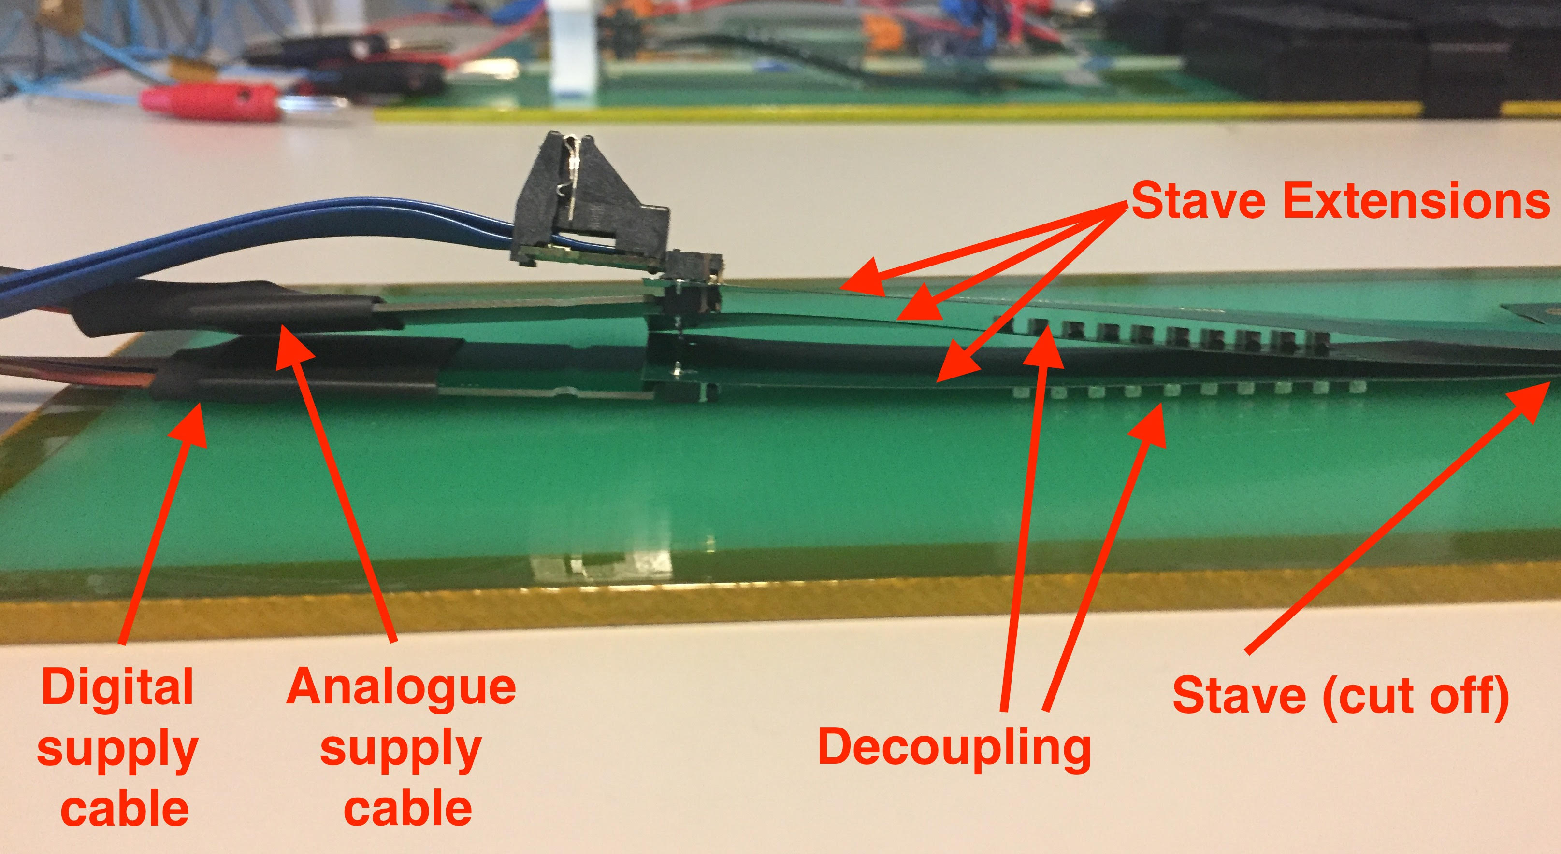
ALICE ITS/IB HIC: Signal, AVDD and DVDD

Slide 9
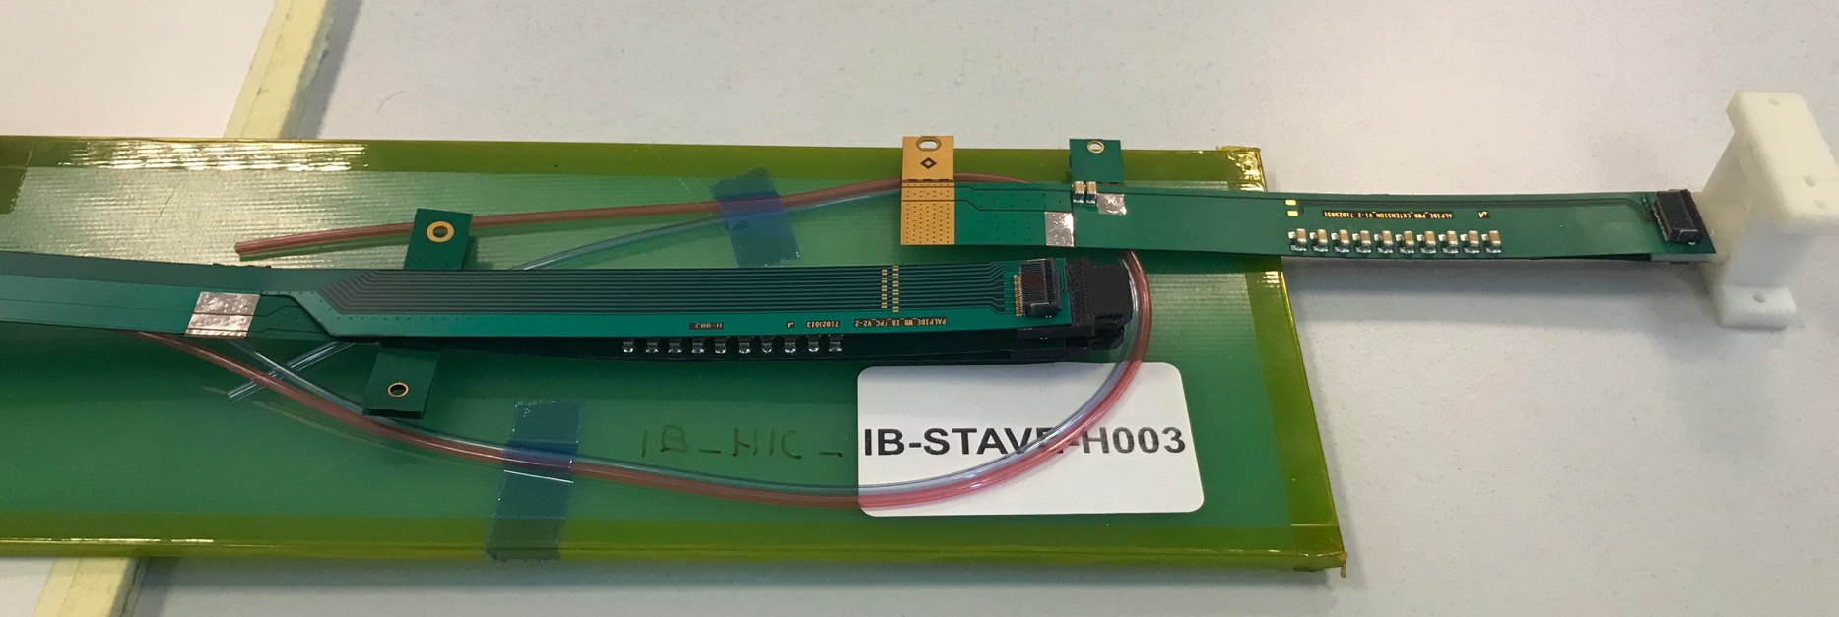
FPC R&D @CERN and LANL
Analogy and Digital Power
Extension
High-speed signal, 1.2Gbps
Try to extend high-speed portion of FPC by 10cm @CERN, ~September 18
2) Try to extend AV and DV by ~50cm at LANL, ~summer 18

Slide 10
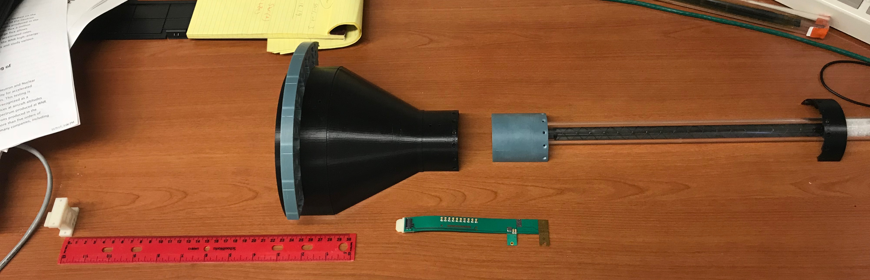
MVTX Mockup & FPC Extension R&D
PWR extension
L=15cm
Extend FPC/data
cable by ~10cm?, R&D
Extended power cables AVDD/DVDD:
L = ~50cm, and possibly with 2~3 different lengths, like 30cm and 40cm
Separate PWR and signal connections at different Z-locations.

Slide 11
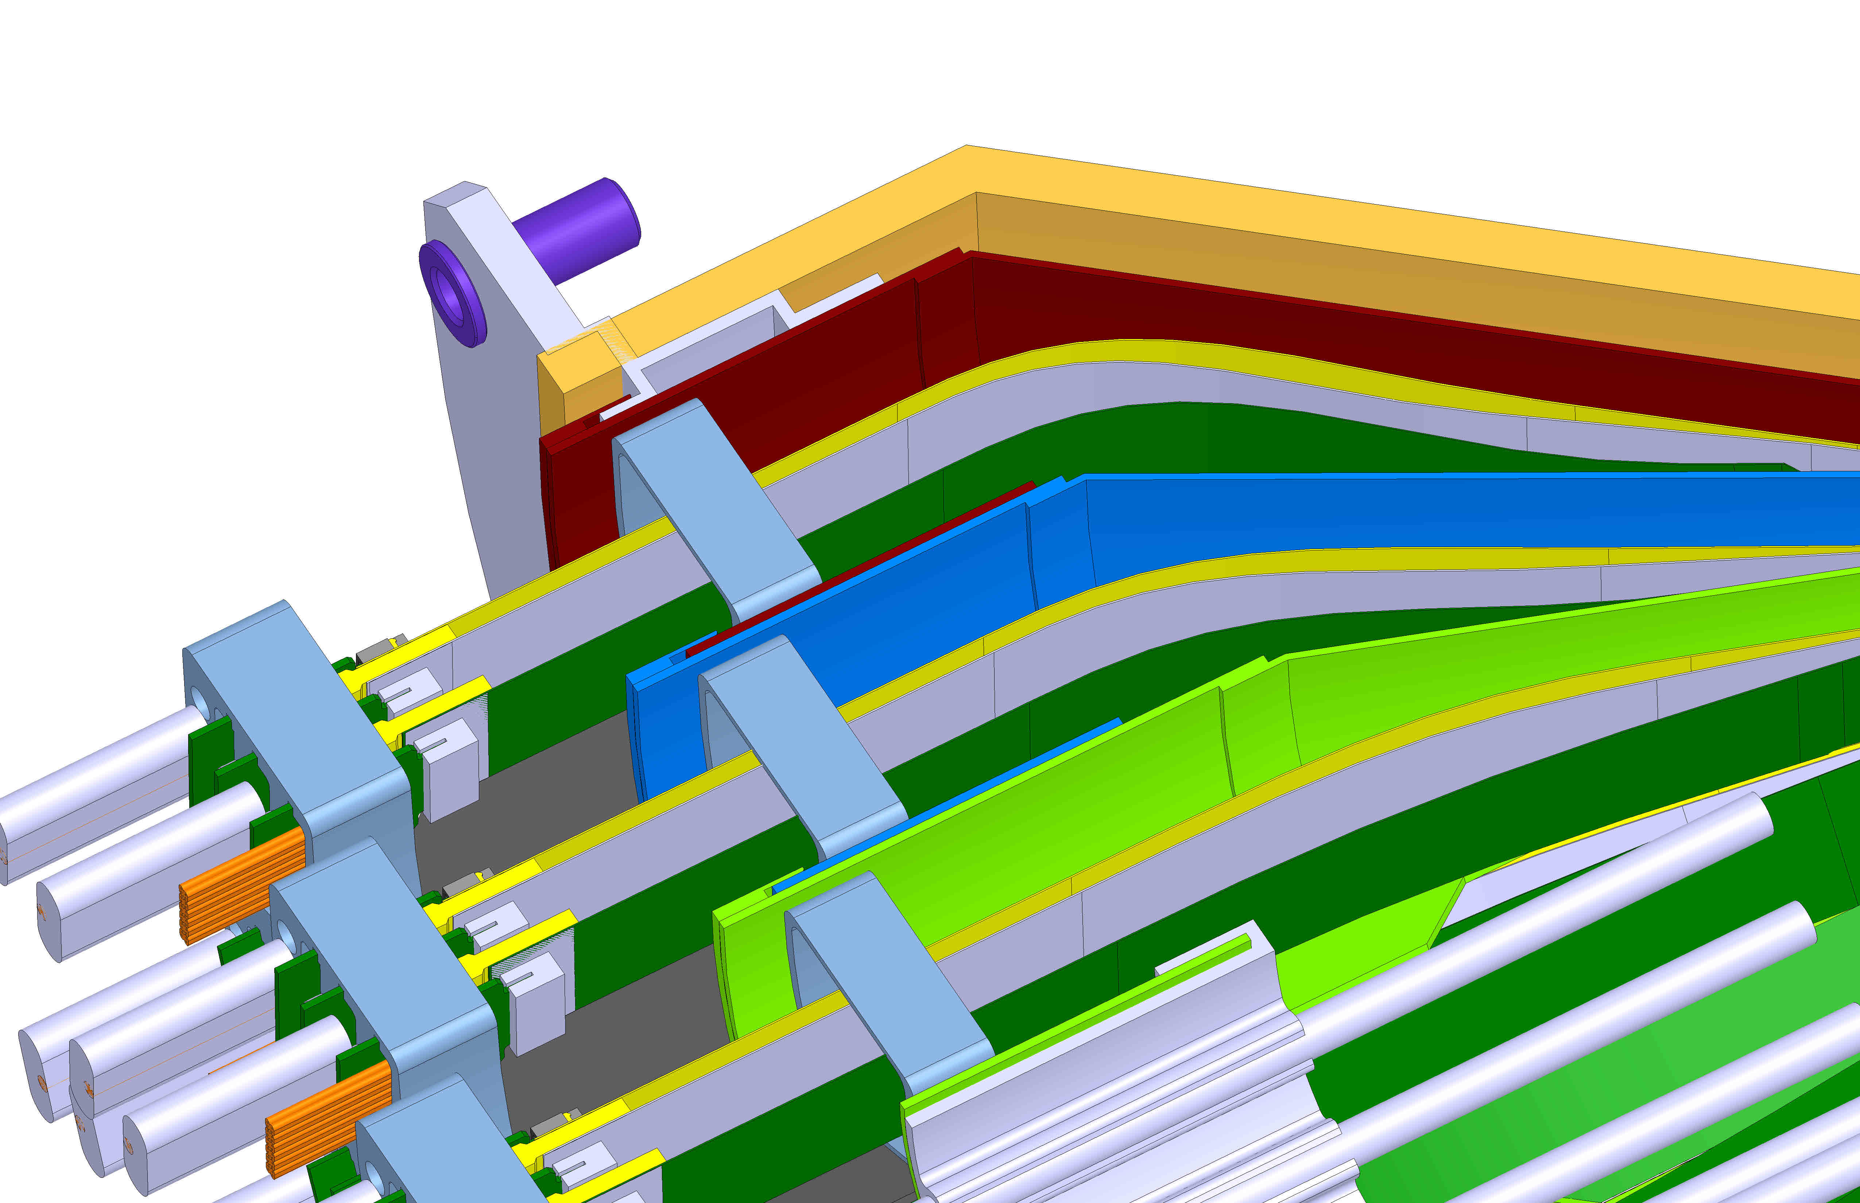
Requires New Design

Slide 12
End View of ALICE Patch Panel

Slide 13
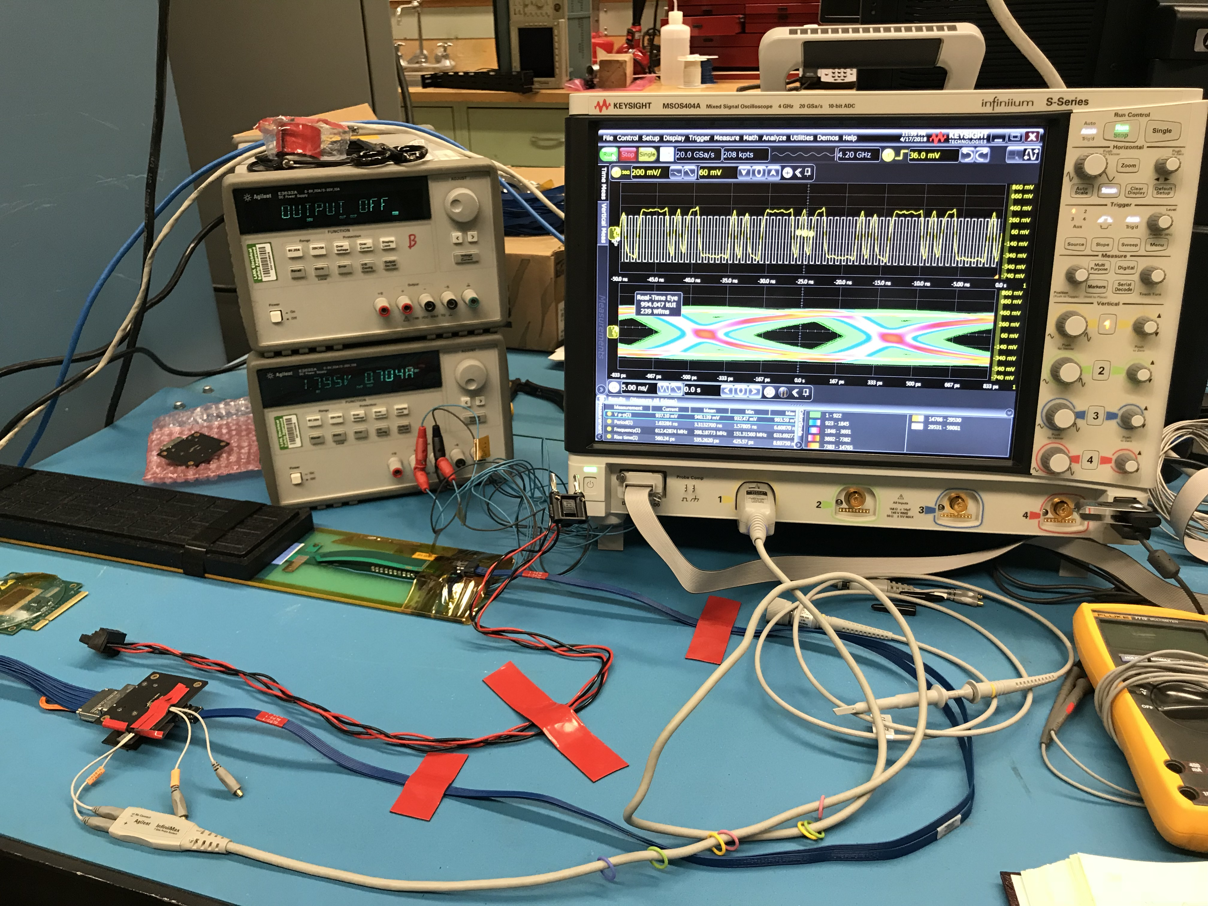
SamTec Cable and FPC Extension R&D

Slide 14

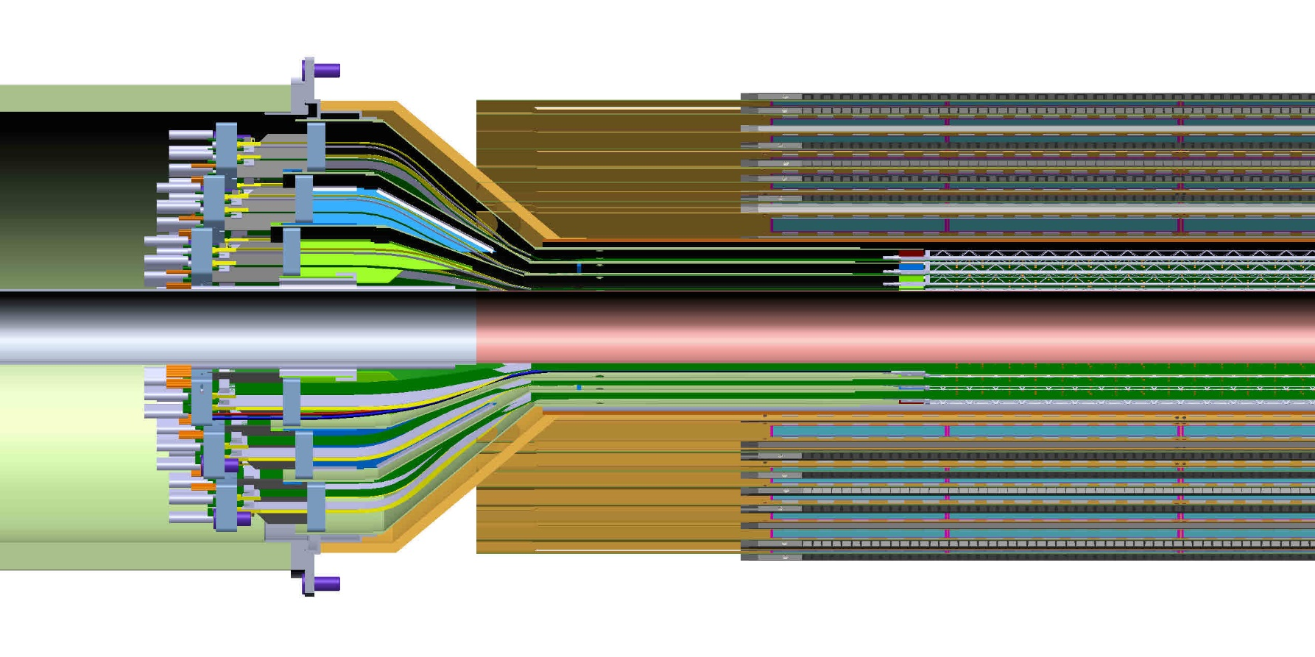
MVTX and INTT Integration
It is clear from this detail view the conical region of the MVTX detector barrel with the INTT that the MVTX will need to translate in Z…, but there is a limitation;
Optimize INTT design to fit within the limitation

Slide 15
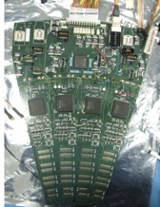
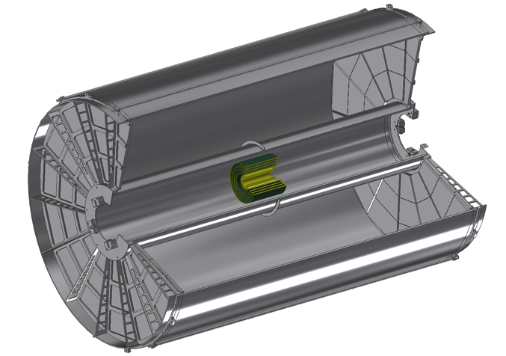
INTT Readouts from both North and South
ROC boards mount off inner EMCAL
Identical to FVTX Big Wheel
35cm
Bus Extender
ROC
Boards
Bus Extender
105 cm
η=1
ROC
Boards
η=0
The bus extender needs to run to ROC boards (reuse FVTX ROC) outside TPC.
Minimum length is 105cm – ladder length + distance to ROC board.

Slide 16
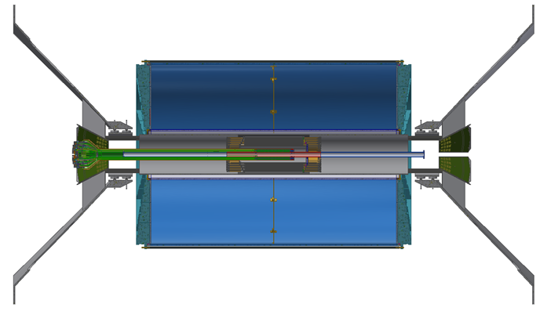
INTT supported off Inner HCal from Dan Cacace/BNL
Very hard/Impossible for MVTX to have such a long extension

Slide 17
Mechanical Integration
- Model of MVTX with INTT inside TPC with the addition of two concentric composite cylinders;
- INTT would like to use the outer shell of the MVTX as the inner shell of the INTT half detectors as a part of their cooling gas containment volume.
Location of conflat flange on beam-pipe
- MVTX Electronics Racks;
- PS racks
Location in Z where the inner-hcal ends (see control drawing) Z=2175.0 mm

Slide 18
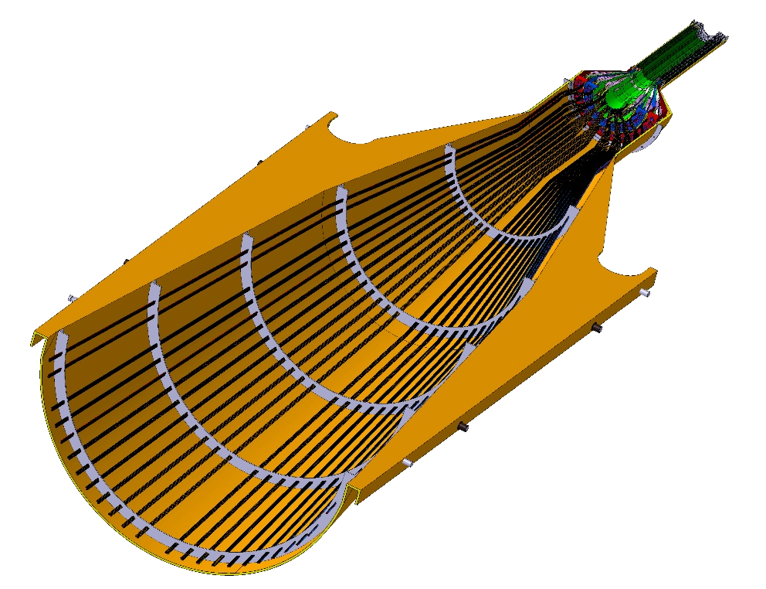
Service Barrel: Design and Fabrication, modify ALICE design
MVTX will have a similar but much smaller service barrel
Need:
Support structure and
installation procedure
DETECTOR SECTION
SERVICES, SUPPORT
SECTION
ALICE HALF-BARREL ASSY

Slide 19
To Do List – Readout and Controls
Update firmware, sync with latest ALICE firmware
  Scrubbing etc.
  Burn-in test, stability
Detector Control System (DCS) integration
  Power distribution and monitoring
  LV, “HV” and temperature
Sensor operation optimization
  Scan parameters for optimal operation
  Laser test bench setup at LANL
Multi-stave readout
  Up to 3 staves per RU
  Default: 1 stave per RU

Slide 20
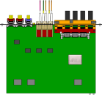

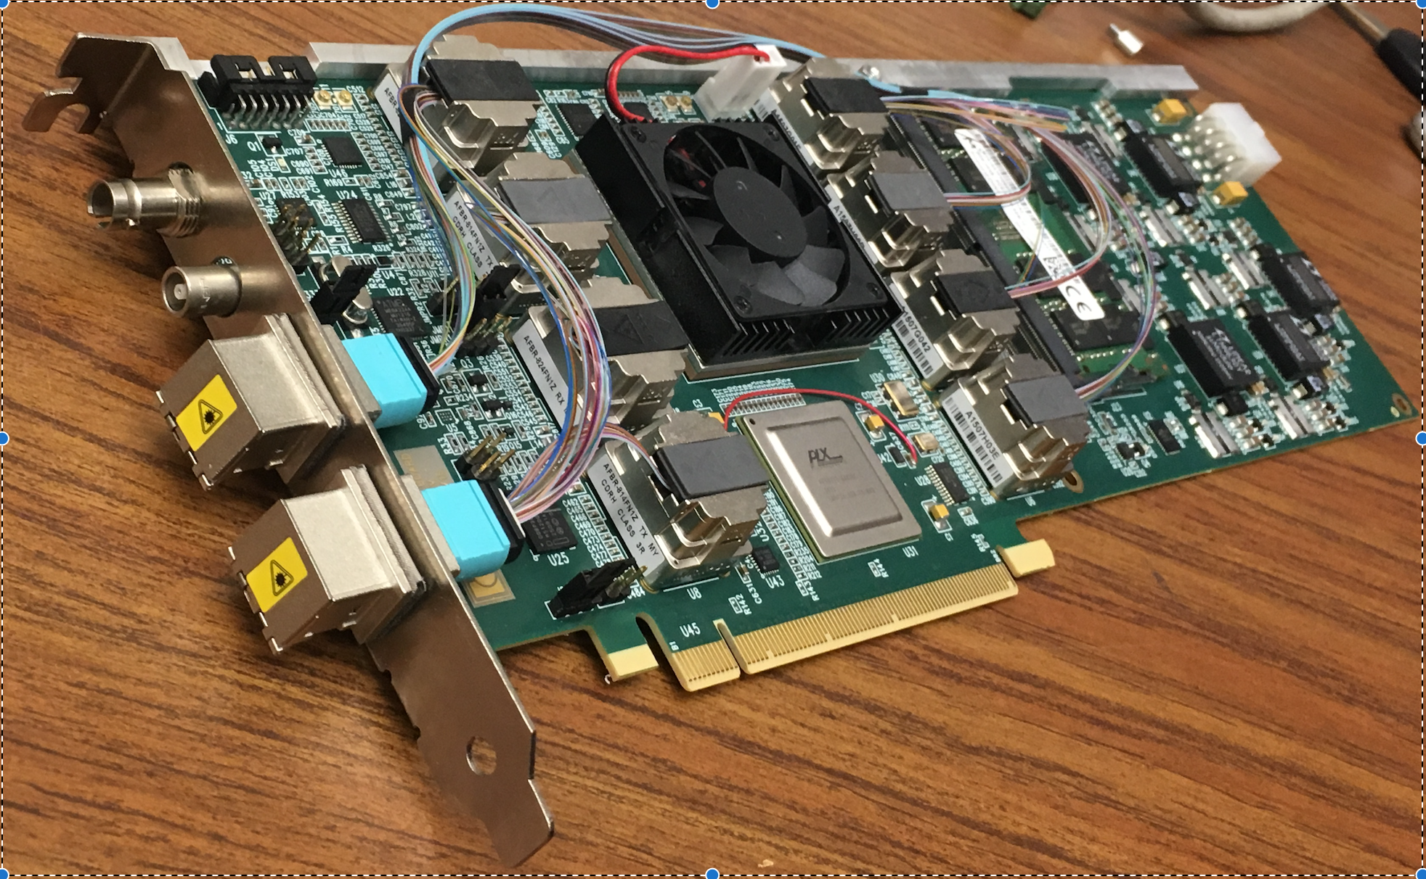
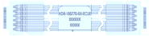
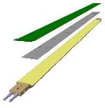

MVTX Electronics, Power and Controls
CAN bus
DCS
5-10 m
Trigger & Clock
Readout Unit
Front End
GBT Optical Links
9-sensor Stave
9 Data (1.2Gbps)
1 Clock, 1 Control/Trigger
Control
Data (9.6 Gb/s max)
Trigger
Samtec Twinax “FireFly”
FELIX
Back End
FPC
Power
Alpide Sensors
Power
Filtering Capacitors
regulators
Power supplies
Cold Plate
Regulated Power
Power Board
Interaction Region
Experimental Hall
Counting House
MVTX Detector Electronics consists of three parts
Sensor-Stave (9 ALPIDE chips) | Front End-Readout Unit | Back End-FELIX

Slide 21
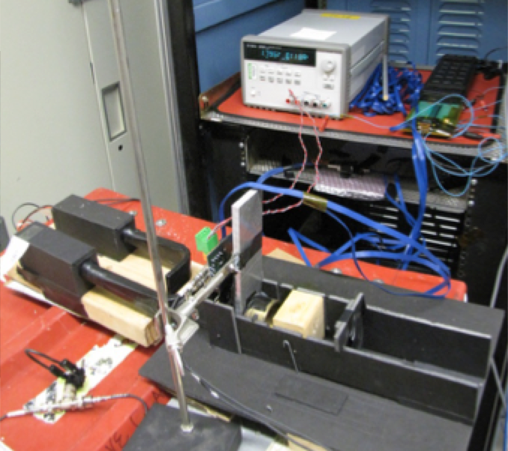
Sensor and Electronics R&D @LANL
ALPIDE evaluation and optimization
  MOSAIC + Single Chip/Stave
  Cosmic and source
  Laser system
Power unit tested
  PU + MOSAIC
  PU + RU
Full readout chain demonstrated
  ALPIDE + RUv1.0 + FELIX v1.5 + RCDAQ
  Full stave + RUv1.x + FELIX v2.0 + RCDAQ
Mechanical system integration
  Conceptual design developed
  MVTX+INTT integration
  FPX & SamTec cables
  RU location etc
MVTX
ALPIDE chip
Scintillator
Collimator
Sr⁹⁰ source

Slide 22
Parallel Effort at UT-Austin
– Shared R&D

Slide 23
Summary: Major Remaining R&D
Mechanical/Electrical integration with INTT+TPC
  Carbon structure design
  FPC extension
  Support structure and installation procedure
Full electrical system control
  Power
  Safety and interlock
  Online monitoring & controls
Integrate readout system firmware/software with slow controls
  Multi-stave readout with single RU
Detector & Physics simulations

Slide 24
backups

Slide 25
More slides

Slide 26
What if we have to reuse PHENIX VTX Pixel Detectors for the sPHENIX?
Could the new RU be used for reading out old PHENIX VTX pixel detector?

Slide 27
Some Issues with VTX Pixel detector during Run16/15/14 …
PHENIX experienced some serious problems with VTX pixel readout during the runs, and this affected the data quality… some of them being corrected offline, work in progress
A good technical summary note:
https://www.phenix.bnl.gov/phenix/WWW/publish/rnouicer/VTX/2016_VTX/Technical_Note_Silicon_Pixels_Tracker.pdf
The causes of these problems are not very clear, at least to me …
  Sensor quality issues?
  Readout electronics related issues?
  Noise and/or grounding issues?
  ….
Observations:
  Event misalignment
  Unstable and jump pixels/chips …
  Significant dead areas …
VTX groups has 6 fully 100% working spare ladders for replacement, and enough good readout boards
Can somehow the new RU be used to improve the PHENIX pixel detector readout if we have to use the old pixel detector?

Slide 28
Run16
Au+Au
From the PHENIX VTX pixel
technical note

Slide 29
Run15 p+p
From the PHENIX VTX pixel
technical note

Slide 30
Run14
Au+Au
From the PHENIX VTX pixel
technical note

Slide 31
PHENIX Pixel Detector
R0= 2.5cm
R1 = 5.0cm
Lz = 20cm
Pixel:
425 um x 50 um,

Slide 32
Readout the old PHENIX Pixel Sensors with new RU for sPHENIX?
Slow signal:
4 x 32bits bus @ 10MHz
One sensor: 256 x 32 pixels
It takes 25.6 sec to read-out one ALICE1LHCb chip at 10 MHz with a 32-bit data width. Thus in order to achieve the detector readout time of 50 sec, two of the four ALICE1LHCb readout chips in a sensor hybrid should be read out in parallel simultaneously. There are two sensor hybrids on a half-ladder that is read-out by a single bus. This means that the bus should read out four ALICE1LHCb readout chips simultaneously.

Slide 33
Pixel Readout
256 in Raw x 32 in Colum:
- 32bit Bus x 256 readout

Slide 34
SPIRO (Phenix Pixel ReadOut)
Very similar functionalities in the new RU,
with more powerful FPGA and GBT
A daughter board could be used to match the slow 10MHz parallel 2x32bits bus outputs
from the old pixel sensors to the RU inputs,
- can be directly connected to the RU inputs (# I/O? )?

Slide 35
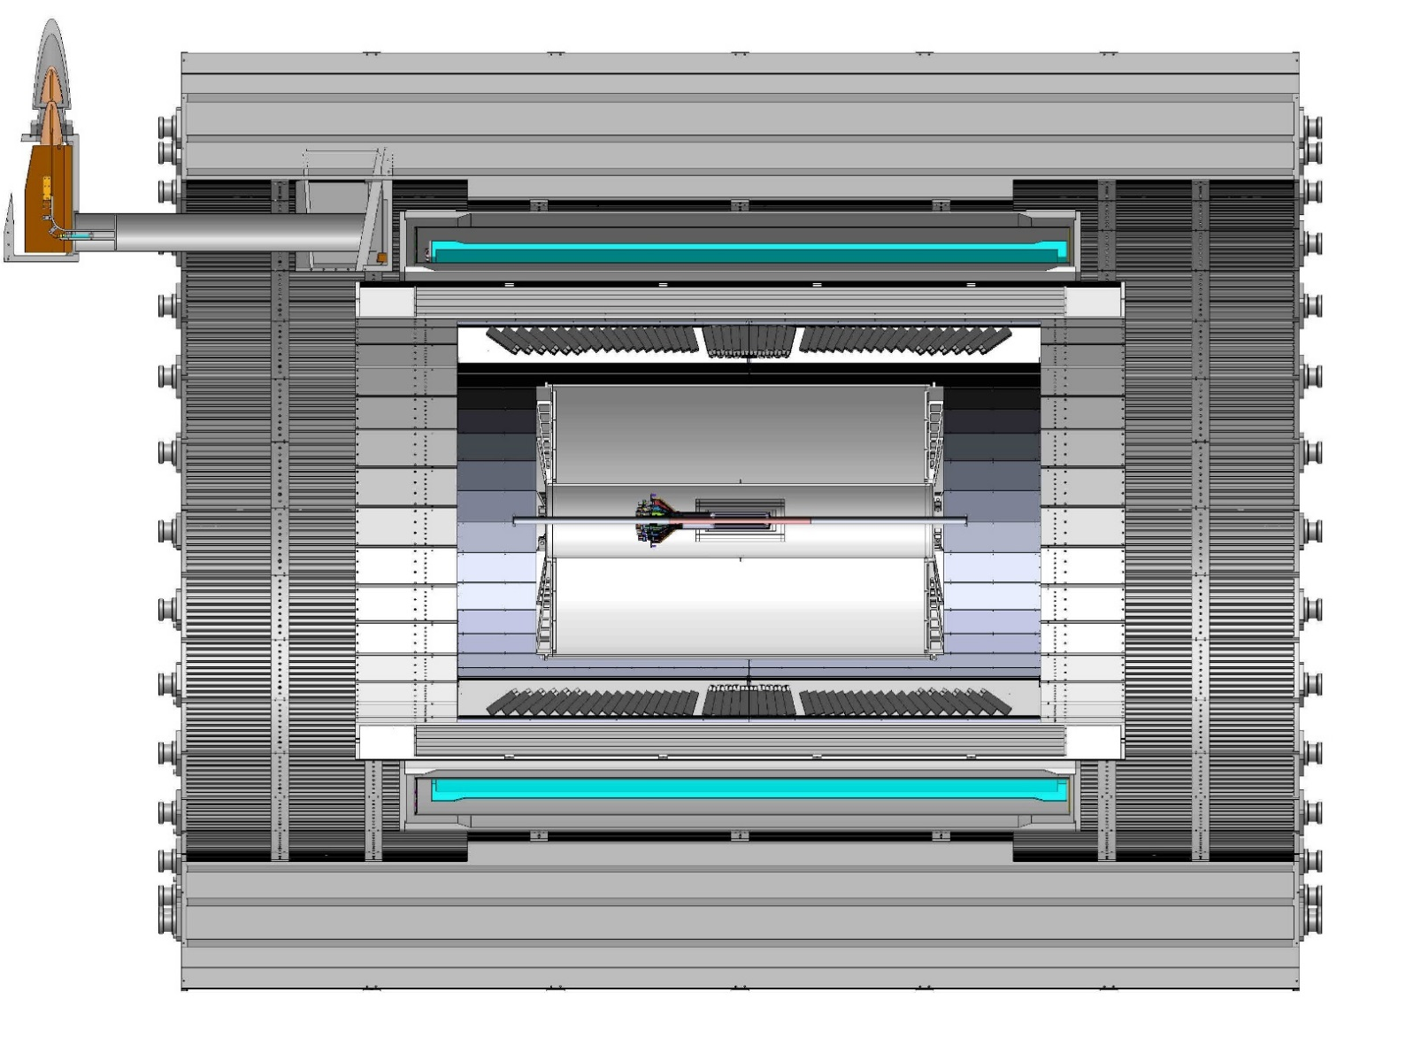
sPHENIX CAD model sectioned - view showing overall scale of sPHENIX detector; including all three tracking elements; MVTX, INTT and TPC
TPC
INTT
3,285.235 mm
NOTE; MVTX service cone and supports are not shown, MVTX offset in Z by 18cm

Slide 36
BNL control envelope drawing - needs update for TPC, INTT, MVTX, MB
Z location of the inner Hcal is at 2175,0mm
Z=2175mm

Slide 37
Aluminum Flex
Copper Flex
Bidge Flex

Slide 38
Aluminum Flex
Copper Flex

Slide 40
INTT-MVTX Space Conflict
INTT Acceptance
@ |z|=10
INTT 4-layers
|η|<0.95
|η|<1.09
|η|<1.28
|η|<1.12
Currently a clear conflict between the INTT and MVTX
  INTT only includes ladder, no connectors, cooling barbs, etc
R&D items:
Extend cables to move the conical structure further out in z-direction;
Design/optimize INTT layers to fit current MVTX geometry;
  FPC data cable can’t be easily extended (max additional ~10cm, machine limit)
  Reduce angle of cone – redesign C-structures and connectors

Slide 41
INTT + TPC

Slide 42
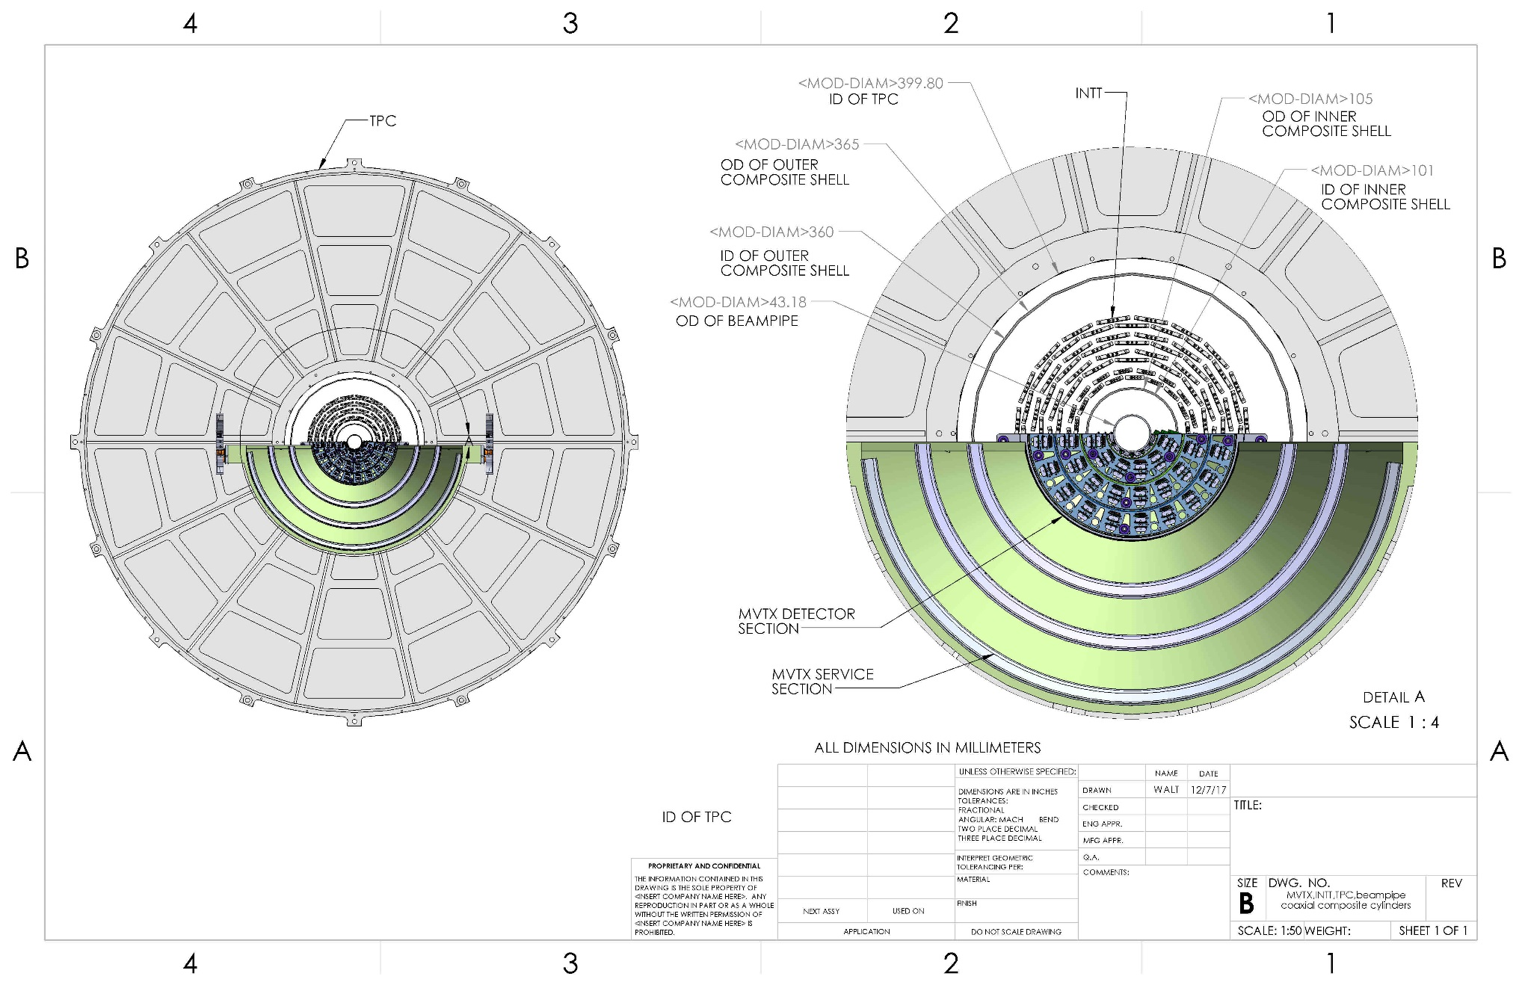
Cross-section view from CAD model of MVTX, INTT, TPC, beam-pipe, plus two composite conical shells:
MVTX radius are increased by 1.5mm to have a minimum 2mm gap between beam pipe and then inner MVTX structures

Slide 43
Gap between conical shell (CYSS) of MVTX and inner layer of INTT is 11.58 mm
Dist= R61.58 – R50
= 11.58mm

Slide 44
56.0 mm gap between INTT and inner radius of TPC
Gap= R200-R143.5
= 56mm

Slide 45
Offset from OD of beampipe and innermost component of the MVTX
New gap 2.025 mm

Slide 46
Offset needed to install split MVTX into run location around beampipe, passing over 2.75 in conflat flange
37.6mm

