Slide 1
MVTX/INTT R&D
Ming Liu
Los Alamos
Many inputs from Walt, Alex, Sho, Hubert,
Cesar, Xuan, Dan, Rachid, Itaru and the MVTX group

Slide 2
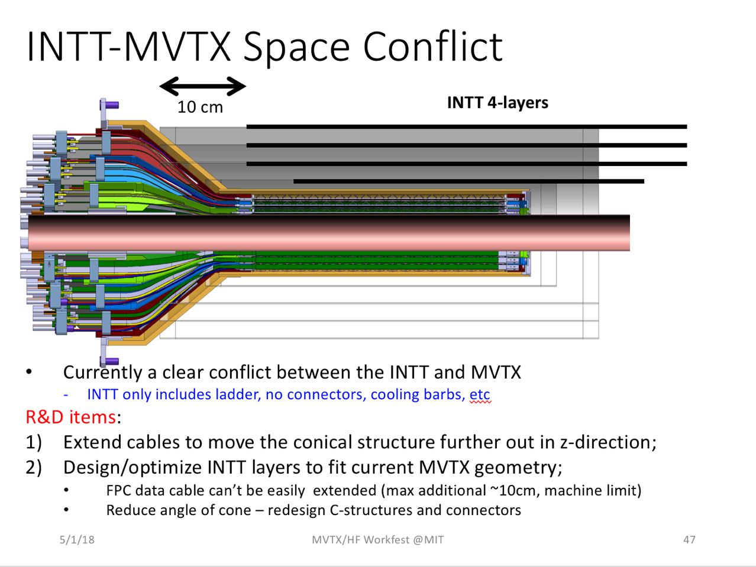
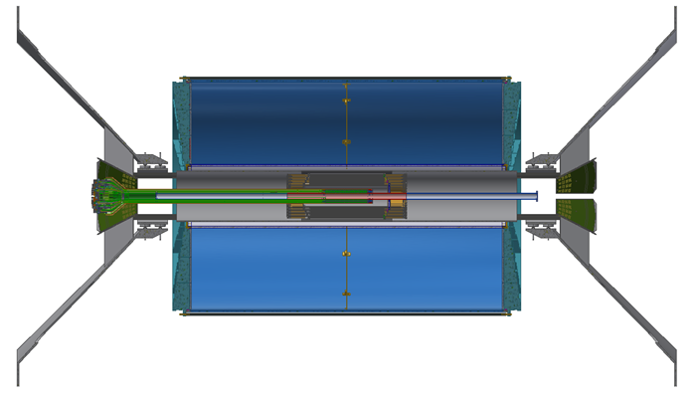
MVTX/INTT Integration Review: around the week of June 25
w/ ~50cm FPC power extension
  @LANL, voltage drop, noise pickup
  MVTX conical structure modification, reduced radius
w/ 10cm extension FPC – Plan A
  INTT layout, “cables” and supporting structures
  Final extension bus ~1.2m, INTT, summer 18
  MVTX conical structure modification
  10cm HS signal simulation now ..
  Early R&D possible? right now, ~Sept 2018 @CERN
  Mechanical mockup: MVTX+INTT + .. , @BNL, LANL
w/o FPC extension – Plan B
  Revisit INTT layout, cables and supporting structures
  Final 1.2m bus, summer 18
  MVTX conical structure modification
INTT/MVTX simulations
  New INTT postdoc, INTT optimization, including supporting structure
Resources
  MIT engineers Jim/Jason ?
  Walt, Dan, Mike L, Hubert, Chris …, new $$ from non-MIE BNL project? New engineers?

Slide 3
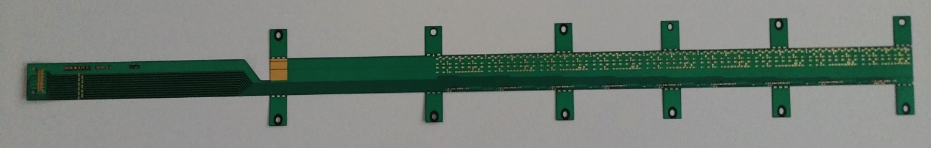
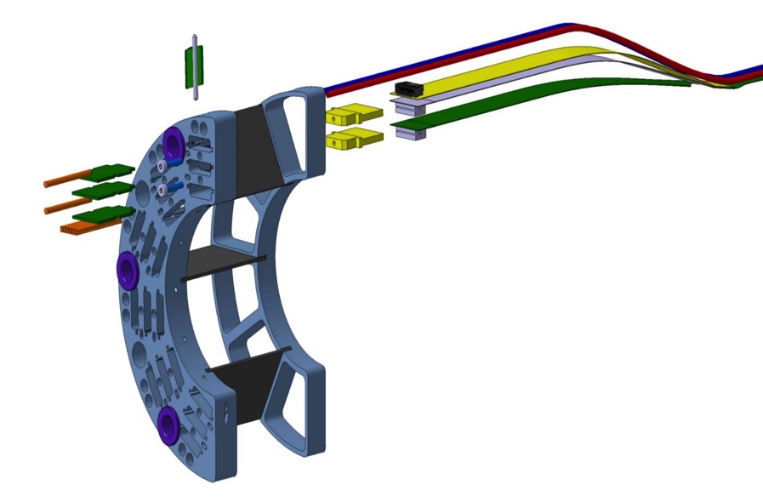
MVTX Flexible Printed Circuit (FPC)
Extend MVTX Service Cables?
Maximum +10cm for HS signal, TBD through R&D
Extend FPC/signal path by ~10cm
506.2 mm
Extend by ~10cm
41.9 mm
16 mm
16.15 mm
Signal connection
Power connection
signal
Also Impacting
SamTec
Cable length:
5~7m
Power cable
Extension ~50cm

Slide 4
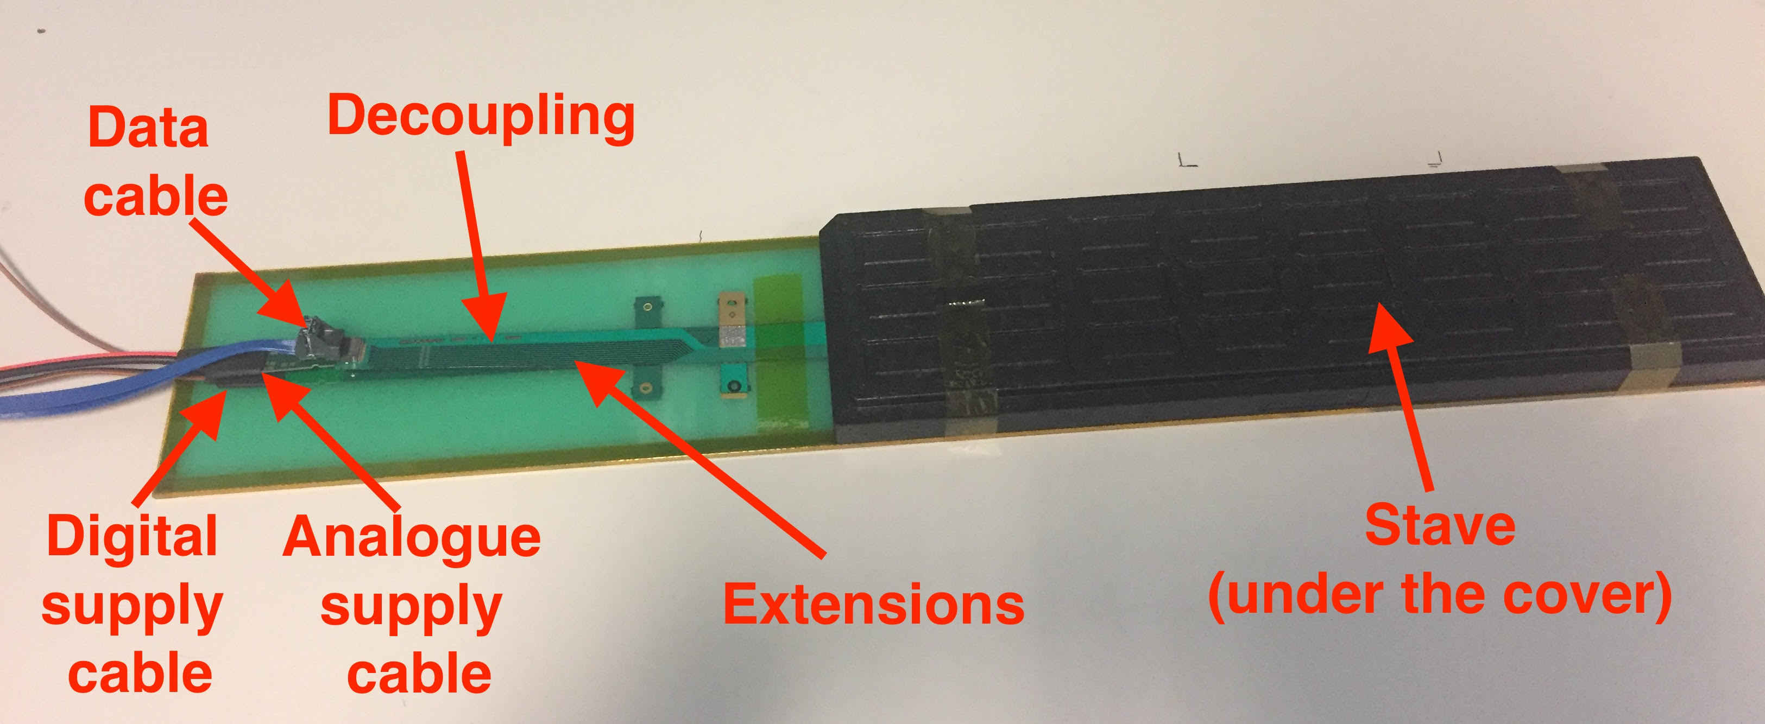
ALICE ITS/IB HIC: Signal, AVDD and DVDD

Slide 5
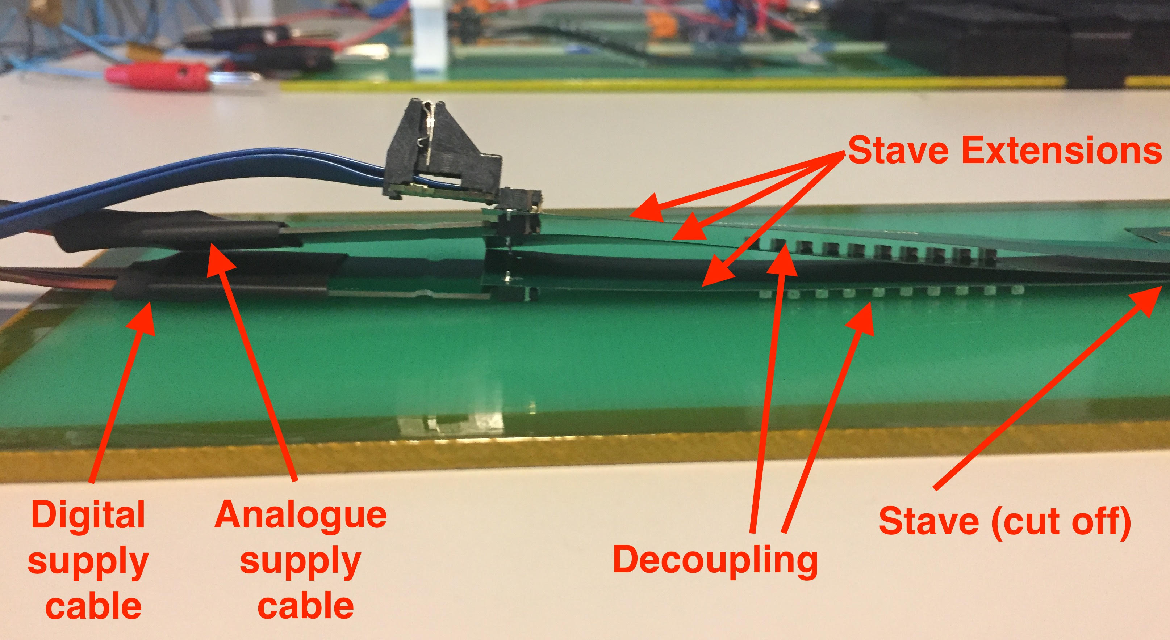
ALICE ITS/IB HIC: Signal, AVDD and DVDD

Slide 6
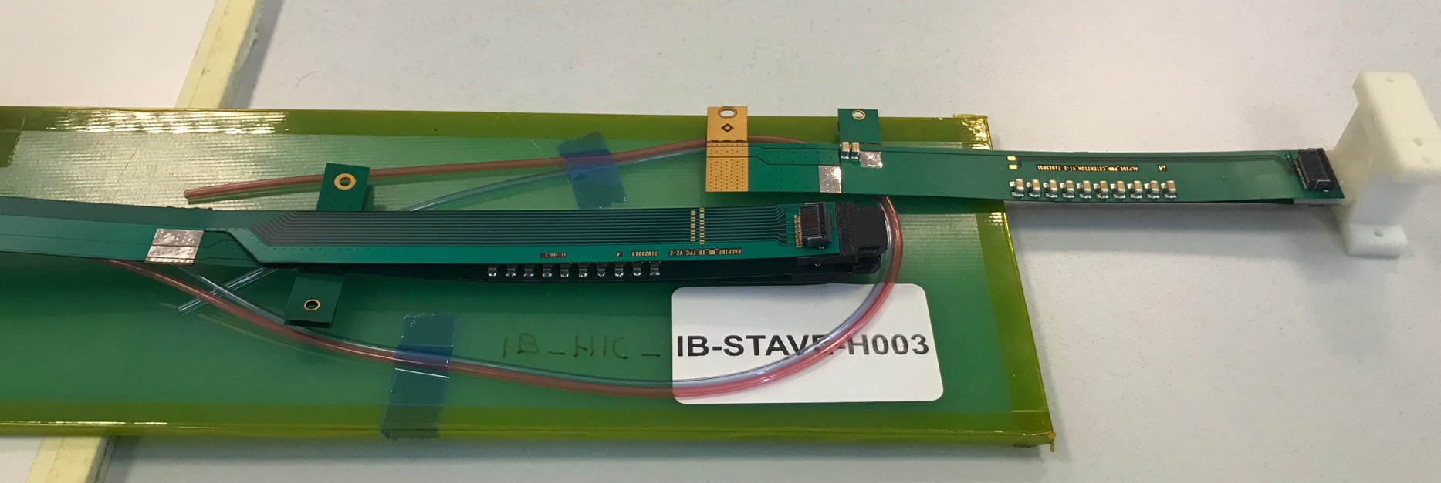
FPC R&D @CERN and LANL
Analogy and Digital Power
Extension
High-speed signal, 1.2Gbps
Try to extend high-speed portion of FPC by 10cm @CERN, ~September 18
2) Try to extend AV and DV by ~50cm at LANL, ~summer 18

Slide 7
ITS/IB FPC, 50cm long;
CERN can make FPC up to 60cm long, but needs to be confirmed
Caps, resistors, connectors, etc

Slide 8
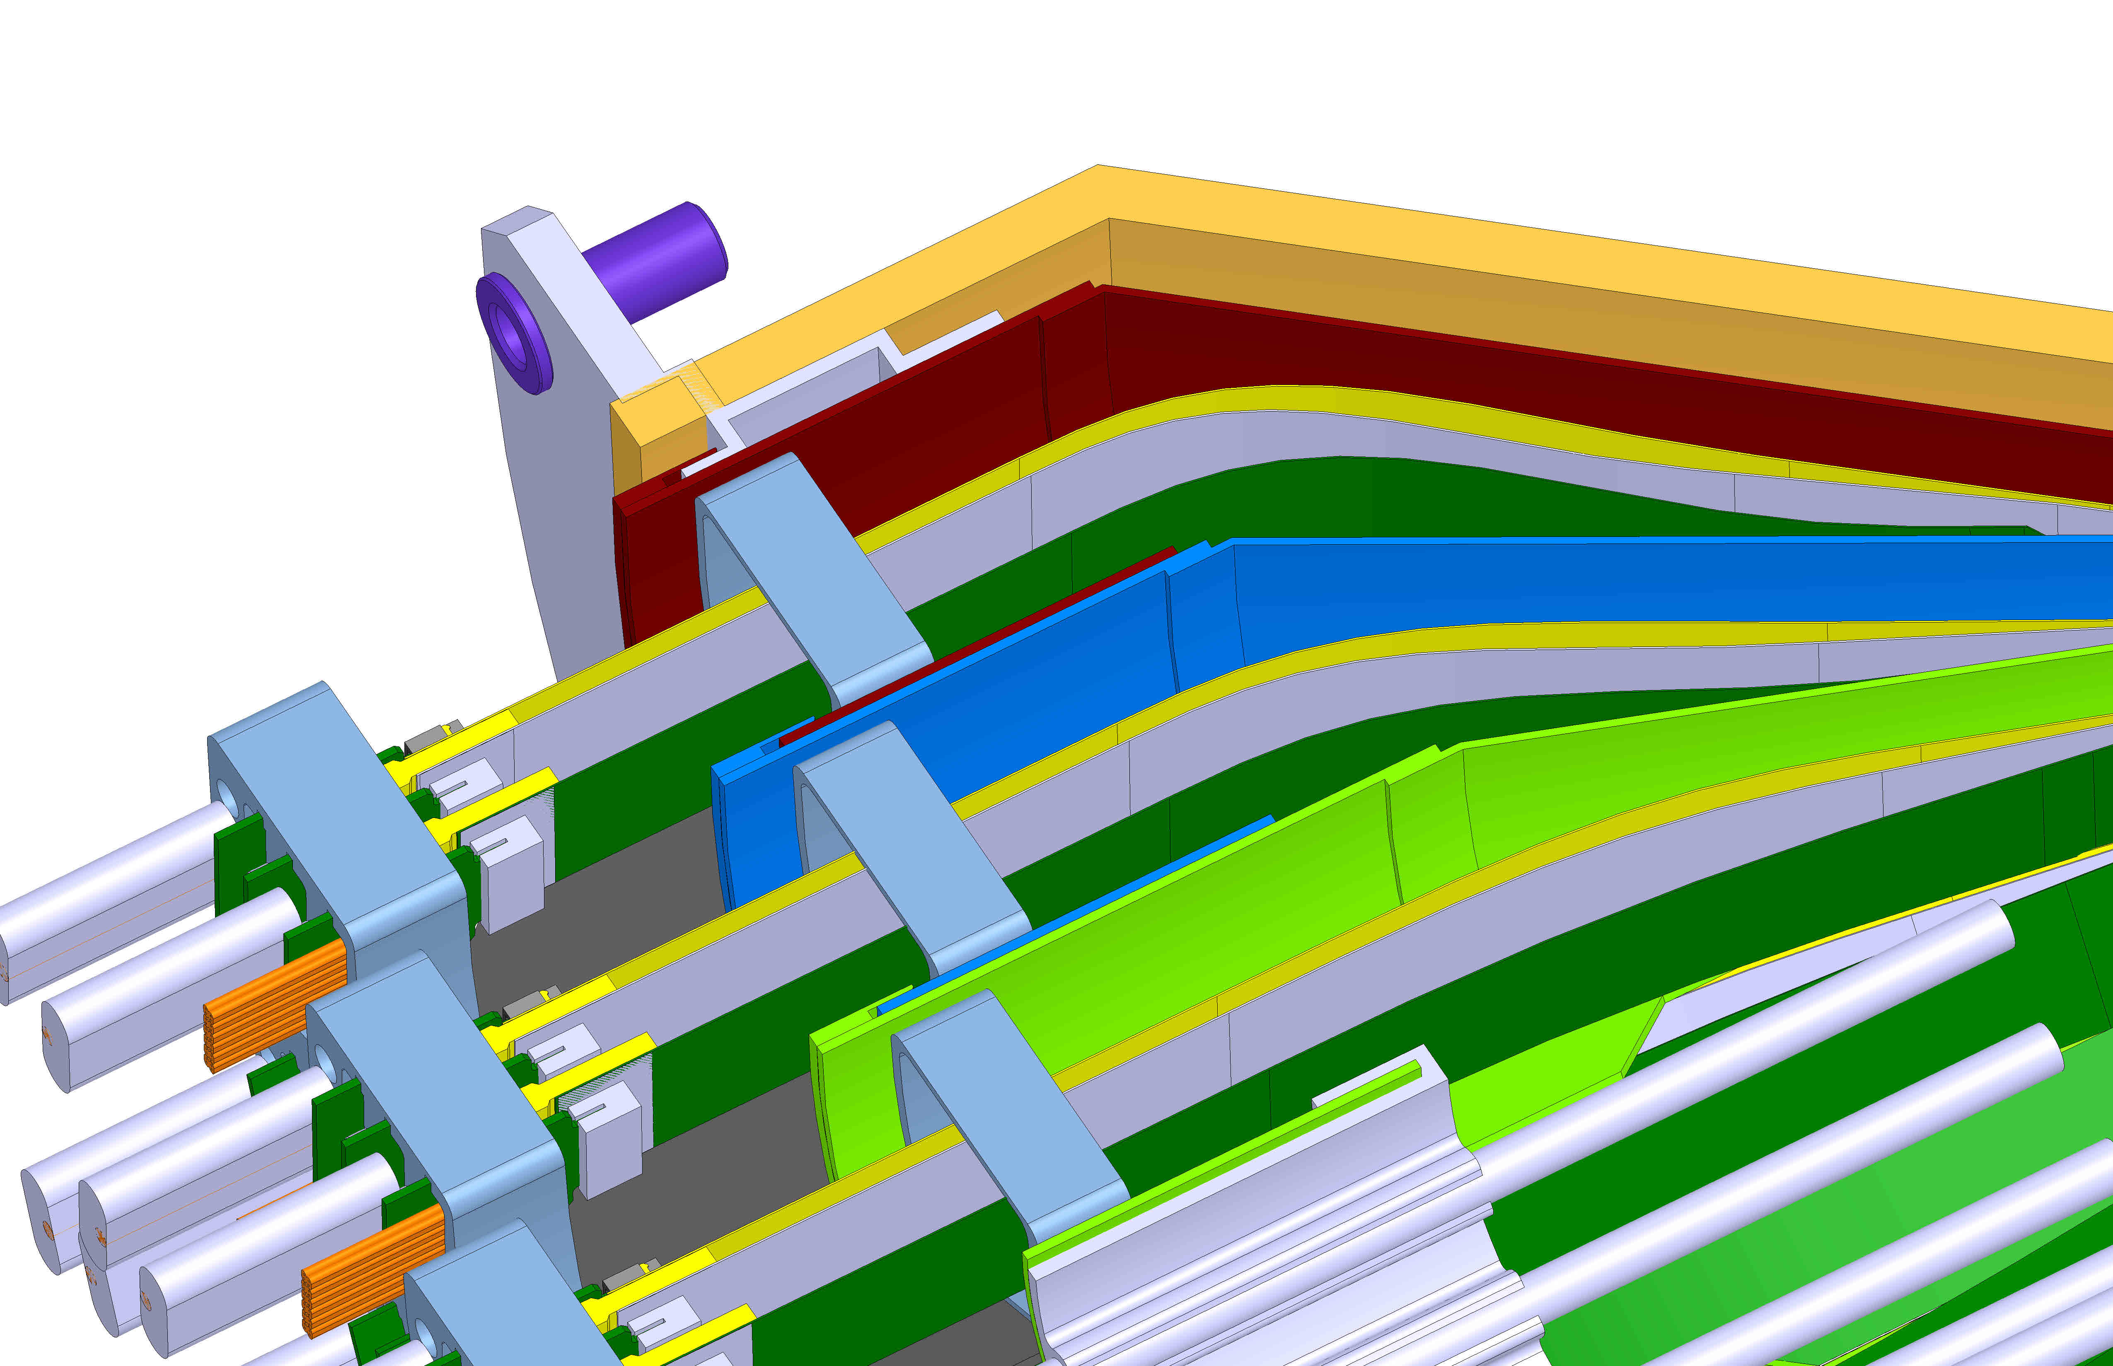
Requires New Design

Slide 9
End View of ALICE Patch Panel

Slide 10
Near Term Action Items: after Day-1 discussion
FPC simulation, with 10cm extension on signal
  May – June,18
Mechanical design of conical sector for:
  Default 50cm FPC
  Extended 60cm FPC
  With extended ~50cm PWR extension
  Build 3-D print mockup, with INTT configuration
Produce ~50cm PWR extension to study voltage drop and also possible noise pickup

Slide 11
Full MVTX+INTT system test beam at Fermilab in ~Feb 2019
MVTX will carry out full system beam test with final staves, in ~Feb 2019.
INTT will carry our full system (Sensors+HDI + ~1m-long Extension-Bus + ROC) in ~Feb 2019
A full mockup of MVTX + INTT system could be tested at Fermilab Test Beam facility

Slide 12
Cost reduction and in-kind contributions
Carbon structures
  In-kind, CYSS & End-Wheels
  Alternative fabrication sites:
    France – ALICE cost ?
    Italy – ALICE cost?
    Korea – also quote for end-wheels, and make ”real mockup”?
    China ? – possibility of CYSS etc.
Integration and interface structures
  BNL sPHENIX/MIE provide the interface?
  RIKEN contribution?
Stave and RU testing at CERN?
  In-kind, students/postdocs at LHC

Slide 13
Forward MAPS detector for sPHENIX/EIC
Develop a forward 3~4 planes MAPS detectors for both EIC and f/sPHENIX forward tracking
  2 x 6staves/plane + 2 x 2 RUs for readout
  MFT-like disk array inside the INTT supporting tube
MAPS-disks

Slide 15
Day-1 discussion

Slide 16
MVTX Detectors
Mechanical system integration
Electrical system integration

Slide 17
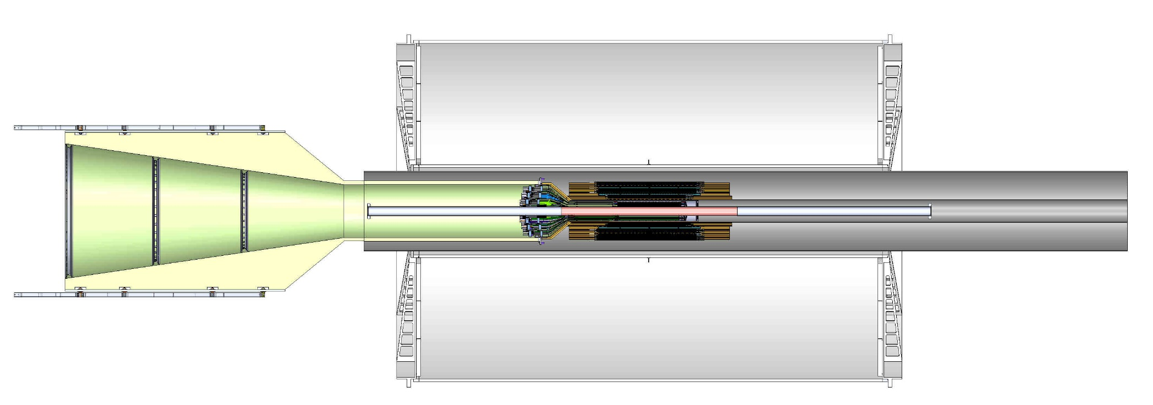
To Do List – Mechanical Integration
FPC extension
  Signal path, +10cm
  Power extension, ~50cm
SamTec cable length vs signal quality
  5~7m
  RU location, MVTX electrical system integration
Carbon structure and connector design
  FPC HS signal connectors
  FPC power extension connectors
  MVT Service barrel and mechanical system integration
  Installation procedure

Slide 18
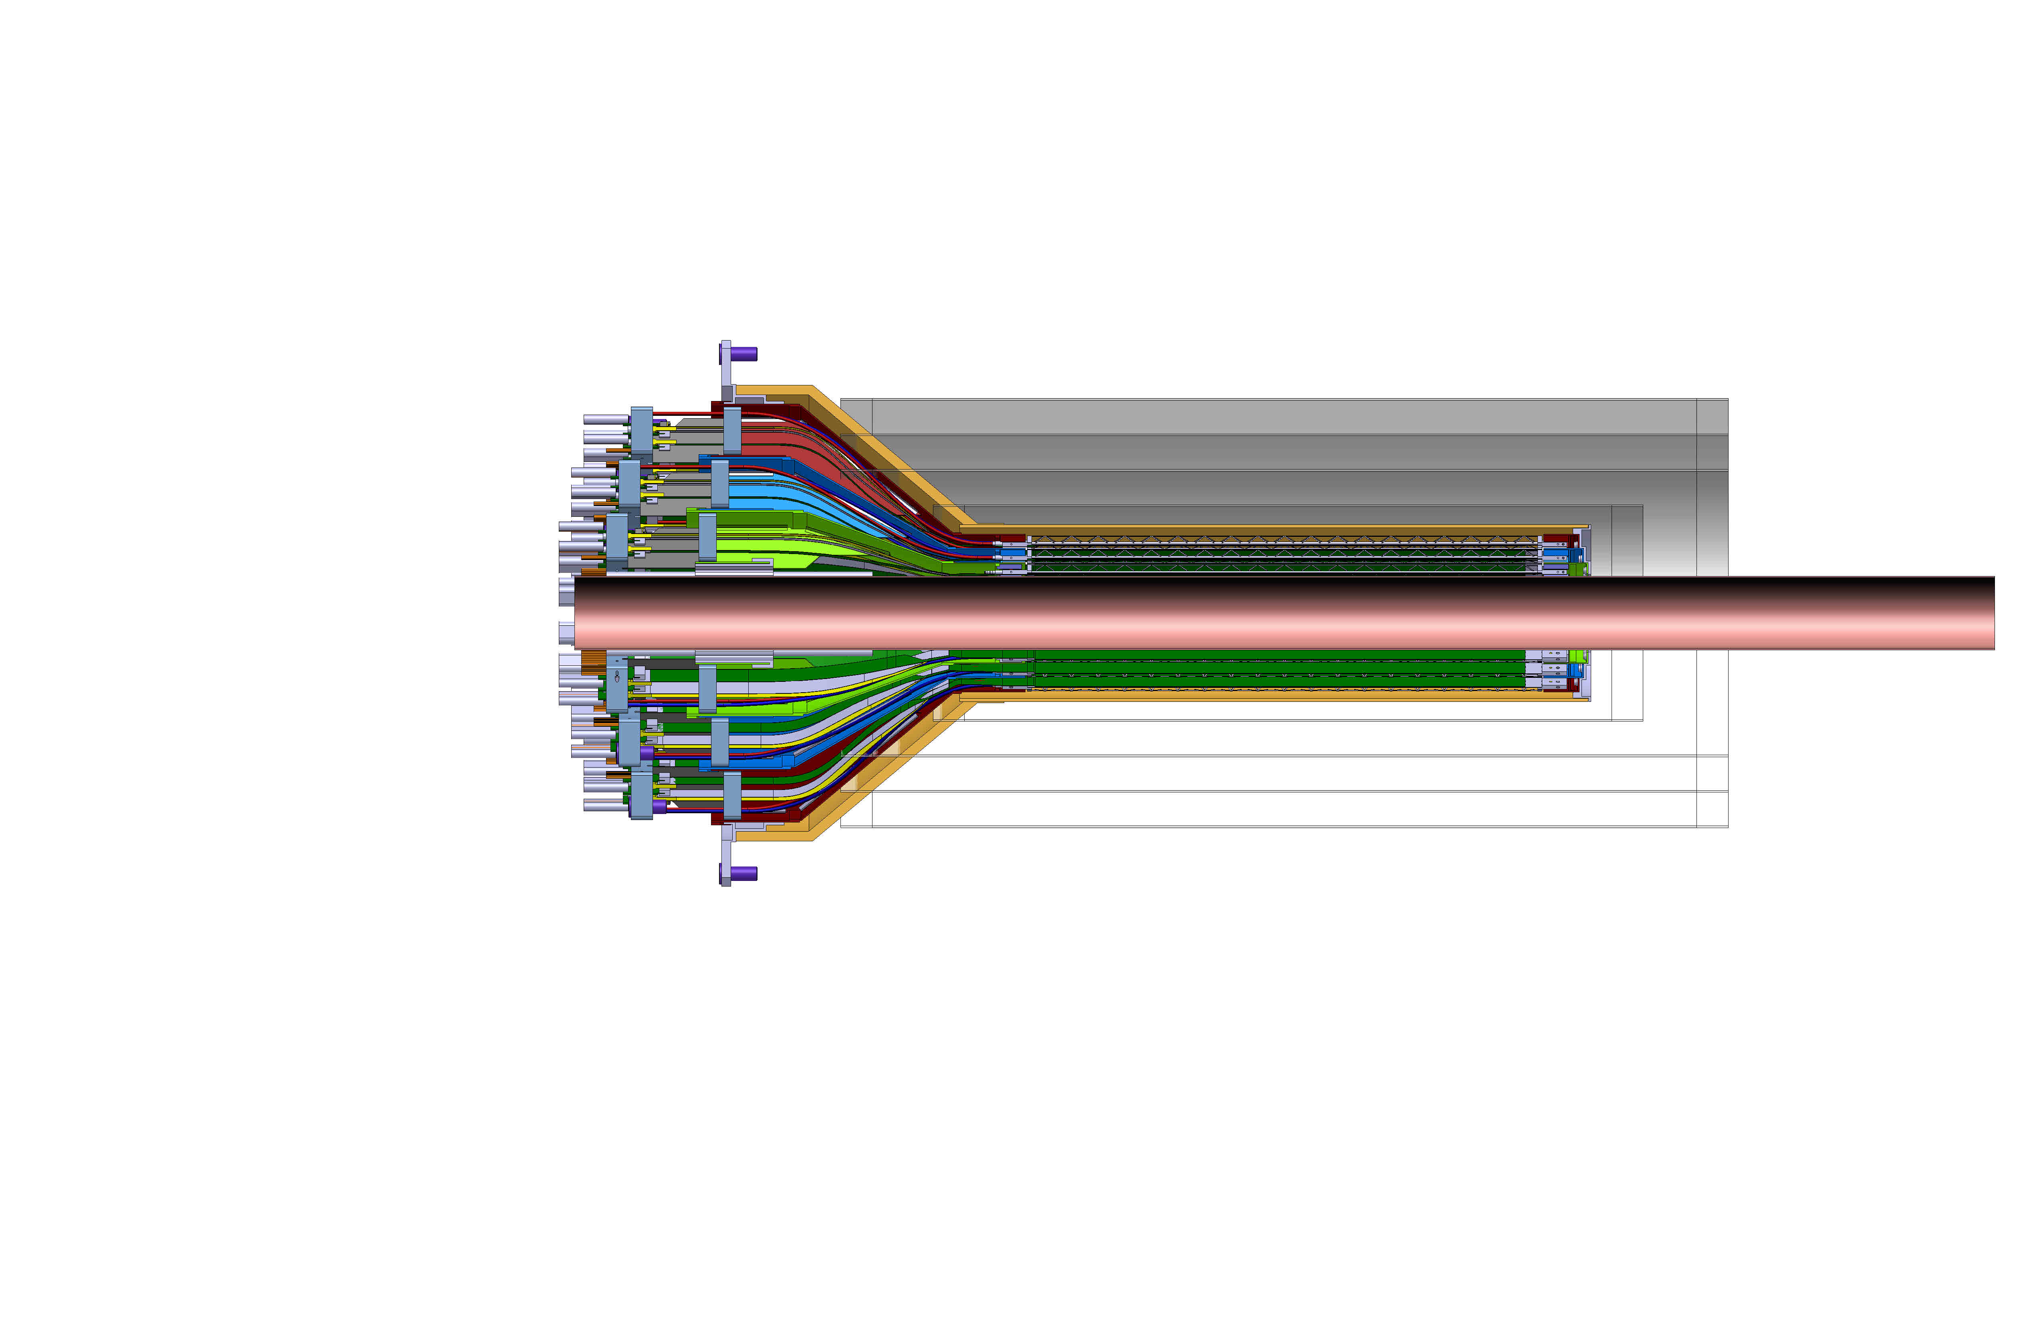
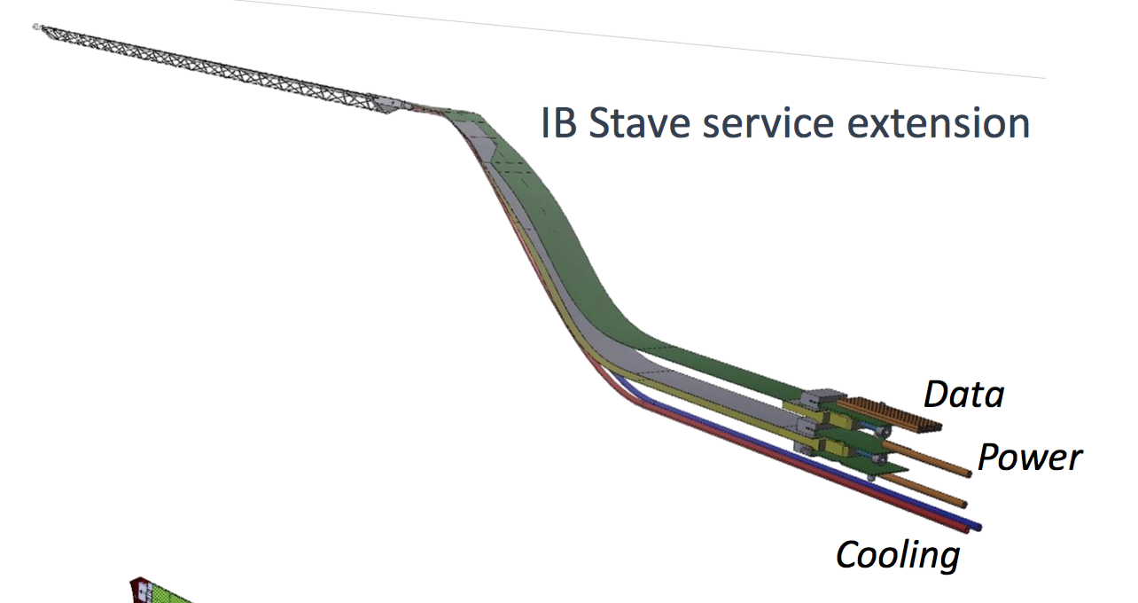
INTT-MVTX Conflict
INTT 4-layers
Extend cables to move the conical structure further out in z-direction
FPC data cable is the HDI and can’t be easily extended, CERN will produce a prototype FPC (add ~10cm) for testing, ~Sept. 2018
Make long power extension, ~50cm,
Reduce angle of cone to free up space for INTT services (how much is needed?)
Redesign patch panel/cable connection shape and location

Slide 19
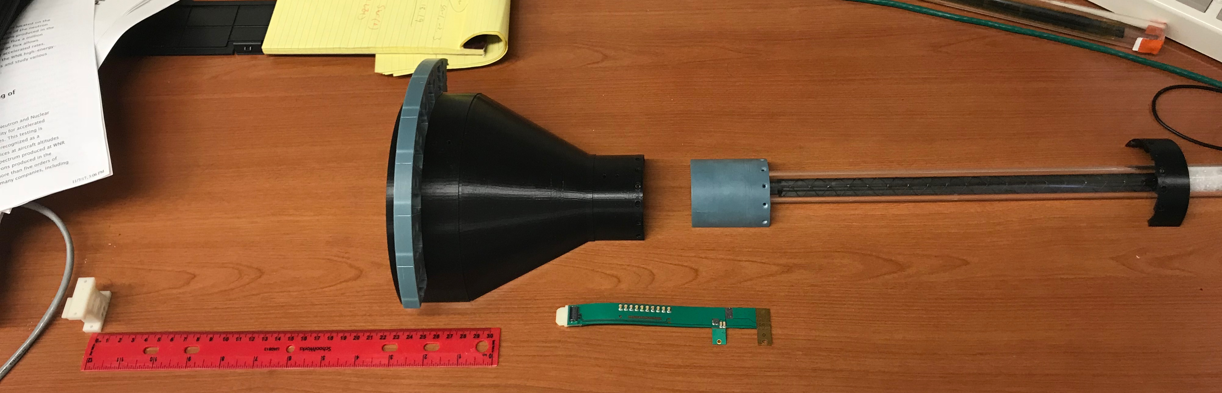
MVTX Mockup & FPC Extension R&D
PWR extension
L=15cm
Extend FPC/data
cable by ~10cm?, R&D
Extended power cables AVDD/DVDD:
L = ~50cm, and possibly with 2~3 different lengths, like 30cm and 40cm
Separate PWR and signal connections at different Z-locations.

Slide 20
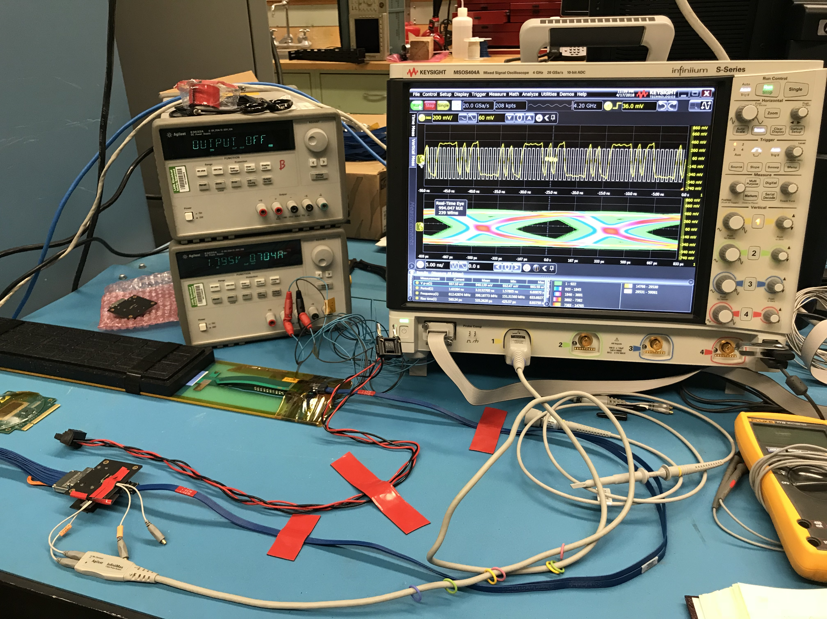
SamTec Cable and FPC Extension R&D

Slide 21

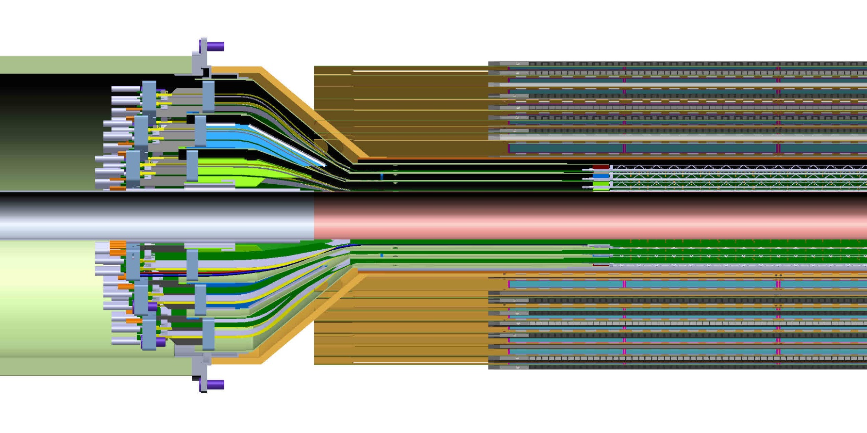
MVTX and INTT Integration
It is clear from this detail view the conical region of the MVTX detector barrel with the INTT that the MVTX will need to translate in Z…, but there is a limitation;
Optimize INTT design to fit within the limitation

Slide 22
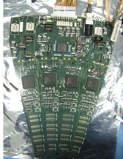
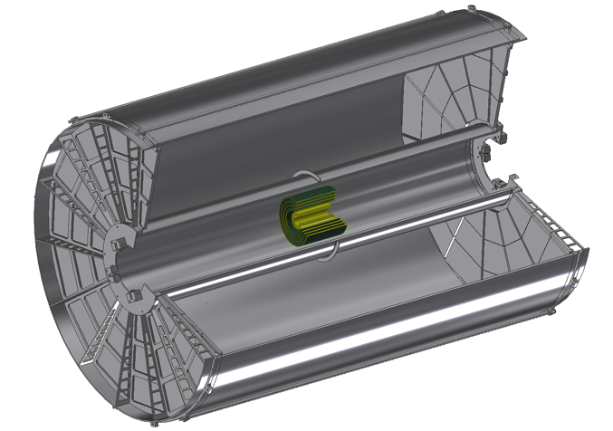
INTT Readouts from both North and South
ROC boards mount off inner EMCAL
Identical to FVTX Big Wheel
35cm
Bus Extender
ROC
Boards
Bus Extender
105 cm
η=1
ROC
Boards
η=0
The bus extender needs to run to ROC boards (reuse FVTX ROC) outside TPC.
Minimum length is 105cm – ladder length + distance to ROC board.

Slide 23
INTT supported off Inner HCal from Dan Cacace/BNL
Very hard/Impossible for MVTX to have such a long extension

Slide 24
Mechanical Integration
- Model of MVTX with INTT inside TPC with the addition of two concentric composite cylinders;
- INTT would like to use the outer shell of the MVTX as the inner shell of the INTT half detectors as a part of their cooling gas containment volume.
Location of conflat flange on beam-pipe
- MVTX Electronics Racks;
- PS racks
Location in Z where the inner-hcal ends (see control drawing) Z=2175.0 mm

Slide 25
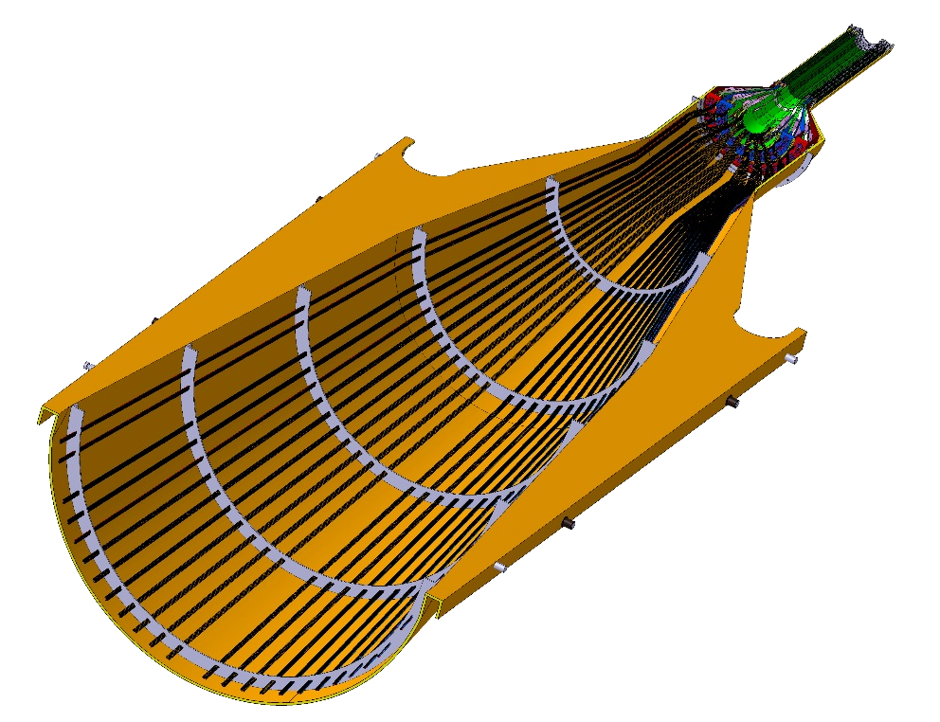
Service Barrel: Design and Fabrication, modify ALICE design
MVTX will have a similar but much smaller service barrel
Need:
Support structure and
installation procedure
DETECTOR SECTION
SERVICES, SUPPORT
SECTION
ALICE HALF-BARREL ASSY

Slide 26
To Do List – Readout and Controls
Update firmware, sync with latest ALICE firmware
  Scrubbing etc.
  Burn-in test, stability
Detector Control System (DCS) integration
  Power distribution and monitoring
  LV, “HV” and temperature
Sensor operation optimization
  Scan parameters for optimal operation
  Laser test bench setup at LANL
Multi-stave readout
  Up to 3 staves per RU
  Default: 1 stave per RU

Slide 27
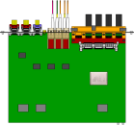

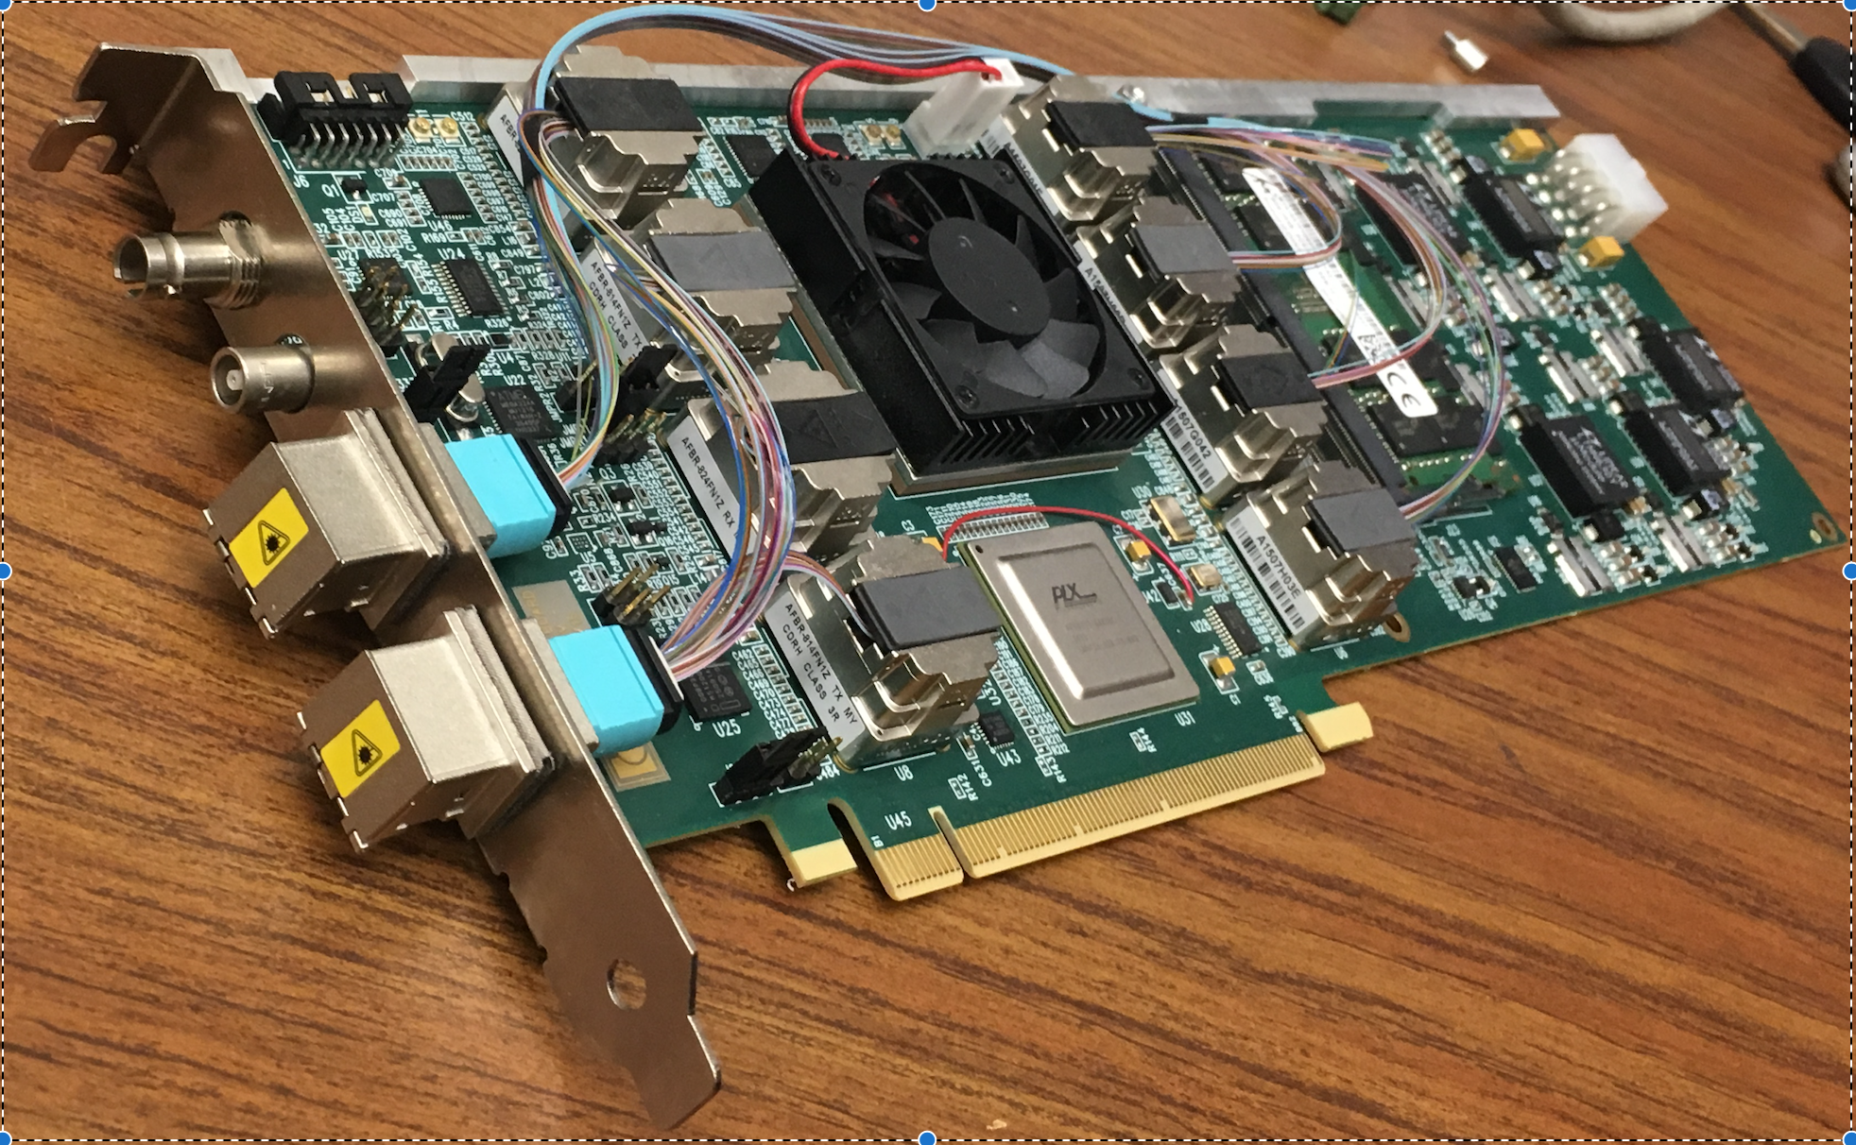
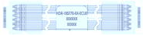
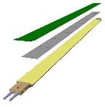

MVTX Electronics, Power and Controls
CAN bus
DCS
5-10 m
Trigger & Clock
Readout Unit
Front End
GBT Optical Links
9-sensor Stave
9 Data (1.2Gbps)
1 Clock, 1 Control/Trigger
Control
Data (9.6 Gb/s max)
Trigger
Samtec Twinax “FireFly”
FELIX
Back End
FPC
Power
Alpide Sensors
Power
Filtering Capacitors
regulators
Power supplies
Cold Plate
Regulated Power
Power Board
Interaction Region
Experimental Hall
Counting House
MVTX Detector Electronics consists of three parts
Sensor-Stave (9 ALPIDE chips) | Front End-Readout Unit | Back End-FELIX

Slide 28
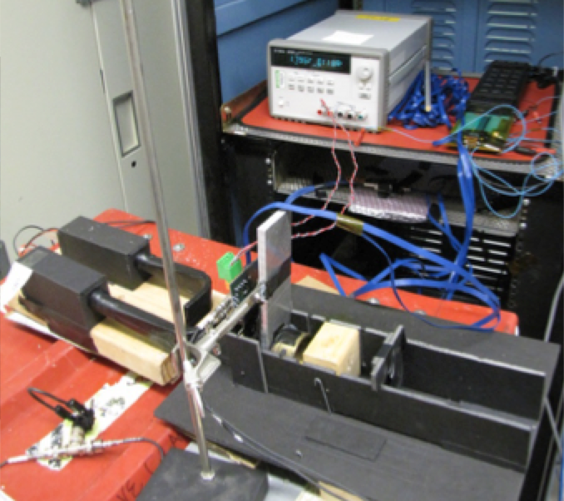
Sensor and Electronics R&D @LANL
ALPIDE evaluation and optimization
  MOSAIC + Single Chip/Stave
  Cosmic and source
  Laser system
Power unit tested
  PU + MOSAIC
  PU + RU
Full readout chain demonstrated
  ALPIDE + RUv1.0 + FELIX v1.5 + RCDAQ
  Full stave + RUv1.x + FELIX v2.0 + RCDAQ
Mechanical system integration
  Conceptual design developed
  MVTX+INTT integration
  FPX & SamTec cables
  RU location etc
MVTX
ALPIDE chip
Scintillator
Collimator
Sr⁹⁰ source

Slide 29
Parallel Effort at UT-Austin
– Shared R&D

Slide 30
Summary: Major Remaining R&D
Mechanical/Electrical integration with INTT+TPC
  Carbon structure design
  FPC extension
  Support structure and installation procedure
Full electrical system control
  Power
  Safety and interlock
  Online monitoring & controls
Integrate readout system firmware/software with slow controls
  Multi-stave readout with single RU
Detector & Physics simulations

Slide 31
backups

Slide 32
More slides

Slide 33
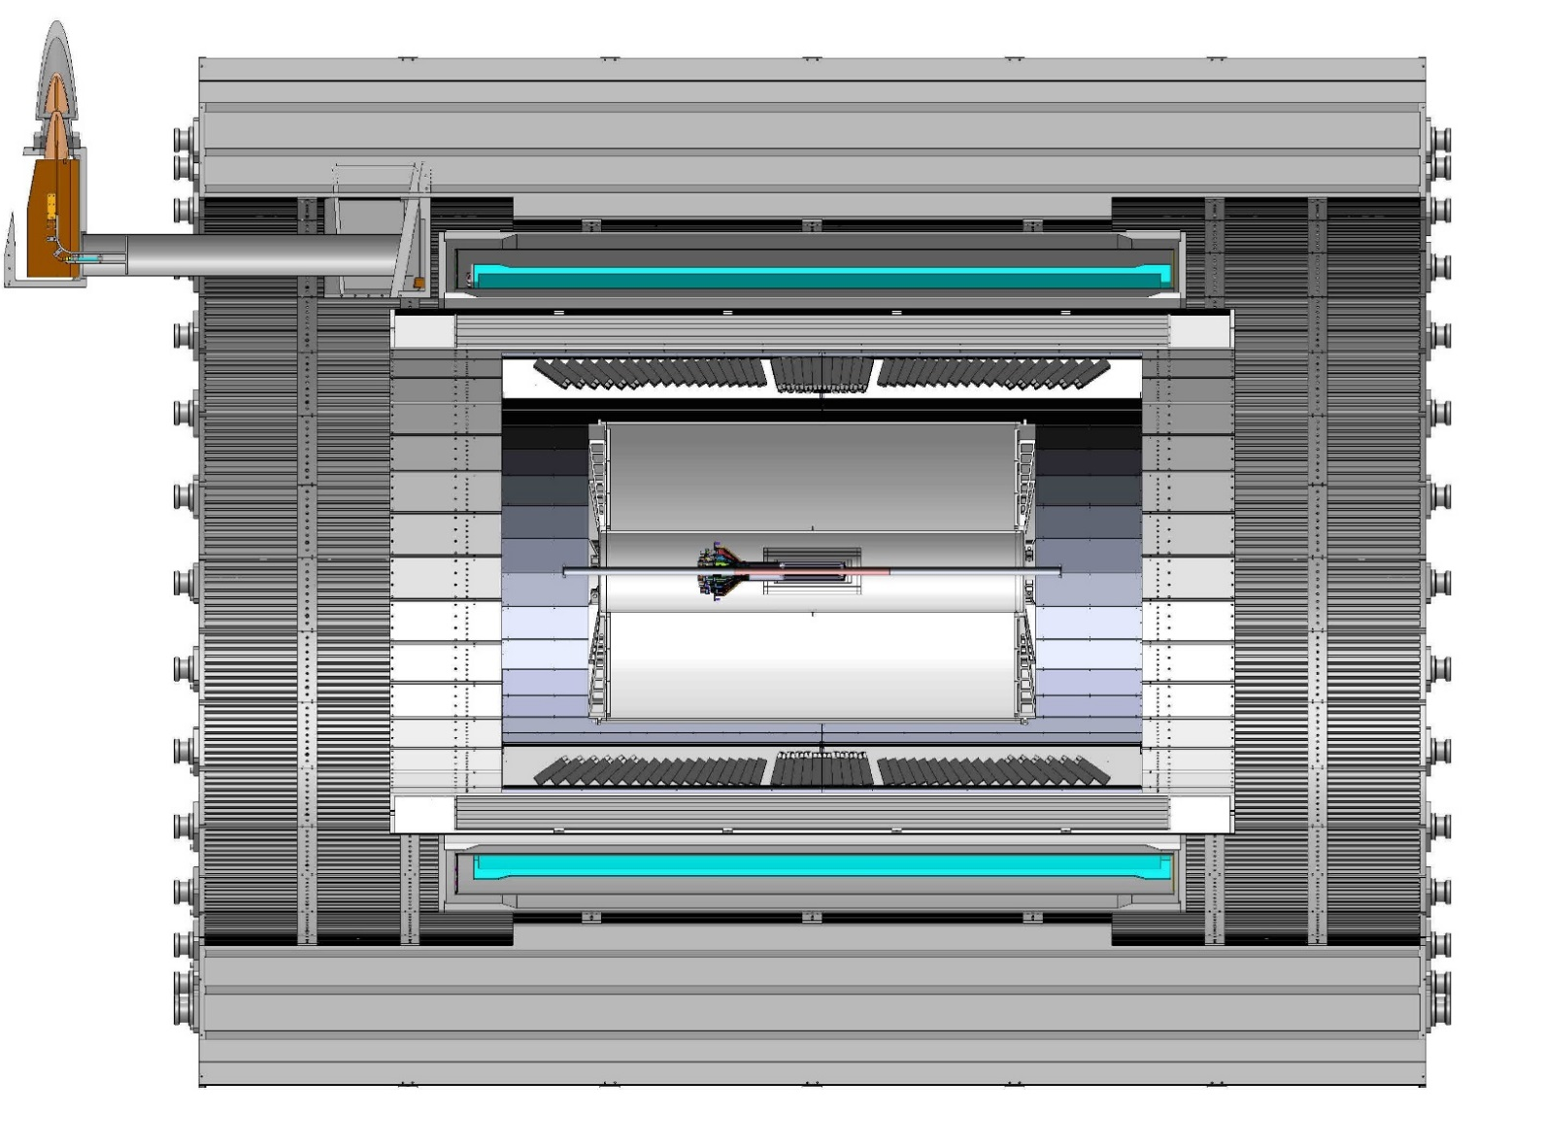
sPHENIX CAD model sectioned - view showing overall scale of sPHENIX detector; including all three tracking elements; MVTX, INTT and TPC
TPC
INTT
3,285.235 mm
NOTE; MVTX service cone and supports are not shown, MVTX offset in Z by 18cm

Slide 34
BNL control envelope drawing - needs update for TPC, INTT, MVTX, MB
Z location of the inner Hcal is at 2175,0mm
Z=2175mm

Slide 35
Aluminum Flex
Copper Flex
Bidge Flex

Slide 36
Aluminum Flex
Copper Flex

Slide 37
INTT-MVTX Space Conflict
INTT Acceptance
@ |z|=10
INTT 4-layers
|η|<0.95
|η|<1.09
|η|<1.28
|η|<1.12
Currently a clear conflict between the INTT and MVTX
  INTT only includes ladder, no connectors, cooling barbs, etc
R&D items:
Extend cables to move the conical structure further out in z-direction;
Design/optimize INTT layers to fit current MVTX geometry;
  FPC data cable can’t be easily extended (max additional ~10cm, machine limit)
  Reduce angle of cone – redesign C-structures and connectors

Slide 38
INTT + TPC

Slide 39
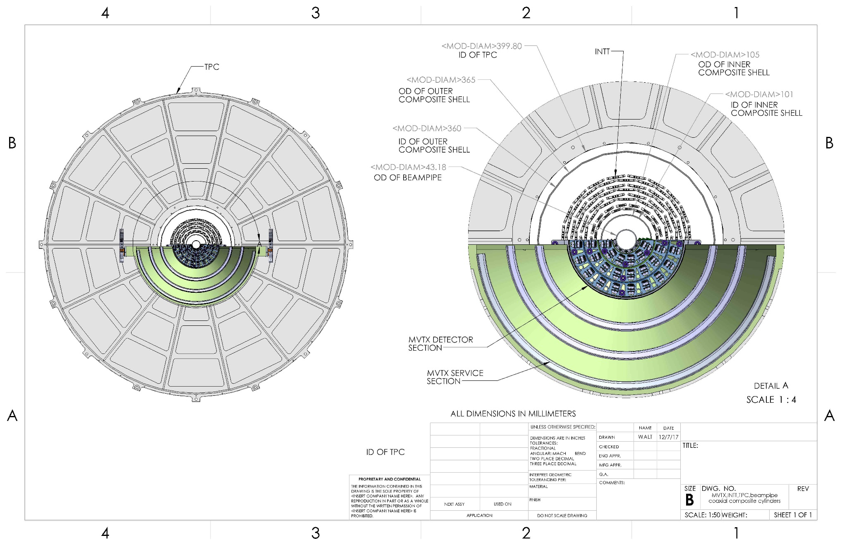
Cross-section view from CAD model of MVTX, INTT, TPC, beam-pipe, plus two composite conical shells:
MVTX radius are increased by 1.5mm to have a minimum 2mm gap between beam pipe and then inner MVTX structures

Slide 40
Gap between conical shell (CYSS) of MVTX and inner layer of INTT is 11.58 mm
Dist= R61.58 – R50
= 11.58mm

Slide 41
56.0 mm gap between INTT and inner radius of TPC
Gap= R200-R143.5
= 56mm

Slide 42
Offset from OD of beampipe and innermost component of the MVTX
New gap 2.025 mm

Slide 43
Offset needed to install split MVTX into run location around beampipe, passing over 2.75 in conflat flange
37.6mm

