Slide 1
MVTX Update
Ming Liu
LANL
09/27/2018

Slide 2
Summary of Recent Progress and Activities
Completed sensor/HIC/stave evaluations at CERN
  Built and tested two HICs with 40cm and 60cm long power FPC
    Confirmed sensor performance same as the ALICE default configuration
  Sensors irradiated up to 2.7MRad, no problem (updated 9/18/2018).
  Addressed all recommendations on stave/sensor R&D from recent BNL review
Technical specs document in preparation for production
  RUs, production starts soon as part of ALICE production
  Staves, sPHENIX production starts ~ January 2019, expect to last 6-12 months
  Document under discussion with CERN now, to be finalized in this week
MVTX/INTT integration
  Mechanical design being updated and mockup in progress, Walt and Ross
  Inner tracking task force, good progress, Christopher et al.
  SamTec cables
    ALICE confirmed signal performance with 8m long readout cables

Slide 3
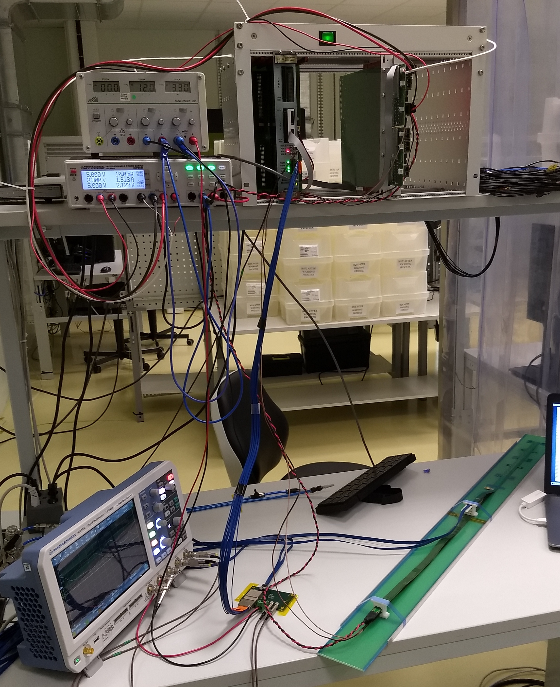
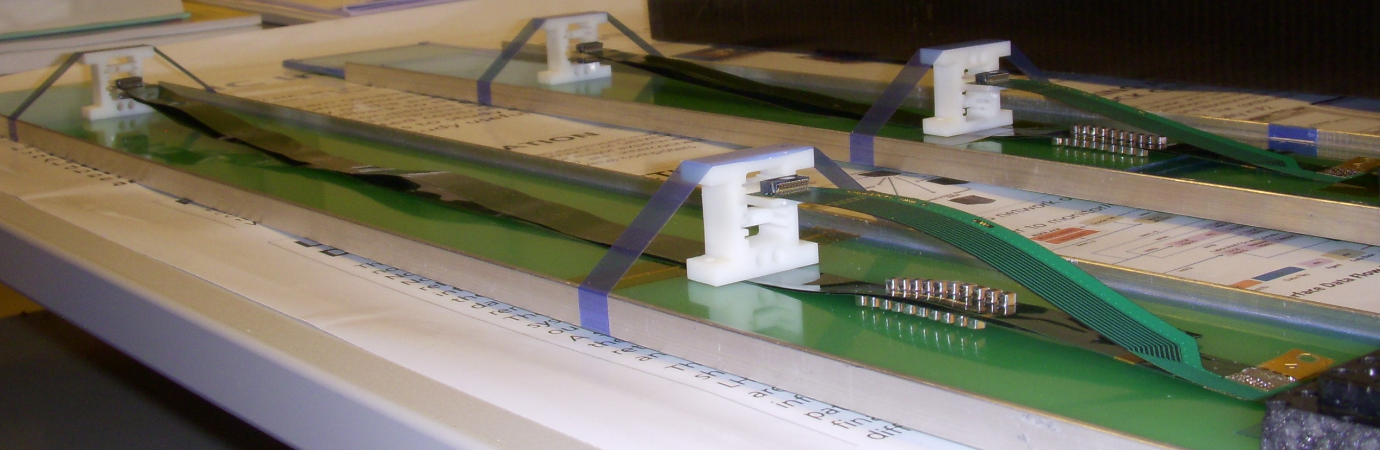
Test Stave/HIC with extended power FPC
Built and tested two HICS at CERN in the week of 9/17
  No change in sensor performance (noise, threshold) observed, as expected;
More details presented by Sho at last Friday’s sPHENIX general meeting 9/23/2018
40cm PWR FPC
60cm PWR FPC
ALICE: 15cm PWR FPC
Followed identical
ALICE IB QA test procedure,
with a 8m SamTec cable

Slide 4
HICs Test Results from CERN
After: same ALICE HICs, replaced power FPCs
Before: 2 ALICE IB HICs
HIC1
HIC2
Noise level: ~4 e’s; Threshold: ~180e’s; MIP: ~1000 e’s
Chip-0
Chip-8

Slide 5
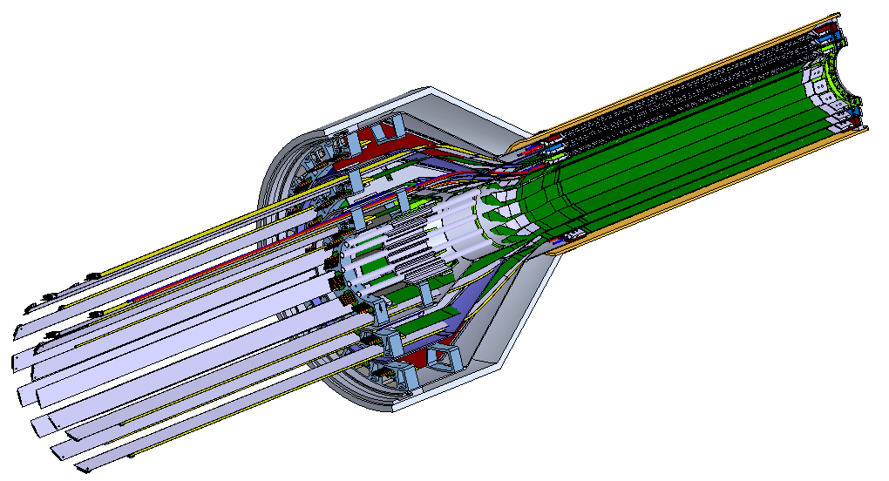
Updated MVTX earlier model, interferences fixed with in shell structures:
This model shown with 35 and 40mm flat extension cables
From Walt,
A mockup being produced at MIT, Ross

Slide 6
SamTec Cables Finalized for ALICE ITS: ~8m!
Two cables per IB stave: 2.65m + 5.30m
HDR-203194 (Type B)
HDR-206142 (Type A)
RUs
PP2
Staves
L: 5300 mm
L: 2650 mm

Slide 7
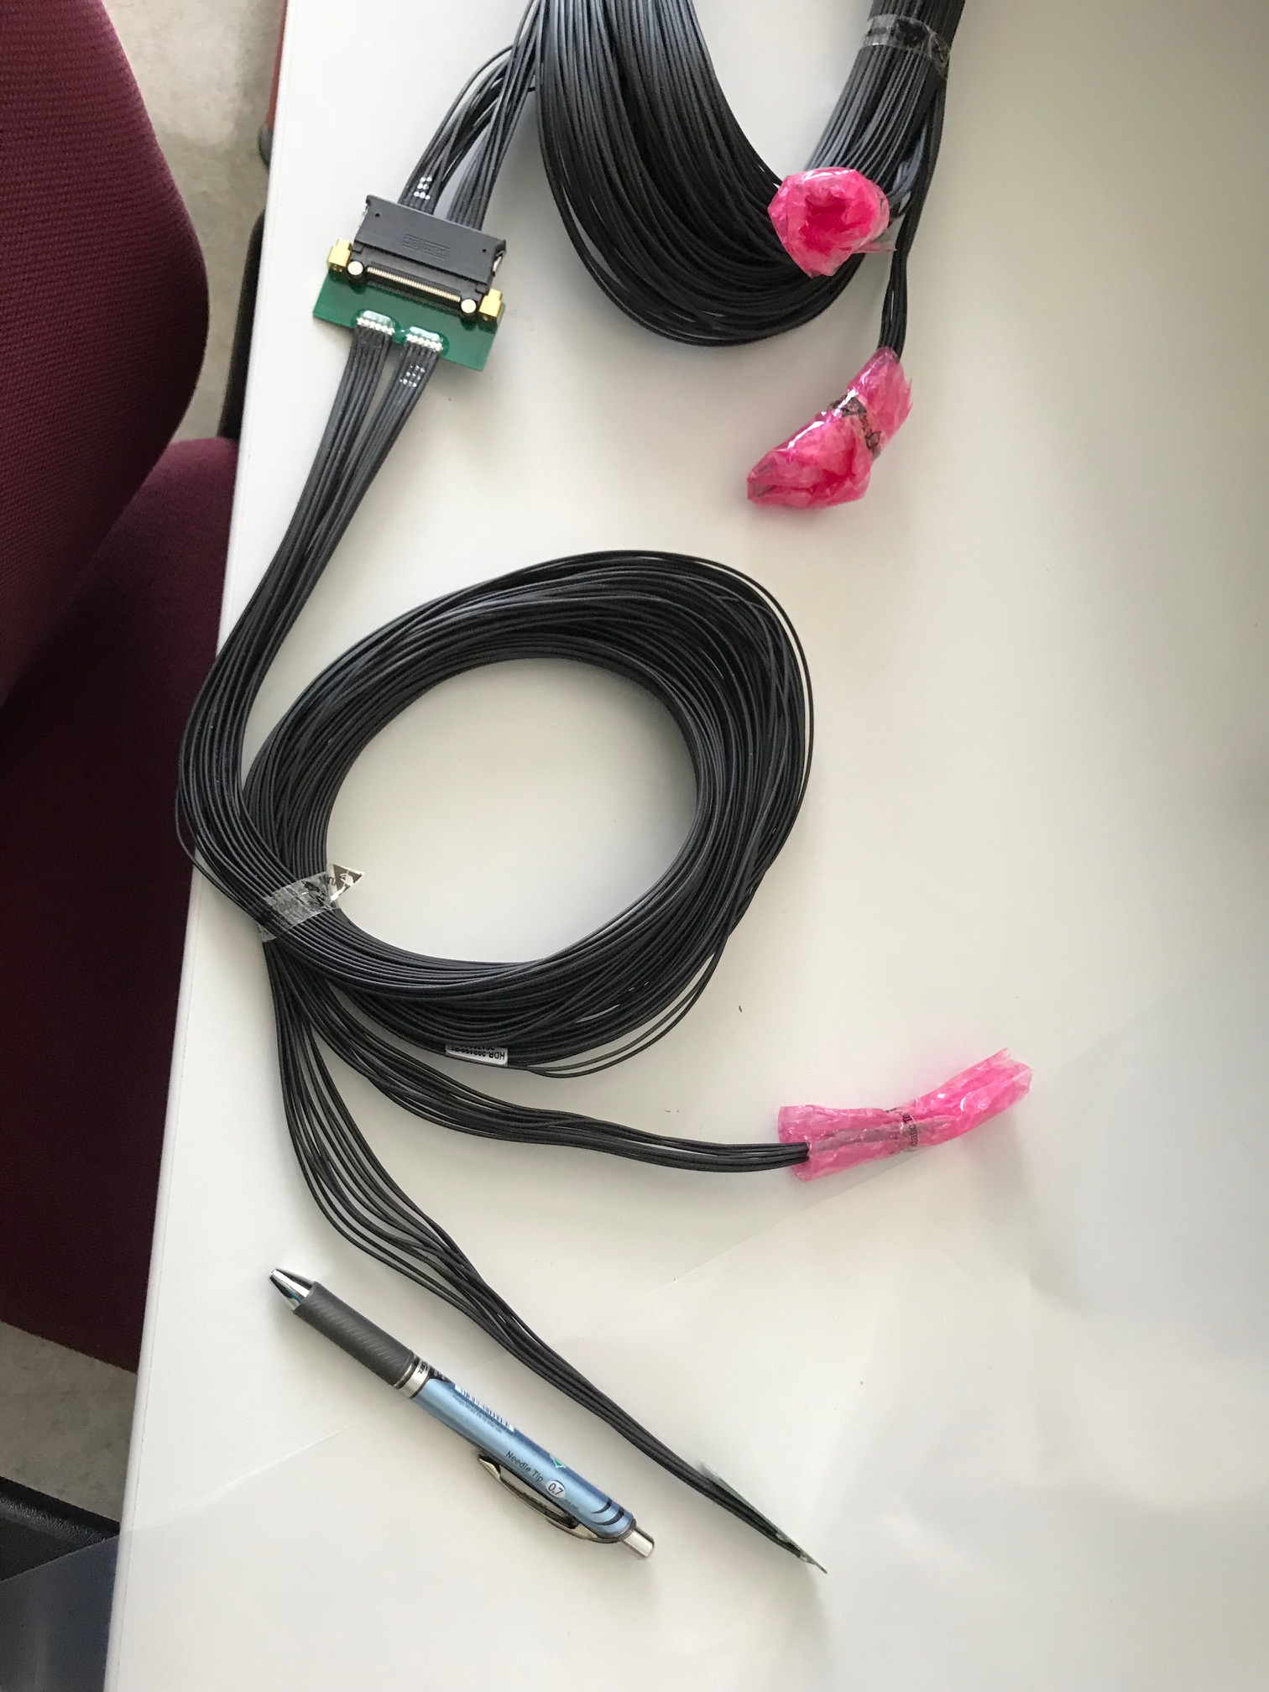
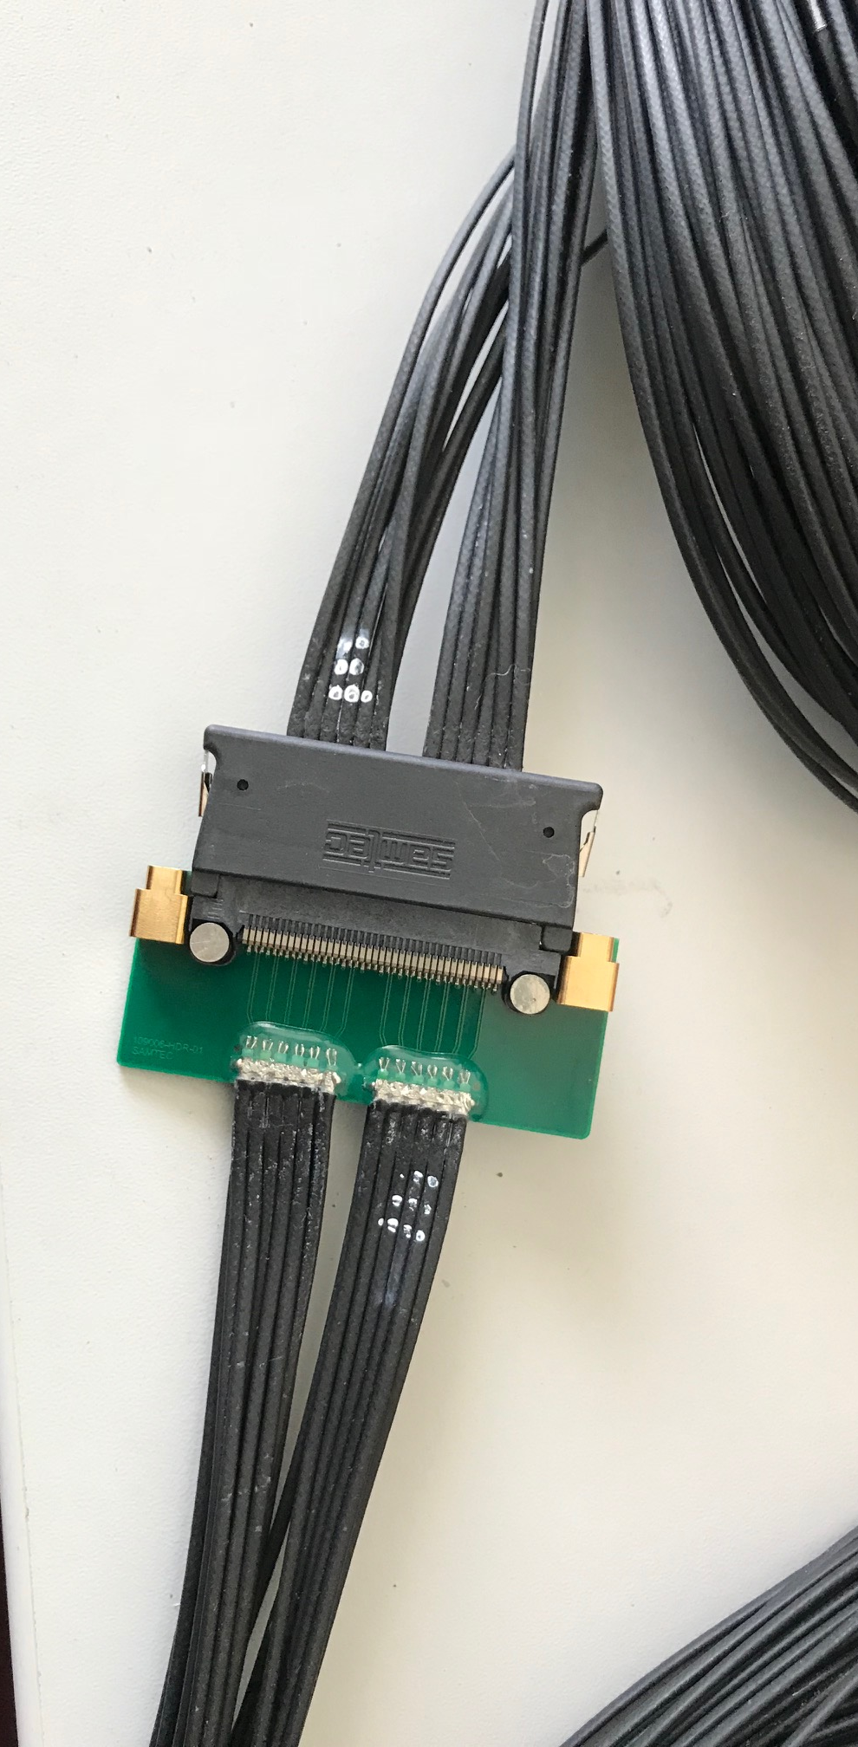
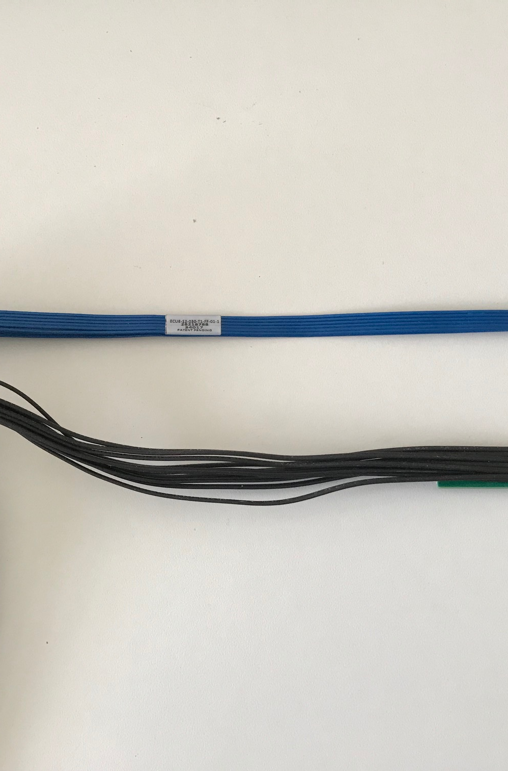
Type-A
Type-B
Type-A

Slide 8
Sensor Irradiation Test – OK at 2.7MRad
Continuous effort by ALICE (@NPI, Czech)
BNL review recommendation: test sensor up to 1MRad
https://indico.cern.ch/event/758048/

Slide 9
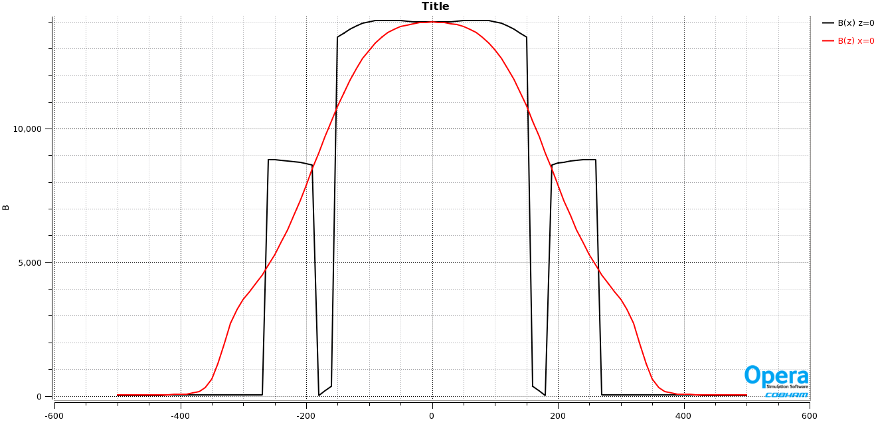
Expected B-field in the Rack Area (RU, PU Electronics)
Low fringe field, < 50Gauss outside of HCal
ALICE RU and PU designed to operate in 0.5T field
Simulation:
Steel 1020
Thanks John H.
for the plot
Rack. B < 50G

Slide 10
Backup

Slide 11
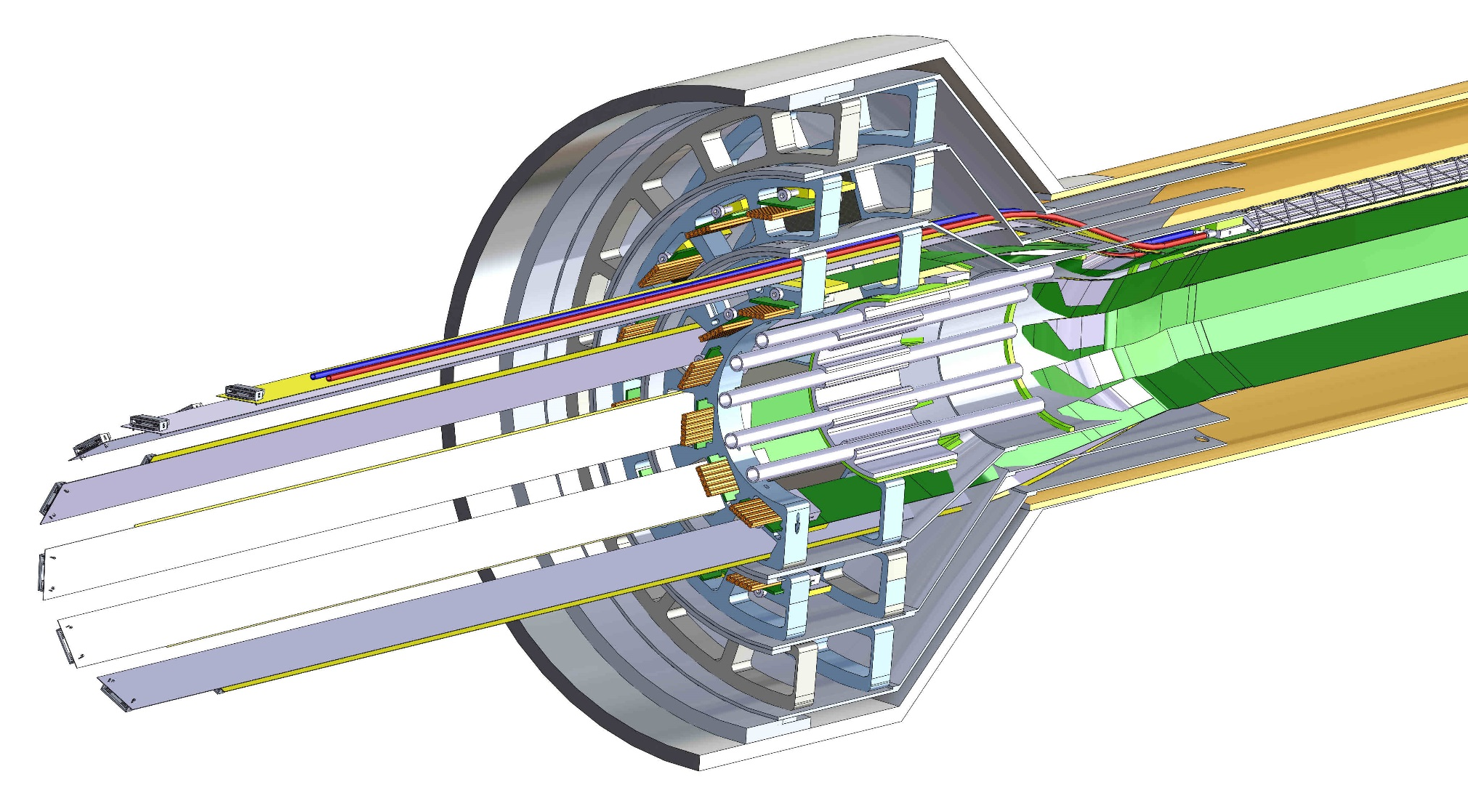
Later CAD model patch panels;
Patch-panels; middle and outer layer do not have interconnection for analog cables

Slide 12
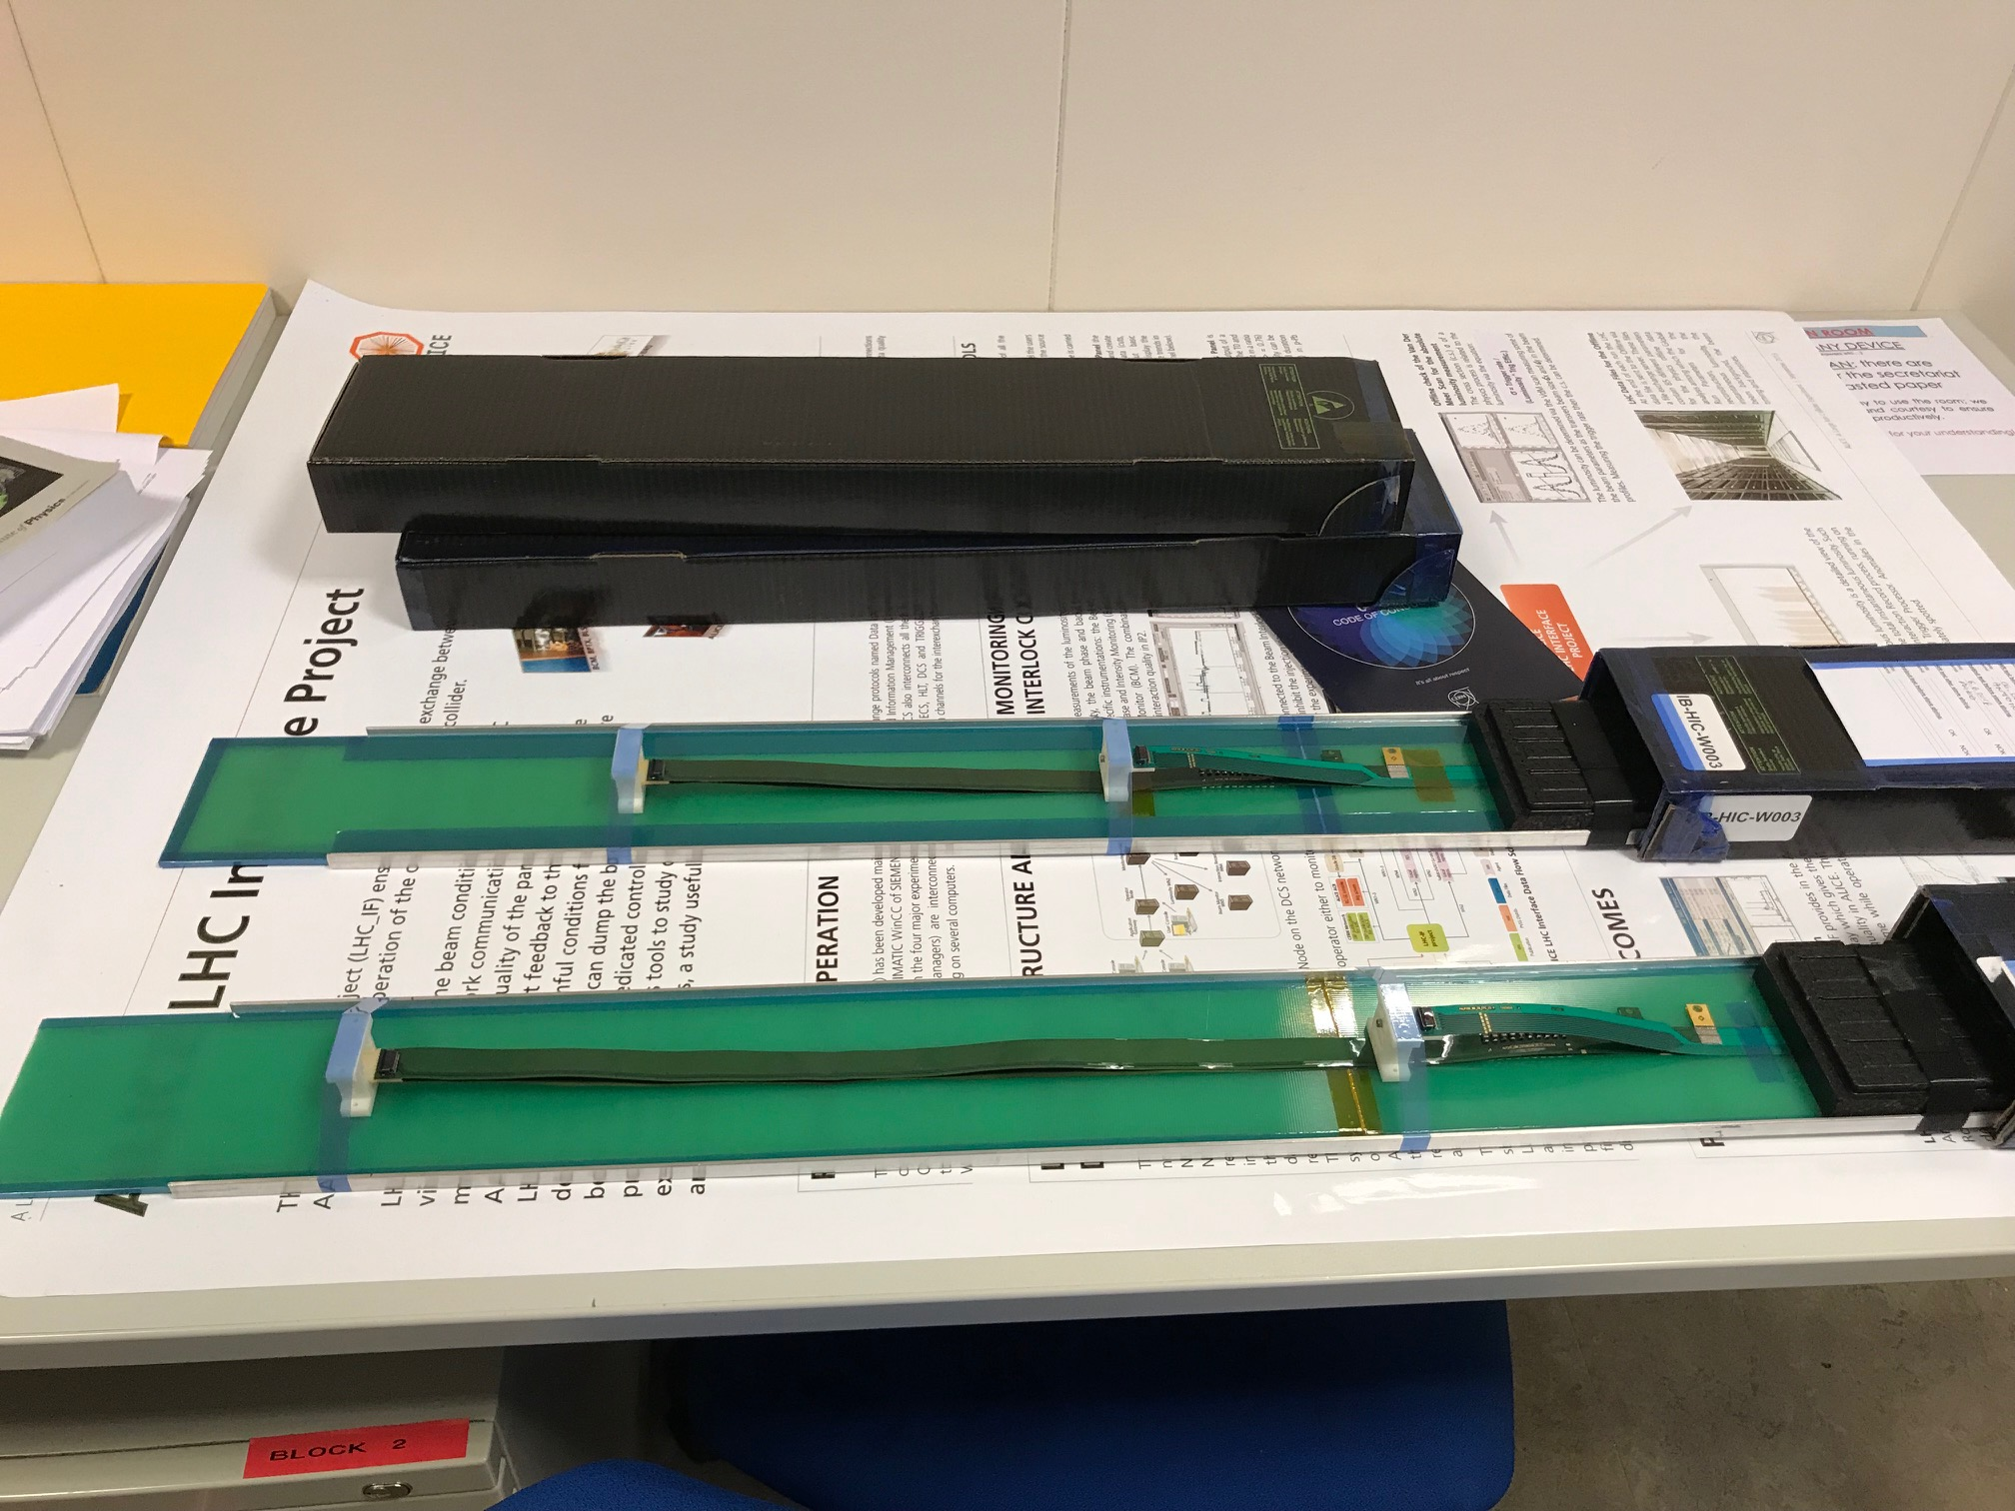
W003 & W004 HICs
40cm PWR FPC
60cm PWR FPC

Slide 13
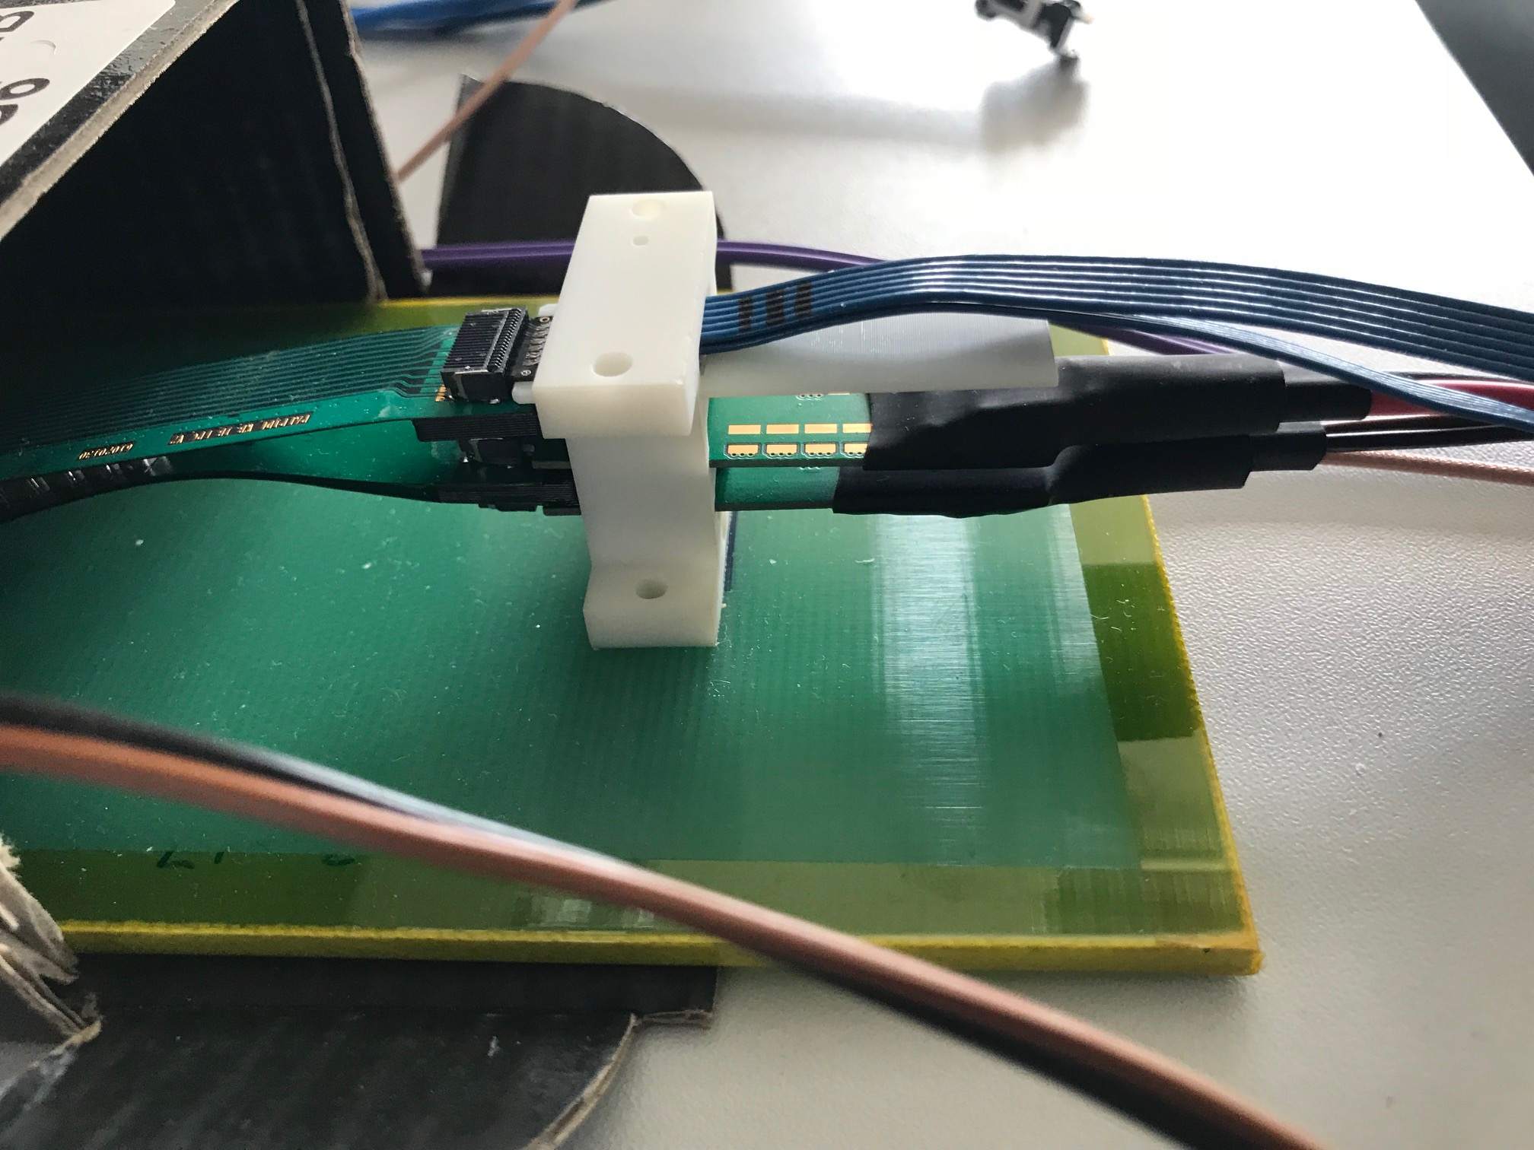
ALICE IB HIC connections:
HS signal
DVDD
AVDD/BiasV

Slide 14
ALICE RU Production – Timeline
Both RUs and Data Cables are at the DAI. Goal is having 20 RUs before Christmas Break, as well as enough data cables to connect the whole IB (24 assemblies, equal to 40 data cables).
Jul
Aug
Sep
Oct
Nov
Dec
Jan
Feb
Mar
Apr
May
Data cables
TP
Tendering
DAI
Batch 1a (24 A+B)
Batch 1b
(46 A+B)
Batch 2 (90 A+B)
Batch 3 (90 A+B)
Batch 4 (90 A+B)
IB covered
Acpt.
48 Lnk
92 Lnk
180 Lnk
180 Lnk
180 Lnk
RUs
TP
Tendering
DAI
Ref.
Prototypes (20)
Batch 1 (140)
Batch 2 (150)
Acpt. (extensive)
Acpt. (40 b/w)
(standard)
Acpt. (40 b/w)
(standard)
Microsemi
140 RU
150 RU
Tendering
DAI
Lead time
(26)
Xilinx
→sPHENIX production
Tendering
DAI
Lead time
2018
2019

