Slide 1
MVTX Status Overview
WBS 3.2
Ming Liu
LANL
For the MVTX Group

Slide 2
Outline
Document: sPH-HF-2018-001
https://indico.bnl.gov/event/4072/
Submitted to BNL ALD 2/2018
MVTX project scope update
Design and R&D progress
Highlights from workfest
Near term plan

Slide 3
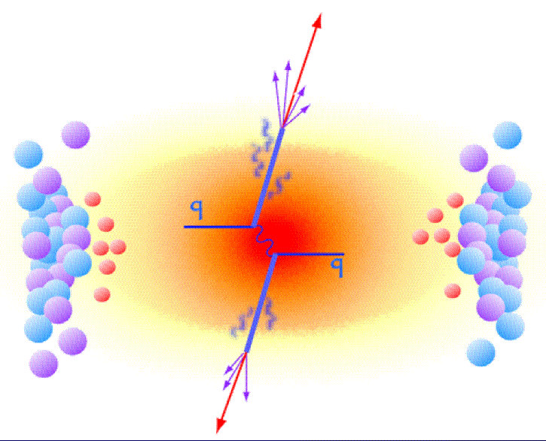
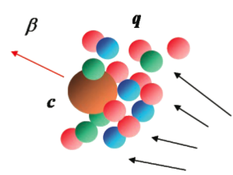
MVTX Enables the 3rd Science Pillar
Jin/Xin’s talk
Jets
Upsilons
Open Heavy Flavor
Bottom quarks are heavy (4.2 GeV)
Produced in initial collision, probe QGP evolution
Well controlled in pQCD
Provide access to fundamental transport properties

Slide 4

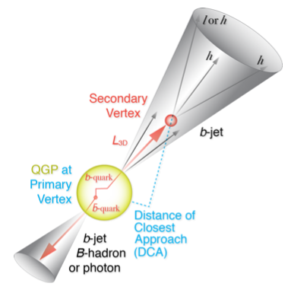
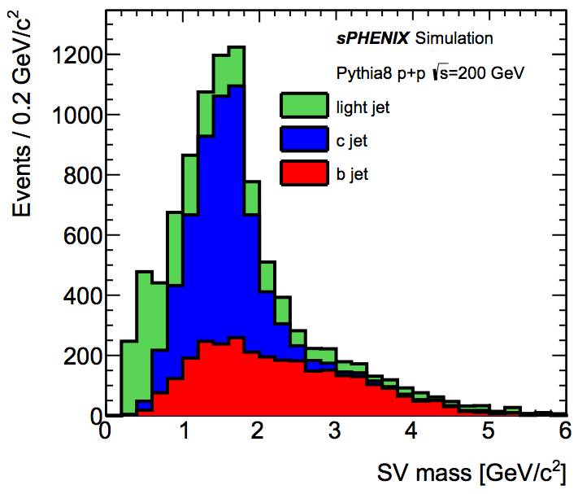
B-Hadron & b-Jet Tagging
Detected using the long lifetime of bottom quark hadrons:
  Displaced tracks
  Large 2nd vertex invariant mass
Need high precision tracking and vertex determination – MVTX!
Need excellent jet detection capabilities – sPHENIX!

Slide 5
MVTX Physics Highlights
“B meson and b-jet modification”
Heavy quarks – unique probe of QGP w/ new scales, m_{c}, m_{b}
  Study mass dependence
    Jet quenching & energy loss
    Flow – interaction with medium
  Access QGP properties
    Temperature, density, coupling, transport coefficients, viscosity etc.
“B meson and b-jet flow”
m_{u} m_{d}
m_{s}
Λ_{QCD}
m_{c}
m_{b}
MeV
1
10
10²
T_{c}
T_{QGP}
10³
10⁴

Slide 6
A Short Summary of the Project Status
RU and Stave production – a separate direct procurement from ALICE/CERN
  Technical doc and paperwork were prepared and sent to UTK from BNL in November
  Paperwork in progress through OSP at UTK, aim for sign-off by December.
    60 RUs and 84 staves, production starts ~ January 2019.
MVTX upgrade project in sPHENIX P6
  RU and stave production moved out from this scope
  Work in progress on funding details
    Split engineering/tech T&E among LANL, MIT, LBNL, BNL etc.
  Adjustment in WBS scope (some moved to WBS 2.x) to keep the total cost under $5M
  To be discussed and updated at this sPHENIX collaboration meeting
Recent reviews since last collaboration meeting in June 2018
  MVTX Production Review 07/19-20, 2018
    Stave and RU procurement readiness
    https://indico.bnl.gov/event/4729/
    Draft responses presented and discussed at PMG meeting
      Review committee members, BNL and sPHENIX management
  MVTX Interim Design Review, 11/19/2018
    Mechanical system integration
    Led by John Haggerty, draft recommendations being discussed
      no evident showstoppers
    https://indico.bnl.gov/event/5351/
Status at UTK: (12/6/2018):
Document in PAMS at UTK OSP, waiting for approval; (target ~12/14)
Approval in Germantown;
Approval in the Chicago office and negotiation of a grant funding document with the University.
All recommendations from July Review
on stave/sensor R&D addressed
Interim design review report, draft

Slide 7

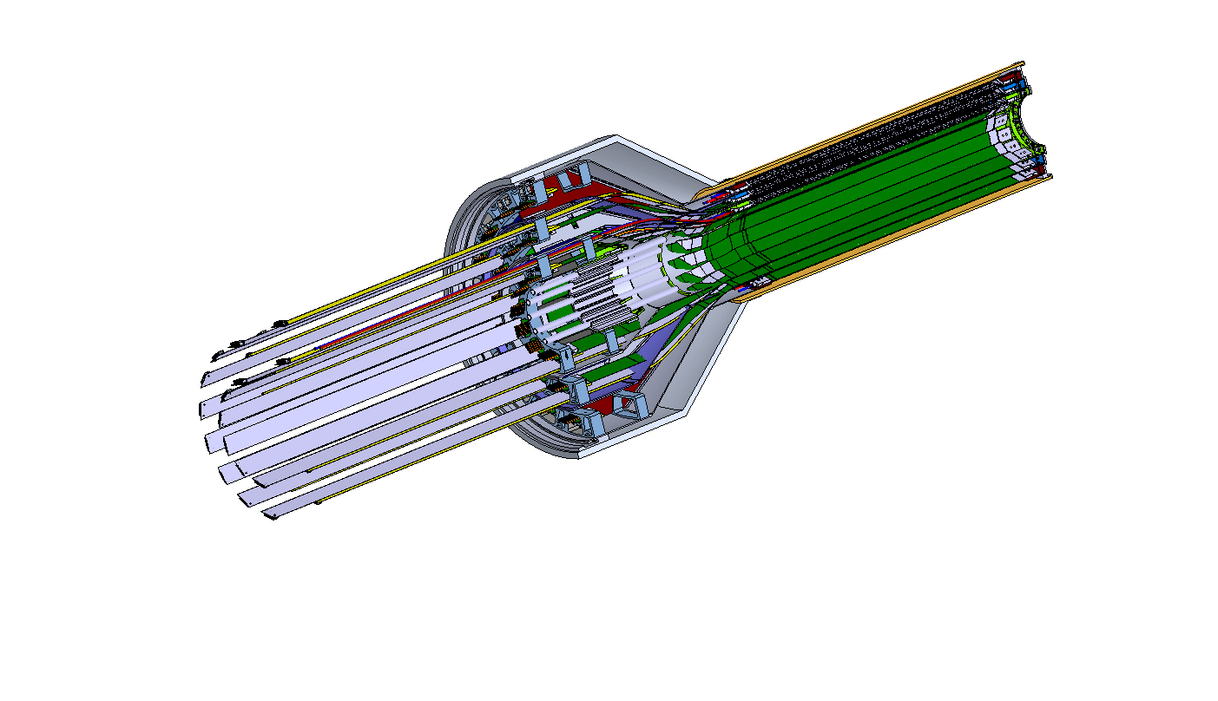
MVTX Detector
Service cone: signal, power, cooling
and mechanical support
CYSS: Cylindrical Shell Structure
End-Wheel
Extended power FPC
3-layer sensor barrel
- 48 staves, 432 chips
MVTX
parameters
MVTX RUs, PUs & other services

Slide 8
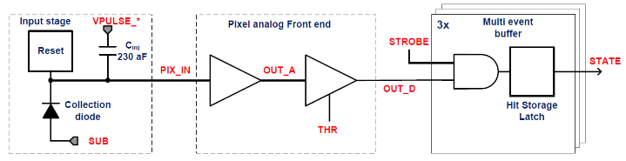
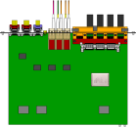

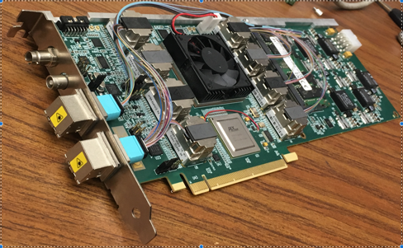

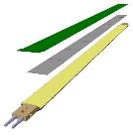
MVTX Readout, Power and Controls (11/2018)
CAN bus
DCS
Trigger & Clock
Readout Unit
Front End
GBT Optical Links
one pixel
9 Data (1.2Gbps)
1 Clock, 1 Control/Trigger
Control
Data (9.6 Gb/s max)
Trigger
9-sensor Stave
Samtec Twinax “FireFly”
FELIX
Back End
FPC
Power
ATLAS Front-End Link eXchange (FELIX):
sPHENIX Data Aggregation Module(DAM)
Alpide Sensors
Flex PCB Filtering Capacitors
regulators
Power
Regulated Power
CAEN Power supplies
Cold Plate
ALPIDE pixel:
Shaping
Digitization
Zero-suppression
3x buffer
Power Board
Interaction Region
Experimental Hall
Counting House
MVTX Detector Electronics consists of three parts
Sensor-Stave (9 ALPIDE chips) | Front End-Readout Unit | Back End-FELIX/DAM

Slide 9
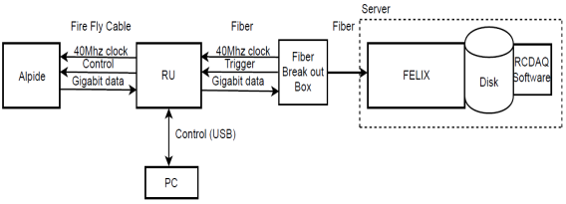
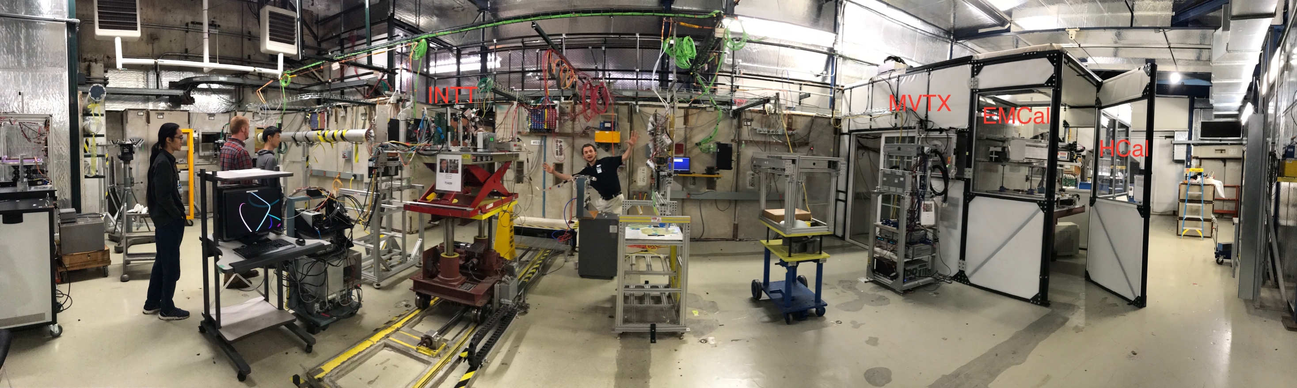
MVTX Full Readout Chain Demonstrated
4-MAPS
telescope
Fermilab Test Beam: Feb-Mar, 2018
Tracking spatial resolution
achieved: <5 um
120 GeV proton
beam
4-hit track
4-MAPS telescope

Slide 10
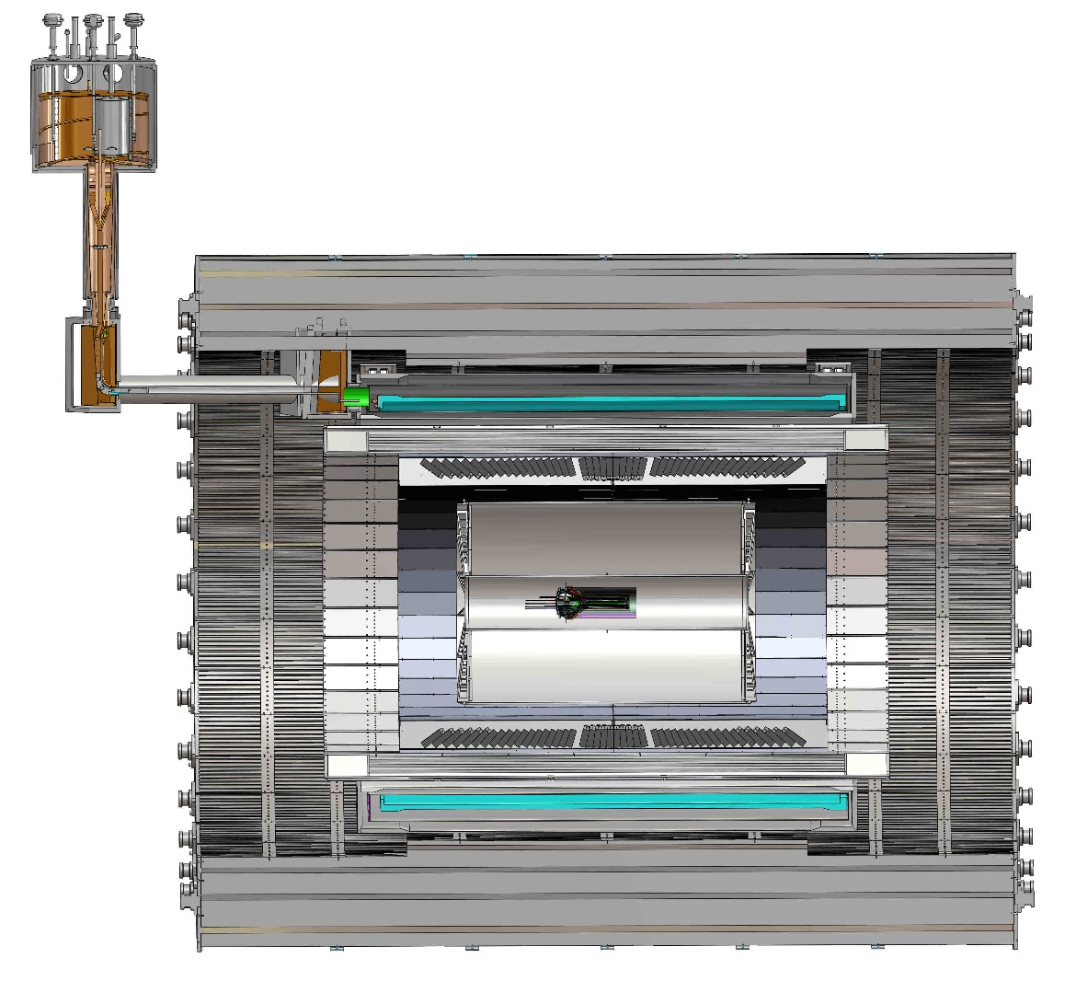
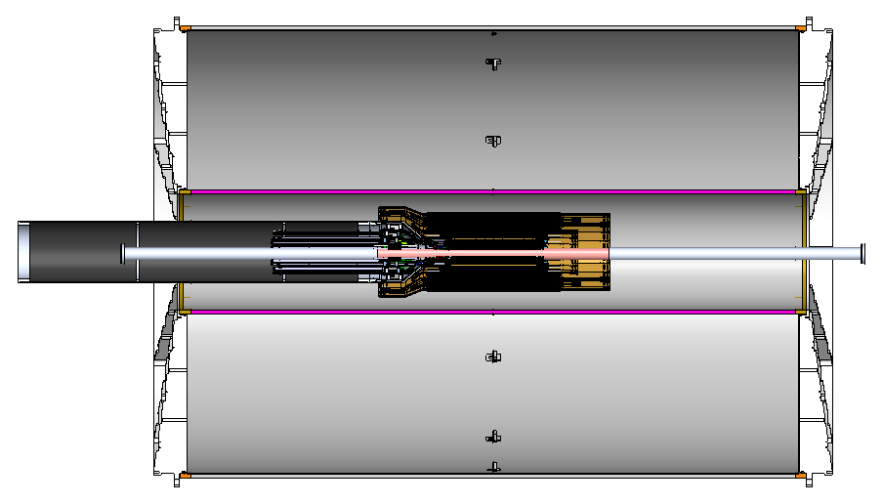
Progress in MVTX Global Mechanical System Integration
MVTX service barrel preliminary design, with two parts:
  Part-1: from MVTX to PP-1b, all power PCB, 40cm
  Part-2: length TBD later, from PP-1b to PP-2
Walt & Ross’ talks
Service Barrel
TPC
TPC
INTT
MVTX
PP-1a:
short signal cables
PP-2:
Signal and power cables
R= 209.6cm
PP-1b:
power cables
L = 350.0 cm

Slide 11
MVTX Mechanical Integration in Progress
Walt’s talk
This MVTX model shown with 40cm flat power extension cables
PP-1a: signal cables
PP-1b: power cables

Slide 12
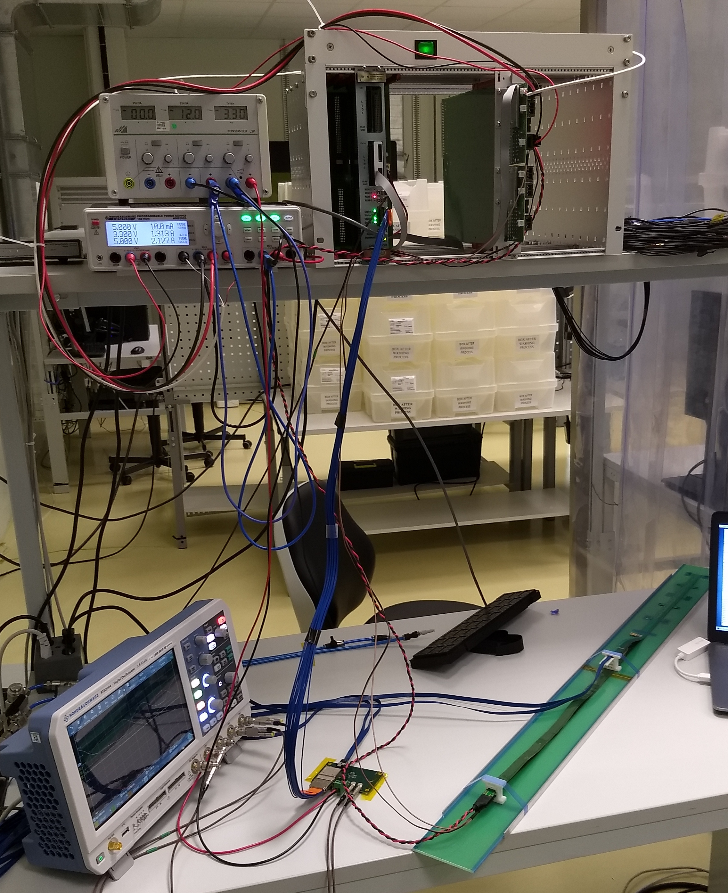
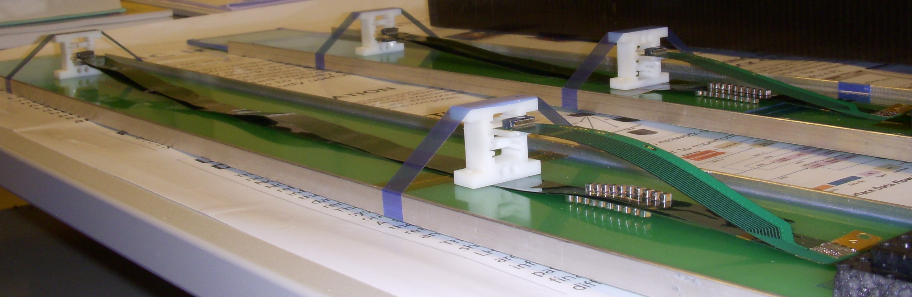
Confirmed HIC with Extended 40(60)cm Power FPC
Built and tested two HICs at CERN in the week of 9/17/2018
  No change in sensor performance (noise, threshold) observed, as expected;
Details presented by Dr. Sho Uemura at the sPHENIX general meeting on 9/23/2018
40cm PWR FPC
60cm PWR FPC
ALICE: 15cm PWR FPC
Followed identical
ALICE IB QA test procedure,
with a 8m SamTec cable!
Nice work by Alex and Sho et al!

Slide 13
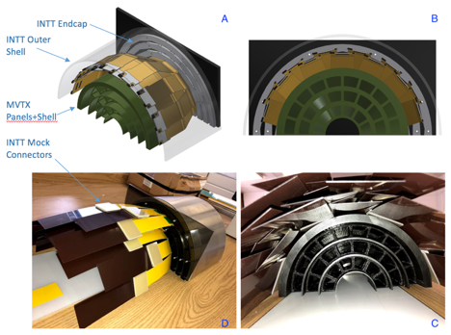
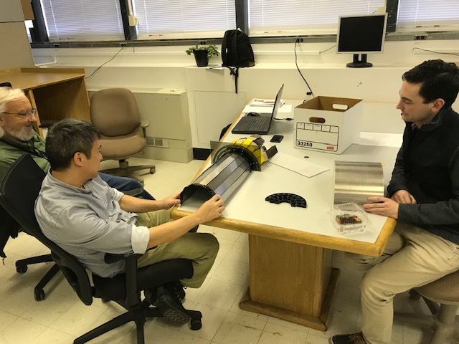
MVTX + 4-layer INTT 3-D Mockup Demonstrated
Office of System Integration
– led by Mickey & Bob,
a team of engineers and physicists
MVTX and INTT
Space conflict resolved!

Slide 14
Sensor Irradiation Test – OK at 2.7MRad
Continuous effort by ALICE (@NPI, Czech)
BNL review recommendation: test sensor up to 1MRad
https://indico.cern.ch/event/758048/

Slide 15
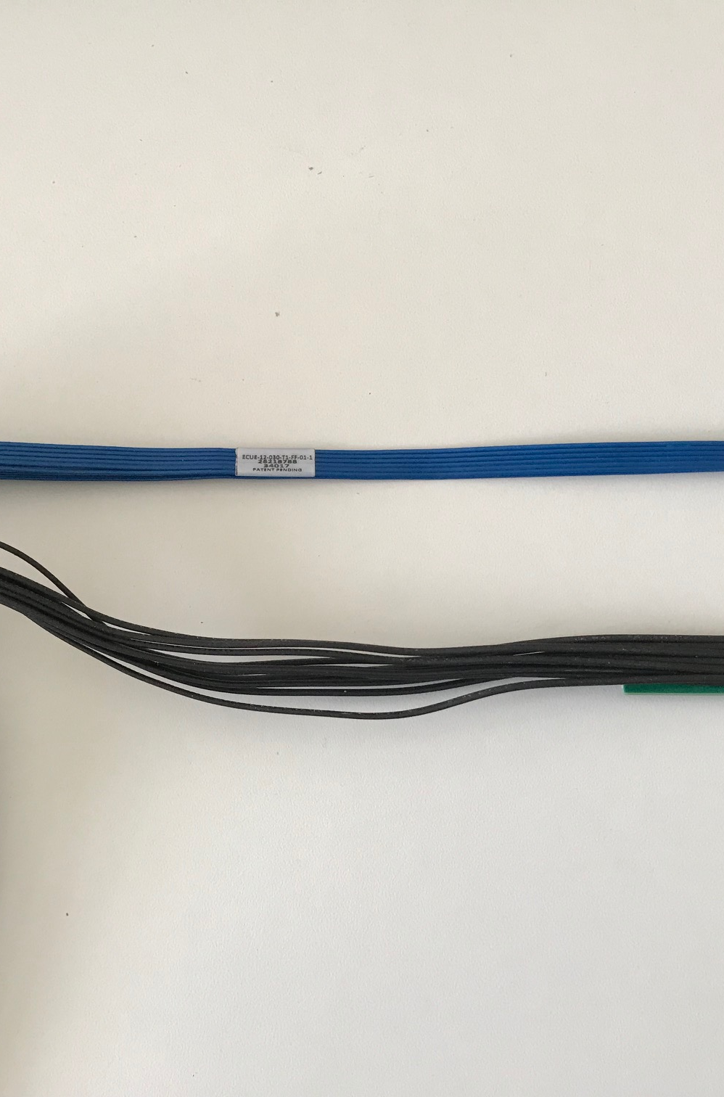
Response to the July MVTX Review Recommendations
https://docs.google.com/document/d/1vsm_G7ZLgqv-kBZqK0jF69T_Nx2Uwk0Zxv86jRVxybw/edit?usp=sharing
Completed sensor/HIC/stave evaluations at CERN
  Built and tested two HICs with 40cm and 60cm long power FPC
    Confirmed sensor performance same as the ALICE default configuration
  Sensors irradiated up to 2.7MRad, no problem (updated 9/18/2018).
Addressed all recommendations on stave/sensor R&D
Cost are set for staves/RU, UTK has started procurement paperwork
  Technical specs document completed for production, BNL/DOE agreed
  RU, Staves, sPHENIX production starts ~ January 2019, expect to last ~12 months
MVTX/INTT mechanical integration
  Mechanical design being updated and mockup done
  Inner tracking task force completed evaluation, preferred INTT-layer < 4
Cables
  BNL approved the use of SamTec blue cables
    Electrically better & mechanically compact
    ALICE confirmed signal performance with 8m long readout cables. For MVTX, 10m very likely works (30AWG/sPHENIX vs 32AWG/ALICE), to be confirmed by on-going R&D
  Signal and power cable samples ordered/obtained for mechanical global system integration mockup and test

Slide 16
MVTX Schedules and Milestones (11/2018)
Dave’s talk
sPHENIX: CD1/3a CD2
Installation
1st collisions
CY-2018 | 2019 | 2020 | 2021 | 2022 | 2023
MVTX
ALICE IB stave done;
Facilities available for
sPHENIX production;
A window of opportunity:
Low technical risk
Cost saving
Stave & RU
production
FELIX
production
Detector mechanics design & production, global interface to sPHENIX
End Wheels
CYSS
Global integration
/interface design?
Service barrel
design & production
Ready for beam;
sPHENIX day-1 run
Barrel Assembly & Testing @LBNL
Install half barrels
@sPHENIX IR
Half barrel #1
Power system
production
Half barrel #2
To be updated @FSU 12/2018
Work in progress:
LANL/MIT/LBNL
Design and fabrication
Half barrels
arrive @BNL
design & procure
interface to
sPHENIX rails
Design & procure
sPHENIX rails
MVTX installation & commissioning @BNL
RU, FELIX, PS, cables etc.

Slide 17
Stave Production and Shipping etc.
Hand carry staves from CERN to LBNL, 4 trips
Preliminary design from CERN for stave transportation plates
  To be produced at CERN, paid by LBNL/sPHENIX
Extended design from CERN
for MVTX
ALICE ITS IB

Slide 18
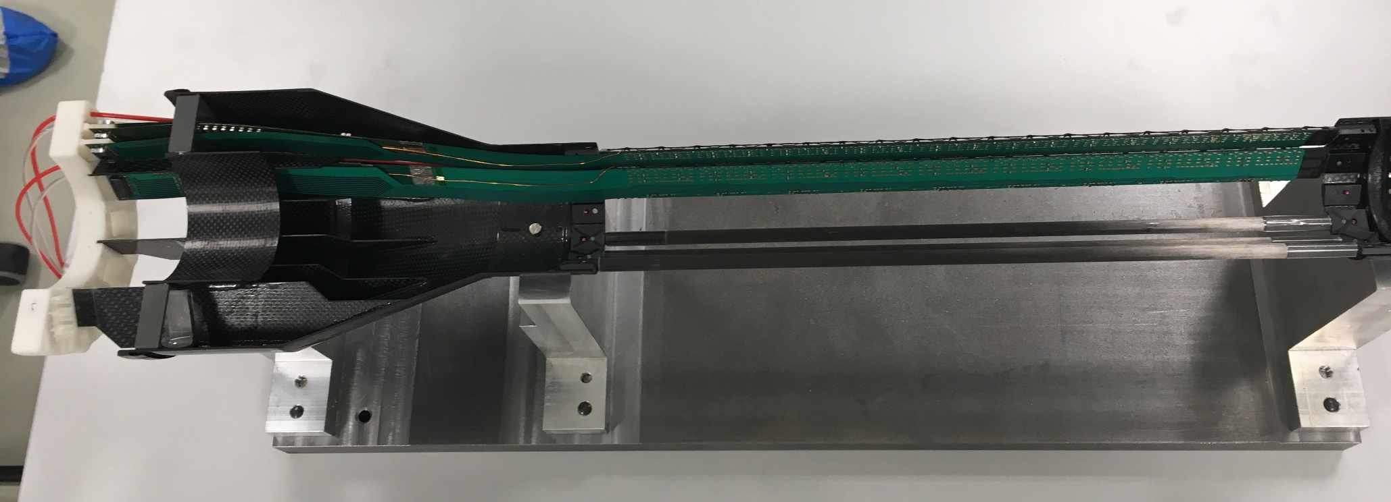
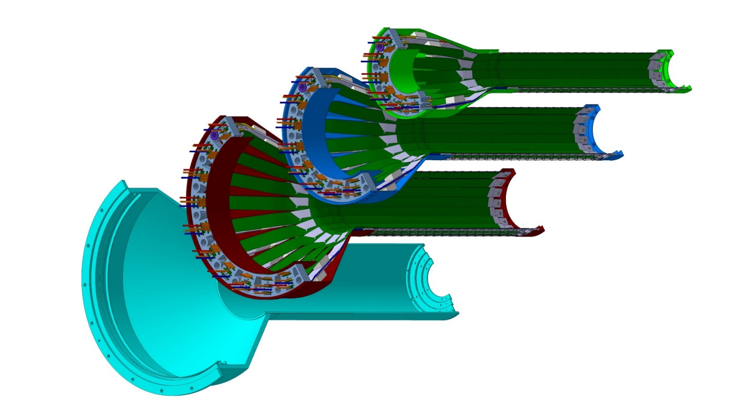
Detector Assembly & QA at LBNL
Walt & Yuan’s Talks
staves
Precision positioning and installation of staves on end-wheels
dummies
ALICE 1st half inner layer being assembled
6/2018@CERN
Layer 0
Layer 1
Follow ALICE IB assembly procedures to build half-detectors for MVTX
QA records in DB, travelers
Modified jigs for MVTX
Build two full half-barrel detector with the service structures
Layer 2
IB CYSS
Install SamTec & power cables during half-barrel assembly with the service barrel at LBNL (under discussion)

Slide 19
ALICE jig assembly steps;
Walt

Slide 20
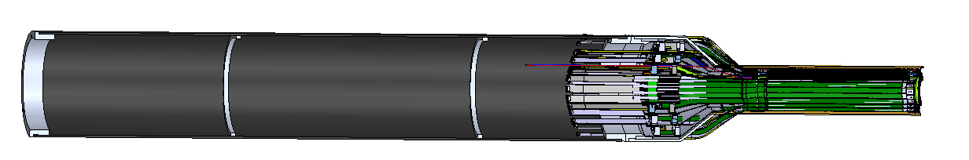
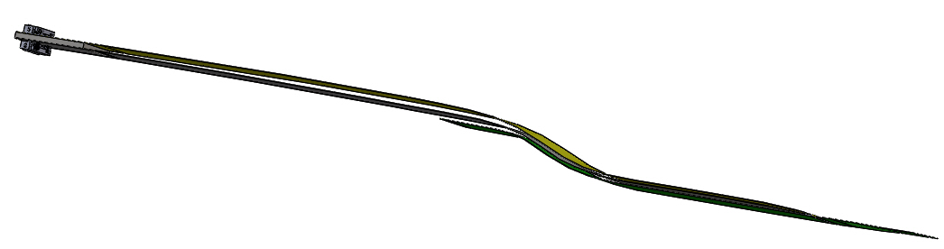
MXTX model with correct length power cables:
Walt et al
New shorter 40 cm overall length for power extension cables from stave, more than 220. mm shorter than was shown in previous model, same length service-barrel – 1200.0mm, location for a new patch panel 1B.
Updated inner layer power extension cable – overall length 40.0 cm, as agreed to by ALICE at CERN

Slide 21
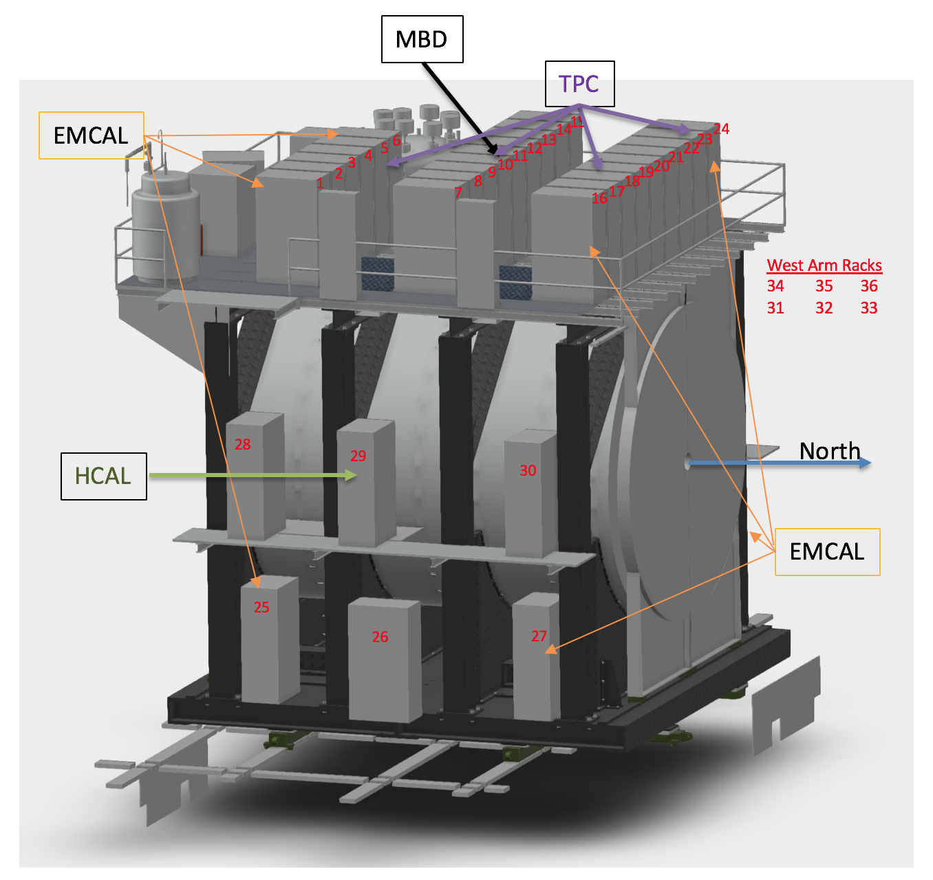
MVTX Services - Work in Progress
Service racks located close to MVTX detector
  Electronics, power etc
  “Minimal cable length”, ~8m
    R&D on 10m cable at LANL
48 RU and 24 PU
  1PU ->2RU
  6-U VME crates
CAEN bulk power supply
  located nearby
Cooling plant
  Location TBD
MVTX
RU/PU& PS

Slide 22
sPHENIX MVTX Group: Institution Roles
Major institutions lead key tasks

Slide 23
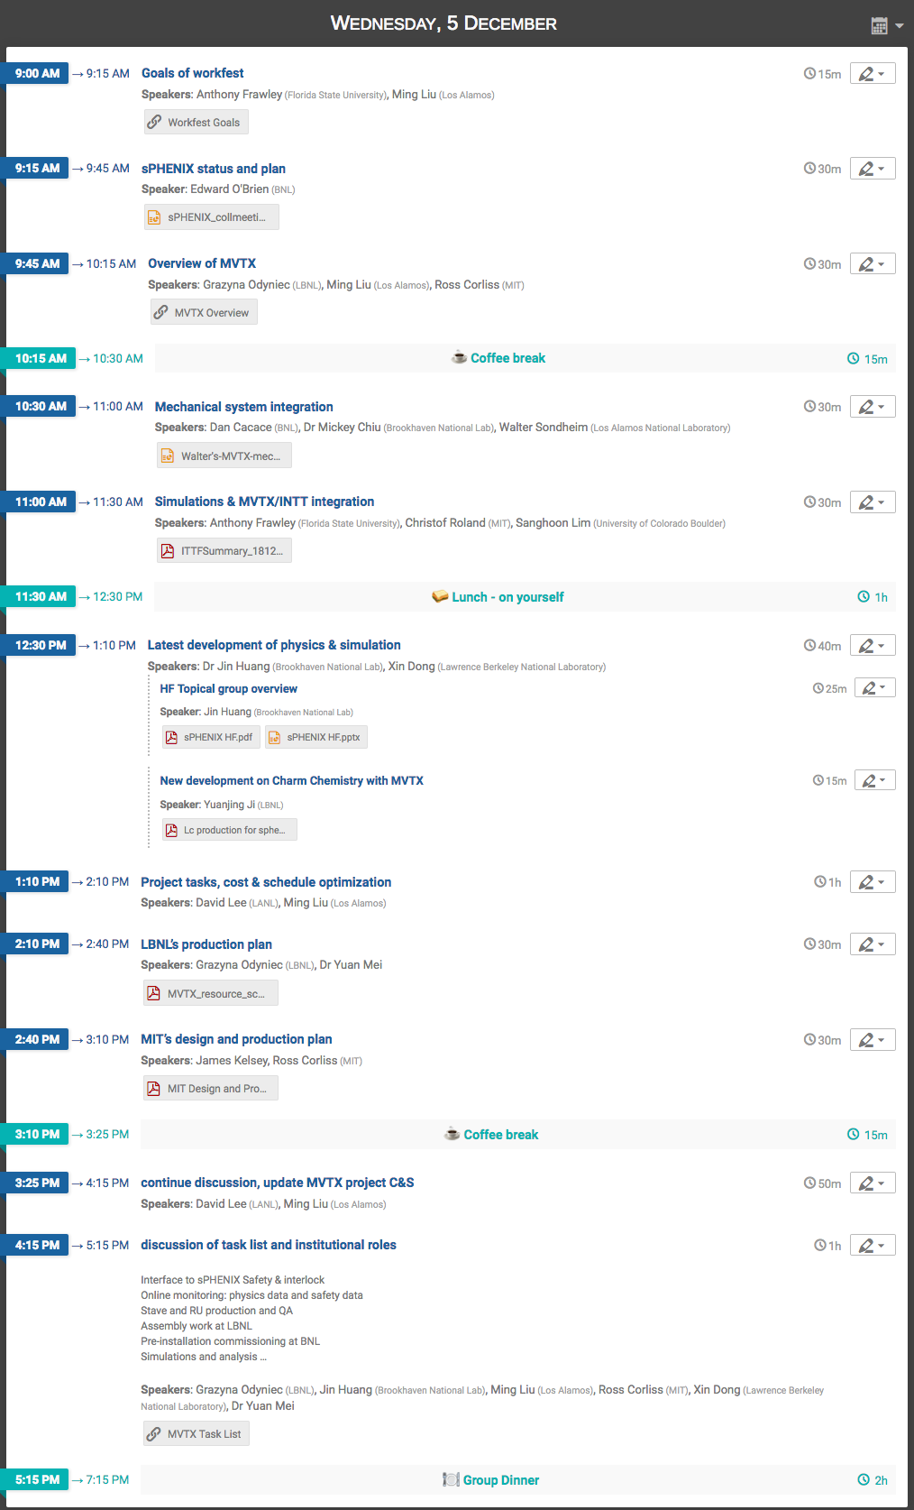

MVTX Workfest
https://indico.bnl.gov/event/5404/
A very productive meeting
  Science update
  Project tasks and schedules
    production plan
    Global system integration
Project cost & schedule
  More follow up, MIT & LBNL
  Update by the end of next week ~12/15
MVTX related tracking discussion continues, 12/8-9
  Global tracking, pile up etc

Slide 24
New Topics under Study – Charm Chemestry
Yuanjing, Xiaolong/USTC,LBNL, Xin, Jin …

Slide 25
Production Plan
Detector Assembly and Integration
Ross Corliss
Yuan Mei
Detailed sharing of engineering design, FEA/simulations, review and fabrication discussed

Slide 26
Project C&S being Updated
Dave, Glenn et al

Slide 27
Near Term Project Tasks & Schedule
RU production through ALICE: 60 RUs
  Being started at CERN, first batch of ALICE production ~ Dec., 2018
    sPHENIX RUs available: ~Summer 2019
  Acceptance test and QA at UT-Austin: starting ~summer 2019
Stave production through ALICE: 84 staves (ALICE Gold/Silver QA)
  sPHENIX sensor production ~Jan. 2019
    Stave assembly starts @CERN, ~ April 2019, ~12 months to finish
  Acceptance test and QA at LBNL, ~Summer 2019
    Hand-carrying staves to LBNL, ~4 trips, ~20 staves each trip
Mechanical system integration design
  In good progress, under OSI
Carbon and non-composite structure design and fabrication
  Design & review – LANL/MIT/LBNL
  Carbon structures fabrication @LBNL
  Non-composite structure fabrication @MIT
Half-detector assembly at LBNL: starting ~ summer 2019
  To setup assembly & test lab as soon as fund available
Safety, slow-control and monitoring
MVTX detector commissioning at BNL: ~summer 2021
  Setup lab, pre-installation commissioning
  IR installation
(Physics & detector simulations, tracking etc.)
Great opportunity for university
groups to contribute!

Slide 28
Other Activities and Plan
CERN/ALICE visit planned ~end of January 2019
  Walt, Ming, and MIT/Bolek, Jim, Ross et al
  Mechanical design and integration
  Produce 5 staves for MVTX telescope
Preparation for MVTX stave production at CERN
  One LANL PD hired at CERN
  MIT student/postdoc/tech help at CERN, under discussion
  LBNL will start preparing the MVTX detector lab as soon as funds will transferred
Fermilab beam test with INTT, ~May 2019
  Waiting for HDI cables for INTT
  MVTX telescope will be ready ~March 2019
  A joint test beam proposal being developed
  Test global tracking, timing etc.
Possible MVTX beam test at LBNL
  MVXT sensor and readout electronics characterization etc.
  Details under discussion

Slide 29
Summary: MVTX - WBS 3.2
MS Project being updated, now in the sPHENIX P6
  Stave and RU production through US-ALICE, moved out of the scope
  The rest of tasks, being optimize for cash flow and production schedule
Early procurements of staves and readout units (RU) through US-Alice
  DOE and BNL agreed, DOE directly pays UTK/US-ALICE
  Received signed letter from CERN on the cost of 60 RUs and 84 Stave, ~$1.36M
  Purchase paperwork in progress at UTK, aiming to complete by ~ December 2018
About $5M to be added to the sPHENIX Management Portfolio
  Open MVTX accounts in progress
  As a separated project from the MIE, for the rest of MVTX tasks
    Mechanical system design and fabrication
    Monthly report to sPHENIX and BNL upper management
    Update baseline cost and schedule by January 2019
  Will NOT be part of CD-2/3 DOE review
    Prepared for a separate DOE review in FY19

Slide 30
backup

Slide 31
Scope of the MVTX Project
Dave’s talk
MAPS Staves & Electronics
  Readout Integration R&D (LANL LDRD)
    Frontend: ALICE/ITS, RU
    Backend: ATLAS FELIX
    Reprogram RU & FELIX into RCDAQ/sPHENIX
  Production-I:
    84 ALICE/ITS-IB staves from CERN
      Acceptance test @LBNL, 48+spares(36)
    60 ALICE/ITS-RU from CERN
      Acceptance test @UT-Austin, 48+spares(10)
  Production-II:
    sPHENIX production
      Acceptance test @LANL, 8 FELIX
    Final detector assembly in US
      LBNL half detectors
      BNL full detector
    Ancillary systems
      “adopt” ALICE ITS system
      Power, slow control & monitoring etc.
Mechanics & Cooling
  Changes to ALICE/ITS inner tracker mechanical structures
    End Wheels
    Cylindrical structure shells
    Detector half barrels
    Detector and Service half barrels
  Mechanical Integration,
    Conceptual design (LANL LDRD)
    Prototyping sPHENIX R&D
    Design integration frames, MIT/LANL/LBNL
    Composite structures, LBNL
    Non-composite structure, MIT
    Installation tooling etc., BNL/LANL/MIT/LBNL
  Adopt ALICE cooling plant design
    Modifications to fit sPHENIX, MIT/BNL
    Much smaller heat load than ALICE ITS
Installation & commissioning (BNL + MVTX group)

Slide 32
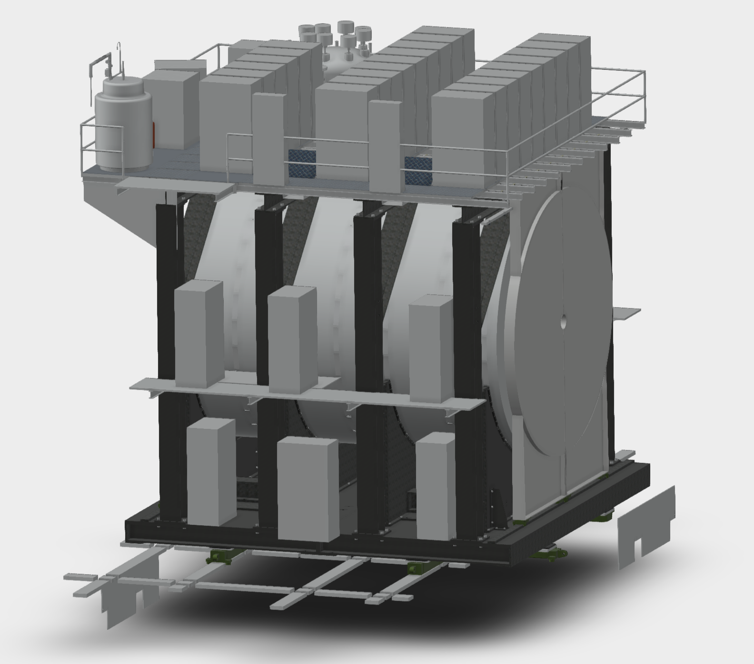
Mickey 10-26-2018
MBD
TPC
3B9
3C9
Rack Name | Subsystem
2E2 | HCAL
2W2 | HCAL
1E1 | EMCAL Digi
1E3 | EMCAL Digi
1W1 | EMCAL Digi
1W3 | EMCAL Digi
3A1 | EMCAL Digi
3A6 | EMCAL Digi
3C1 | EMCAL Digi
3C9 | EMCAL Digi
3A3 | EMCAL Control/Bias
3A4 | EMCAL Control/Bias
3C3 | EMCAL Control/Bias
3C7 | EMCAL Control/Bias
3A3 | TPC
3A4 | TPC
3C2 | TPC
3C8 | TPC
2W1 | INTT
2W3 | INTT
2E1 | MVTX
2E3 | MVTX
3B5 | MBD
EMCAL
3A5
3A6
3B7
3B8
3C7
3C8
3A3
3A4
3B5
3B6
3C5
3C6
3A1
3A2
3B3
3B4
3C3
3C4
3B1
3B2
3C1
3C2
West Arm Racks
2W1 2W2 2W3
1W1 1W2 1W3
MVTX
2E1
2E2
North
HCAL
2E3
EMCAL
1E1
1E3
1E2
(PATCH)
Cables have 6” clearance to get out of detector at door
Still need to decide on gas panels

Slide 33
Stave and RU Production QA Plan Documents Available
https://indico.bnl.gov/event/4729/
Staves
Purchase 84 staves from ALICE/CERN
  48 + 28(spares for 2 inner layers) + 8 spares
  Production following the completion of ALICE ITS/IB
  Starting ~Oct. 2018, will last 6-12 months
  Fully tested at CERN before shipping to US
    All Gold/Silver staves (same as ALICE IB)
    A LANL postdoc (Dr. Yasser Morales) oversees production QA at CERN
Acceptance QA at LBNL
  Full test and QA
    Electrical
    Mechanical
  Detector assembly at LBNL
Readout Units
Purchase 60 RUs from ALICE/CERN
  48 + 12 spares(20%)
  To be part of ALICE production
    Cost saving
    Minimize technical risks
  Initial test at CERN
Acceptance QA at UT-Austin
  Full test
  LANL as the 2nd test site

Slide 34
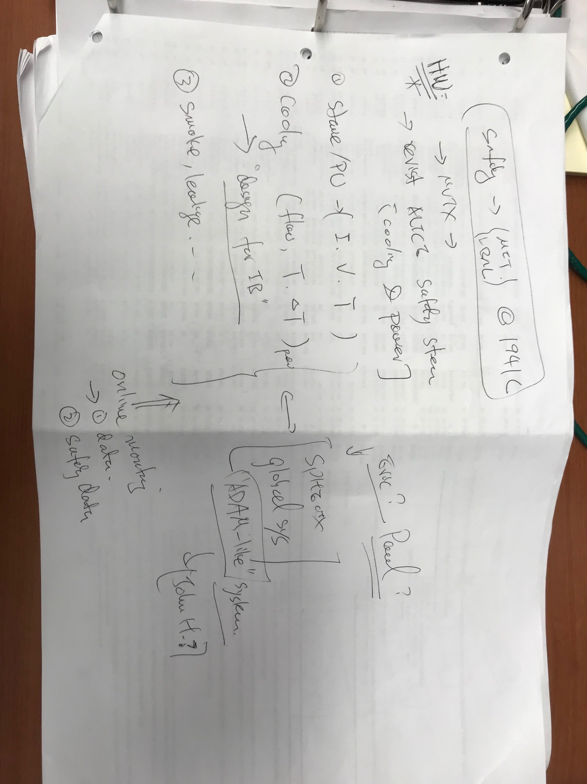

Slide 35
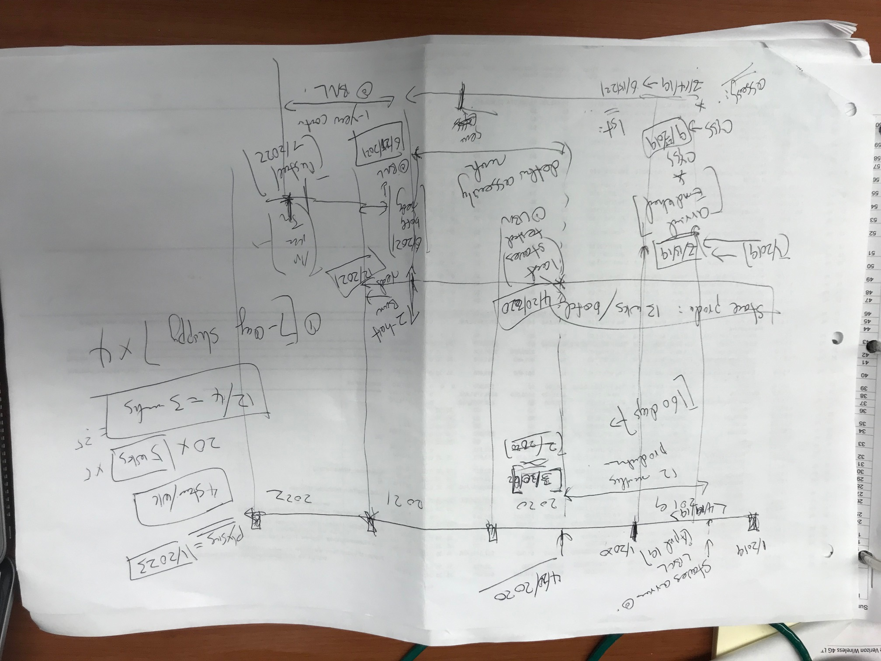

Slide 36
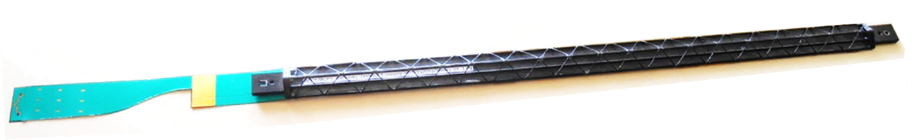
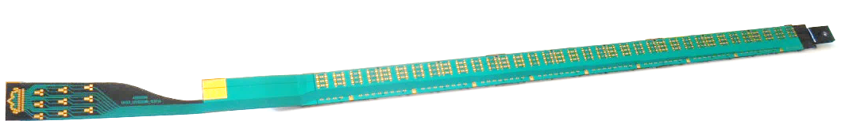
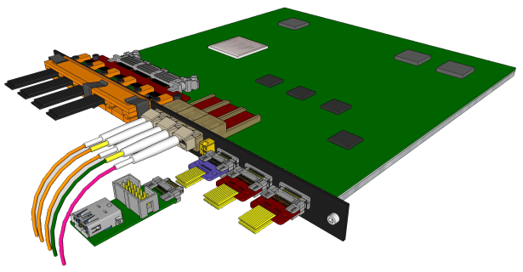
MVTX Sensors and Electronics Production
Major hardware:
  48 ALICE ALPIDE Staves + Interface Cables
  48 Front End Electronics (ALICE RUv2)
  6 Back End Electronics (ATLAS FELIX v2)
  6 EBDC Linux servers
  24 Power Boards + CAEN Supplies + Cables
  48 Stave to RU cables
  144 data fiber optic cables (3 fibers x 48 FEE)
Stave production: total 84, 75% spares
  Two inner layers: 12+16=28
  10% spares: 8 staves
RU production: 60 in total, 25% spares
ALICE ITS/IB stave
ALICE ITS RU

Slide 37
Collision Rates: PHENIX vs ALICE
 | ALICE (Run3) | sPHENIX (Max) | Ratio of data rates sPHENX/ALICE
Pb+Pb / Au+Au | 50kHz | 200 kHz | 0.3
p+p | 200kHz | 13 MHz | (1.6)
Trigger/Readout | 50 kHz/(C.R.) | 15 kHz | -
MB Event track multiplicity dN/dη
  sPHENIX = 1/3 ALICE (pp)
  sPHENIX = 1/5 ALICE (AA)
sPHENIX triggered data rate fits well within ALICE readout hardware specs

Slide 38
Projected Radiation Level after 5-year Runs
sPH-TRG-2018-001
Projected sPHENIX integrated luminosities after 5-year operation
  AuAu: Lum. = 214 nb⁻¹
  pp+pAu: Lum. = 1340 pb⁻¹
PHENIX study
arXiv: 0710.2676 [nucl-ex]
Projected sPHENIX MVTX L0 fluence:
Outer layers:
L1 = 0.6 x L0; L2 = 0.4 x L0
TID = 1060krad
NIEL = 6x10¹² N_{eq}/cm²
Sensors tested to full MVTX NIEL and ~3x TID @ALICE (as of 9/18/2018)

Slide 39
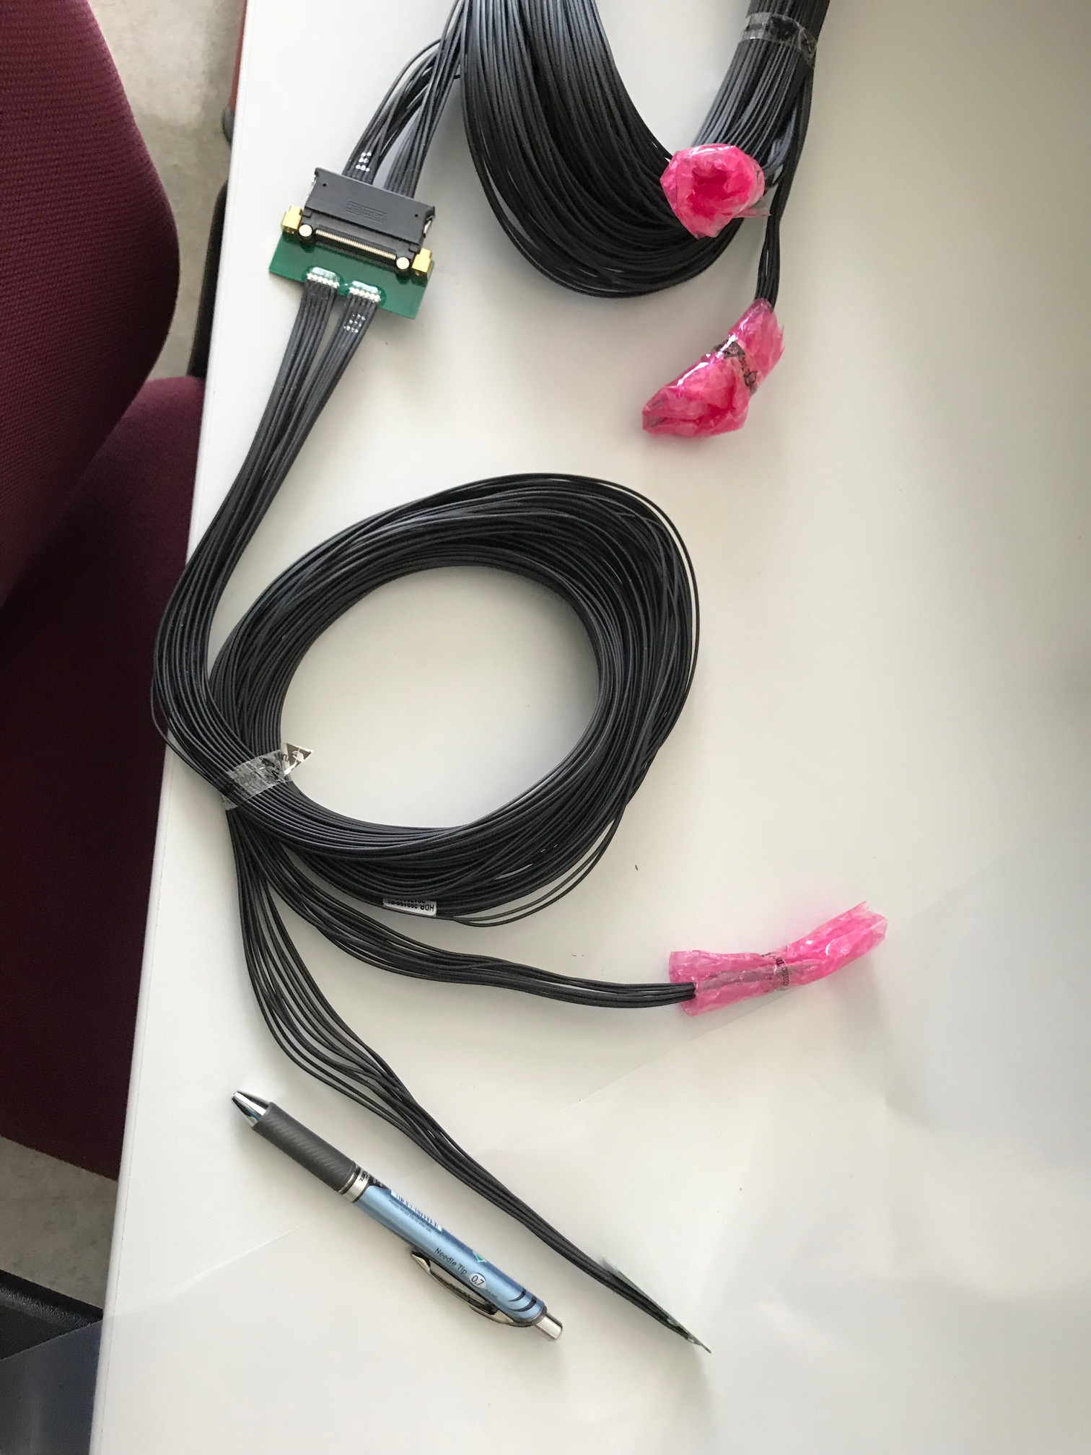
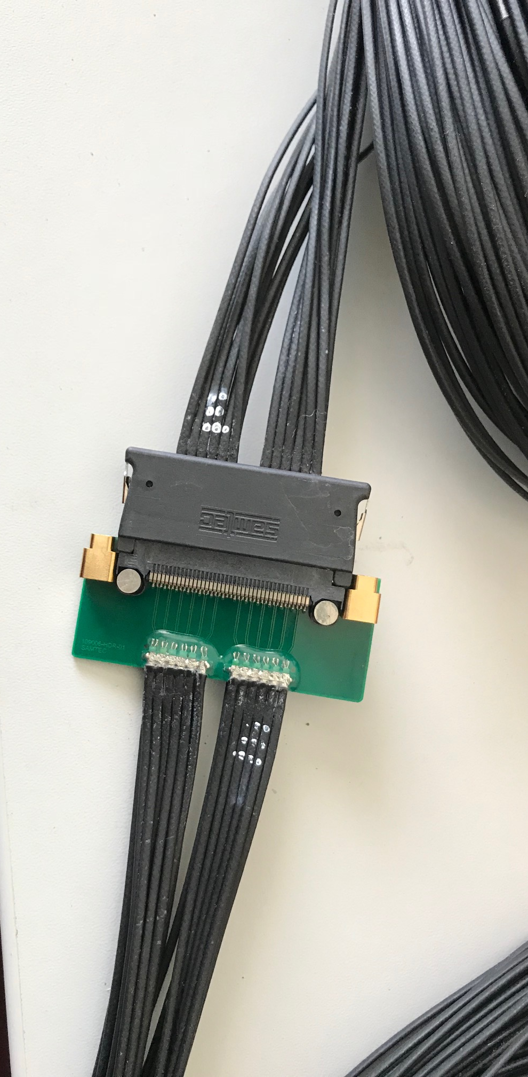
Type-A
Type-B
Type-A

Slide 40
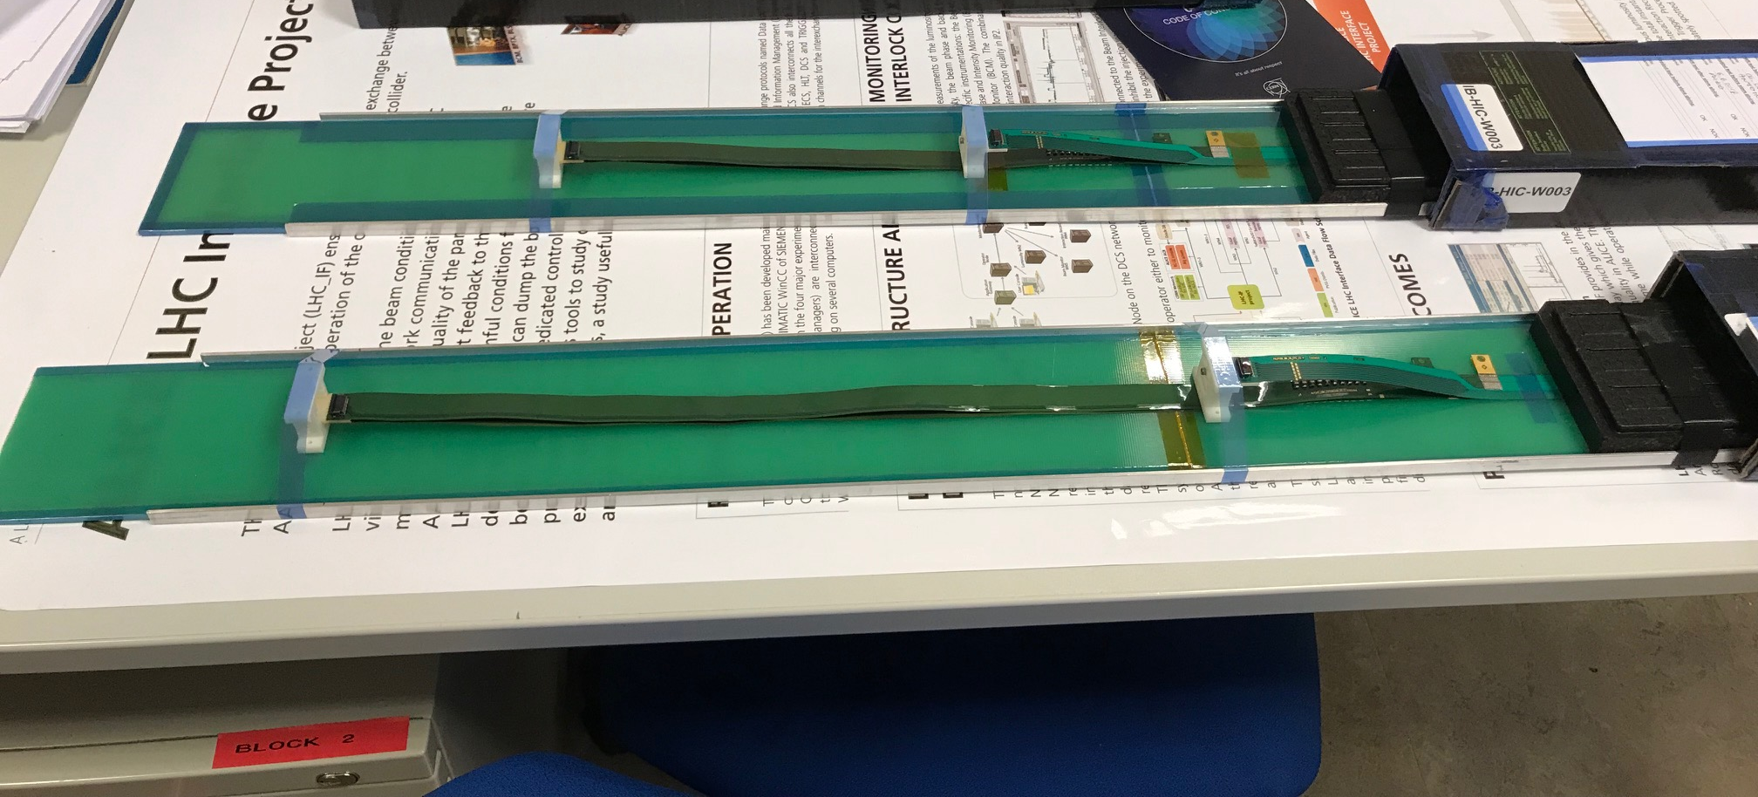
Two HICs Produced and Tested at CERN w/ Extended Power Cables
NO noticeable difference in sensor performance, as expected, 9/2018
MVTX: 40cm flex power PCB
MVTX: 60cm flex power PCB
ALICE IB: 15cm

Slide 41
HICs Test Results from CERN (9/2018)
After: same ALICE HICs, replaced power FPCs
Before: 2 ALICE IB HICs
Thr.
HIC1
Noise
Thr.
Noise
HIC2
Noise level: ~4 e’s; Threshold: ~180e’s; MIP: ~1000 e’s
Chip-8
Chip-0

Slide 42
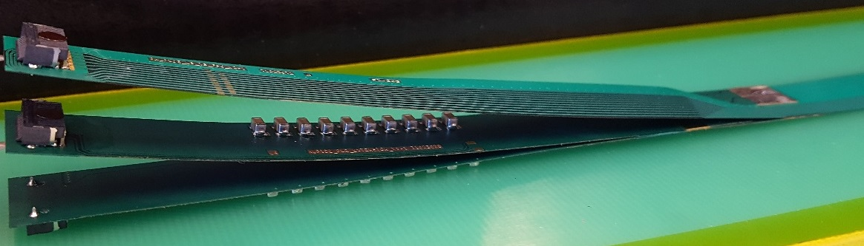
FPC Extension for Connection to Electrical Services
From Antonello Di Mauro
The connection to the service cables is achieved by a double FPC extension which is soldered to the HIC
x-section at interconnection between FPC and extensions
AVDD
AVDD
AVDD
AVDD
DVDD
FPC
AVDD
DVDD
AGND
AGND
Flex power extension
AVDD
DVDD
AGND
FPC
AGND
DGND
DVDD
DVDD
AGND
DGND
DVDD
AGND
DGND
FPC
DGND
DGND
Flex power extension
DGND
signal lines (FPC)
Modified for sPHENIX:
15cm -> 40cm
digital power
analogue power

Slide 43
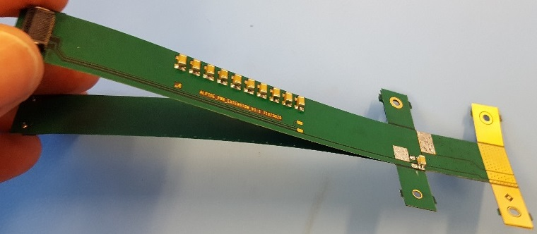
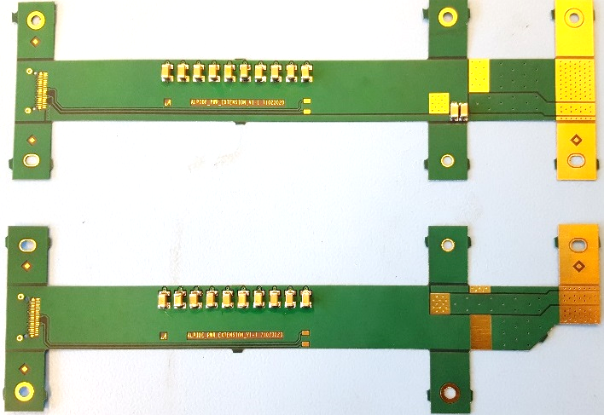
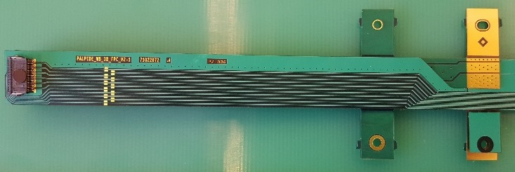
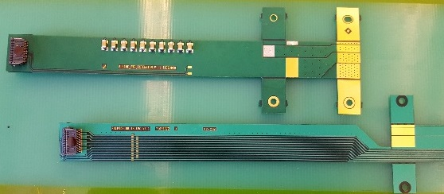
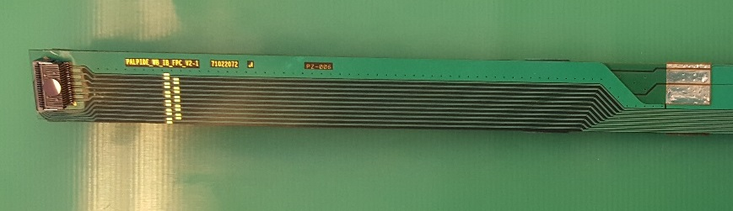
From Antonello Di Mauro
FPC Extension for Connection to Electrical Services
2-layer flex, PI: 50 µm, Cu: 35 µm, solder mask: 20 µm
analogue
analogue
Unchanged
digital
DGND
AGND
Longer copper traces ~30cm
for sPHENIX, no other components
digital
The two flexes are connected together, AVDD is transferred from top to bottom
digital
AVDD
DVDD
The PWR extension is connected to the FPC by iron soldering and wings are cut.

Slide 44
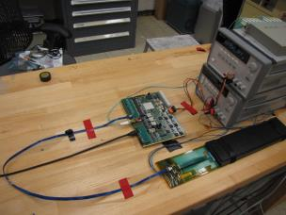
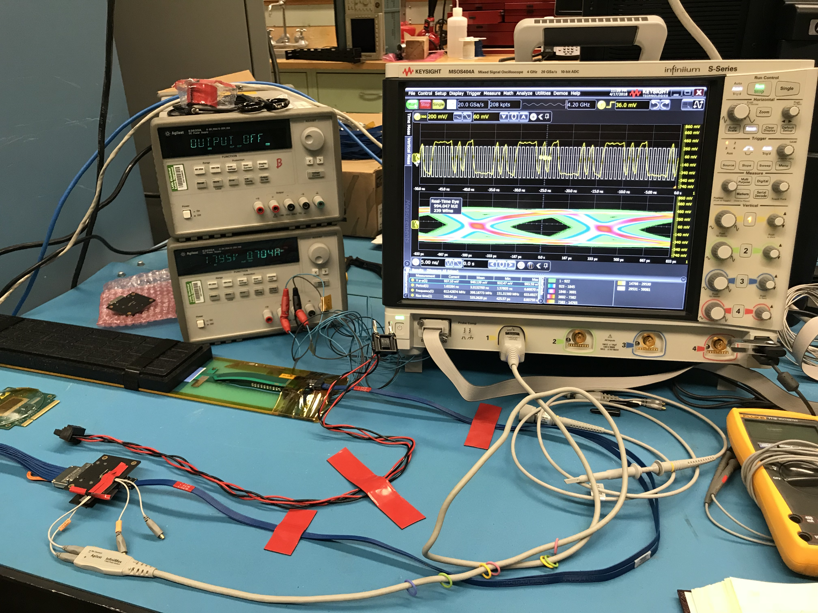
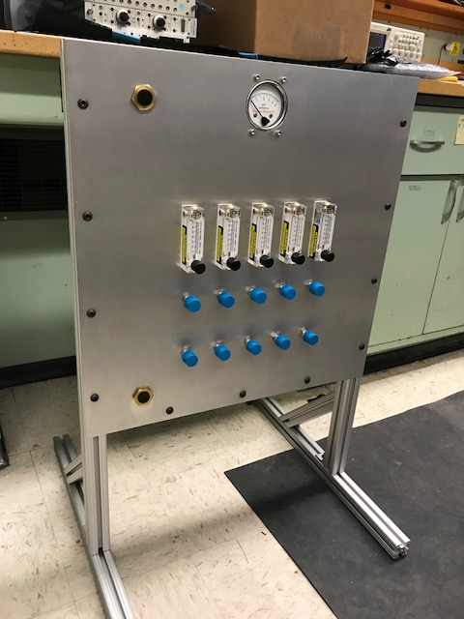
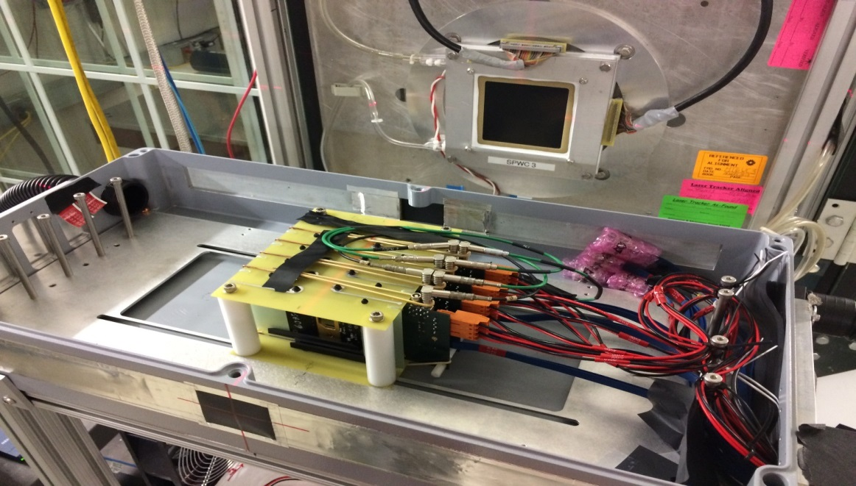
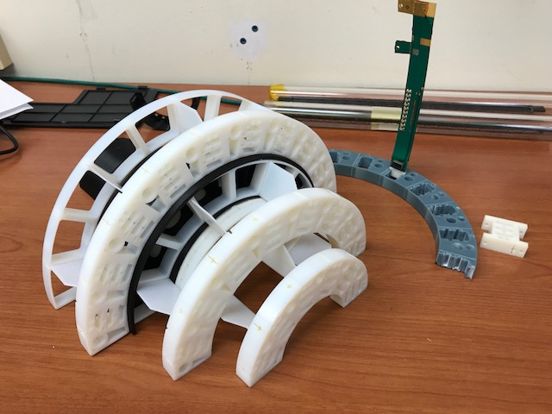
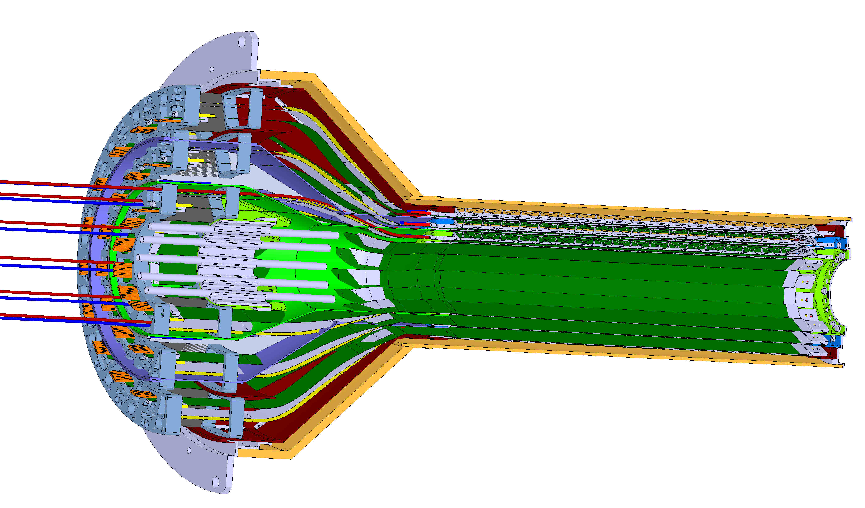
LANL LDRD Activity Highlights
MAPS evaluation
Readout integration
4-sensor telescope
Test beam at Fermilab
Mechanical & cooling
Readout R&D
Signal integrity & cables
RU
Cooling system
prototype
stave
4-ALPIDE Telescope;
5m-long SamTec cables
Service cone R&D
Sensor source test
FPC power extension R&D

Slide 45
sPHENIX/MVTX IB Stave Assembly
Procedure at CERN by ALICE ITS Group
Prepare sensors and FPC
Glue 9 sensors to FPC
Wire bonding 9 sensors to FPC
Solder power flex PCB to FPC
Glue HIC to coldplate/carbon space frame
A stave is ready for QA
CMM

Slide 46
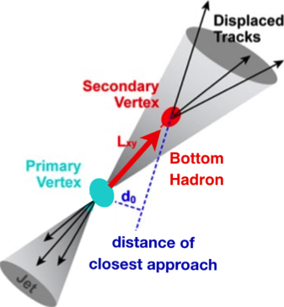

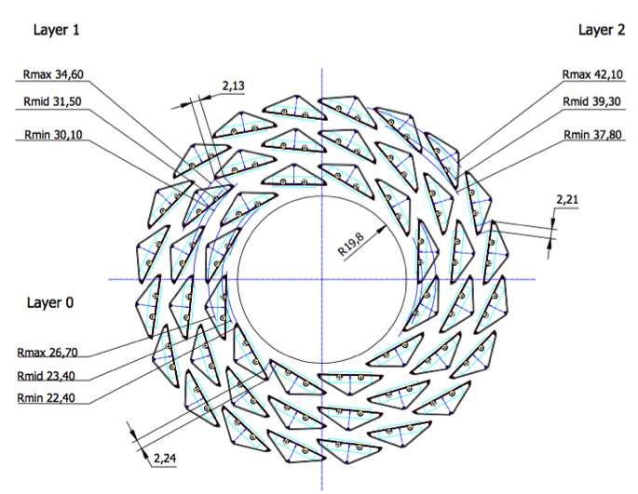
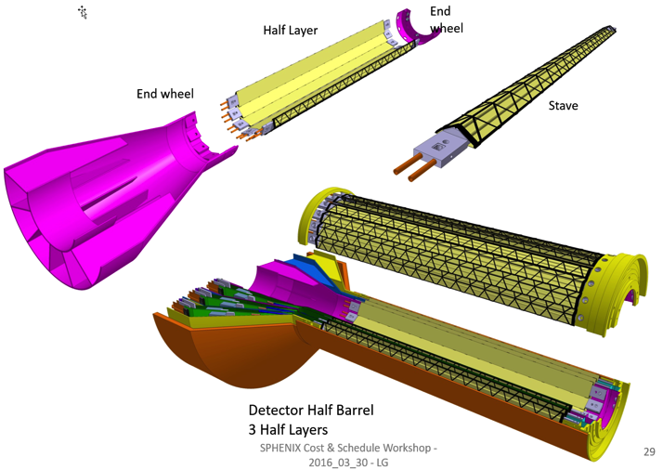
MVTX: MAPS-based VerTeX Detector
sPHENIX@RHIC
(2023+)
Key integration tasks:
Readout
Mechanics
ALICE ITS Upgrade @CERN;
Inner Tracker System (2021+)
sPHENIX Inner Tracking: MVTX
“Adopt” ALICE ITS/IB:
- Minimum risk
- Maximum physics
Leveraging on extensive R&D and design work by ALICE

Slide 47


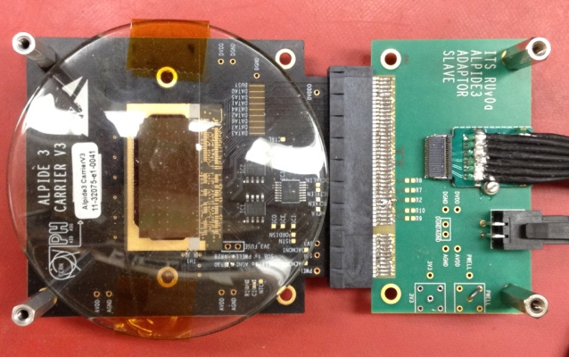
Monolithic Active Pixel Sensors (MAPS)
The Next-Generation, State-of-the-Art Pixel Tracker
Advantages of ALICE PIxel DEtector (ALPIDE) sensor:
Very fine pitch (27μm x 29μm), for superb spatial resolution
High efficiency (>99%) and low noise (<10⁻⁶), for excellent tracking
Time resolution, as low as ~5 μs, for less pileup
Ultra-thin/low mass, 50μm (~0.3% X₀), for less multiple scatterings
0.5M channels with on-pixel digitization, for zero-suppression and fast readout
Low power dissipation, 40mW/cm², for minimal service materials
An ideal detector for QGP physics!
Flexible Printed Circuit(FPC)
9 Chips
Cold plate
A 9-chip MAPS stave, 1.5cm x 27cm
ALPIDE design
ALPIDE sensor:
1.5cm x 3.0cm, 0.5M channels
50 μm
~28 μm

Slide 48
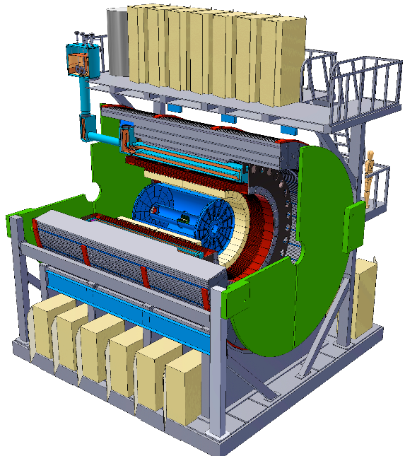



Simulation for b-jet and B-meson tagging
sPHENIX Geant4 display of p_{T}=30 GeV/c B⁺-hadron
Design to Simulation
MVTX and INTT _
_ MVTX Ladders modeled in details
MVTX sensors

Slide 49
Expected Performance
Tony’s talk

Slide 50

MXTX possible cable routing in sPHENIX
Walt
Possible location for the two MVTX racks, from previous slide
Estimated 2D plane cable length 7.3 meters

