Slide 1
MVTX Major Cost Items
Major Items | Cost w/ 35%Cont. ($M) | Schedule
Staves (WBS 1.5.3.1) | 1.3 | 8/2018-5/2019
Readout & Controls (WBS 1.5.2) | 1.3 | 1/2019-6/2019
Mechanics & Detector Assembly (WBS 1.5.3) | 1.8 | 2019-2022, TBO
Integration (WBS 1.5.4) | 1.0 | 2021-2022, TBO
Project Management | 1.0 | 8/2018-1/2023

Slide 2
Time Sensitive Items: ~1.5M
Stave production @CERN: 1.3M
  0.97M(quote from ALICE, $11.5K/stave x84)
  Cost & technical risk reduction
Readout Unit: 0.66M
  0.48M (best estimate, paid for RUv1.0, 58RUs)
  Cost reduction (~50%) through ALICE mass production
Major Items | Cost ($M) | Schedule
Staves (WBS 1.5.3.1) | 1.3 | 8/2018-5/2019
Readout & Controls (WBS 1.5.2) | 1.3 | 1/2019-6/2019
Mechanics & Detector Assembly (WBS 1.5.3) | 1.8 | 2019-2022, TBO
Integration (WBS 1.5.4) | 1.0 | 2021-2022, TBO
Project Management | 1.0 | 8/2018-1/2023
CCNU?

Slide 3
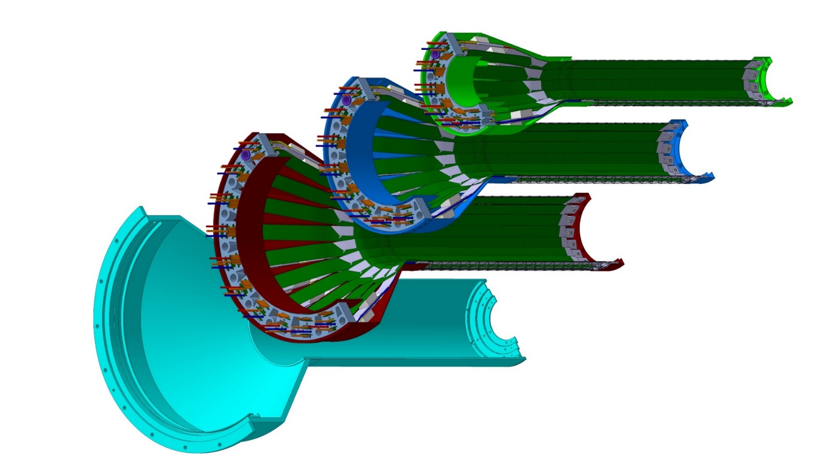
Detector Assembly @LBNL/CCNU?
Layer 0
Layer 1
Layer 2
IB CYSS

