Slide 1
sPHENIX @RHIC
Ming Xiong Liu
Los Alamos National Laboratory
5/22/2017 @CCNU

Slide 2
Outline
Discovery of QGP at RHIC
  Jet quenching in QGP
  J/Psi suppression in QGP
The next step – sPHENIX
  Physics
  Detectors
Heavy Flavor Physics with MVTX upgrade
Outlook

Slide 3
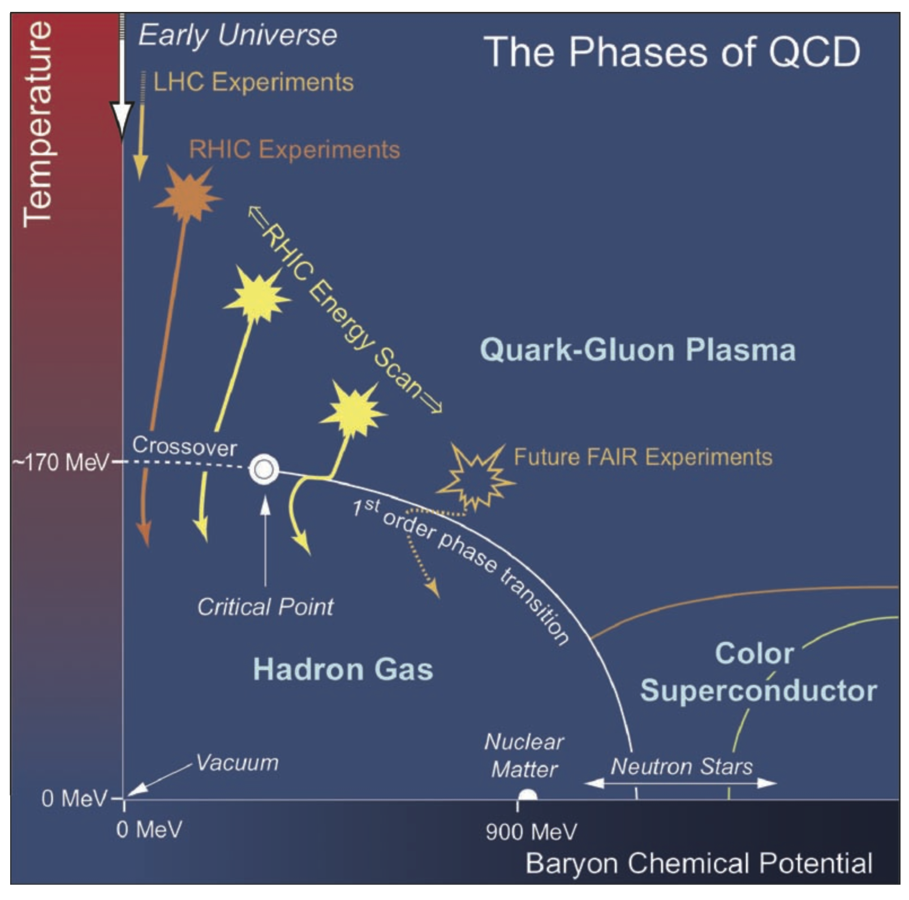
Early Universe and QCD Phase

Slide 4
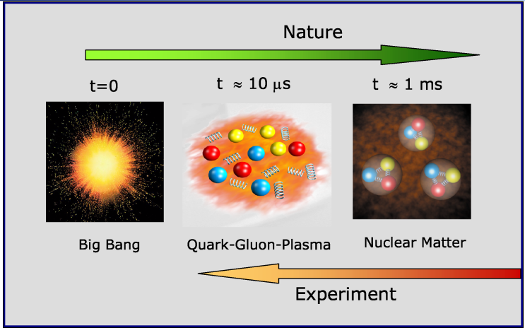
Recreate a State of the Early Universe?

Slide 5
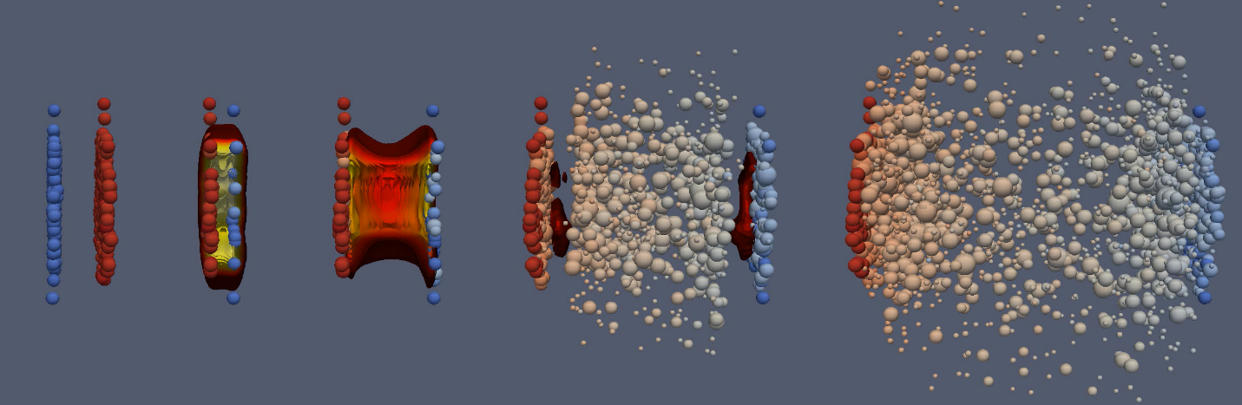
Create QGP in Heavy Ion Collisions?!
Au + Au collision
QGP
Hadrons

Slide 6

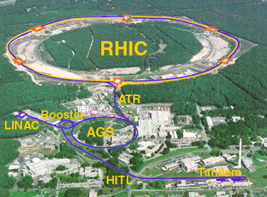
The Relativistic Heavy Ion Collider
at Brookhaven National Laboratory
RHIC’s First Decades: A discovery Machine
HI
New state of matter
QGP
De-confinement
…
polarized proton
Nucleon Spin Structure
Spin Fragmentation
pQCD
…
RHIC is a QCD Lab:
PHENIX -> sPHENIX -> EIC
BRAHMS
PHENIX/
sPHENIX
STAR

Slide 7
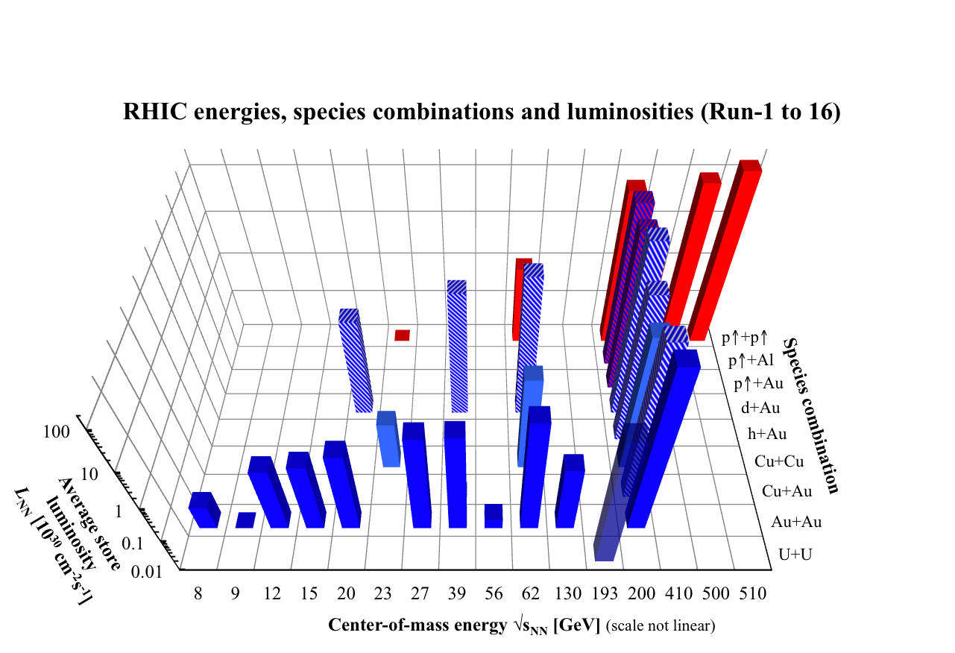
RHIC – a very flexible machine

Slide 8
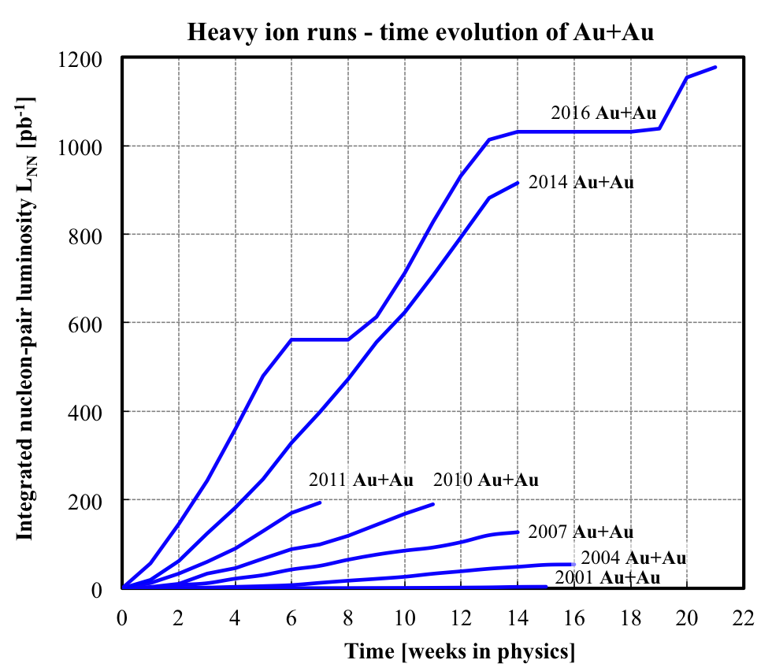
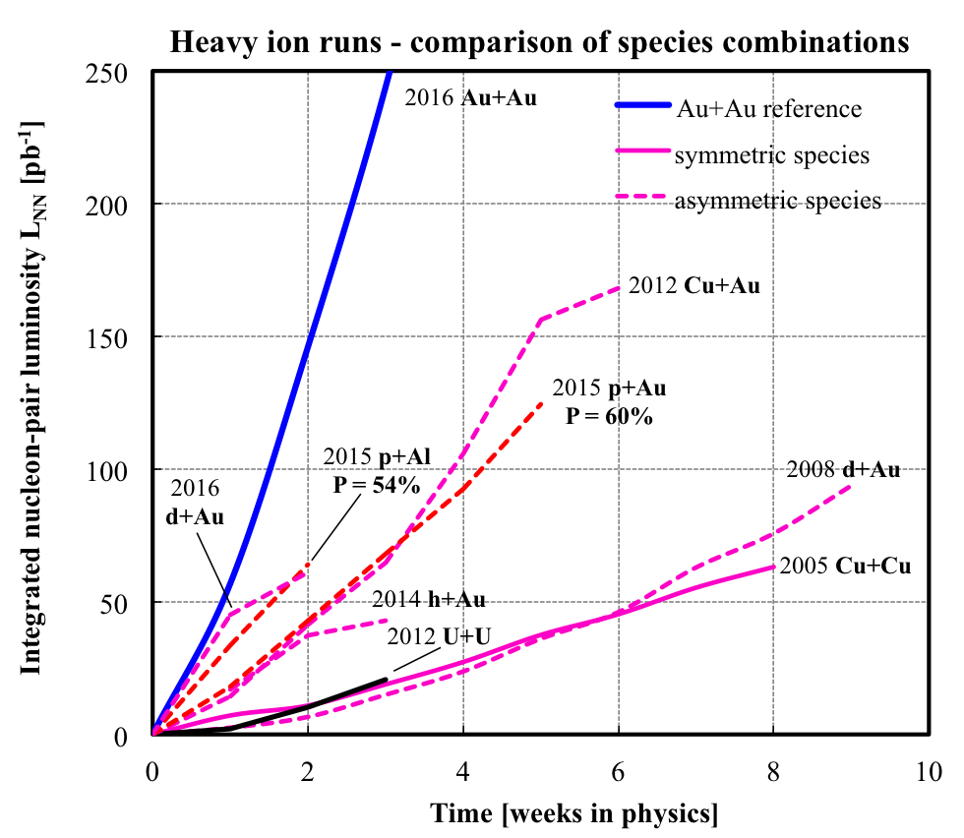
RHIC Runs: 2001 – 2016+
PHENIX completed data taking in 2016, in transition into sPHENIX upgrade
STAR continues to ~2020, BES-II etc.

Slide 9
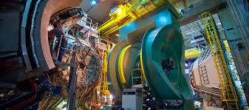
PHENIX Detectors at RHIC: 2001-2016
A large international collaboration, ~500 scientists from 13 countries

Slide 10
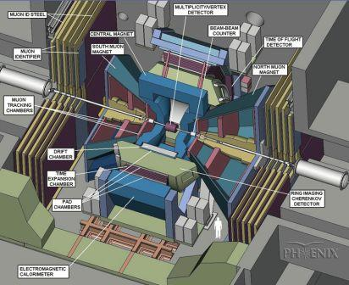
PHENIX Detectors

Slide 11
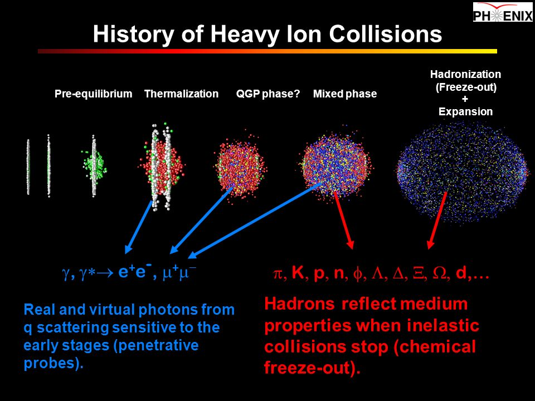

Slide 12
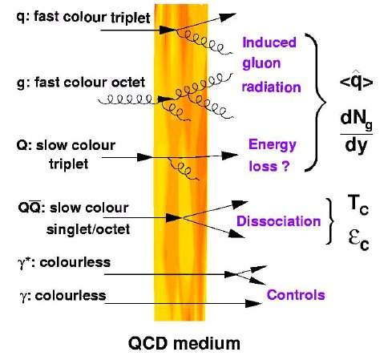
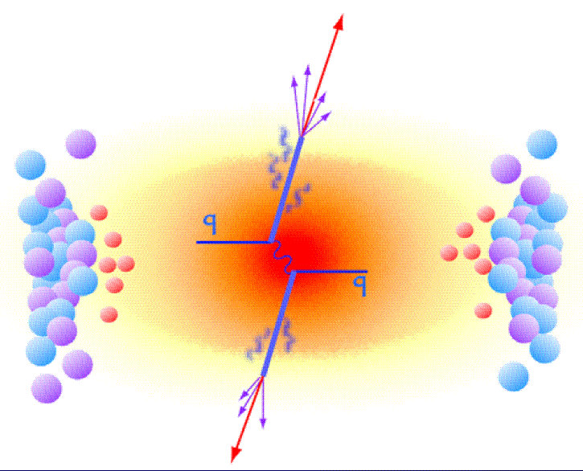
QGP and Jet Quenching
High density QGP medium suppresses high energy particle productions

Slide 13
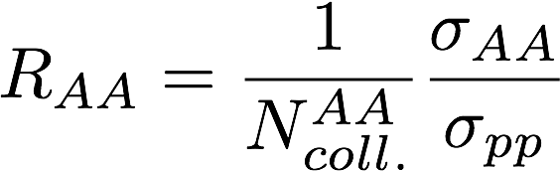
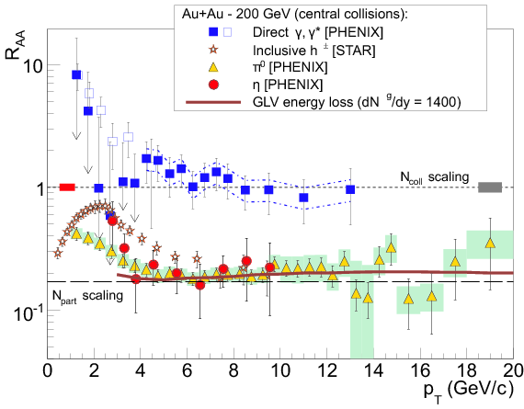
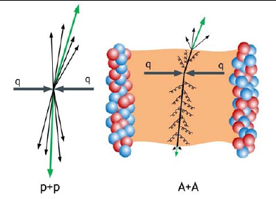
Large Jet Quenching Observed @RHIC
QGP density > 10x normal nucleus

Slide 14
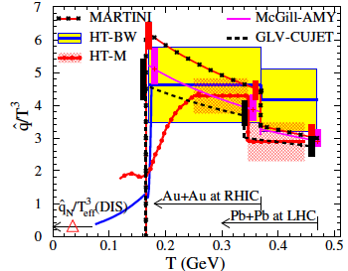
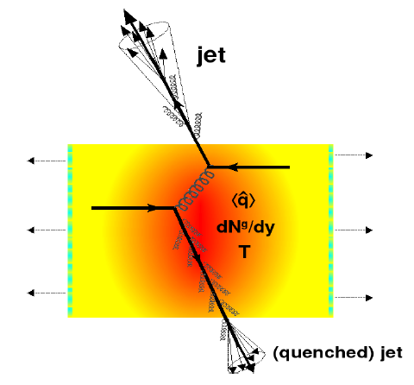
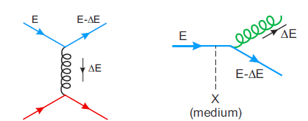

QGP and Jet Quenching
Various parton energy loss mechanisms
  Radiative energy loss
    e.g. DGLV, BDMPS, AMY …
  Collisional energy loss
Theoretical quenching factor
- much model dependent!

Slide 15
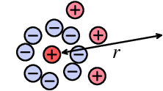
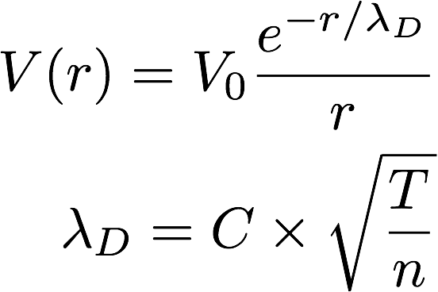
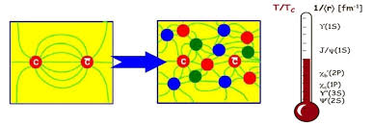
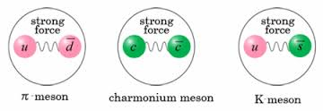
QGP Color Screening and J/Psi Suppression
Plasma Debye Length:
The shorter the r_{D},
the stronger the screening
effects

Slide 16
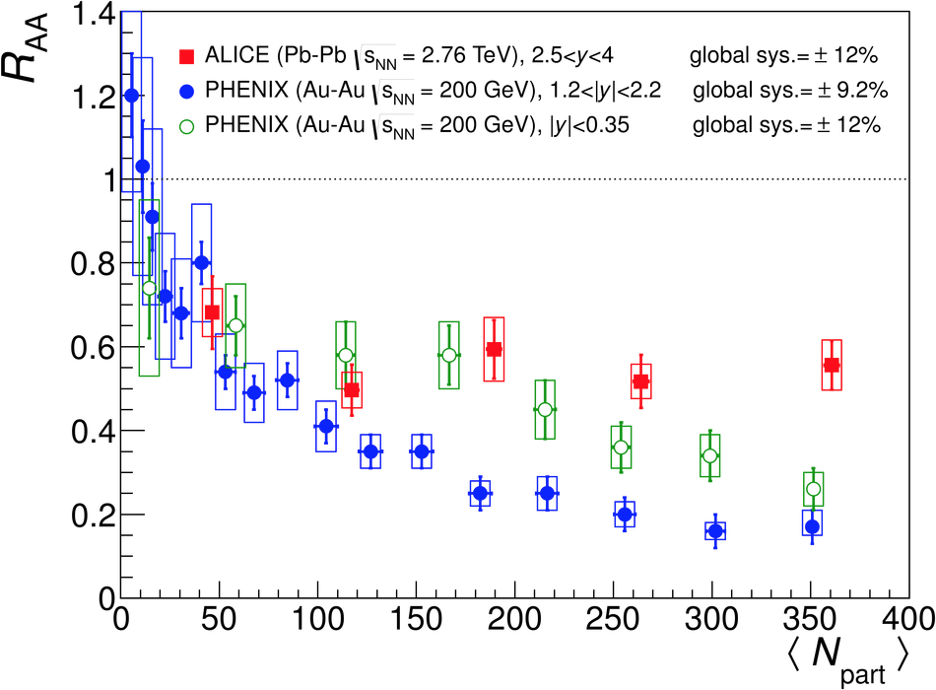
J/Psi Suppression at RHIC and LHC a surprise?
Large recombination
@LHC?
Large suppression
@RHIC ?

Slide 17
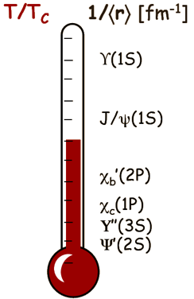
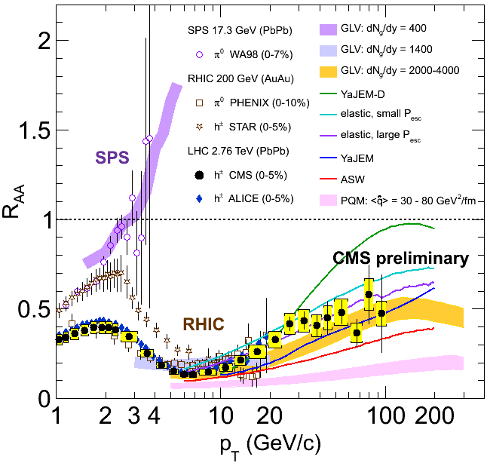
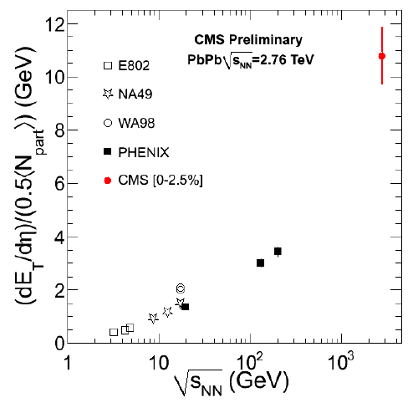
Compare RHIC vs LHC Results
LHC ~ RHIC! @high pT
Parton dE/dx & QGP properties
  Radiation & collisional dE/dX
    Light vs heavy quarks
  CNM effects
QGP color screening & heavy quarkonia “melting”
  Color screening & recombination
  CNM effects
h
Jet suppression
J/Psi suppression
Achieved QGP Densities
LHC
RHIC

Slide 18

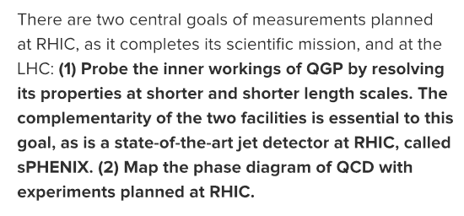
Why sPHENIX @RHIC?
RHIC Au+Au Luminosity
2016
2001

Slide 19
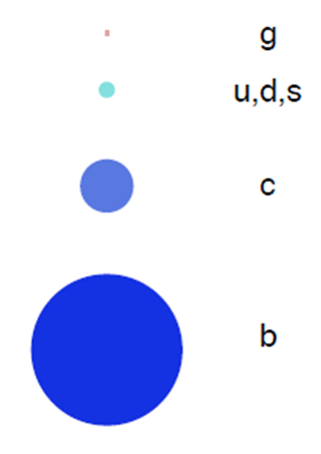
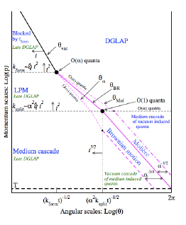
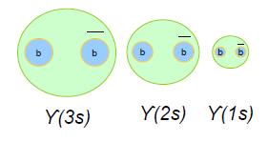
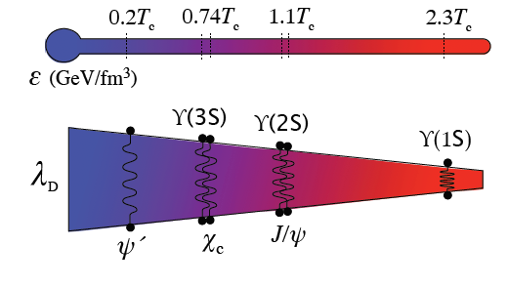
Probe QGP at multiple scales
Parton Mass/Flavor
Jet evolution and structure
Upsilon spectroscopy
Phys. Lett. B 740 172 (2015)

Slide 20


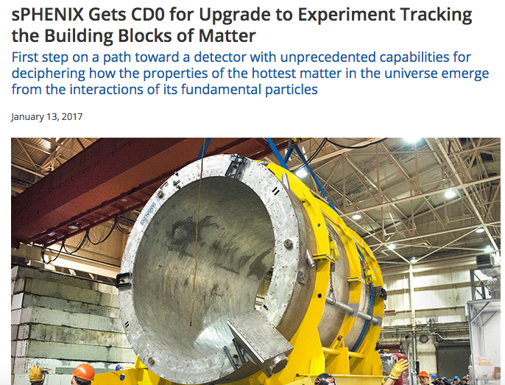
sPHENIX Status
Nov 2015
Collaboration formed (Dec 2015)
Successful magnet tests
Successful Test Beam of calorimeter system
Tracking system defined:
  TPC and Silicon tracking
Improved simulations
CD-0! Approve Mission Need
  DOE project phase: Initiation
CD-1 review Nov. 2017
Oct 2016

Slide 21
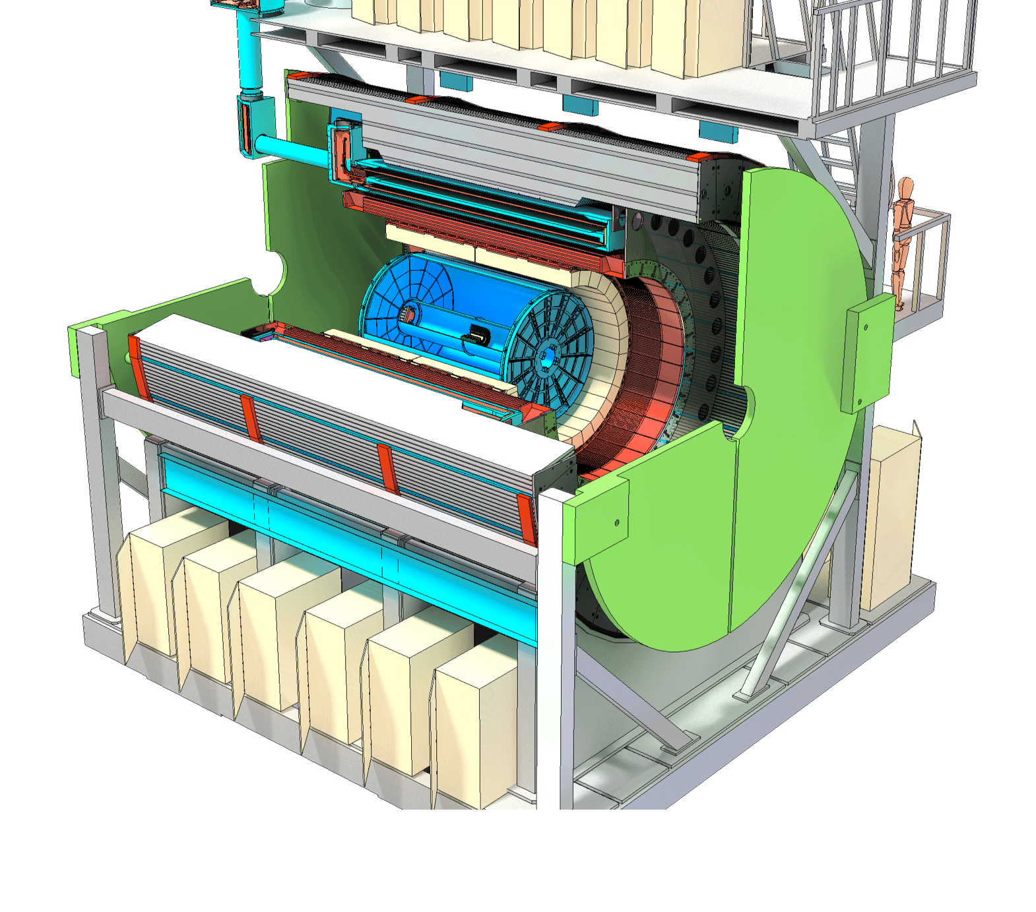
Detector Designed for Measurements
TPC
INTT
MVTX
Outer HCal
Solenoid Magnet
Inner HCal
EMCal

Slide 22
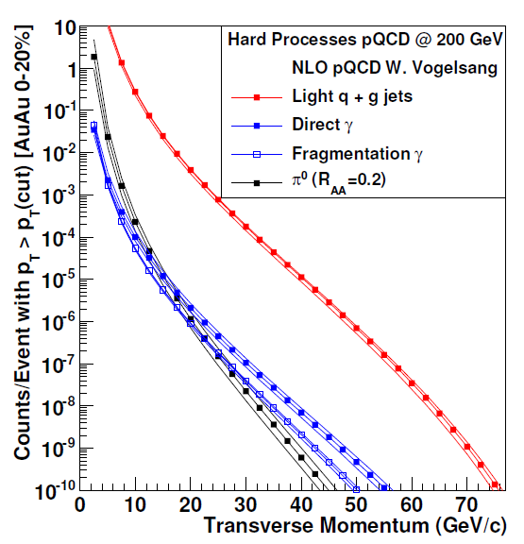
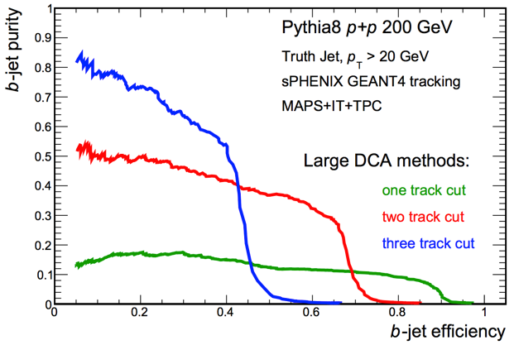
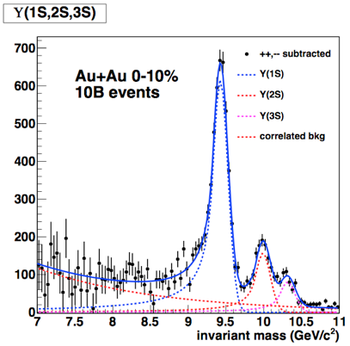
Measurements of sPHENIX
22 weeks of Au+Au at RHIC
100B MB events
20B 0-20% events
Central Yields p_{T} Range
10⁷ jets > 20 GeV/c
10⁶ jets > 30 GeV/c
10⁴ γ_{dir} > 20 GeV/c
10⁴ b-jets > 20 GeV/c
Jet Structure
b-tagged jets
3 state ϒ suppression

Slide 23
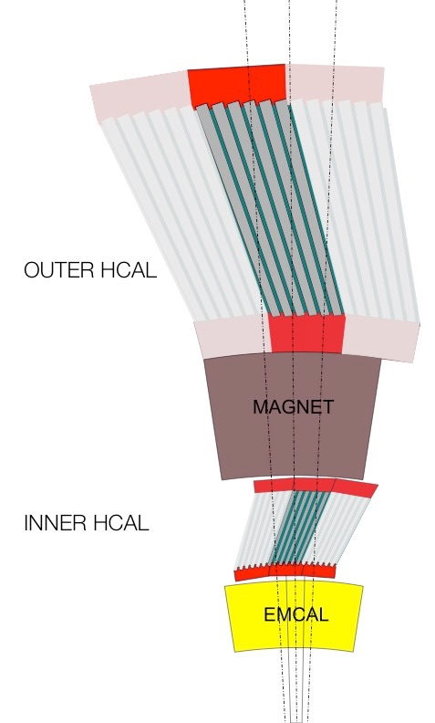
Calorimetry for Jet Physics
Physics Goal | Detector Requirement
Jets/Fragmentation Functions/jet substructure | Single particle Resolution: σ/E < 100%/√E
Distinguish Upsilon States | Good e/π separation
HF jet tagging | Electron ID
Designed to Measure Jet energy

Slide 24
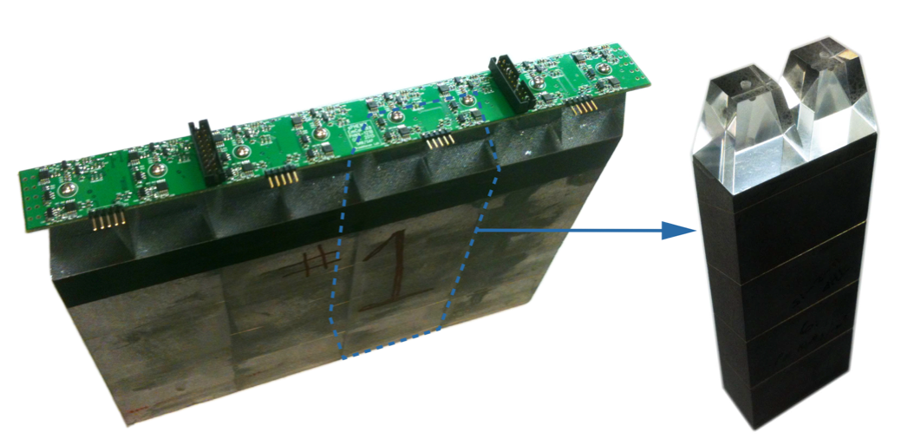
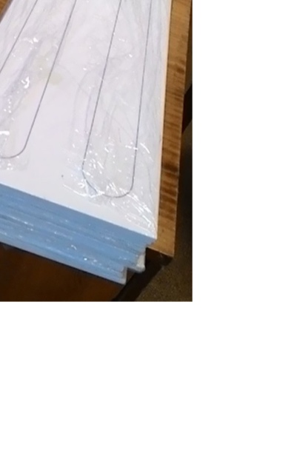
The Calorimeters
EMCal Towers: fibers embedded in Tungsten-epoxy
HCal: Plastic scintillator tiles with embedded fiber between tilted steel plates
All read-out with SiPMs

Slide 25
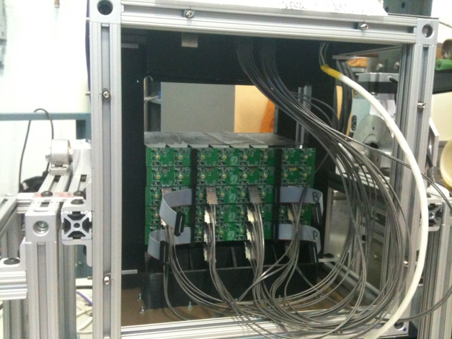
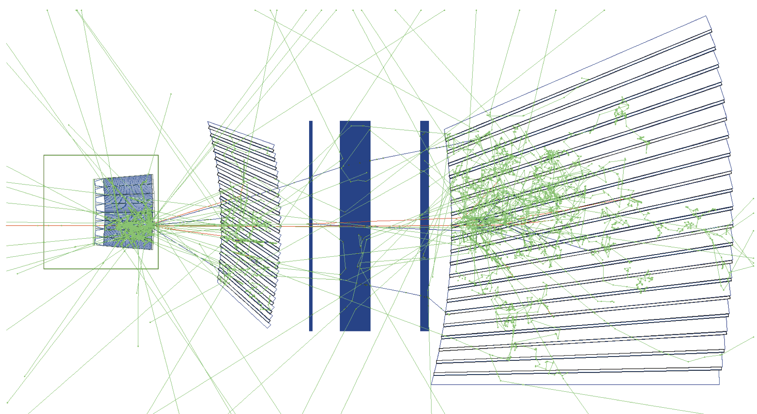
Test Beam 2016
How well does simulation reproduce the data?
EMCal
Mock Cryostat
Beam
Inner HCal
Outer HCal

Slide 26
Test Beam 2016 – EMCal Results
Resolution meets sPHENIX requirements
Excellent data-simulation agreement

Slide 27
Test Beam 2016 – HCal Results
Resolution within sPHENIX expectations
Excellent data-simulation agreement

Slide 28
Test Beam 2016 – Hadrons
Combined system takes into account where the particles shower develops
Satisfies the single particle energy resolution needed for sPHENIX program

Slide 29
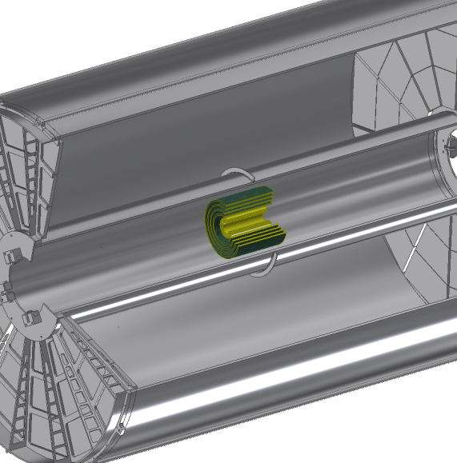
Importance of Tracking for QGP Physics
Physics Goal | Detector Requirement
Fragmentation Functions | Excellent Momentum Resolution: dp/p ~ 0.2%p to > 40 GeV/c
Jet Substructure | Excellent track pattern recognition
Distinguish Upsilon States | Mass resolution: σ_{M} < 100 MeV/c²
HF jet tagging | Precise DCA resolution σ_{DCA} < 100 μm
High Statistics Au+Au 200 GeV | Handle multiplicity and full RHIC luminosity
TPC
INTT
MVTX

Slide 30
Tracking for Jets and Upsilons
MVTX
3 layers Si pixel
Based on ALICE ITS upgrade
DCA_{xy} < 70 μm
|z_{vtx}|< 10 cm
INTT
TPC
Radius 20–78 cm
~250 μm effective hit resolution
Continuous (non-gated) readout
Pattern recognition, momentum resolution, p_{T} 0.2-40 GeV/c
4 layers Si strips
Use PHENIX FVTX electronics
Pattern recognition, DCA, connect tracking systems, reject pile-up

Slide 31
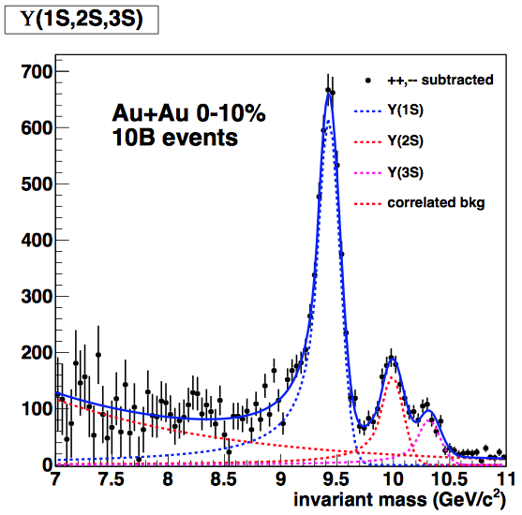

Designed to Measure Upsilons
Modeled as uniform cylindrical tracking layers
Single track efficiency 90% by 5 GeV/c in p+p
Momentum resolution ~0.06 at 30 GeV/c

Slide 32
Surprises in Jet Quenching
Important to study heavy flavor at low pT ~ M

Slide 33
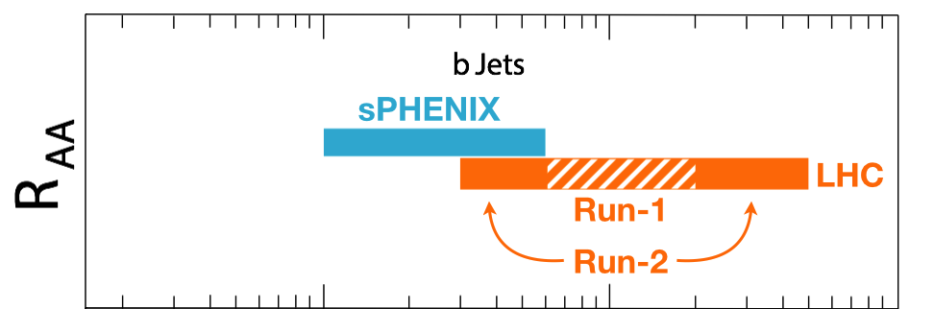
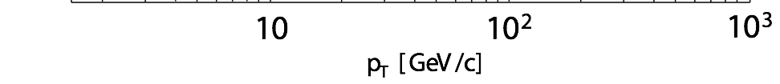
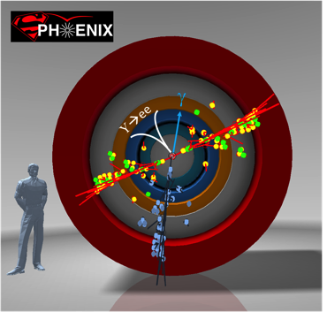
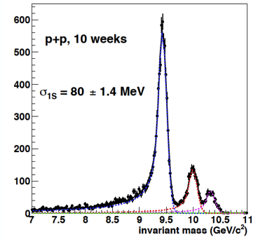
Open Heavy Flavor Physics: the 3rd Pillar
Cannot be done at the LHC for lack of low pT reach and huge backgrounds
sPHENIX is the next flagship heavy ion physics experiment in US
  Jets
  Upsilons
  B-jets & B-hadrons
MVTX will complete b-jet physics
sPHENIX Three Physics Pillars
Jets
Upsilons
B-Jets Physics

Slide 34


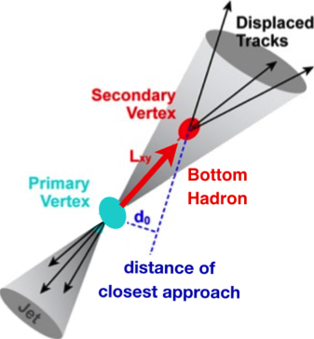
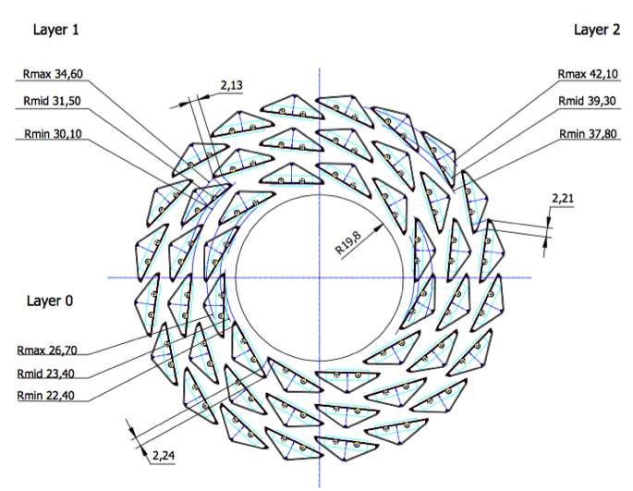
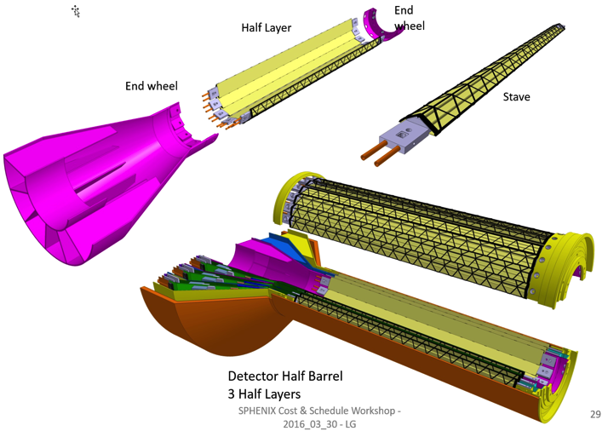
MAPS-based Vertex Detector (MVTX) Upgrade
2022+
ALICE ITS Upgrade (2021+);
Inner Tracker System
Key issues:
- Readout
- Mechanics
sPHENIX Inner Tracking
“Adopt” ALICE/ITS
Mini. risk,
Max. physics

Slide 35

sPHENIX MVTX Project
MVTX in sPHENIX
MVTX

Slide 36

Project Tasks and Timeline
FY2016
FY2017
FY2018
FY2019
FY2020
FY2021
sPHENIX
baseline
CD-0
9/2016
CD-1
CD-2/3
8/1
Ready for
Beam
6/1
ALICE ITS/IB
Prod. ends
Readout R&D
Mech. design
@LANL/ALICE
A schedule driven project!
Key R&D
Mech. Integr.
& Prototype
@MIT/LBNL
Production
MAPS Prod. & QA
@ALICE
Stave prod.&test @CERN;
RU prod @CERN
CRU Prod. @US
Detector Assembly
& Test @LBNL
Det. Install.
@BNL
+2%
+50%
“MoU” w/ ALICE/ITS: 11/2016
- Produce MAPS chips and Stave Space frames for sPHENIX as part of ALICE production!
- Full staves and RU & CRU production cost & schedule → MVTX MIE

Slide 37


MVTX Designed to Measure b-jets
Outstanding DCA resolution
  25 𝜇m for p_{T} 1-2 GeV/c
Simulation Improvements:
  Realistic ladder geometry

Slide 38

TAMU Model heavy quark diffusion and hadronization/recombination

Slide 39






B Production @RHIC
STAR: QM17

Slide 40

X. Dong

Slide 41
MVTX Project Status and Plan
Pre-proposal submitted to DOE, 2/2017
  Follow-up discussions with DOE and BNL managers
Plan to update proposal to DOE, late 2017
  Expanded science “CD0” + Cost & Schedule “CD1”
  Funding in FY18, stave production @CERN in Aug. 2018+, ~6 months;
  Other options being explored for stave production @CERN/CCNU for delayed ALICE/ITS or funding
BNL Director’s Review July 10-11, 2017
  Expanded science “CD0” + Cost & Schedule “CD1”
System integration R&D
  Readout
  Mechanical support

Slide 42
Outlook
Projected sPHENIX Schedule
CD-0 9/2016
Construction Phase Jul 2018
Installation complete Apr 2021
Ready for Beam Jan 2022

Slide 43
Forward s/ePHENIX
Cold QCD at EIC
Partonic structure of the proton
Low-x and Saturation
Spin-momentum correlations
Diffraction
Hadronization in e+A
sPHENIX era Cold QCD
Transverse spin phenomena
Collective behavior in small systems
Pre-equilibrium QGP
CNM physics in p+A

Slide 44
Summary
sPHENIX obtained CD-0 and working toward next stage
  Topical groups studying the physics goals
    Jet structure
    HF jets
    Heavy quarkonia
    Cold QCD, spin, saturation
Tracking defined:
  MVTX, INTT, TPC
Beam tests of calorimeter system
  Calorimeter performance within sPHENIX requirements
  Simulation reproduces the data very well
Active collaboration with lots to do:
  https://www.facebook.com/sPHENIX.Experiment/
  Looking forward to data in 2022

Slide 45

Collaboration
62 institutions, 235 collaborators & growing
3rd Collaboration Meeting @ GSU Dec 2016
Please join us for the exciting journey!

Slide 46
Backup slides

Slide 47

Big Bang and Early Universe

Slide 48

B Physics @sPHENIX
RHIC physics reach
  PHENIX
  STAR
D physics well covered by RHIC and LHC/ALICE
  What we learned
  Desires B measurements at low pT
sPHENIX opportunity
  Precision B and b-jet measurements
  Upsilons

Slide 49


sPHENIX Coverage
Low pT B mesons?
  0<pT<20GeV
  Currently limited at both RHIC/LHC to
    B->J/Psi + X
    B->leptons + X
Inclusive B measurements
  R_{AA}
  V₂
  Correlations
B-Jet in A+A
  <Z> ~ 0.8 in p+p
  pT_Jet >~20GeV

Slide 50


Theory Predictions

Slide 52


Elliptic Flow of D⁰ in 10-40%
STAR
Liang He, Tue 17:10
Mass ordering
NCQ scaling
D⁰ v₂ for 10-40% follows mass ordering and
NCQ scaling of other hadrons
→ Evidence for thermalization of charmed mesons
Submitted
arXiv:1701.06060
* Whole 2014 HFT data from second pass of production

Slide 53


Upsilon Production
QM17, Zaochen Ye
Indication for more suppression towards more central collisions
In central collisions Υ(2S+3S) is more suppressed than Υ(1S)
→ sequential melting
Indication for less suppression than at LHC for Υ(2S+3S)

Slide 54


Slide 55


Slide 56

D: pT > 8GeV
B->J/Psi: pT > 6.5GeV

Slide 57

MAPS-based Vertex Detector (MVTX)
|eta| < 2.0
R = 2.4; 3.2; 3.9cm;
L = 27.1cm
“Adopt” ALICE ITS Upgrade Inner Barrel 3-layer MAPS detector
  Mini. risk, Max. Physics
Precision vertexing for b-jet/B-hadron tagging with high efficiency and high purity
B-jet modification in QGP at low-medium pT to determine QGP properties, study mass-dependence on collisional vs radiative energy loss, flow etc.
A separate DOE MIE to build the full detector, WBS 1.12, ~$5M for construction;
Early R&D by LANL/LDRD, $5M, FY17-19, readout and mechanical integration;

Slide 58
Scope of the MVTX Project
MAPS staves & Electronics
  MAPS Detectors
    “MoU” to build 68 ITS MAPS staves
    No modification
  Readout Electronics
    Use ALICE/ITS, RU + CRU
    Modify/reprogram CRU for sPHENIX
      Plan-B: build a custom board to convert ALICE/ITS into sPHENIX DAQ format; BNL FILEX etc.
    R&D by LANL LDRD
  Production
    Extend ALICE/ITS MAPS stave production
    sPHENIX personnel help assembly and testing staves at CERN
    Reproduce additional ALICE RU+CRU for sPHENIX
    Final assembly and test in US/LBNL
  Ancillary systems, copy ALICE
    LV, cables, crates, racks etc.
    Slow control, safety and monitoring
Mechanics & Cooling
  No/(some) changes to ALICE/ITS inner tracker mechanical structures
    End Wheels
    Cylindrical structure shells
    Detector half barrels
    Service half barrels
    Detector and Service half barrels
    Half support structures
  Mechanical Integration
    Conceptual design by LANL LDRD
    Prototype by sPHENIX R&D
    Design integration frames
    Carbon frames etc.
    Installation tooling etc.
  Copy ALICE cooling plant design
    Minor modification to fit sPHENIX
    Smaller heat load than ALICE ITS
  Metrology and Survey
WBS 1.12: a new MIE fund the full MAPS Vertex Detector, ~$5M

Slide 59






ITS Readout and Control System
5 m
Readout Unit
Optical Links
9 Sensor Stave
9 Data (1.2Gbps)
1 Clock, 1 Control/Trigger
Control
Data (9.6 Gb/s max)
Trigger
Samtec Twinax “FireFly”
Common Readout Unit (CRU)
Flex
Power
Alpide Sensors
Regulated Power
Filtering Board
(Capacitors)
regulators
Cold Plate
Power Board

Slide 60


Slide 61

Potential new groups:
Czech groups
Peking Univ.
CCNU – lab
USTC

Slide 62




The Goals of Little Bang: QGP Physics
- Understand the Properties of QGP
- Explore the QCD phase diagram
Before collision
Initial state
CNM effects
QGP
Hadron gas
Hadrons detected
Heavy Ion Collision – Time Evolution
Time (fm/c)
1 10
- Gluon saturation
- Parton shadowing
- CNM Parton energy loss

Slide 63


QGP Medium Behavior
Anisotropic flow

Slide 64





QGP Discovery @RHIC: 2004
QGP discovery announced in 2004 by RHIC experiments, confirmed later at LHC
Unambiguous evidence for phase transition from ordinary nuclear matter to QGP (T~175 MeV, ~10¹² degrees)
Exhibits strong collective behavior, has huge stopping power for color-charged particles (quarks, gluons – the fundamental constituents)
Fundamental discovery:
QGP is not a weakly interacting gas of quarks and gluons, but rather a strongly coupled near-perfect liquid!

