Slide 1
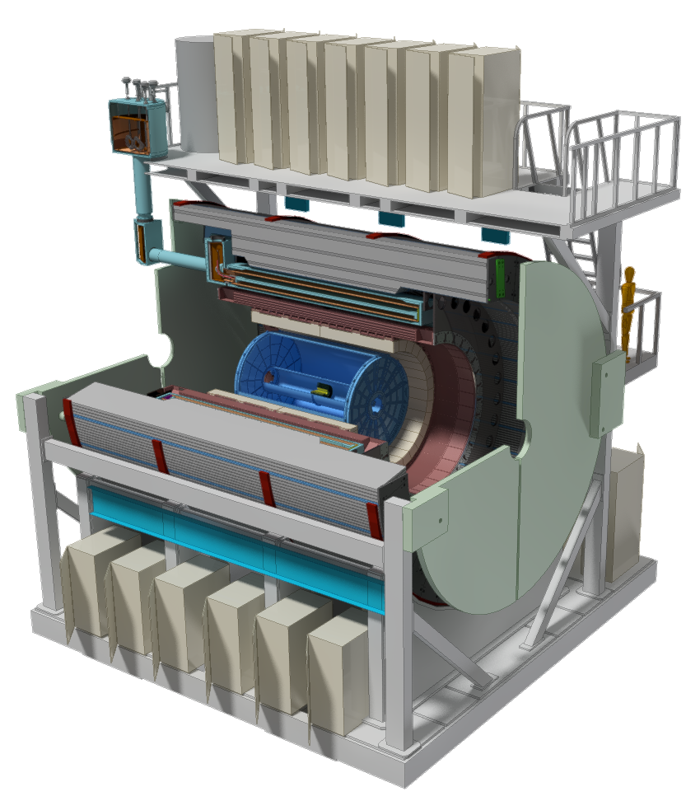
MVTX: WBS 1.12
A separate MIE as an upgrade project

Slide 2
MVTX Update
Meetings with Maria Chamizo Llatas of BNL Project Office
Weekly LANL/LBNL/MIT/BNL phone meetings to discuss path toward reviews, project plan etc
A full day meeting 4/25 @BNL, LANL/LBNL/MIT
Bi-weekly MVTX detector group meetings discussed
MVTX BNL Directors review: Science + C&S
~mid July, a dry run in late June
A draft charge of review, ~next week?
Cost and Schedule project file updated 4/7/2017
LANL & LBNL, detailed labor profile
MIT, discussed last week, some thoughts on mechanical integration issues
MVTX as a standalone, NO modification of the service end etc;
if other subsystems introduced, they work out integration issues
Potential increase in cost & schedule if MVTX/INTT/TPC, tracking integration task force report
Other institutions, in progress
DOE wants to keep the fund below $5M, possibly from some redirected $$
Project webpage: BOE, WBS, project file
https://p25ext.lanl.gov/maps/mvtx/mvtx.html

Slide 3
MVTX R&D Status
Readout R&D
Workfest @UT-Austin, 4/19-20
LANL MOSAIC test bench setup in progress
RUv1 available in May, will be used for LDRD telescope
CRU being prototyped with Altera evaluation boards, able to communicate with the board;
BNL/ATLAS FELIX being evaluated as an alternative
Computer arrived, fibers/cables ordered
Obtain one FELIX in a few weeks
Stave production for LDRD telescope
ALICE Stave Production Readiness Review 4/27, prod. Starts in May
LANL people do assembly and test at CERN, May – Sept. 2017
Project C&S – work in progress
Detailed commitment from each institutions etc
More work after BNL meeting w/ Project Office, 4/25
Tracker integration task force, led by Mickey
MVTX + INTT + TPC mechanical integration issues
Identify the major tasks, report due by the end of April
Resources will be workout later

Slide 4
Prepare for the BNL Director’s Review Physics/Detector Simulations
Produce preliminary by early June, prepare for a dry run in mid/late June
B hadron physics
B-jet physics
Detector performance plots
To be ready for BNL Directors Review in July
Money plots for the proposal

