Slide 1
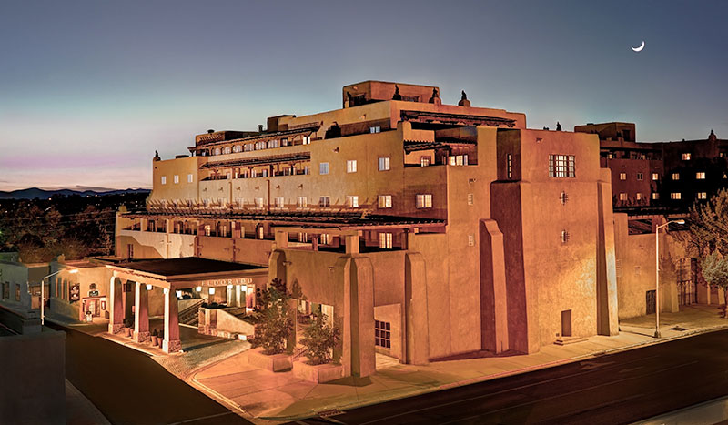
Welcome to Santa Fe!

Slide 2
Goals of the Workfest
MAPS detector group
  Make significant progress on MAPS MIE proposal
  Update the cost and schedule to be ready for discussion with DOE in Feb budget meeting
  Develop additional physics cases for MAPS detector beyond sPHENIX scientific proposal
HF-jet topical group
  Produce near final b­jet tagging performance plot for MAPS proposal and QM2017 conference
  Advance the tracking detector simulation towards new baseline simulation configuration
  Develop B-meson simulations

Slide 3
Plan
Day -1
  Brief summary of status
  Working sessions: simulations and MIE discussion
Day-2: parallel work sessions
  Simulations
  MIE writing
  End of the day summary
Day-3: parallel work sessions
  Simulations
  MIE writing
  End of the day summary

Slide 4

Group Lunch Today: 12:30 – 14:00

Slide 5


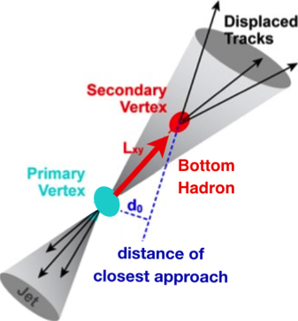
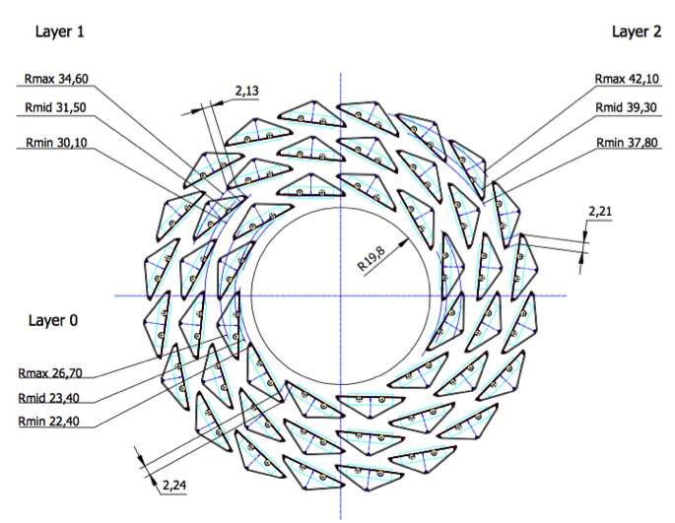
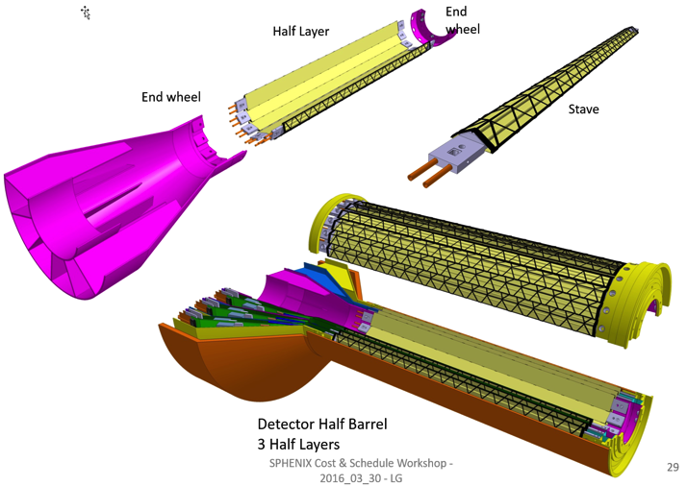
sPHENIX MAPS Inner Tracker
2022+
ALICE ITS Upgrade (2021+);
Inner Tracker System
Key integration issues:
- Readout
- Mechanics
sPHENIX Inner Tracking
“Adopt” ALICE/ITS
Mini. risk,
Max. physics

Slide 6

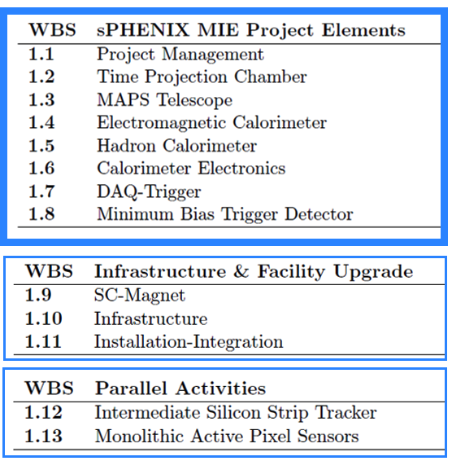
WBS of the Latest sPHENIX MIE
From Ed O’Brien
A new MIE to build the full MAPS detector

Slide 7
Toward the full MAPS MIE
Early communication with DOE
  MIE pre-proposal, ~20 pages
  Science, resources and cost & schedule
  First full doc by the end of Jan 2017, for DOE Feb. budget meeting, LANL & LBNL
Possible timeline of MAPS MIE
  Submitted and reviewed in FY17, establish DOE “mission need”
  Federal budget request by DOE, Feb 2018
  Fund available FY20 for construction (“normal route”)
Highly desired:
  Advanced funding by mid 2018 to produce full staves following the completion of ALICE/ITS/IB production at CERN
  Or high level “agreement” to secure CERN facility for sPHENIX

Slide 8
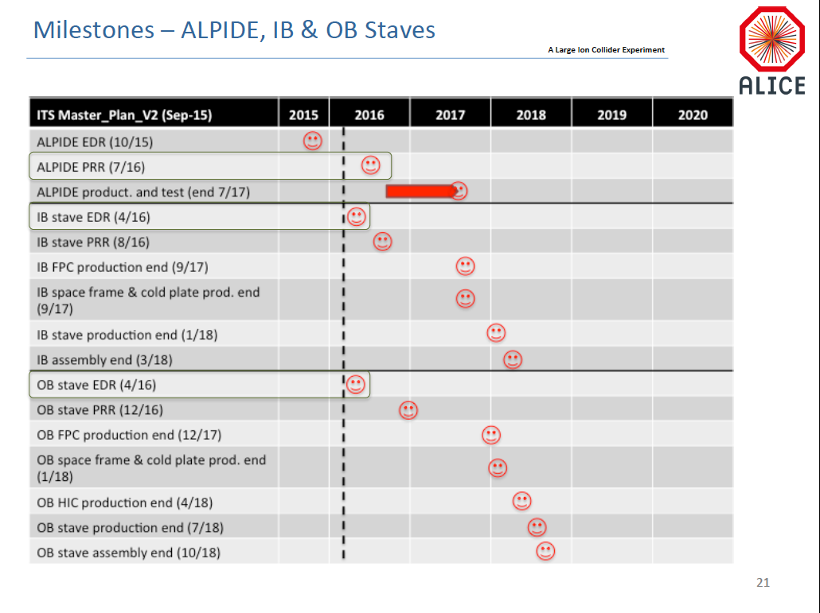
✔
✔
sPHENIX

Slide 9
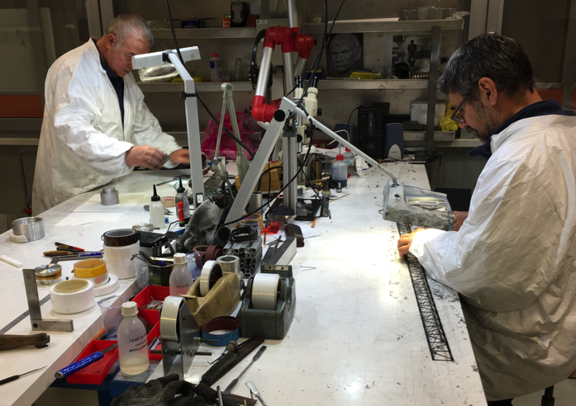
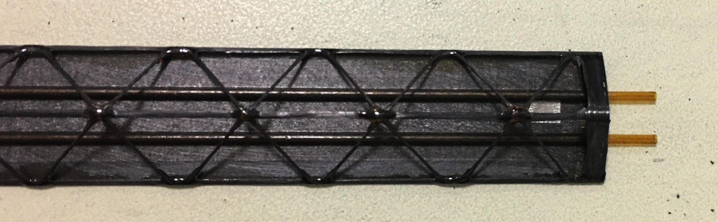
Stave Frame Production
Very good progress, ahead of schedule

Slide 10
Scope of the Project
MAPS & Electronics
  MAPS Detectors
    MoU to build 68 ITS MAPS staves
    No modification
  Readout Electronics
    Use ALICE/ITS, RDO + CRU
    Modify/reprogram CRU for sPHENIX
      Plan-B: build a custom board to convert ALICE/ITS into sPHENIX DAQ format
    R&D by LANL LDRD
  Production
    Extend ALICE/ITS MAPS stave production
    Train sPHENIX personnel for assembly and testing staves at CERN
    Reproduce additional ALICE RDO+CRU for sPHENIX
  Ancillary systems
    LV, cables, crates, racks etc.
    Slow control, safety and monitoring
Mechanics & Cooling
  No/(some) changes to ALICE/ITS inner tracker mechanical structures
    End Wheels
    Cylindrical structure shells
    Detector half barrels
    Service half barrels
    Detector and Service half barrels
    Half support structures
  Mechanics Integration
    Conceptual design by LANL LDRD
    Prototype by sPHENIX R&D
    Design integration frames
    Cage etc.
    Installation tooling etc.
  Copy ALICE cooling plant design
    Minor modification to fit sPHENIX
    Smaller heat load than ALICE ITS
  Metrology and Survey

Slide 11
Participating and Interested Institutions
LANL - Readout & FEMs, mechanical design
MIT – Mechanical integration, cooling system, stave assembly and testing at CERN and BNL,
LBNL – Carbon structure design and production, LV/HV PS and controls, system assembly and test
BNL – Integration and services, safety and monitoring, readout
UT-Austin – MAPS readout electronics and testing
Univ. of Colorado – sPHENIX DAQ/DCM-II integration
Univ. of New Mexico – LV cabling & connectors
New Mexico State University – Offline tracking and simulations
Iowa State University – Assembly and testing, simulations
Georgia State University - Slow control and monitoring, safety system
Florida State University - Offline and simulations
Univ. of California, Los Angeles – Assembly and testing, simulations
Univ. of California, Riverside – Assembly and testing, simulations
RIKEN/RBRC, Japan – Assembly and testing, integration
Yonsei, Korea – MAPS QA, simulations
CCNU – ALICE/ITS upgrade, 5th layer experience, assembly and testing
Univ. of IL of Chicago – Stave assembly and testing, simulation and offline analysis
Czech Group – Stave assembly and electronics testing at CERN
Purdue Univ. – Simulations and analysis
Potential collaboration

Slide 12
Organization Chart
Updated from
09/2016 review
BNL Program Manager
sPHENIX Project Office
Manager: Ed O’Brien
sPHENIX Management
Spokespersons
Gunther Roland
David Morrison
sPHENIX MAPS Project Office
Project Manager: Ming Liu (LANL)
Deputy Project Managers: G. Odytniec(LBNL), R. Redwine(MIT)
Electrical Engineer:TBD
Mechanical Engineer: Walt Sondheim
Readout
LANL/BNL
(Prokop)
MAPS Sensor
ALICE
Stave
LANL/ALICE
(da Silva)
Cablings & Test
UNM
C-Structures
LBNL/LANL
(Anderssen)
Mech. Integration
MIT/BATES
(Redwine)
Electrical & Safety
BNL
(Mannel)
Software
FSU/BNL/NMSU
(Frawley)
FEM
LANL/UTA
(Klein)
Sensor Production
TowerJAZZ
Stave Design
LANL/MIT
LV/HV Controls
LBNL
Assembly and Test
LBNL/MIT
Cooling
MIT
Low Voltage Cables
UNM/NMSU/LBNL
Simulation
LBNL/BNL/Purdue
Slow Control &
Monitoring
BNL/GSU
(He)
Sensor QA
Yonsei(Korea)
Assembly@CERN
MIT/CCNU/LANL
Fibers test
UNM
Installation
BNL/MIT
Alignment
BNL/UIC
Offline
BNL/NMSU
DCM Integration
U-Colorado
(Nagel)
Stave QA
LBNL/ISU/UIC
Mechanical Stability
BNL/LBNL
B-jet tagging
LANL/NMSU/LBNL
Safety System
BNL

Slide 13
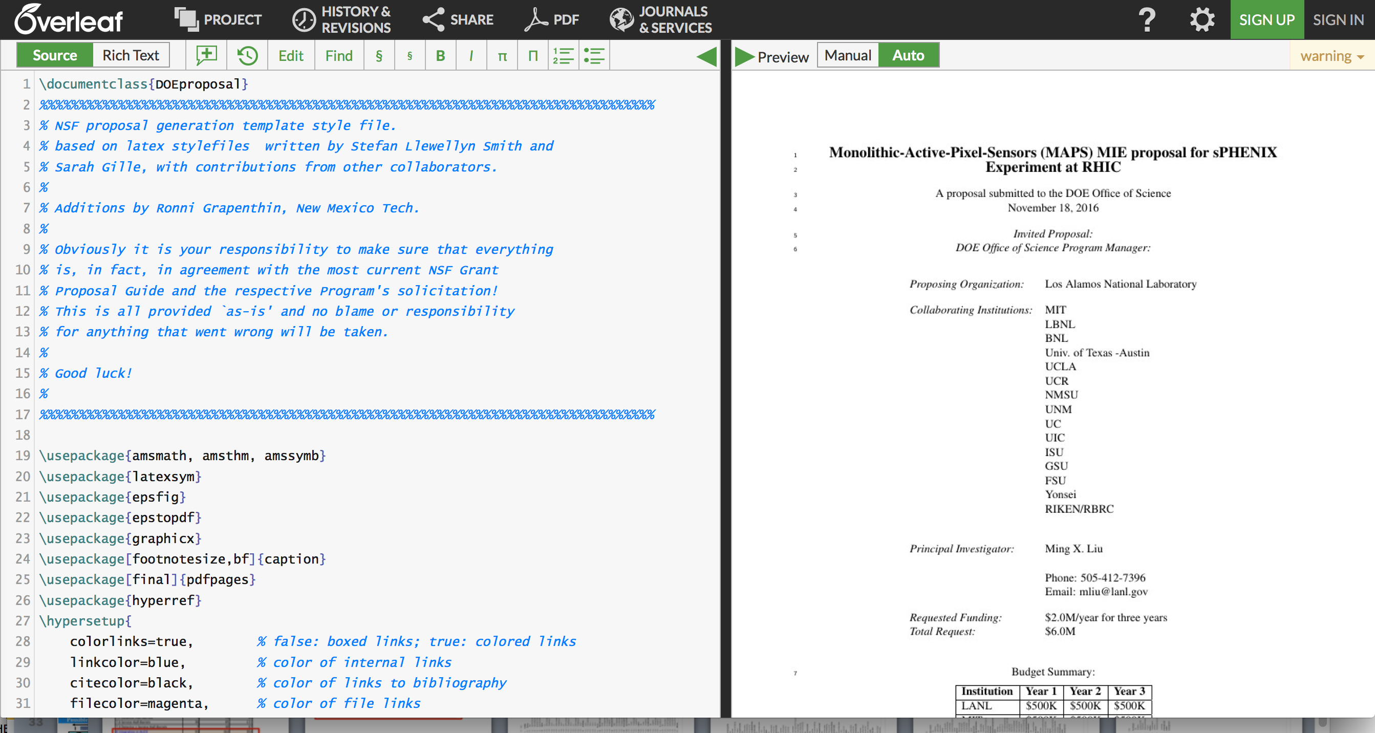
MAPS MIE Proposal Writing

Slide 14
Major Tasks and Lead Institutions for sPHENIX MAPS Project (MIE Writing)
MAPS chips/stave production
  LANL/ALICE (Ming Liu)
Readout integration and testing
  LANL, BNL, UT-Austin, U-Colorado (Mike McCumber)
Mechanical carbon structures
  LBNL (Grazyna Odyneic/Eric)
Mechanical integration
  MIT, LBNL (Bob Redwine)
LV/HV PS and controls
  LBNL (Grazyna Odyneic/Leo)
MAPS stave assembly and testing at CERN
  MIT, LANL, CCNU and others (Gunther Roland)
Full module assembly and test in US
  LBNL, MIT and others (Grazyna Odyneic)
Online software and Trigger
  BNL, GSU, LBNL (He)
Offline software - detector simulation, geometry, offline tracking
  NMSU, FSU, LANL (Tony Frawley)
Physics simulations - to make “Money Plots”
  LBNL, LANL, U-Colorado and all (Xin Dong)
Cost and Schedule and Resources (Dave Lee)
Collaboration and Org (Cesar)

Slide 15
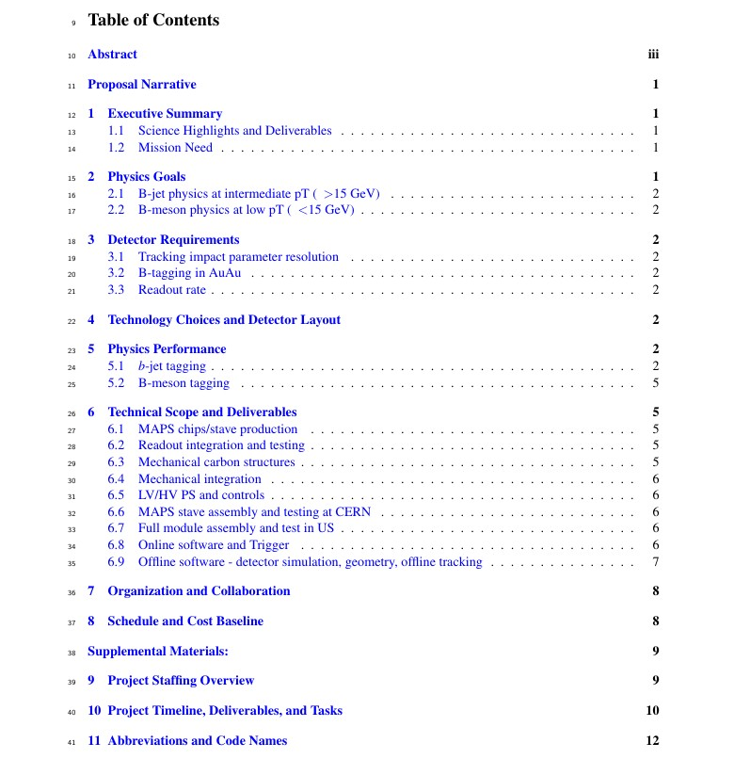
Editing/Proofreading – Dennis, Darren, Hubert et al
1. Ming, Mike, Gunther et al
2. Cesar, Xin et al
3. Jin, Darren, Haiwang et al
4. Giacomo et al
5. Tony, Haiwang, Jin et al
6.1 Cesar, Mike, Ming,
6.2 Grazyna/Leo, Ming et al
6.3 Walt, Grazyna/Eric et al
6.4 Bob, Gunther, Walt
6.5 Grazyna/Leo et al
6.6 Gunther etal
6.7 Grazyna/Leo
6.8 Xiaochun, Chris et al
6.9 Tony, Jin, Chris et al
7. Cesar, Gunther et al
8. Dave, Ming et al

Slide 16
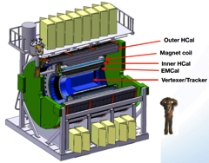
Project Tasks and Timeline
From 09/2016
review
FY2016
FY2017
FY2018
FY2019
FY2020
FY2021
CD-0
11/1
CD-1
11/1
CD-2/3
8/1
Ready for
Beam
6/1
ALICE ITS/IB
production
Readout R&D
Mech. design
@LANL/ALICE
A schedule driven project!
Key R&D
Mech. Integr.
& Prototype
@MIT/LBNL
Production
MAPS Prod. & QA
@ALICE
Stave prod.&Test @CERN;
RUs Prod. @US
Detector. Assembly
& Test @BNL
Det. Install.
@BNL
+2%
+50%
“MoU” w/ ALICE/ITS: 11/2016
- Produce MAPS chips and stave frames for sPHENIX as part of ALICE production!
- Full staves, space frames and RUs production cost & schedule → MAPS MIE

Slide 17
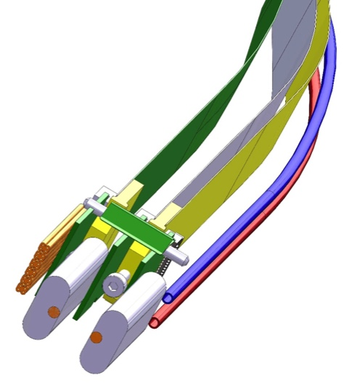
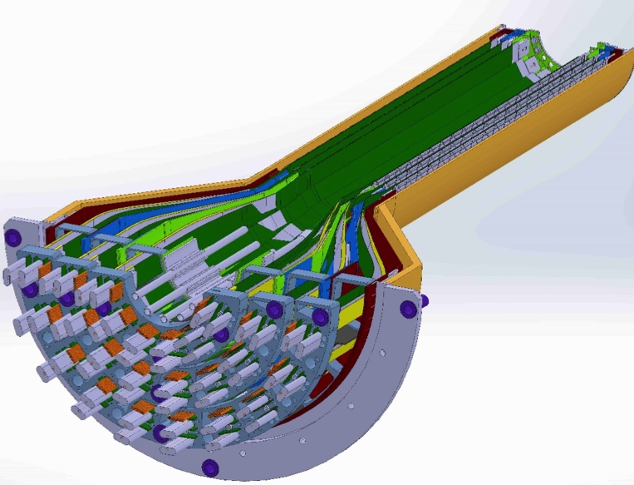
MAPS-sPHENIX Mechanical Integration
Service End Wheel
Possible modifications
High speed signal
Analogy power
Digital power
Cooling

Slide 18
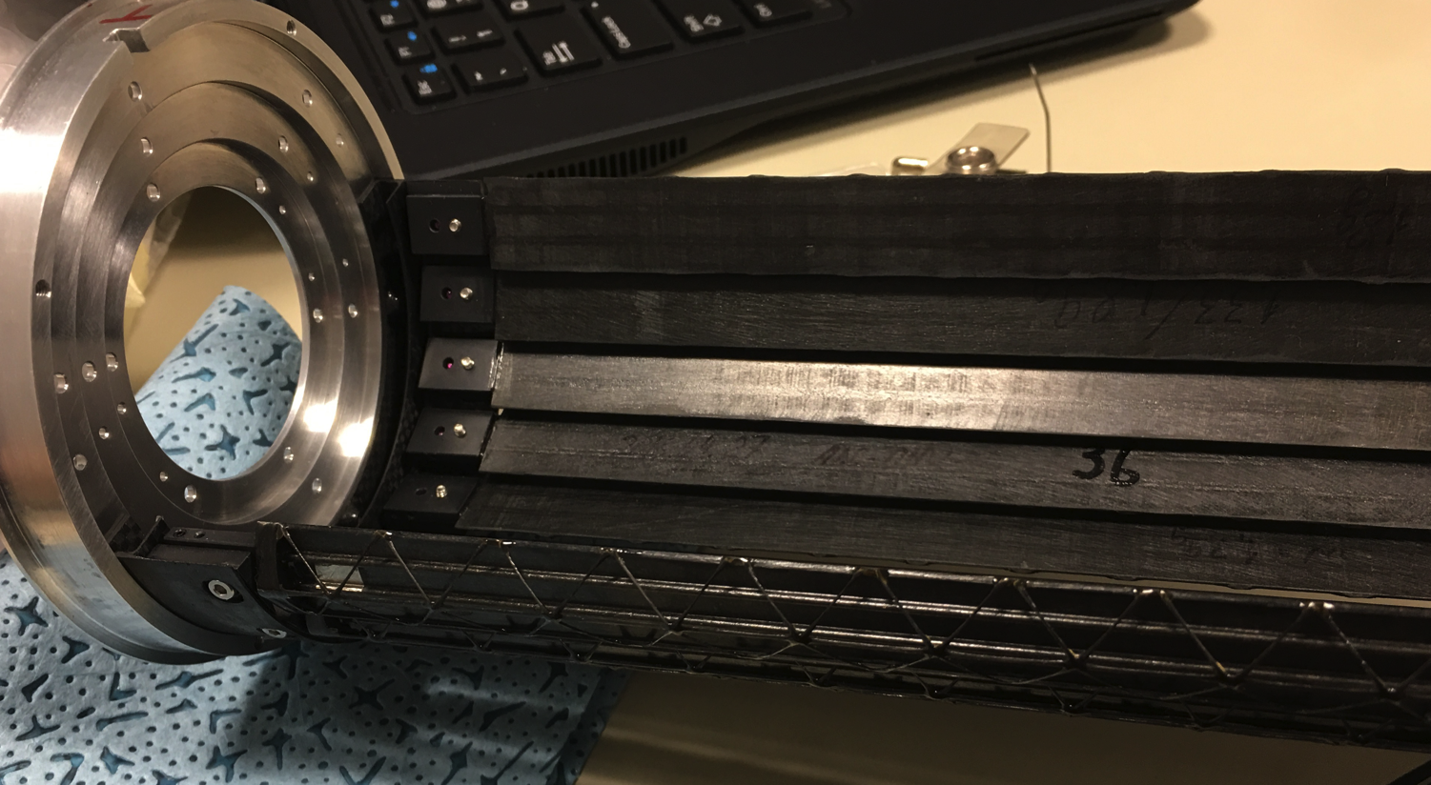
Staves

Slide 19
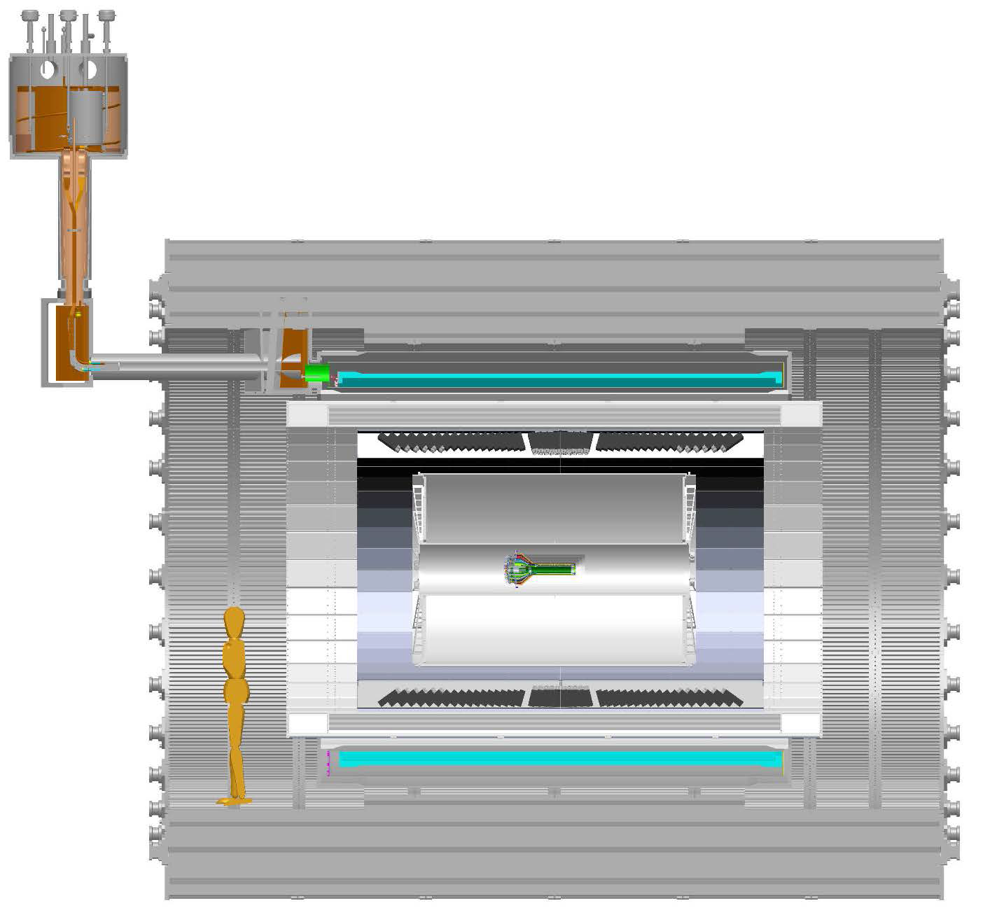
Global Support Structures and Other Services
MAPS->ReadoutUnitt:
- “5m” copper wires
- 6U VME modules
- 48 modules
RU->CRU@CH:
30+m fibers
Global support frame

