Slide 1
sPHENIX MVTX Upgrade
Ming Liu
Los Alamos National Lab
for the sPHENIX Collaboration

Slide 2
Outline
Science
MVTX upgrade
Physics prospects

Slide 3
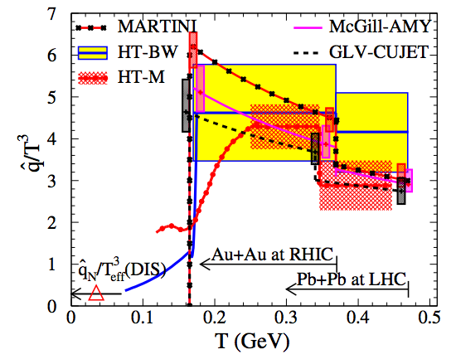
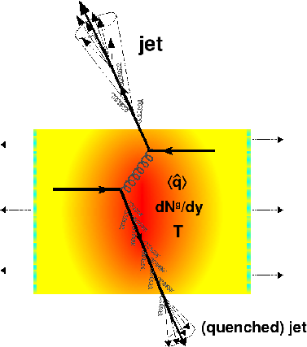
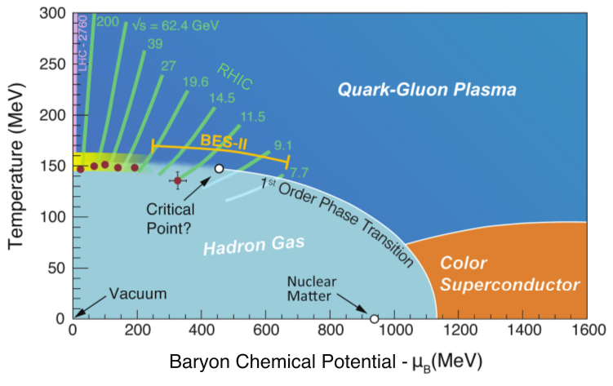
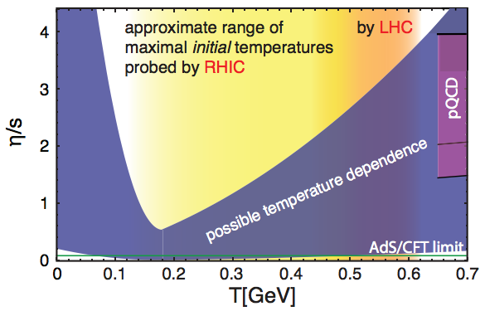
sPHENIX – the Next Generation HI Experiment @RHIC
To study the inner workings of QGP with,
  Jets
  Upsilons
  Heavy flavors

Slide 4
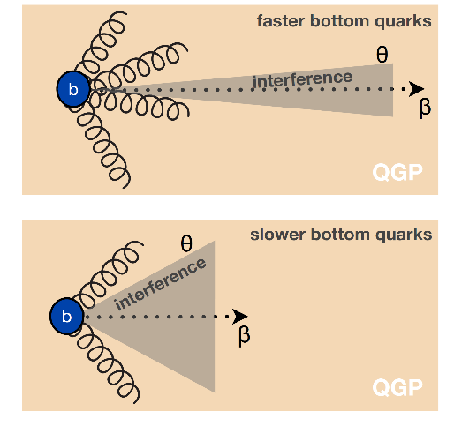
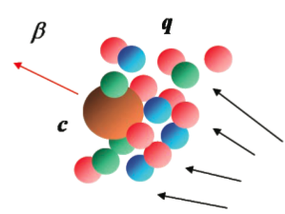
Heavy Quarks - Unique Probe of QGP
Study mass dependence
  Jet quenching
  Flow – interaction with medium
Access QGP properties
m_{u} m_{d}
m_{s}
Λ_{QCD}
m_{c}
m_{b}
MeV
1
10
10²
T_{c}
T_{QGP}
10³
10⁴

Slide 5
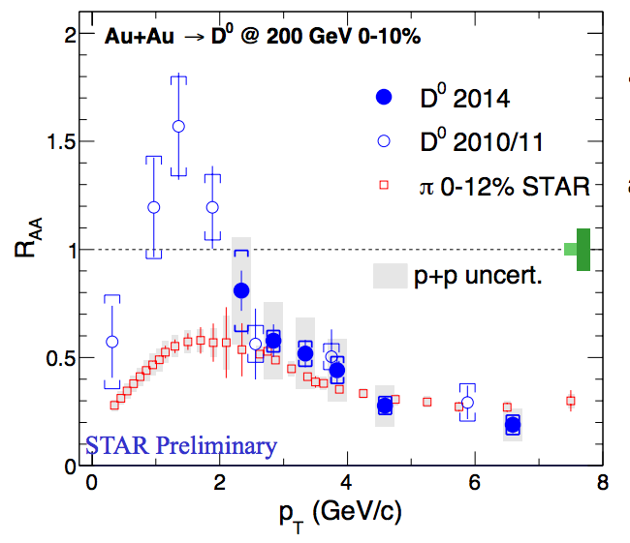
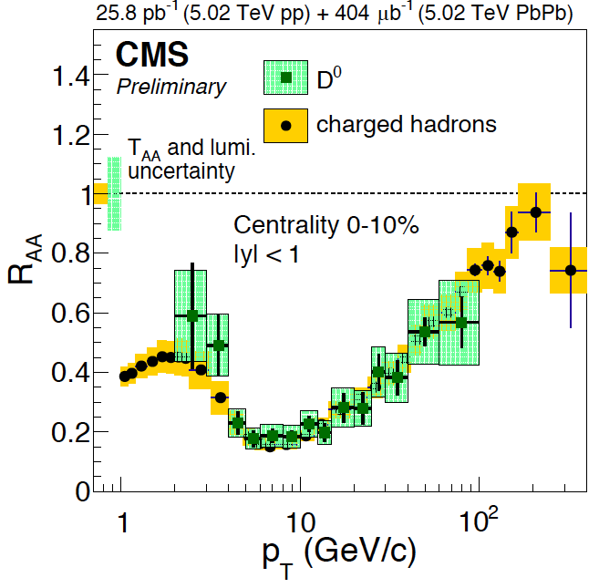
Charm R_{AA}
R_{AA} (D-meson) ~ R_{AA} (h) at high p_{T} ~> 4 GeV/c
significant suppression of charmed hadron R_{AA} in central A+A collisions
strong charm-medium interactions
mass effect expected important at low pT, dead-cone effects etc.

Slide 6
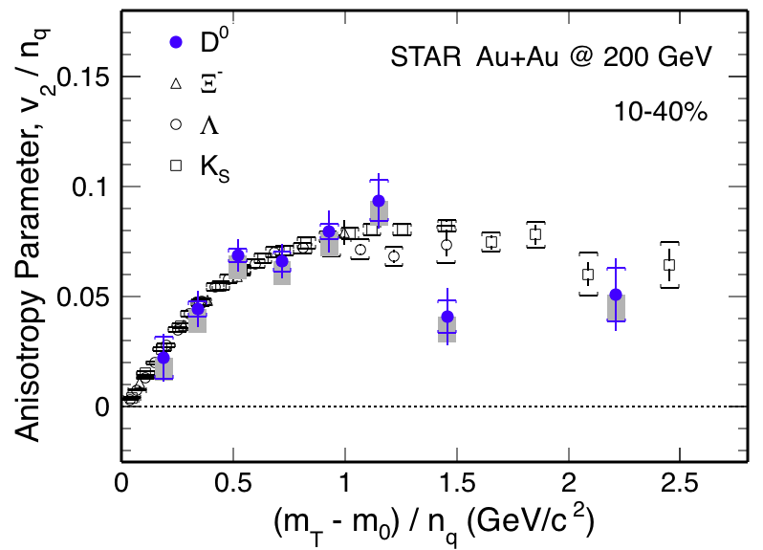
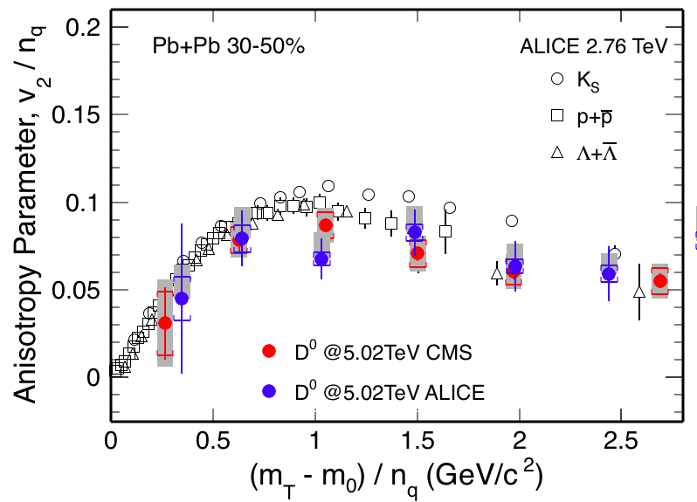
Charm V₂
v₂ of D⁰ follows the same trend as light hadrons
Charm quarks flow the same as light quarks
Strong coupling to medium at low pT?

Slide 7
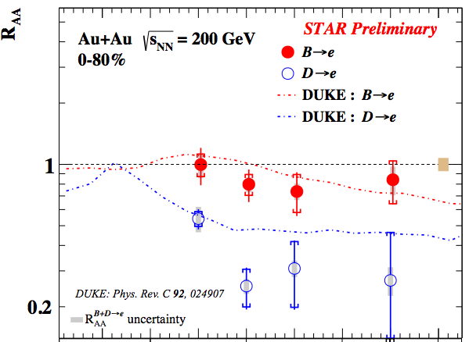
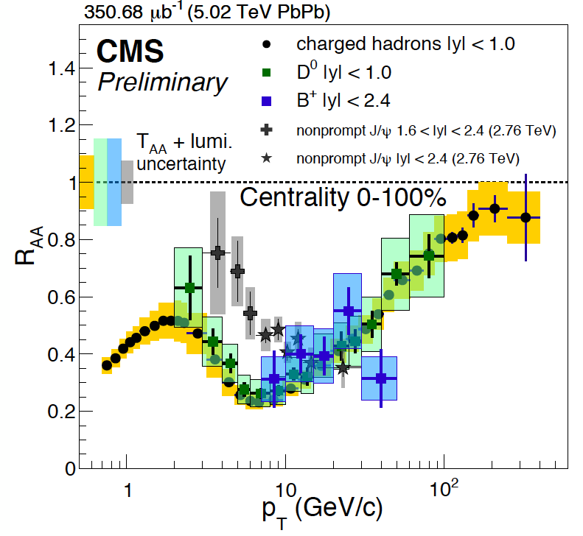
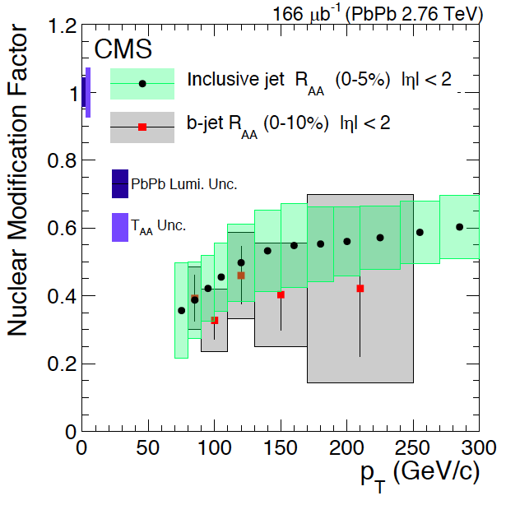

Beauty?
Highly desired:
precision measurements of
B @low pT ~< 50GeV
R_{AA} (B->e) > R_{AA} (D->e, h) @low pT
B⁺ & b-jet ~ light hadrons & charm @high pT
STAR, QM17

Slide 8
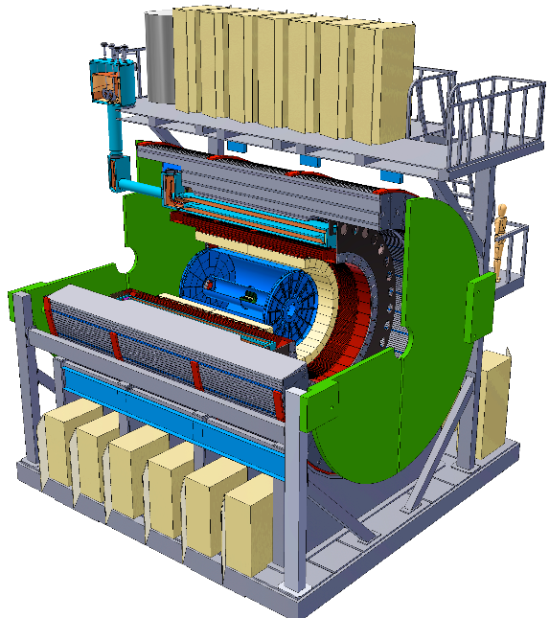
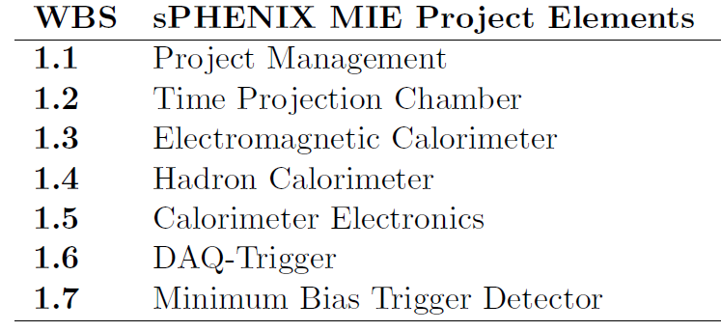
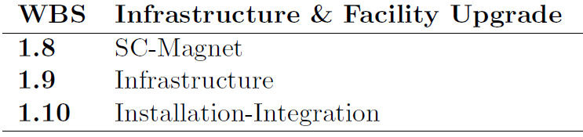
MVTX:MAPS-based Vertex Detector
A separate upgrade project for the baseline sPHENIX: Jet + B-tagging
Baseline
Parallel Activities
MAPS-based Vertex Detector (MVTX)
Intermediate Silicon Strip Tracker (INTT)
Upgrades

Slide 9

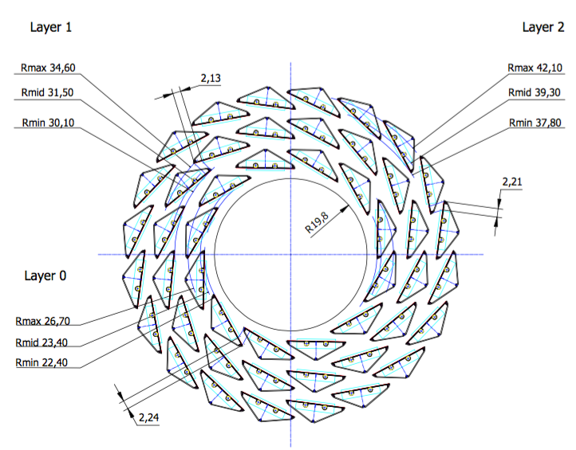
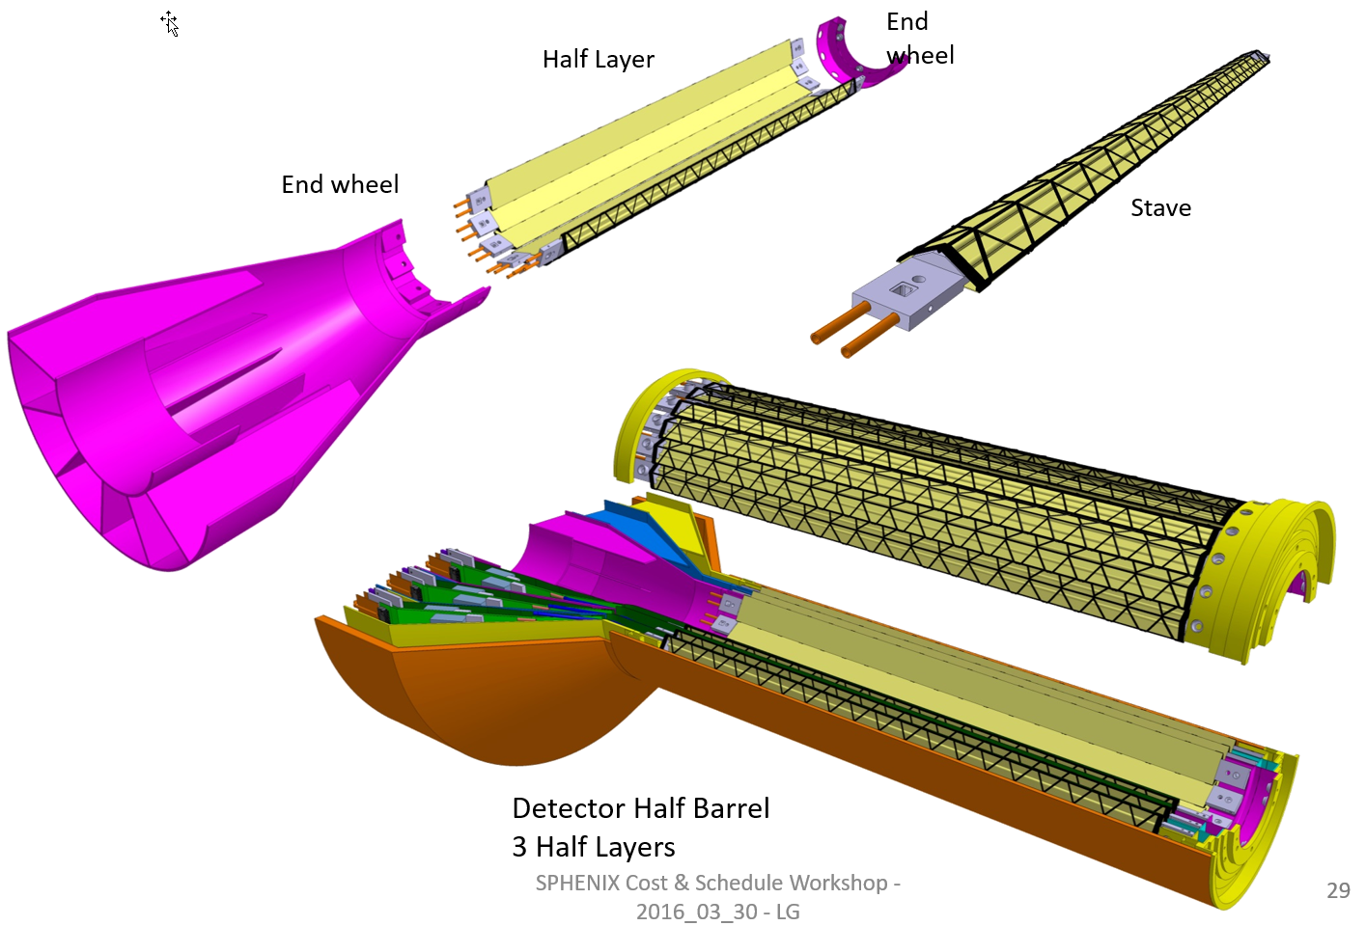
MVTX Proposal
ALICE ITS Upgrade:
Inner Barrel Tracker
Major challenges:
- Readout
- Mechanics
R = 23/32/39 mm
Z = 271 mm
sPHENIX Inner Tracking
Adapt ITS/IB
- Min. Risks
- Max. Phys.

Slide 10
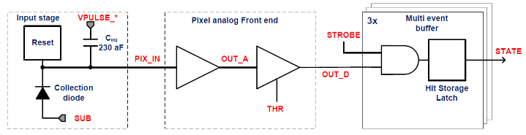
ALPIDE Timing & Trigger
Well fit sPHENIX/RHIC environment, 10MHz Clock (LHC 40MHz)
v
PIX_IN
v
OUT_A
~5-6 μs
t_{f}~= 10 ns
OUT_D
ΔV=Q/C
threshold
t_{r}> 100 μs
~5-6 μs
STROBE
t
t
sPHENIX trigger latency: ~4 μs

Slide 11
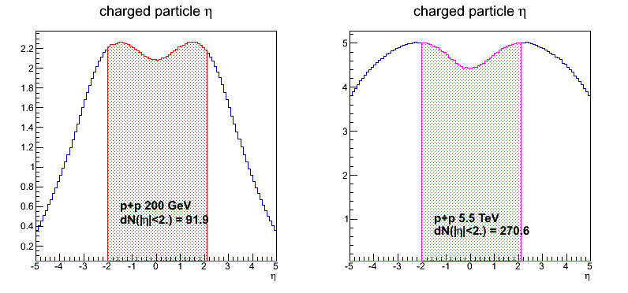
sPHENIX vs ALICE Specifications
 | ALICE (Run3) | sPHENIX
Pb+Pb / Au+Au | 100 kHz (50kHz) | 200 kHz
p+p | 400 kHz (200kHz) | 13 MHz
Trigger | 50 kHz | 15 kHz
Event size, dN/dη: sPHENIX = 1/3 ALICE (pp), 1/5 ALICE(AA)
sPHENIX
ALICE

Slide 12
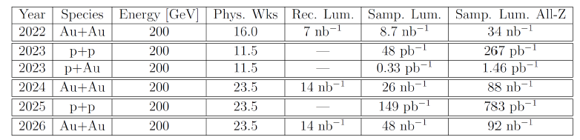
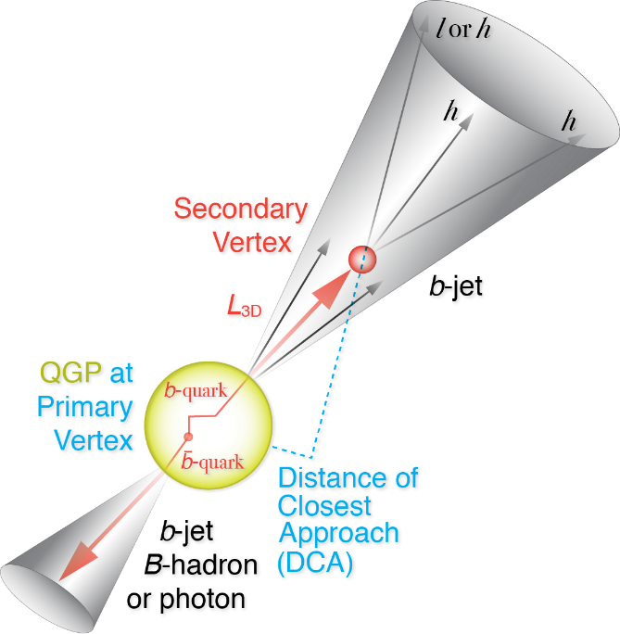
RHIC Multi-Year Plan: sPHENIX 2022-2026+
Evolving
B hadrons/pT<15GeV: O(1M)
b-jets/pT>15GeV: O(100K)
Precision 2nd vertexing for B-tagging:
  Tracking resolution better than 50um @pT=1GeV
  High multiplicity HI collisions
  Low multiplicity but high rate p+p collisions
  High efficiency and high purity

Slide 13
MVTX Proposal Status
Pre-proposal submitted to DOE, 2/2017
  Follow-up discussions with DOE and BNL managers
Update proposal to DOE, early 2018
  Expanded science + Cost & Schedule
  Assumed funding starts ~FY19
A growing collaboration
  15+ institutions from US and abroad
Early R&D by LANL internal fund
  FY17-19, $5M
  Readout and mechanical design

Slide 14
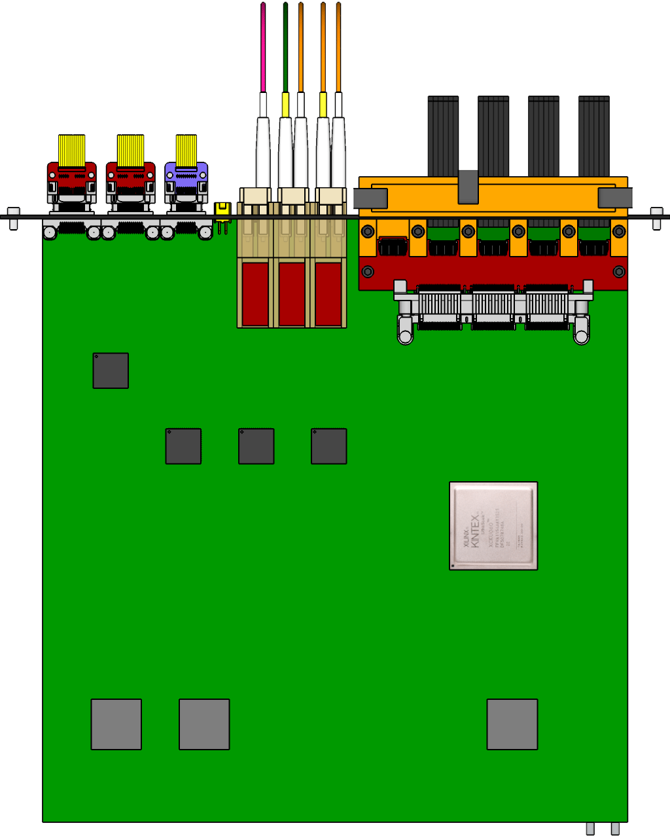

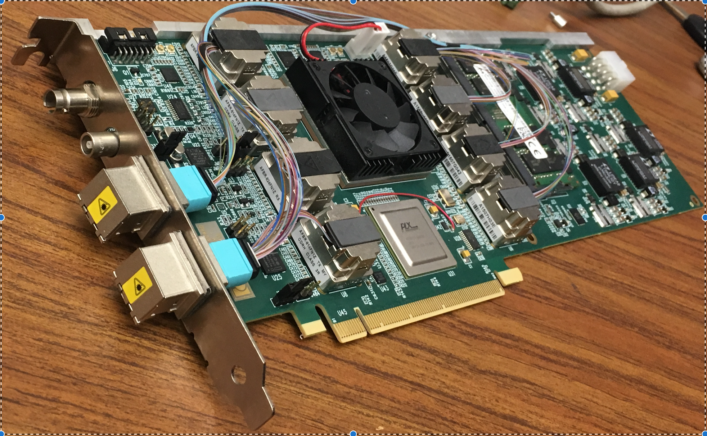
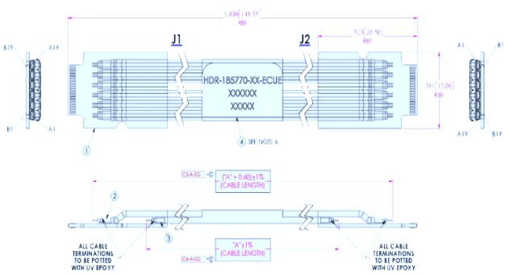

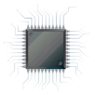
MVTX Readout and Control R&D at LANL
sPHENIX GL-1 & GTM
ALPIDE
CAN bus
DCS
5~10 m
Trigger & Clock
Readout Unit
GBT Optical Links
9-sensor Stave
9 Data (1.2Gbps)
1 Clock, 1 Control/Trigger
Control
Data (9.6 Gb/s max)
Trigger
Samtec Twinax “FireFly”
FELIX
FPC
Power
Alpide Sensors
Power
Filtering
Capacitors
regulators
Power supplies
Cold Plate
Regulated Power
Power Board
LANL, UT-Austin, LBNL, BNL, ALICE/ITS …
Established the readout chain test: ALPIDE + KC705(RU) + FELIX + RCDAQ/sPHENIX
RUv.10 arrived last week, 10/21/2017
ALPIDE and Power Unit being tested

Slide 15
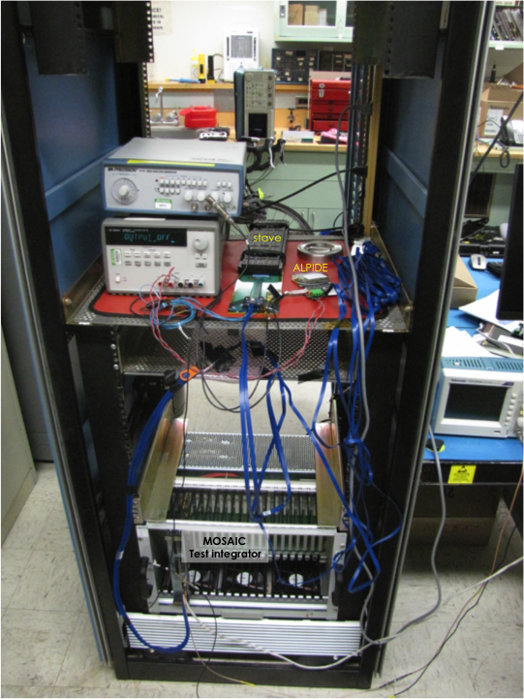
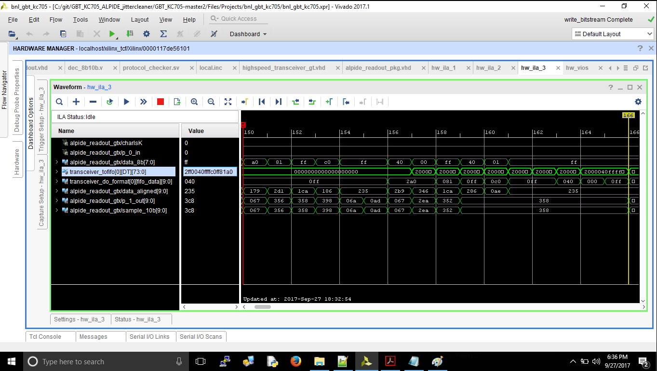
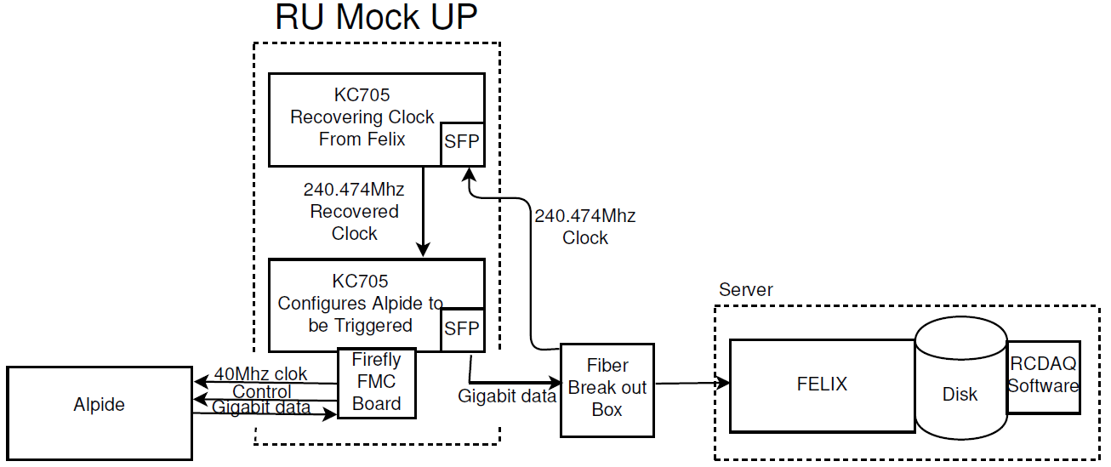
R&D at LANL
Power unit test
ALPIDE/Stave evaluation test bench

Slide 16
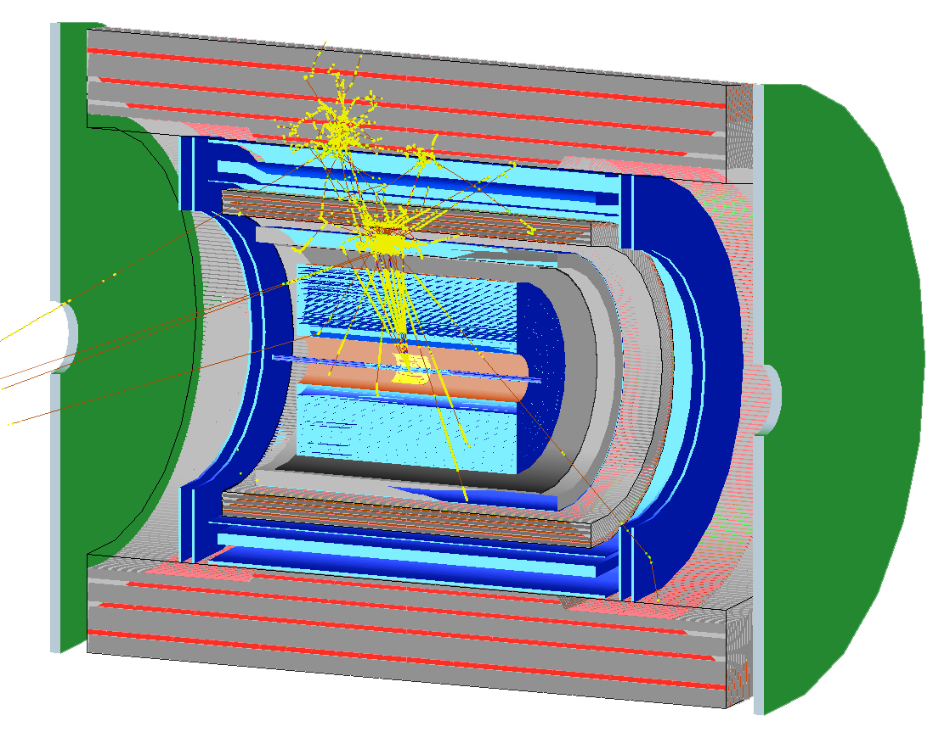
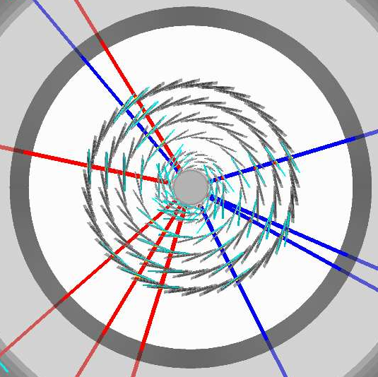
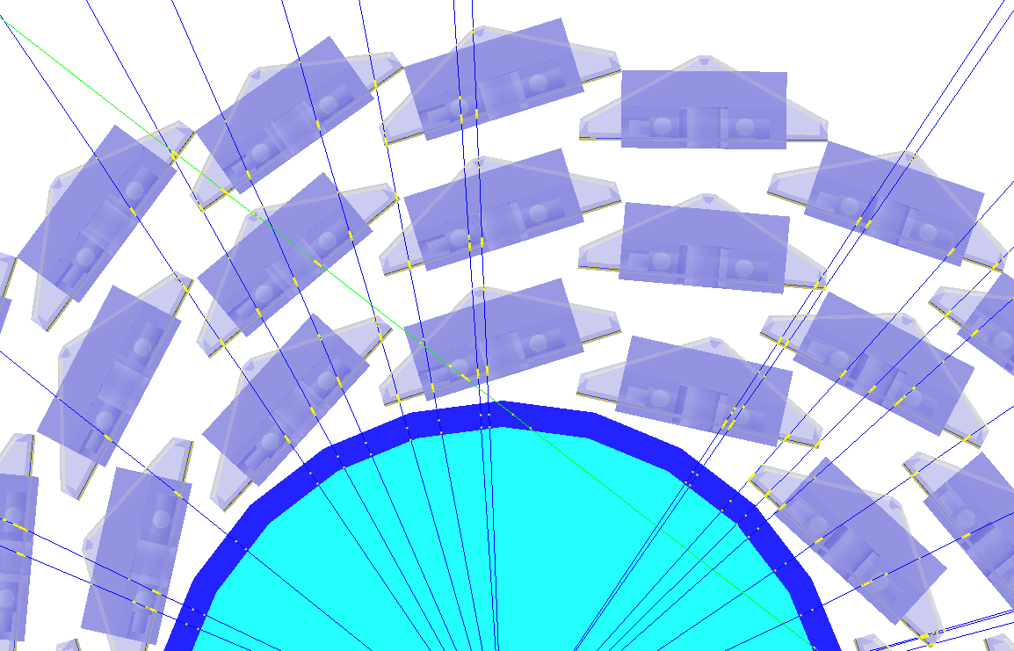
Simulation for b-jet and B-meson
sPHENIX Geant4 display of p_{T}=30 GeV/c B⁺-hadron
Design to Simulation
MVTX and INTT _
_ MVTX Ladders modeled in details
MVTX sensors

Slide 17
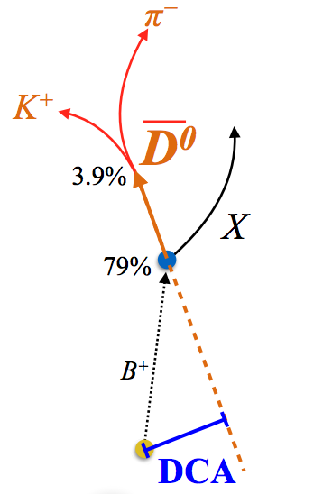
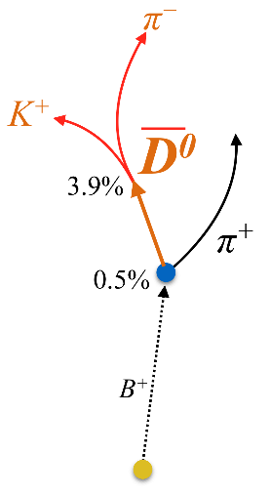
Physics Channels:
Open Charm and Beauty
Hadron | Abundance | cτ (μm)
D⁰ | 61% | 123
D⁺ | 24% | 312
D_{s} | 8% | 150
Λ_{c} | 6% | 60
B⁺ | 40% | 491
B⁰ | 40% | 455
B_{s} | 10% | 453
Λ_{b} | 10% | 435
b-tagged jet and cor.
p_{T}>15 GeV
60%
0.5%
p_{T}<15 GeV
Exploring and more

Slide 18
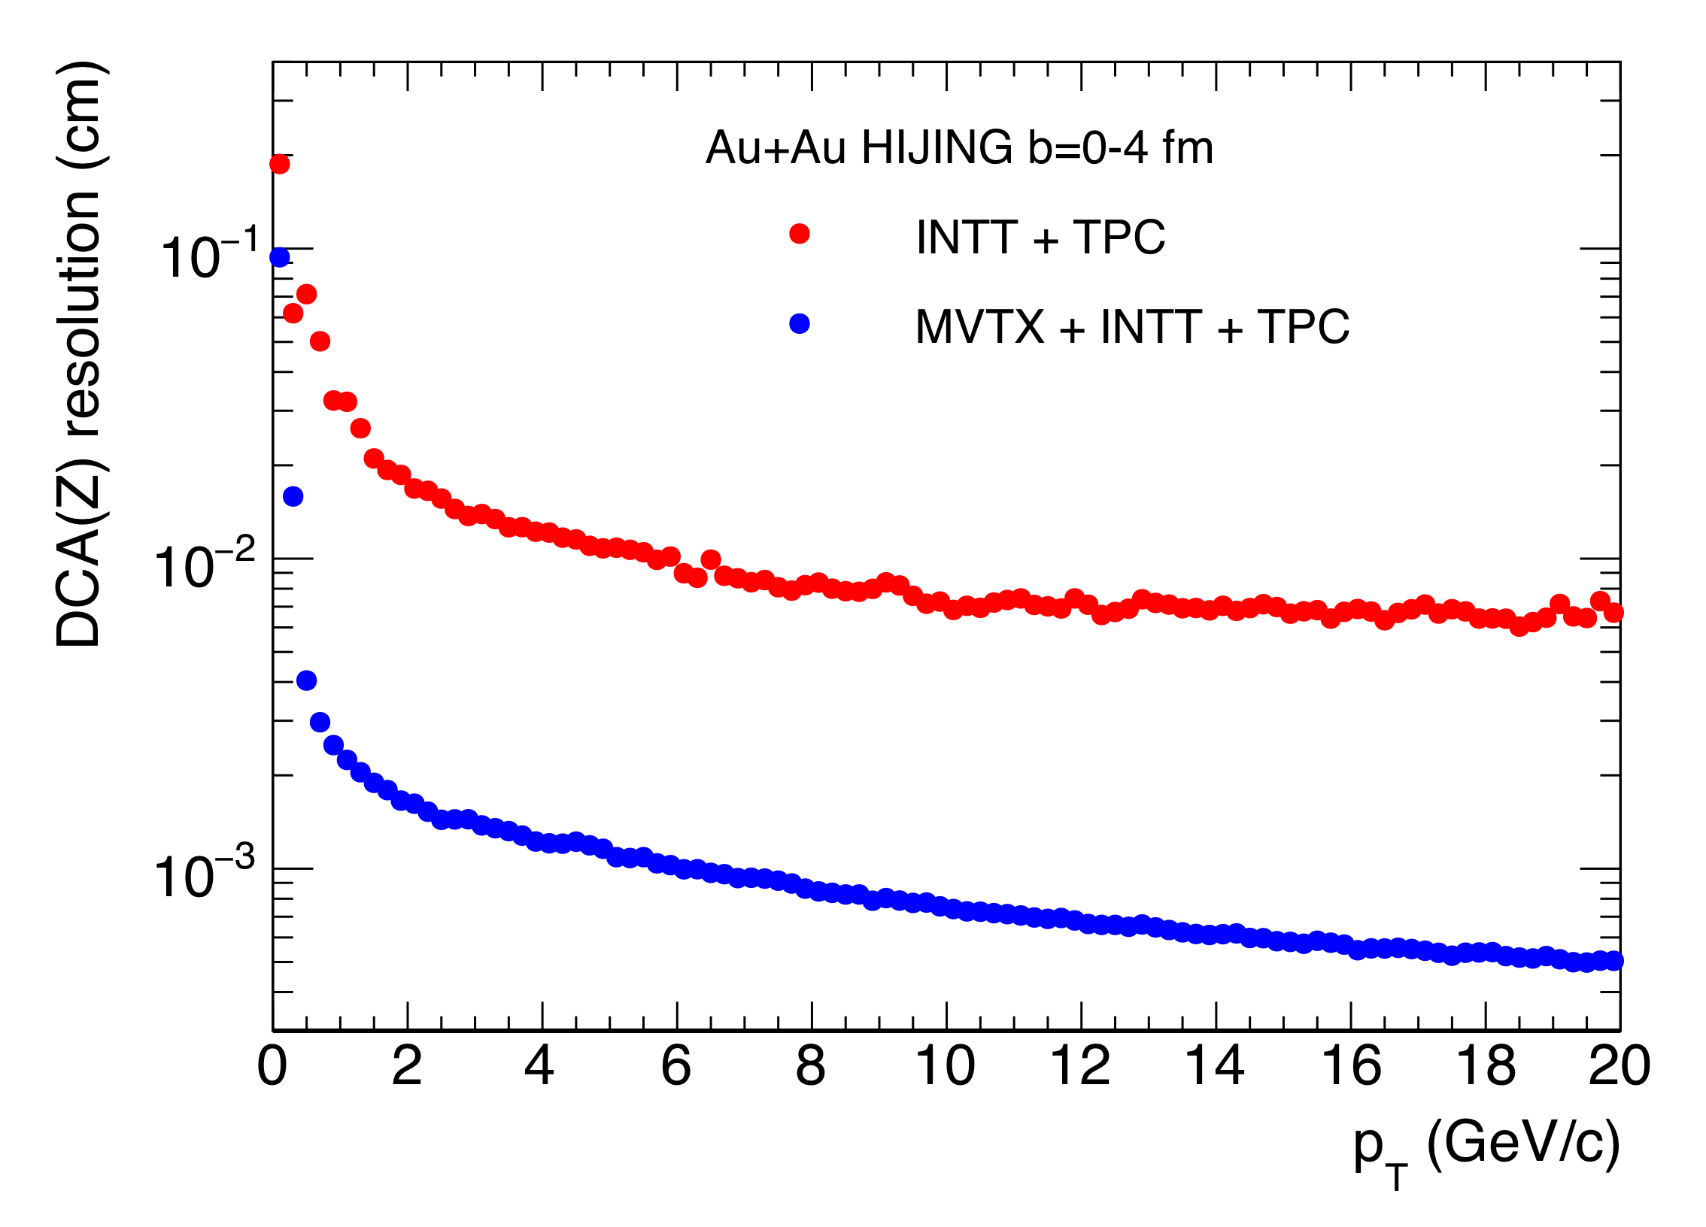
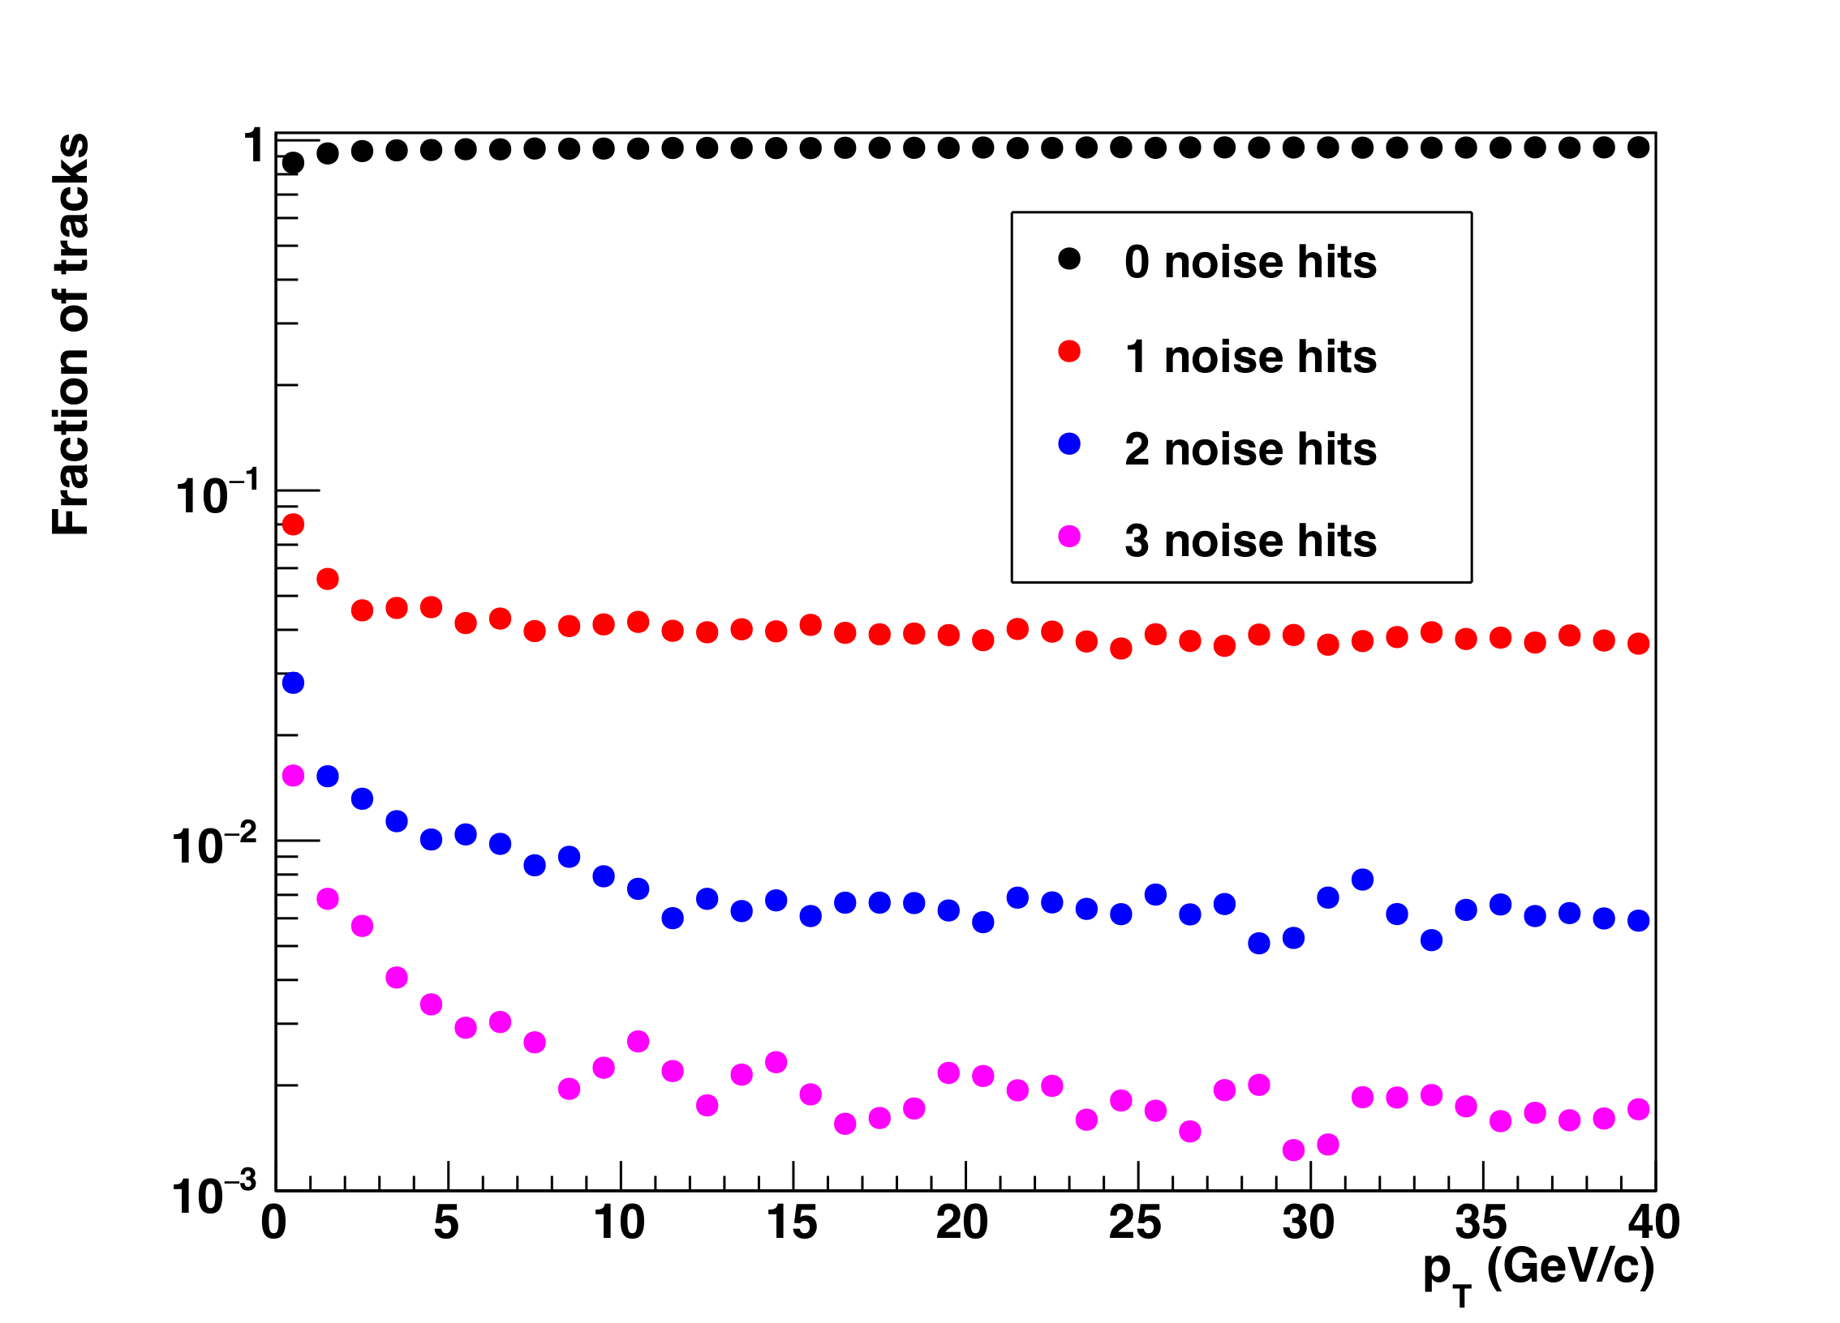
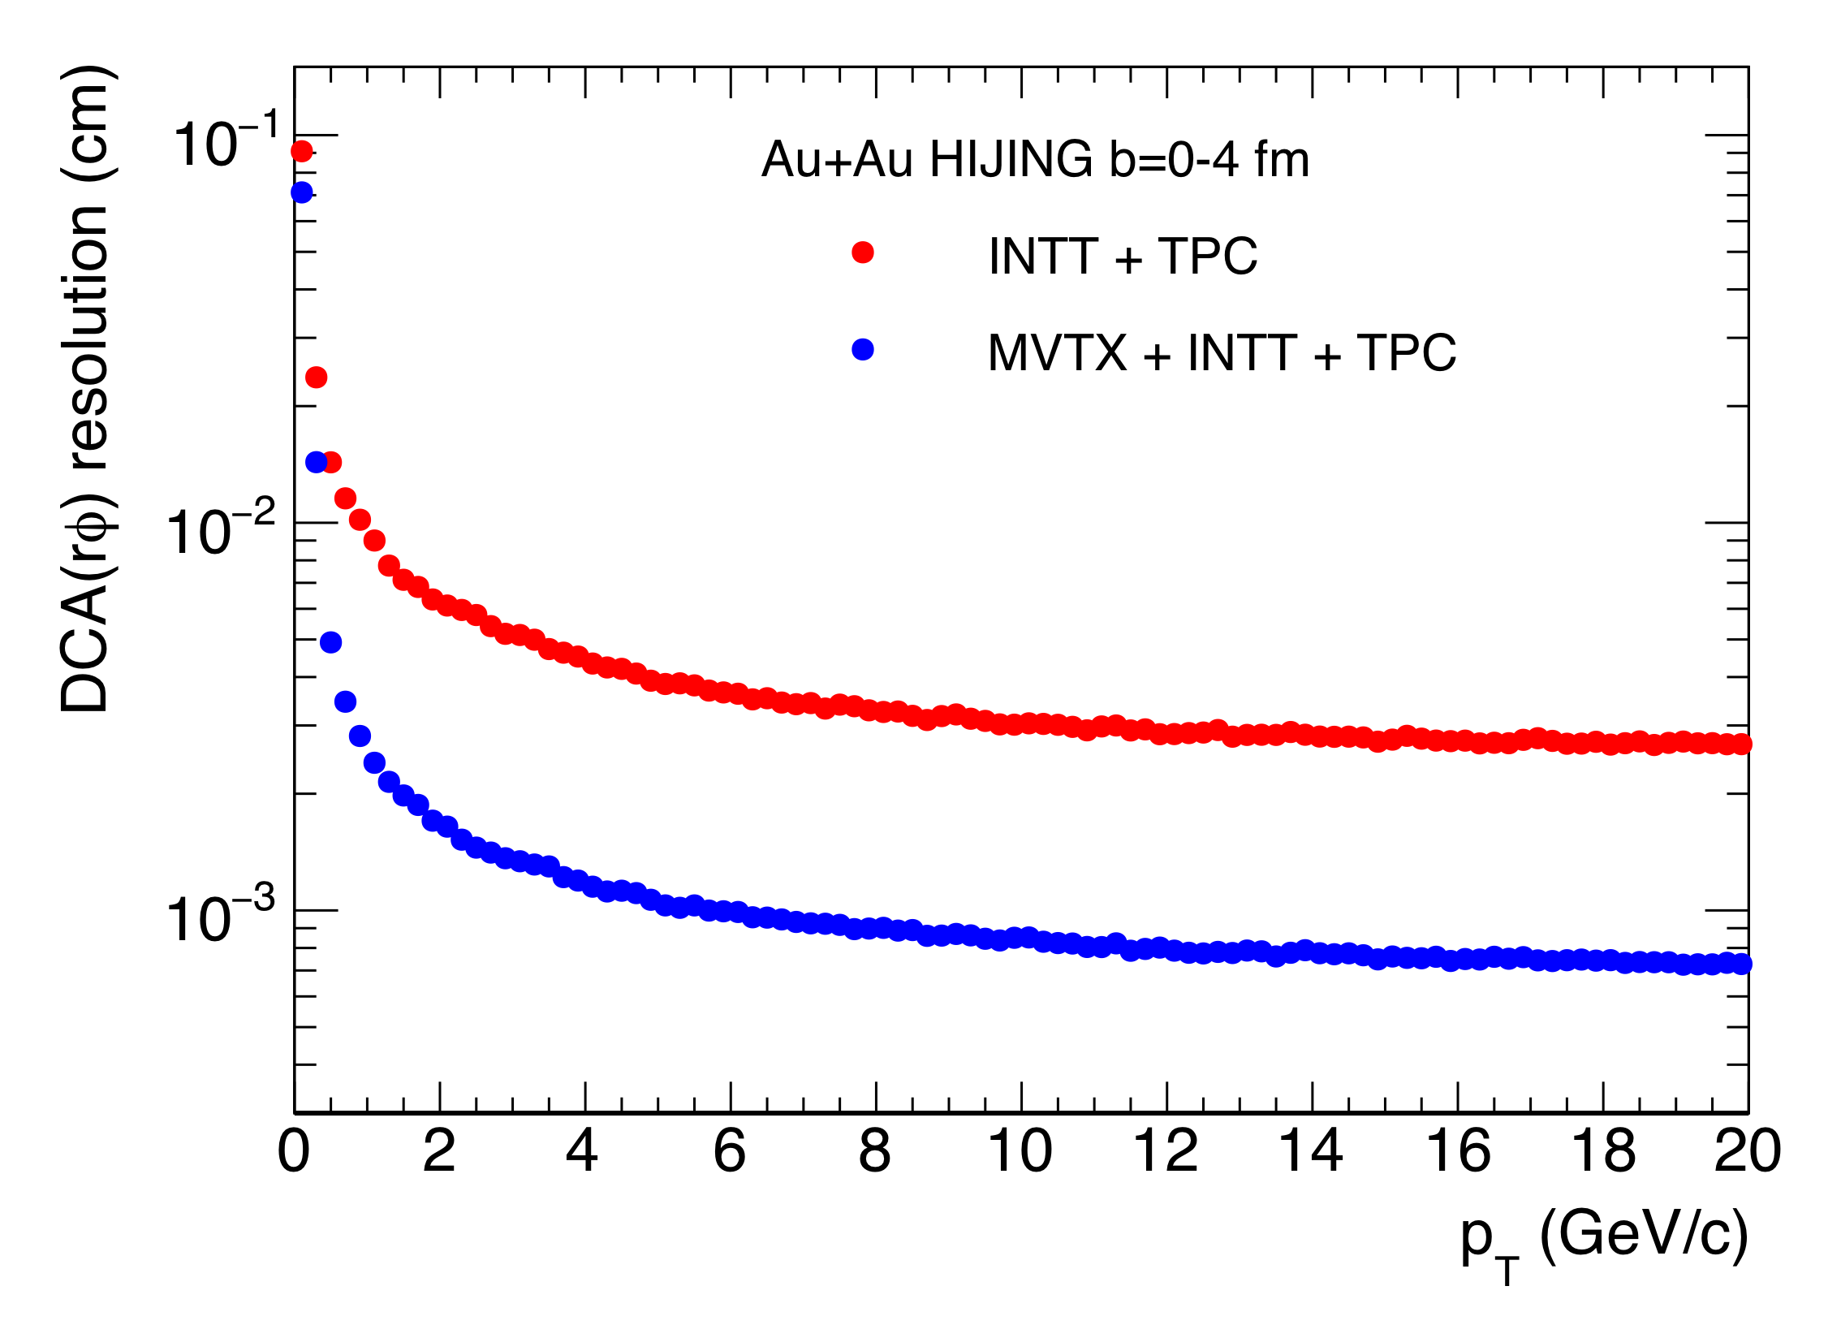
Tracking Performance with Full GEANT
MVTX geometry modeled and digitized according to ALICE ITS/IB
Cluster resolution: ~5 µm
DCA_{2D ,} DCA_{z}<30 µm down to 1 GeV/c
DCA_rφ
DCA_z
Fake hit fraction

Slide 19
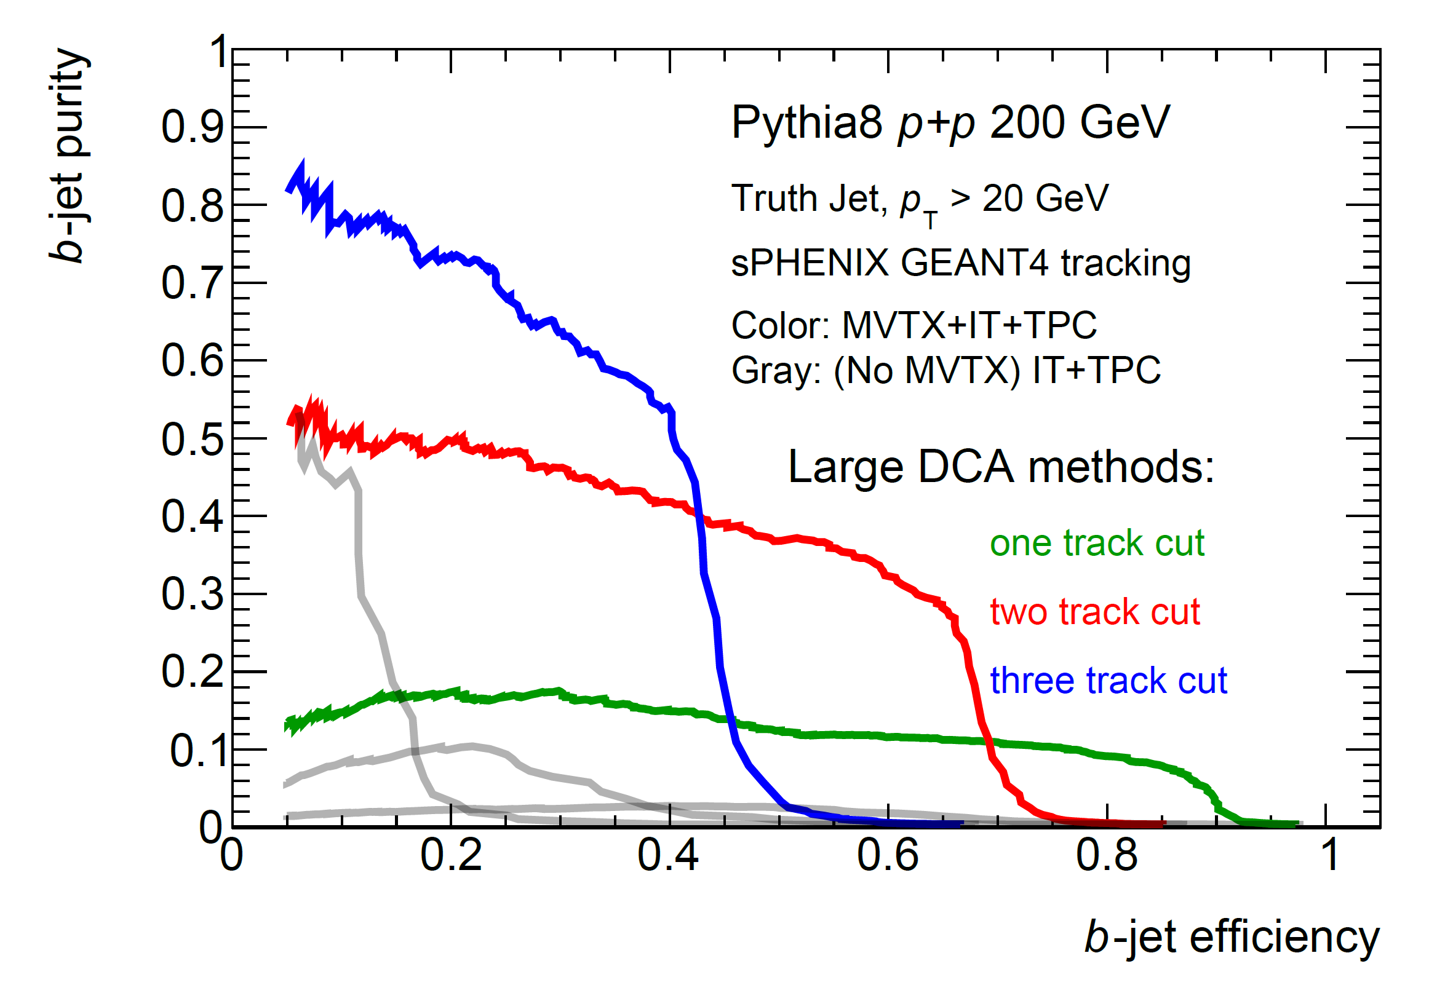
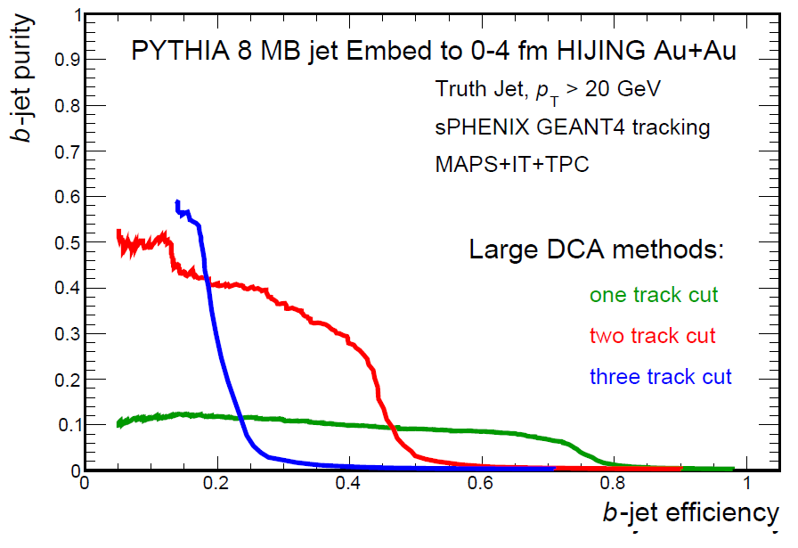
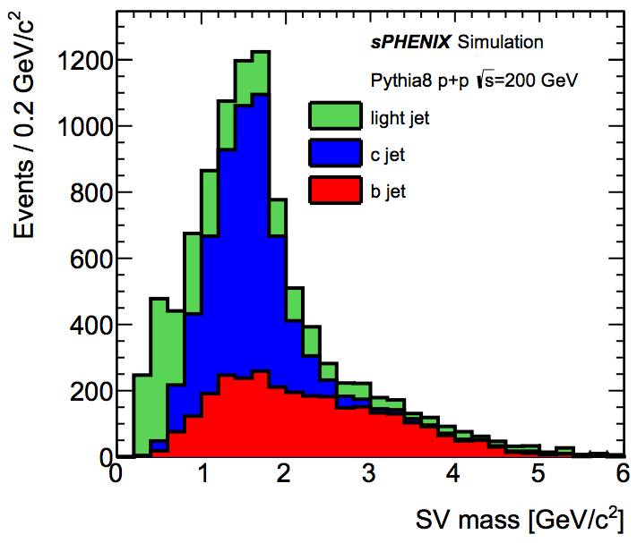
B-jet tagging
Multi-tracks w/ large DCA
2nd vertex mass reco’s
CMS work-point, Phys. Rev. Lett. 113, 132301 (2014)

Slide 20
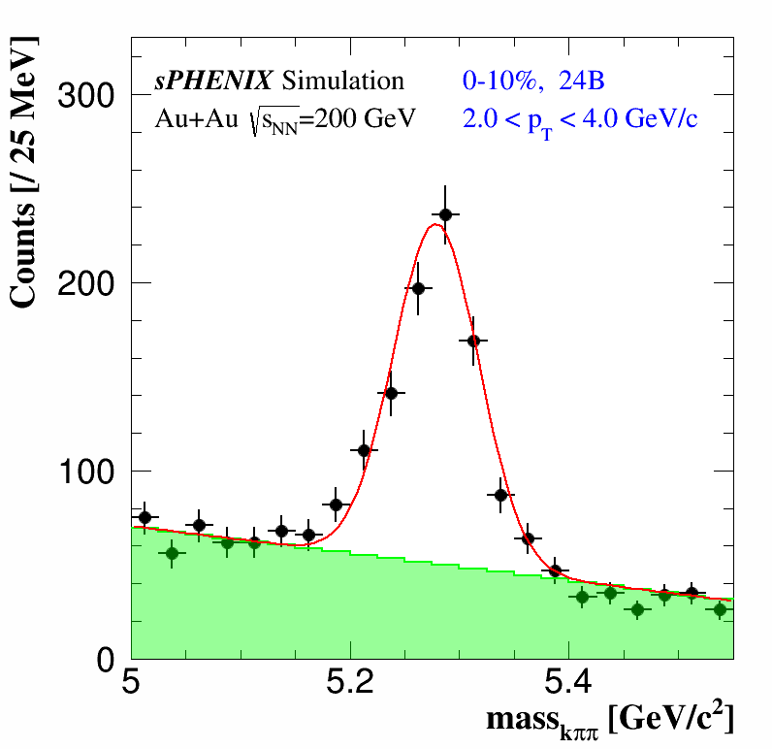
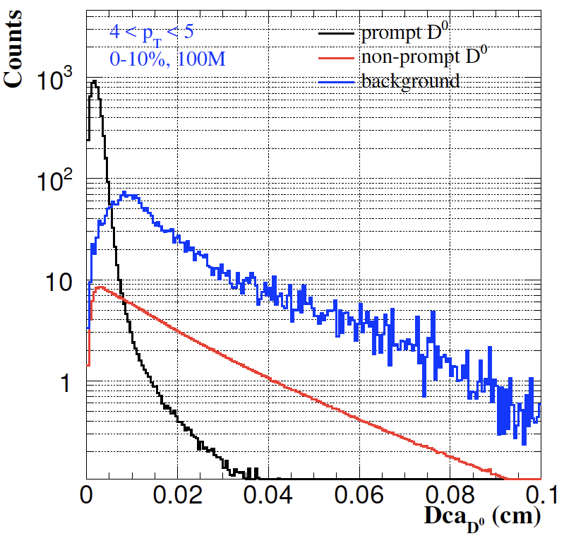
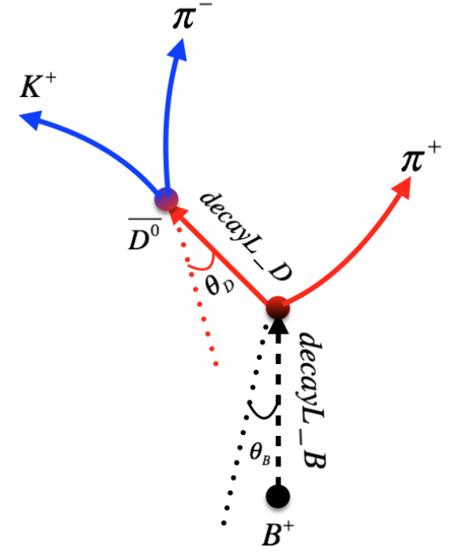
B-hadron Tagging
Impact parameter (DCA) method to tag non-prompt D⁰ from B-meson decays
Inclusive and exclusive channels possible

Slide 21
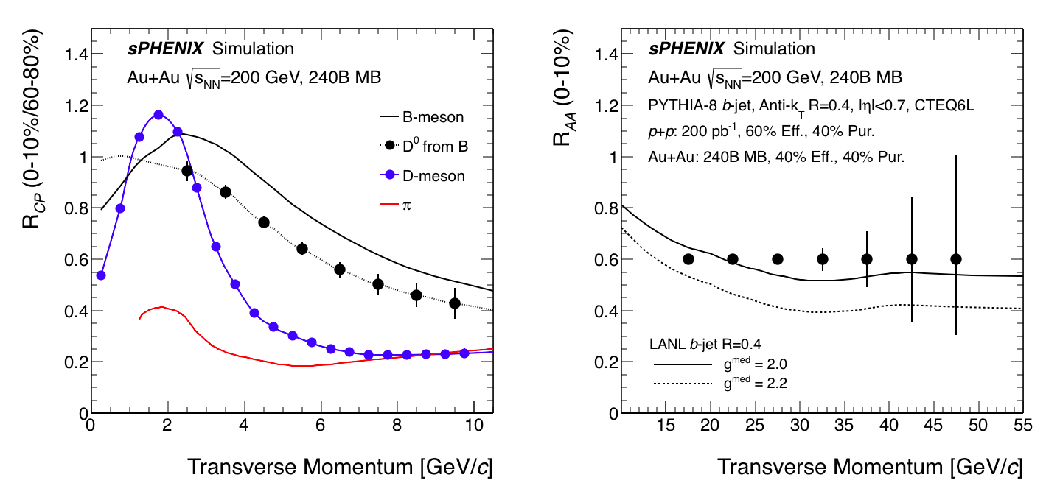
Projected R_{AA}
Open questions: energy loss and medium properties

Slide 22
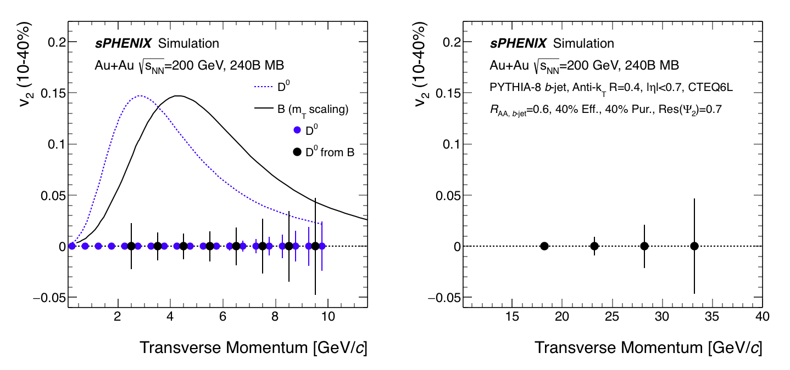
Project Elliptical Flow v₂
Open questions: quasi-particle and medium interactions

Slide 23
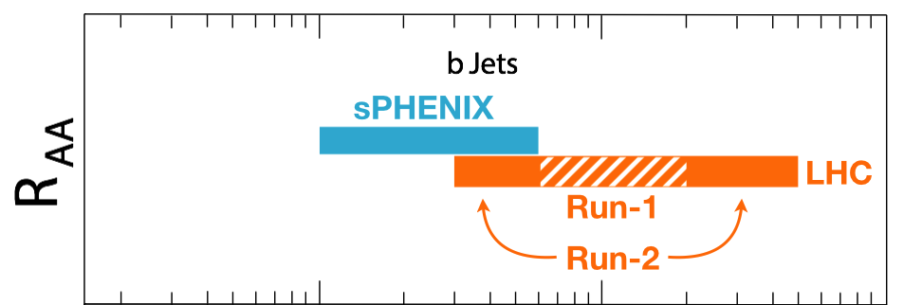
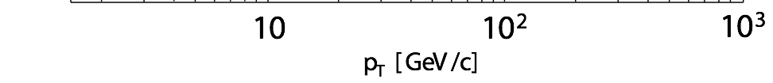
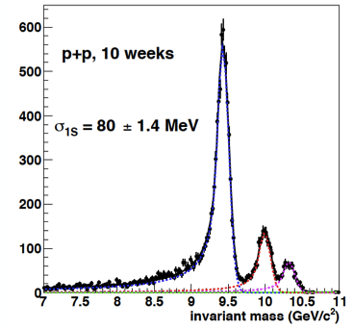
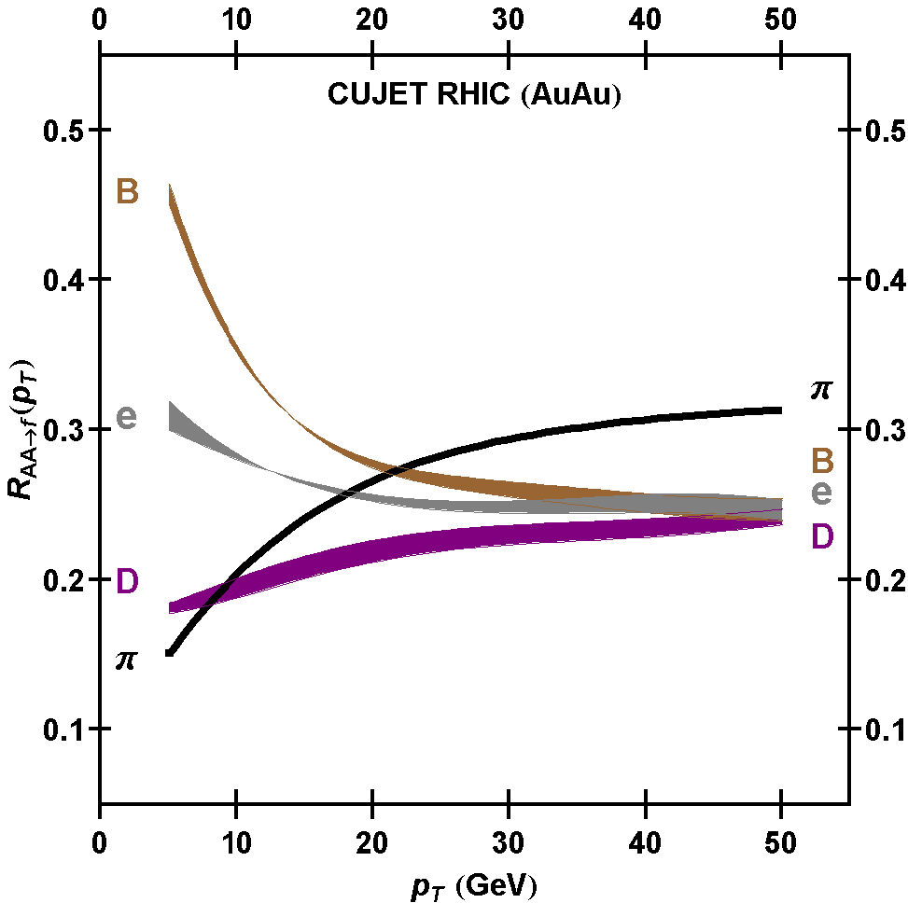
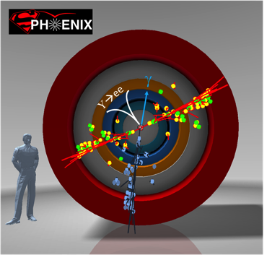
Summary: Exciting Science
sPHENIX is the next flagship heavy ion physics experiment in the US (NSAC LRP2015)
  Jets
  Upsilons
  B-jets and B hadrons
MVTX will complete QGP heavy flavor physics
  Unambiguous determination of key parameters of QGP properties and interactions
  Precision study of the “inner workings of QGP”(LRP15)
Complement & extend current and future RHIC and LHC QGP programs
sPHENIX Three Physics Pillars
Jets
Upsilons
B
D

Slide 24

4th sPHENIX Collaboration Meeting at BNL, June 2017

Slide 25
Summary and Outlook
sPHENIX collaboration fully engaged toward physics in early 2020s with the baseline detectors
MVTX upgrade will bring in the 3rd science pillar – open heavy flavor physics and more
Strong support from the community, LANL LDRD etc.
Great opportunity to advance our understanding of the inner workings of QGP
sPHENIX:
CD-1
Installation
1st beam
2017
2018
2019
2020
2021
2022
2023+
MVTX:
Full
proposal
Construction
Installation
Day-1 physics

Slide 26
MVTX Funding & Schedule
Tied to sPHENIX and ALICE schedule
  Stave production
  Readout electronics
  Minimize technical risk and R&D cost
Cost based on ALICE/ITS and similar recent STAR & PHENIX upgrade projects
  STAR HFT
  PHENIX FVTX

Slide 27
Schedule
sPHENIX ready for installation: 4/2021
sPHENIX installed and ready for commission 7/2022
sPHENIX commission complete 9/2022
First beam 1/2023
sPHENIX CD-4 1/2024
Install INTT 4/22/2022
MVTX ready for installation: ~1/2022 (or with INTT, ~4/2022)
MVTX installed and ready for commission 7/2022
MVTX ready for beam: 1/2023

Slide 28


Monolithic-Active-Pixel-Sensors (MAPS)
The next Generation State of the Art Pixel Tracker
Advantages of ALICE MAPS/ALPIDE:
  Very fine pitch (28x28 μm)
  High efficiency (>99%) and low noise (<10⁻⁶)
  Fast readout, ~5 μS
  Ultra-thin/low mass, 50μm (~0.3% X₀)
  On-pixel digitization, low power dissipation
An ideal detector for QGP b-jet physics!
FPC
9 Chips
Cooling plate
A 9-chip MAPS stave, 1.5 x 27cm²
ALPIDE design
50 μm
28 μm

Slide 29
Scope of the MVTX Project
MAPS Staves & Electronics
  MAPS staves “MoU” to build 68 ITS inner Barrel Staves
    No modification
  Readout Electronics R&D
    Frontend: ALICE/ITS, RU
    Backend: ATLAS FELIX
    Modify/reprogram RU & FELIX for sPHENIX
    R&D by LANL LDRD
  Production:
    Extend ALICE/ITS MAPS stave production
      WBS 1.5.3.1, LANL
      sPHENIX personnel help at CERN
    Reproduce additional ALICE/RU & ATLAS/FELIX
      WBS 1.5.2.1, UT-Austin
      WBS 1.5.2.2 , LANL
    Final assembly and test in US
      WBS 1.5.3, LBNL
  Ancillary systems, “adopt” ALICE system
    Power distribution, cables, crates, racks etc.,
      WBS 1.5.2.3, LBNL
    Slow control, safety and monitoring
Mechanics & Cooling
  Some changes to ALICE/ITS inner tracker mechanical structures, WBS 1.5.3
    End Wheels
    Cylindrical structure shells
    Detector half barrels
    Detector and Service half barrels
  Mechanical Integration, WBS 1.5.4
    Conceptual design by LANL LDRD
    Prototype by sPHENIX R&D, MIT/LANL
    Design integration frames
    Carbon frames etc., LBNL
    Installation tooling etc.
  Adopt ALICE cooling plant design
    Minor modification to fit sPHENIX
    Smaller heat load than ALICE ITS
  Metrology and Survey

Slide 30


Detector Assembly
Precision positioning and installation of staves on end-wheels
Layer 0
Layer 1
Assembly of layers and carbon fiber structure into half-detector
Stave testing at each step
Metrology survey
Layer 2
IB CYSS

Slide 31
Sheet 3, showing extended inner tracker with current outer composite shell

Slide 32
Sheet 1, section view of sPHENIX inner detector assembly (inside the superconducting solenoid magnet), the ALICE service barrel has been modified – shortened, see later sheets for detail

Slide 33

sPHERNIX cross-section view, including envelope for services; TPC and INTT, the following 2 slides detail views -
TPC services (one end)
INTT services, (one –end)

