Slide 1
sPHENIX MVTX Upgrade
Ming Liu
Los Alamos National Lab
for the sPHENIX Collaboration
Heavy Flavor Workshop @LBNL
10/30-11/1, 2017

Slide 2
Outline
Science of sPHENIX
MVTX upgrade proposal
Physics prospects

Slide 3
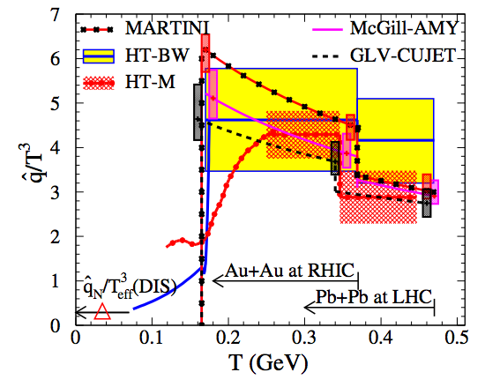
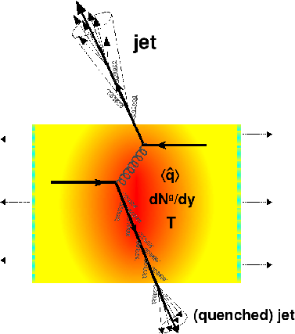
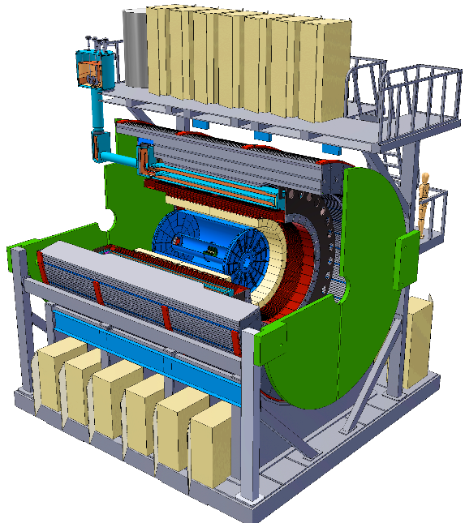
sPHENIX – the Next Generation HI Experiment @RHIC
To study the inner workings of QGP
  Jets
  Upsilons
  Heavy flavors
US DOE NSAC LRP 2015

Slide 4
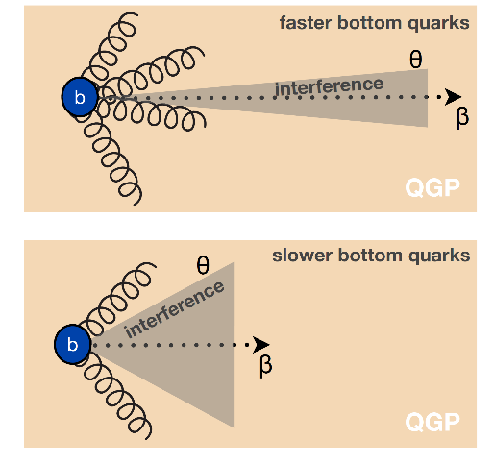
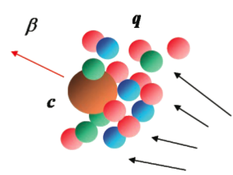
Heavy Quarks - Unique Probe of QGP
Study mass dependence
  Jet quenching, hadronization
  Collectivity –interaction with medium
Access QGP properties
  Diffusions, transport coefficients etc.
Distinct experimental signatures
  Displaced 2nd vtx
  Heavy mass, >> Λ_{QCD}
Theoretical controls
  pQCD
  LQCD
m_{u} m_{d}
m_{s}
Λ_{QCD}
m_{c}
m_{b}
MeV
1
10
10²
10³
10⁴
T_{c}
T_{QGP}

Slide 5
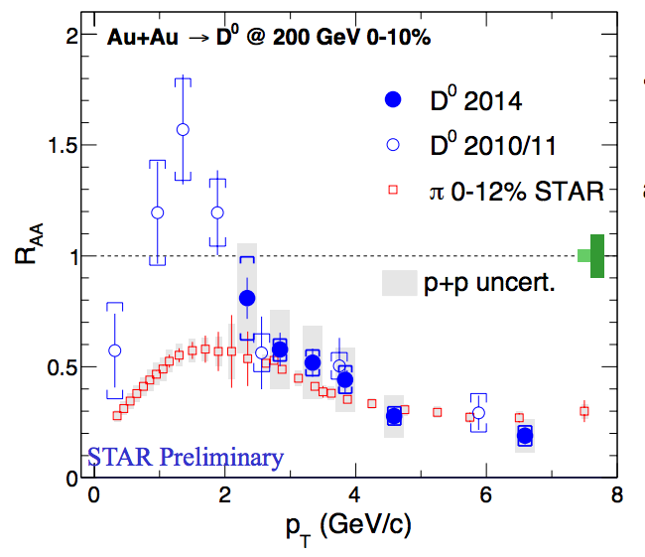
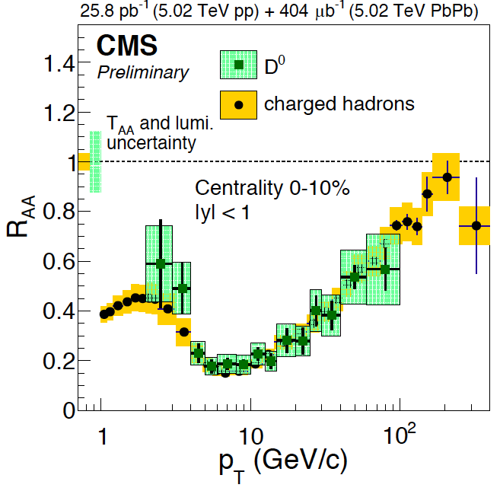
Charm R_{AA}
R_{AA} (D-meson) ~ R_{AA} (h) at high p_{T} ~> 4 GeV/c
significant suppression of charmed hadron R_{AA} in central A+A collisions
strong charm-medium interactions
mass effect expected important at low pT, dead-cone effects etc.

Slide 6
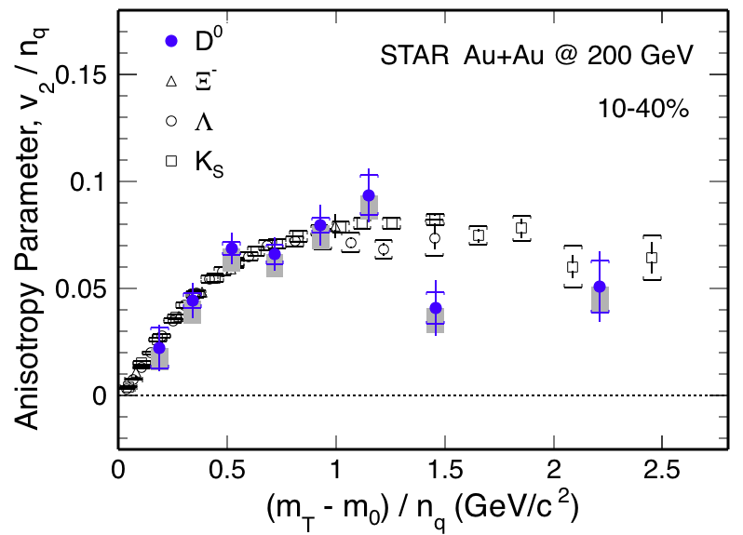
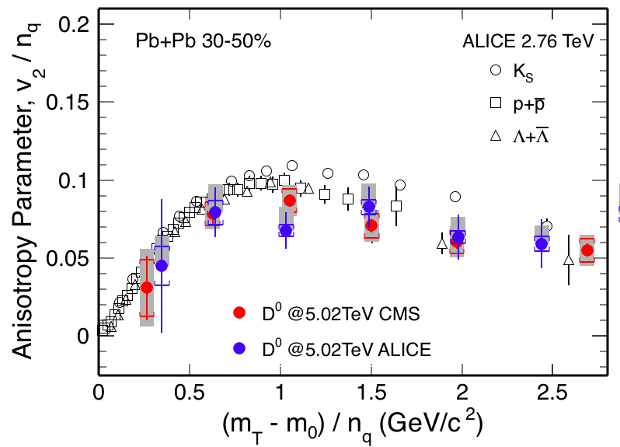
Charm V₂
v₂ of D⁰ follows the same trend as light hadrons
Strong coupling with medium at low pT?

Slide 7
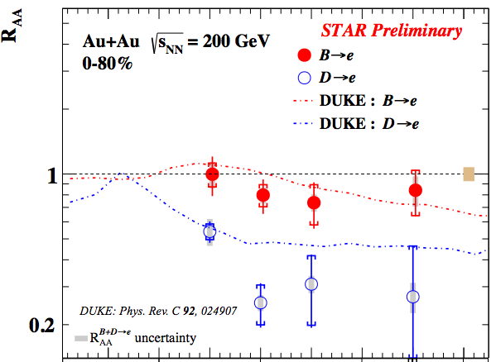
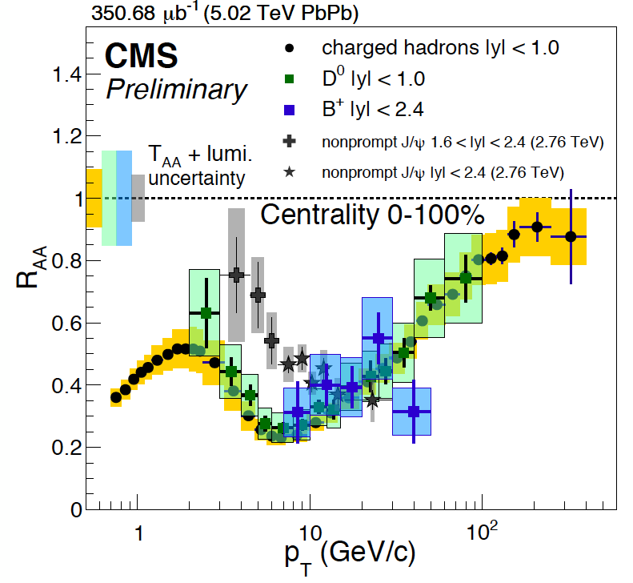
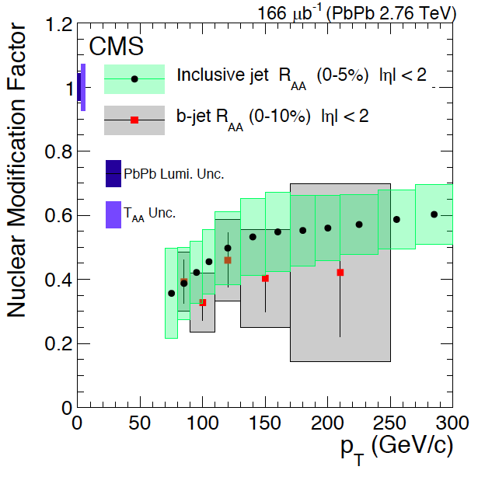

Beauty?
Highly desired:
precision measurements
of B @pT ~O(m_{b})
R_{AA} (B->e) > R_{AA} (D->e, h) @low pT
B⁺ & b-jet ~ light hadrons & charm @high pT
STAR, QM17

Slide 8
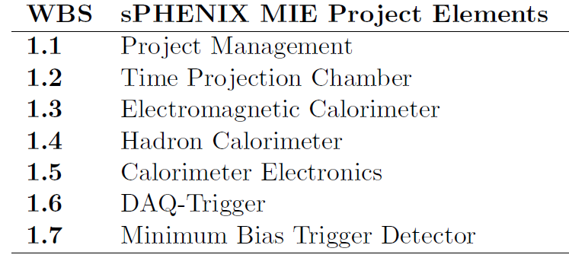
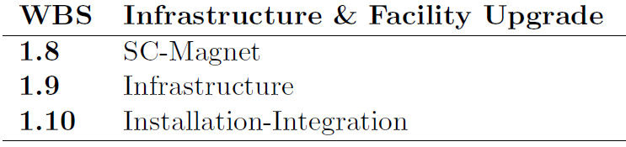
MVTX:MAPS-based Vertex Detector
A separate upgrade project for the baseline sPHENIX: Jet + B-tagging
Baseline
Parallel Activities
MAPS-based Vertex Detector (MVTX)
Intermediate Silicon Strip Tracker (INTT)
Inner tracking system upgrades

Slide 9
Central Tracking Systems

Slide 10

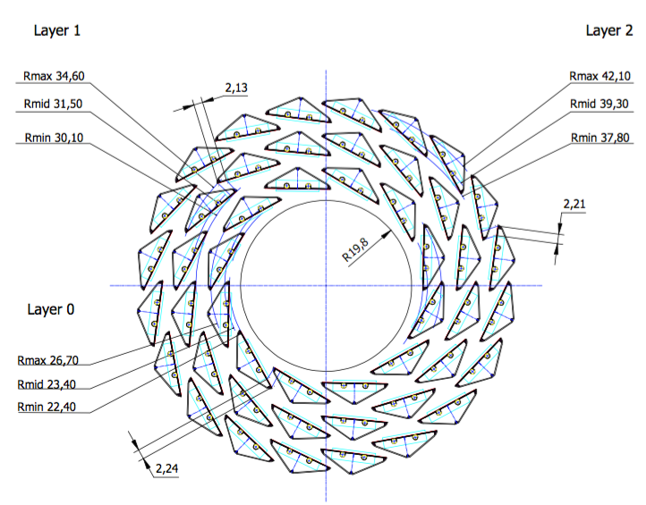
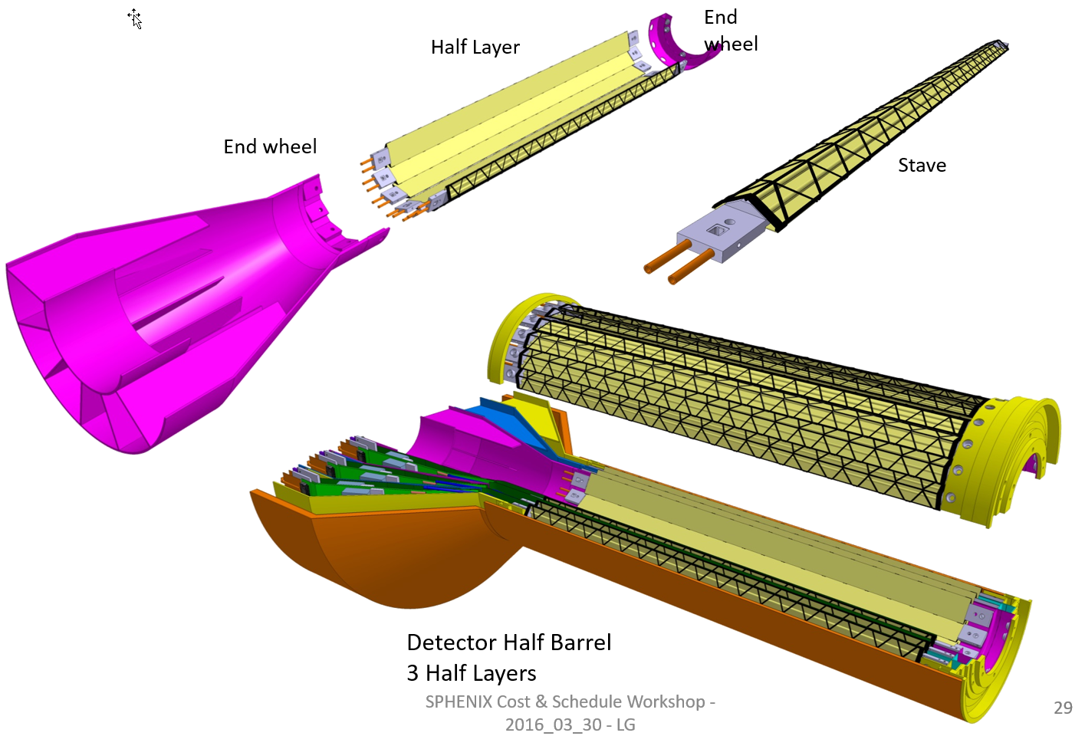
MVTX Proposal
ALICE ITS Upgrade:
Inner Barrel Tracker
Major challenges:
- Readout
- Mechanics
R = 23/31/39 mm
Z = 271 mm
sPHENIX Inner Tracking
Adapt ITS/IB
- Min. Risks
- Max. Phys.

Slide 11
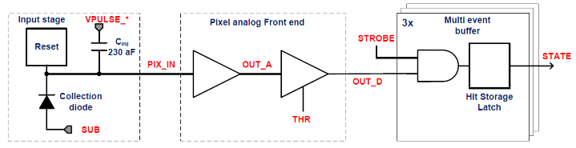
ALPIDE/MAPS Timing & Trigger
Well fit sPHENIX/RHIC environment, 10MHz Clock (LHC 40MHz)
v
PIX_IN
v
OUT_A
~5-6 μs
t_{f}~= 10 ns
OUT_D
ΔV=Q/C
threshold
t_{r}> 100 μs
~5-6 μs
STROBE
t
t
sPHENIX trigger latency: ~4 μs

Slide 12
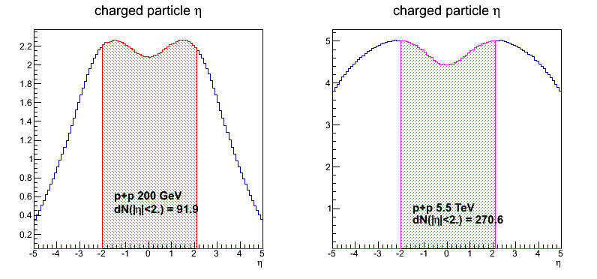
sPHENIX vs ALICE Specifications
 | ALICE (Run3) | sPHENIX
Pb+Pb / Au+Au | 100 kHz (50kHz) | 200 kHz
p+p | 400 kHz (200kHz) | 13 MHz
Trigger | 50 kHz | 15 kHz
Event size, dN/dη: sPHENIX = 1/3 ALICE (pp), 1/5 ALICE(AA)
sPHENIX
ALICE

Slide 13
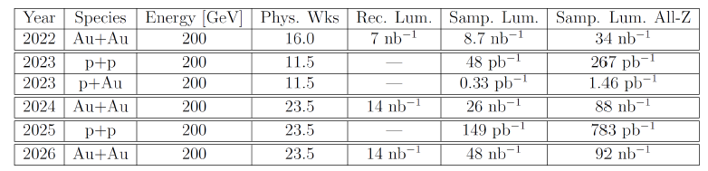
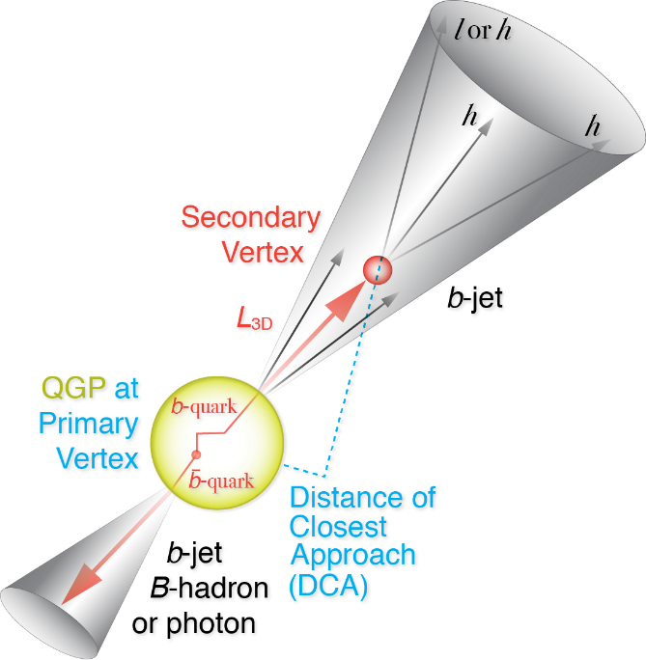
RHIC Multi-Year Plan: sPHENIX 2022-2026+
Evolving
B hadrons/pT<15GeV: O(1M)
b-jets/pT>15GeV: O(100K)
Precision 2nd vertexing for B-tagging:
  Tracking resolution better than 30um @pT=1GeV
  High multiplicity HI collisions
  Low multiplicity but high rate p+p collisions
  High efficiency and high purity

Slide 14
MVTX Proposal Status
Pre-proposal submitted to DOE, 2/2017
  Follow-up discussions with DOE and BNL managers
Update proposal to DOE, early 2018
  Expanded science + Cost & Schedule
  Assumed funding starts ~FY19
  Ready for sPHENIX day-1, ~Jan. 2023
A growing collaboration
  15+ institutions from US and abroad
Early R&D by LANL internal fund
  FY17-19, $5M
  Readout and mechanical design

Slide 15
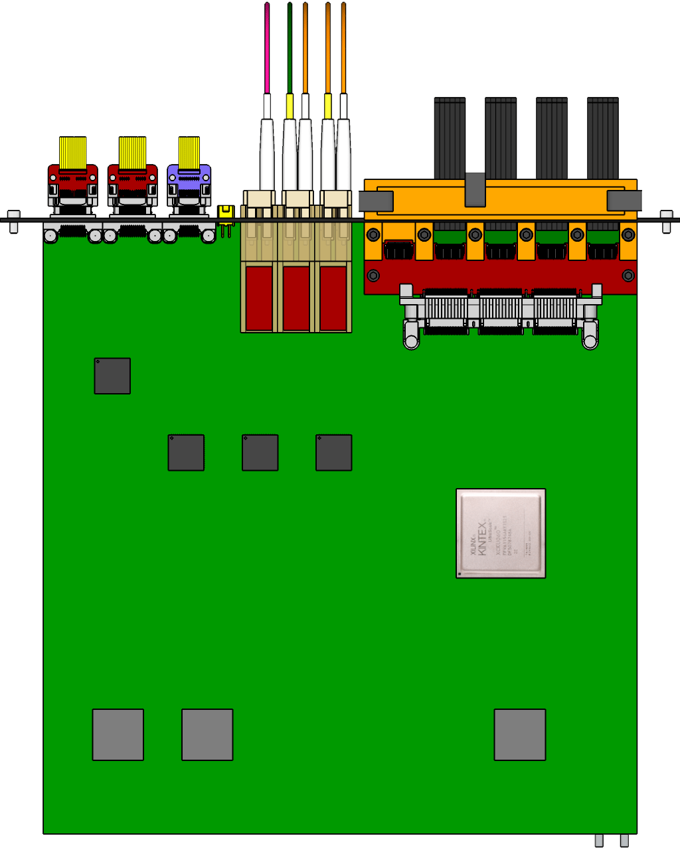

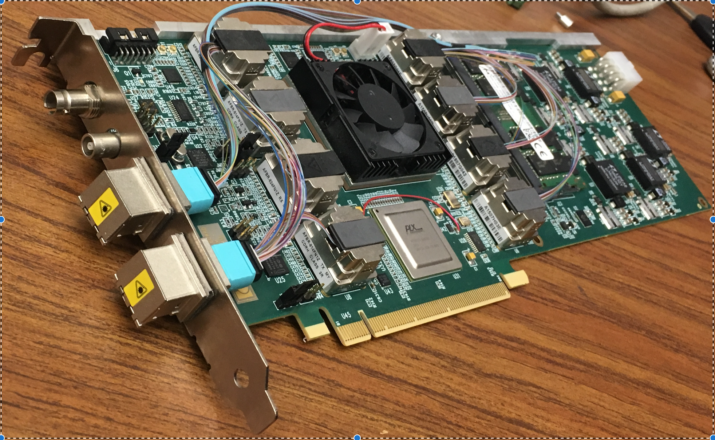
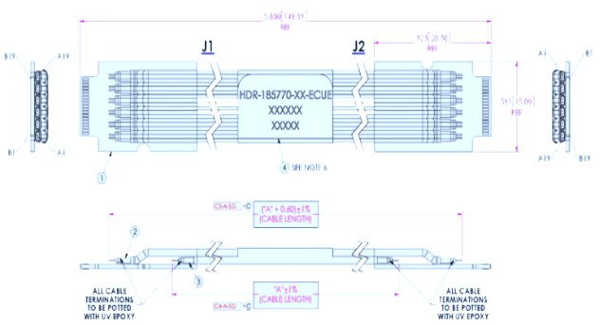

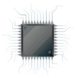
MVTX Readout and Control R&D at LANL
sPHENIX GL-1 & GTM
ALPIDE
CAN bus
DCS
5~10 m
Trigger & Clock
Readout Unit
GBT Optical Links
9-sensor Stave
9 Data (1.2Gbps)
1 Clock, 1 Control/Trigger
Control
Data (9.6 Gb/s max)
Trigger
Samtec Twinax “FireFly”
FELIX
FPC
Power
Alpide Sensors
Power
Filtering
Capacitors
regulators
Power supplies
Cold Plate
Regulated Power
Power Board
LANL, UT-Austin, LBNL, BNL, ALICE/ITS …
Established the readout chain test: ALPIDE + KC705(RU) + FELIX + RCDAQ/sPHENIX
RUv1.0 arrived last week, 10/21/2017
ALPIDE/MAPS and Power Unit being tested

Slide 16
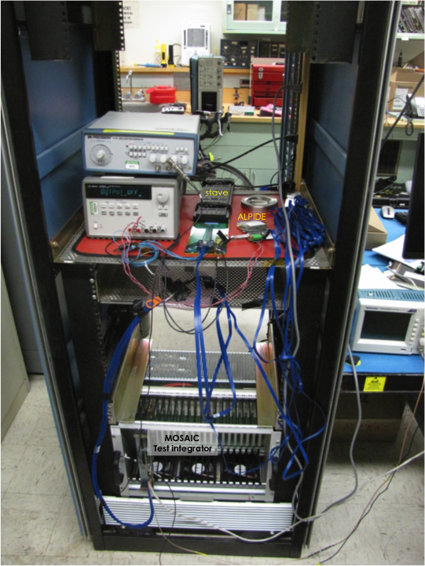
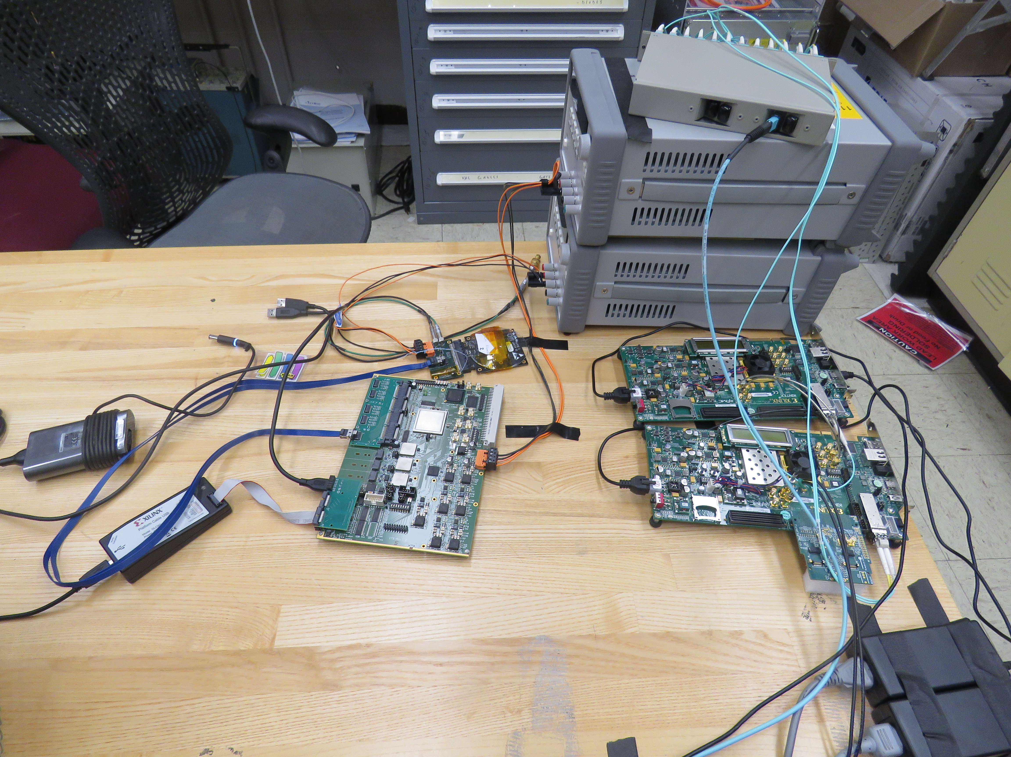
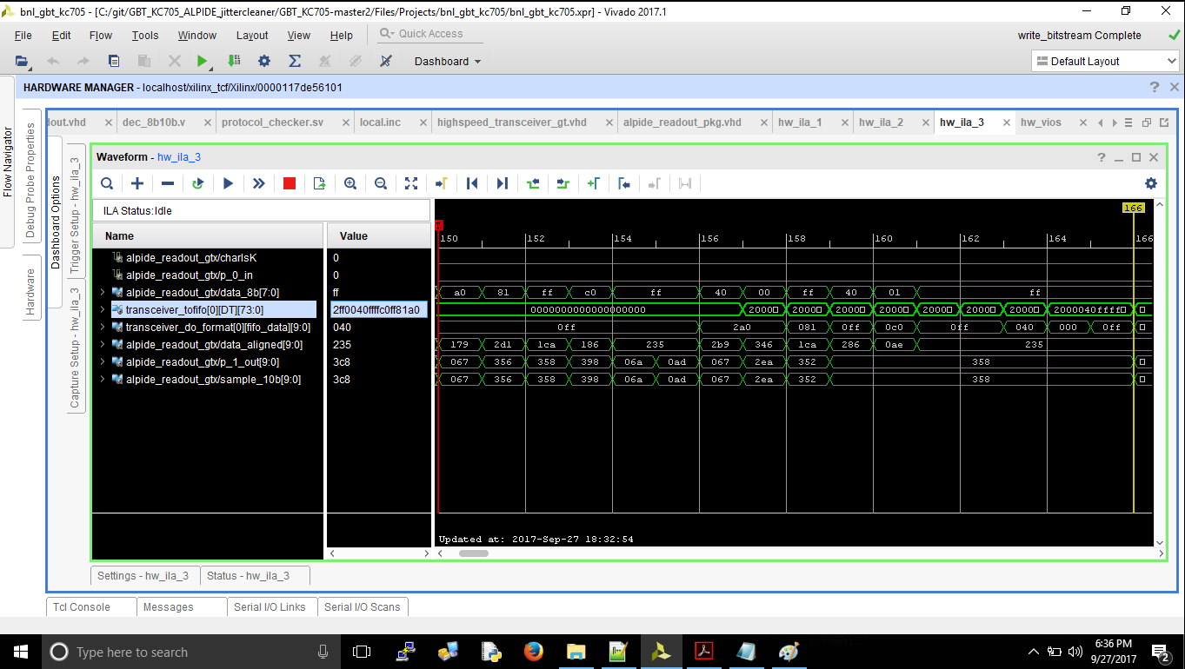
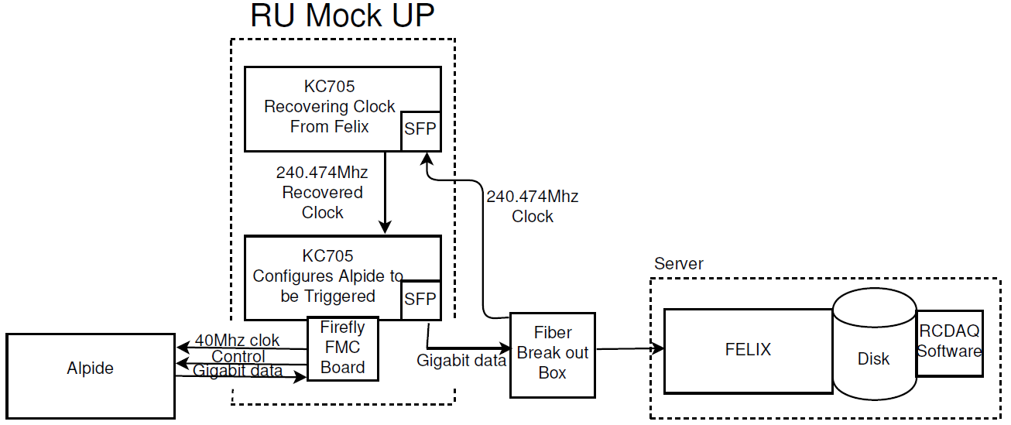
R&D at LANL
Power unit test
ALPIDE/MAPS sensor evaluation
LV/HV controls
DAQ integration

Slide 17
Section view of sPHENIX inner detector assembly the ALICE service barrel has been modified – shortened

Slide 18
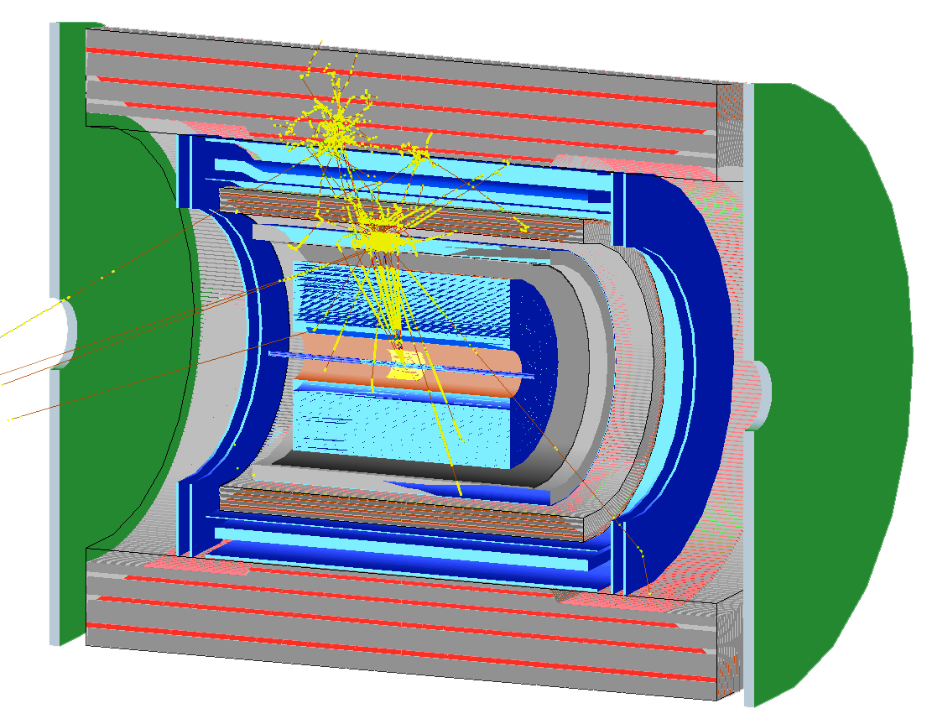
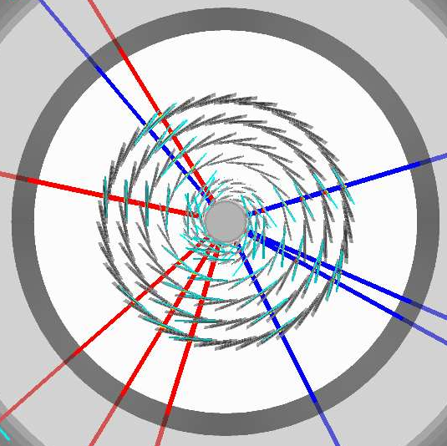
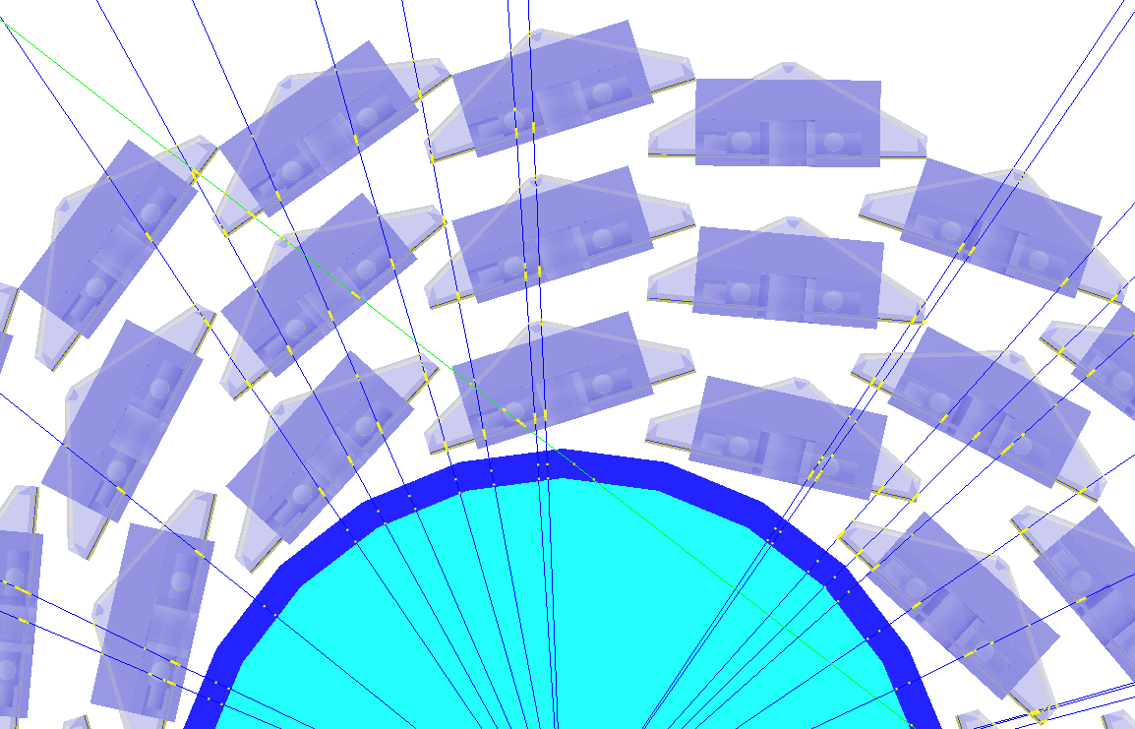
Simulation for b-jet and B-meson
sPHENIX Geant4 display of p_{T}=30 GeV/c B⁺-hadron
Design to Simulation
MVTX and INTT _
_ MVTX Ladders modeled in details
MVTX sensors

Slide 19
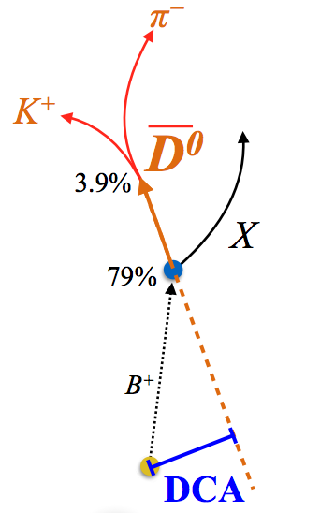
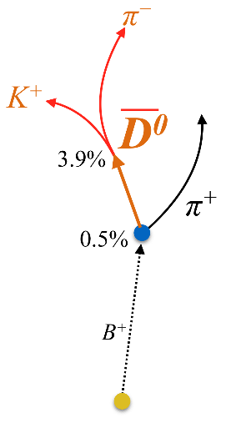
Physics Channels Simulated:
Open Charm and Beauty
Hadron | Abundance | cτ (μm)
D⁰ | 61% | 123
D⁺ | 24% | 312
D_{s} | 8% | 150
Λ_{c} | 6% | 60
B⁺ | 40% | 491
B⁰ | 40% | 455
B_{s} | 10% | 453
Λ_{b} | 10% | 435
b-tagged jet and cor.
p_{T}>15 GeV
60%
0.5%
p_{T}<15 GeV
Exploring and more

Slide 20
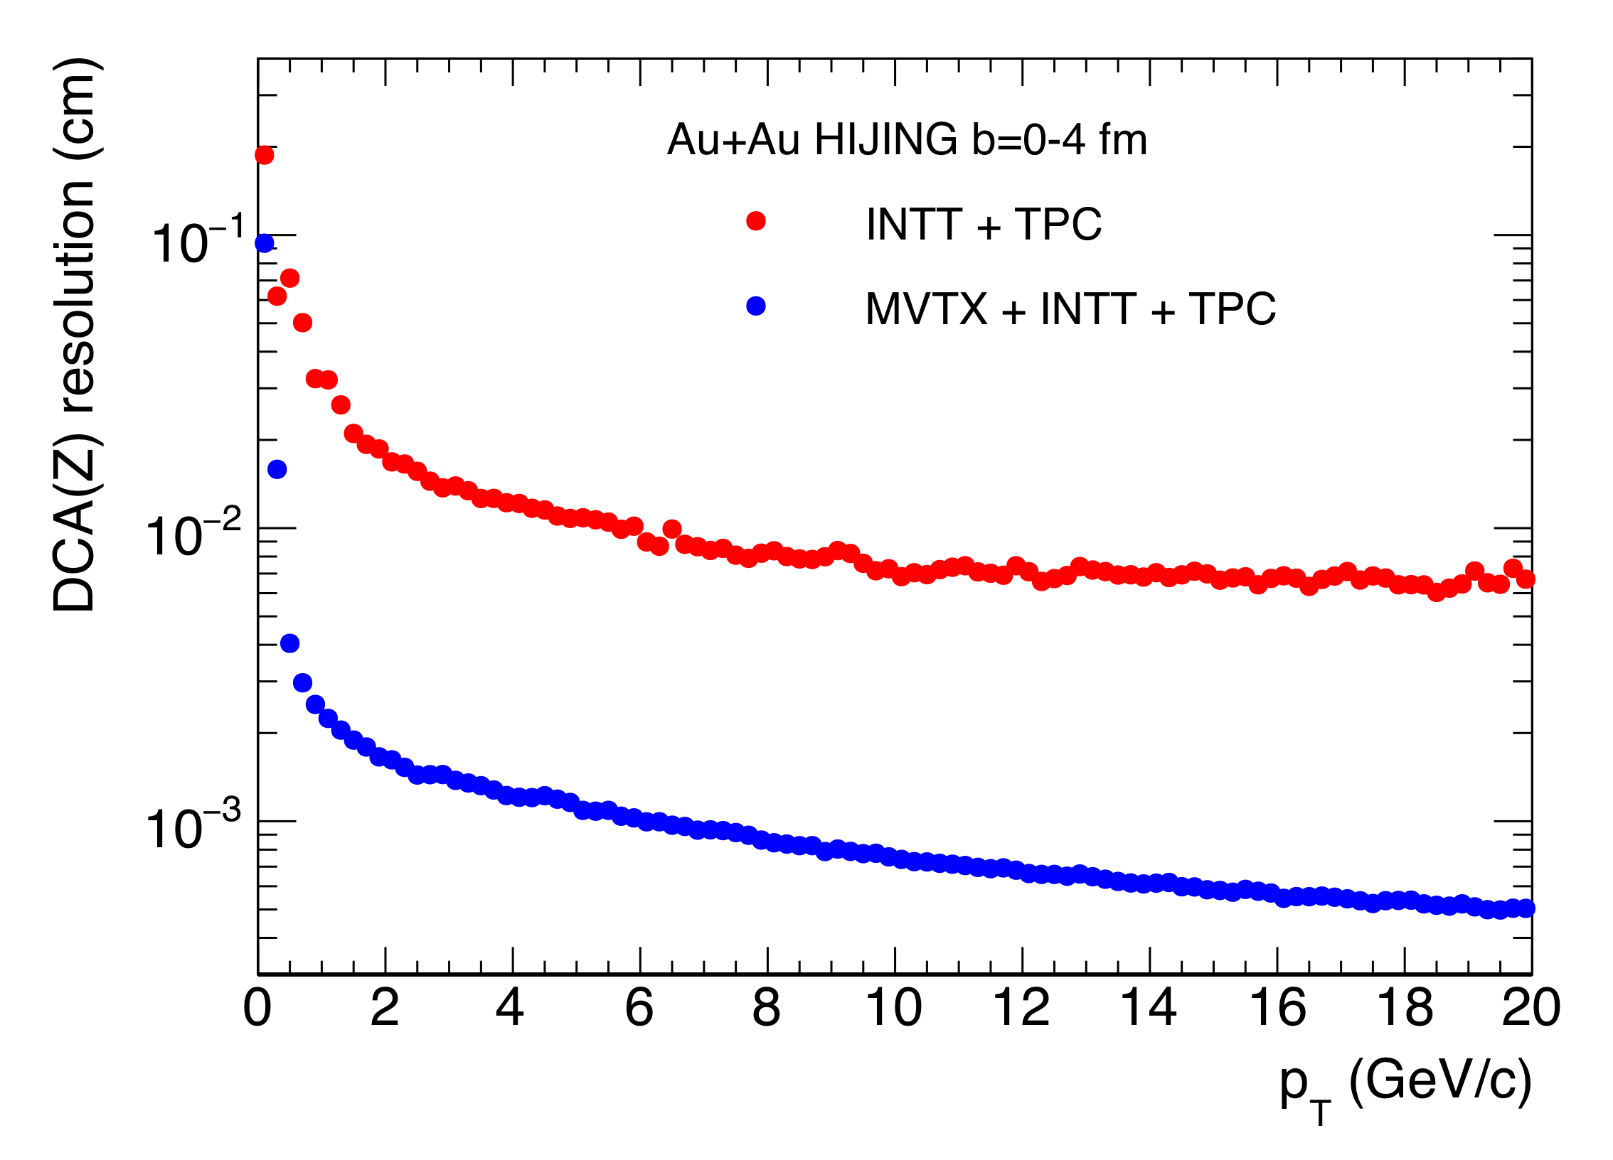
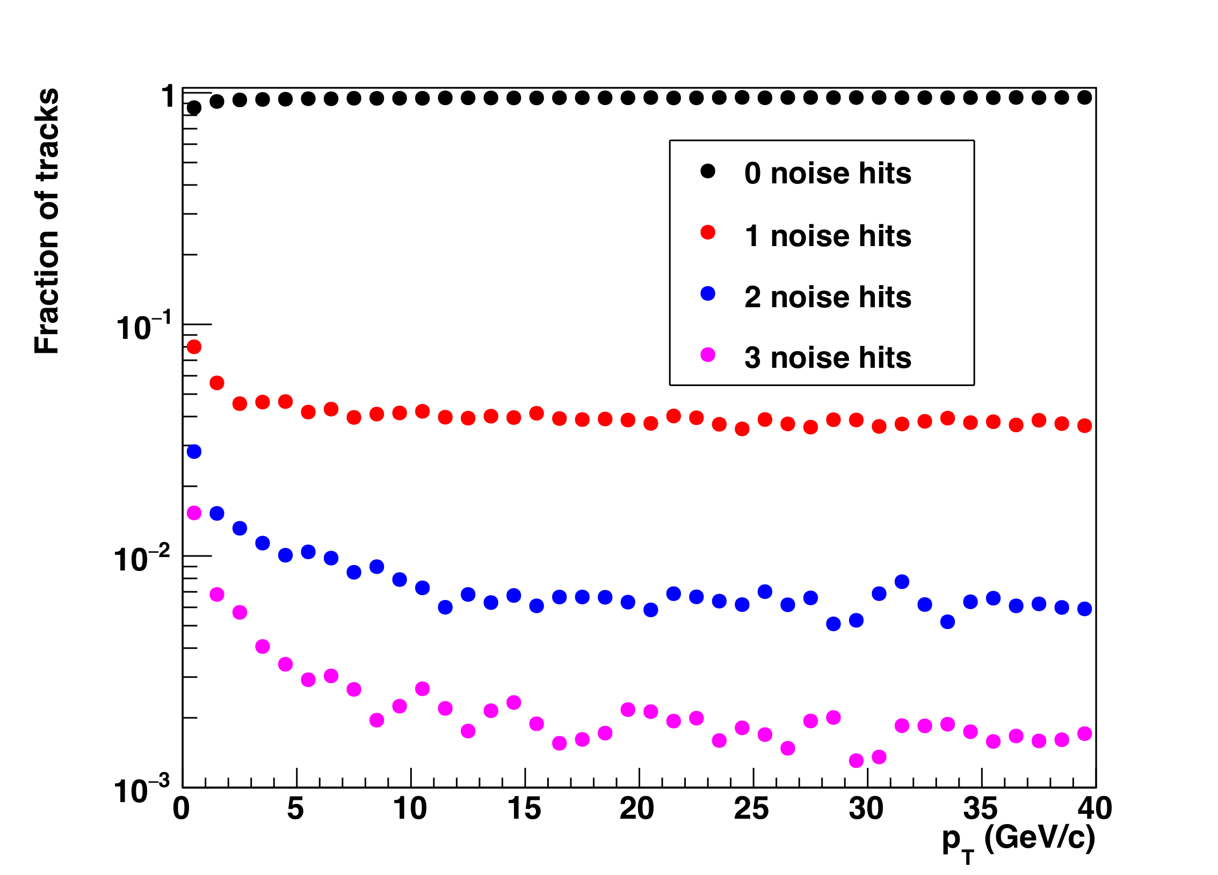
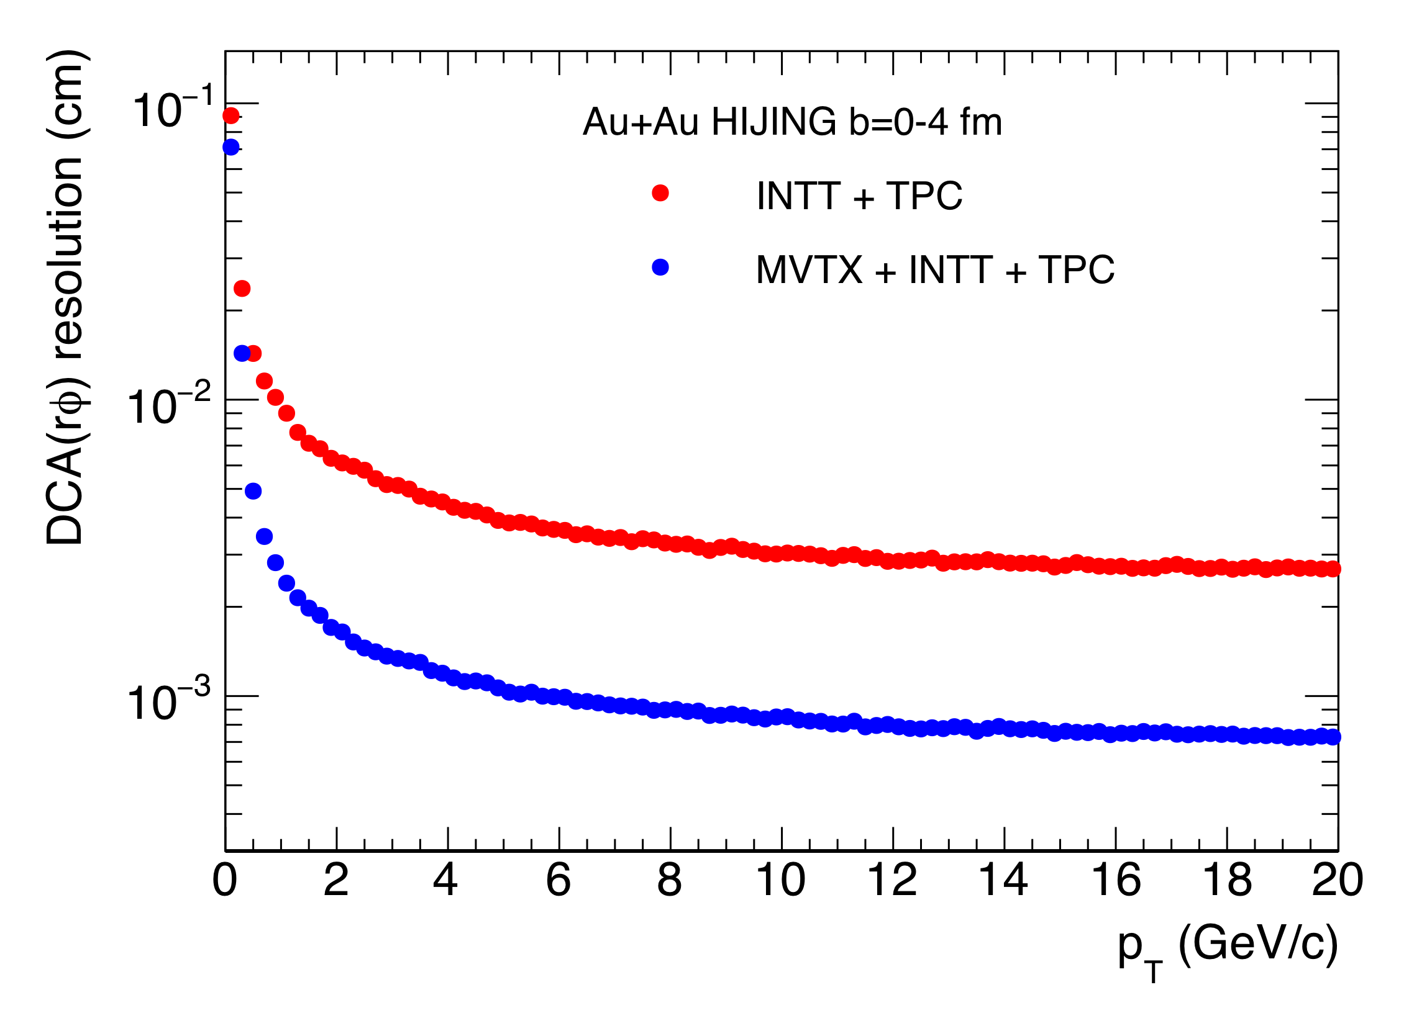
Tracking Performance with Full GEANT
MVTX geometry modeled and digitized according to ALICE ITS/IB
Cluster resolution: ~5 µm
DCA_{2D ,} DCA_{z}<30 µm down to 1 GeV
DCA_rφ
DCA_z
Fake hit fraction

Slide 21
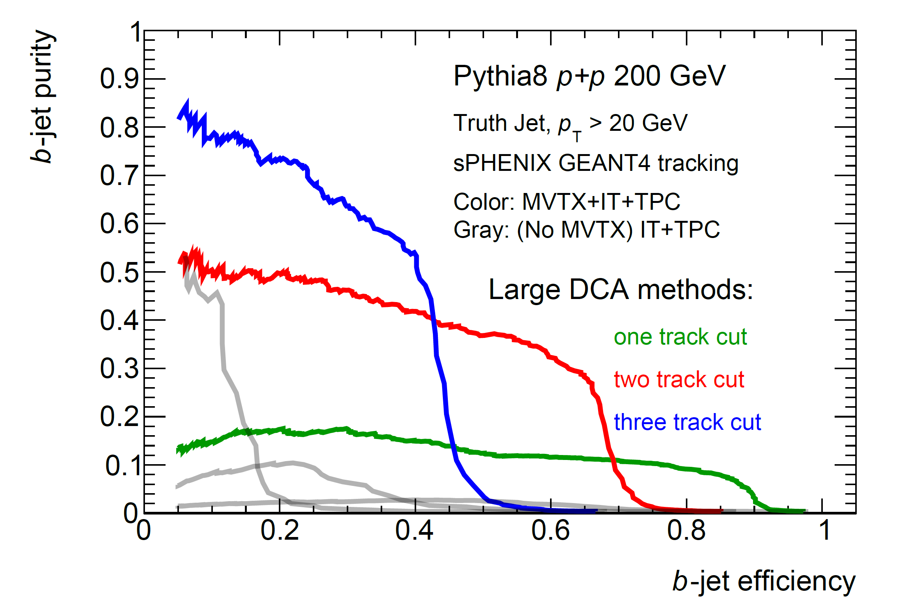
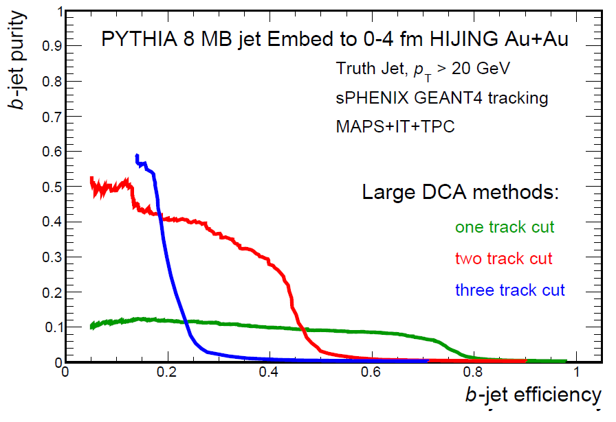
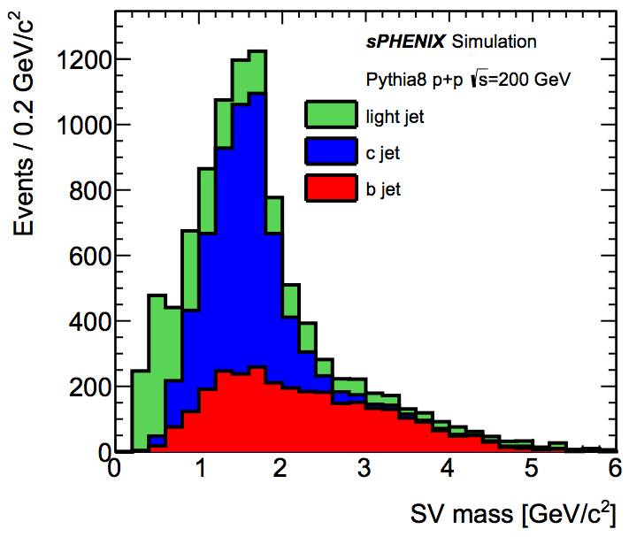
B-jet tagging
Multi-tracks w/ large DCA
2nd vertex mass reco’ed
CMS work-point, Phys. Rev. Lett. 113, 132301 (2014)

Slide 22
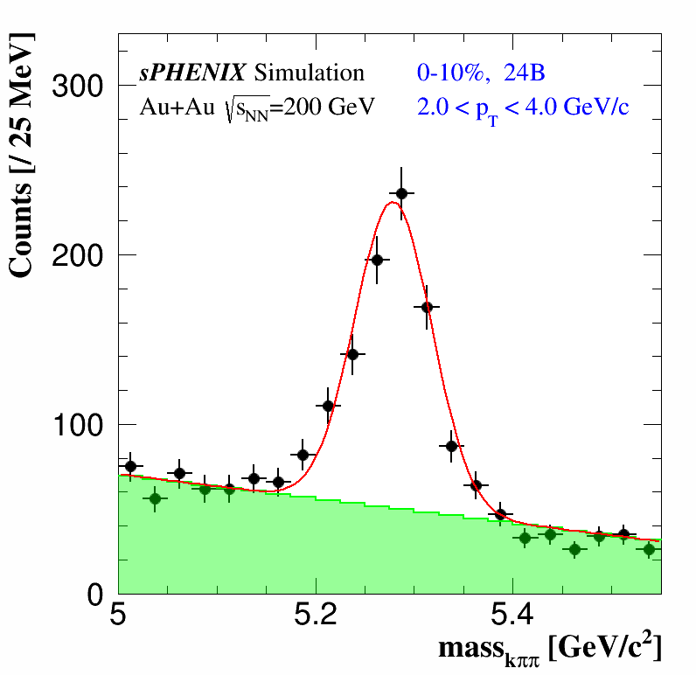
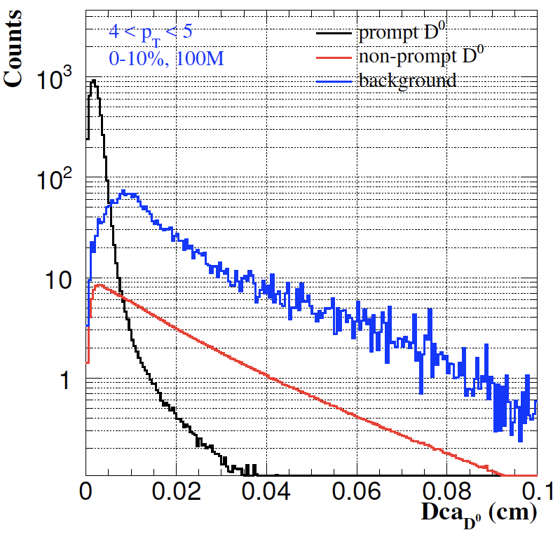
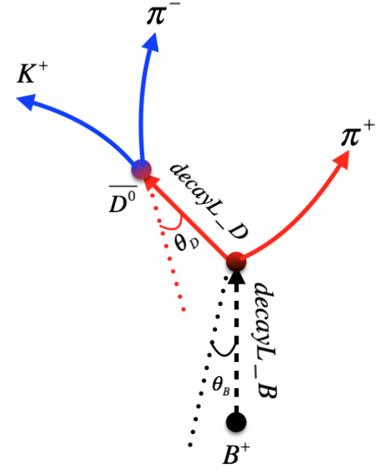
B-hadron Tagging
Impact parameter (DCA) method to tag non-prompt D⁰ from B-meson decays
Inclusive and exclusive channels possible

Slide 23
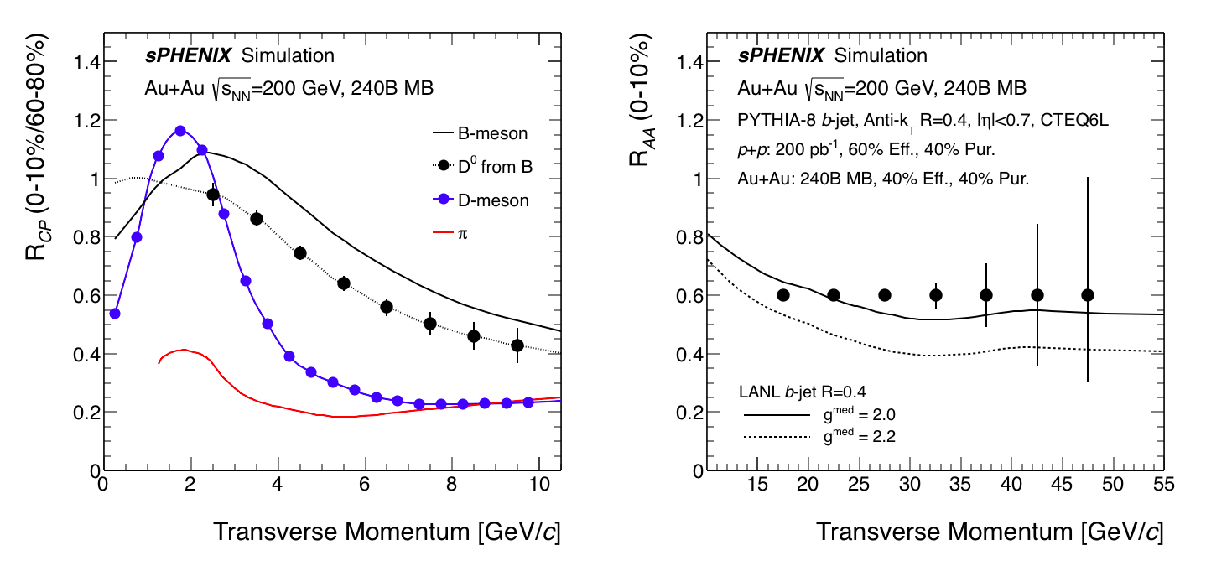
Projected R_{AA}
Open questions:
energy loss mechanisms, fragmentation/coalescence , QGP medium etc.

Slide 24
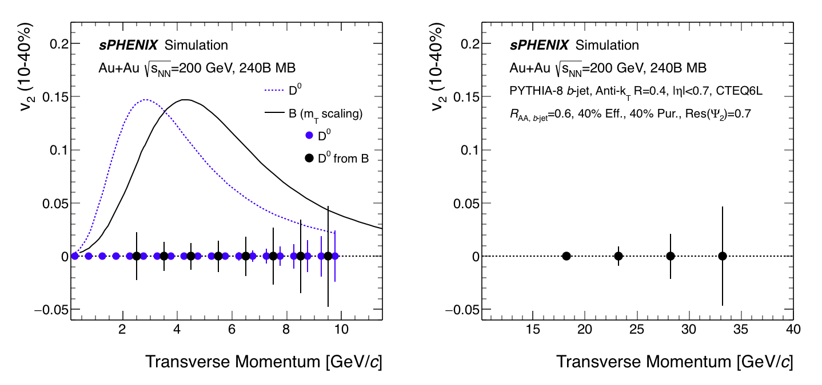
Project Elliptical Flow v₂
Open questions:
quasi-particles, medium interactions, fragmentation/coalescence etc.

Slide 25
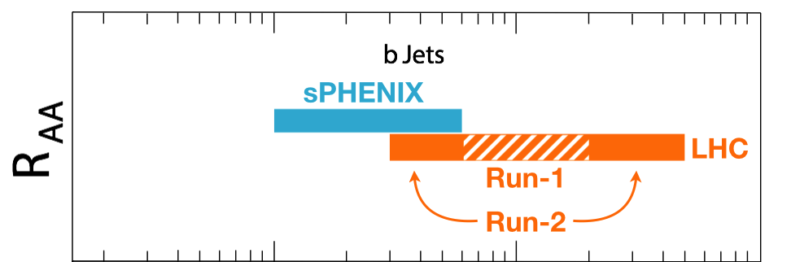
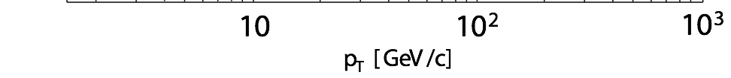
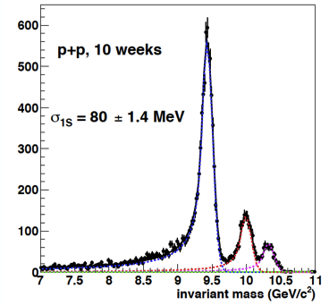
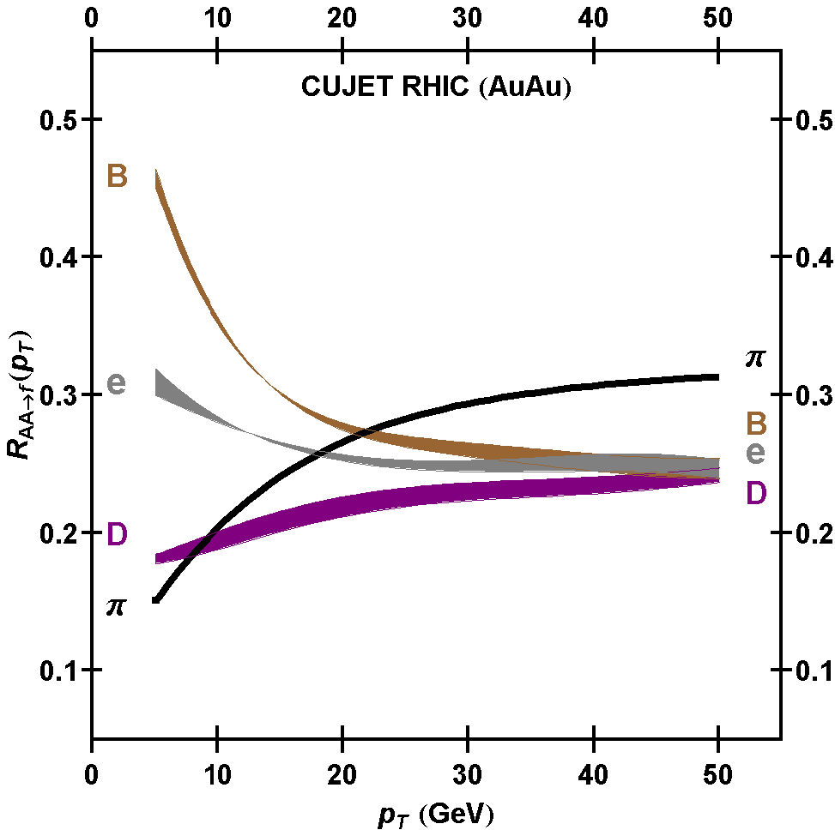
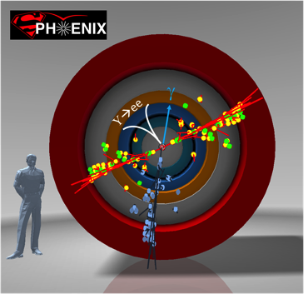
Summary
sPHENIX is the next flagship heavy ion physics experiment in the US (NSAC LRP2015)
  Jets
  Upsilons
  B-jets and B hadrons
MVTX upgrade will complete QGP heavy flavor physics
  Unambiguous determination of key parameters of QGP properties and interactions
  Precision study of the “inner workings of QGP”(LRP15)
Complement & extend current and future RHIC and LHC QGP programs
sPHENIX Three Physics Pillars
Jets
Upsilons
Frawley’s Talk
B
D

Slide 26
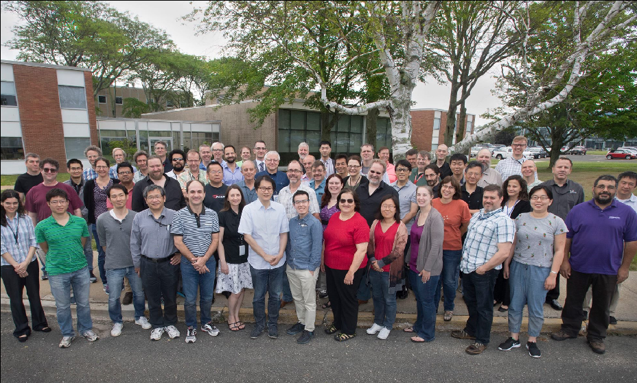
4th sPHENIX Collaboration Meeting at BNL, June 2017
64 institutions and counting …

Slide 27

sPHENIX cross-section view, including envelope for services; TPC and INTT
TPC services (one end)
INTT services, (one –end)

Slide 28
Extended inner tracker with current outer composite shell

Slide 29
Outlook
sPHENIX collaboration fully engaged toward physics in early 2020s with the baseline detectors
MVTX upgrade will bring in the 3rd science pillar – open heavy flavor physics and more
Strong support from the community, LANL LDRD etc.
Great opportunity to advance our understanding of the inner workings of QGP
sPHENIX:
CD-1
Installation
1st beam
2017
2018
2019
2020
2021
2022
2023+
MVTX:
Full
proposal
Construction
Installation
Day-1 physics

Slide 30
MVTX Funding & Schedule
Tied to sPHENIX and ALICE schedule
  Stave production
  Readout electronics
  Minimize technical risk and R&D cost
Cost based on ALICE/ITS and similar recent STAR & PHENIX upgrade projects
  STAR HFT
  PHENIX FVTX

Slide 31
Schedule
sPHENIX ready for installation: 4/2021
sPHENIX installed and ready for commission 7/2022
sPHENIX commission complete 9/2022
First beam 1/2023
sPHENIX CD-4 1/2024
Install INTT 4/22/2022
MVTX ready for installation: ~1/2022 (or with INTT, ~4/2022)
MVTX installed and ready for commission 7/2022
MVTX ready for beam: 1/2023

Slide 32

B->D->K+pi

