Slide 1
sPHENIX MVTX Upgrade
Ming Liu
Los Alamos National Lab
For the sPHENIX Collaboration

Slide 2
Outline
Science
MVTX upgrade
Status & prospects

Slide 3
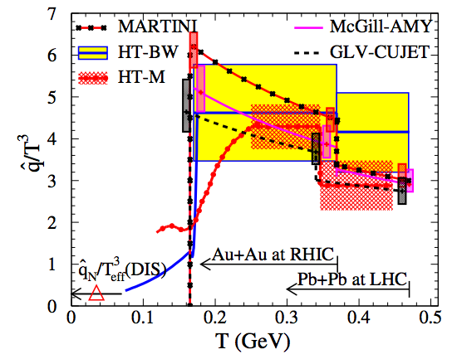
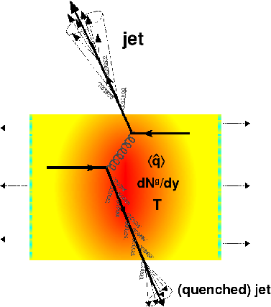
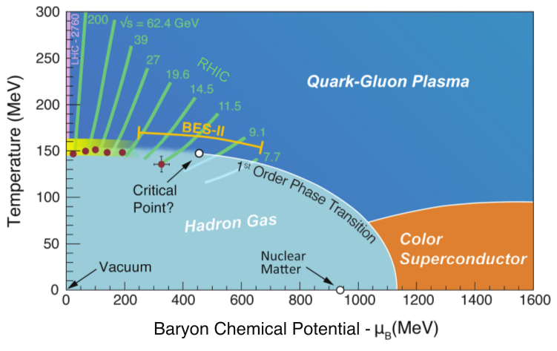
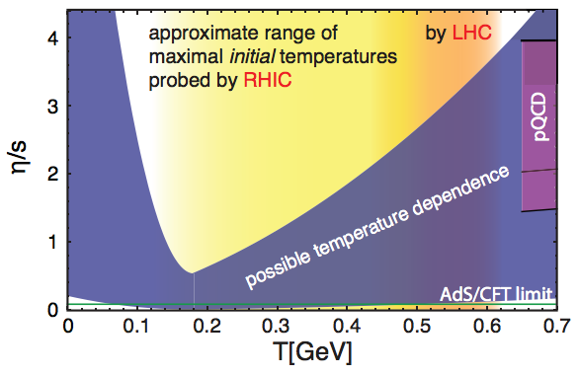
sPHENIX – the Next Generation HI Experiment @RHIC
To study the inner workings of QGP with,
  Jets
  Upsilons
  Heavy flavors

Slide 4
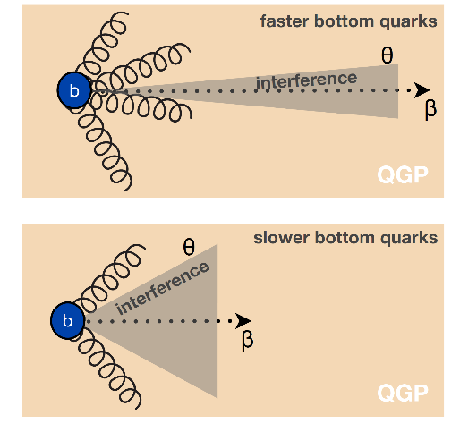
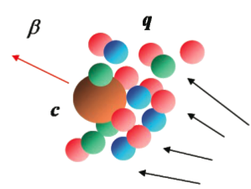
Heavy Quarks - Unique Probe of QGP
Study mass dependence
  Jet quenching
  Flow – interaction with medium
Access QGP properties
m_{u} m_{d}
m_{s}
Λ_{QCD}
m_{c}
m_{b}
MeV
1
10
10²
T_{c}
T_{QGP}
10³
10⁴

Slide 5
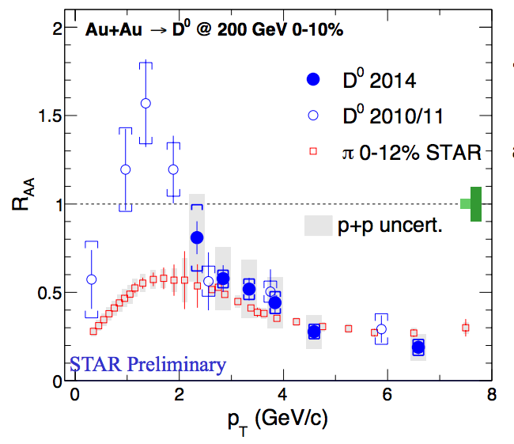
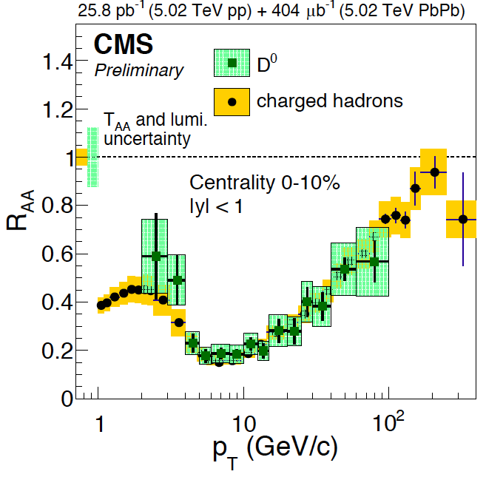
What do we know? - Charm
R_{AA} (D-meson) ~ R_{AA} (h) at high p_{T} ~> 4 GeV/c
significant suppression of charmed hadron R_{AA} in central A+A collisions
strong charm-medium interactions
mass effect important at low pT, dead-cone effects?

Slide 6
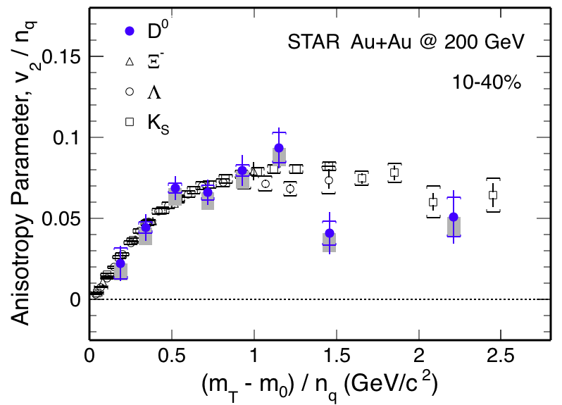
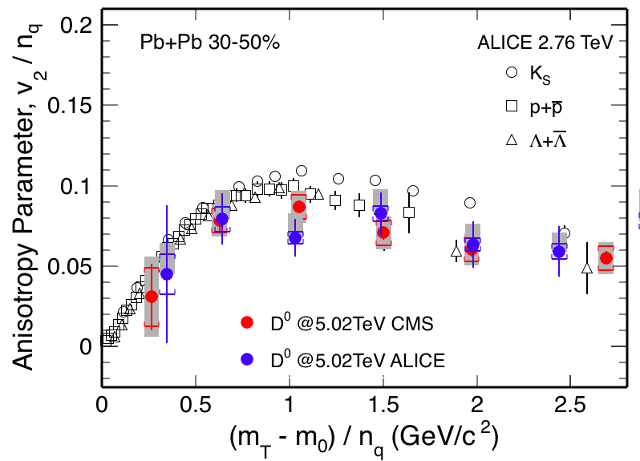
What do we know? - Charm
v₂ of D⁰ follows the same trend as light hadrons
Charm quarks flow the same as light quarks
Strong coupling to medium at low pT?

Slide 7
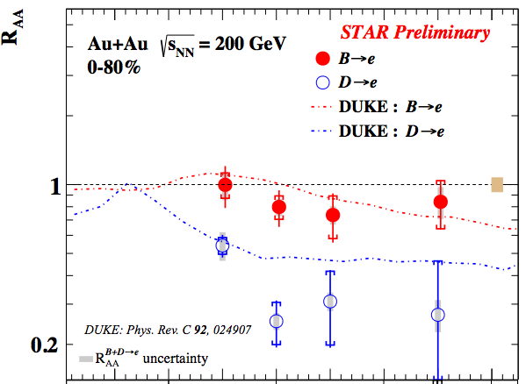
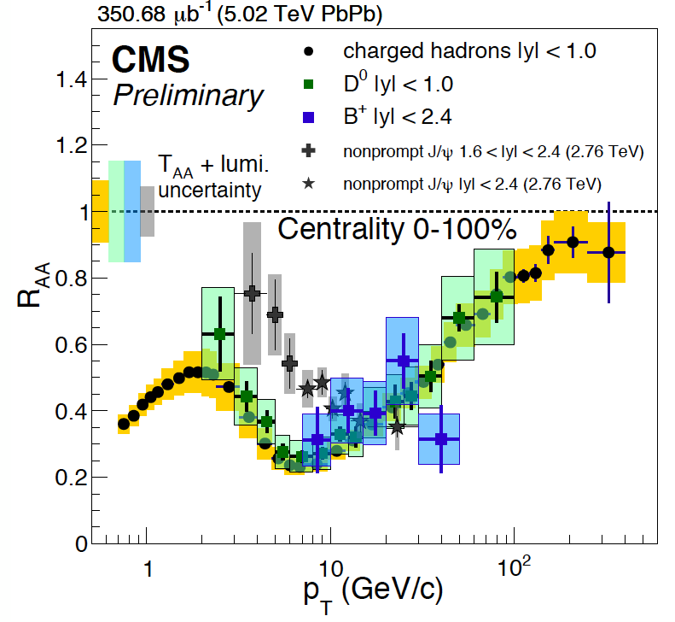
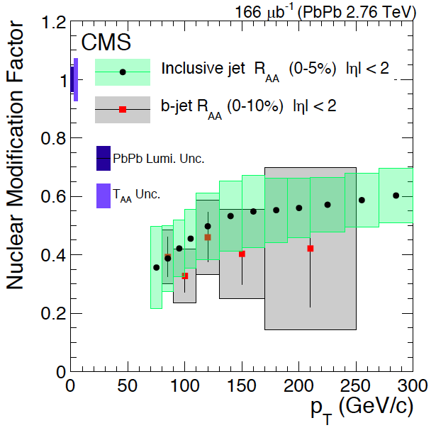

What do we know? - Beauty
Highly desired:
precision measurements of
B @low pT ~< 50GeV
R_{AA} (B->e) > R_{AA} (D->e, h) @low pT
B⁺ & b-jet ~ light hadrons & charm @high pT
STAR, QM17

Slide 8
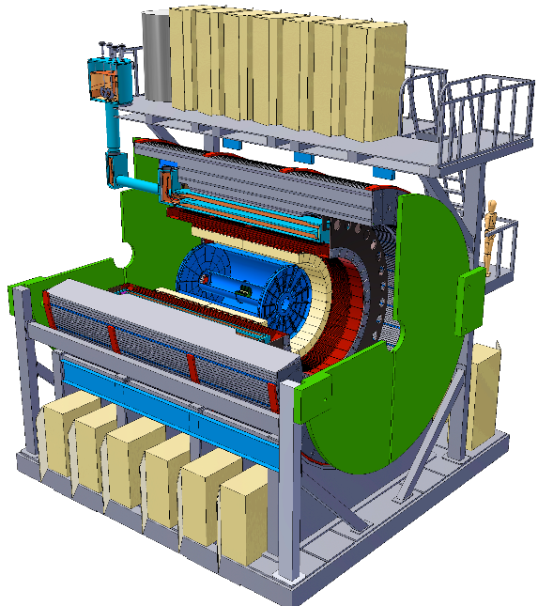
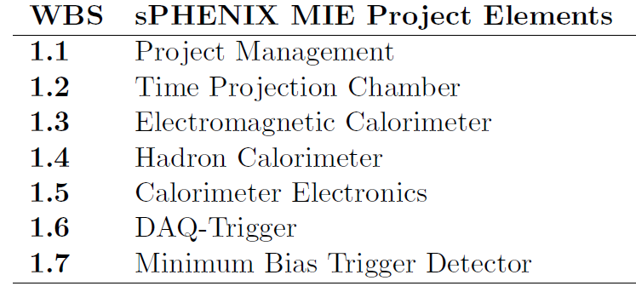
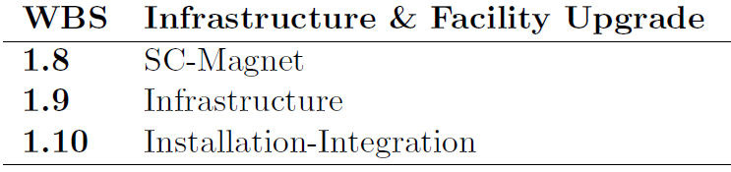
MVTX:MAPS-based Vertex Detector for sPHENIX
A separate upgrade project for the baseline sPHENIX: Jet + B-tagging
Baseline
Parallel Activities
MAPS-based Vertex Detector (MVTX)
Intermediate Silicon Strip Tracker (INTT)
Upgrades

Slide 9

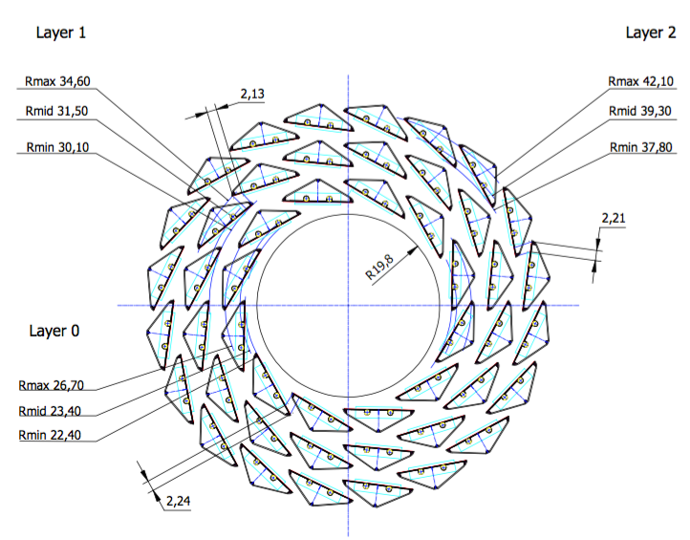
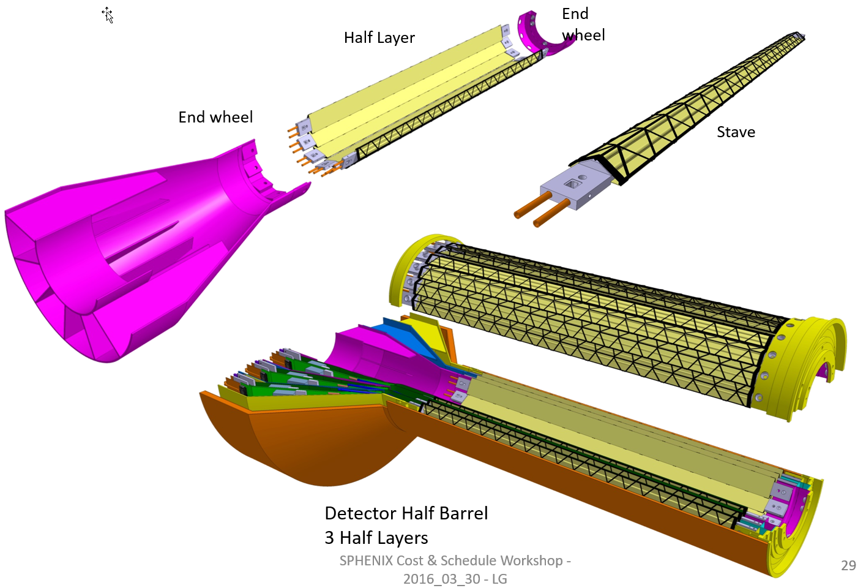
MVTX Proposal
ALICE ITS Upgrade:
Inner Barrel Tracker
Major challenges:
- Readout
- Mechanics
R = 23/32/39 mm
Z = 271 mm
sPHENIX Inner Tracking
Adapt ITS/IB
- Min. Risks
- Max. Phys.

Slide 10
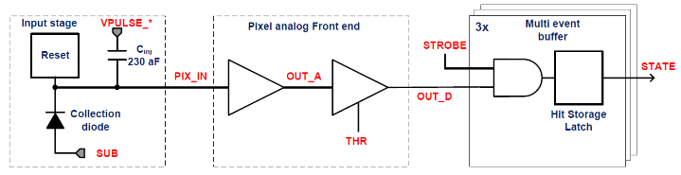
ALPIDE Timing & Trigger Latency
Well fit sPHENIX/RHIC environment, 10MHz Clock (LHC 40MHz)
v
PIX_IN
v
OUT_A
~5-6 μs
t_{f}~= 10 ns
OUT_D
ΔV=Q/C
threshold
t_{r}> 100 μs
~5-6 μs
STROBE
t
t
sPHENIX trigger latency: ~4 μs

Slide 11
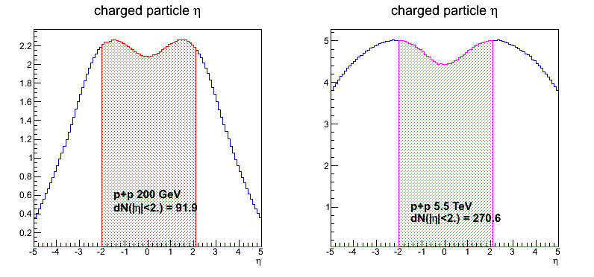
sPHENIX MVTX vs ALICE ITS/IB Specifications from ALICE ITS Upgrade & sPHENIX design
 | ALICE (Run3) | sPHENIX
Pb+Pb / Au+Au | 100 kHz (50kHz) | 200 kHz
p+p | 400 kHz (200kHz) | 13 MHz
Trigger | 50 kHz | 15 kHz
Event size, dN/dη: sPHENIX = 1/3 ALICE (pp), 1/5 ALICE(AA)
sPHENIX
ALICE

Slide 12
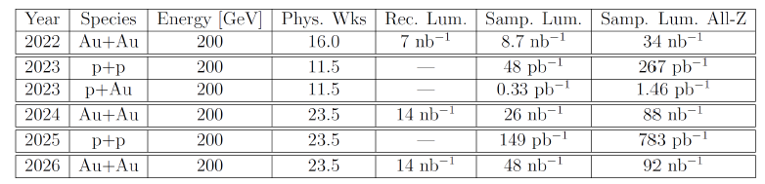
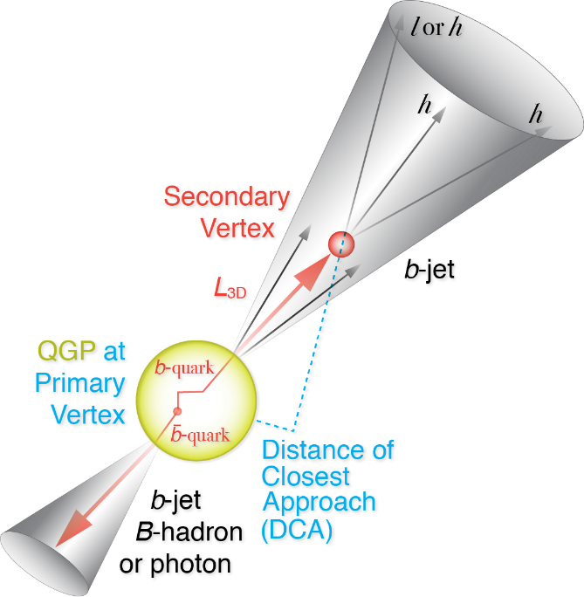
RHIC Multi-Year Plan: sPHENIX 2022-2026+
To be updated
Projected maximum collision rates:
  Au+Au: 200 kHz ( ~50 kHz, |Z|<10cm)
  p+p: 13 MHz ( ~3 MHz, |Z|<10cm)
  p+A: 2.8 MHz ( ~0.7 MHz,|Z|<10cm)
  sPHENIX DAQ: 15kHz
Precision 2nd vertexing for B-tagging:
  Tracking resolution better than 60um @pT=1GeV
  High multiplicity HI collisions
  Low multiplicity but high rate p+p collisions
  High efficiency and high purity
B hadrons/pT<15GeV: O(1M)
b-jets/pT>15GeV: O(100K)

Slide 13
MVTX Proposal Status
Pre-proposal submitted to DOE, 2/2017
  Follow-up discussions with DOE and BNL managers
Update proposal to DOE, early 2018
  Expanded science + Cost & Schedule
  Assumed funding starts ~FY19
A growing collaboration
  15+ institutions from US and abroad
Early R&D by LANL internal fund
  FY17-19, $5M
  Readout and mechanical design

Slide 14
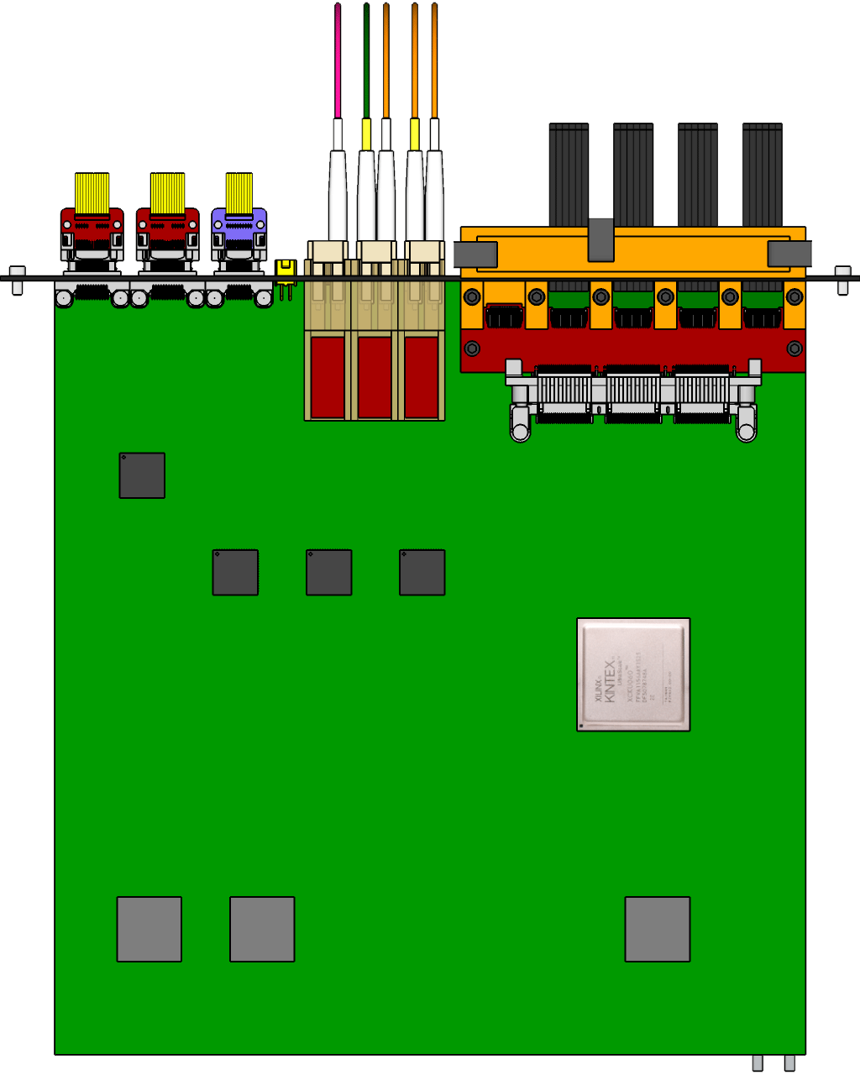

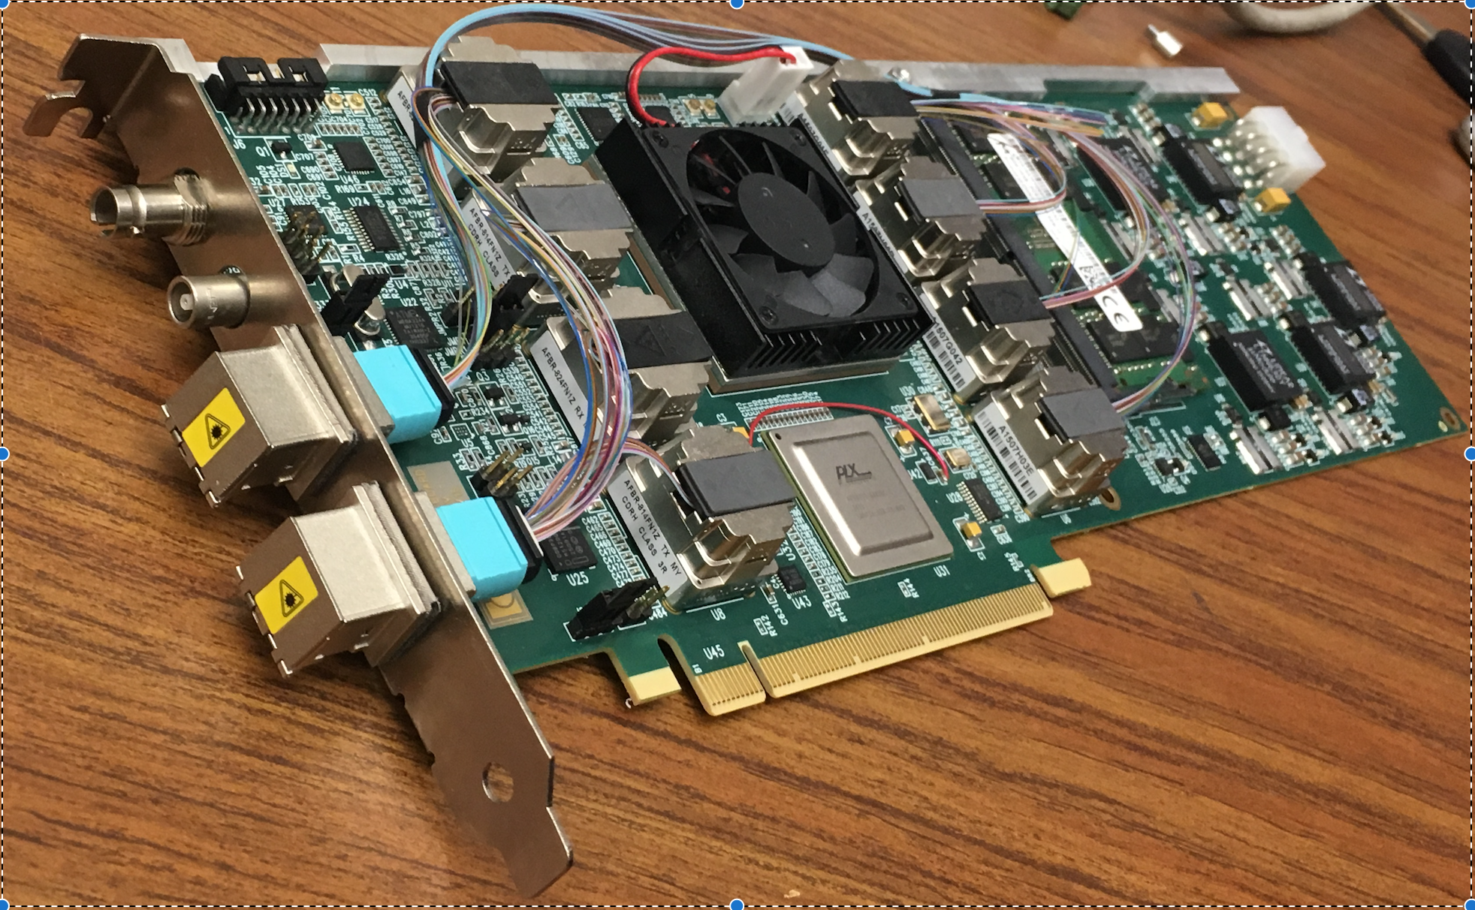
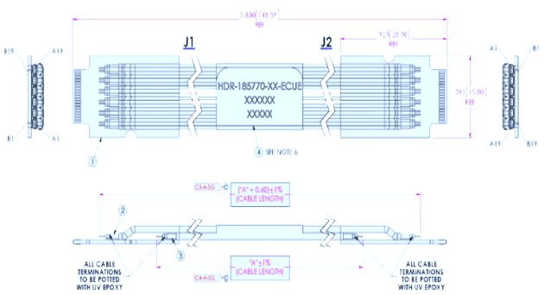

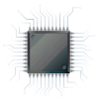
MVTX Readout and Control R&D at LANL
sPHENIX GL-1 & GTM
ALPIDE
CAN bus
DCS
5~10 m
Trigger & Clock
Readout Unit
GBT Optical Links
9-sensor Stave
9 Data (1.2Gbps)
1 Clock, 1 Control/Trigger
Control
Data (9.6 Gb/s max)
Trigger
Samtec Twinax “FireFly”
FELIX
FPC
Power
Alpide Sensors
Power
Filtering
Capacitors
regulators
Power supplies
Cold Plate
Regulated Power
Power Board
LANL, UT-Austin, LBNL, BNL, ALICE/ITS …
Established the readout chain test: ALPIDE + KC705(RU) + FELIX + RCDAQ/sPHENIX
RUv.10 arrived last week, 10/21/2017
ALPIDE and Power Unit being tested

Slide 15
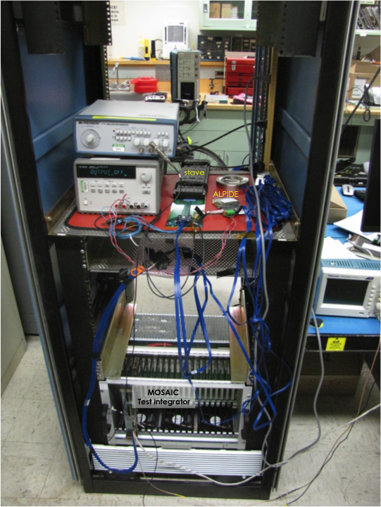
R&D at LANL
Power unit test
ALPIDE/Stave evaluation test bench

Slide 16
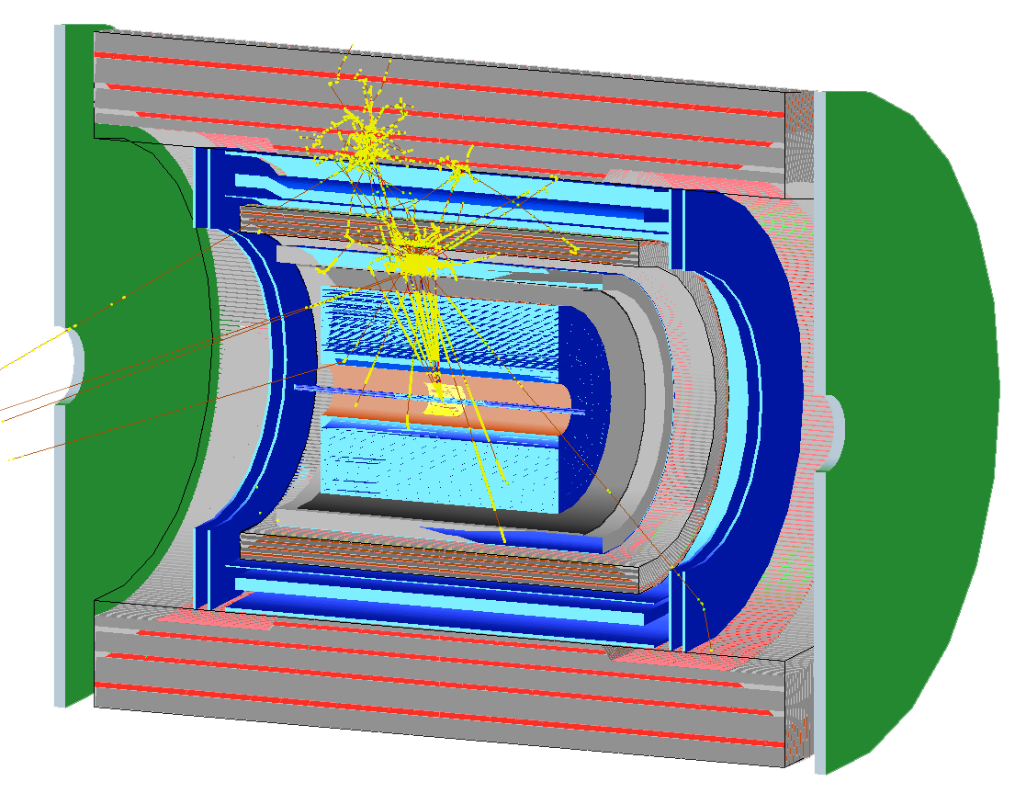
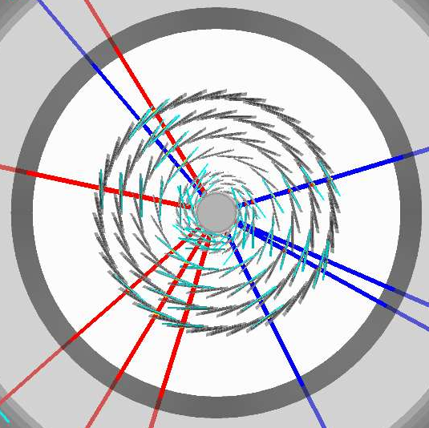
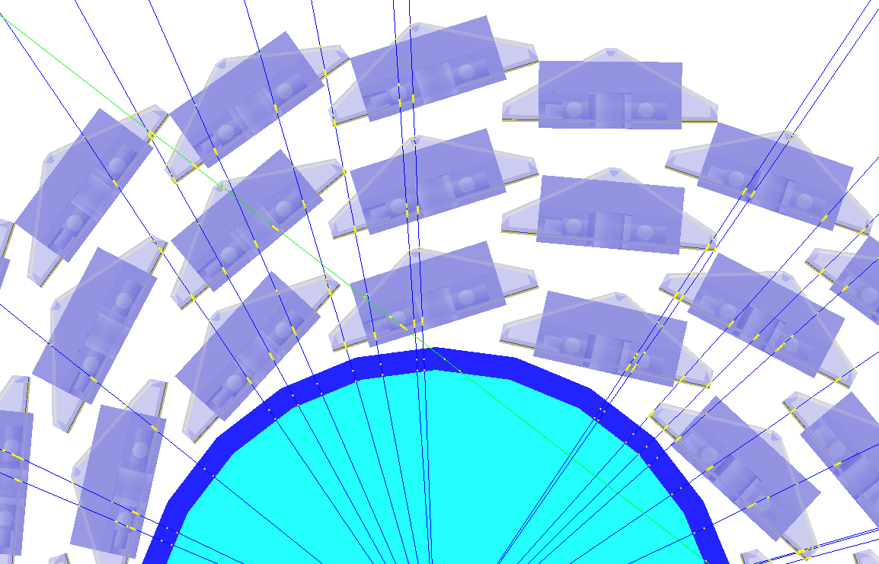
Simulation for b-jet and B-meson in sPHENIX
sPHENIX Geant4 display of p_{T}=30 GeV/c B⁺-hadron
Design to Simulation
MVTX and INTT _
_ MVTX Ladders modeled in details

Slide 17
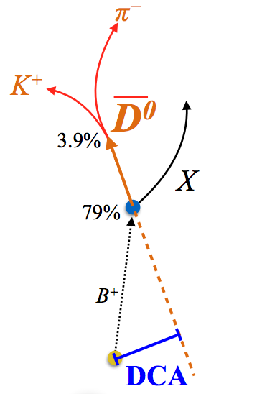
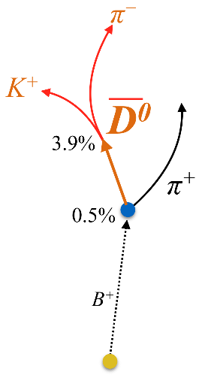
Physics Channels: Open Charm and Beauty
Hadron | Abundance | cτ (μm)
D⁰ | 61% | 123
D⁺ | 24% | 312
D_{s} | 8% | 150
Λ_{c} | 6% | 60
B⁺ | 40% | 491
B⁰ | 40% | 455
B_{s} | 10% | 453
Λ_{b} | 10% | 435
b-tagged jet and cor.
p_{T}>15 GeV
60%
0.5%
p_{T}<15 GeV
Exploring and more

Slide 18
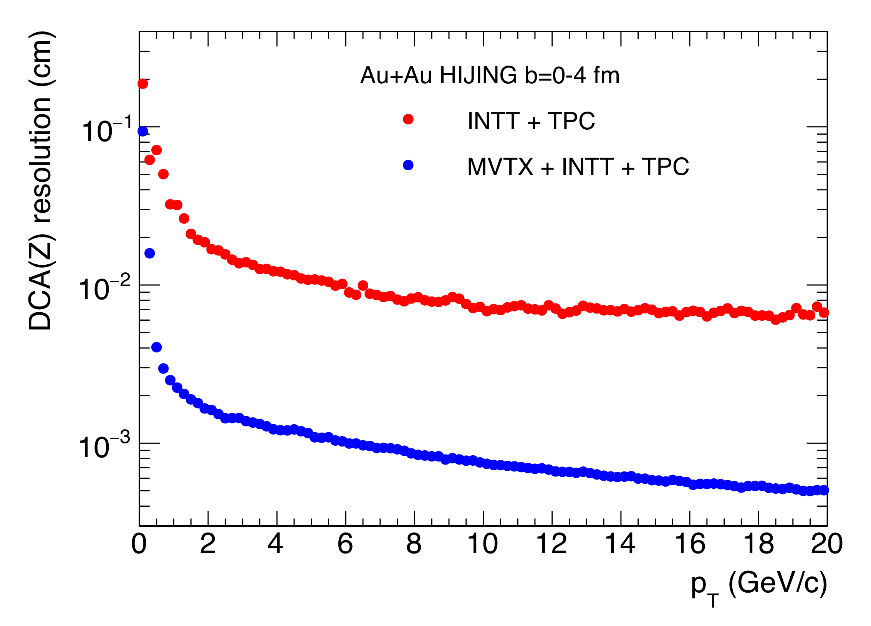
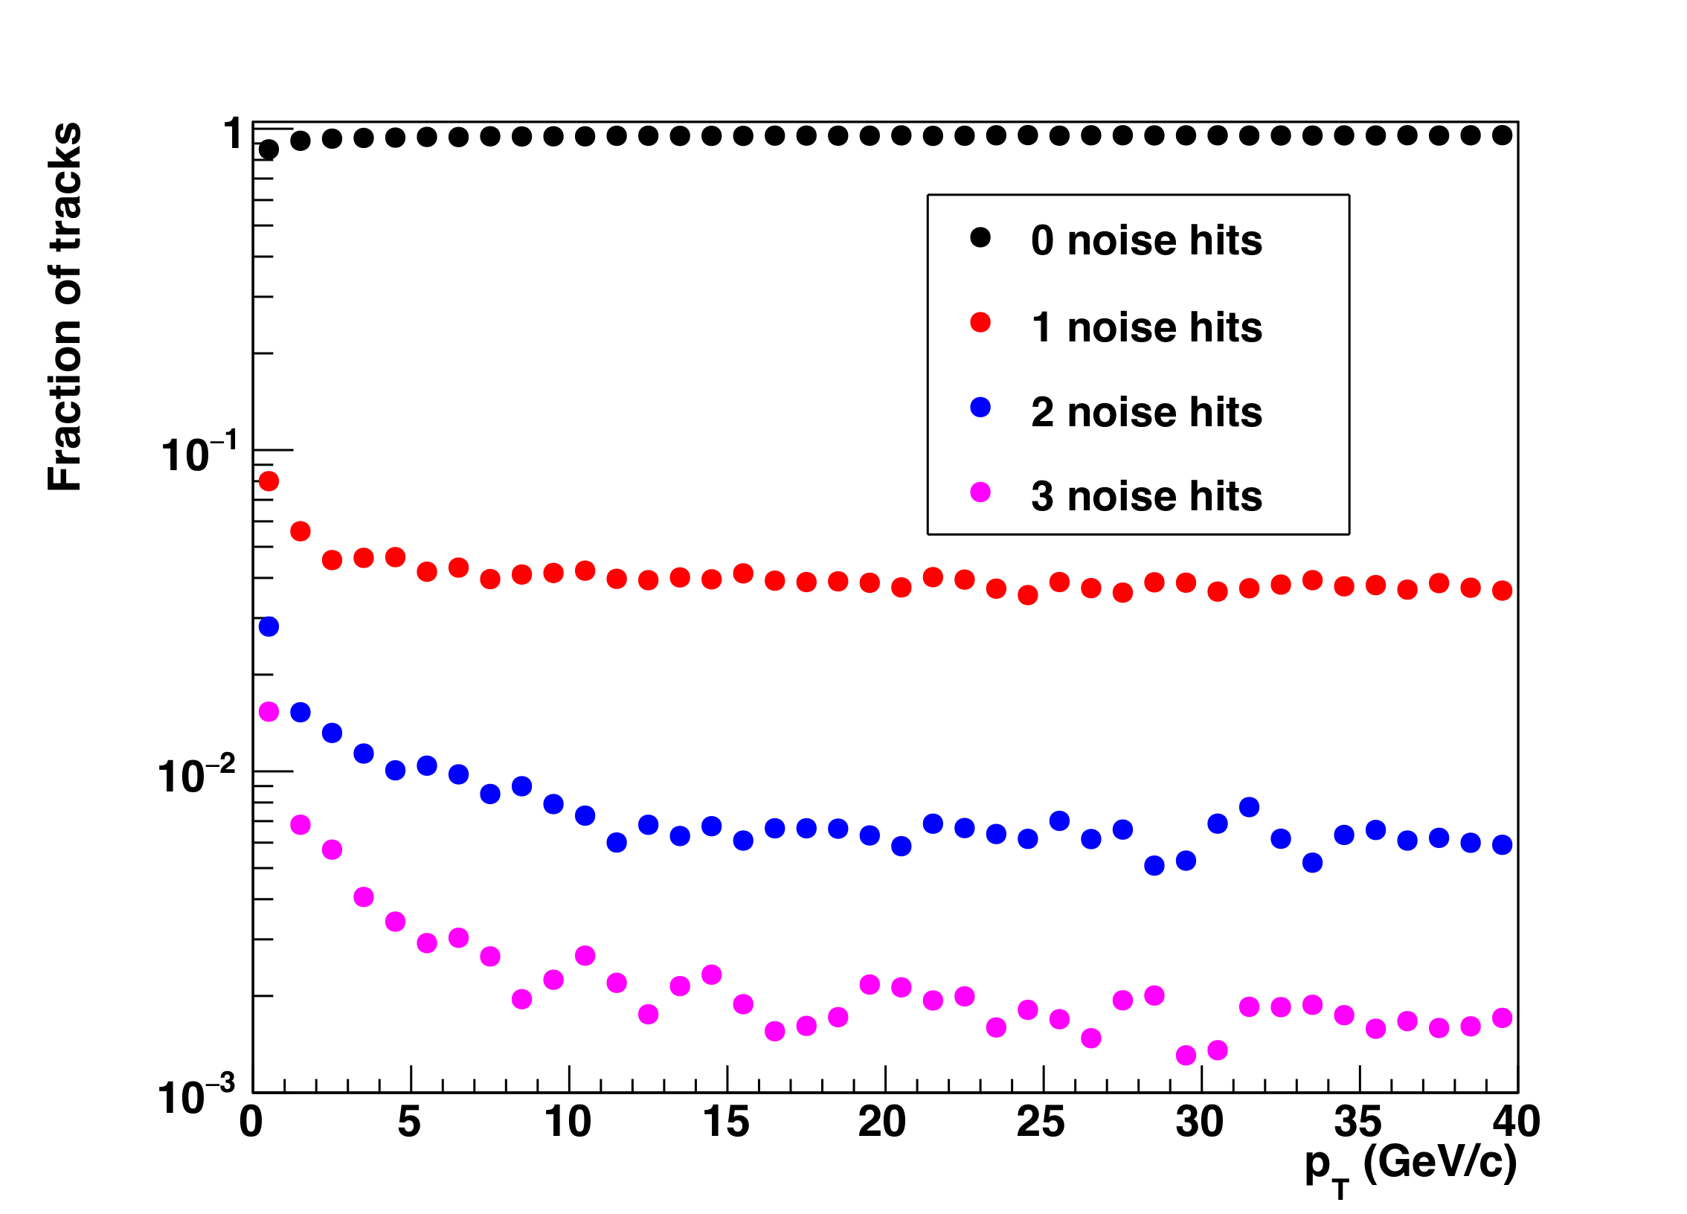
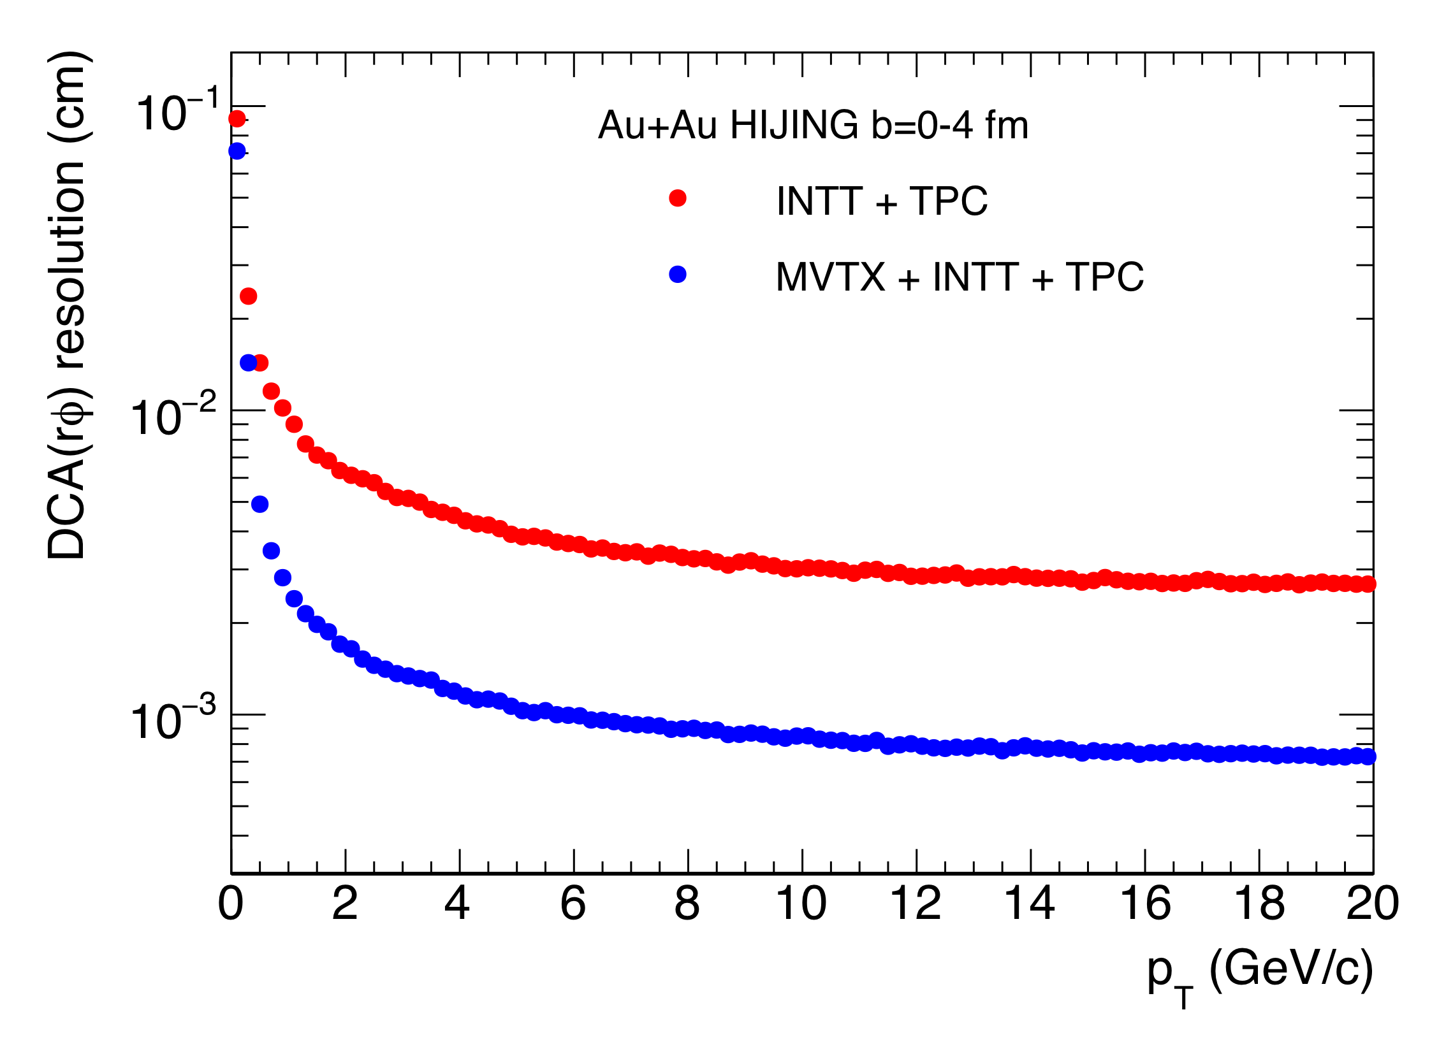
Tracking Performance with Full GEANT
MVTX geometry modeled and digitized according to ALICE ITS/IB
Cluster resolution: ~5 µm
DCA_{2D ,} DCA_{z}<30 µm down to 1 GeV/c
DCA_rφ
DCA_z
Fake hit fraction

Slide 19
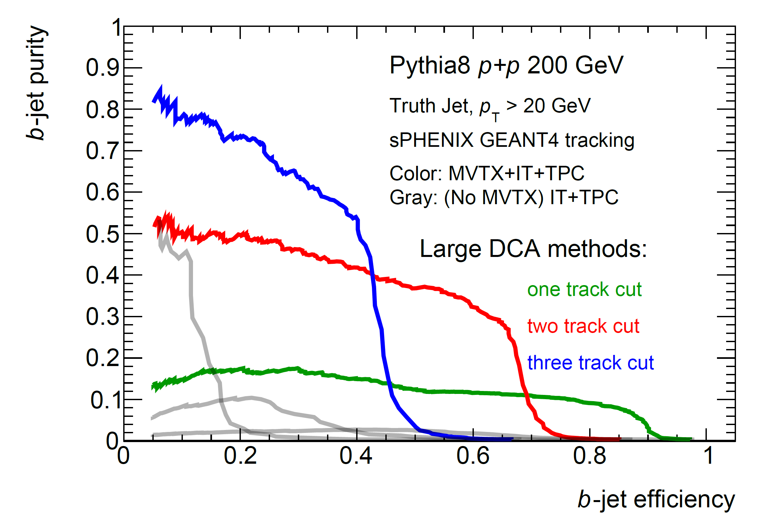
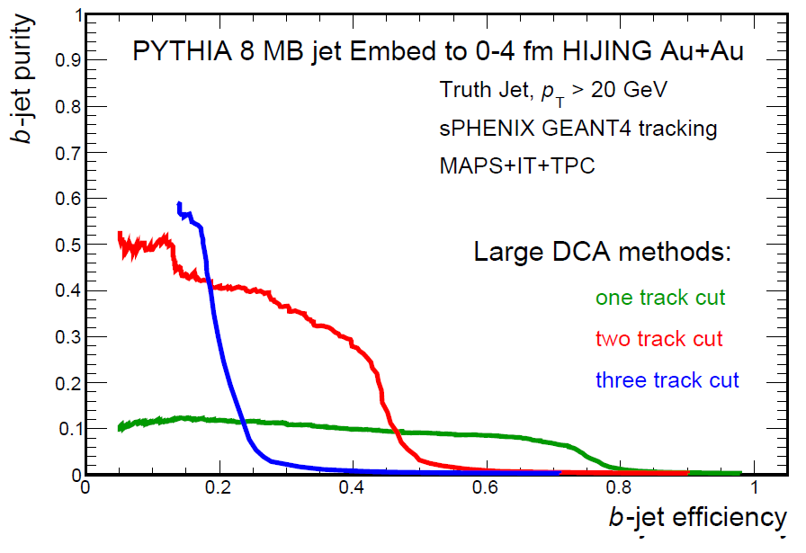
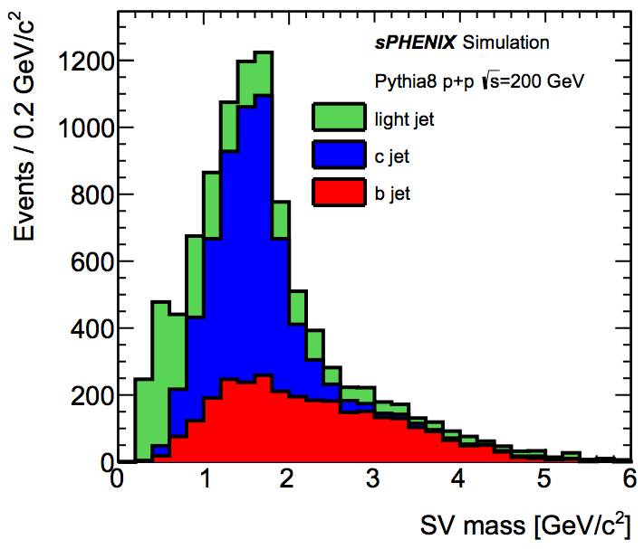
B-jet tagging
Multi-tracks w/ large DCA
2nd vertex mass reco’s
CMS work-point, Phys. Rev. Lett. 113, 132301 (2014)

Slide 20
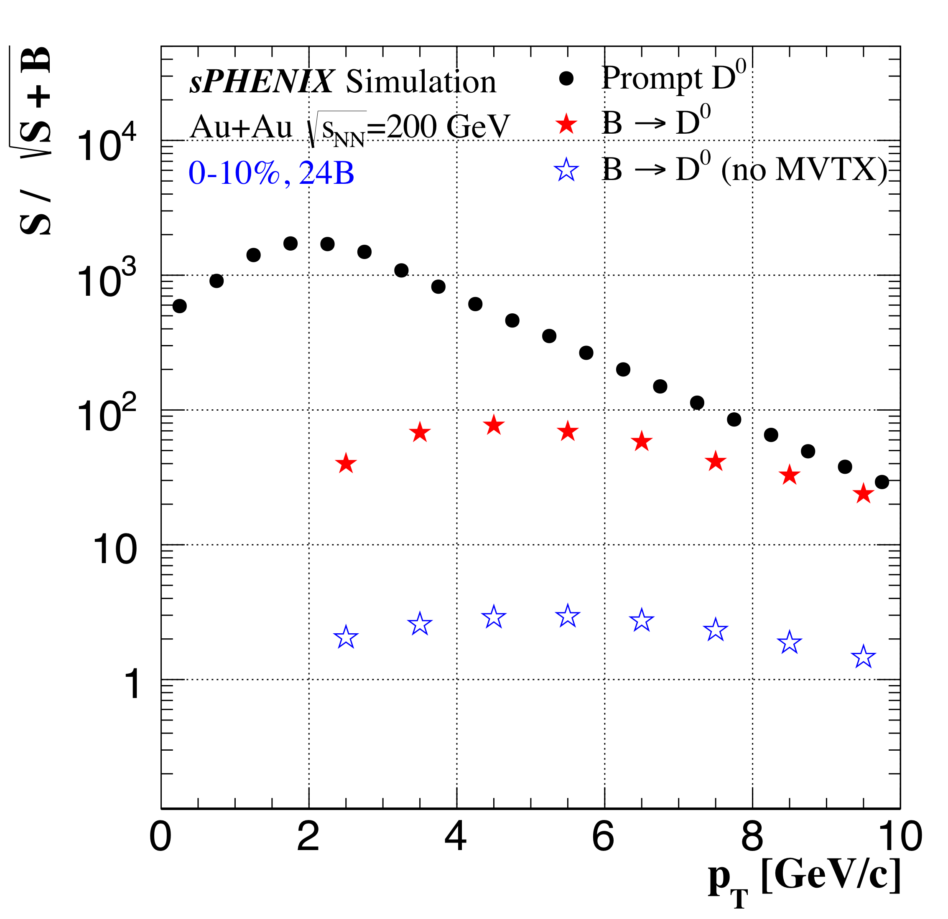
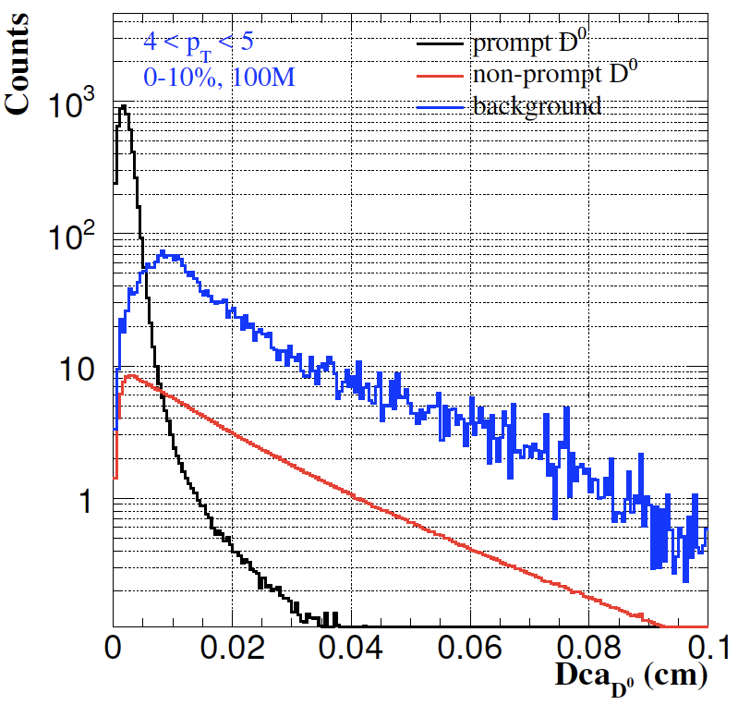
B –hadron Tagging
Impact parameter (DCA) method to tag non-prompt D⁰ from B-meson decays

Slide 21
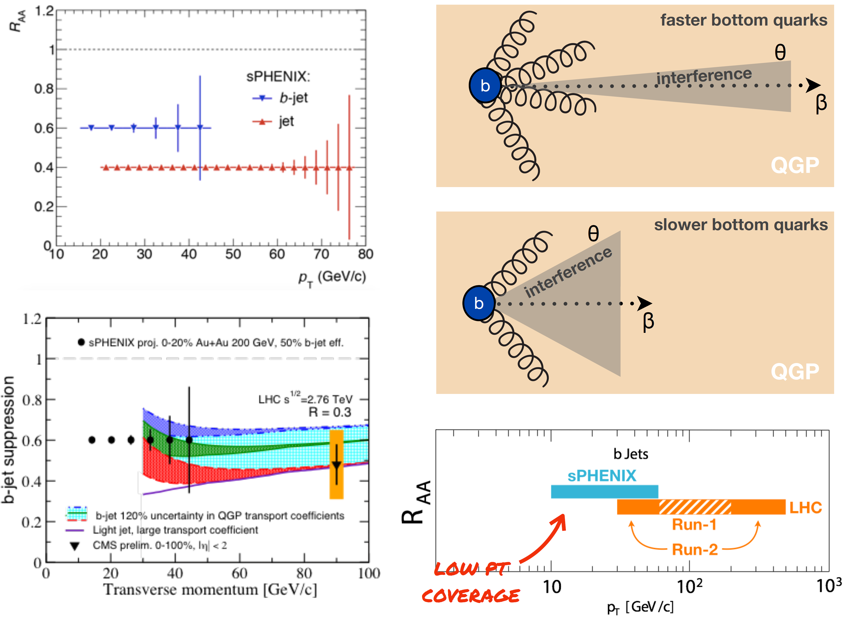
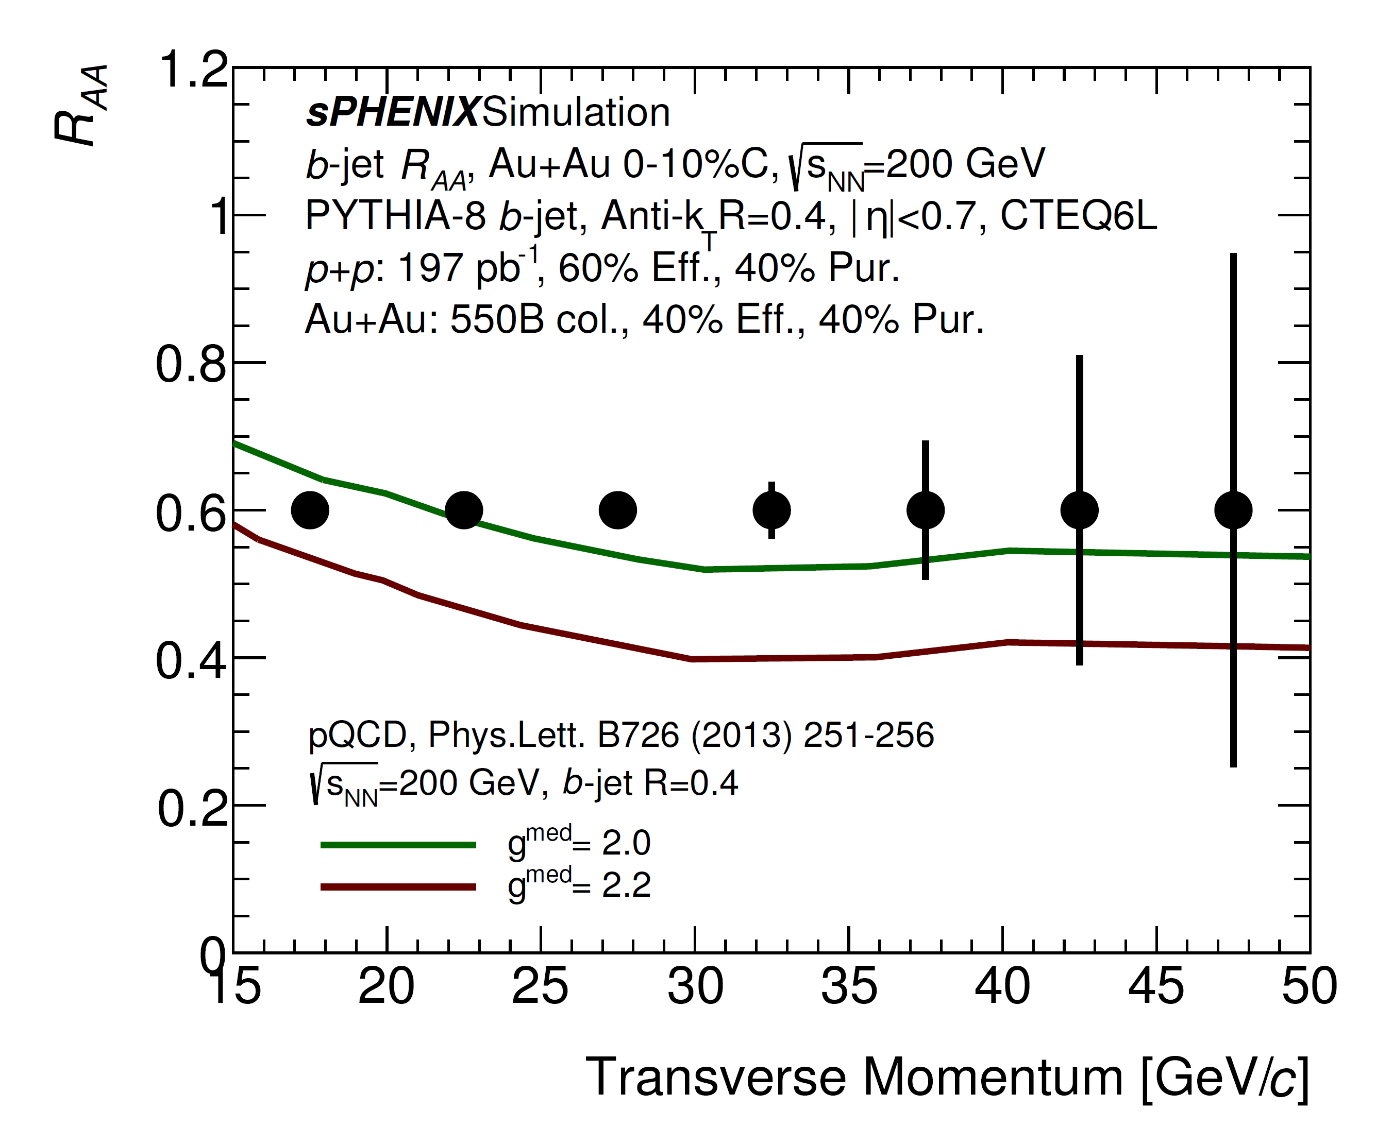
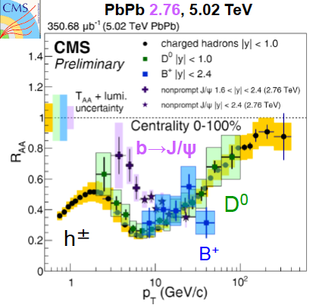
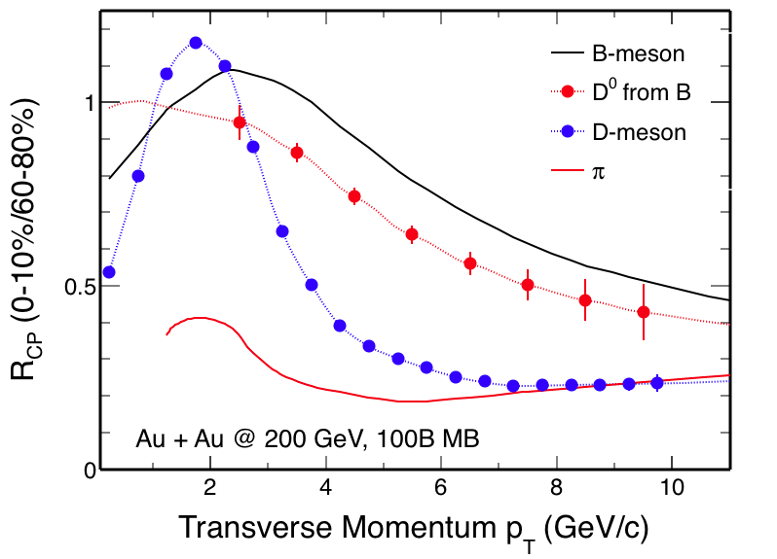
MVTX – Bring sPHENIX to a New Horizon
Unambiguously determine quark energy loss mechanisms, particularly over the interesting transition region, pT ~ M
  Radiative dE/dX
  Collisional dE/dX
  Other effects
Expectations @sPHENIX
Learned @CERN
sPH-HF-2017-002
sPH-HF-2017-001
B-hadron
B-jet
sPHENIX

Slide 22
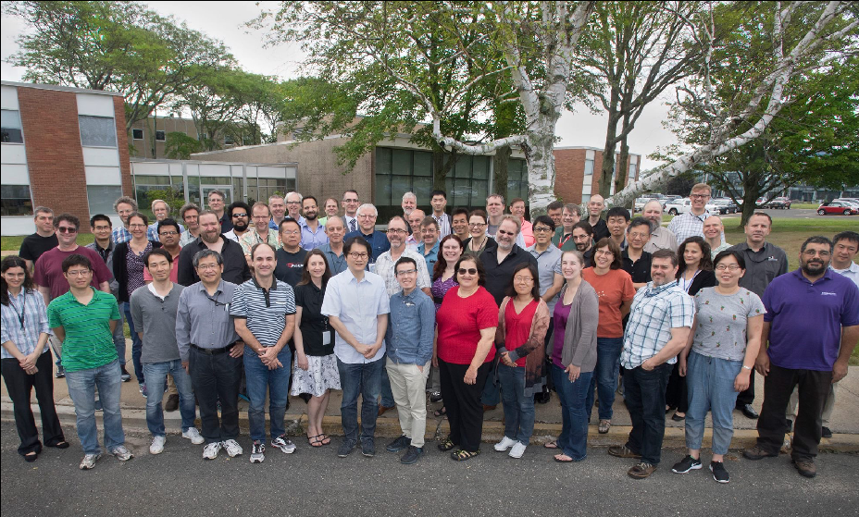
4th sPHENIX Collaboaration Meeting at BNL, June 2017

Slide 23


Monolithic-Active-Pixel-Sensors (MAPS)
The next Generation State of the Art Pixel Tracker
Advantages of ALICE MAPS/ALPIDE:
  Very fine pitch (28x28 μm)
  High efficiency (>99%) and low noise (<10⁻⁶)
  Fast readout, ~5 μS
  Ultra-thin/low mass, 50μm (~0.3% X₀)
  On-pixel digitization, low power dissipation
An ideal detector for QGP b-jet physics!
FPC
9 Chips
Cooling plate
A 9-chip MAPS stave, 1.5 x 27cm²
ALPIDE design
50 μm
28 μm

Slide 24
Funding & Schedule
Tied to sPHENIX and ALICE schedule
  Stave production
  Readout electronics
  Minimize technical risk and R&D cost
Cost based on ALICE/ITS and similar recent STAR & PHENIX upgrade projects
  STAR HFT
  PHENIX FVTX

Slide 25
Scope of the MVTX Project
MAPS Staves & Electronics
  MAPS staves “MoU” to build 68 ITS inner Barrel Staves
    No modification
  Readout Electronics R&D
    Frontend: ALICE/ITS, RU
    Backend: ATLAS FELIX
    Modify/reprogram RU & FELIX for sPHENIX
    R&D by LANL LDRD
  Production:
    Extend ALICE/ITS MAPS stave production
      WBS 1.5.3.1, LANL
      sPHENIX personnel help at CERN
    Reproduce additional ALICE/RU & ATLAS/FELIX
      WBS 1.5.2.1, UT-Austin
      WBS 1.5.2.2 , LANL
    Final assembly and test in US
      WBS 1.5.3, LBNL
  Ancillary systems, “adopt” ALICE system
    Power distribution, cables, crates, racks etc.,
      WBS 1.5.2.3, LBNL
    Slow control, safety and monitoring
Mechanics & Cooling
  Some changes to ALICE/ITS inner tracker mechanical structures, WBS 1.5.3
    End Wheels
    Cylindrical structure shells
    Detector half barrels
    Detector and Service half barrels
  Mechanical Integration, WBS 1.5.4
    Conceptual design by LANL LDRD
    Prototype by sPHENIX R&D, MIT/LANL
    Design integration frames
    Carbon frames etc., LBNL
    Installation tooling etc.
  Adopt ALICE cooling plant design
    Minor modification to fit sPHENIX
    Smaller heat load than ALICE ITS
  Metrology and Survey

Slide 26
LDRD – MVTX Key Tasks/Milestones
7/17
10/17
10/18
10/19
Today
RUv1.0/FELIX1.5 Integration
40MHz, 7/17-12/17
LDRD
RUv1.x/FELIX2.0, 10MHz,
10/17 – 6/18
MVTX Design Review 7/2018
System test, cosmic & source
6/18 - 1/19
Test Beam, tracking performance
analysis, physics sim, NIM paper etc.
1/19 – 9/19
MVTX: 2018 – 2021
Stave Production, procure FPGA, GBT etc.
8/18-4/19
BNL Director Review
7/10-11, 2017
Electronics Production
1/19-8/19

Slide 27
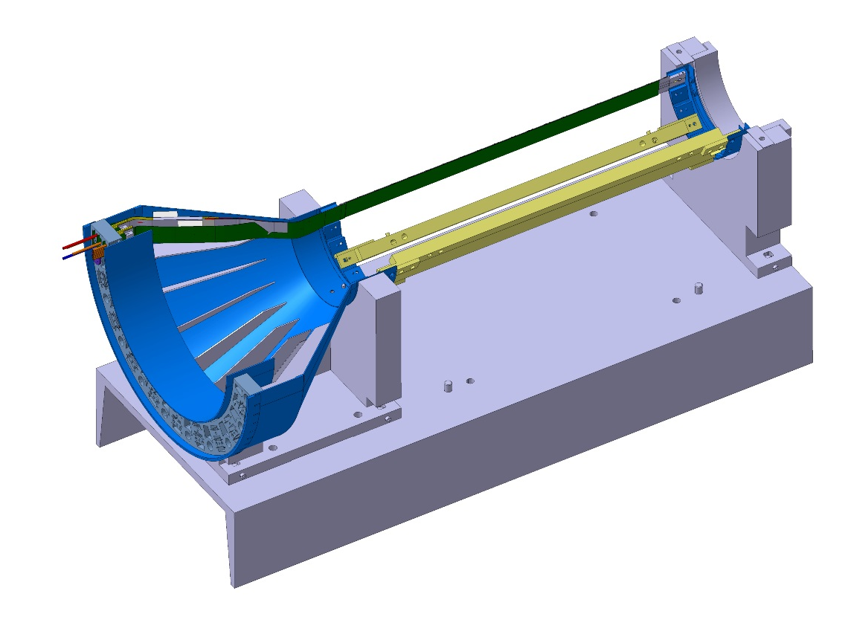
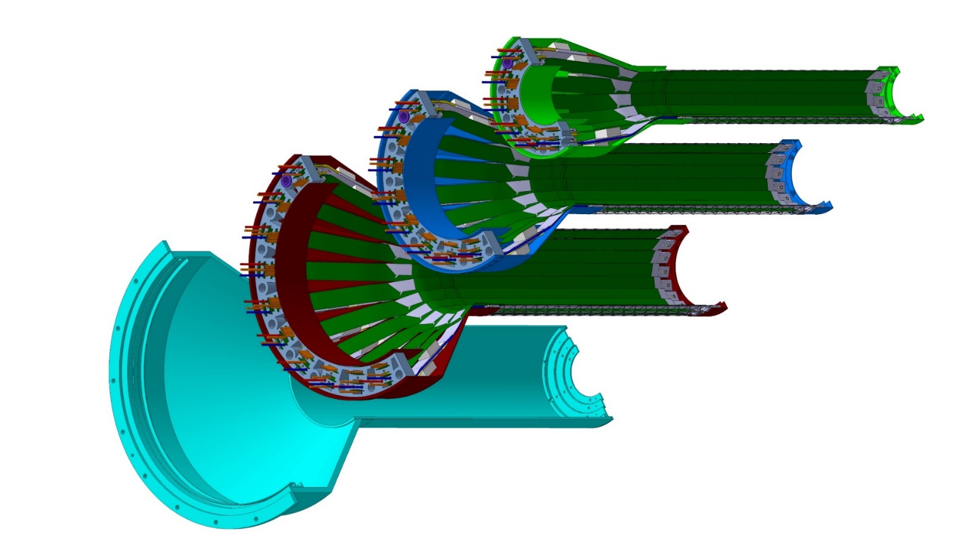
Detector Assembly
Giacomo’s talk
Precision positioning and installation of staves on end-wheels
Layer 0
Layer 1
Assembly of layers and carbon fiber structure into half-detector
Stave testing at each step
Metrology survey
Layer 2
IB CYSS

Slide 28
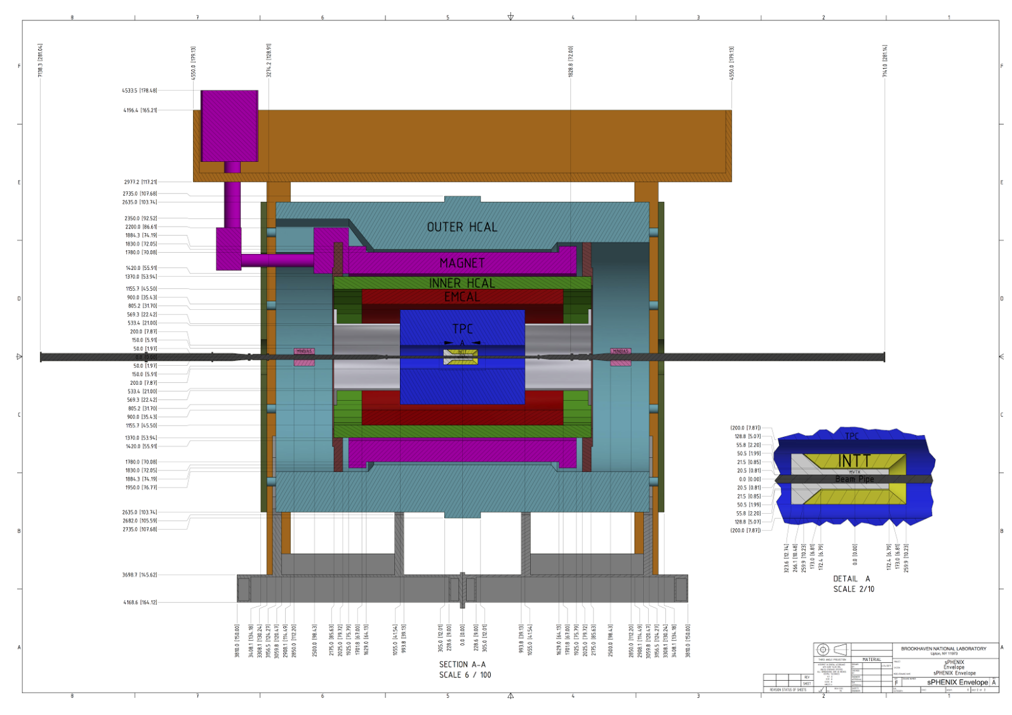
System Integration
Walt’s talk
MVTX+INTT

Slide 29
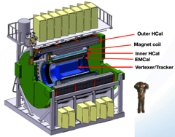
Project Tasks and Timeline
FY2016
FY2017
FY2018
FY2019
FY2020
FY2021
sPHENIX
baseline
CD-0
9/2016
CD-1
CD-2/3
8/1
Ready for
Beam
6/2021
ALICE ITS/IB
prod. ends
Readout R&D
Mech. design
@LANL/ALICE/UT-A
Key R&D
LDRD@LANL
A schedule driven project!
Mech. Integr.
& Prototype
@LANL/MIT/LBNL
Stave prod.&test @CERN;
C-Stru. Prod.
@LBNL
“RU” & “FELIX”
Prod. @US
Production
MAPS Prod. & QA
@ALICE
Detector Assembly
& Test @LBNL
Det. Install.
@BNL
“MoU” w/ ALICE/ITS: 11/2016
- Produce MAPS chips and Stave Space frames for sPHENIX as part of ALICE production!
- Full staves and RU & FELIX production cost & schedule → MVTX Upgrade

Slide 30
Summary
Exciting science
  New B-physics @RHIC Xin
Early ALICE & ATLAS R&D investment
  Reduce technical risk and R&D cost
LANL LDRD critical
  mitigate risks and minimize contingency Cesar
No high risk R&D
  Readout Mark
  Mechanics Giacomo
  Integration Walt
Ready for sPHENIX Day-1
  Cost & schedule Dave

Slide 31
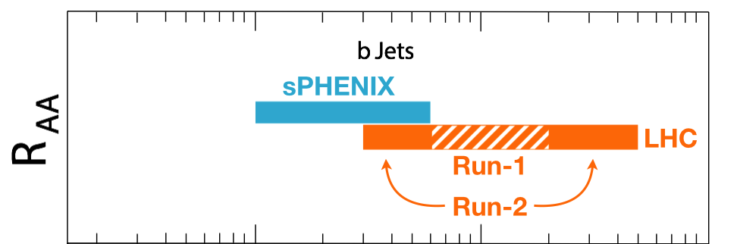




Exciting Science
sPHENIX is the next flagship heavy ion physics experiment in the US (NSAC LRP2015)
  Jets
  Upsilons
  B-jets and B hadrons
MVTX will complete QGP heavy flavor physics
  Unambiguous determination of key parameters of QGP properties and interactions
  Precision study of the “inner workings of QGP”(LRP15)
complement & extend current and future RHIC and LHC QGP programs
sPHENIX Three Physics Pillars
Jets
Upsilons
B
D

Slide 32

B-jet/B-hadron Tagging in sPHENIX
Goal: much improved B-jet Identification in Heavy Ion Collisions
Secondary Vertexing Possible!
A new b-jet identification with high efficiency and high purity is possible
Figure of merit is efficiency x purity. Greatly enhancing the b-jet physics program, x4 improvement in FOM (compared to alternatives)
Jin, Xin, Cesar, Haiwang et al

Slide 33
LDRD+MVTX Schedule & Milestones
LDRD:
  10/1: ALPIDE + KC705 _ FELIX1,5 + RCDAQ
  11/1: ALPIDE + RUv1.0
  12/1: RUv1.0 + FELIX1.5
  12/30: ALPIDE+RUv1.0 + FELIX1.5 + RCDAQ
  1/2018-6/2018: RUv1.0 +
  2/2018-4/2018: setup laser system and evaluate ALPIDE
  Telescope:
    1-3/2018: mechanical frame and assembly, cooling system test
    4-5/2018: 4-staves and 4 RUv1.x installation and readout integration
    5/2018: full system assembly and cooling integration
    6/2018-1/2019: cosmic run, system test
  Production readniess reviews
    7/2018: stave production
    1/2019: electronics production
  Test beam at FERMILab: 1/2019 – 9/2019
    Test beam ~ March 2019 2-3/2019
    Data analysis and NIM paper 4-9/2019
sPHENIX milestones
  CD-1: 5/2018
  Ready for installation 4/2022
  Installation completed: 7/2022
  1st beam: 1/2023
  CD-4: 1/2024
  INTT ready for installatino: 4/2022
MVTX milestones
  Ready for installation: 4/2022
  Installation: 7/2022
  Ready for beam : 4/20

Slide 34

sPHENIX MAPS-based Vertex Detector (MVTX)
|eta| < 2.0
R = 2.4; 3.2; 3.9cm;
L = 27.1cm
“Adopt” ALICE ITS Upgrade Inner Barrel 3-layer MAPS detector
  Mini. risk, Max. Physics
Precision vertexing for b-jet/B-hadron tagging with high efficiency and high purity
B-jet modification in QGP at low-medium pT to determine QGP properties, study mass-dependence on collisional vs radiative energy loss, flow etc.
A separate DOE MIE to build the full detector, WBS 1.13, ~$5M for construction
Early R&D by LANL/LDRD, $5M, FY17-19, readout and mechanical integration; Recycle staves and electronics for WBS 1.3 Telescope

