Slide 1
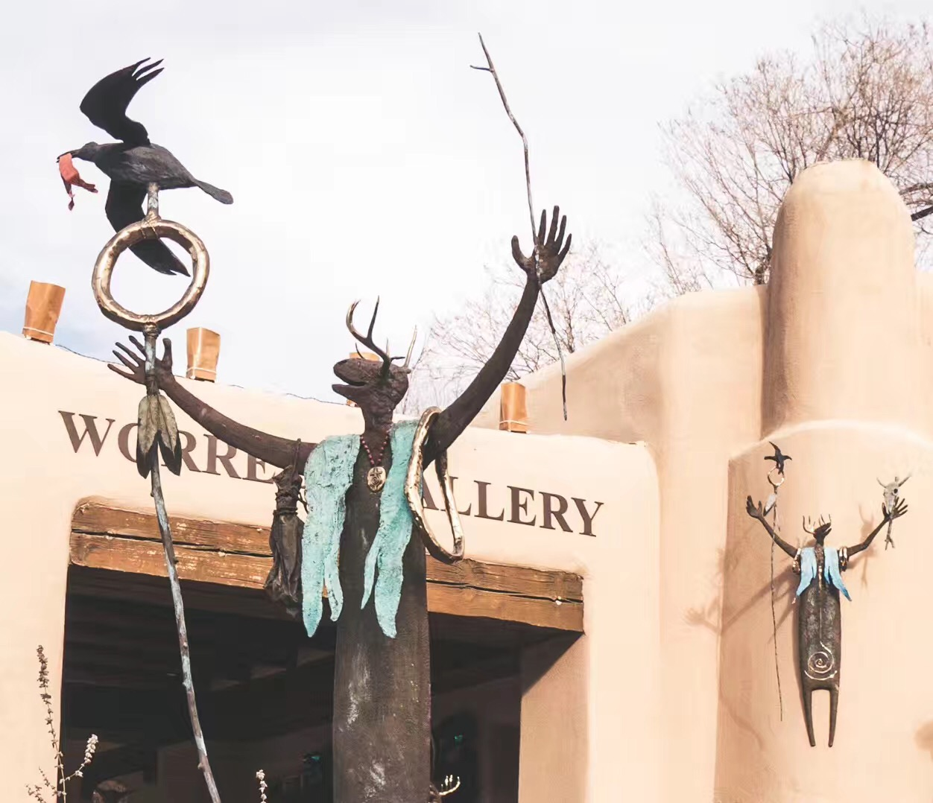
Welcome to Santa Fe
Meeting room: Zuni
Breakfast: 8:00-9:00AM
Coffee breaks: 10:30AM and 3:30PM
Junior event tonight, 12/8 @7:00PM
@Tomasita's,
http://tomasitas.com/menus/.
(Haiwang Yu)
Group Dinner @Gabriel’s
Tomorrow 12/9 @7:00PM
Car pool required
https://www.gabrielsofsantafe.com/
(Cesar da Silva)
Local contacts/help:
505-412-7396 (Ming)
631-384-4381 (Cesar)
Photo by
Haiwang Yu

