Slide 1
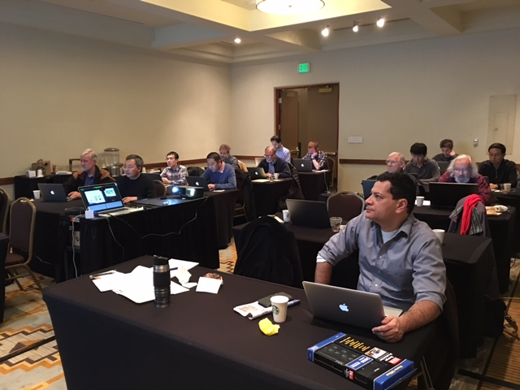
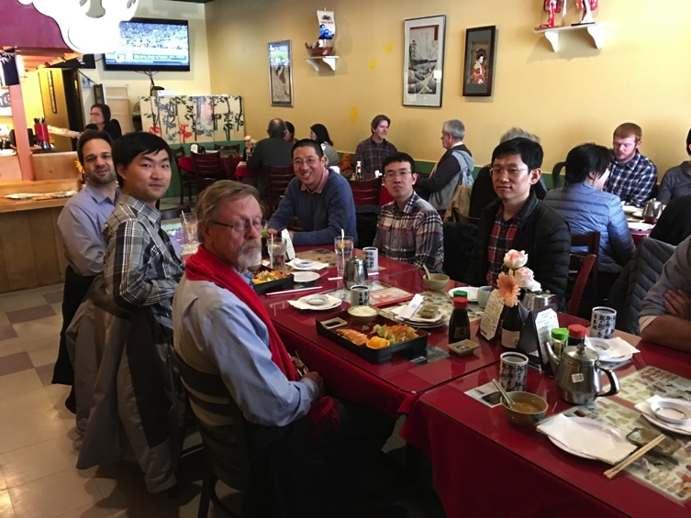
Goals of the Workfest https://indico.bnl.gov/conferenceDisplay.py?ovw=True&confId=2641
MAPS detector group
  Make significant progress on MAPS MIE proposal
  Update the cost and schedule to be ready for discussion with DOE in Feb budget meeting
  Develop additional physics cases for MAPS detector beyond sPHENIX scientific proposal
HF-jet topical group
  Produce near final b­jet tagging performance plot for MAPS proposal and QM2017 conference
  Advance the tracking detector simulation towards new baseline simulation configuration
  Develop B-meson simulations
Well attended by experts, ~20+ people
  BNL, LBNL, MIT, FSU, Colorado, GSU, NMSU, UCLA, LANL
Agenda
  Day-1: Intro and status reports, working sessions
  Day-2: parallel working sessions – Sim and MIE
  Day-3: parallel working sessions – Sim and MIE

Slide 2
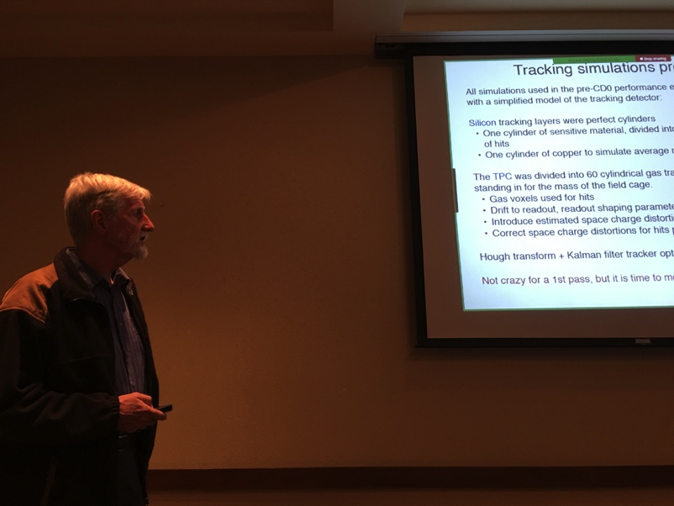
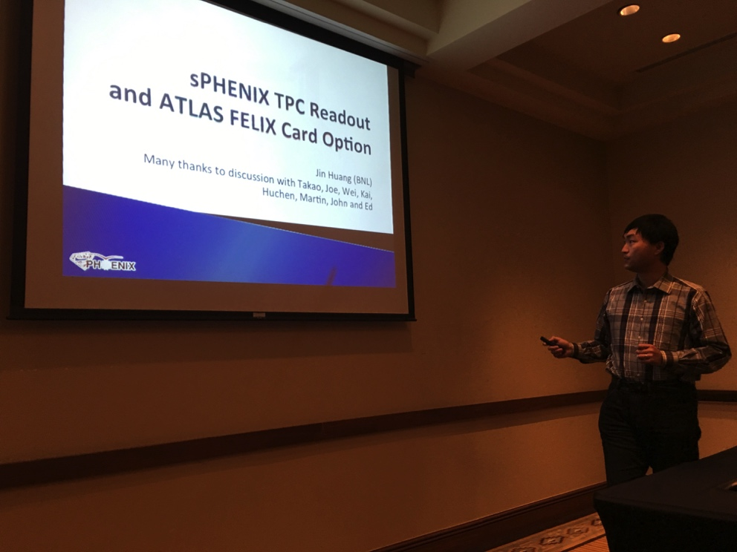
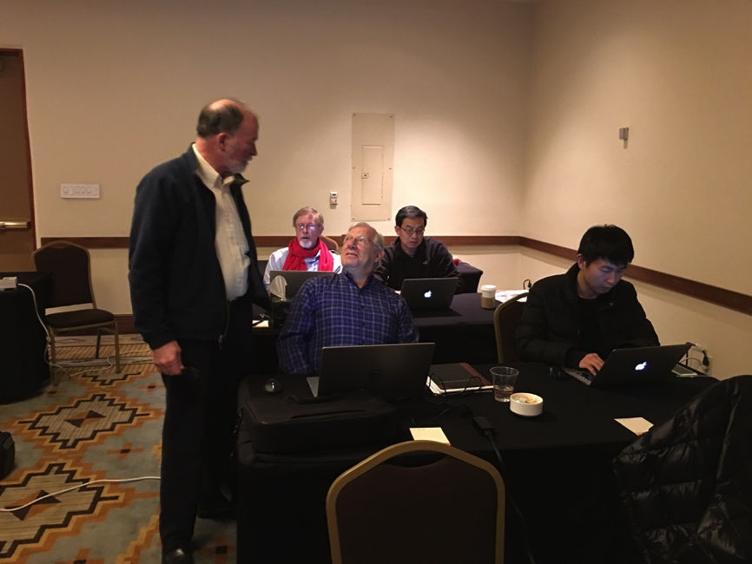
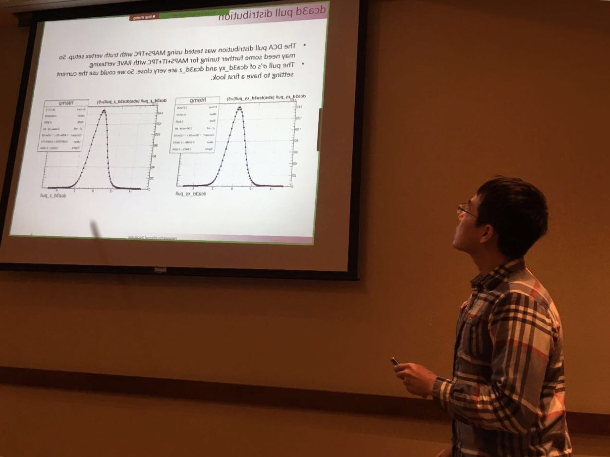
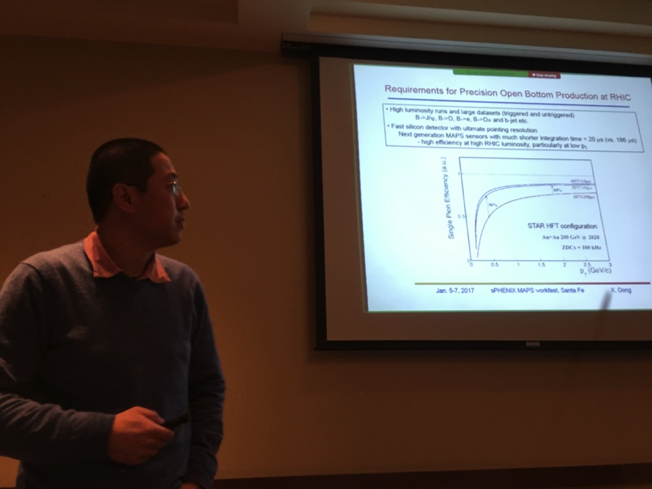
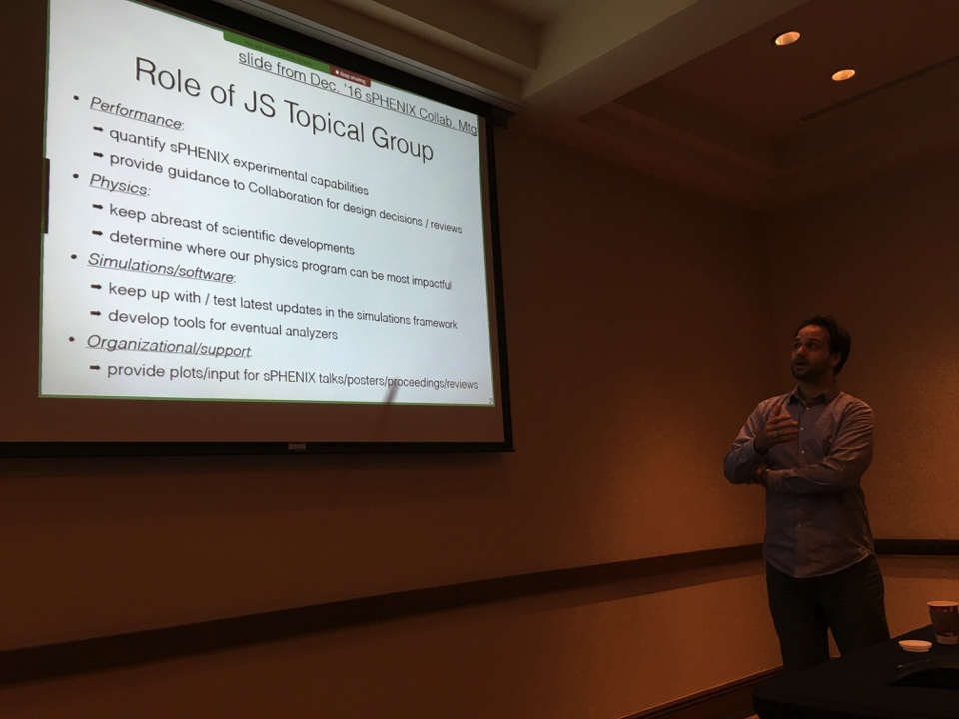
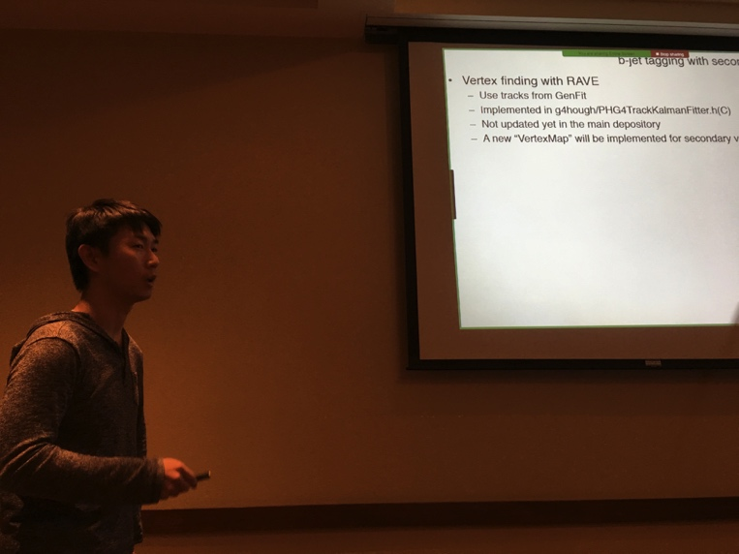

Slide 3
Major Tasks and Lead Institutions for sPHENIX MAPS Project (MIE Writing)
MAPS chips/stave production
  LANL/ALICE (Ming Liu, Cesar da Silva)
Readout integration and testing
  LANL, BNL, UT-Austin, U-Colorado (Mike McCumber. Ming, Leo etal)
Mechanical carbon structures
  LBNL (Grazyna Odyneic/Eric, Walt etal)
Mechanical integration
  MIT, LBNL (Bob Redwine, Walt etal)
LV/HV PS and controls
  LBNL (Grazyna Odyneic/Leo)
MAPS stave assembly and testing at CERN
  MIT, LANL, CCNU and others (Gunther Roland)
Full module assembly and test in US
  LBNL, MIT and others (Grazyna Odyneic/Leo)
Online software and Trigger
  BNL, GSU, LBNL (Xiaochun He, Chris P. etal)
Offline software - detector simulation, geometry, offline tracking
  NMSU, FSU, LANL (Tony Frawley, Jin etal)
Physics simulations - to make “Money Plots”
  LBNL, LANL, U-Colorado and all (Xin Dong, Haiwang, Sanghoon et al)
Cost and Schedule and Resources (Dave Lee, Ming etal )
Collaboration and Org (Cesar, Ming etal)

Slide 4
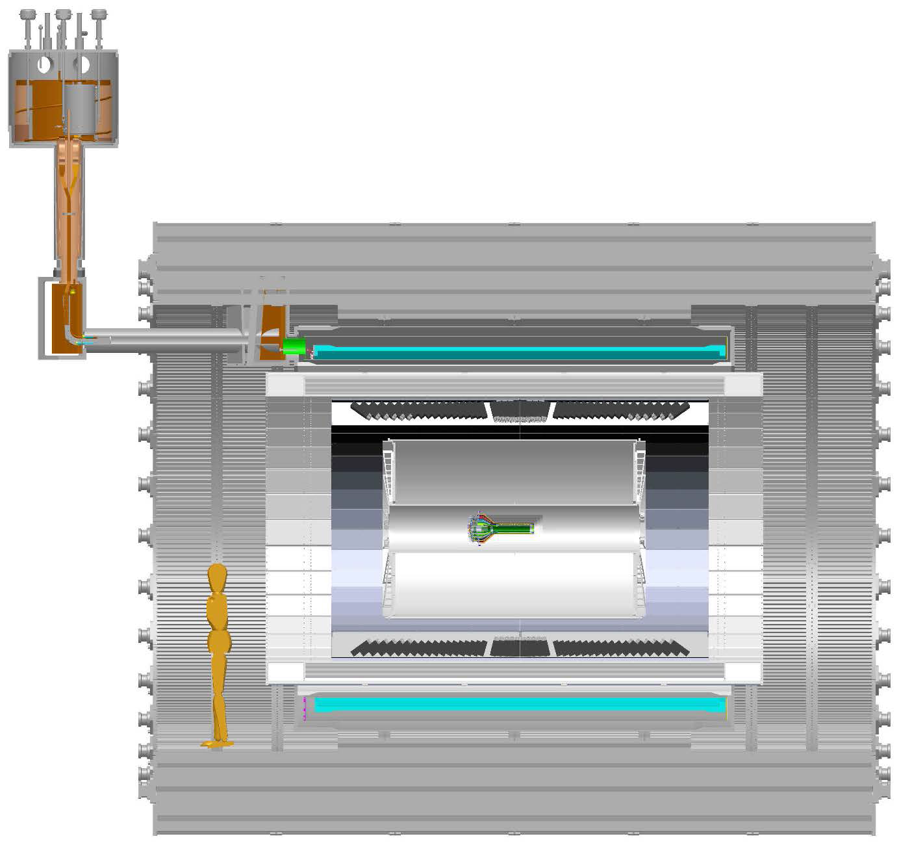
Global Support Structures and Other Services
More follow-up
discussions happened
this week:
MIT/BATES & LANL
MIE writing
BNL & LANL
MAPS->ReadoutUnitt:
- “5m” copper wires
- 6U VME modules
- 48 modules
RU->CRU@CH:
30+m fibers
Global support frame

Slide 5
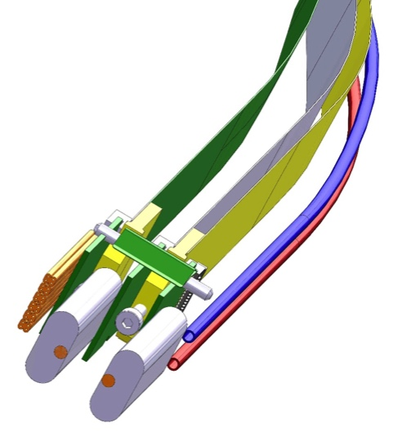
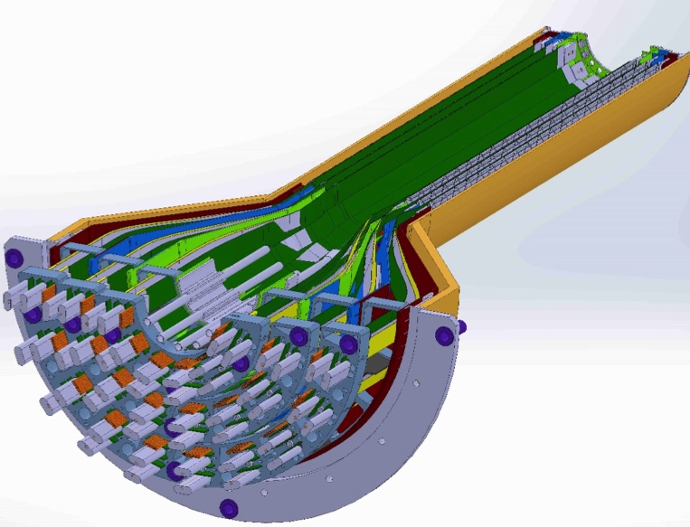
MAPS-sPHENIX Mechanical Integration
Carbon structure design and production @LBNL + MIT/BATES + LANL
Service End Wheel
Possible modifications
High speed signal
Analogy power
Digital power
Cooling

Slide 6
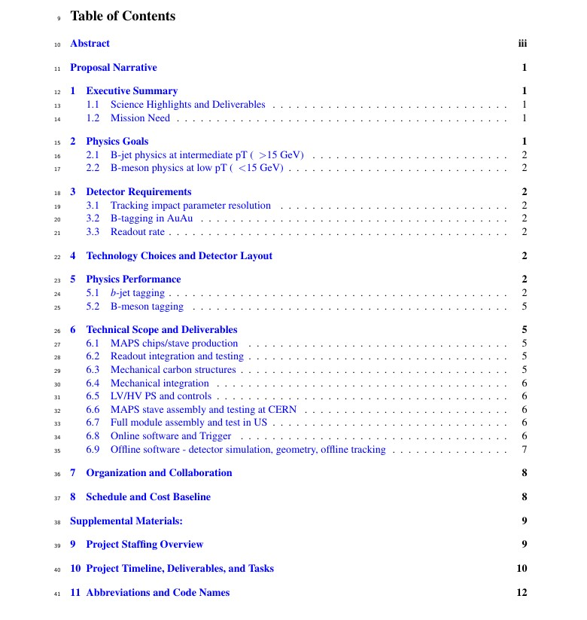
Editing/Proofreading – Dennis, Darren, Hubert et al
1. Ming, Mike, Gunther et al
2. Cesar, Xin et al
3. Jin, Darren, Haiwang et al
4. Giacomo et al
5. Tony, Haiwang, Jin et al
6.1 Cesar, Mike, Ming,
6.2 Grazyna/Leo, Ming et al
6.3 Walt, Grazyna/Eric et al
6.4 Bob, Gunther, Walt
6.5 Grazyna/Leo et al
6.6 Gunther etal
6.7 Grazyna/Leo
6.8 Xiaochun, Chris et al
6.9 Tony, Jin, Chris et al
7. Cesar, Gunther et al
8. Dave, Ming et al

Slide 7
Toward the full MAPS MIE
Early communication with DOE
  MIE pre-proposal, ~20 pages
  Science, resources and cost & schedule
  First full doc by the end of Jan 2017, for DOE Feb. budget meeting, LANL & LBNL
Possible timeline of MAPS MIE
  First complete draft, LBNL workshop Jan 24-25
  Submitted and reviewed in FY17, establish DOE “mission need”
  Federal budget request by DOE, Feb 2018
  Fund available FY20 for construction (“normal route”)
Highly desired:
  Advanced funding by mid 2018 to produce full staves following the completion of ALICE/ITS/IB production at CERN
  Or high level “agreement” to secure CERN facility for sPHENIX

Slide 8
Overview for plots for MAPS pre-proposal and QM17
From Jin’s summary slides
Preliminary: HIJING
Place holder: Dijet asymmetry
Place holder for HIJING

Slide 9
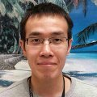
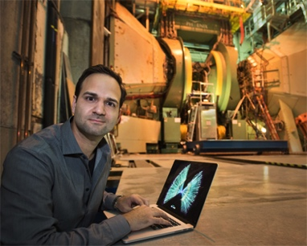
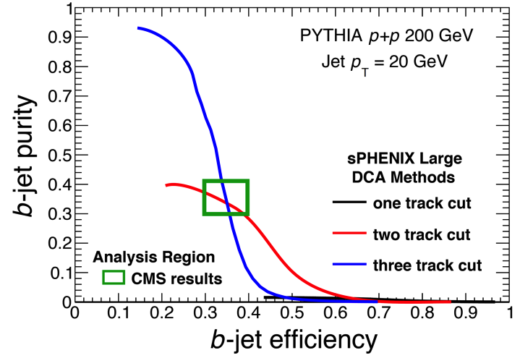
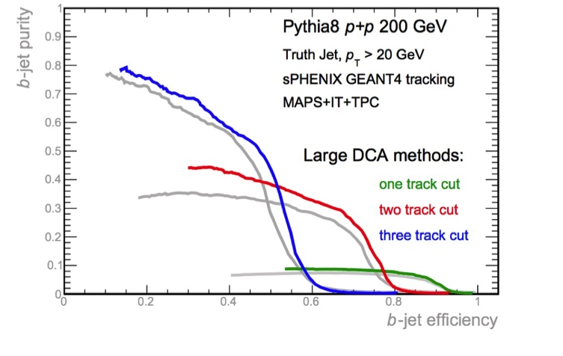
Highlight recent activities: b-jet tagging – High DCA track counting
Progress since last general meeting
  Dennis and Haiwang implemented track counting tagger in the full Geant4 simulation
  Haiwang produced projection plot in
On-going past few weeks
  Systematically validating the Geant4-based track fit procedure, in order to optimize 3-D DCA and likelihood
Next
  Reevaluate in HI background with HIJING embedding
  Optimizing cuts to suppress fake off-vertex tracks
Exploring 3-D DCA in G4
NOT optimal tune yet!
Fast sim in Proposal
Full Geant4 Sim in G4 (DCA_{XY})
DCA_{XY}
DCA_{3D}
From Haiwang’s talk
https://indico.bnl.gov/conferenceDisplay.py?confId=1926
b-tagging performance in HI
Detector choice justifications

Slide 10
New plots from track counting
Answering two main questions in this workfest:
How we do in HIJING
What if we use other technology
Impact of MAPS vs other option
on DCA and b-tagging

Slide 11
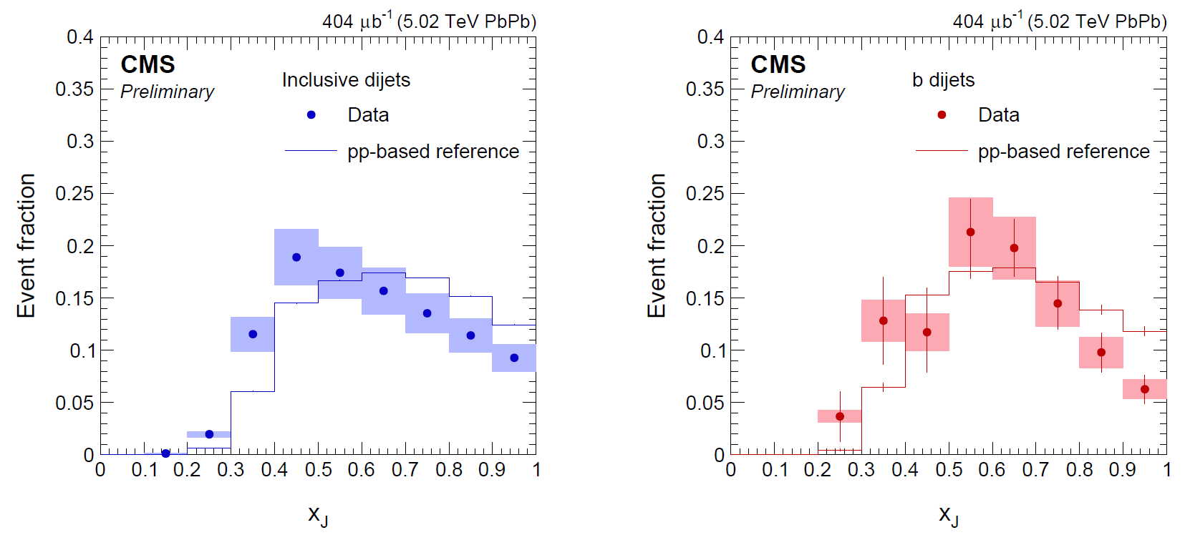
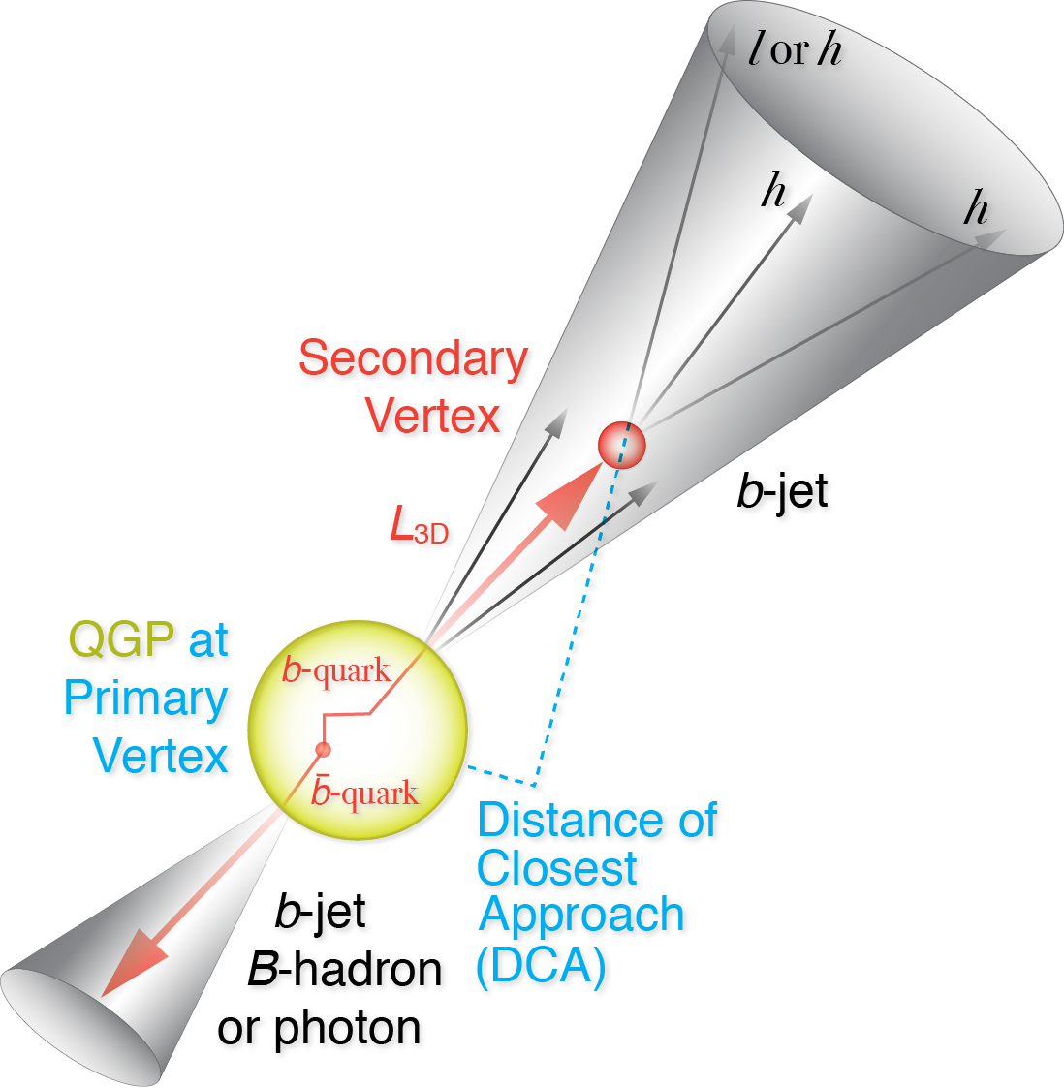
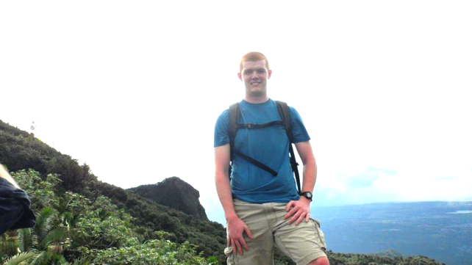
New plots from Di-b-jet asymmetry
CMS PAS HIN-16-005
Started in workfest : sPHENIX di-bjet asymmetry,
This plot is preview: fast-sim, hardQCD-B, NOT scaled to lumi
- Darren McGlinchey (UCB)

Slide 12
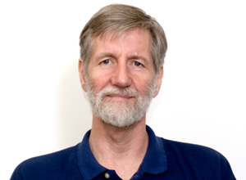
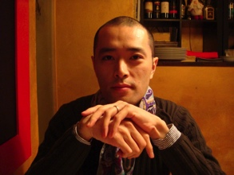
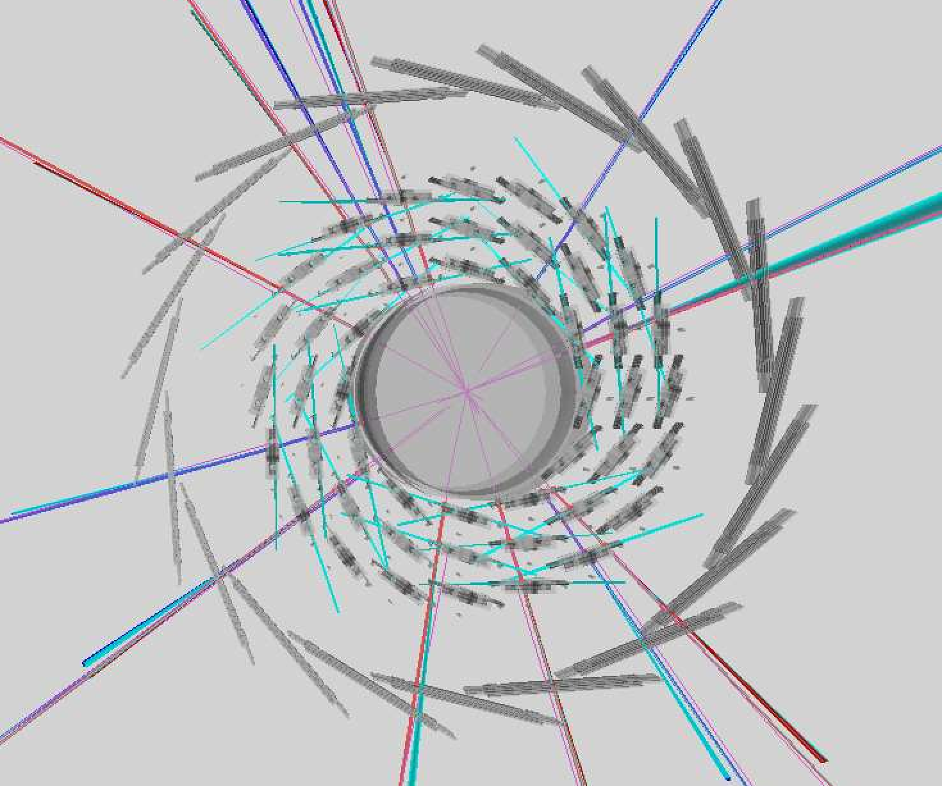
Silicon ladder setup
Implementing realist geometry in laddered silicon detectors
Base-code in nightly build
Tuning on going for
  INTT ladder thickness
  Kalman filter to interface with geometry
Pipe
MAPS inner tracker
INTT-layers 1

Slide 13
Summary on
High priority development tasks
Realistic implementation in Geant4
  Made major progress by Tony and Haiwang
  Near term goal – fix INTT thickness and merge for general user – Tony, Gaku, Haiwang
Pile up simulation
  Mike McCumber developed framework and init tests.
  Near term goal – complete development for general user – Mike + Gaku?
Generalized Kalman filter
  Haiwang Y./Chris P., Improved with ladder geometry
Multi-vertexing/b-tagging via secondary vertexing in jet
  Sanghoon L./Haiwang Y.: improve fitting utility,
  Near term goal - HI analysis – Sanghoon
b-jet tagging: Track Counting
  Haiwang Y./Dennis P.: produced first HIJING performance plot with 7-layer MAPS VS Silicon
  Near term goal – Certify MAPS+IT+TPC plot for HIJING embedding performance – Haiwang
b-jet tagging: Soft Lepton Tagging, exploratory
b-quark jet selection: di-bjet asymmetry
  Darren volunteered to lead the work
  Near term goal – certify plot for proposal and QM17 – Darren
  Also Xuan Li (LANL) started look at B-meson-b-jet asymmetry

