Slide 1
MVTX Status and Plan
Ming Liu
Los Alamos

Slide 2

MAPS-based Vertex Detector (MVTX)
|eta| < 2.0
R = 2.4; 3.2; 3.9cm;
L = 27.1cm
“Adopt” ALICE ITS Upgrade Inner Barrel 3-layer MAPS detector
  Mini. risk, Max. Physics
Precision vertexing for b-jet/B-hadron tagging with high efficiency and high purity
B-jet modification in QGP at low-medium pT to determine QGP properties, study mass-dependence on collisional vs radiative energy loss, flow etc.
A separate DOE MIE to build the full detector, WBS 1.12, ~$5M for construction;
Early R&D by LANL LDRD, $5M, FY17-19, readout and mechanical integration;

Slide 3
Outline
MVTX Pre-proposal
BNL Director’s review
R&D status and plan
  Stave
  Readout
  PS and Controls
  MOSAIC test bench
Mechanical integration
  MVTX/INTT/TPC

Slide 4
MVTX Pre-proposal Submitted!
Pre-proposal submitted to DOE, 2/2017
  Follow-up discussions with DOE and BNL managers
  Weekly proj. leaders meeting BNL/LANL/LBNL/MIT
Plan to update proposal to DOE, late 2017
  Expanded science “CD0” + Cost & Schedule “CD1”
  Funding in FY18, stave production @CERN in Aug. 2018+, ~6 months;
    Other options being explored for stave production @CERN/CCNU for delayed funding
BNL Director’s Review: July 10-11, 2017
  Expand science case, “CD0”
  Update Cost & Schedule, “CD1”
  A dry run next Monday 6/19

Slide 5
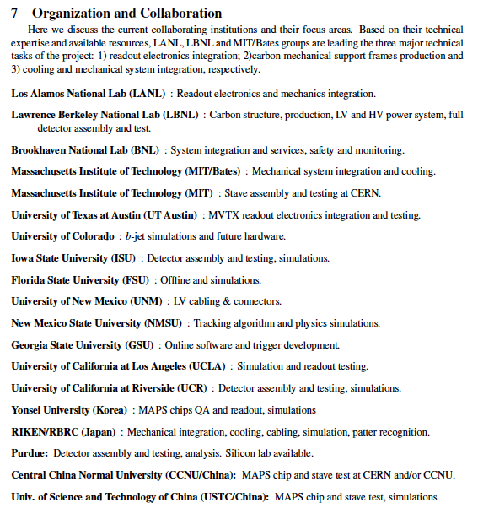
A growing collaboration!
new sPHENIX/MVTX members:
Czech groups
CCNU – lab
USTC
Peking Univ.
A great opportunity for:
Physics
Detector R&D
Hardware
Offline software

Slide 6
Scope of the MVTX Project
MAPS staves & Electronics
  MAPS Detectors
    “MoU” to build 68 ITS MAPS staves
    No modification
  Readout Electronics
    Frontend: ALICE/ITS, RU
    Backend: ATLAS FELIX
    Modify/reprogram RU & FELIX for sPHENIX
    R&D by LANL LDRD
  Production
    Extend ALICE/ITS MAPS stave production
    sPHENIX personnel help assembly and testing staves at CERN
    Reproduce additional ALICE RU & FELIX for sPHENIX
    Final assembly and test in US, LBNL/BNL
  Ancillary systems, copy ALICE
    LV/HV, cables, crates, racks etc.
    Slow control, safety and monitoring
Mechanics & Cooling
  No/(some) changes to ALICE/ITS inner tracker mechanical structures
    End Wheels
    Cylindrical structure shells
    Detector half barrels
    Detector and Service half barrels
  Mechanical Integration
    Conceptual design by LANL LDRD
    Prototype by sPHENIX R&D
    Design integration frames
    Carbon frames etc.
    Installation tooling etc.
  Copy ALICE cooling plant design
    Minor modification to fit sPHENIX
    Smaller heat load than ALICE ITS
  Metrology and Survey
WBS 1.12: a new MIE fund the full MAPS Vertex Detector, ~$5M

Slide 7
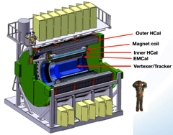
Project Tasks and Timeline
FY2016
FY2017
FY2018
FY2019
FY2020
FY2021
sPHENIX
baseline
CD-0
9/2016
CD-1
CD-2/3
8/1
Ready for
Beam
6/1
ALICE ITS/IB
Prod. ends
Readout R&D
Mech. design
@LANL/ALICE
A schedule driven project!
Key R&D
Mech. Integr.
& Prototype
@MIT/LBNL
Production
MAPS Prod. & QA
@ALICE
Stave prod.&test @CERN;
“RU” prod @CERN
“FELIX” Prod. @US
Detector Assembly
& Test @LBNL
Det. Install.
@BNL
+2%
+50%
“MoU” w/ ALICE/ITS: 11/2016
- Produce MAPS chips and Stave Space frames for sPHENIX as part of ALICE production!
- Full staves and RU & CRU production cost & schedule → MVTX MIE

Slide 8
Prepare for the BNL Director’s Review
Science
  Preliminary for a dry run next week
    B hadron physics
    B-jet physics
    Detector performance plots
  Near final “money plots” for July review
Cost and Schedule
  Updated WBS structure and org chart
  Work in progress, cost & schedule, 6/5/2017
MVTX stave production options
  Ming’s visit to CCNU in May
  Maria’s visit to CERN this week
HF-Jet Topical Group

Slide 9
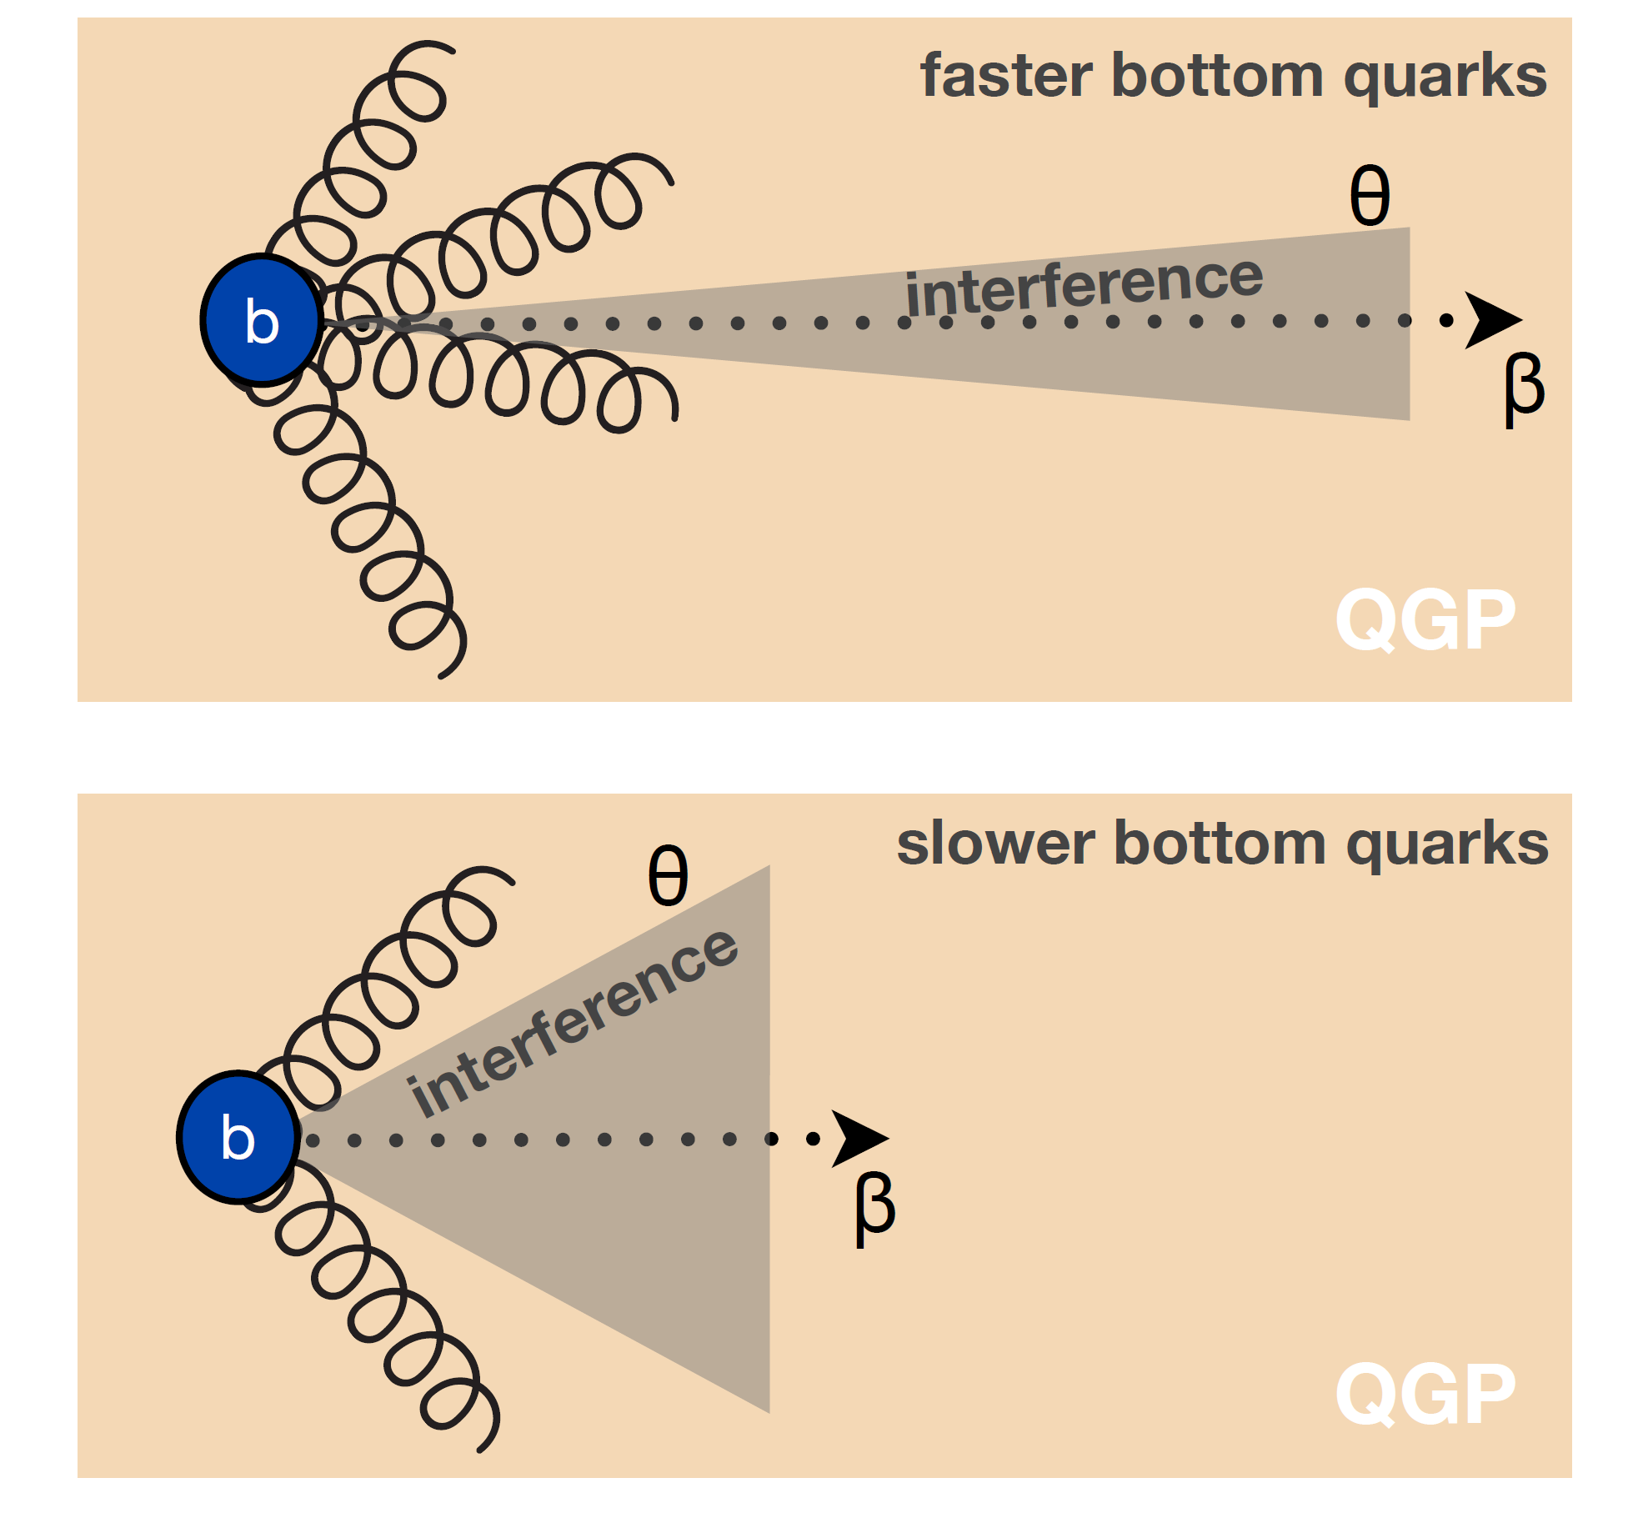
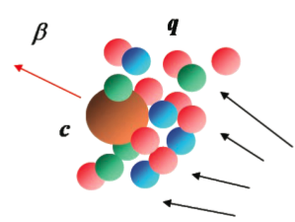
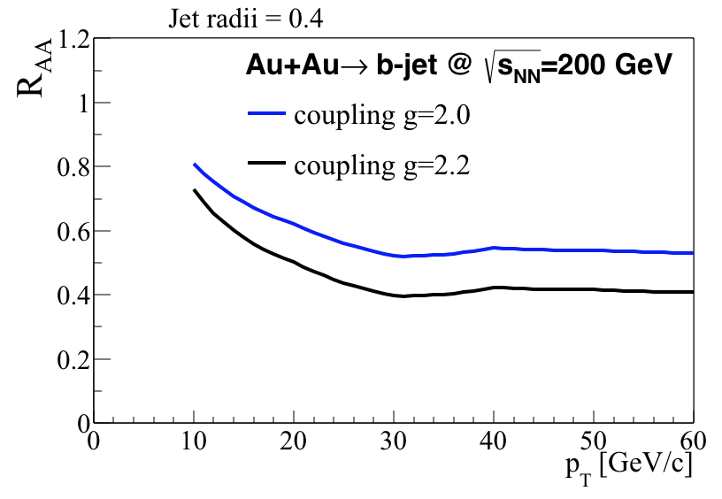
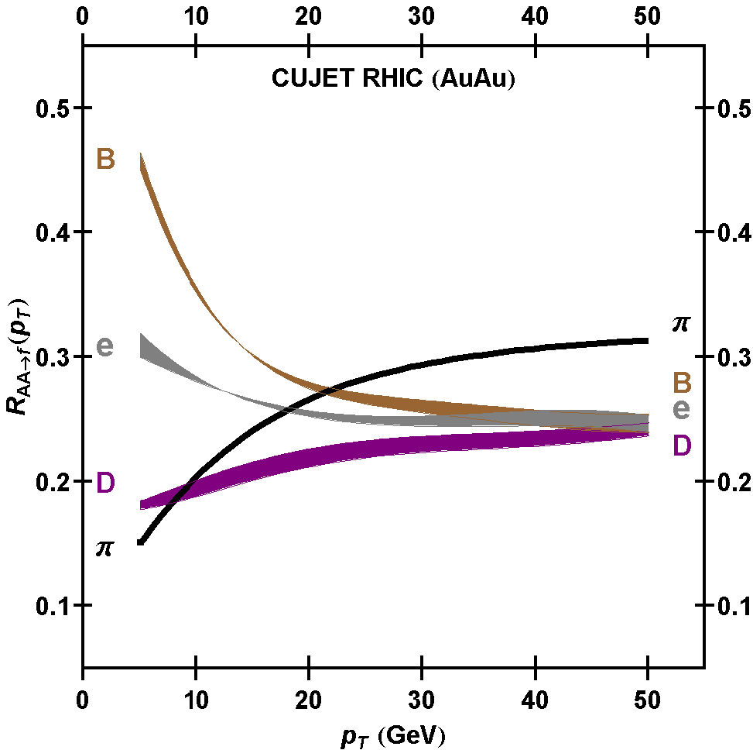
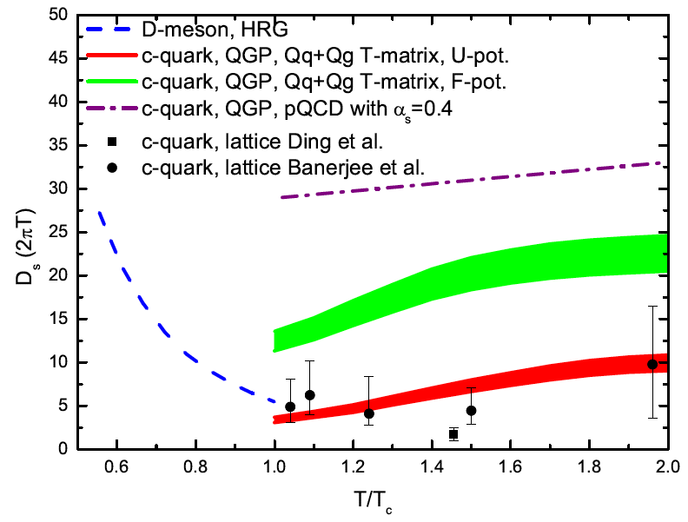
Uniqueness of Heavy Quarks in QCD
Jin’s Talk
m_{u} m_{d}
m_{s}
Λ_{QCD}
m_{c}
m_{b}
MeV
1
10
10²
10³
10⁴
T_{c}
T_{QGP}
differentiating sensitivity
to collision VS
radiative energy loss
Access the medium
transport, such as diffusion
coefficient D_{HQ}
arXiv: 1502.02730
pQCD calculation for sPHENIX via
theory component of LANL MVTX LDRD
PRL 108 (2012) 022301

Slide 10
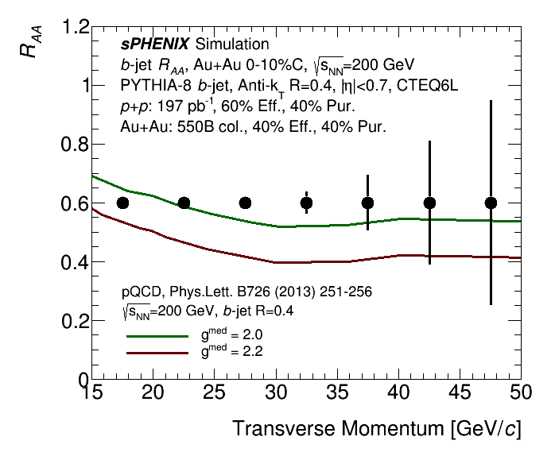
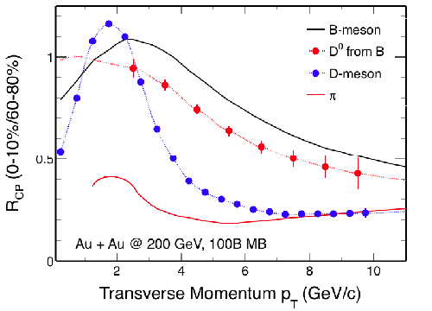
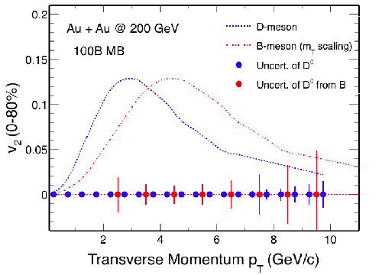
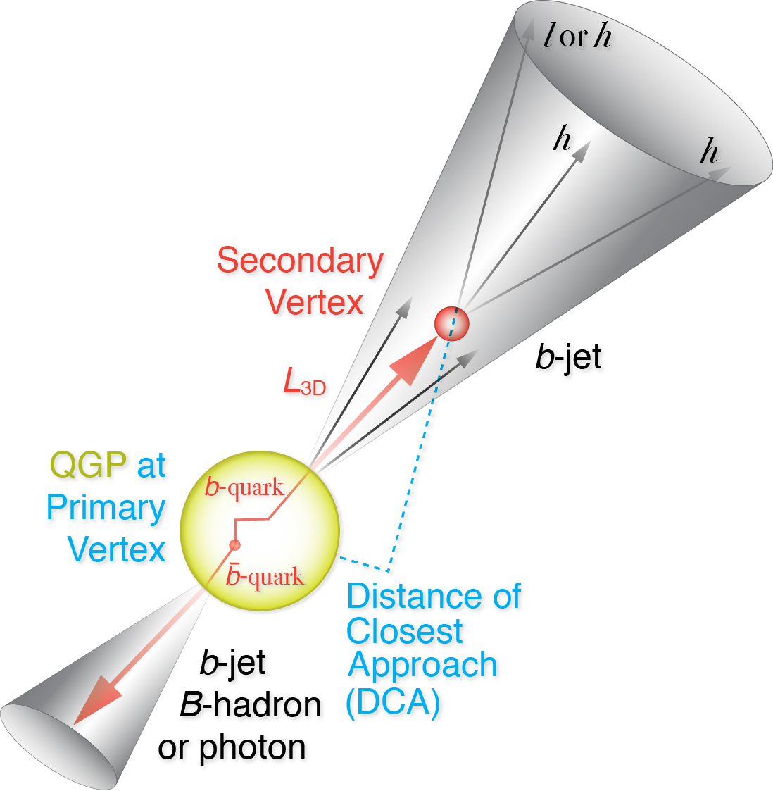
HF-topical group
Jin’s Talk
HF in sPHENIX: in particular B-meson and b-jets, provide differentiating sensitivity to collision VS radiative energy loss, access to HQ transport parameter of QGP, total cross section. Bring results to precision era.
  0<p_{T}<15 GeV/c - B-meson: access down to zero pT, max sensitivity to HQ mass effect
  p_{T}>15 GeV/c - b-Jet: less dependence on FF complication, probing parton kinematics and higher p_{T}-scale
High priority task are set to develop and simulate performance for coming MVTX reviews and proposals, expanding the program in HF-jet and HF-meson programs
Communication:
  Discussion email list: https://lists.bnl.gov/mailman/listinfo/sphenix-hf-jets-l
  Wiki page under construction: https://wiki.bnl.gov/sPHENIX/index.php/Heavy_Flavor_Topical_Group
Meetings/Events
  Use weekly simulation meetings for updates, https://indico.bnl.gov/categoryDisplay.py?categId=88
  Monthly TG meetings: https://indico.bnl.gov/categoryDisplay.py?categId=151
  Goal oriented irregular events:
    MVTX brainstorming meeting, Mar 8 / MAPS+HF-jet joint workfests, e.g. Jan 5-7 2017 @ Santa Fe / Pre-collaboration meeting work-fest on May 16-17, 2016 / Initial TG meeting on Apr 22 , 2016

Slide 11
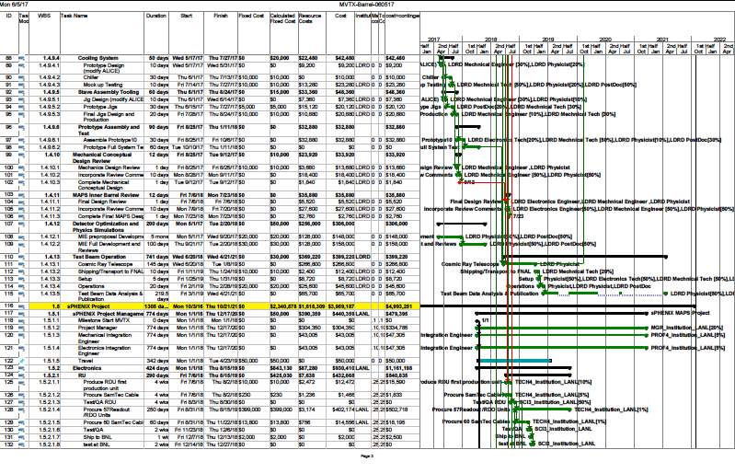
Updated Cost and Schedule WBS: 6/5/2017
Dave Lee et al

Slide 12
MVTX
Project Manager: M. Liu (LANL)
Lead Coordinator: M. Chamizo-Llatas (BNL)
Deputy Project Managers: G.Odyenic (LBNL),R.Redwine(MIT)
ES&H liason:
QA liason :
DRAFT May 4
For discussion
Electronics
WBS 1.1
Mechanics & Detector Assembly
WBS 1.2
Integration & Infrastructures
WBS 1.3
Readout Units
WBS 1.1.1
Staves
WBS 1.2.1
Cooling
WBS 1.3.1
Back-end
WBS 1.1.2
Carbon Structures
WBS 1.2.2
Safety System
WBS 1.3.2
Power system
WBS 1.1.3
Barrel
WBS 1.2.3
Global Support
WBS 1.3.3
Alignment
WBS 1.2.4
Installation & Commissioning
WBS 1.3.4

Slide 13
MVTX R&D Status and Plan
Readout R&D
  5 single-chip MAPS tested at LANL
  Workfest @UT-Austin, 4/19-20
  RUv1 available in July, will be used for LDRD telescope
  BNL/ATLAS FELIX being evaluated as the default backend
    Computer arrived, fibers/cables ordered
    Obtain one FELIX in a few weeks
    “CRU” being prototyped with Altera evaluation boards, able to communicate with the RUv0 board @ UT-Austin;
  LANL MOSAIC test bench in operation!
Tracker integration task force
  MVTX + INTT + TPC mechanical system integration
  Identified the major tasks
Stave production @CERN
  ALICE Stave Production Readiness Review 4/27, prod. Starts in June/July
  LANL people do assembly and testing at CERN, May – Sept. 2017
  MVTX plan

Slide 14
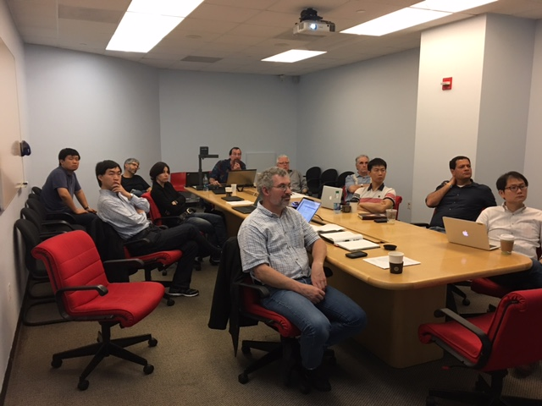
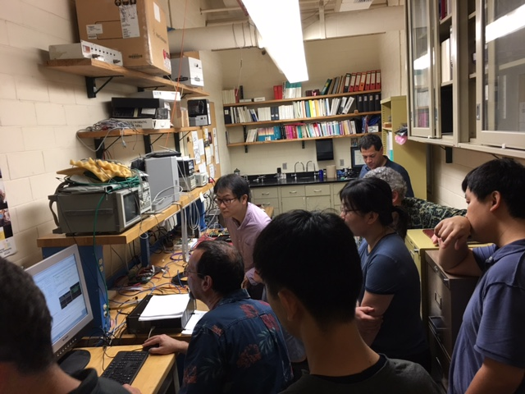
MVTX Readout Workfest
@UT-Austin, 4/19-20 https://indico.bnl.gov/conferenceDisplay.py?confId=3047
Christina
Jo
Very productive discussions:
  sPHENIX readout – Martin
  TPC readout – Jin and Takao
  ALICE ITS readout system – Jo
  LV/HV and Slow controls - Giacomo
  MVTX readout options – Mark
Lab demo of RUv0 and “CRU” R&D
  RU v0
  “CRU” prototype with an Altera eval. board
A brief summary
  Defined a possible MVTX readout path
    RDO Unit, some modification
    CRU/FELIX (TPC), significant R&D needed
  Joint R&D on RU and CRU, maybe also FELIX integration
  UT-Austin’s interest in RU and CRU production & test!

Slide 15
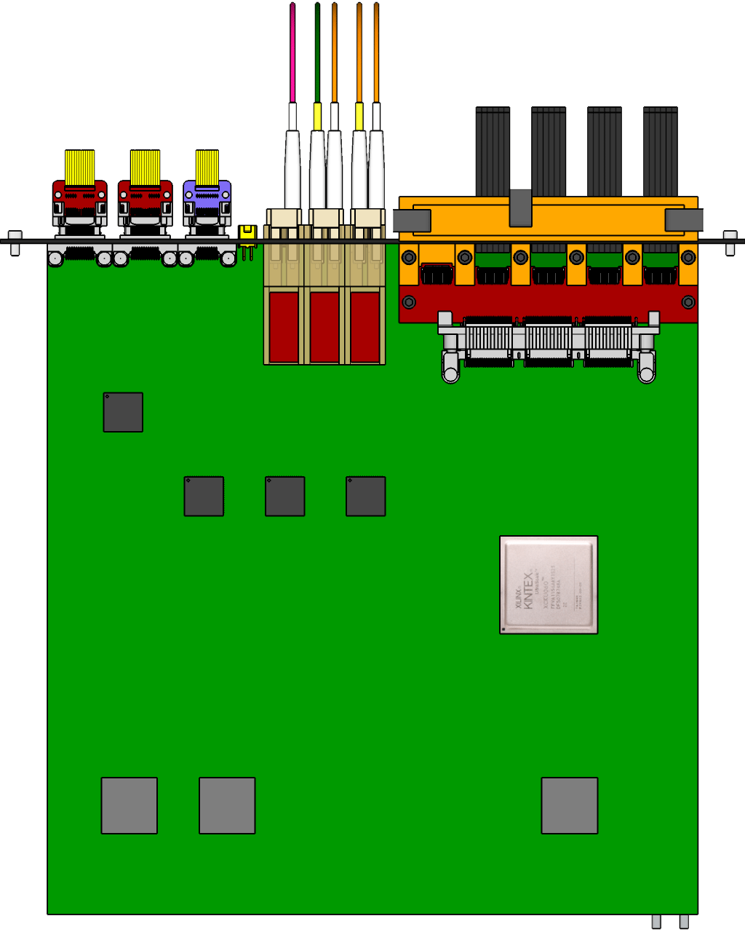
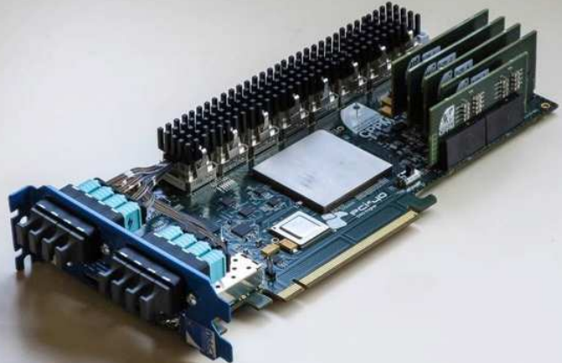

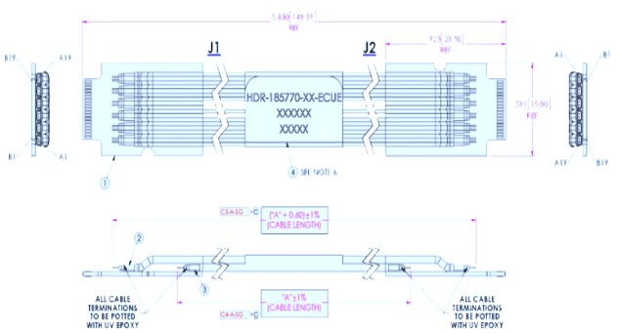

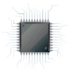
MVTX Readout and Control System Status
RUv1: ~July
Prototype:
~June
5 m
Readout Unit
Optical Links
9 Sensor Stave
9 Data (1.2Gbps)
1 Clock, 1 Control/Trigger
Control
Data (9.6 Gb/s max)
Trigger
Samtec Twinax “FireFly”
FELIX (or CRU)
Flex
Power
Alpide Sensors
FELIX v1.5:
~June
Filtering Board
(Capacitors)
regulators
Cold Plate
Regulated Power
Power Board
Available
~August

Slide 16
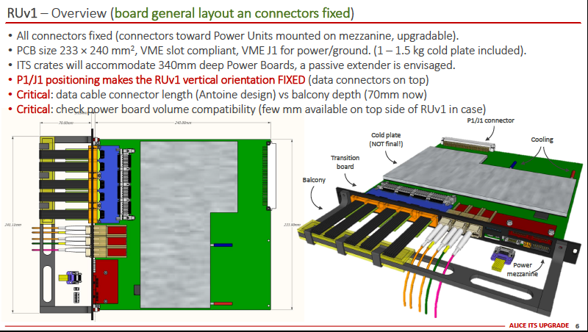
ALICE/ITS Readout R&D
5 RUv1 available for LANL R&D ~July 2017

Slide 17
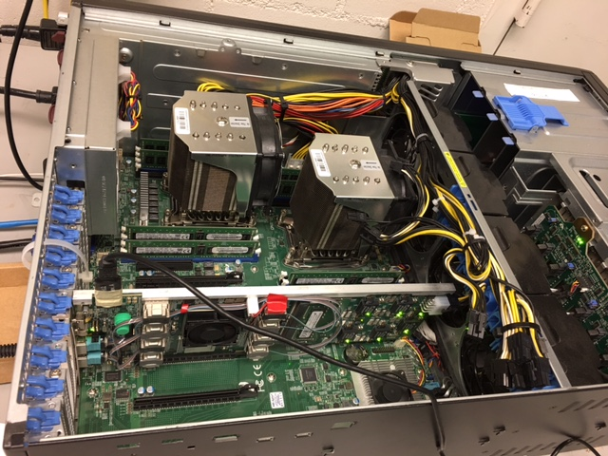
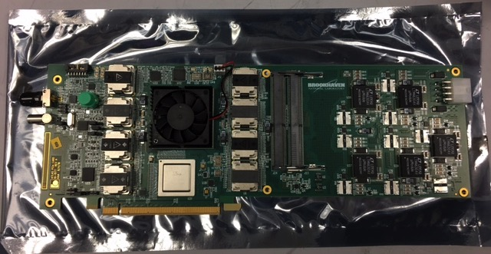
Electronics R&D – Cont.
FELIX and MVTX Power Distribution Boards
FELIX: visited BNL Labs and had FELIX system demo
  V1.5 boards, all functionalities available- data, slow control and Timing/Trigger/Busy, w/ GBT
  Multi-channel GBT links and PCIe interface code developed, with examples of user modules
  V2.0, available ~end of 2017, sPHENIX application
  A 1.5v FELIX board produced and tested, ready for shipment to LANL; Optical cables etc. to be ordered soon for LANL test bench
Power distribution boards and PS
  LBNL PS distribution board available for R&D from CERN/LBNL ~ August. Order placed, 4wks + testing
  R&D power supply and control system ordered (CAEN), available ~August
FELIX: tested @BNL
To be shipped to LANL

Slide 18
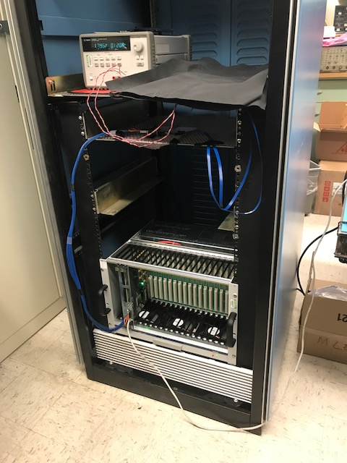
R&D @LANL on MAPS Single Chip Readout
Sho, Elena, Xuan et al
MAPS chip
MOSAIC test bench in operation
  Single MAPS chip with high-speed readout
  Threshold scan
  Noise scan
  External trigger
  Test data readout performance
    1.2Gb/sec
    0.6Gb/sec
    0.4Gb/sec
Test firefly cable performance
  5m (ALICE default)
  7m, 10m
  Short extension cables, +20~30cm
10m FireFly cable
MOSAIC test bench

Slide 19
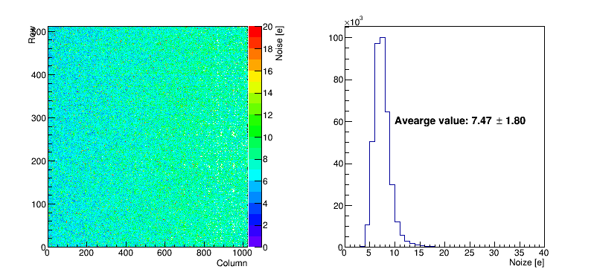
Test under internal trigger (40MHz)
From Xuan
Readout speed 1.2 Gb/s and 50 injections.
Scan the noise per pixel and the average value is 7.47±1.80 (e).

Slide 20
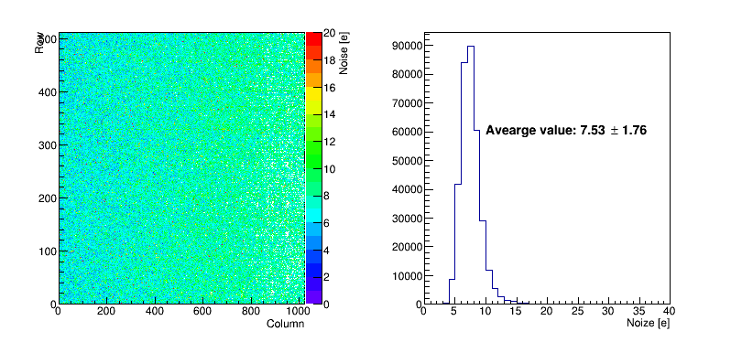
Test under internal trigger (40MHz)
Readout speed 600 Mb/s and 50 injections.
Scan the noise per pixel and the average value is 7.53±1.76 (e).

Slide 21
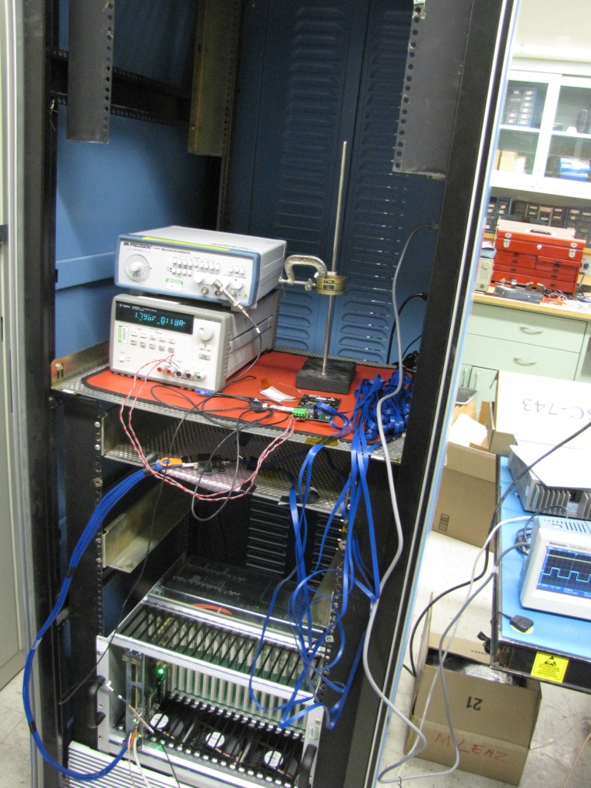
External Trigger and Source
Xuan et al
Single chip readout
Use a pulse generator as the external trigger
Use the Strontium-90 to produce beta rays.
  Vary the distance between the source and the silicon chip
Sr-90
1kHZ trigger

Slide 22
A Single-chip MAPS Telescope
Check the readout occupancy and efficiency under different internal trigger clock (10-40MHz), readout speed (400-1200Mb/s) and threshold (set up by the analog signal or the configuration file?).
Set cosmic ray triggers with scintillator bars or pads to read out single MVTX chip with the external coincidence cosmic ray trigger.
Design of single chip based telescope in progress
Efficiency tester
Simple tracker
μ⁻
μ⁻

Slide 23
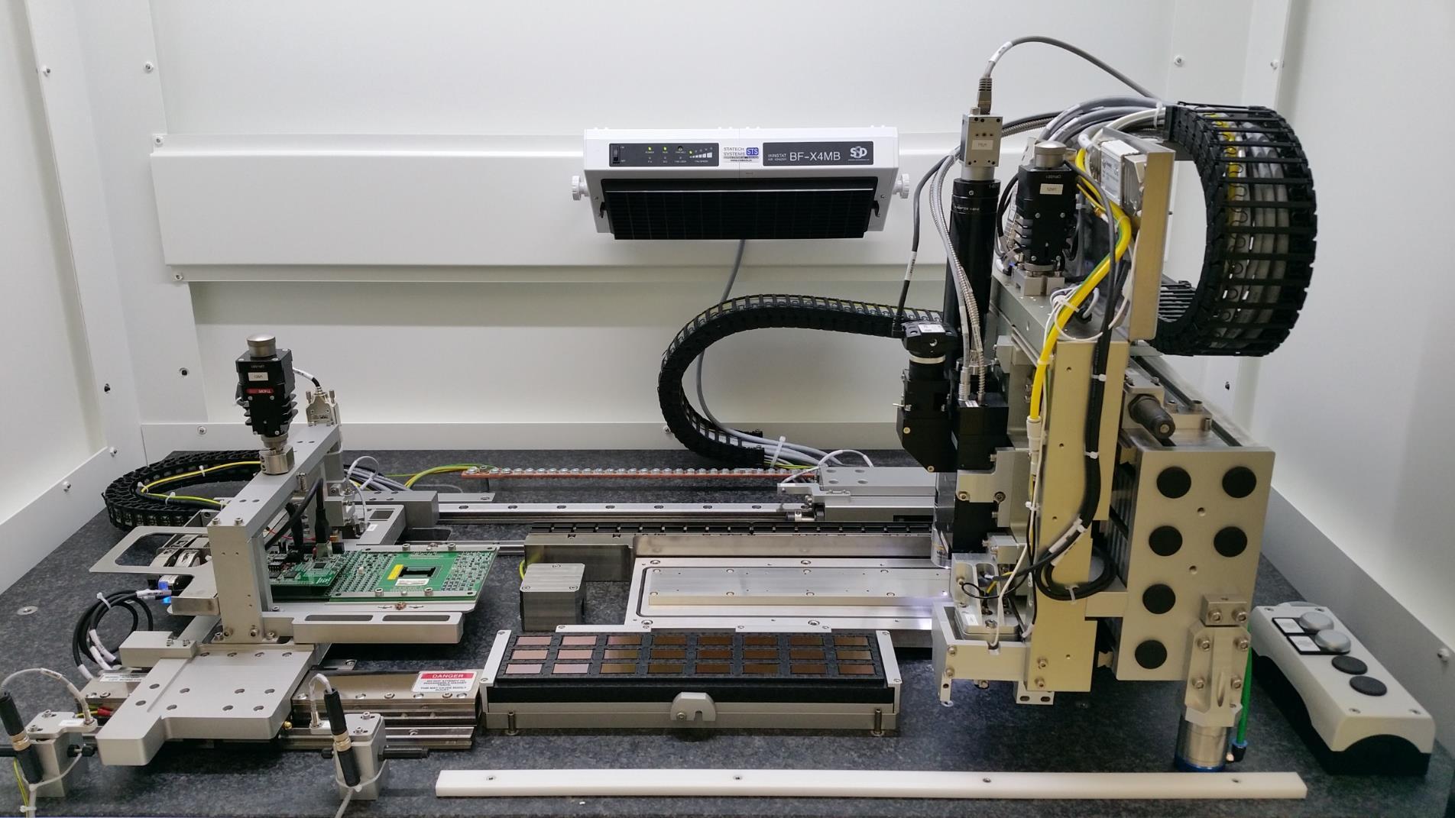
Stave Production & Test @ CERN
From Sanghoon
Under preparation for massive stave production
  Overall ALPIDE chip test and HIC/stave production procedure is well established
  Successful ITS Stave production readiness review on Apr/27
  Optimization of fine configuration is underway
  Expect to finalize the entire procedure with a new set of ALPIDE chips w/o PIQ which will be ready soon
  ALPIDE chips with PIQ will be available from mid July
Chip test and HIC assembly machine
Chip
pre-position
Chuck (PPC)
HIC assembly table
Probe-card
Chips tray
Chip gripper

Slide 24
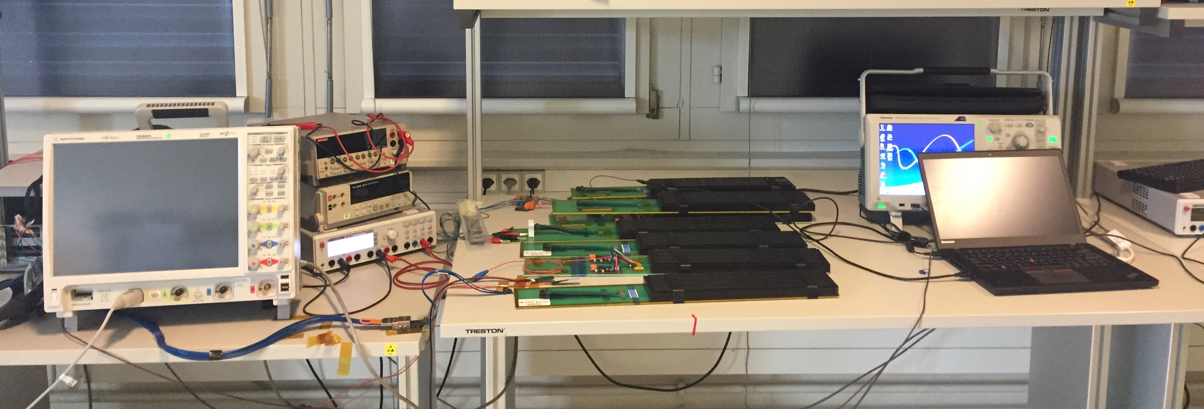
Stave Production & Test @ CERN
Prototype HICs and staves will be available for LANL R&D soon
  Multichip readout
  Mechanical cooling
Sanghoon, Cesar et. al. working @CERN
May – Sept. 2016
Czech group – postdocs + Tech @CERN
HIC/Stave test setup @CERN
MOSAIC board
Power supply
HIC
Firefly cables
PC

Slide 25
MVTX Stave Production Plans
Plan-A
  CERN production:
    Assembly and test
  Time: starting 08/2018, 6-9 months
Plan-B
  HICs production @CCNU, Sep. 2018, 2-3 months
  Stave space frame production @CERN ITS/IB, by 2017
  Stave assembly: US/LBNL? Or China/CCNU, 4-6 months
DOE Budget: FY18
Impact on sPHENIX start date?
CCNU option → plan A?

Slide 26
Latest News from CERN
1) FPC and chip gluing has ben tested and settled. Production will use 90 microns droplet glue which introduced minimum material budget.
2) Production starts early July. One stave per day. Expect first ALICE/ITS ready January 2018, second detector ready in June 2018.
3) Confirmed MAPS chips and staves frames being produced for MVTX as part of the ALICE contingency
4) Despite the rumors propagated recently, the stave assembly room, machinery and personal will be available after ALICE production. They are also going to make a replica of the entire ITS for NIKA experiment in Dubna during 2019-2020. ATLAS consults on the possibility to use the MAPS technology for their inner tracker upgrade in the future. If they decide for it they will use a completely different facility.
5) LANL is going to send post-docs for 2-3 months stages at CRN to work on the stave characterization.
6) FZU Institution from Prague are also sending post-docs and staff to CERN to work on stave characterization.
7) We are discussing the possibility for Prague to send a skilled person to work on the construction of the staves. This task requires a skilled person, long training, and to stay at CERN at least six months.
8) Will have at least one stave sent to LANL for R&D in June. We expect to have four (at least partially functioning) staves by the end of September.

Slide 27
MVTX/INTT Integration Issues
From Walt

Slide 28
From Walt

Slide 29
Possible Low Profile Connections
From Sanghoon/Walt
Aluminum Flex
Copper Flex
Bridge Flex

Slide 30

Summary and Outlook
Exciting physics and great opportunity!
A lot happened
  Physics and detector simulations & optimization
  Good progress with MAPS readout R&D
  Mechanical integration
  Some challenges due to delays in ALICE ITS R&D
A lot to do
  Staves, RU, FELIX/CRU integration
  PS and controls
  BNL, DOE Reviews
  Build and operate the detector
  and more fun …
  Join us!

Slide 31
Winter Collaboration Meeting @Santa Fe
A 2.5-day event
Things to consider:
  Before or after final exams, or winter breaks
  Avoid other major meetings/reviews
  Avoid busy travel seasons
  Good time for sPHENIX planning etc.
Possible dates (Fri-Sun?)
  Nov. 17-19
  Dec. 1-3
  Dec. 8-10
  Jan. 5 -7, 2018

Slide 32
backup

Slide 33
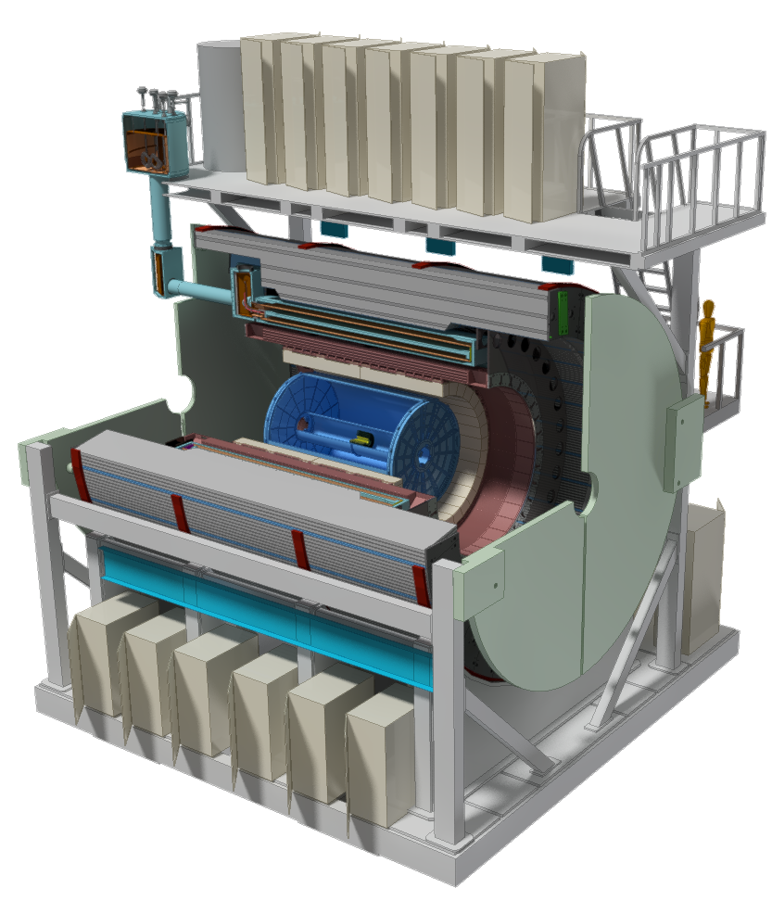
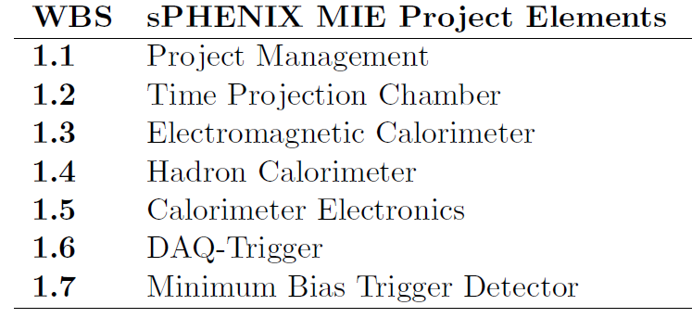
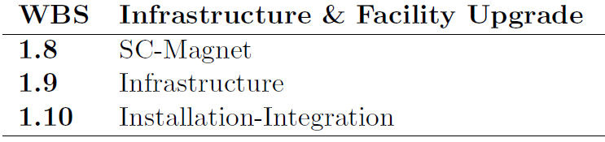
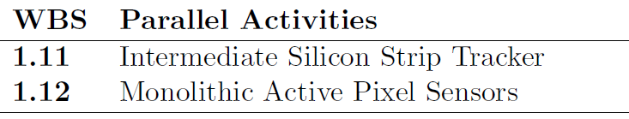
MVTX: WBS 1.12
A separate MIE as an upgrade project

Slide 34
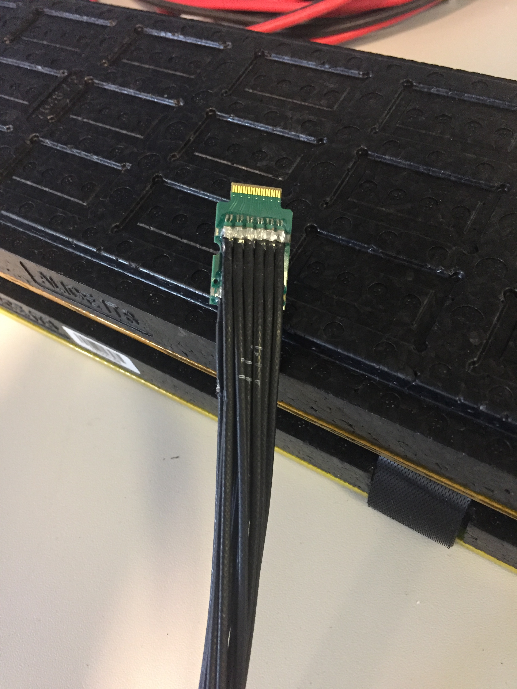
FPC and FireFly Cable Extension

Slide 35
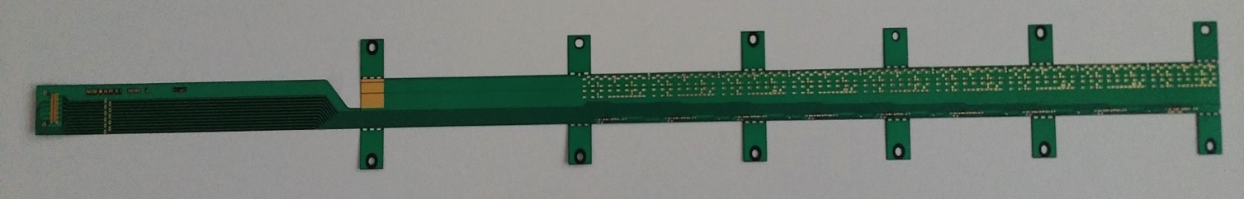
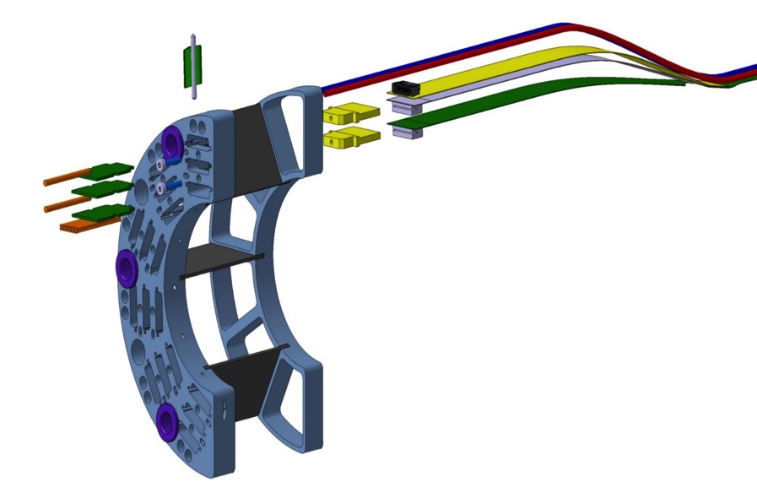
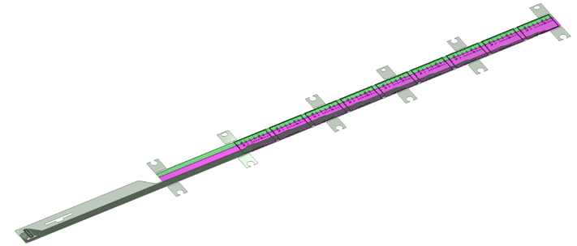
MVTX/INTT Integration
Extend MVTX Service Cables?
506.2 mm
16 mm
16.15 mm
41.9 mm
CHIP 9
……
CHIP 2
CHIP 1
The 9 silicon chips are read out in parallel: each chip sends its data stream to the end of Stave by a dedicated differential pair, 100 μm wide. Two additional differential pairs distribute the clock and configuration signals.

Slide 36
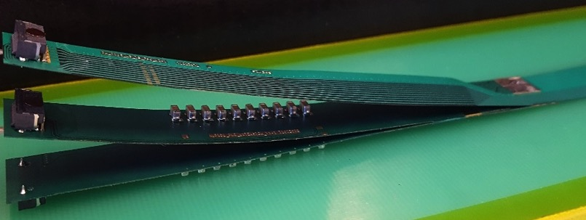
FPC Extension for Connection to Electrical Services
Antonello Di Mauro, Stave PRR 4/27/2017
The connection to the service cables is achieved by a double FPC extension which is soldered to the HIC
x-section at interconnection between FPC and extensions
AVDD
AVDD
AVDD
AVDD
DVDD
FPC
AVDD
DVDD
AGND
AGND
Flex power extension
AVDD
DVDD
AGND
FPC
AGND
DGND
DVDD
DVDD
AGND
DGND
DVDD
AGND
DGND
FPC
DGND
DGND
Flex power extension
DGND
signal lines (FPC)
digital power
analogue power

Slide 39
Aluminum Flex
Copper Flex

Slide 40
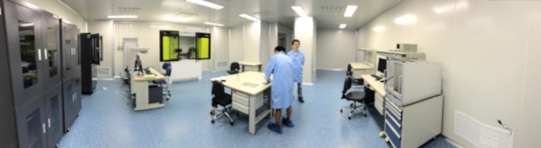
HICs Assembly Lab @CCNU space ~ 70m² (1K clean room); 20m² (10K clean room, 2.9m head room)
Chip and FPC gluing
Gluing FPC/MAPS
Chip mounting
Wire Bonding
Electrical circuit testing
Storage
Machine shop: (Sun, Daming, Tech.)
CNC etc.
Simple mechanical structures
Not Doing at present:
Stave assembly
No carbon structures
Chip mounting
Wire bonding
Test bench
storage
Gluing & assembly
tables

Slide 41
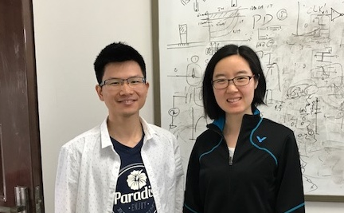
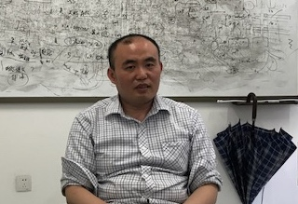
CCNU Plan – Cont.
Gao
Yang
Experts and Designers of ALICE MAPS/ALPIDE on-chip electronics
  Analogy circuit – Dr. Chaosong Gao
  Digital circuit – Dr. Ping Yang
  They will help us!
PLAC – Pixel Lab At CCNU
  Also interested in mechanical system integration
  Plan to hire a full time engineer to work on sPHENIX integration effort
    Visit LANL 6-12 months, work on preliminary conceptual design for the MVTX/INTT/TPC
Physics simulation and analysis
  Many students
PLAC Ass. Director
Dr. Xiangming Sun

Slide 42

Overall ITS Planning (Simplified Global View)
ALICE ITS Upgrade
2016
2017
2018
2019
2020
PRR
Sensor Series Production
CMOS processing, thinning & dicing, test
From L. Musa, 4/27/2017
Stave PRR Presentation
Stave Develop
PRR
Stave Mechanics
HIC Production
HIC and Stave
Stave Production
Mechanical Support Structures
Dry Assembly Test
Development
Production
EDR
PRR
Readout Electronics
Global Assembly
Commissioning @ Surface
Design & Prototyping
Design & Prototyping
Production & Test
Installation
EDR
PRR
Commissioning
11 months
Commissioning in ALICE
2016
2017
2018
2019
2020

Slide 43
Project Review Milestones
ALICE ITS Upgrade
From L. Musa, 4/27/2017
  Pixel Sensor Chip - EDR (Oct’ 15)
  Stave - EDR (May’ 16)
  Detector Barrel Mechanics - EDR (Jul ’16)
  Cooling – EDR (Jul ’16)
  Pixel Sensor Chip - PRR (Nov ’16)
  Detector Barrel Mechanics - PRR (Dec ’16)
  Service Barrel Mechanics - EDR (Dec ‘16): done
  Cooling – PRR (Dec ’16): done
  Readout Electronics – EDR (Jan ‘17): done
  Stave - PRR (Apr ‘17)
  Service Barrel Mechanics – PRR (May ‘17)
  Readout Electronics – PRR (Dec ’17)
Stave Production Readiness Review:
4/27/2017
Stave production starts ~May/June;
1st set of IB by Jan 2018;
2nd set of IB by July 2018
LANL people + others/MVTX work on stave production from May 2017 at CERN, prototype available soon at LANL
Fully working staves for R&D available ~Jan 2018;
Near final readout RU/CRU: ~12/2017

Slide 44
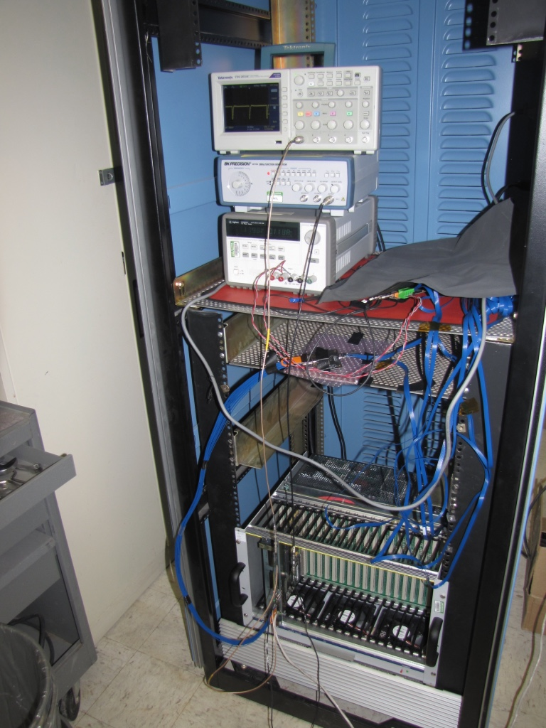
External trigger setting with a pulse generator
Use Chip 4 for test.
Use a pulse generator as the external trigger source. Now use 2MHz square pulse.
Readout the FE trigger output of the MOSAIC board and check in the oscilloscope.
Need to tune the external trigger to be in the phase locker.
Oscilloscope readout
MOSAIC trigger
Function generator
Power supply
MOSAIC board with
external trigger from
the function generator.

Slide 45
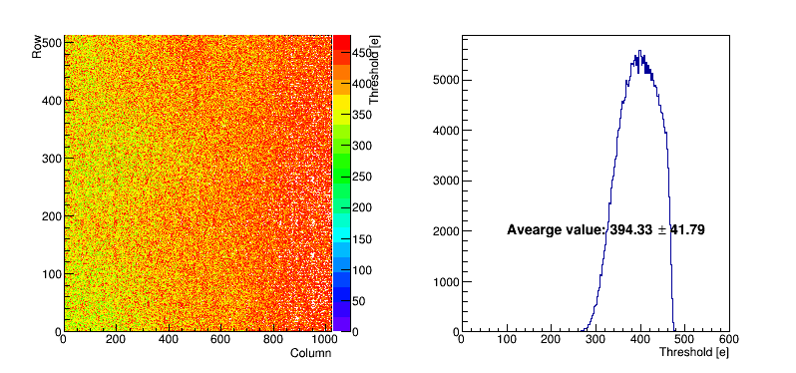
Test under internal trigger (40MHz)
From Xuan
Readout speed 600 Mb/s and 50 injections.
Scan the threshold per pixel and the average value is 394.33±41.79 (e).

