Slide 1
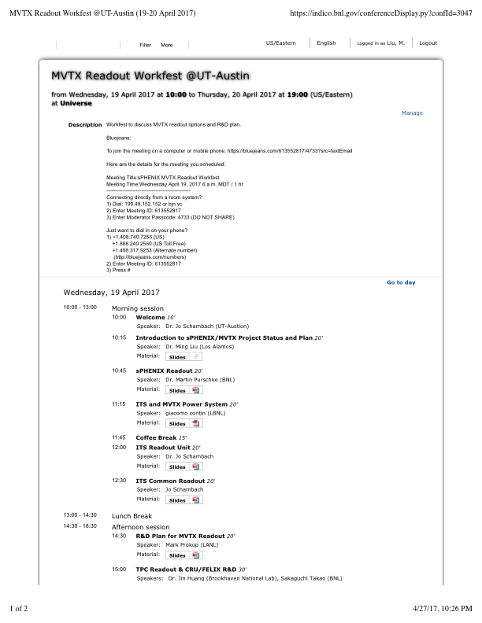
MVTX Update 4/28/2017
UT-Austin Meeting
Thank you Jo and Christina!
Meetings @BNL
Maria, Ed, Bob, Grazyna and Ming
In-depth MVTX project discussions
FELIX discussions with BNL engineer
Preferred option for TPC
ALICE Stave PRR 4/27/2017
Good progress
Updated schedules

Slide 2
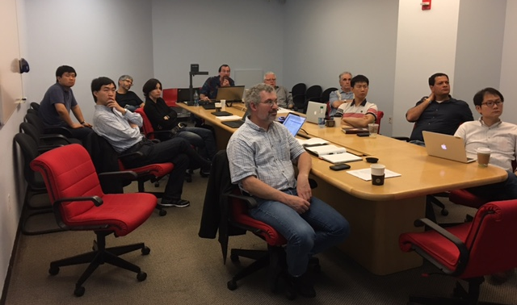
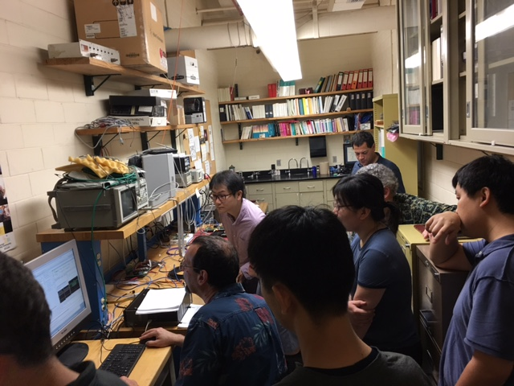
MVTX Readout Workfest @UT-Austin https://indico.bnl.gov/conferenceDisplay.py?confId=3047
Very productive discussions on the technical sides:
sPHENIX readout – Martin
TPC readout – Jin and Takao
ALICE ITS readout system – Jo
LV/HV and Slow controls - Giacomo
MVTX readout options – Mark
Lab demo of RUv0 and “CRU” R&D
RU v0
“CRU” prototype with an Altera eval board
A brief summary
Possible MVTX readout path
RDO Unit, some modification
CRU or FELIX (TPC), both could work OK, significant R&D needed
Joint R&D on RU and CRU, maybe also FELIX integration
UT-Austin’s interest in RU and CRU production & test!

Slide 3
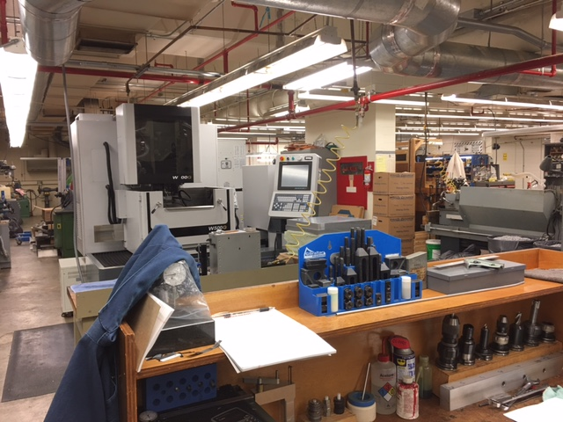
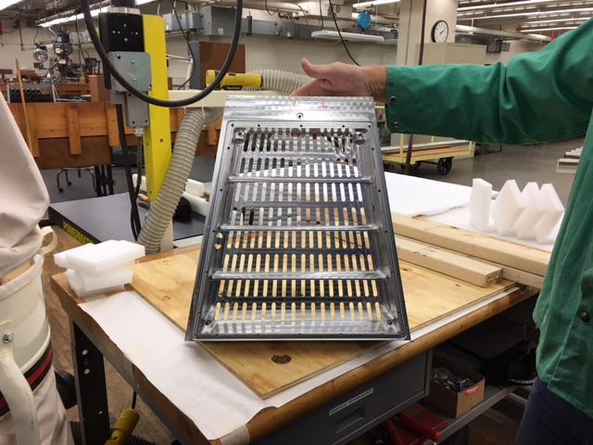
A nice/low cost Machine Shop @UT-Austin Fast turn around R&D mechanical structures

Slide 4
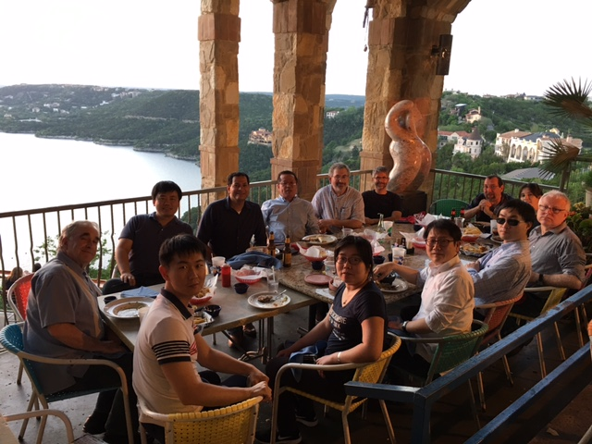
Wish you were here too ;-)

Slide 5
Meetings @BNL
A full day in-depth discussions of project plan, cost and schedule
Follow up discussions through out the week on project cost and schedule
BNL, LANL, MIT and LBNL
CERN recognized experiment and “MOU” etc
BNL Directors Review: July 10-11 (Tentative)
A dry run in June, date TBD
Action items
Identified areas for improvement, C&S,
Org chat being updated, institution tasks etc
Review dates etc.

Slide 6
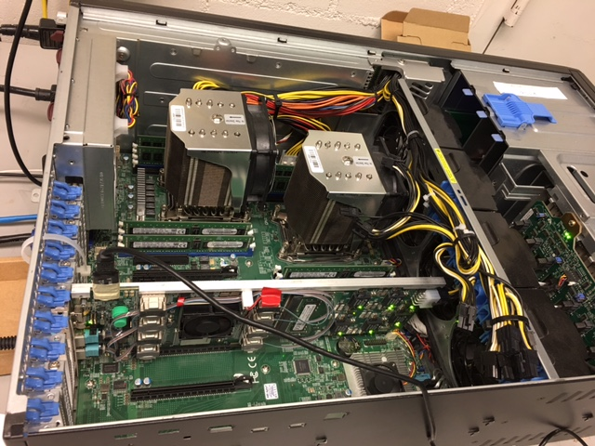
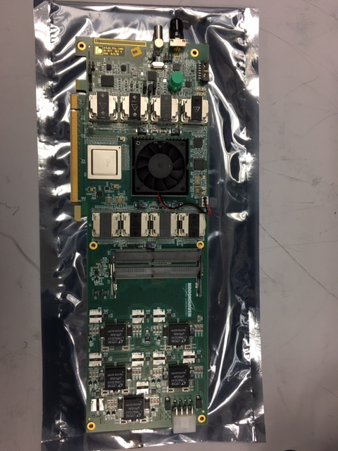
Electronics R&D FELIX and MVTX Power Distribution Boards
Visited BNL Labs and had FELIX system demo
V1.5 boards, all functionalities available- data, slow control and Timing/Trigger/Busy, w/ GBT
Multi-channel GBT links and PCIe interface code developed, with examples of user modules
V2.0, available end of 2017, sPHENIX application
A 1.5v FELIX board produced and tested, ready for shipment to LANL; Optical cables etc. to be ordered soon for LANL test bench
Power distribution boards
LBNL PS distribution board availablefor R&D from CERN/LBNL ~ June
R&D power supply system to be ordered
FELIX: tested

Slide 7
Project Review Milestones
From L. Musa, 4/27/2017
Stave PRR Presentation
ALICE ITS Upgrade
Pixel Sensor Chip - EDR (Oct’ 15)
Stave - EDR (May’ 16)
Detector Barrel Mechanics - EDR (Jul ’16)
Cooling – EDR (Jul ’16)
Pixel Sensor Chip - PRR (Nov ’16)
Detector Barrel Mechanics - PRR (Dec ’16)
Service Barrel Mechanics - EDR (Dec ‘16): done
Cooling – PRR (Dec ’16): done
Readout Electronics – EDR (Jan ‘17): done
Stave - PRR (Apr ‘17)
Service Barrel Mechanics – PRR (May ‘17)
Readout Electronics – PRR (Dec ’17)
Stave Production Readiness Review:
4/27/2017
Stave production starts ~May/June;
1st set of IB by Jan 2018;
2nd set of IB by July 2018
LANL people + others/MVTX work on stave production from May 2017 at CERN
Fully working staves for R&D available ~Jan 2018;
Near final readout RU/CRU: ~12/2017

Slide 8
Overall ITS Planning (Simplified Global View)
ALICE ITS Upgrade
2016
2017
2018
2019
2020
PRR
Sensor Series Production
CMOS processing, thinning & dicing, test
From L. Musa, 4/27/2017
Stave PRR Presentation
Stave Develop
PRR
Stave Mechanics
HIC Production
HIC and Stave
Stave Production
Mechanical Support Structures
Dry Assembly Test
Development
Production
EDR
PRR
Readout Electronics
Global Assembly
Commissioning @ Surface
Design & Prototyping
Design & Prototyping
Production & Test
Installation
EDR
PRR
Commissioning
11 months
Commissioning in ALICE
2016
2017
2018
2019
2020

Slide 9
Project R&D and Construction Milestones
ALICE ITS Upgrade
Nov-16 | 2015 | 2016 | 2017 | 2018 | 2019 | 2020
ALPIDE EDR (10/15)
ALPIDE PRR (25/11/16)
ALPIDE product. and test (end 12/17)
IB stave EDR (3-4/5/16)
IB stave PRR (27/4/17)
IB FPC production end (12/17)
IB space frame & cold plate prod. end (9/17)
IB-1 stave production end (1/18)
IB-1 assembly end (3/18)
OB stave EDR (3-4/5/16)
OB stave PRR (27/4/17)
OB FPC production end (6/18)
OB space frame & cold plate prod. end (1/18)
OB HIC production end (6/18)
OB stave production end (8/18)
OB stave assembly end (10/18)
From L. Musa, 4/27/2017
Stave PRR Presentation

Slide 10
Project R&D and Construction Milestones
ALICE ITS Upgrade
Mar-17 | 2015 | 2016 | 2017 | 2018 | 2019 | 2020
RO electronics EDR (27/1/17)
RO electronics PRR (12/17)
RO electronics prod. end (12/18)
Detector barrel EDR (20/7/16)
Detector barrel PRR (14/12/16)
Detector barrel prod. end (7/17)
Service barrel/cage EDR (14/12/16)
Service barrel/cage PRR (5/5/17)
Service barrel/cage prod. end (9/17)
Cooling plant EDR (21/7/16)
Cooling plant PRR (16/12/16)
Cooling plant ready (9/18)
Commissioning surface end (5/19)
Installation during LS2 (4/20)
From L. Musa, 4/27/2017
Stave PRR Presentation
11 months contingency

Slide 11
To do list
Prepare for BNL Directors reviews
Update links between Org. Chart and Cost & schedule WBS
Update cost and schedule, missing items etc.
Physics and detector simulations, Money plots
Detector R&D
Readout
Mechanical integration
Stave production at CERN
Test bench at LANL
Joint LANL/UT-Austin on RU, CRU/FELIX work

Slide 12
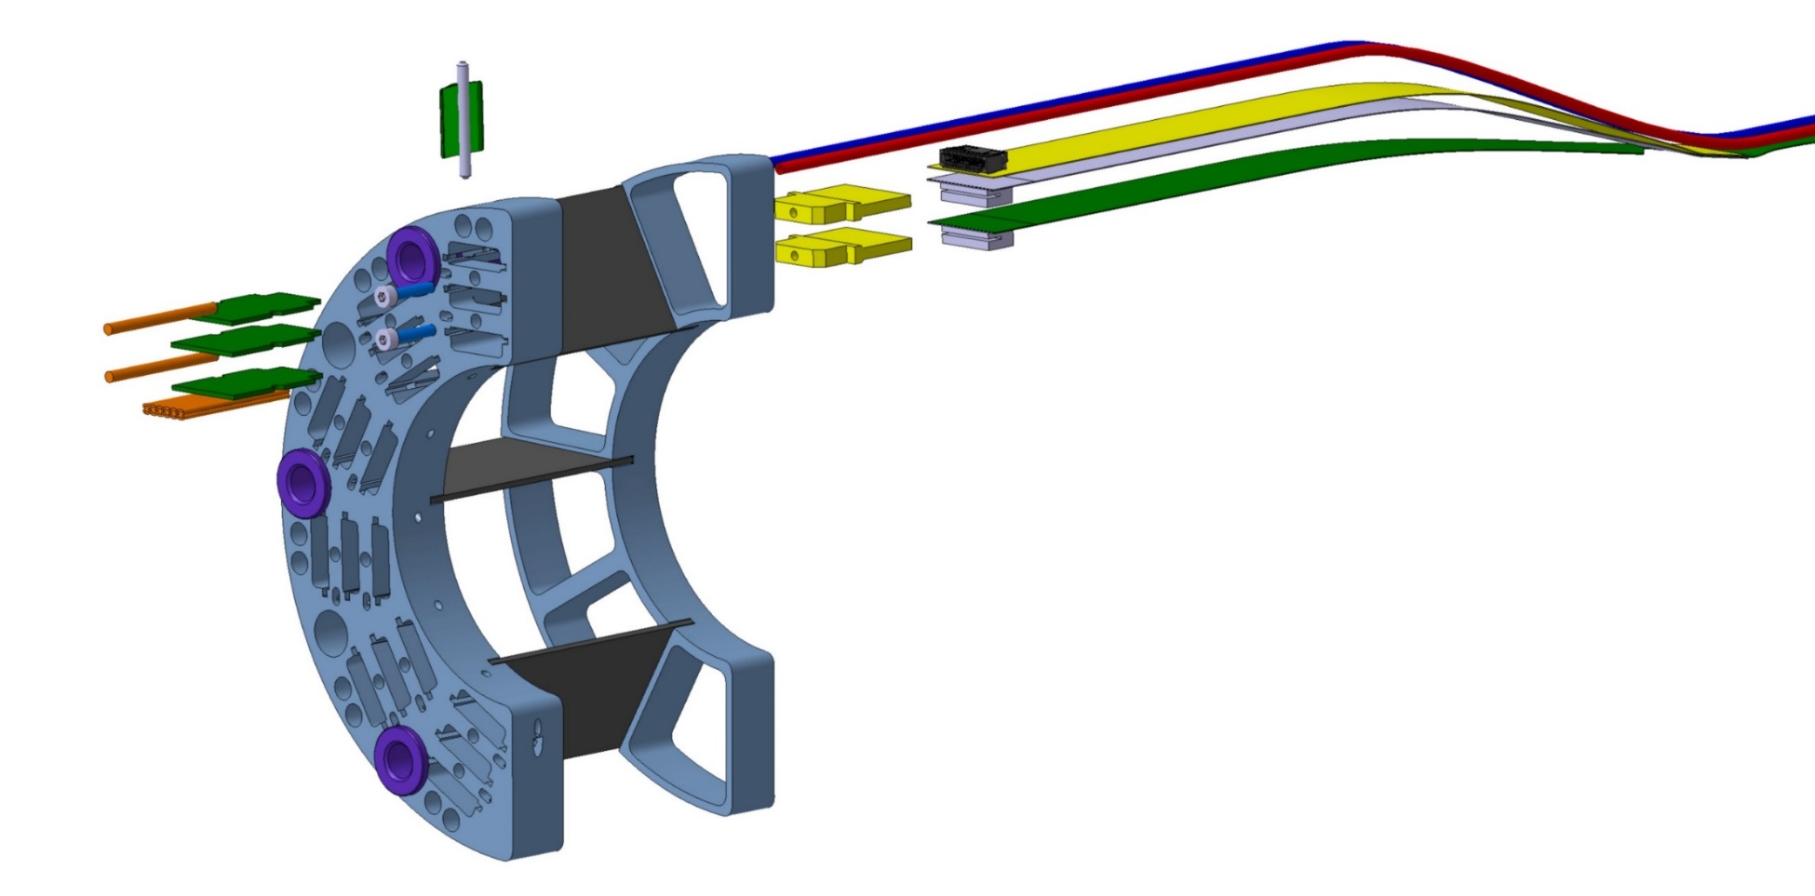
Service Cables
506.2 mm
16 mm
16.15 mm
41.9 mm
CHIP 9
……
CHIP 2
CHIP 1
The 9 silicon chips are read out in parallel: each chip sends its data stream to the end of Stave by a dedicated differential pair, 100 μm wide. Two additional differential pairs distribute the clock and configuration signals.

Slide 13
FPC Extension for Connection to Electrical Services
Antonello Di Mauro, Stave PRR 4/27/2017
The connection to the service cables is achieved by a double FPC extension which is soldered to the HIC
x-section at interconnection between FPC and extensions
AVDD
AVDD
AVDD
AVDD
DVDD
FPC
AVDD
DVDD
AGND
AGND
Flex power extension
AVDD
DVDD
AGND
FPC
AGND
DGND
DVDD
DVDD
AGND
DGND
DVDD
AGND
DGND
FPC
DGND
DGND
Flex power extension
DGND
signal lines (FPC)
digital power
analogue power

