Slide 1
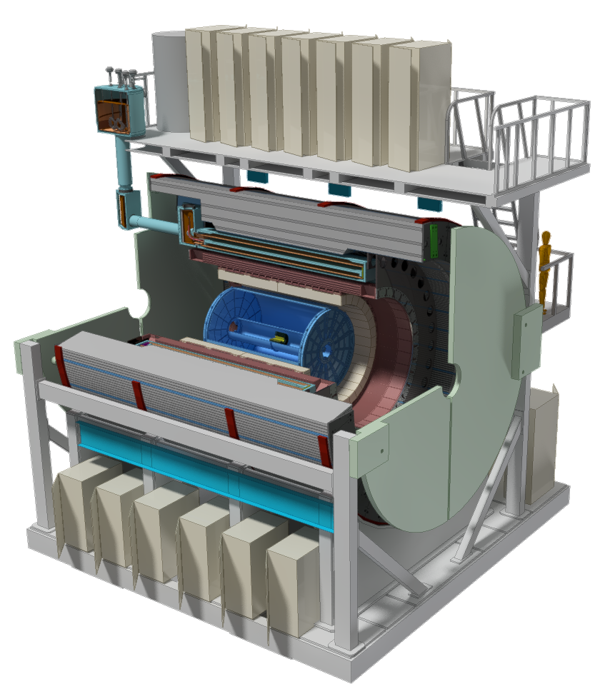
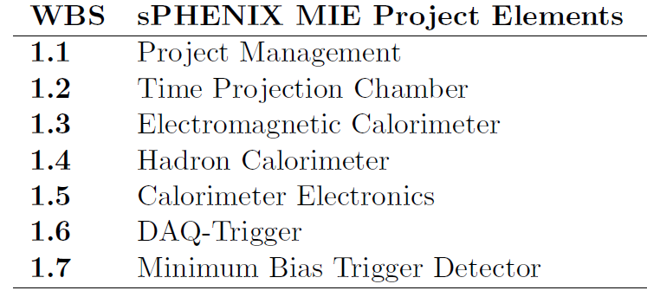
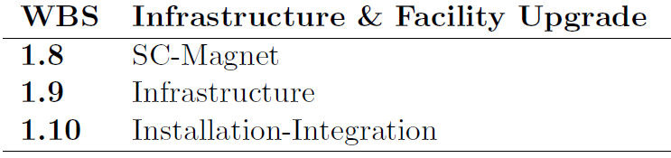
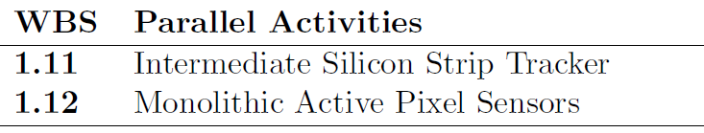
MVTX: WBS 1.12
A separate MIE as an upgrade project

Slide 2

sPHENIX MAPS-based Vertex Detector (MVTX)
|eta| < 2.0
R = 2.4; 3.2; 3.9cm;
L = 27.1cm
“Adopt” ALICE ITS Upgrade Inner Barrel 3-layer MAPS detector
  Mini. risk, Max. Physics
Precision vertexing for b-jet/B-hadron tagging with high efficiency and high purity
B-jet modification in QGP at low-medium pT to determine QGP properties, study mass-dependence on collisional vs radiative energy loss, flow etc.
A separate DOE MIE to build the full detector, WBS 1.12, ~$5M for construction;
Early R&D by LANL/LDRD, $5M, FY17-19, readout and mechanical integration;

Slide 3
Scope of the MVTX Project
MAPS staves & Electronics
  MAPS Detectors
    “MoU” to build 68 ITS MAPS staves
    No modification
  Readout Electronics
    Use ALICE/ITS, RU + CRU
    Modify/reprogram CRU for sPHENIX
      Plan-B: build a custom board to convert ALICE/ITS into sPHENIX DAQ format; BNL FILEX etc.
    R&D by LANL LDRD
  Production
    Extend ALICE/ITS MAPS stave production
    sPHENIX personnel help assembly and testing staves at CERN
    Reproduce additional ALICE RU+CRU for sPHENIX
    Final assembly and test in US/LBNL
  Ancillary systems, copy ALICE
    LV, cables, crates, racks etc.
    Slow control, safety and monitoring
Mechanics & Cooling
  No/(some) changes to ALICE/ITS inner tracker mechanical structures
    End Wheels
    Cylindrical structure shells
    Detector half barrels
    Service half barrels
    Detector and Service half barrels
    Half support structures
  Mechanical Integration
    Conceptual design by LANL LDRD
    Prototype by sPHENIX R&D
    Design integration frames
    Carbon frames etc.
    Installation tooling etc.
  Copy ALICE cooling plant design
    Minor modification to fit sPHENIX
    Smaller heat load than ALICE ITS
  Metrology and Survey
WBS 1.12: a new MIE fund the full MAPS Vertex Detector, ~$5M

Slide 4
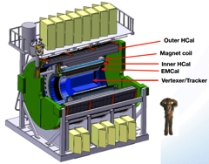
Project Tasks and Timeline
FY2016
FY2017
FY2018
FY2019
FY2020
FY2021
sPHENIX
baseline
CD-0
9/2016
CD-1
CD-2/3
8/1
Ready for
Beam
6/1
ALICE ITS/IB
Prod. ends
Readout R&D
Mech. design
@LANL/ALICE
A schedule driven project!
Key R&D
Mech. Integr.
& Prototype
@MIT/LBNL
Production
MAPS Prod. & QA
@ALICE
Stave prod.&test @CERN;
RU/CRU Prod. @US
Detector Assembly
& Test @LBNL
Det. Install.
@BNL
+2%
+50%
“MoU” w/ ALICE/ITS: 11/2016
- Produce MAPS chips and Stave Space frames for sPHENIX as part of ALICE production!
- Full staves and RU & CRU production cost & schedule → MVTX MIE

Slide 5
MVTX Project Status and Plan
Pre-proposal submitted to DOE, 2/2017
  Follow-up discussions with DOE and BNL managers
  BNL appointed Maria to coordinate the project
  Several meetings BNL/LANL/LBNL/MIT NP managers
Plan to update proposal to DOE, late 2017
  Expanded science “CD0” + Cost & Schedule “CD1”
  Funding in FY18, stave production @CERN in Aug. 2018+, ~6 months; other options being explored for stave production @CERN/CCNU for delayed funding
BNL Director’s Review ~July 2017
  Expanded science “CD0” + Cost & Schedule “CD1”
  A dry run mid/late June
  DOE is OK with sPHENIX baseline w/o HF
Readout R&D
  RU & CRU
  System integration
Mechanical integration task force
  Draft report available
Proof of principle needed
before stave production, ~8/2018

Slide 6
CD-1 Preparation and Review Schedule
From Ed, L2 meeting 4/13/2017
ALL DATES TENTATIVE
sPHENIX CD-1 “Dry Run” with BNL internal Review committee (Jun 12-13)
  Review state of the documentation, Project files with drill down, project controls
  Tentatively scheduled for 1.5 days. Presentations June 12 , homework and close-out June 13.
  We will need some kind of practice the first week of June. Will wait until we see the charge before setting the agenda
sPHENIX Director’s Review. (Week of Aug 7)
  Jay Marx will chair. Likely DOE will observe either Jim Sowinski or Elizabeth Bartosz.
  2.5 days. 1 day of plenary. 1 day of breakout. ½ day of report writing and close out
DOE-OPA CD-1 Review (Week of Nov 6)
  Likely Ethan Merril from OPA will chair
  2.5 days. 1 day of plenary. 1 day of breakout. ½ day of report writing and close out
(MVTX “CD0”+”CD1”: ~July )

Slide 7
Project Recent Activities
Meetings with Maria Chamizo Llatas of BNL Project Office
  Weekly LANL/LBNL/MIT/BNL phone meetings to discuss path toward reviews, project plan etc
  A full day meeting 4/25 @BNL, LANL/LBNL/MIT
  Bi-weekly MVTX detector group meetings discussed
  MVTX BNL Directors review: Science + C&S
    ~mid July, a dry run in late June
    A draft charge of review, ~next week?
Cost and Schedule project file updated 4/7/2017
  LANL & LBNL, detailed labor profile
  MIT, discussed last week, some thoughts on mechanical integration issues
    MVTX as a standalone, NO modification of the service end etc;
    if other subsystems introduced, they work out integration issues
    Potential increase in cost & schedule if include MVTX/INTT/TPC integration; tracking integration task force report available soon?
  Other institutions, in progress
  DOE wants to keep the fund below $5M, possibly from some redirected $$
  Project webpage: BOE, WBS, project file
  https://p25ext.lanl.gov/maps/mvtx/mvtx.html

Slide 8
MVTX R&D Status
Readout R&D
  Workfest @UT-Austin, 4/19-20
  LANL MOSAIC test bench setup in progress
  RUv1 available in May, will be used for LDRD telescope
  CRU being prototyped with Altera evaluation boards, able to communicate with the board;
  BNL/ATLAS FELIX being evaluated as an alternative
    Computer arrived, fibers/cables ordered
    Obtain one FELIX in a few weeks
Stave production for LDRD telescope
  ALICE Stave Production Readiness Review 4/27, prod. Starts in May
  LANL people do assembly and test at CERN, May – Sept. 2017
Project C&S – work in progress
  Detailed commitment from each institutions etc
  More work after BNL meeting w/ Project Office, 4/25
Tracker integration task force, led by Mickey
  MVTX + INTT + TPC mechanical integration issues
  Identify the major tasks, draft available now, final report due early May
  Resources will be worked out later

Slide 9
Prepare for the BNL Director’s Review Physics/Detector Simulations
Produce preliminary by early June, prepare for a dry run in mid/late June
  B hadron physics
  B-jet physics
  Detector performance plots
To be ready for BNL Directors Review in July
  Money plots for the proposal
HF-Jet Topical Group

Slide 10
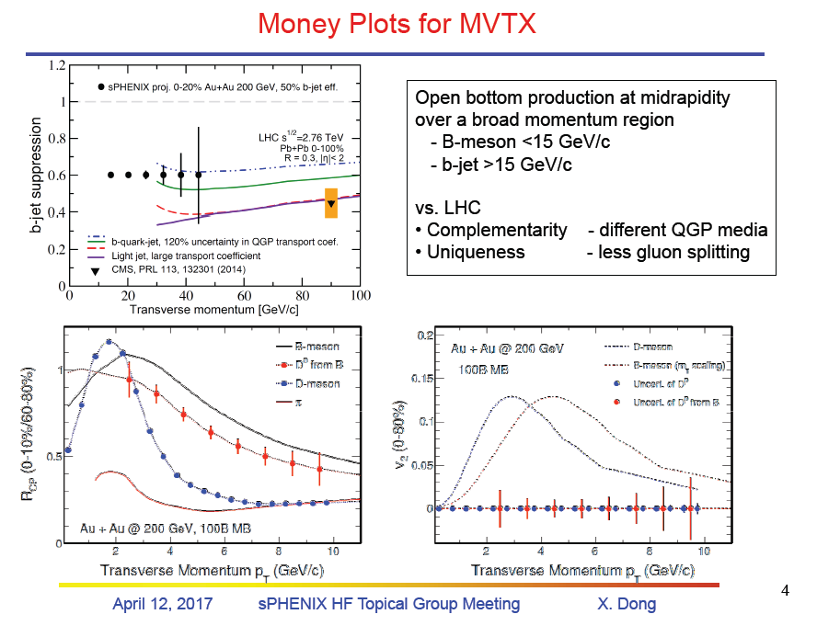
HF-Jet TG 4/12/2017

Slide 11
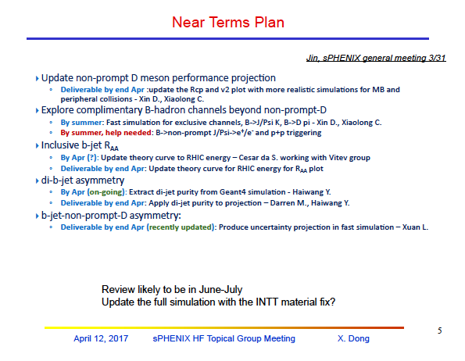

Slide 12
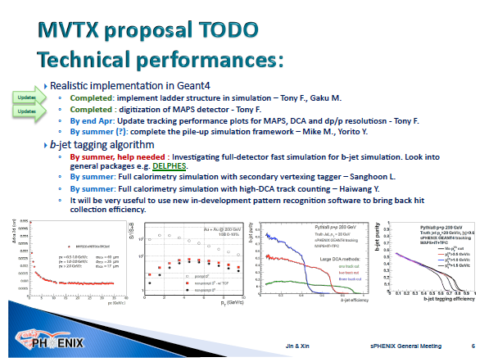

Slide 13
MVTX Proposal Discussion @BNL
04/25/2017
Project organization
  What is in the pre-proposal
Commitments from each institution
  What is in the pre-proposal, what is missing
Infrastructure needs at BNL
  Pre-installation checkup
  Technicians & other resource needs for installation
Cost - what is (not) included
  From this project
  LDRD and other in-kind contributions
Schedule – matching sPHENIX baseline for day-1?
  locations for assembly? CERN, CCNU, other places?
  “Agreement” between DOE/BNL and CERN about using ALICE/ITS facilities at CERN
Go through the MVTX project file
  Cost, schedule and resources
R&D needs
  Readout
  Mechanical system
  Simulations, 3-layer or other configuration, early work etc
Project management: expect ~ STAR iTPC upgrade
  $5M, no need CD processes
  Local DOE oversee the project?
Charge for the BNL Director’s Review
  Dates
  What is next?
Setup MVTX bi-weekly meetings
  Biweekly sPHENIX general meeting (Fri)
  MVTX/HF-jet topical group biweekly/monthly meeting
  sPHENIX weekly simulation meeting (Tue)
  Project R&D progress
Develop a plan to update
the proposal

Slide 14
BNL Program Manager
Last update:02/09/2017
MVTX pre-proposal
sPHENIX Project Office
Manager: Ed O’Brien
sPHENIX MAPS Project Office
Project Manager: M. Liu (LANL)
Deputy Project Managers: G. Odyniec(LBNL), R. Redwine(MIT)
Electrical Engineer:TBD
Mechanical Engineer: W. Sondheim
sPHENIX Management
Spokespersons
G. Roland
D. Morrison
Readout Integration
(Liu*/LANL)
(Schambach/UTA)
Stave Production
(da Silva/LANL)
LV/HV and Slow
Controls
(G.Odyniec/LBNL)
Carbon Structures
(G.Odyniec/LBNL)
Mech. Integration
and cooling
(R.Redwine/
MIT Bates)
Electr. Integration
& Safety
(E.Mannel/BNL)
Software
(A.Frawley/FSU)
FEM
LANL/UTA
Stave Frame
Design
LANL/LBNL
Cablings & Test
LBNL/UNM
Detector Assembly
and Test
LBN/UCR/UCLA
Cooling
MIT/RIKEN
Simulation
BNL/BNL/
Purdue
DCM Integration
U-Colorado
(Nagel)
Assembly and test
@CERN
MIT/CCNU/
LANL
Slow Control &
Monitoring
GSU/BNL
(He)
Installation
MIT/LBNL
Alignment
BNL/MIT
Offline
NMSU/BNL
Stave QA
LBNL/ISU/UCR
B-jet tagging
LANL/NMSU/
LBNL
Need to update major tasks/lead institutions

