Slide 1

Welcome to Santa Fe
Meeting rooms:
  Main room: Zuni South
  2nd room: Chaco West for afternoon
Breakfast: 8:00-9:00AM
Group dinner tonight at 6PM (Cesar)
  Pink Adobe
Local contact/help:
  505-412-7396 (Ming)
  631-384-4381 (Cesar)
Photo by
Haiwang Yu

Slide 2
MVTX Status and Plan
MVTX & HF-Jet Workfest, Santa Fe
12/5-7, 2017
Ming, Maria, Bob, Grazyna, Jin and Xin

Slide 3
Outline
MVTX update since July Director’s Review
  Physics and Simulations
  Readout and Controls
  Mechanical System
  Budget and Schedule
Plan for the rest of the week

Slide 4
New sPHENIX baseline and MVTX Plan
Ed’s talk
New sPHENIX baseline schedule
  CD-1 Review: 5/2018
  sPHENIX installation
    4/2021 – 7/2022
  sPHENIX ready for beam: 9/2022
  First collision: 1/2023
New/reduced sPHENIX baseline detectors
  EMCal: |eta| < 0.85 (1.1)
  OHCal: |eta| < 1? (1.1)
  IHCal: not available (1.1)
MVTX plan – align with the new sPHENIX schedule
  Stave production
    Following ALICE production: ~8/2018
  Readout units production
    Be part of ALICE RU production:
      FPGA & GTB chipset
  Ready for installation: later 2021
    INTT ready for installation 4/2021
  MVTX ready for beam
    sPHENIX day-1

Slide 5
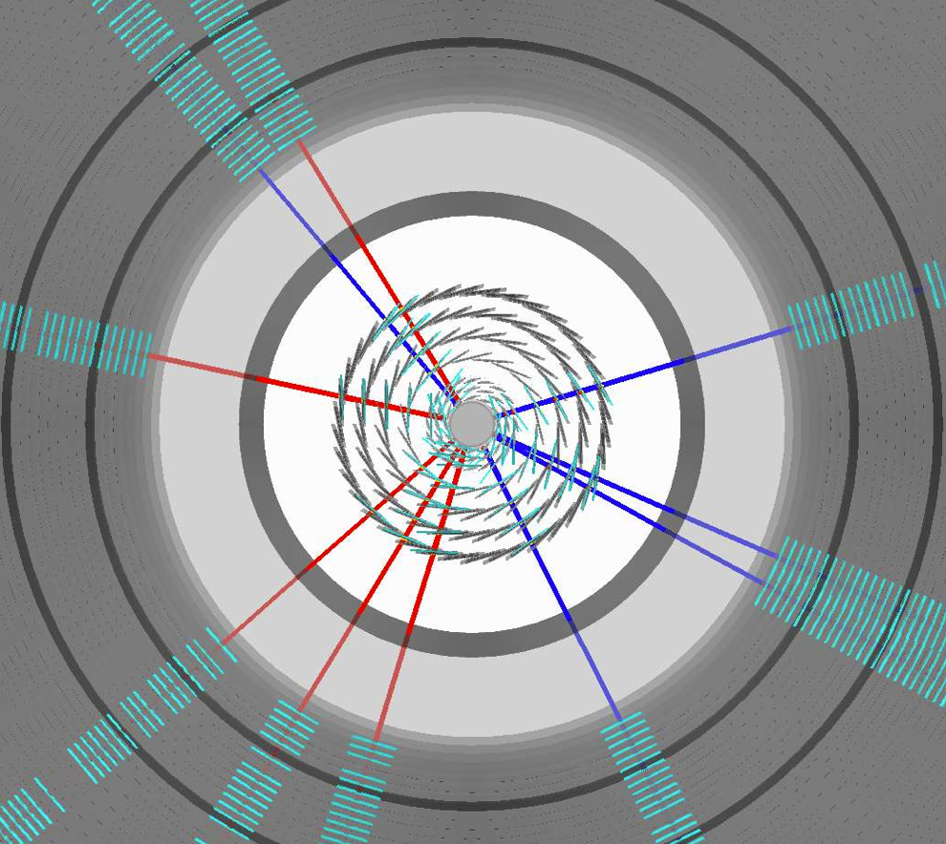
Performance Update
Xin’s talk
Fully implemented MVTX models used
in performance projection
Large jets production in full detectors, including detailed MVTX detector + full calorimetry
  250k MB jets in p+p collisions
  100k MB jet embedded into central Au+Au collisions

Slide 6
Updated p+p and Au+Au b-jet Projections
b-jet tagging projection re-evaluated with full tracking + calorimetry simulation
  Tagging work point has been stable (60% Purity 40% eff for pp)
  Central Au+Au Tagging work point has been stable (40% Purity 40% eff)
Performance has been stable using truth jet finding or calorimetry reconstructed jet finding
sPHENIX b-jet work point

Slide 7
Theoretical Inputs – in Progress
LANL model
Duke model
TAMU
AMPT
PHSD
Ads/CFT
JetScape
….
New calculations from PHSD

Slide 8
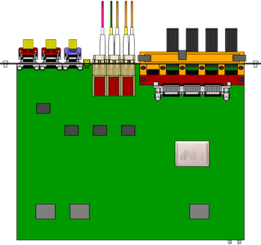

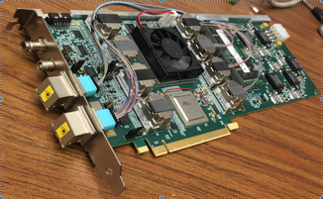
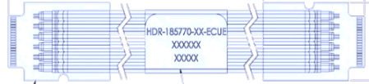


MVTX Readout and Controls
Sho’s talk
sPHENIX GL-1 & GTM
RUv1.0: 10/2017
Stave: 06/2017
Front End Electronics
Readout Unit/ALICE
CAN bus
DCS
5-10 m
Trigger & Clock
GBT Optical Links
9-sensor Stave
9 Data (1.2Gbps)
1 Clock, 1 Control/Trigger
Control
Data (9.6 Gb/s max)
Trigger
Samtec Twinax “FireFly”
Back End Electronics
FELIX/ATLAS
FPC
Power
Alpide Sensors
Power
FELIXv1.5:
6/2017
Filtering Capacitors
regulators
Power supplies
Cold Plate
Regulated Power
Power Board/ALICE
Interaction Region
Experimental Hall
Counting House
PS: 08/2017
CAEN PS: 08/2017

Slide 9
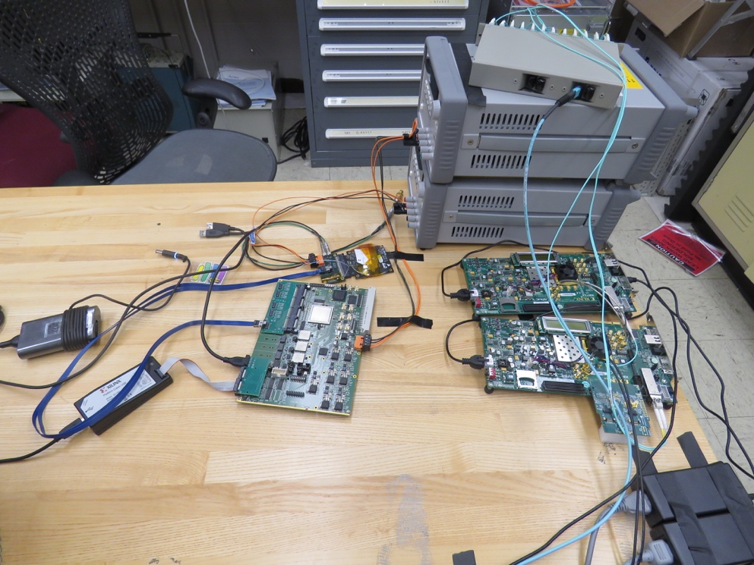
Excellent Progress in Detector R&D
ALPIDE Evaluation and optimization
  MOSAIC + Single Chip/Stave
  Laser system
Power unit tested
  PU + MOSAIC
  PU + RU
Full readout chain demonstrated
  ALPIDE + RUv1.0 + FELIX v1.5 + RCDAQ
  Full stave + RUv1.x + FELIX v2.0 + RCDAQ
Telescope under development
  Mechanical frame
  GEANT simulation
  Alignment & tracking
  Cooling

Slide 10
LDRD – MVTX/sPHENIX Key Tasks/Milestones
7/17
10/17
10/18
10/19
Today
RU/KC705)/FELIX1.5 Integration
40MHz, 7/17-12/17
LDRD
RUv1.x/FELIX2.0, 10MHz,
11/17 – 6/18
MVTX Design Review 7/2018
System test, cosmic & source
6/18 - 1/19
Test Beam, tracking performance
analysis, NIM paper etc.
1/19 – 9/19
MVTX: 2018 – 2023
Stave Production, procure FPGA, GBT etc.
8/18-4/19
BNL Director Review
7/10-11, 2017
Electronics Production
1/19-8/19

Slide 11
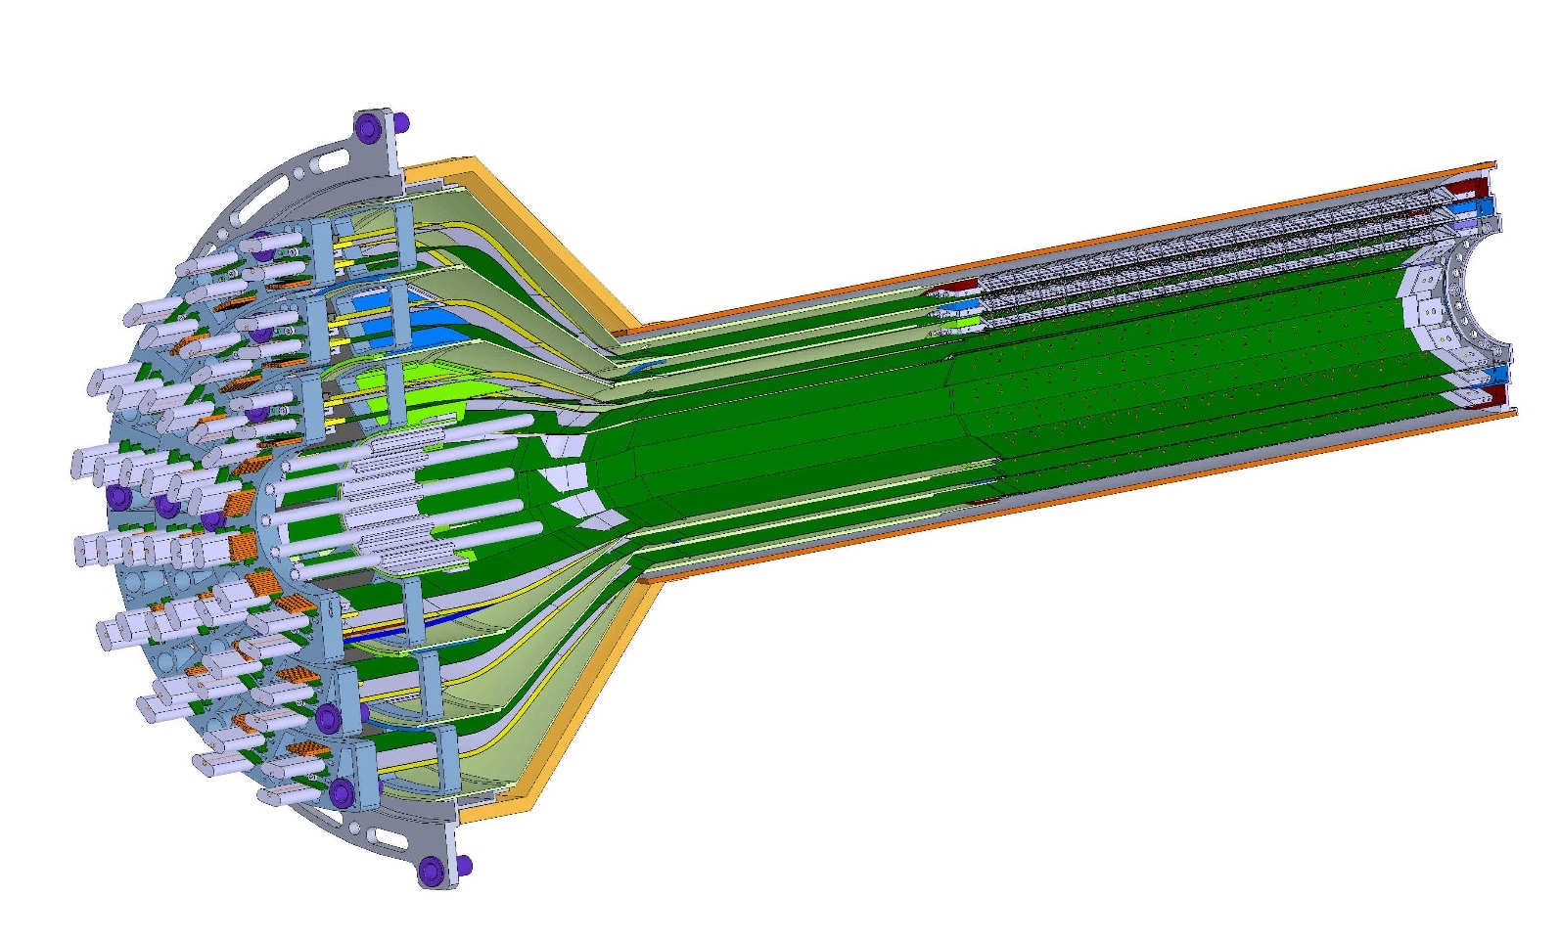
Mechanical System & Integration
Walt’s talk
ESTIMATED TOTAL MASS HALF DETECTOR 1,100.0 grams
PATCH PANEL
MVTX Design
  Extended CYSS
MVTX+INTT+TPC
END WHEELS
CONICAL SECTION

Slide 12
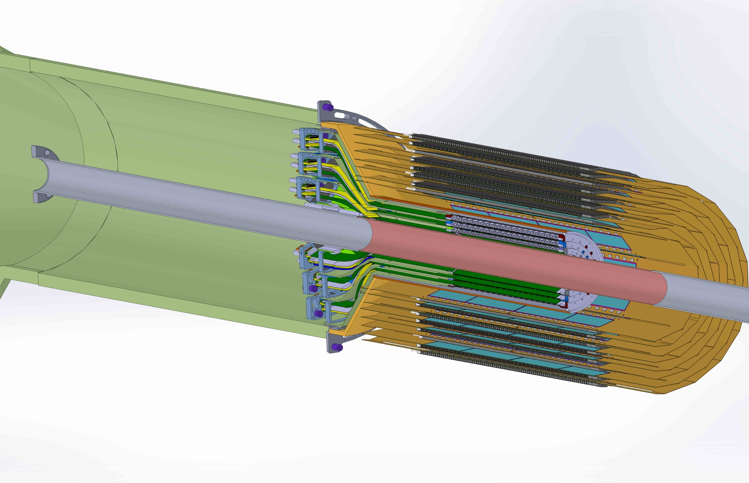
MVTX + INTT Integration

Slide 13
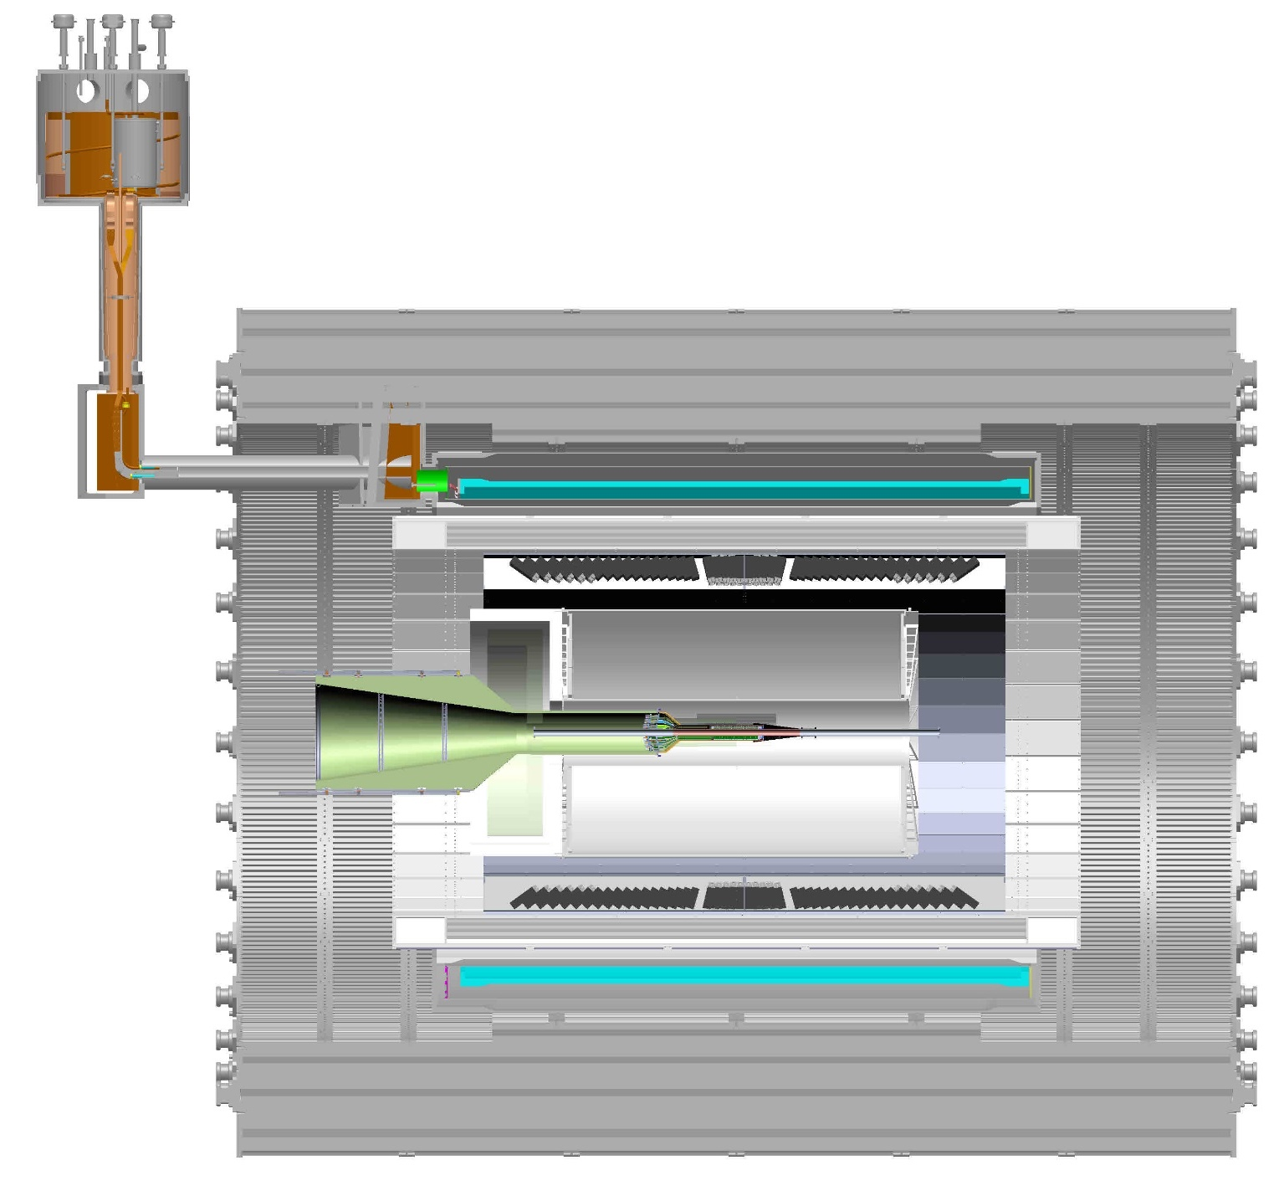
sPHENIX cross-section view, including envelope for services; TPC and INTT
TPC services (one end)
INTT services, (one –end)

Slide 14
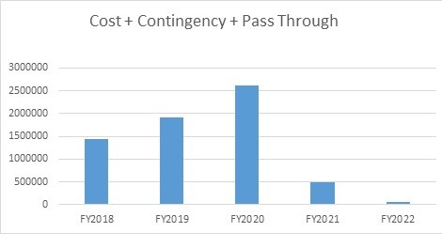
Budget and Schedule – in Progress
Dave’s talk
Total budget: 6.5M
  Production
  Assembly
  Integration
Major Items | Cost ($M) | Schedule
Staves (WBS 1.5.3.1) | 1.4 | 8/2018-5/2019
Readout & Controls (WBS 1.5.2) | 1.3 | 1/2019-6/2019
Mechanics & Detector Assembly (WBS 1.5.3) | 1.8 | 2019-2022, TBD
Integration (WBS 1.5.4) | 1.0 | 2021-2022, TBD
Project Management | 1.0 | 8/2018-1/2023

Slide 15
Plan for the Workfest
Writing, Writing and Writing …. To update the full proposal document
Chris has assigned 9 powerful interactive machine for this workfest (40 Core/80 GB memory), no time limit.
Valid for use until Dec 12.
These interactive RCF nodes are: rcas2901-2904 and rcas2906-2910

Slide 16
Agenda
Day-1: (12/5, Tue.)
  Review current draft – by WG TLs
    Identify and discuss areas for improvements
  Working sessions in the afternoon: working groups
Day-2:
  Discuss updates from day-1 – by WG TLs
  Working sessions in the afternoon: working groups
Day-3:
  Discuss updates from day-2
  Finalize a preliminary full proposal
4 working groups with
team leaders:
Physics & simulations
Electronics & sensors
Mechanical system
Cost, Schedule & Risks
Two rooms available
Zuni South
Chaco West
Workfest Indico Page: https://indico.bnl.gov/conferenceModification.py?confId=3557

Slide 17
4 Working Groups
To complete the draft by the end of this workshop
Physics and Simulations
  HF-Jet TG, Jin, Xin, Tony, Sanghoon, Haiwang, Darren, Xiaolong, SukHyun, Cesar, Ming et al
Staves, electronics & power system
    Readout - Mark, Sho, AlexT, Jo, Kun, Ming, Giacomo, Kai/BNL/ATLAS, Jin/BNL, Martin, JohnH …
    Staves/Sensors- Cesar, Xuan, Maria, Ming …
Mechanical system & Integration
  Integration - Bob, Grazyna, Walt, Jim K., Giacomo, Chris …
  Carbon structures – Grazyna
Project Cost, Schedule, Risks
  Dave, Ming, Maria, Bob, Grazyna, Giacomo, Jo, …
* Working group team leaders

Slide 18
Backup

Slide 19
Day 1: 12/5
8:00-9:00 Breakfast
9:00-9:10: Workshop Goals (Ming, Maria) Chair: Cesar
9:10 – 9:30: sPHENIX plan (Ed, Maria)
9:30 – 9:50 MVTX Overview (Maria, Ming)
9:50-10:20 Status Report 30’: Science and Simulations (Jin/Xin)
10:20-10:40 coffee break 20’
10:40 – 11:10: Status Report 30’: Readout (Mark, Sho) Chair: Jin
11:10-11:30: Status Report 30’: Mechanical system (Bob, Walt, Grazyna)
11:30-12:00: Status Report 30’: Cost and Schedule (Dave, Maria)
Lunch break: 12:00-1:30
1:30-2:00 INTT/MVTX integration – Mickey Chiu Chair: Maria
2:00-2:30 sPHENIX Readout integration discussions – (Ed Desmond, Martin, John)
2:30 – 5:30 Working sessions, 4 groups
3:30-4:00 Coffee break
group dinner @6:00PM in Santa Fe

Slide 20
Day-2
8:00-9:00 Breakfast
9:00- 9:20: Progress report and discussion 20’: Physics and Simulations Chair - Bob
9:20- 9:40: Progress report and discussion 20’: Readout
9:40- 10:00: Progress report and discussion20’: Mechanical system
10:00- 10:20: Progress report and discussion20’: Cost and Schedules
10:20-11:00: coffee break
11:00- 11:30: Physics presentation by Haitao Li/Ivan Vitev Chair - Xin
  title:
  Inverting the mass hierarchy of jet quenching with b-jet substructure
  abstract:
  The two-prong substructure of the leading subjets inside a reconstructed jet opens new windows on precision constraints on the in-medium modification of parton showers. We present the first resumed calculation of the groomed soft dropped subjet momentum sharing distribution in heavy ion collisions, and demonstrate that both the STAR data at RHIC and the CMS results can be understood in the unified framework of soft-collinear effective theory with Glauber gluon interactions. Recent advances in understanding mass effects on the QCD splitting functions enables us to apply this method for the first time to heavy flavor tagged jets. We find that in the kinematic region that will be accessed by sPHENIX in the future there is a unique reversal of the mass hierarchy of jet quenching effects. Namely, the momentum sharing distribution of b-tagged jets is more strongly modified in comparison to the one for light jets.
Lunch break: 12:00-1:30
1:30 – 5:30 Working sessions, 4 groups
3:30-4:00 Coffee break

Slide 21
Day-3 (half-day?)
8:00-9:00 Breakfast
9:00- 9:20: Progress report and discussion 20’: Physics and Simulations Chair - Grazyna
9:20- 9:40: Progress report and discussion 20’: Readout
9:40- 10:00: Progress report and discussion 20’: Mechanical system
10:00- 10:20: Progress report and discussion 20’: Cost and Schedules
10:20-11:00: coffee break
11:00 – 12:00: sPHENIX MVTX plan general discussions, full proposal submission etc – all Chair - Ming
  full proposal submission to DOE, 1/15/2018(Monday)?
Lunch break: 12:00-1:30
1:30 – 5:00 Working sessions, 4 groups
3:30-4:00 Coffee break

Slide 22
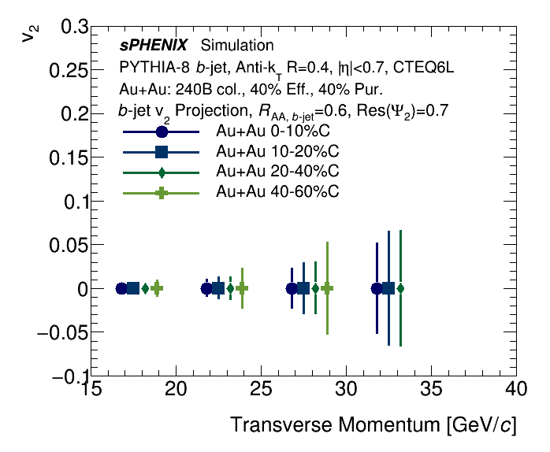
b-jet v2 projection
From the MVTX Director’s review, we were also recommended to make projection for b-jet v2
In mid-central events, probing path-length dependent energy loss for b-quark
Inclusive jet and photon arXiv:1501.06197 [nucl-ex]
b-jets

Slide 23

Performance study update since July review
Fully implemented MVTX models used
in performance projection
Large jets production in full detectors, including detailed MVTX detector + full calorimetry
  250k MB jets in p+p collisions
    Macros modifications: https://github.com/sPHENIX-Collaboration/macros/compare/master...blackcathj:HF-production-bjet-pp200?expand=1
    Final sample available:
    /sphenix/data/data02/HF-production-bjet-pp200/pythia8/
  100k MB jet embedded into central Au+Au collisions
    Production file location: /sphenix/data/data02/HF-production-bjet-AuAu200/pythia8
    Example analysis macro is on this branch: https://github.com/blackcathj/macros/tree/HF-production-bjet-AuAu200-readback

Slide 24
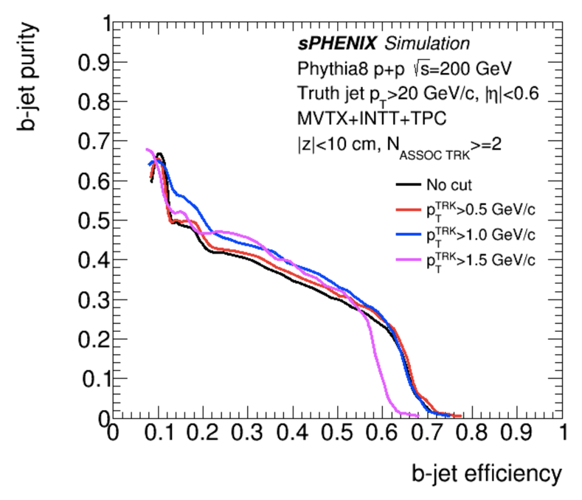
Updated p+p and Au+Au b-jet ProjectionS
b-jet tagging projection reevaluated with full tracking + calorimetry simulation
  Tagging work point has been stable (60% Purity 40% eff)
Performance has been stable using truth jet finding or calorimetry reconstructed jet finding
Track counting method by Haiwang Yu
Secondary vertex method by Sanghoon Lim
sPHENIX b-jet work point

Slide 25
Updated central Au+Au b-jet tagging
Track counting tagging: Haiwang reevaluated with full tracking + calorimetry simulation of p+p jets embedded in central Au+Au
  Central Au+Au Tagging work point has been stable (40% Purity 40% eff)
Toolsets prepared to update the secondary vertex tagging too
  https://github.com/sPHENIX-Collaboration/coresoftware/pull/386
Using truth jet finding, by Haiwang Yu
Using calorimetry reco jet finding, by Haiwang Yu
sPHENIX b-jet work point

Slide 26
MVTX Readout Electronics
sPHENIX GL-1 & GTM
RUv1.0: 10/2017
Stave: 06/2017
CAN bus
DCS
5-10 m
Trigger & Clock
Front End Electronics
GBT Optical Links
9-sensor Stave
9 Data (1.2Gbps)
1 Clock, 1 Control/Trigger
Control
Data (9.6 Gb/s max)
Trigger
Samtec Twinax “FireFly”
Back End Electronics
FPC
Power
Alpide Sensors
Power
FELIXv1.5:
6/2017
Filtering Capacitors
regulators
Power supplies
Cold Plate
Regulated Power
Power Board
Interaction Region
Experimental Hall
Counting House
PS: 08/2017
CAEN PS: 08/2017

Slide 27
Extended inner tracker with current outer composite shell

Slide 28
Section view of sPHENIX inner detector assembly the ALICE service barrel has been modified – shortened

Slide 29
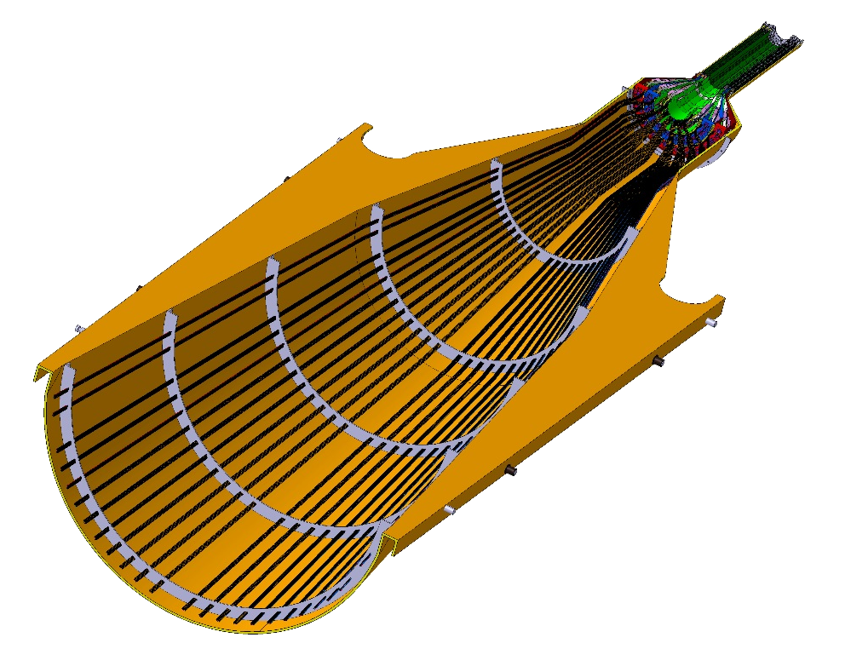
DETECTOR SECTION
SERVICES, SUPPORT
SECTION
ALICE HALF-BARREL ASSY

Slide 30
First INTT Drawing from Don Cacace

