Slide 1
Welcome to Santa Fe
All meetings will be in this room
Breakfast: 8:00-9:00AM
Group dinner tonight (Cesar)

Slide 2
MVTX Status and Plan
MVTX & HF-Jet Workfest, Santa Fe
Ming, Maria, Bob, Grazyna, Jin and Xin

Slide 3
Outline
MVTX update since July Director’s Review
Physics and Simulations
Readout and Controls
Mechanical System
Budget and Schedule
Plan for the rest of days

Slide 4
New sPHENIX baseline and MVTX Update
New sPHENIX baseline schedule: ~1 year delay
  CD-1 Review: 5/2018
  sPHENIX installation: 4/2021 – 7/2022
  sPHENIX ready for beam: 9/2022
  First collision: 1/2023
New sPHENIX baseline configuration with reduced acceptance
  EMCal: |eta| < 0.85 (1.1)
  OHCal: |eta| < 1? (1.1)
  IHCal: not available (1.1)
MVTX plan – align with the new sPHENIX schedule
  Stave production
    Following ALICE production: ~8/2018
  Readout units production
    Part of ALICE RU production: ~1/2019
  Ready for installation: ~4/2021
    INTT ready for installation 4/2021
  MVTX ready for beam: 9/2022
  First collisions: 1/2023

Slide 5
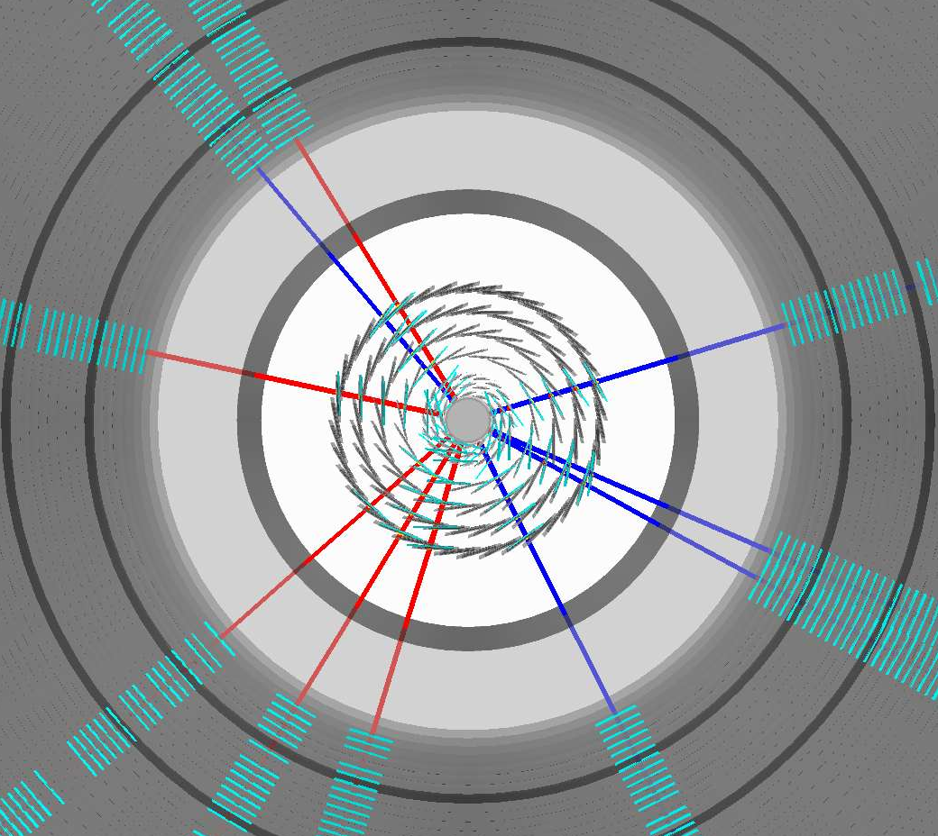
Performance study update since July review
Xin & Jin
Fully implemented MVTX models used
in performance projection
Large jets production in full detectors, including detailed MVTX detector + full calorimetry
  250k MB jets in p+p collisions
  100k MB jet embedded into central Au+Au collisions

Slide 6
Updated p+p and Au+Au b-jet ProjectionS
b-jet tagging projection reevaluated with full tracking + calorimetry simulation
  Tagging work point has been stable (60% Purity 40% eff for pp)
  Central Au+Au Tagging work point has been stable (40% Purity 40% eff)
Performance has been stable using truth jet finding or calorimetry reconstructed jet finding
sPHENIX b-jet work point

Slide 7
Theoretical Inputs – in Progress
LANL model
Duke model
TAMU
AMPT
PSHD
Ads/CFT
JetScape

Slide 8
Readout and Control
Sho et al
Full readout chain demonstrated
  ALPIDE + RUv1.0 + FELIX v1.5 + RCDAQ
Power unit tested

Slide 9
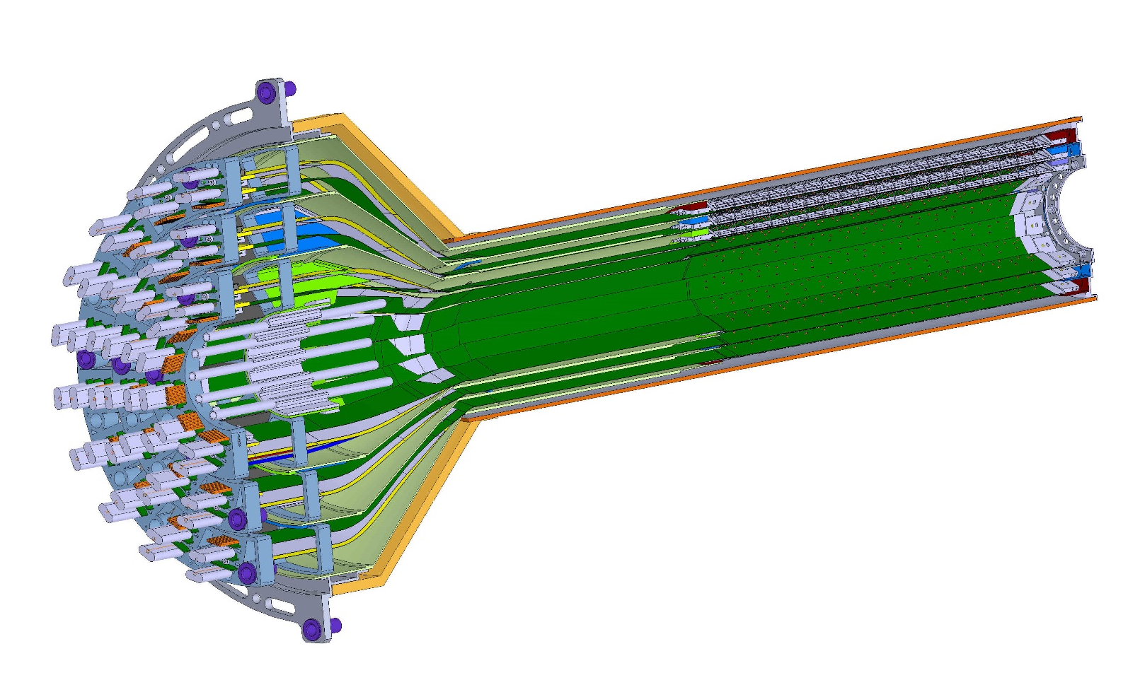
Mechanical System
Walt et al
ESTIMATED TOTAL MASS HALF DETECTOR 1,100.0 grams
MVTX Design
PATCH PANEL
END WHEELS
CONICAL SECTION

Slide 10
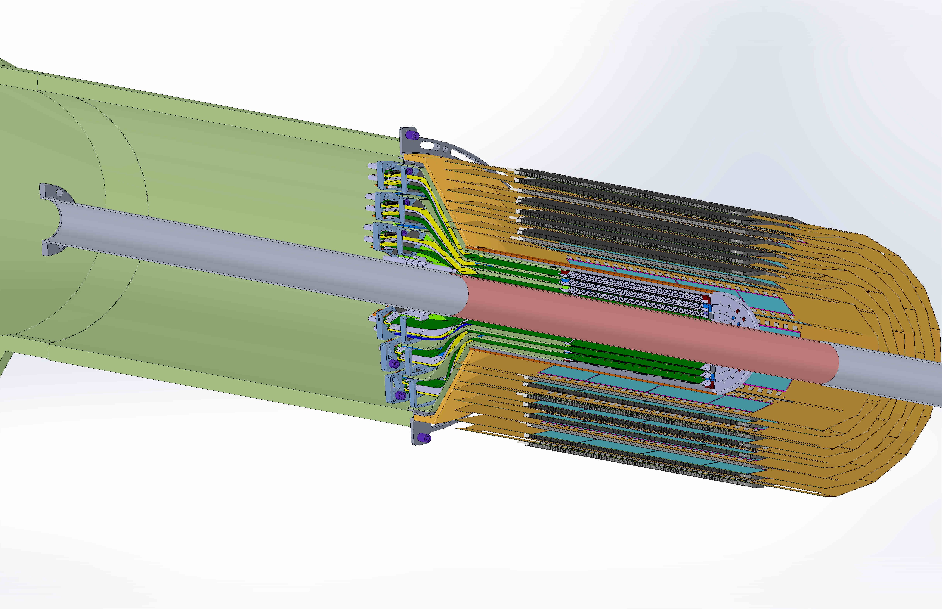
MVTX + INTT + TPC Integration

Slide 11
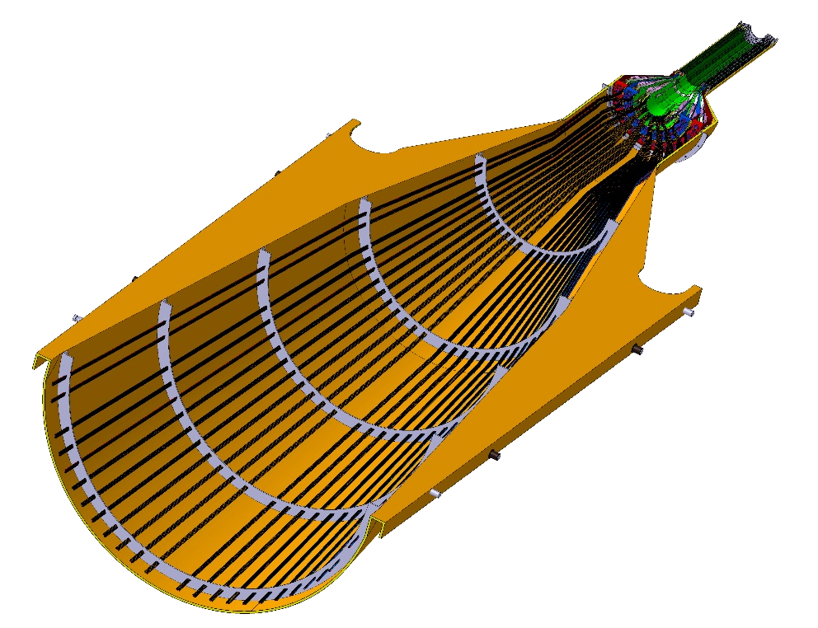
DETECTOR SECTION
SERVICES, SUPPORT
SECTION
ALICE HALF-BARREL ASSY

Slide 12
Budget and Schedule
Dave et al
Total budget: 6.5M
  Production
  Assembly
  Integration
Major Items | Cost ($K) | Schedule
Staves (WBS 1.5.3.1) | 1,432 | 8/2018-5/2019
Readout & Controls (WBS 1.5.2) | 1,301 | 1/2019-6/2019
Mechanics & Detector Assembly (WBS 1.5.3) | 1,800 | 2019-2022
Integration (WBS 1.5.4) | 1,024 | 2021-2022

Slide 13
Plan for the Workfest

Slide 14
Dec. MVTX Workfest Agenda –Draft
To complete the full proposal
Travel page: http://www.cvent.com/events/sphenix-collaboration-meeting/event-summary-090b732e1d5b4851a0dbb88d21b2ce64.aspx
Day-1: (12/5, Tue.)
  Review current draft – by WG TLs
    Identify and discuss areas for improvements
  Working sessions in the afternoon: working groups
Day-2:
  Discuss updates from day-1 – by WG TLs
  Working sessions in the afternoon: working groups
Day-3:
  Discuss updates from day-2
  Finalize a preliminary full proposal
4 working groups with
team leaders:
Physics/Electronics/Mechanics/Project
Physics & simulations
Electronics & sensors
Mechanical system
Cost, Schedule & Risks
Workfest Indico Page: https://indico.bnl.gov/conferenceModification.py?confId=3557

Slide 15
4 Working Groups: complete draft ~Workshop
Physics and Simulations
  HF-Jet TG, Jin, Xin, Tony, Sanghoon, Haiwang, Darren, Xiaolong, SukHyun, Cesar, Ming et al
Staves, electronics & power system
    Readout - Mark, Sho, AlexT, Jo, Kun, Ming, Giacomo, Kai/BNL/ATLAS, Jin/BNL, Martin, JohnH …
    Staves/Sensors- Cesar, Xuan, Maria, Ming …
Mechanical system
  Integration - Bob, Grazyna, Walt, Jim K., Giacomo…
  Carbon stru. – Grazyna
Project Cost, Schedule, Risks
  Dave, Ming, Maria, Bob, Grazyna, Giacomo, Jo, …
* Working group team leaders

Slide 16
Day 1: 12/5
8:00-9:00 Breakfast
9:00-9:10: Workshop Goals (Ming, Maria) Chair: Cesar
9:10 – 9:30: sPHENIX plan (Ed, Maria)
9:30 – 9:50 MVTX Overview (Maria, Ming)
9:50-10:20 Status Report 30’: Science and Simulations (Jin/Xin)
10:20-10:40 coffee break 20’
10:40 – 11:10: Status Report 30’: Readout (Mark, Sho) Chair: Jin
11:10-11:30: Status Report 30’: Mechanical system (Bob, Walt, Grazyna)
11:30-12:00: Status Report 30’: Cost and Schedule (Dave, Maria)
Lunch break: 12:00-1:30
1:30-2:00 INTT/MVTX integration – Mickey Chiu Chair: Maria
2:00-2:30 sPHENIX Readout integration discussions – (Ed Desmond, Martin, John)
2:30 – 5:30 Working sessions, 4 groups
3:30-4:00 Coffee break
group dinner @6:00PM in Santa Fe

Slide 17
Day-2
8:00-9:00 Breakfast
9:00- 9:20: Progress report and discussion 20’: Physics and Simulations Chair - Bob
9:20- 9:40: Progress report and discussion 20’: Readout
9:40- 10:00: Progress report and discussion20’: Mechanical system
10:00- 10:20: Progress report and discussion20’: Cost and Schedules
10:20-11:00: coffee break
11:00- 11:30: Physics presentation by Haitao Li/Ivan Vitev Chair - Xin
  title:
  Inverting the mass hierarchy of jet quenching with b-jet substructure
  abstract:
  The two-prong substructure of the leading subjets inside a reconstructed jet opens new windows on precision constraints on the in-medium modification of parton showers. We present the first resumed calculation of the groomed soft dropped subjet momentum sharing distribution in heavy ion collisions, and demonstrate that both the STAR data at RHIC and the CMS results can be understood in the unified framework of soft-collinear effective theory with Glauber gluon interactions. Recent advances in understanding mass effects on the QCD splitting functions enables us to apply this method for the first time to heavy flavor tagged jets. We find that in the kinematic region that will be accessed by sPHENIX in the future there is a unique reversal of the mass hierarchy of jet quenching effects. Namely, the momentum sharing distribution of b-tagged jets is more strongly modified in comparison to the one for light jets.
Lunch break: 12:00-1:30
1:30 – 5:30 Working sessions, 4 groups
3:30-4:00 Coffee break

Slide 18
Day-3 (half-day?)
8:00-9:00 Breakfast
9:00- 9:20: Progress report and discussion 20’: Physics and Simulations Chair - Grazyna
9:20- 9:40: Progress report and discussion 20’: Readout
9:40- 10:00: Progress report and discussion 20’: Mechanical system
10:00- 10:20: Progress report and discussion 20’: Cost and Schedules
10:20-11:00: coffee break
11:00 – 12:00: sPHENIX MVTX plan general discussions, full proposal submission etc – all Chair - Ming
  full proposal submission to DOE, 1/15/2018(Monday)?
Lunch break: 12:00-1:30
1:30 – 5:00 Working sessions, 4 groups
3:30-4:00 Coffee break

Slide 19
Backup

Slide 20
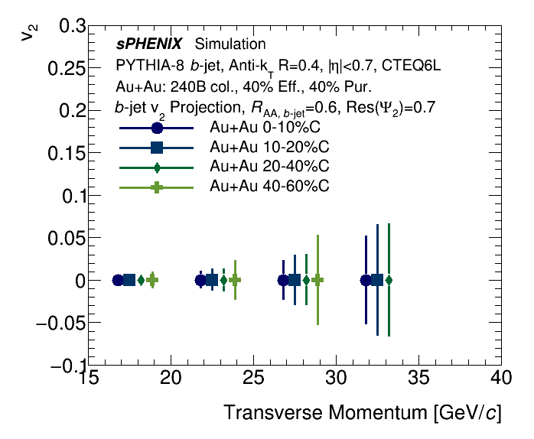
b-jet v2 projection
From the MVTX Director’s review, we were also recommended to make projection for b-jet v2
In mid-central events, probing path-length dependent energy loss for b-quark
Inclusive jet and photon arXiv:1501.06197 [nucl-ex]
b-jets

Slide 21
Performance study update since July review
Fully implemented MVTX models used
in performance projection
Large jets production in full detectors, including detailed MVTX detector + full calorimetry
  250k MB jets in p+p collisions
    Macros modifications: https://github.com/sPHENIX-Collaboration/macros/compare/master...blackcathj:HF-production-bjet-pp200?expand=1
    Final sample available:
    /sphenix/data/data02/HF-production-bjet-pp200/pythia8/
  100k MB jet embedded into central Au+Au collisions
    Production file location: /sphenix/data/data02/HF-production-bjet-AuAu200/pythia8
    Example analysis macro is on this branch: https://github.com/blackcathj/macros/tree/HF-production-bjet-AuAu200-readback

Slide 22
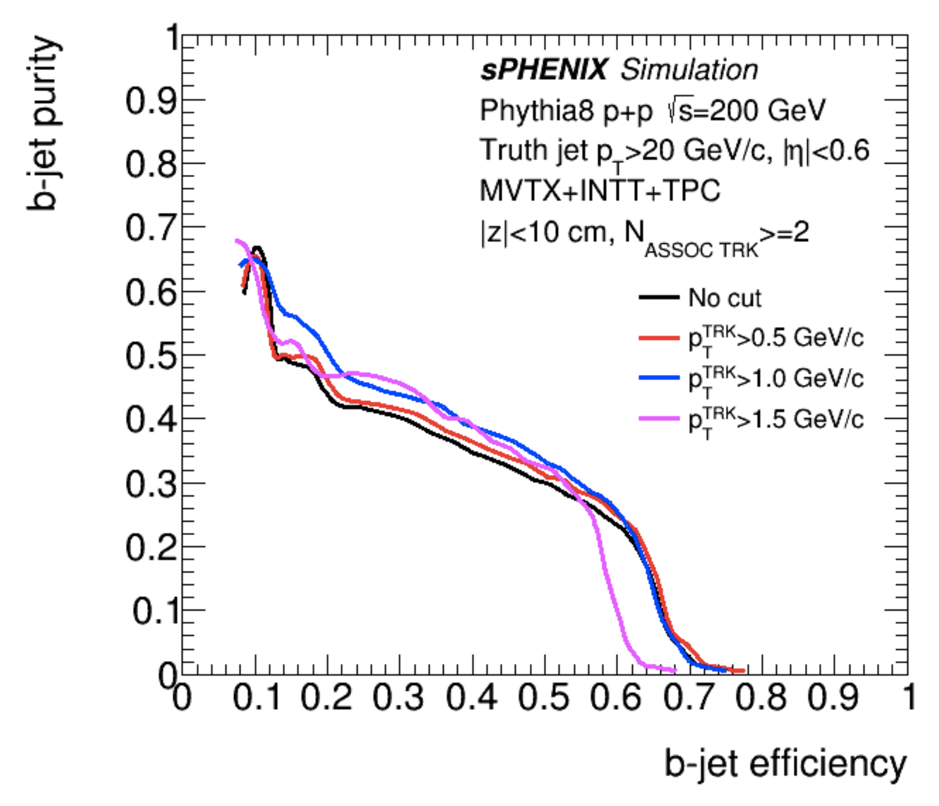
Updated p+p and Au+Au b-jet ProjectionS
b-jet tagging projection reevaluated with full tracking + calorimetry simulation
  Tagging work point has been stable (60% Purity 40% eff)
Performance has been stable using truth jet finding or calorimetry reconstructed jet finding
Track counting method by Haiwang Yu
Secondary vertex method by Sanghoon Lim
sPHENIX b-jet work point

Slide 23
Updated central Au+Au b-jet tagging
Track counting tagging: Haiwang reevaluated with full tracking + calorimetry simulation of p+p jets embedded in central Au+Au
  Central Au+Au Tagging work point has been stable (40% Purity 40% eff)
Toolsets prepared to update the secondary vertex tagging too
  https://github.com/sPHENIX-Collaboration/coresoftware/pull/386
Using truth jet finding, by Haiwang Yu
Using calorimetry reco jet finding, by Haiwang Yu
sPHENIX b-jet work point

