Slide 1
MVTX Status & Plan
Ming Liu
Los Alamos National Lab
For the MVTX Group
sPHENIX Collaboration Meeting, Santa Fe, NM

Slide 2
Outline
MVTX workfest summary
  Plan for DOE submission
Project status and plan
  Physics and Simulations
  Readout and Controls
  Mechanical Integration
  Budget and Schedule

Slide 3
  MVTX & HF-Jet Workfest @Santa Fe,12/5-7, 2018
Goal - complete full proposal, implement recommendations from last Director’s Review
  Expand the MVTX Science case
  Update cost & schedule
About 25 participants
4 working groups
  Physics and simulations
  Sensors and readout
  Mechanical system
  Budget and schedule
Updated the proposal with latest results & development!
https://www.overleaf.com/10919417bwssgrhhgryc#/41088600/
On track for DOE submission in late January 2018

Slide 4
4 Working Groups
23 institutions, and counting!
Physics and Simulations
  HF-Jet TG, Jin, Xin, Tony, Chris, Sanghoon, Haiwang, Darren, Xiaolong, SukHyun, Cesar, Ming, Nu et al
Staves, electronics & power system
    Readout - Mark, Sho, AlexT, Jo, Kun, Ming, Giacomo, Kai/BNL/ATLAS, Jin, Martin, JohnH, Eric …
    Staves/Sensors- Cesar, Xuan, Maria, Ming …
Mechanical system & Integration
  Integration - Bob, Grazyna, Walt, Jim K., Giacomo, Chris O’…
  Carbon structures – Grazyna
Project Cost, Schedule, Risks
  Dave, Maria, Ming, Bob, Grazyna, Giacomo, Jo, …
* Working group team leaders

Slide 5
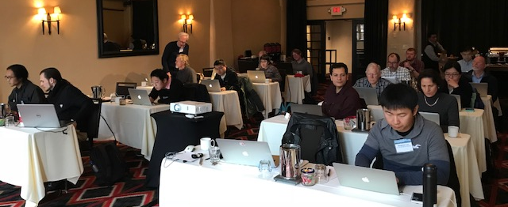
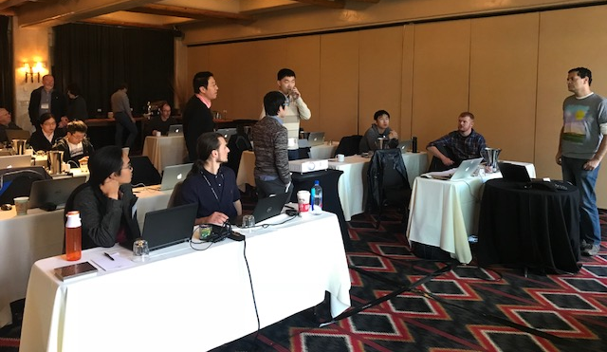
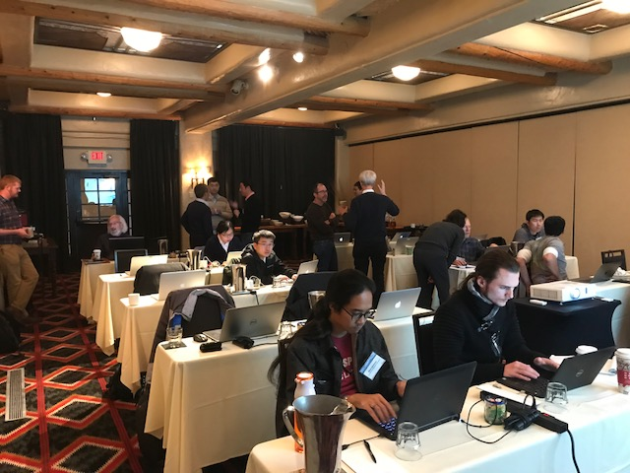
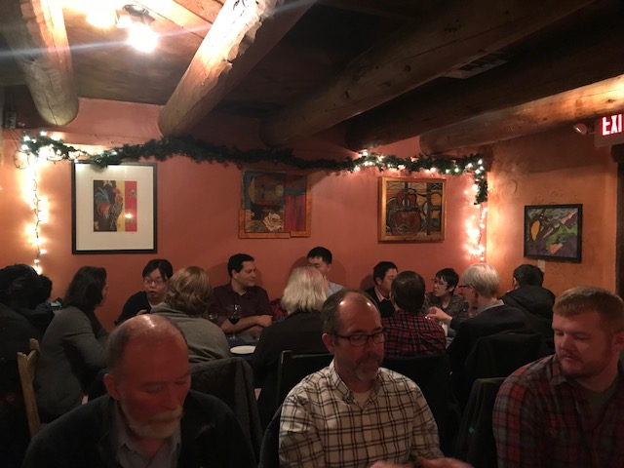
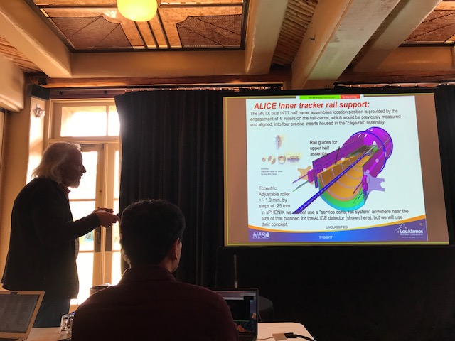
Very productive workfest

Slide 6
MVTX Full Proposal in Progress
- all key elements discussed and updated/to be updated soon
63 pages now … will be updated through out next a few weeks

Slide 7
Plan for the Proposal Submission – Draft Timeline on-going discussion with ALD about the submission date and process
Draft ready for sPHENIX collaboration comments:
  Jan 3(Wed)-10(Wed), 2018, one week
  Update document – 1/11(Thur)-15(Mon), 2018
For ALD review and feedback
  Jan 15(Mon)-22(Mon), 2018
Ready for DOE submission
  Jan 22(Mon)-29(Mon), 2018, final editing, one week
  Jan 29(Mon), 2018, ready for submission
To be submitted before Feb 2018 DOE budget meetings
  2/22/2018 for LANL NP, similar timeframe for BNL and LBNL

Slide 8
MVTX Project Status and Highlights
Expanded science
Sensor & readout system
Mechanical system
Budget & Schedule

Slide 9
Money Plots Updated: R_AA and V_2
Xin’s talk
B-meson
B-Jet
B-meson
B-Jet
To be updated with more model calculations

Slide 10
More Theoretical Inputs (I): B-meson v2
New calculations from PHSD for B-hadrons:
Significant v2 suggested, but may NOT follow the scaling due to large bmass!
LANL model
CUJET
Duke model
TAMU
UrQMD
AMPT
PHSD
Ads/CFT
BAMPS
HQ+EPOS2
JetScape
….
B-meson
D-meson

Slide 11
More Theoretical Inputs (II): B-meson R_AA
New calculations from PHSD for B-hadrons:
Potential significant anti-shadowing effects
Open b-bar in AuAu, very important baseline for Upsilon program!
EPS09
B prod.
x~0.05
@RHIC
Gluon
anti-shadowing
Q² ~100

Slide 12
More Theoretical Inputs (III): HF-Jet Substructure
H. Li & I. Vitev @MVTX Workshop
QCD Splitting function in QGP
f->f+g
g->f+fbar

Slide 13
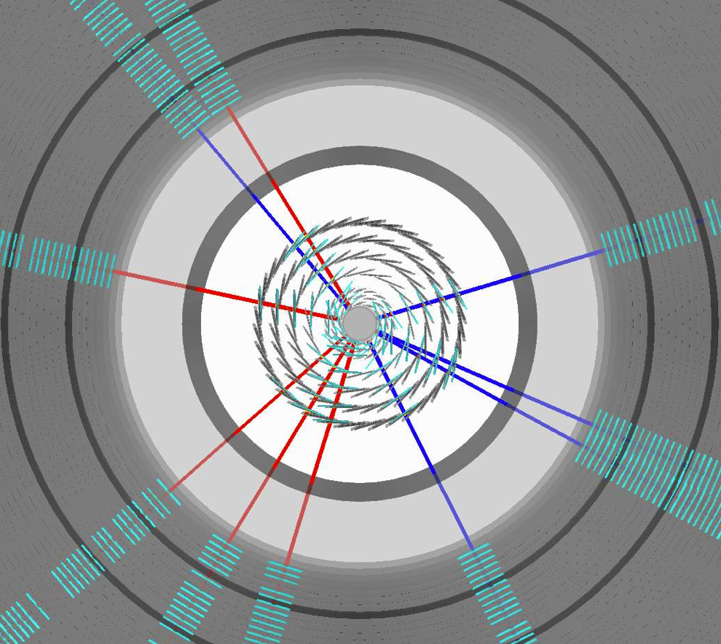
Simulation Updated
Jin, Haiwang, Sanghoon’s talks
Fully implemented MVTX models used
in performance projection
Large jets production in full detectors, including detailed MVTX detector + full calorimetry
  250k MB jets in p+p collisions
  100k MB jet embedded into central Au+Au collisions

Slide 14
Updated p+p and Au+Au b-jet Projections
b-jet tagging projection re-evaluated with full tracking + calorimetry simulation
  Tagging work point has been stable (60% Purity 40% eff for pp)
  Central Au+Au Tagging work point has been stable (40% Purity 40% eff)
Performance has been stable using truth jet finding or calorimetry reconstructed jet finding
sPHENIX b-jet work point

Slide 15
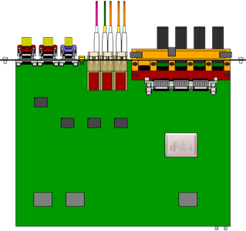

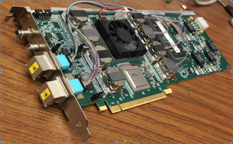
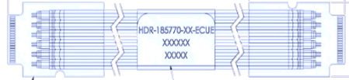


MVTX Readout and Control R&D
Sho, Alex & Xuan’s talks
sPHENIX GL-1 & GTM
Front End Electronics
Readout Unit/ALICE
CAN bus
DCS
5-10 m
Trigger & Clock
GBT Optical Links
9-sensor Stave
9 Data (1.2Gbps)
1 Clock, 1 Control/Trigger
Control
Data (9.6 Gb/s max)
Trigger
Samtec Twinax “FireFly”
Back End Electronics
FELIX/ATLAS
FPC
Power
Alpide Sensors
Power
Filtering Capacitors
regulators
Power supplies
Cold Plate
Regulated Power
Power Board/ALICE
Interaction Region
Experimental Hall
Counting House

Slide 16
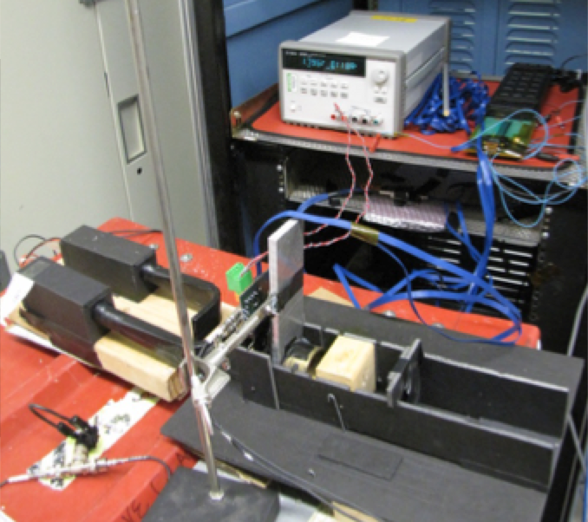
Excellent Progress in LANL LDRD
ALPIDE Evaluation and optimization
  MOSAIC + Single Chip/Stave
  Cosmic and source
  Laser system
Power unit tested
  PU + MOSAIC
  PU + RU
Full readout chain demonstrated
  ALPIDE + RUv1.0 + FELIX v1.5 + RCDAQ
  Full stave + RUv1.x + FELIX v2.0 + RCDAQ
Mechanical system integration
  Conceptual design developed
  MVTX+INTT integration
A telescope under development
  Mechanical frame, cooling etc
  GEANT sim, alignment & tracking
MVTX
ALPIDE chip
Scintillator
Collimator
Sr⁹⁰ source

Slide 17
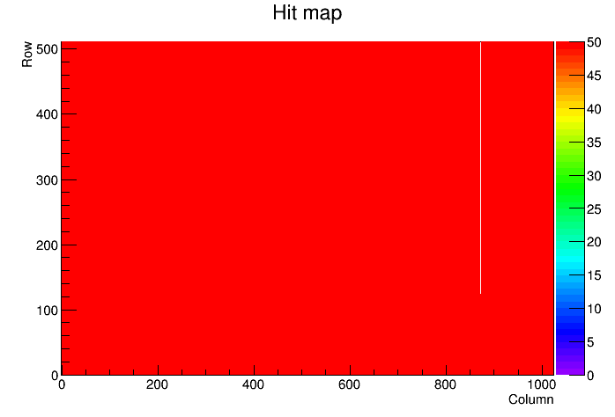
Single ALPIDE Chip Scan – Active Channel Fraction
Scanned the available chips and stave at the LANL lab through digital scan to verify the dead channel fraction: the bad channel fraction is <1%.
Similar results with different readout speeds.
Chip 1 test example
No. of 0 hits
777
Cold channel
1
Hot channel
0
Bad fraction
0.15%

Slide 18
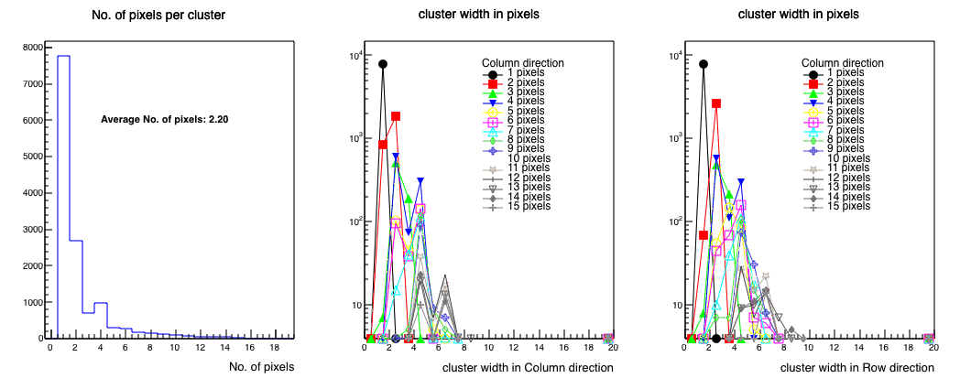
Hit Pixel Cluster Distribution from Source Test (Sr⁹⁰)

Slide 19
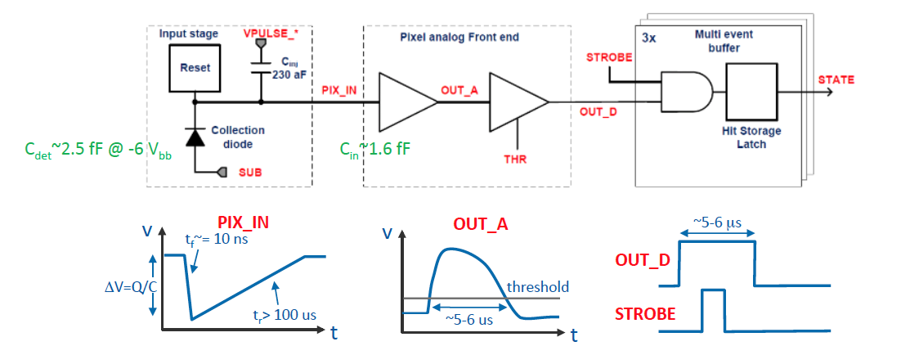
ALPIDE Readout Optimization and Trigger Latency Study
clipping point
OUT_A clipping: VCLIP. Decreasing VCLIP decreases clipping point.
OUT_A returns to baseline time: ITHR, VCLIP. Increasing ITHR decreases discharge time, and decreasing VCLIP decreases discharge time after clipping.
OUT_D return to baseline time: IDB. Increasing IDB increasing charging time hence decreasing pulse duration.

Slide 20
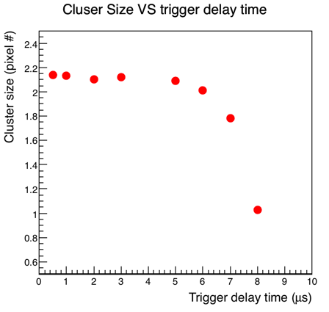
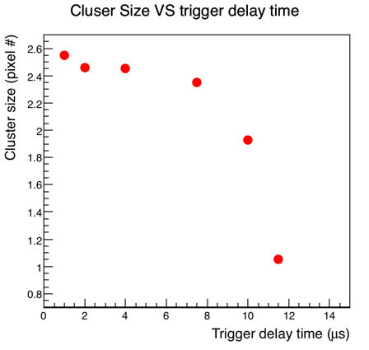
Trigger Latency Scan
Lower the OUT_D threshold (IDB) increases the trigger duration time, but also increases the cluster size which might include more background hits.
Lower Threshold
(Lower the IDB)
Default set

Slide 21
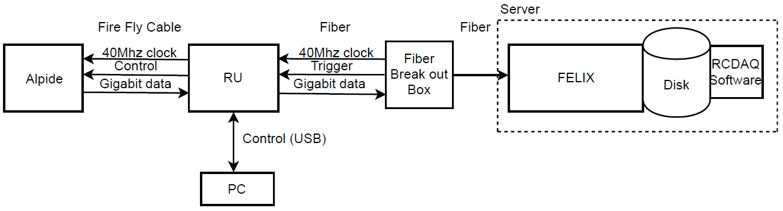
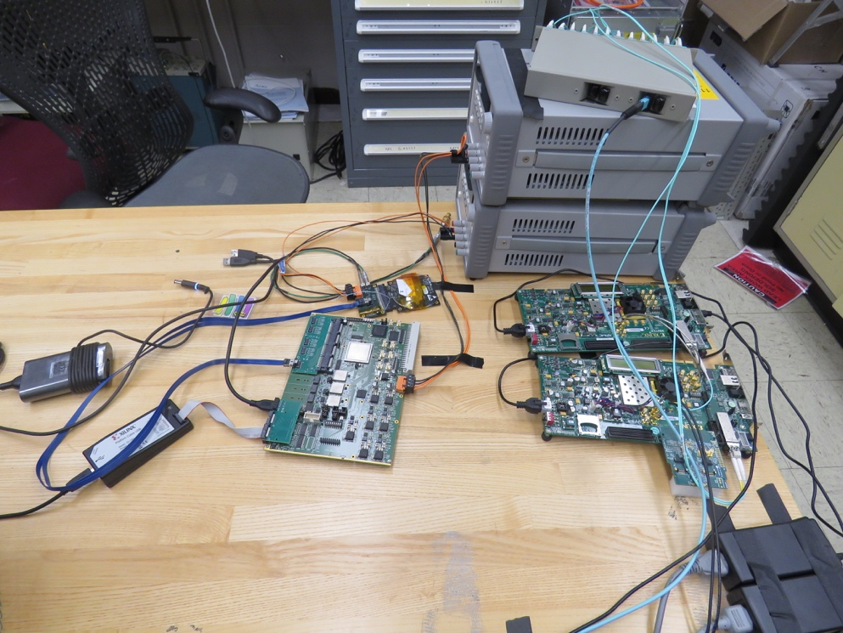
First Full Chain Readout: Success!
LANL + Martin, JohnH et al
Successfully configured, triggered and readout single ALPIDE chip
  RU configures ALPIDE using python scripts interfacing the USB chip on RU
  Felix distributes clock to RU, the RU then distributes the clock to the ALPIDE
  ALPIDE is triggered on the control line, sends data at 1.2Ghz over copper
  The RU receives the data and sends the data to FELIX over fiber using GBT link
  FELIX packs the data and stores in on disk which is read out using RCDAQ
  Configured ALPIDE to accept triggers from FELIX using python software that came with the RU
  Configured GBT link to recover clock from FELIX and GT link (FGPA gigabit interface)
  8 RU’s emulated using 1 fiber link per RU on FELIX, 15kHz, 400 hits per RU
Currently working the implementation of the above using a Stave
RUv1.0

Slide 22
Parallel Effort at UT-Austin – Shared R&D
From Jo

Slide 23
Mechanical Integration
Walt, Bob et al
Update from MVTX mechanics workfest
Incorporates the current INTT model and the TPC as components for the sPHENIX tracking system

Slide 24
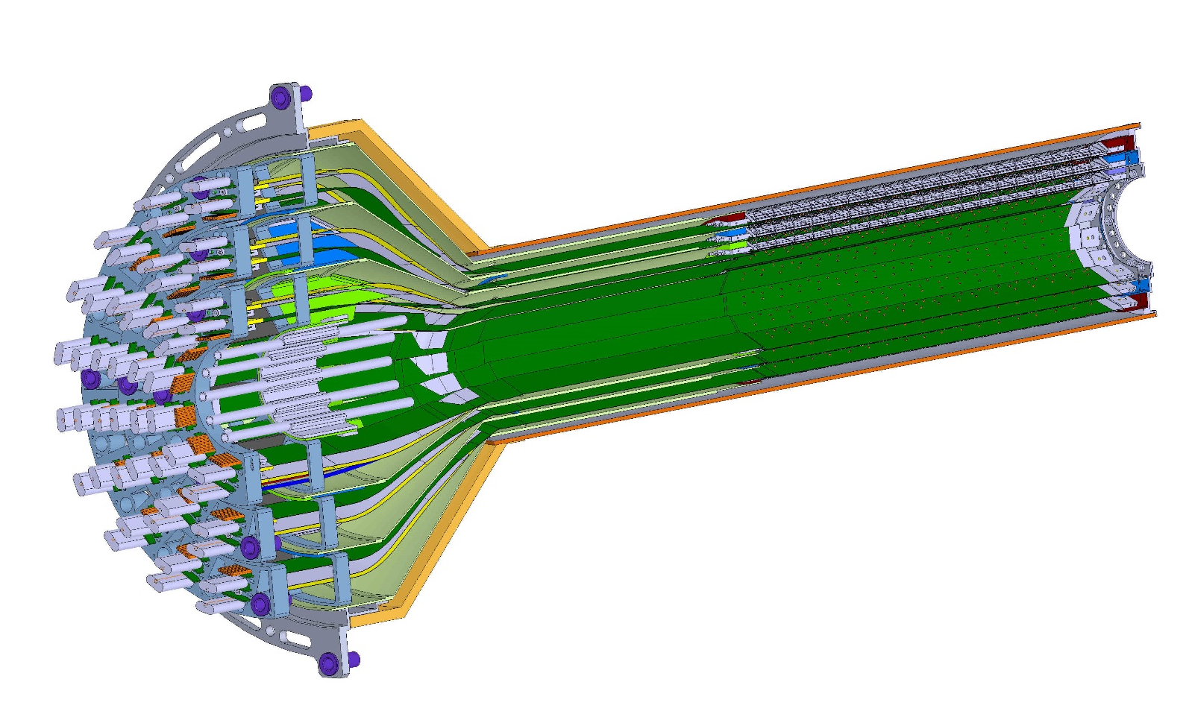
ESTIMATED TOTAL MASS HALF DETECTOR 1,100.0 grams
PATCH PANEL
END WHEELS
CONICAL SECTION
MVTX half detector assembly

Slide 25
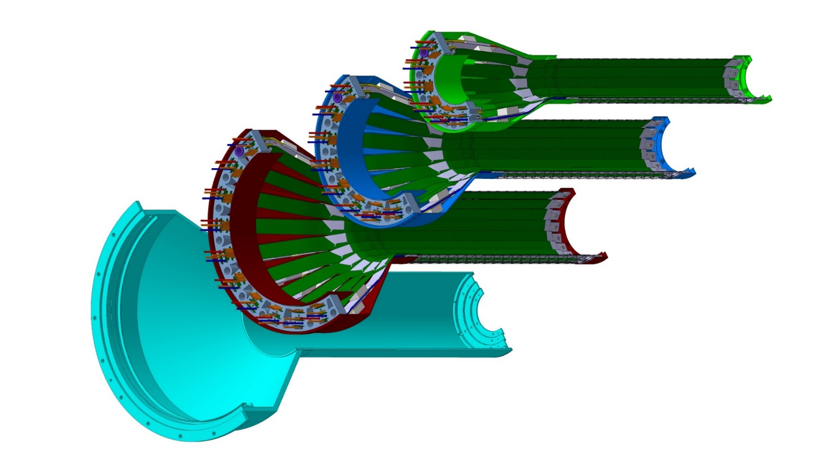
Layer 0
Layer 1
Layer 2
IB CYSS
MVTX layer break-out; three sensor layers with a carbon composite outer shell for mechanical stiffness

Slide 26
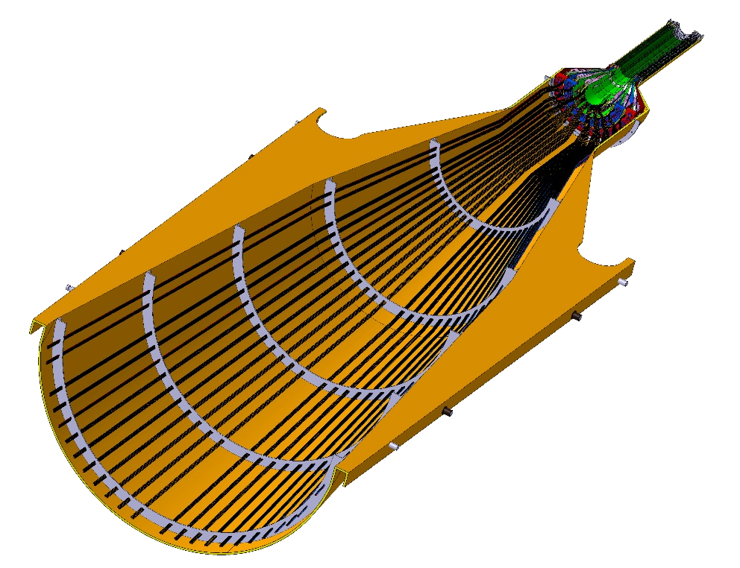
Service barrel
DETECTOR SECTION
SERVICES, SUPPORT
SECTION
ALICE HALF-BARREL ASSY

Slide 27
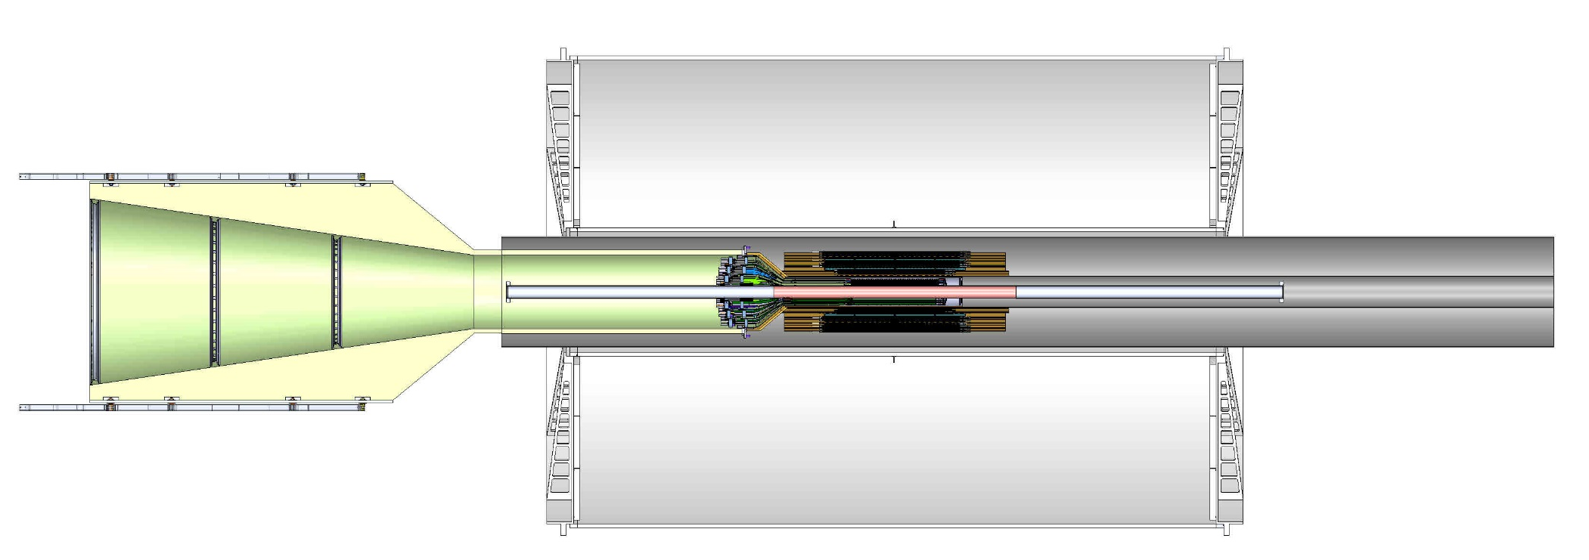
Model of MVTX with INTT inside TPC with the addition of two concentric composite cylinders;
Location of conflat flange on beam-pipe
Location in Z where the inner-hcal ends (see control drawing) Z=2175.0 mm

Slide 28
ALICE Inner Tracker Rail Support
The MVTX plus INTT half barrel assemblies location position is provided by the engagement of 4 rollers on the half-barrel, which would be previously measured and aligned, into four precise inserts housed in the “cage-rail” assembly.
Rail guides for upper half assembly
Eccentric:
Adjustable roller +/- 1.0 mm, by steps of .25 mm
In sPHENIX we will not use a “service cone, rail system” anywhere near the size of that planned for the ALICE detector, but we will use their concept.

Slide 29
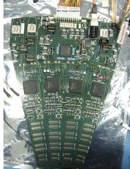
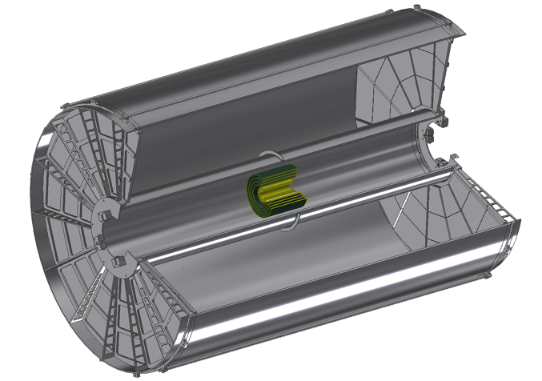
INTT Readouts from both North and South
ROC boards mount off inner EMCAL
Identical to FVTX Big Wheel
35cm
Bus Extender
ROC
Boards
Bus Extender
105 cm
η=1
ROC
Boards
η=0
The bus extender needs to run to ROC boards (reuse FVTX ROC) outside TPC.
Minimum length is 105cm – ladder length + distance to ROC board.

Slide 30
MVTX Schedule and new sPHENIX baseline Plan
Ed’s talk
MVTX schedule – align with sPHENIX plan
  Stave production
    Following ALICE production: ~8/2018
  Readout units production
    Be part of ALICE RU production:
      FPGA & GTB cost saving
  Ready for installation: late 2021
    INTT ready for installation 4/2021
  MVTX ready for beam
    sPHENIX day-1
New sPHENIX baseline schedule
  CD-1 Review: 5/2018
  sPHENIX installation
    4/2021 – 7/2022
  sPHENIX ready for beam: 9/2022
  First collision: 1/2023

Slide 31
Cost and Schedule
Dave’s talk
Total budget: 6.5M
  Production
  Assembly
  Integration
About 9 months schedule float
Major Items | Cost ($M) | Schedule
Staves (WBS 1.5.3.1) | 1.3 | 8/2018-5/2019
Readout & Controls (WBS 1.5.2) | 1.3 | 1/2019-6/2019
Mechanics & Detector Assembly (WBS 1.5.3) | 1.8 | 2019-2022, TBO
Integration (WBS 1.5.4) | 1.0 | 2021-2022, TBO
Project Management | 1.0 | 8/2018-1/2023

Slide 32
Major Cost Items

Slide 33
Project Organization

Slide 34
Summary
MVTX proposal document updated
  Addressed recommendations from last Director’s Review
  Expanded science
  Updated cost and schedule
  To be submitted to DOE in Jan 2018
Excellent progress in R&D
  Readout and controls proof-of-principle demonstrated
  Conceptual mechanical system design developed
MVTX+INTT+TPC mechanical integration in progress
  sPHENIX wide coordination needed
Ready for sPHENIX Day-1 Physics

Slide 35
Backup slides

Slide 36
LDRD – MVTX/sPHENIX Key Tasks/Milestones
7/17
10/17
10/18
10/19
Today
RU/KC705)/FELIX1.5 Integration
40MHz, 7/17-12/17
LDRD
RUv1.x/FELIX2.0, 10MHz,
11/17 – 6/18
MVTX Design Review 7/2018
System test, cosmic & source
6/18 - 1/19
Test Beam, tracking performance
analysis, NIM paper etc.
1/19 – 9/19
MVTX: 2018 – 2023
Stave Production, procure FPGA, GBT etc.
8/18-4/19
BNL Director Review
7/10-11, 2017
Electronics Production
1/19-8/19

Slide 37
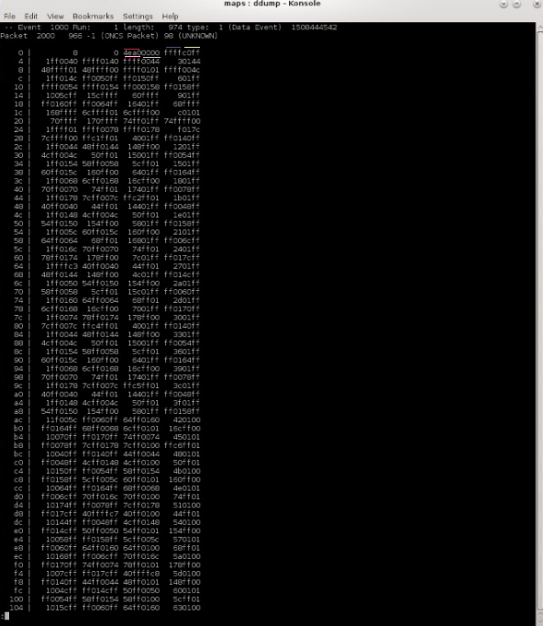
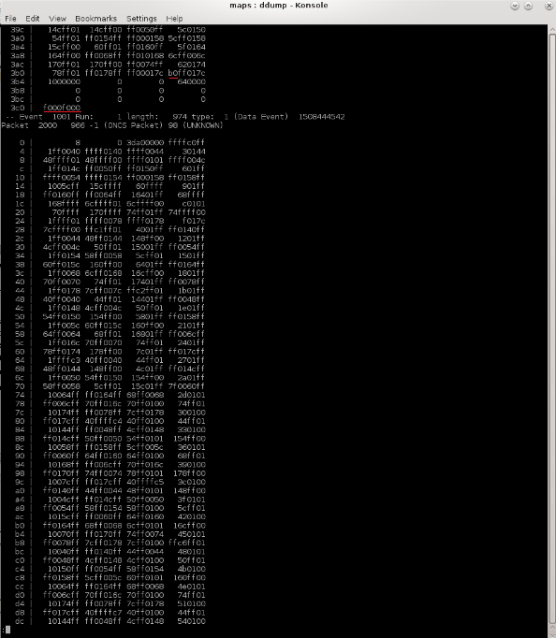
RC DAQ event Data Screen Shot
Rcdaq receiving events from KC705 using ddump utility
ffff0044ffffc0ff4ea0
a0 - Chip Header
4e - bunch counter
ff - IDLE
c0 - Region Header
40 00 - first Hit
Second screen shot showing end of one event (b0…, f000f000) and the beginning of another

Slide 38
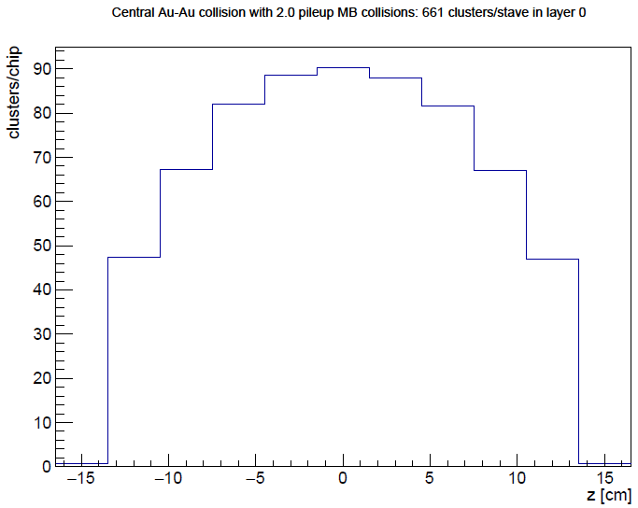

Calculations
 | Collision Rate
Au Au | 200kHz
P P | 10Mhz
  Assume 10us window and cluster size 3
 | Au Au | P P
# of collisions | 2 = 10us * 200kHz | 100 = 10us * 10Mhz
# of hits, hottest chip | 270 = 3 * 90 | 75 = 3 * 25
# of hits in a stave | 1983 = 3 * 661 | 543 = 3 * 181

Slide 39
BNL control envelope drawing; Z location of the inner hcal is at 2175,0mm

Slide 40
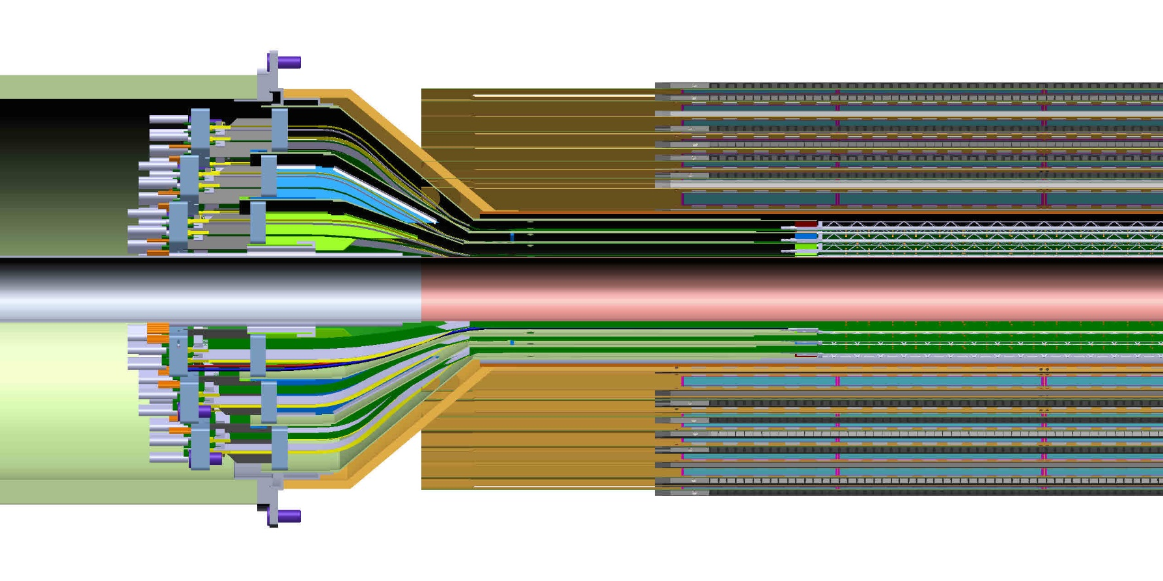
Adding the INTT to model of MVTX in sPHENIX
It is clear from this detail view the conical region of the MVTX detector barrel with the INTT that the MVTX will need to translate in Z by at least another 50.0 mm in addition to the 180.0mm that is seen in this model

Slide 41
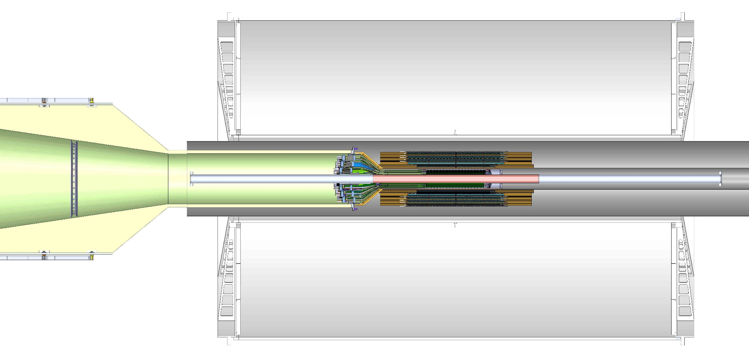
Detail view of MVTX, where the conical region has been translated by an additional 50.9 mm, along with the INTT and two concentric composite cylinders

Slide 42
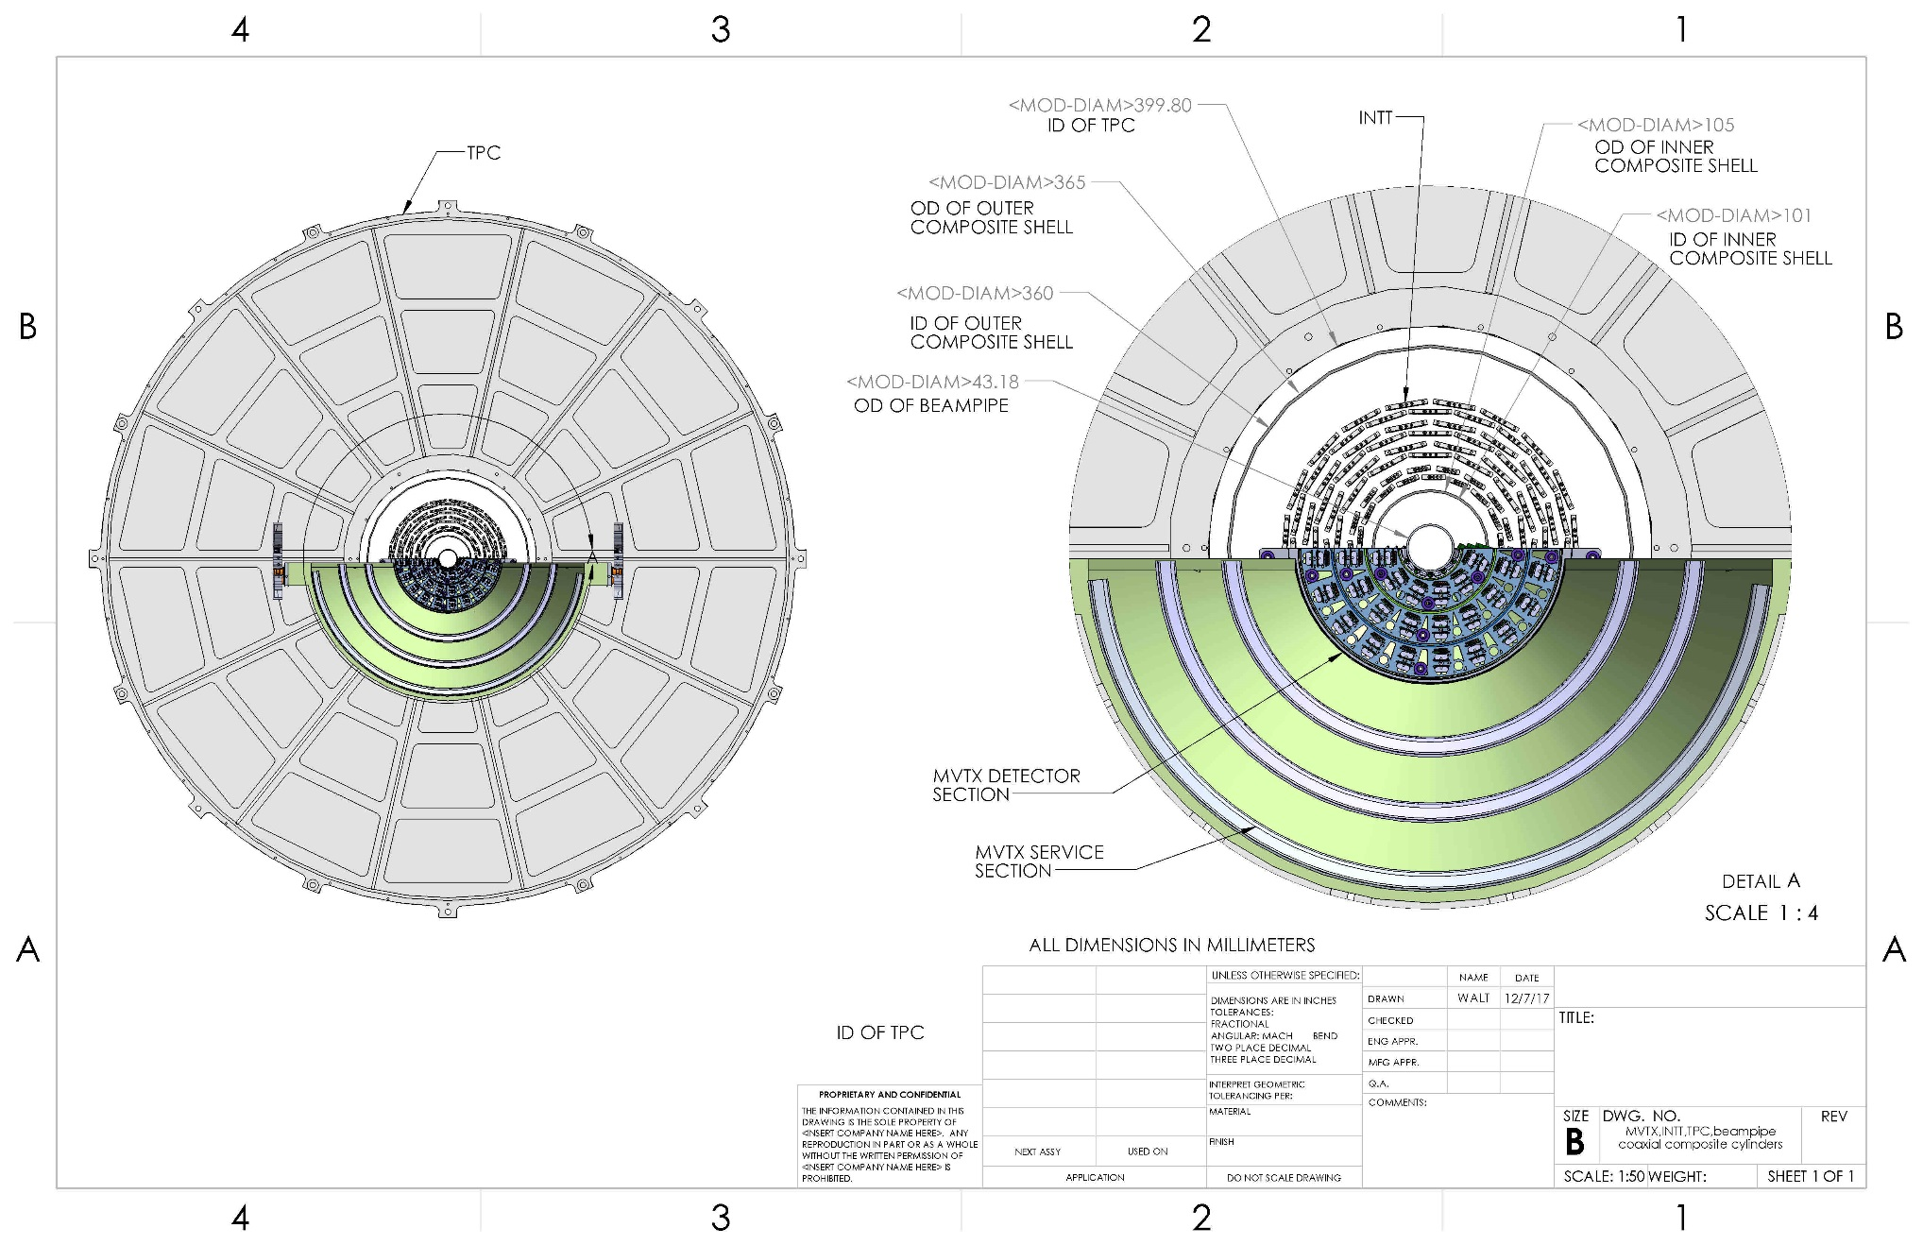
Cross-section view from CAD model of MVTX, INTT, TPC, beam-pipe, plus two composite conical shells

Slide 43
Gap between conical shell of MVTX and inner layer of INTT is 11.58 mm
Dist= R61.58 – R50
= 11.58mm

Slide 44
56.0 mm gap between INTT and inner radius of TPC
Gap= R200-R143.5
= 56mm

Slide 45
Earlier model for the INTT, chevron configuration, inner layer half ladders in width;
Number of ladders:
Layer 0 – 38 half ladders,
Layer 1 – 26
Layer 2 – 34
Layer 3 - 42

Slide 46
Offset from OD of beampipe and innermost component of the MVTX
New gap 2.025 mm

Slide 47
Offset needed to install split MVTX into run location around beampipe, passing over 2.75 in conflat flange
37.6mm

Slide 48
INTT stave design with HDI

Slide 49
Latest configuration of ladders in the INTT, 4 layers where each is made from two layers for hermeticity

Slide 50
New INTT model with HDI extensions;

Slide 51
Some High Level Summary of Specs and Deliverables for MVTX to be added to the proposal

Slide 52
STAR HFT Parameters
sPHENIX:<50 um, w/ 2-layer hits requriement
sPHENIX: >60%
sPHENIX: 15kHz readout

Slide 53
sPHENIX: <0.5%X0
sPHENIX: internal alignment MVTX/INTT
sPHENIX: <20uS
sPHENIX: use ALICE QA? 90%??-→80% seems OK
sPHENIX: <5% additional dead time @15kHz

Slide 54
sPHENIX: mechanical interface structure and tools
to sPHENIX Global Rail System
sPHENIX: 3-Layer MVTX
sPHENIX: 6 DAQ PC, hosting 6 FELIX boards
sPHENIX: 3-Layer MVTX, two clam shells
sPHENIX:48 + (28 + 8 spares) = 84

