Slide 1
MVTX Status & Plan
Ming Liu
For the MVTX Group
sPHENIX Collaboration Meeting, Santa Fe, NM

Slide 2
Outline
MVTX Workfest Summary
Proposal highlights
  Physics and Simulations
  Readout and Controls
  Mechanical Integration
  Budget and Schedule
Plan for DOE submission

Slide 3
Calculations from PHSD for sPHENIX

Slide 4
EPS09
B!
X=0.05

Slide 5
Sensor Evaluation and Optimization @Testbecn
Cosmic & sources

Slide 6
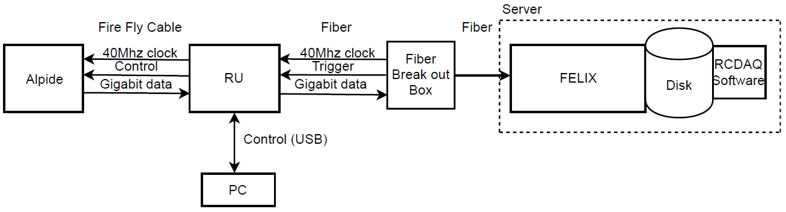
Summary: Readout
Successfully configured, triggered and readout single ALPIDE chip
  RU configures ALPIDE using python scripts interfacing the USB chip on RU
  Felix distributes clock to RU, the RU then distributes the clock to the ALPIDE
  ALPIDE is triggered on the control line, sends data at 1.2Ghz over copper
  The RU receives the data and sends the data to FELIX over fiber using GBT link
  FELIX packs the data and stores in on disk which is read out using RCDAQ
  Configured ALPIDE to accept triggers from FELIX using python software that came with the RU
  Configured GBT link to recover clock from FELIX and GT link (FGPA gigabit interface)
  8 RU’s emulated using 1 fiber link per RU on FELIX, 15kHz, 400 hits per RU
Currently working the implementation of the above using a Stave

Slide 7
Mechanical Integration
Update from MVTX mechanics workfest
that incorporates the current INTT model and the TPC
as components for the sPHENIX tracking system

Slide 8
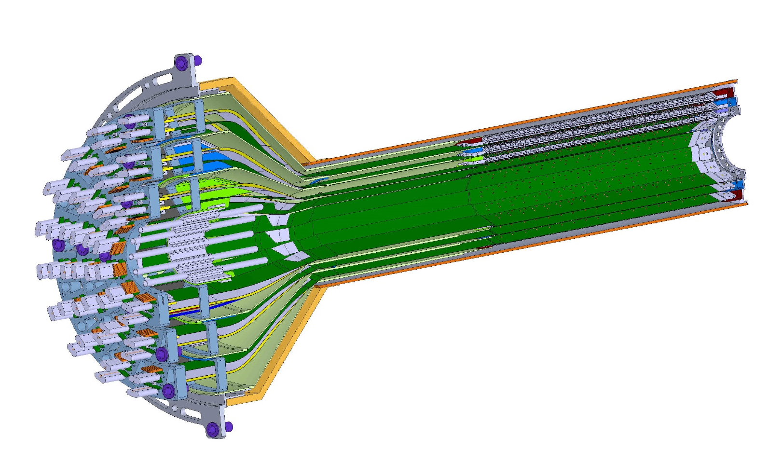
ESTIMATED TOTAL MASS HALF DETECTOR 1,100.0 grams
PATCH PANEL
END WHEELS
CONICAL SECTION
MVTX half detector assembly

Slide 9
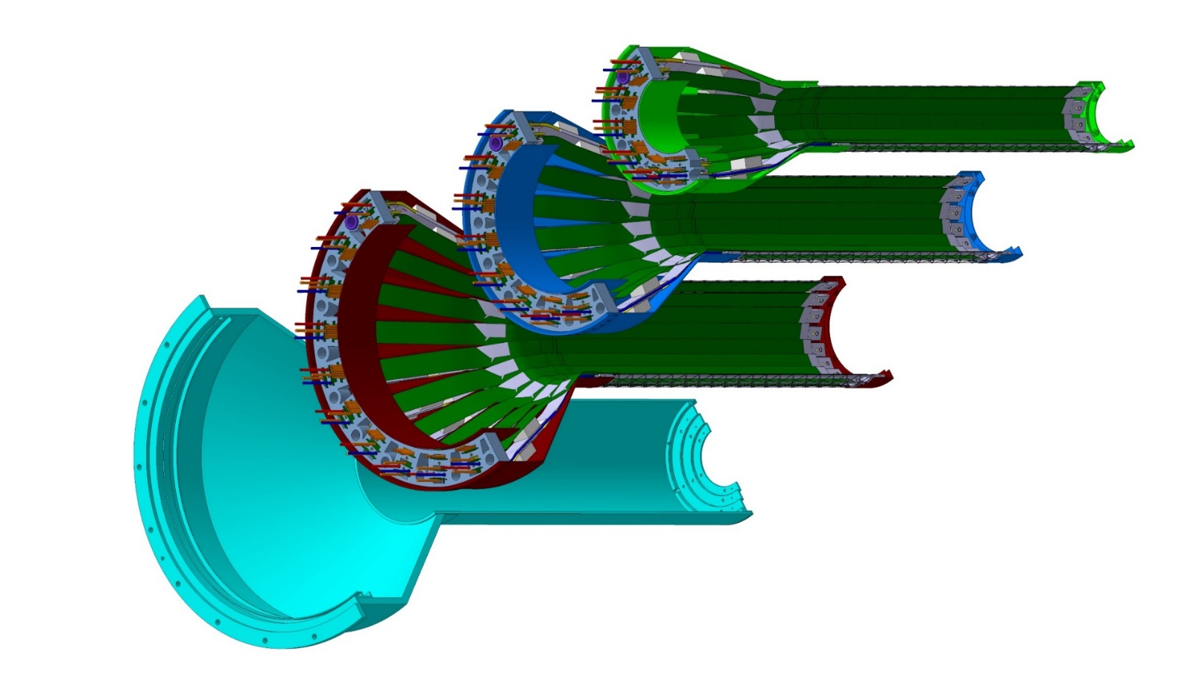
Layer 0
Layer 1
Layer 2
IB CYSS
MVTX layer break-out; three sensor layers with a carbon composite outer shell for mechanical stiffness

Slide 10
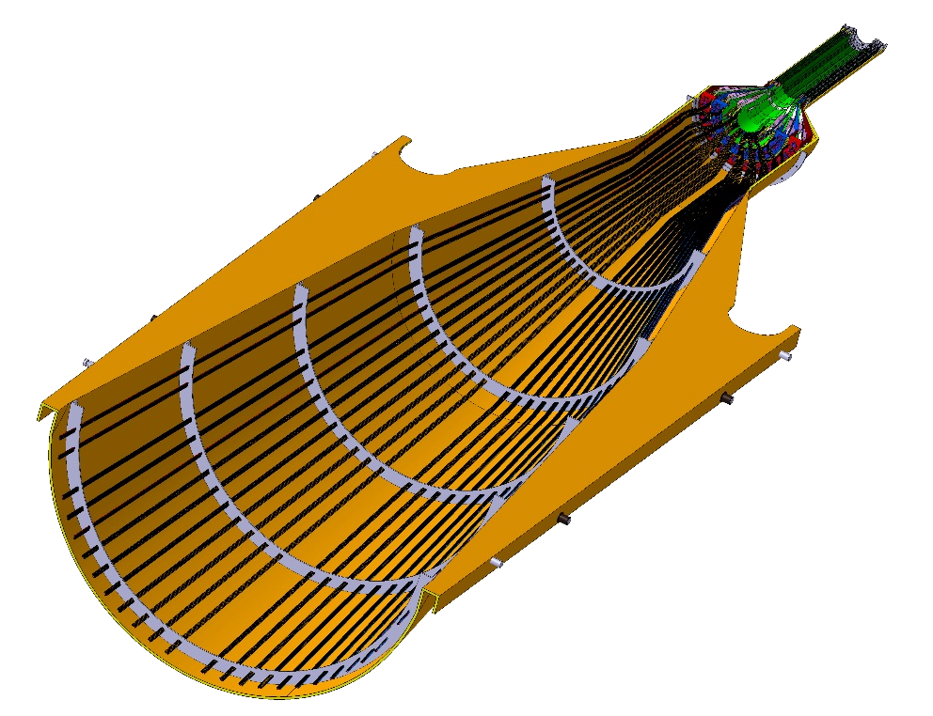
Service barrel
DETECTOR SECTION
SERVICES, SUPPORT
SECTION
ALICE HALF-BARREL ASSY

Slide 11
Offset from OD of beampipe and innermost component of the MVTX
New gap 2.025 mm

Slide 12
Offset needed to install split MVTX into run location around beampipe, passing over 2.75 in conflat flange
37.6mm

Slide 13
INTT stave design with HDI

Slide 14
Latest configuration of ladders in the INTT, 4 layers where each is made from two layers for hermeticity

Slide 15
New INTT model with HDI extensions;

Slide 16
Gap between conical shell of MVTX and inner layer of INTT is 11.58 mm

Slide 17
56.0 mm gap between INTT and inner radius of TPC

Slide 18
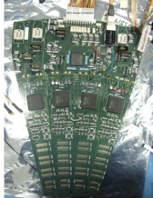
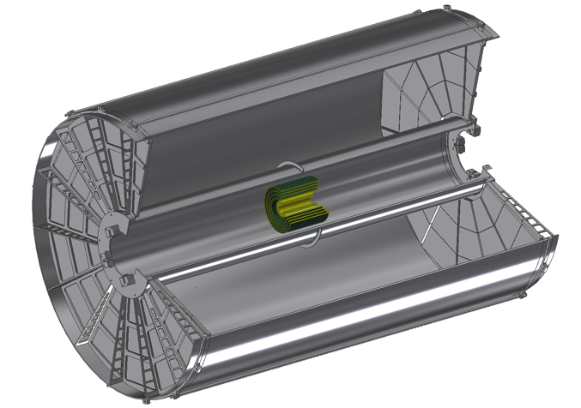
Readouts from both North and South
ROC boards mount off inner EMCAL
Identical to FVTX Big Wheel
35cm
Bus Extender
ROC
Boards
Bus Extender
105 cm
η=1
ROC
Boards
η=0
The bus extender needs to run to ROC boards (reuse FVTX ROC) outside TPC.
Minimum length is 105cm – ladder length + distance to ROC board.

Slide 19
BNL control envelope drawing; Z location of the inner hcal is at 2175,0mm

Slide 20
ALICE inner tracker rail support;
The MVTX plus INTT half barrel assemblies location position is provided by the engagement of 4 rollers on the half-barrel, which would be previously measured and aligned, into four precise inserts housed in the “cage-rail” assembly.
Rail guides for upper half assembly
Eccentric:
Adjustable roller +/- 1.0 mm, by steps of .25 mm
In sPHENIX we will not use a “service cone, rail system” anywhere near the size of that planned for the ALICE detector (shown here), but we will use their concept.

Slide 21
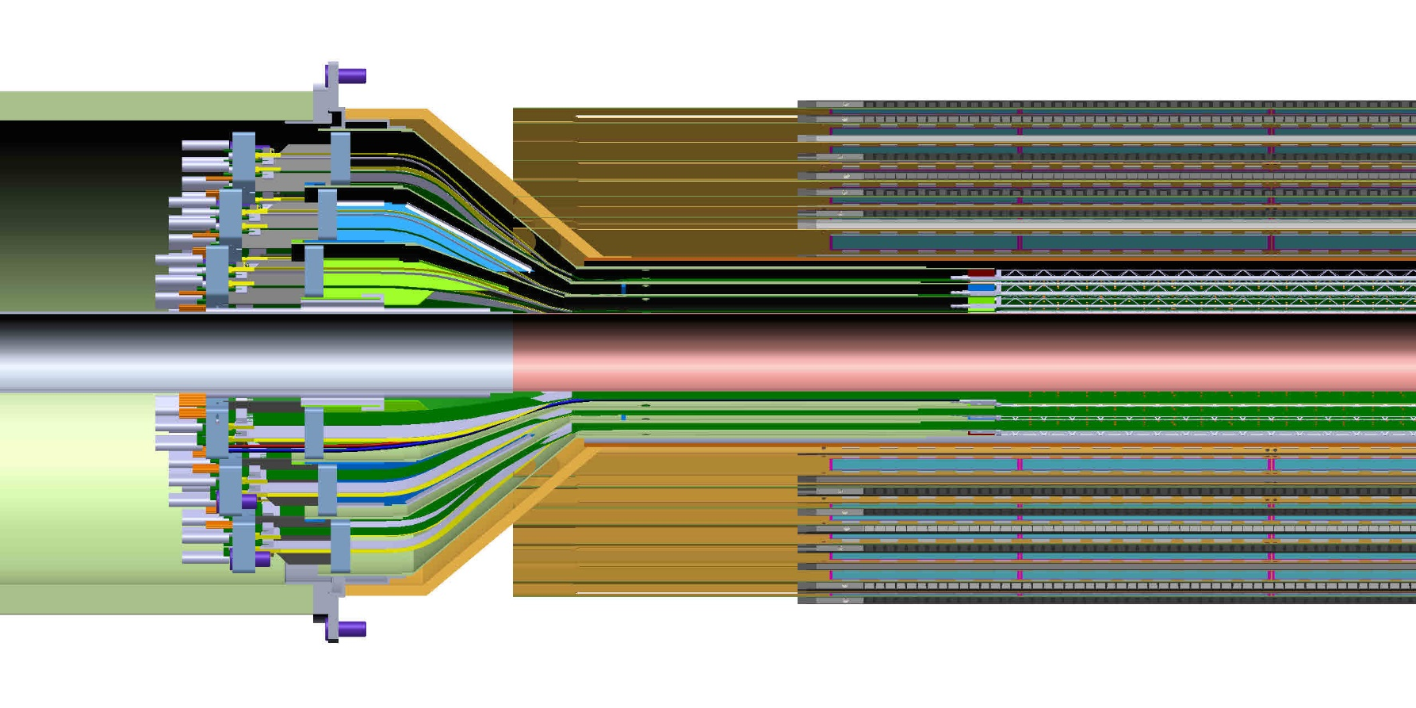
After adding the INTT to model of MVTX in sPHENIX;
It is clear from this detail view the conical region of the MVTX detector barrel with the INTT that the MVTX will need to translate in Z by at least another 50.0 mm in addition to the 180.0mm that is seen in this model

Slide 22
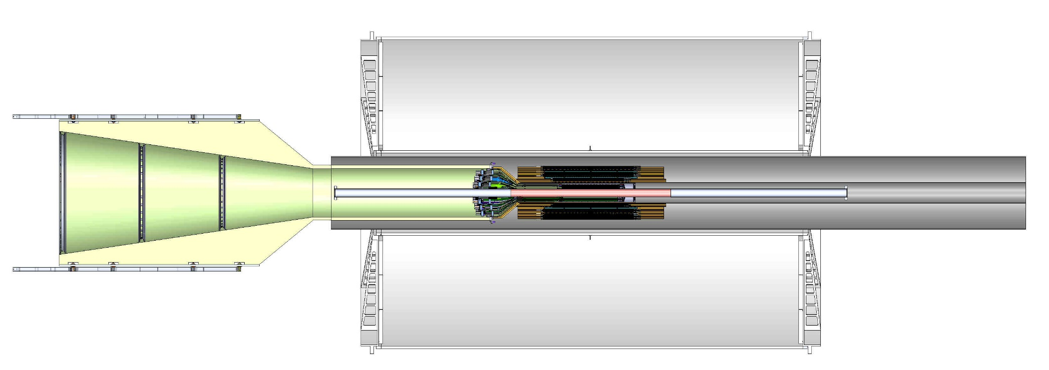
Model of MVTX with INTT inside TPC with the addition of two concentric composite cylinders;
Location of conflat flange on beam-pipe
Location in Z where the inner-hcal ends (see control drawing) Z=2175.0 mm

Slide 23
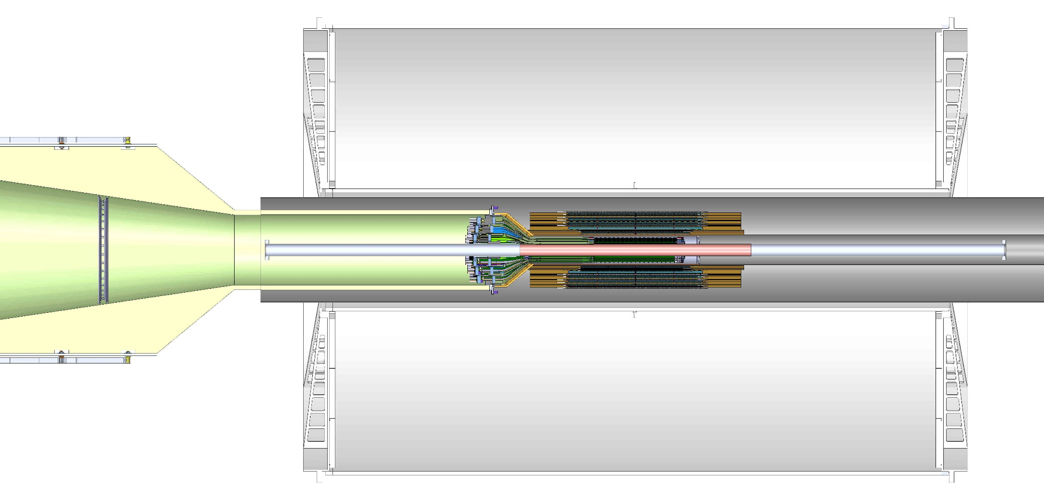
Detail view of MVTX, where the conical region has been translated by an additional 50.9 mm, along with the INTT and two concentric composite cylinders

Slide 24
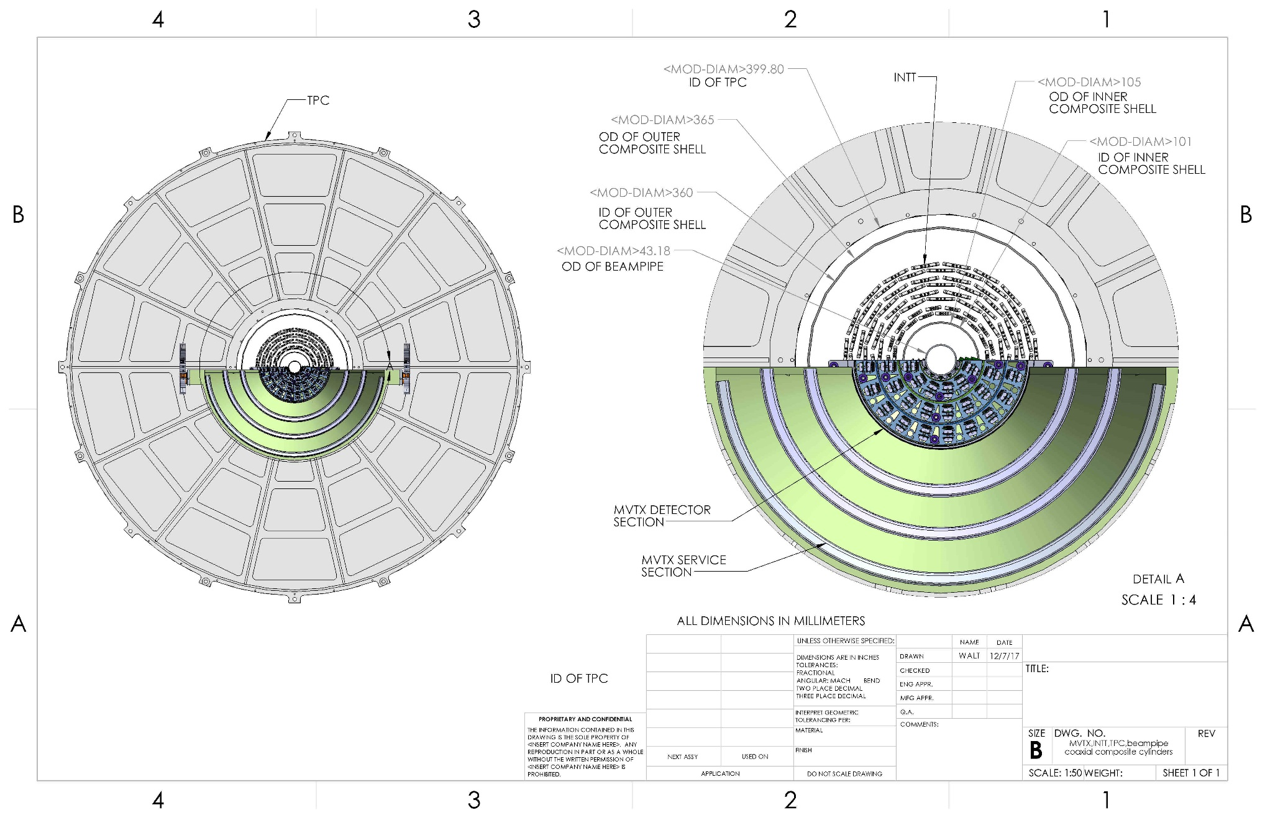
Cross-section view from CAD model of MVTX, INTT, TPC, beam-pipe, plus two composite conical shells

Slide 25
Plan for the Proposal Submission – Draft on-going discussion with ALD about the submission date
Draft ready for sPHENIX collaboration comments:
  Jan 3-10, 2018, one week
  Update document – 1/11-
For ALD review
  Jan 15-21, for feedback, one week
Ready for DOE submission
  Jan 22-26, final editing, one week
  Jan 26(Fri), 2018, ready for submission
Before Feb, 2018 DOE budget brief meeting
  2/22/2018 for LANL NP
  ?? for BNL and LBNL?

Slide 26
Backup slides

Slide 27
Earlier model for the INTT, chevron configuration, inner layer half ladders in width;
Number of ladders:
Layer 0 – 38 half ladders,
Layer 1 – 26
Layer 2 – 34
Layer 3 - 42

Slide 28
Some High Level Summary of Specs and Deliverables for MVTX to be added to the proposal

Slide 29
STAR HFT Parameters
sPHENIX:<50 um, w/ 2-layer hits requriement
sPHENIX: >60%
sPHENIX: 15kHz readout

Slide 30
sPHENIX: <0.5%X0
sPHENIX: internal alignment MVTX/INTT
sPHENIX: <20uS
sPHENIX: use ALICE QA? 90%??-→80% seems OK
sPHENIX: <5% additional dead time @15kHz

Slide 31
sPHENIX: mechanical interface structure and tools
to sPHENIX Global Rail System
sPHENIX: 3-Layer MVTX
sPHENIX: 6 DAQ PC, hosting 6 FELIX boards
sPHENIX: 3-Layer MVTX, two clam shells
sPHENIX:48 + (28 + 8 spares) = 84

