Slide 1
MVTX Update 05/15/2017
BNL Directors Review: July 10-11
A full day dry run on June 19 (Mon) @BNL, reviewers being contacted
Expanded science for MVTX
Update Cost, Schedule and Resources
Org chart being updated, institutional tasks etc
Agenda is being developed
Several meetings on project planning - LANL/BNL/MIT/LBNL
CERN visit in June (Maira) to discuss the feasibility of using ALICE/ITS labs for MVTX stave production etc
CCNU visit in late May (Ming) to discuss a possibility to produce MAPS HICs for MVTX

Slide 2
Work in Progress
Prepare for BNL Directors reviews
Reorganized the Cost and Schedule project file
established links between Org. Chart and Cost & schedule WBS
Cost and schedule, missing items etc. being updated
Physics and detector simulations, Money plots => this TG!
Detector R&D
Readout, FELIX as the default option
Mechanical integration, MVTX and INTT
Stave production at CERN, being
Test bench at LANL, in operation
Joint LANL/UT-Austin on RU, CRU/FELIX work

Slide 3
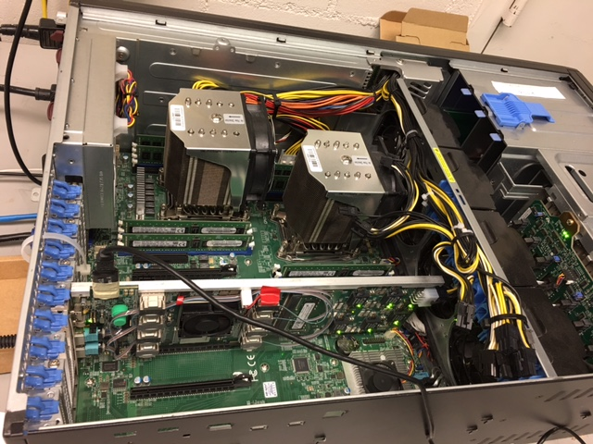
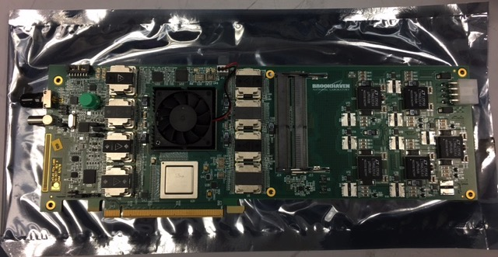
Electronics R&D FELIX and MVTX Power Distribution Boards
Visited BNL Labs and had FELIX system demo
V1.5 boards, all functionalities available- data, slow control and Timing/Trigger/Busy, w/ GBT
Multi-channel GBT links and PCIe interface code developed, with examples of user modules
V2.0, available end of 2017, sPHENIX application
A 1.5v FELIX board produced and tested, ready for shipment to LANL; Optical cables etc. to be ordered soon for LANL test bench
Power distribution boards
LBNL PS distribution board availablefor R&D from CERN/LBNL ~ June
R&D power supply system to be ordered
FELIX: tested

Slide 4
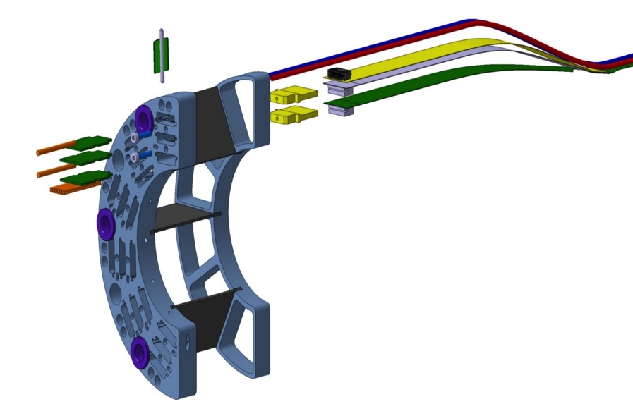
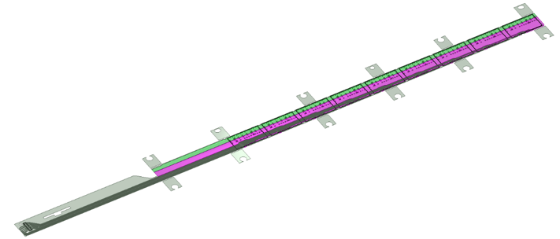
MVTX/INTT Integration Extend MVTX Service Cables?
506.2 mm
16 mm
16.15 mm
41.9 mm
CHIP 9
……
CHIP 2
CHIP 1
The 9 silicon chips are read out in parallel: each chip sends its data stream to the end of Stave by a dedicated differential pair, 100 μm wide. Two additional differential pairs distribute the clock and configuration signals.

Slide 5
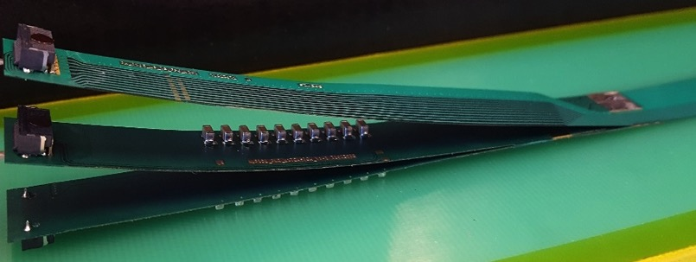
FPC Extension for Connection to Electrical Services
Antonello Di Mauro, Stave PRR 4/27/2017
The connection to the service cables is achieved by a double FPC extension which is soldered to the HIC
x-section at interconnection between FPC and extensions
AVDD
AVDD
AVDD
AVDD
DVDD
FPC
AVDD
DVDD
AGND
AGND
Flex power extension
AVDD
DVDD
AGND
FPC
AGND
DGND
DVDD
DVDD
AGND
DGND
DVDD
AGND
DGND
FPC
DGND
DGND
Flex power extension
DGND
signal lines (FPC)
digital power
analogue power

