Slide 1
MVTX Status & Plan
Ming, Maria, Bob and Grazyna
09/29/2017

Slide 2
Today’s Agenda
MVTX Status & Plan – Maria, Grazyna, Bob Ming
Tracking – Xiaolong
Jets – Sanghoon and Haiwang
LDRD – Cesar, Sho, Alex et al
MVTX Full proposal discussion – Xuan, Cesar, Ming et al
Other topics - all

Slide 3
Priority List for ALD’s Oct. DOE Visit – from last meeting
Refine 4 physics plots
B-hadron and b-jet R_AA & V_2
Updated simulations
Refine cost estimate → assign a large contingency (40%) based on conceptual MVTX/INTT integration design
Contingency of engineering cost to modify carbon structures etc.
Include extension cables etc.
Risks on cost and schedule risks if funding delayed
Highlight in preliminary Project Management Plan/Risk Registry
Today’s presentations
A meeting on mechanics
Integration held 9/18,
Plan for next 2 weeks: update all by ~10/15; ALD’s DOE visit planned in late October

Slide 4
Mechanical Integration: MVTX + INTT + TPC
Large uncertainty in the cost of mechanical integration
MVTX project scope: provides interface to the sPHENIX global structure
Needs early project development fund for global integration work, but not available at moment
MVTX mechanical integration meeting, 9/18, LANL/MIT/LBNL/BNL
Include a large contingency for the proposal, 40%
Revisit MVTX/INTT integration cost in ~4/2018, sPHENIX CD-1 review
LBNL carbon facility – availability, tied to MVTX funding timeframe
LANL’s cooling design for LDRD project, could be used w/ some modifications for sPHENIX, joint R&D with MIT
Good news:
BNL is hiring an engineer to work on INTT mechanics
Global integration engineer hiring comes later in 2018
a student working with Don Lynch on sPHENIX global integration

Slide 5
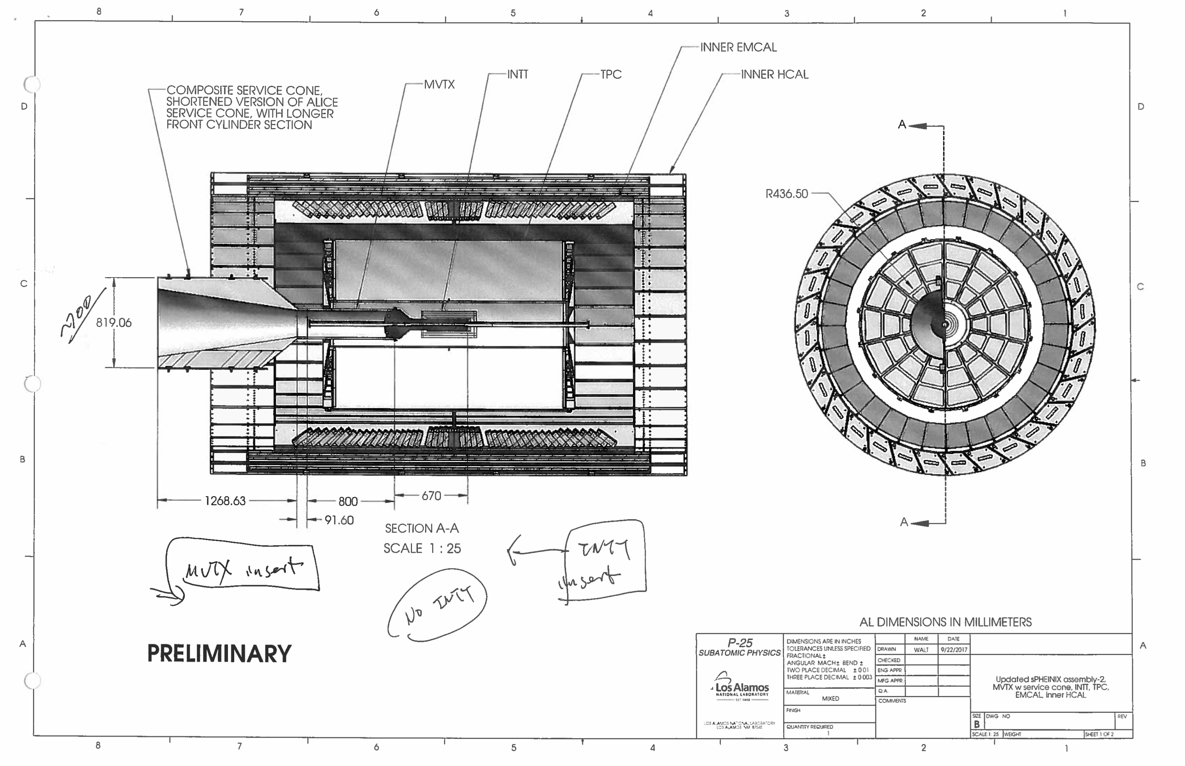
A Conceptual Design from Walt
We take more proactive approach to
define/suggest how the global system could be done

Slide 6
Define the success of MVTX Project – with minimal dependence on other projects
Active pixels: > 80%, from pulser and cosmic rays
Average radiation length per layer: < 0.5%, from final design
Readout speed: 15 kHz, for p+p and AuAu, from test bench
Sensor hit resolution: < 10um, from cosmic rays
Noise rate per trigger: < 10⁻⁵, from test bench
Trigger latency: ~4uS, from test bench external pulser
Sensor efficiency: >90%, from cosmic rays

Slide 7
Dec. MVTX Workfest Agenda – work in progress To complete the full proposal
Day-1: (12/5, Tue.)
Review current draft – by WG TLs
Identify and discuss areas for improvements
Working sessions in the afternoon: working groups
Day-2:
Discuss updates from day-1 – by WG TLs
Working sessions in the afternoon: working groups
Day-3:
Discuss updates from day-2
Finalize a preliminary full proposal
Form working groups with
team leaders:
Physics/Electronics/Mechanics/Project
Physics & simulations
Electronics & sensors
Mechanical system
Cost, Schedule & Risks
Proposed outline update later today
Xuan et al

Slide 8
MVTX Project Management Plan Document
To guide for managing the project
Cleary define the scope of project with WBS dictionary
Evaluate and document all major risks associated with Cost, Schedule and Procurements
A draft being developed by Dave et al, with inputs from MIT, LBNL, LANL, BNL
NOT needed for ALD’s October DOE visit
will be refined later, by 12/2017

Slide 9
backup

Slide 10
Path Forward – discussed @last meeting
Implement recommendations
Follow up findings and recommendations
Bi-weekly MVTX consortium meetings till full proposal submission
Milestones
Update key elements by mid October 2017
4 physics highlight “Money Plots”: B-hadron and b-jet R_AA and V_2
Cost, schedule and risks
Work with ALD to communicate with DOE about budget & timeline, end 2017
Workout a preliminary MOU with CERN, ~12/2017
Full proposal ready for submission, ~end of 12/2017
Goal: secure at least partial funding in late FY18/early FY19 to continue stave production at CERN after ALICE ITS/IB production ~8/2018.
MVTX workfest Dec. 5-7 to push for completion of the final proposal
sPHENIX collaboration meeting @ Santa Fe, Dec. 8-10, 2017

