Slide 1
MVTX Update: 5/28/2018
Progress on project planning
BNL Directors Review: 7/10-11
Speakers TBD soon
Dry run: 6/19
Cost, Schedule and Resources
WBS and org chart being updated
Physics/Detector simulations w/ HF-Jet TG
6/11-12 tracking+HF-Jet workfest @BNL
Weekly meeting for project planning etc
BNL/MIT/LBNL/LANL
CCNU visit
Contributions to MVTX project
Stave production
Global mechanical integration, MVTX/INTT/TPC
Simulations and physics analysis
R&D progress at LANL
Ming visited CCNU, May 2017
Discussed joining sPHENIX/MVTX and CCNU’s possible roles
Maria will visit CERN, June 2017
discuss using CERN facility for MVTX production etc.

Slide 2
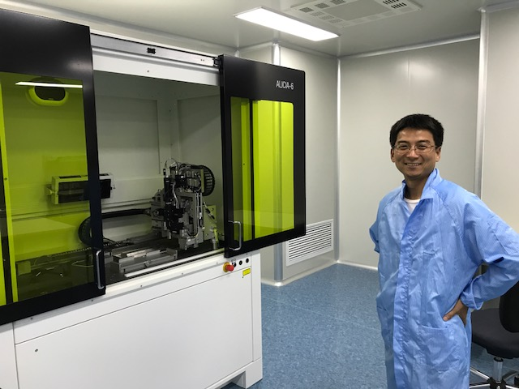
Feasibility to use CCNU Labs for MVTX HICs/Staves production 5/24/2017
CCNU ALICE/ITS HICs assembly lab
Chip assembly machine, installed and tested
2 technicians trained @Italy and also locally
Wire bonding machine, will arrive soon, a few weeks, arriveds in June
2 technicians trained @Italy
1 week local training planned
One old bonding machine in opeation
Wire bonding
machine location
Dr. Yaping Wang,
Assembly lab director

Slide 3
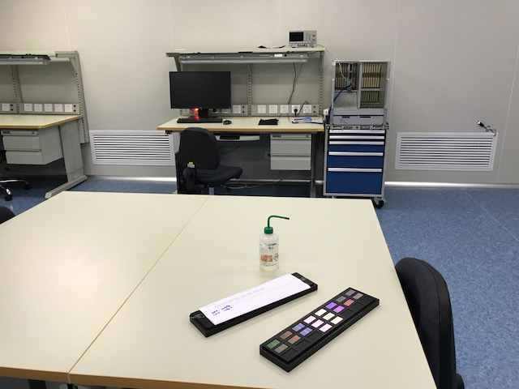
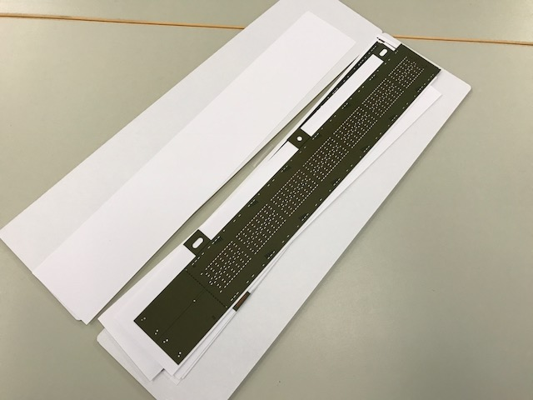
Technical Resources
Technical resources
2 mechanical technicians on MAPS chip mounting on FPCB
FPC gluing
Mount chips on FPCB
Wire bonding
Trained at CERN/Italy
1 electronics technician on testing HICs
Test and fix HICs
Trained at CERN/Italy
One Ph.D (An, Mang Mang) trained in all aspects in R&D on HICs assembly and test @CERN
PLAC – Pixel Lab At CCNU
Electronics readout design engineers,
a team led by Wang, Dong (from ALICE, readout and trigger)
Chip design engineers
A team led by Yang, Ping (participated in ALPIDE design @CERN, 2012-2015)
Staff and Students from CCNU
Staff: 15
Graduate students: 10+ Ph.D and 25+ Master students
Institute of Particle Physics
Staff: 30+
Postdocs and Students: 10+ postdocs, ~80 students

Slide 4
HICs Assembly Lab: space ~ 70m² (1K clean room); 20m2 (10K clean room, 2.9m head room)
Chip and FPC gluing
Gluing FPC/MAPS
Chip mounting
Wire Bonding
Electrical circuit testing
Storage
Not Doing:
Stave assembly
No carbon structures
Machine shop: (Sun, Daming, Tech.)
CNC etc.
Simple mechanical structures
Chip mounting
Wire bonding
Test bench
storage
Gluing & assembly
tables

Slide 5
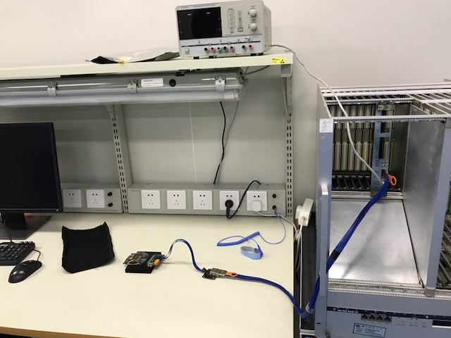
Test Bench
One MOSAIC
4 single chips
What LANL has now

Slide 6
CCNU Plan
CCNU Budget ALICE: $7.5M RMB
Pay MAPS chips
Pay toolings, jigs
Pay assembly machine
Technician salary
Traveling, student labor
To produce 500 ALICE/ITS mid-layer HICs
~2 HICs per day -> 250 days, 10+ months
starting from June 27, 20117 –> June 2018
No immediate use of the lab after June 2018
The lab can be used for MVTX HICs production
3 months replace jigs, training
Starting ~Sep. 2018, ~2 HICs per day, -> 35days -> 2 months (2~3 months)
Many students available for testing
Stave assembly sites: 68 staves
Stave space frame fabricated at CERN ( by 2017)
Assemble at US/LBNL? (replace jigs, copy from CERN ITS/IB)
China/CCNU? -> replace jigs (copy from CERN ITS/IB)
@CERN 2 staves/week, from MAPS/Spaceframe/stave
CCNU budget sPHENIX: US$100K?
toolings, jigs, training
M&S for operation, gas etc.
Technician’s salary
Traveling, student labor
Shipping MAPS/HICs/staves

Slide 7
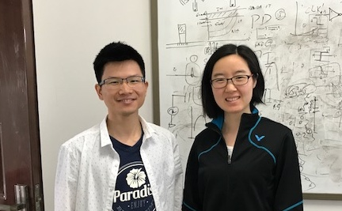
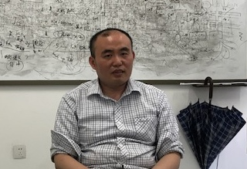
CCNU Plan – Cont.
Gao
Yang
Experts and Designers of ALICE MAPS/ALPIDE on-chip electronics
Analogy circuit – Dr. Chaosong Gao
Digital circuit – Dr. Ping Yang
They will help us!
PLAC – Pixel Lab At CCNU
Also interested in mechanical system integration
Plan to hire a full time engineer to work on sPHENIX integration effort
Visit LANL 6-12 months, work on preliminary conceptual design for the MVTX/INTT/TPC
Physics simulation and analysis
Many students
PLAC Ass. Director
Dr. Xiangming Sun

Slide 8
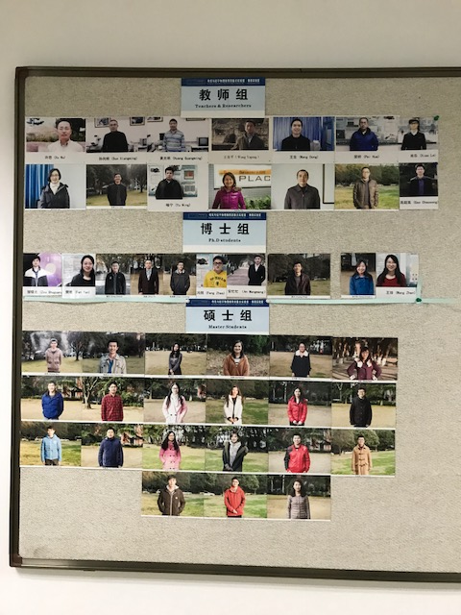
PLAC Members (Pixel Lab At CCNU)
Faculty: ~15
Ph.D students: ~10
Master students: ~25

Slide 9
Stave production plans
Plan-A
CERN production:
Assembly and test
Time: starting 08/2018, 6-9 months
Plan-B
HICs production @CCNU, Sep. 2018, 2-3 months
Stave space frame production @CERN ITS/IB, by 2017
Stave assembly: US/LBNL? Or China/CCNU, 4-6 months
DOE Budget: FY18
Impact on sPHENIX start date?
CCNU option → plan A?

Slide 10
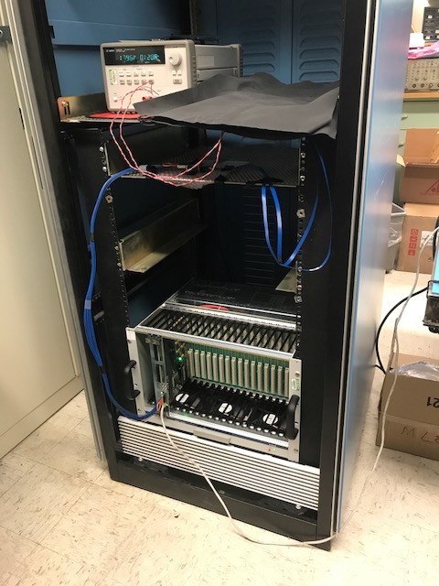
R&D @LANL on MAPS Single Chip Readout
Sho, Elena, Xuan et al
MAPS chip
MOSAIC test bench in operation
Single MAPS chip with high-speed readout
Threshold scan
Noise scane
Test data readout speed
1.2Gb/sec
0.6Gb/sec
0.4Gb/sec
Test firefly cables
5m (ALICE default)
7m, 10m
Short extension cables, +20~30cm
10m FireFly cable
MOSAIC test bench

Slide 11
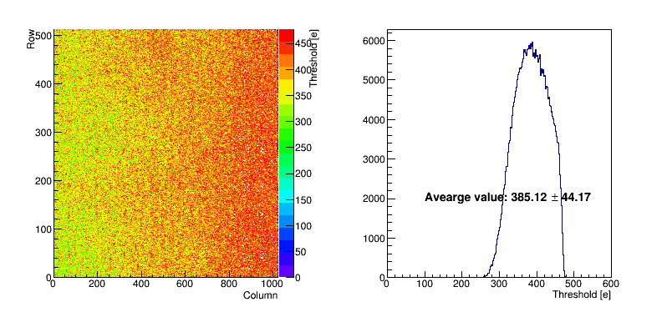
Test under internal trigger (40MHz)
From Xuan
Readout speed 1.2 Gb/s and 50 injections.
Scan the threshold per pixel and the average value is 385.12±44.17 (e).

Slide 12
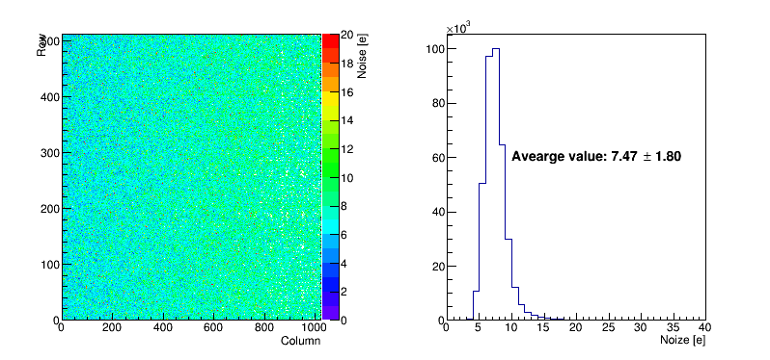
Test under internal trigger (40MHz)
From Xuan
Readout speed 1.2 Gb/s and 50 injections.
Scan the noise per pixel and the average value is 7.47±1.80 (e).

Slide 13
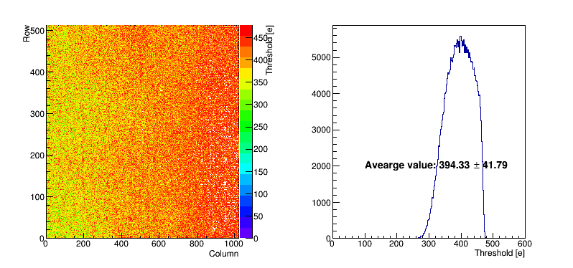
Test under internal trigger (40MHz)
From Xuan
Readout speed 600 Mb/s and 50 injections.
Scan the threshold per pixel and the average value is 394.33±41.79 (e).

Slide 14
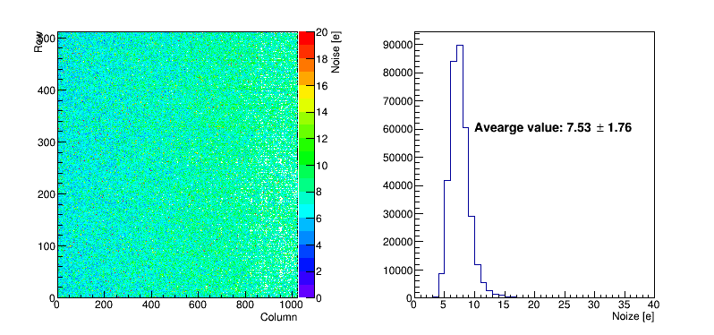
Test under internal trigger (40MHz)
Readout speed 600 Mb/s and 50 injections.
Scan the noise per pixel and the average value is 7.53±1.76 (e).

Slide 15
MVTX single Chip Lab test To-Do List
Check the readout occupancy and efficiency under different internal trigger clock (10-40MHz), readout speed (400-1200Mb/s) and threshold (set up by the analog signal or the configuration file?).
Check the electric trigger logic setup etc, set up the external trigger with a pulse generator.
Set cosmic ray triggers with scintillator bars or pads to read out single MVTX chip with the external coincidence cosmic ray trigger.
Design of single chip based telescope in progress
Efficiency tester
μ⁻
Simple tracker
μ⁻

