Slide 1
Toward the Realization of MVTX Upgrade
Define a clear procedure with ALD how to proceed with MVTX proposal
  MVTX group should propose a plan to ALD how to proceed with project milestones, and get feedback from ALD and DOE.
  MVTX group should update project funding & timeline with ALD and DOE
MVTX consortium updates the proposal, cost, schedule and resources
  Science and simulations
  Project cost & schedule
  Institutions’ roles
  Bi-weekly project report and review

Slide 2
Path Forward - draft
Implement recommendations
  Follow up findings and recommendations
    Develop a draft plan to address recommendations in next 2 weeks
      this document
    Discuss with ALD in ~2 weeks about the plan and develop
  Bi-weekly MVTX consortium meetings till full proposal submission
Milestones
  Update proposal in next 2 months, ~10/15
  Work with ALD to communicate with DOE about budget & timeline, 11-12/2017
  Workout a preliminary MOU with CERN, ~12/2017
  Full proposal ready for submission, ~end of 12/2017
    Goal: obtain at least partial funding in late FY18/early FY19 to start stave production at CERN after ~8/2018.
MVTX workfest ~Dec. 8/10 to push for the final proposal?
  sPHENIX collaboration meeting @ Santa Fe, Dec. 8-10, 2017
  Dec. 5-7(Tue-Thur) or Dec. 11-13 (Mon-Wed)

Slide 3
Action items from the MVTX DR (I) from 8/29/2017 discussion
1. Solicit multiple theory predictions – December 2017 - Grazyna
2. Refine the three key physics plots – October 2017 - All
3. MoU with CERN for stave production – December 2017
4. Refine cost estimate with CERN – DONE
5. QA plan for tests (size of the readout and cooling needed at LBNL and BNL) – October 2017- Giacomo
6. Cost of building two inner layers – DONE
7. Scenarios for repair and replacement – October 2017 – Giacomo
8. Refine estimates for engineering design - End September- 2017 – Bob, Walter, Kelsey MIT-LANL –
9. Include Cost of Extension cables→ Ming – End September 2017

Slide 4
Action items from the MVTX DR (II)
10. Consider including UV sterilization of demineralized water in cooling plant – MIT – Kelsey – October 2017
11. MoU with key production sites – December 2017
12. Optimize design of INTT and MVTX simultaneously – Feb-March 2018 – this will need sometime
13. Re-evaluate mechanical engineering costs once INTT and MVTX are final – after March 2018 – too late. Here one should make sure that the contingency is properly estimated to absorb cost variations due to different designs. → realistic contingency on carbon structures – End September 2017
14. Develop a Project Management Plan – September 2017 –Understand how detailed this plan needs to be at this stage of the project. If PMP needed draft by October 2017 - Maria
15. Clearly define scope, WBS dictionary, deliverables – October 2017 – again I am not sure if all this is needed at this stage of the project, but can be done – Maria/All
16. Evaluation and documentation of risks – October 2017 – Giacomo – Dave -

Slide 5
Summary of MVTX BNL Directors Review Report
Overall very positive
  Scientific case is compelling and drastically enhances the physics capabilities of sPHENIX
  The conceptual design is technically sound and will likely meet or exceed the expectations for the program
  The costs are reasonably well understood
  The technically driven schedule is well defined and well organized
  The resources are reasonably well defined
  the risks on hardware and electronics are well understood and actively being studied
  Overall integration is well understood. The mechanical integration is not fully defined.
Good recommendations

Slide 6
Conclusions & Final Recommendations
We would like to thank the MVTX team for their hard work in preparing for the Review and we thank the three external laboratories (LANL, LBNL and MIT) for sending their speakers to BNL during these tight financial times.
The MVTX project has made excellent progress since the last review and it is worth noting that the Science case for the detector has been especially well articulated with up to date simulations and performance studies.
We recommend that the MVTX project proceed with the process of submitting a full proposal to the DOE Office of Nuclear Science.

Slide 7
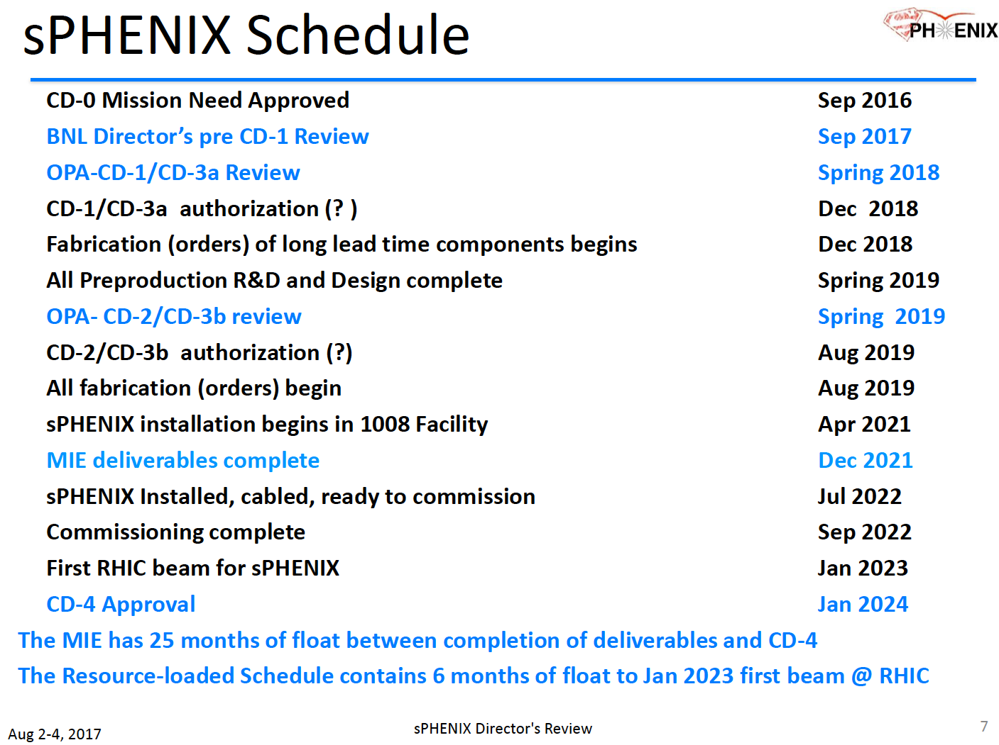
sPHENIX Baseline

Slide 8
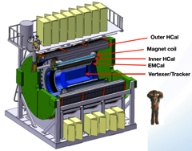
Summary: Project Tasks and Timeline
FY2016
FY2017
FY2018
FY2019
FY2020
FY2021
sPHENIX
baseline
CD-0
9/2016
CD-1:
Spring 18
- Installation:4/2021
- Commission, 9/2022
- 1st bean: 1/2023
ALICE ITS/IB
prod. ends
  Readout R&D
  Mech. design
  @LANL/ALICE/UT-A
Key R&D
LDRD@LANL
Mech. Integr.
& Prototype
@LANL/MIT/LBNL
A schedule driven project!
Stave prod.&test @CERN;
C-Stru. Prod. @LBNL
“RU” & “FELIX”
Prod. @US
Production
MAPS Prod. & QA
@ALICE
Detector Assembly
& Test @LBNL
Det. Install.
@BNL

Slide 9
LDRD – MVTX Key Tasks/Milestones
7/17
10/17
10/18
10/19
End of LDRD
Today
RUv1.0/FELIX1.5 Integration
40MHz, 7/17-12/17
LDRD
RUv1.x/FELIX2.0, 10MHz,
10/17 – 6/18
MVTX Design Review 7/2018
System test, cosmic & source
6/18 - 1/19
Test Beam, tracking performance
analysis, physics sim, NIM paper etc.
1/19 – 9/19
MVTX: 2018 – 2021
Stave Production, procure FPGA, GBT etc.
8/18-4/19
BNL Director Review
7/10-11, 2017
Electronics Production
1/19-6/19

Slide 10
Recommendations and Action Items and Plan

Slide 11
Scientific Program
The collaboration is encouraged to solicit multiple theory predictions in the range where new measurements can be made with sPHENIX, including error bars demonstrating how the MVTX can clarify the theoretical uncertianties. Calculationshould be done on realistic hydo codes and tuned to soft spectra.
Actions & Plan:
  MVTX group has been working closely with sPHENIX HF-Jet Topical Group to fully develop the heavy flavor physics physics program. Besides the LANL model (Ivan Vitev et al), several other theoretical models calculations are being produced through collaborations with TAMU (Ralf Rapp et al, transport model), Duke (more realistic Longevian transport model) and SUBATECH (transport, event-by-event), as well as LBNL (X-N Wang et al, HT) and JetScape collaboration.
  Update theoretical model predictions by 12/2017

Slide 12
Simulations
Findings:
  3 key physics plots
    B-jet R_AA
    B-hadron R_CP
    B-hadron v_2
  Simulation techniques are state of the art, well done
Recommendations
  Refine 3 key physics plots, same style etc. These are essential component of the Science Case for the MVTX project.
  Continue improve simulations. Demonstrate the degree to which sPHENIX(w/ MVTX) can resolve the situation at the LHC where loght and heavy flavor R_AA overlaps each other.
Actions & Plan:
  Refine the 3 key plots and other physics and detector performance plots by the end of 10/2017
  Update tracking and B-tagging simulations, 12/2017

Slide 13
Sensors
Negotiate MOU ASAP between CERN and sPHENIX/BNL to produce staves at CERN
Refine stave cost estimate
Work out QA plan for the MVTX
Prepare for disastrous scenarios (happened to PHOBOS, STAR and PHENIX), encourage the team to consider building a full copy
Refine scenarios for repair and replacement
Actions & Plan:
  Already obtained quote on staves, $11,500 CHF, 07/2017.
  Produced cost estimate to produce additional staves for a full copy of the two inner layers, with +10% spares. Project file updated
  A preliminary MOU with CERN for stave production, by 12/2017
  Develop/update QA plan for stave and system test at LBNL and BNL, will follow closely the ALICE QA plans, 10/2017
  Refine repair and replacement plan for staves and electronics, 11/2017
  Refine alternative sites stave production plan, such as CCNU, and associated changes in cost & schedule & risks, 12/2017

Slide 14
Mechanical Design and Cooling
Refine cost estimate of modifying ITS carbon
Include UV sterilization of the demineralized water in the cooling system
Move forward with MOUs with key production sites such as CERN, LANL and LBNL
Actions & Plan:
  Refine the estimates for ITS carbon structure redesign/modification, 9/2017
  include UV sterilization to the cooling system, 10/2017
  Establish MOUs with key production sites, CERN, LBNL, LANL, UT-Austion, BNL et al, 12/2017

Slide 15
Electronics, DAQ and Readout
LANL LDRD is important
DCS may need new hardware desgin
Interface to sPHENIX DAQ is well planned
Adopting ALICE/ATLAS hardware is a good approach
Interface cable evaluations to confirm the feasibility of the extension
Actions & Plan:
  Collaboration between LANL LDRD team and CERN ALICE/ITS Upgrade Groups, CERN, UT-Austin, LBNL, BNL/ATLAS, BNL/sPHENIX
    Readout & sPHENIX DAQ integration, 12/2017
    Will use/modify ALICE DCS Control system , 12/2017
  LDRD milestones:
    Readout chain with FELIX v1.5 @LHC clock, 12/2017
    Full “sPHENIX” readout chain with FELIX v2.0 @RHIC clock, 6/2018
    Interface cable tests, 12/2017

Slide 16
Integration with sPHENIX
There is a conflict between MVTX and INTT, optimize the mechanical design of INTT and MVTX, simultaneously
Re-evaluate the mechanical engineering costs
Actions & Plan:
  Optimize the design of MVTX and INTT integration, 2/2018
    Carry out MVTX readout extension cable R&D, 12/2017
  Update engineering and production cost after the initial MVTX/INTT integration design, 3/2018 (too late?)

Slide 17
Cost and Schedule: Comments
Mechanical engineering cost
Only 6-month of schedule float
  NOTE: with the delay of sPHENIX baseline, now we have >12 months float
Funding challenge in FY18
MOU and contract with CERN ASAP to produce staves
Actions and Plan:
  Re-evaluate the engineering cost of redesign/modification of mechanical system, 9/2017
  Work with ALD and DOE to update MVTX project cost and schedule plan, 11-12/2017
  Preliminary MOU with CERN to produce staves, 12/2017

Slide 18
Project Management Plan
Develop a Project Management Plan
  Cleary define the scope of the project by developing a WBS dictionary and a list of deliverables
Consider evaluating and documenting all risks associated with cost, schedule, and procurements
Actions & Plan:
  A draft being developed based on PHENIX/FVTX PMP document, 9/2017
    Need to understand the requirements (from ALD and Committee) for a project at this early stage, 9/2017
    Requires project $$ to finalize the Plan document.
  Evaluate and document risks and mitigations, 11/2017

