Slide 1
Topics for Today
https://indico.bnl.gov/conferenceDisplay.py?confId=3244
Overview
  Ming et al
LDRD status and plan
  Cesar, Xuan
Detector constr. & assembly
  Giacomo, Grazyna, Leo, Walt et al
Physics and detector simulations
  Jin, Xin et al
Readout and controls
  Mark, Leo, Jo, Giacomo et al
Lunch break
MVTX integration
  Walt/Bob/George/Christopher et al
Cost & schedule & risk
  Dave et al
Discussions

Slide 2
MVTX Overview
Ming Liu
Los Alamos
BNL Director’s Review Dry Run
06/19/2017

Slide 3
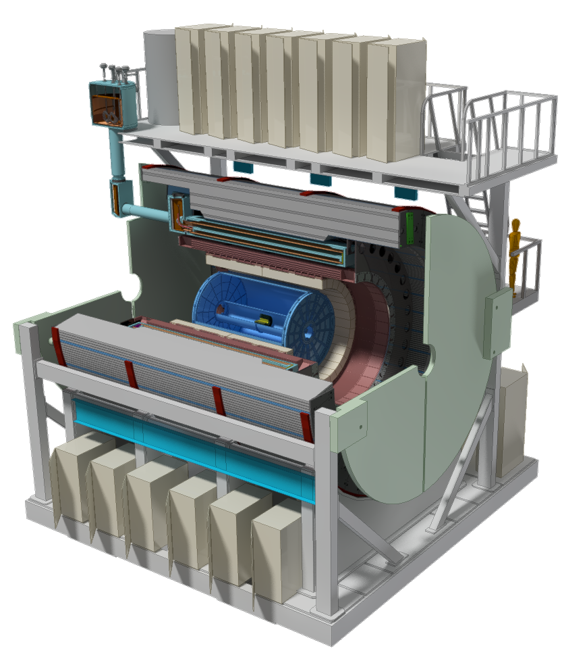
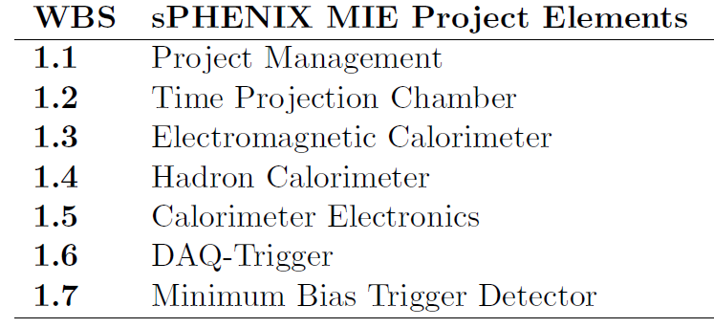
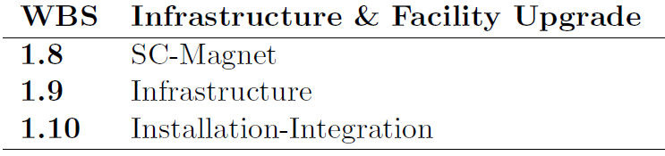
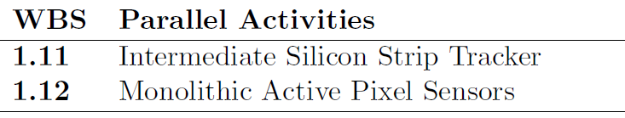
MVTX: MAPS-based Vertex Detector for sPHENIX
A separate MIE as a sPHENIX upgrade project, with
Compelling Science and;
Realizable cost & schedule

Slide 4
Outline
Science
Scope of MVTX proposal
  Readout
  Integration
  Cost & schedule
Organization & plan

Slide 5
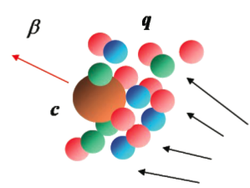
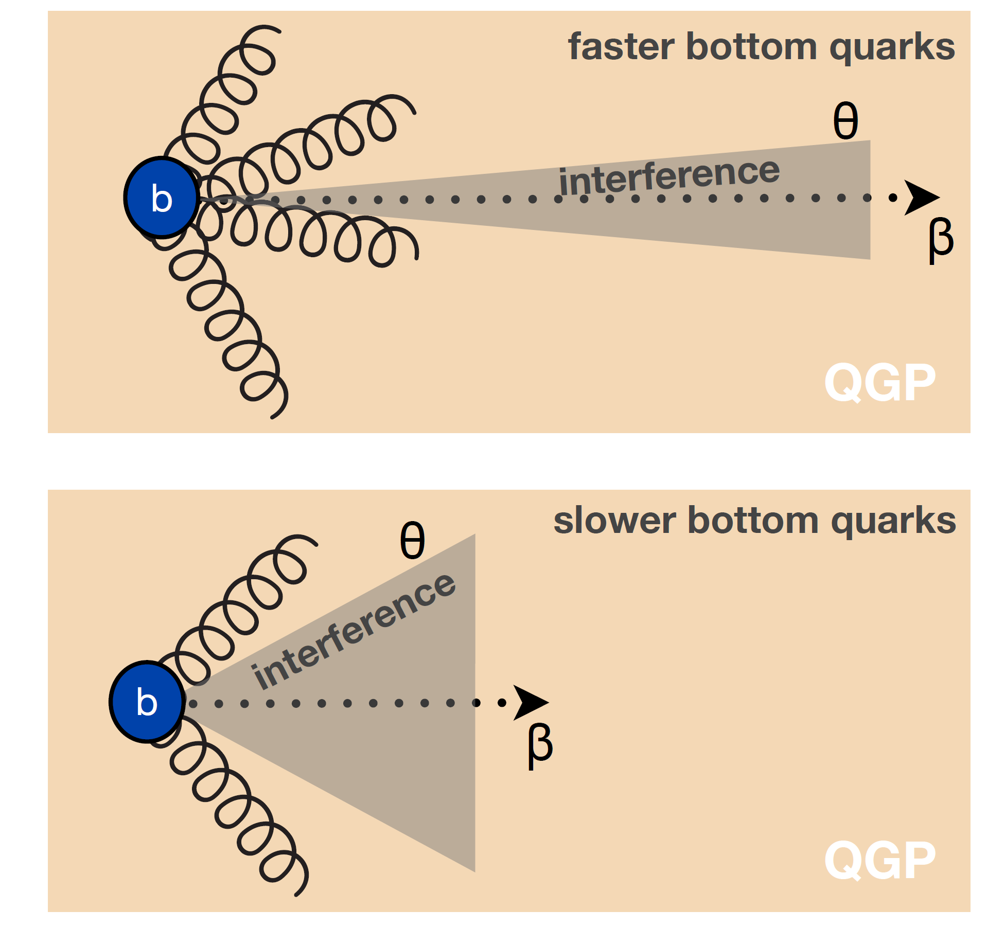
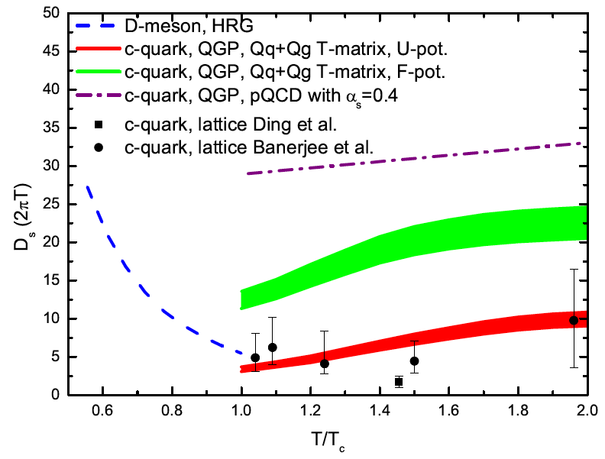
MVTX Science
Use open heavy quarks to study QGP
  Upgrade sPHENIX baseline detectors
- Detailed study of quark energy loss mechanisms in QGP
- Detailed study of QGP properties: T, density, viscosity, couplings etc.
arXiv: 1502.02730

Slide 6
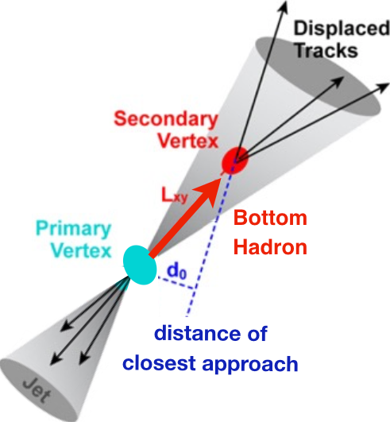
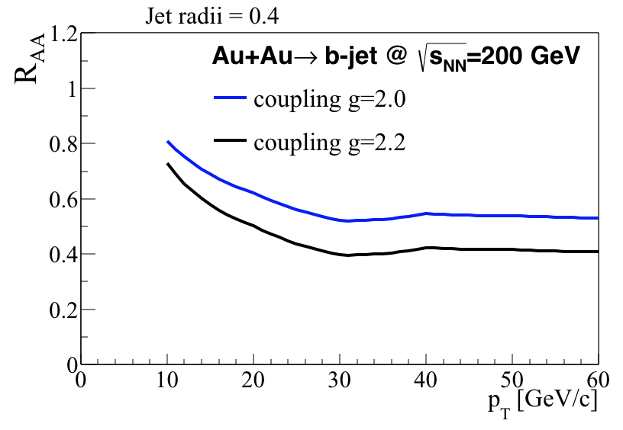
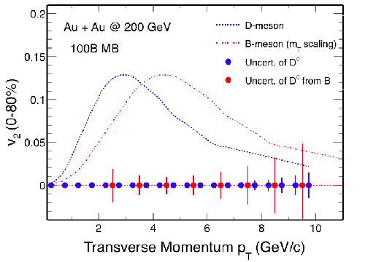
Key Observables
B-jet quenching & correlations
  Energy loss mechanisms
  QGP density
B-hadron “flow”
  Bulk viscosity
  Coupling

Slide 7
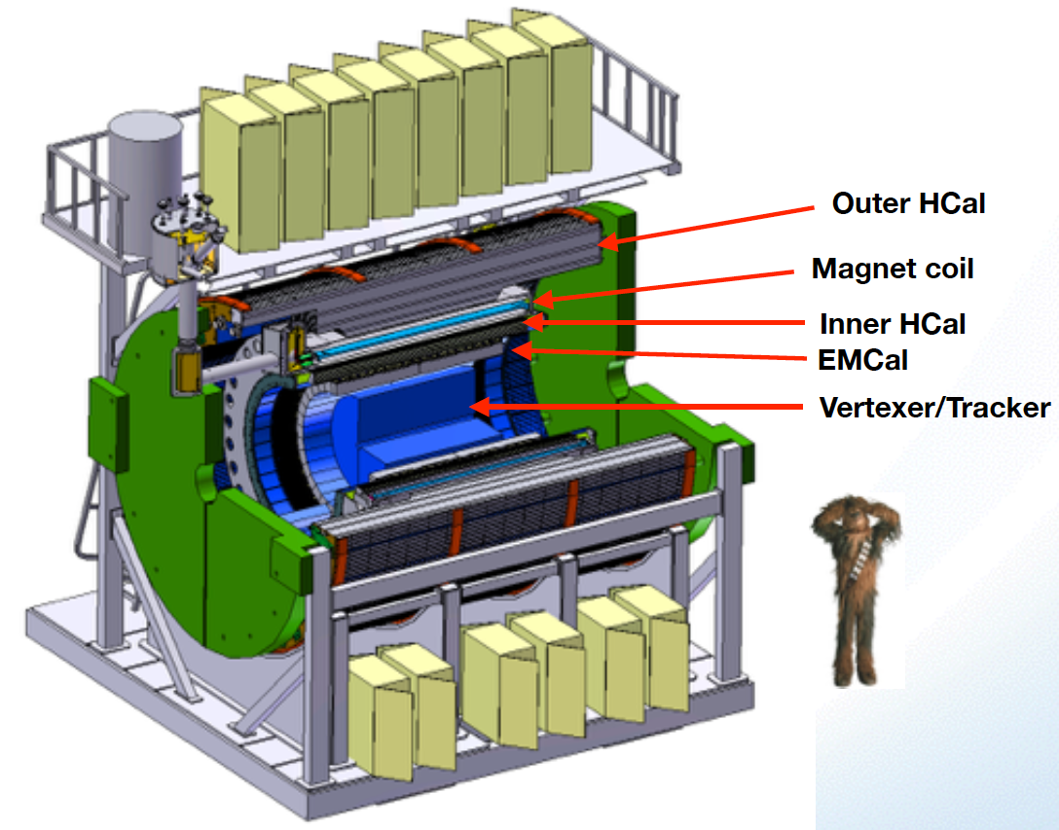

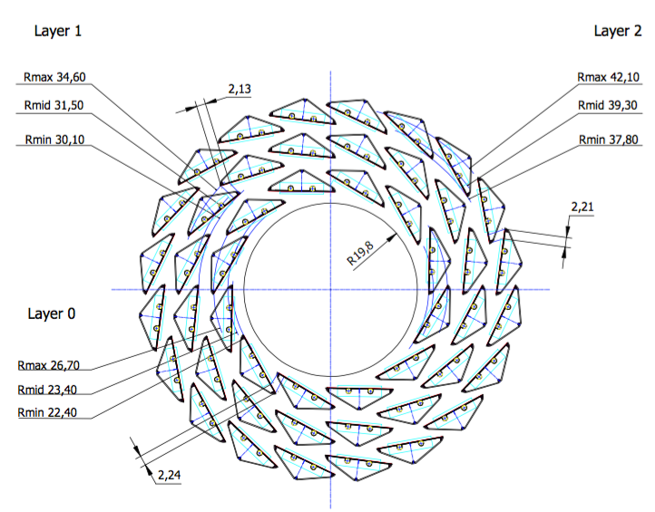
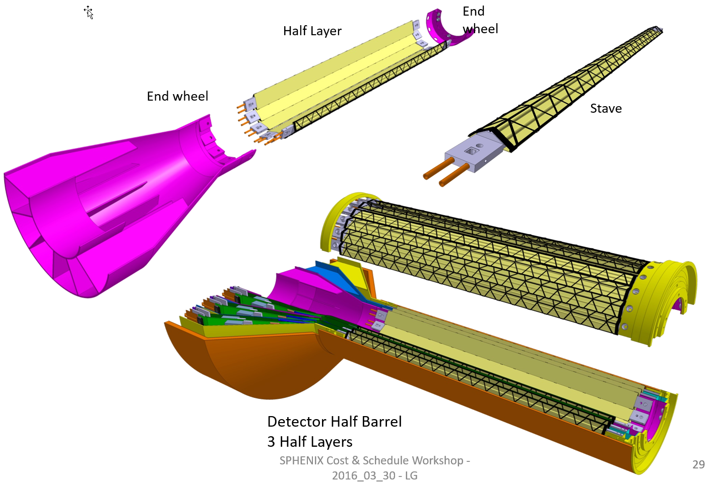
sPHENIX Approach
ALICE ITS;
Inner Tracker System
Key challenges:
- Readout
- Mechanics
sPHENIX Inner Tracking
“Adopt” ITS Inner Tracker

Slide 8


Monolithic-Active-Pixel-Sensors (MAPS)
A State of the Art Tracker
A 9-chip MAPS stave, ITS/IB
Advantages of MAPS:
  Very fine pitch (28x28 μm)
  High efficiency (>99%) and low noise (<10⁻⁶)
  Fast readout, 2~4 μS
  Ultra-thin/low mass, 50μm (~0.3% X₀)
  On-pixel digitization, low power dissipation
An ideal detector for QGP b-jet physics!
FPC
Chips
Cooling plate
ALPIDE design
50 μm
28 μm

Slide 9
MVTX Pre-proposal Submitted!
Pre-proposal submitted to DOE, 2/2017
  Follow-up discussions with DOE and BNL managers
  Weekly proj. leaders meeting BNL/LANL/LBNL/MIT
Plan to update proposal to DOE, late 2017
  Expanded science “CD0” + Cost & Schedule “CD1”
  Assumed funding starts in FY18
A growing collaboration
  15+ institutions from US and abroad
“Adopt” ALICE ITS Upgrade Inner Barrel 3-layer MAPS detector
  Mini. risk, Max. Physics
Precision vertexing for b-jet/B-hadron tagging in HI with high efficiency and high purity
B-jet modification in QGP at low-medium pT to determine QGP properties, study mass-dependence on collisional vs radiative energy loss, flow etc.
A separate DOE MIE to build the full detector, WBS 1.12, ~$5M for construction
Early R&D by LANL LDRD, $5M, FY17-19, readout and mechanical integration

Slide 10
Scope of the MVTX Project
MAPS staves & Electronics
  MAPS staves
    “MoU” to build 68 ITS inner Barrel Staves
    No modification
  Readout Electronics
    Frontend: ALICE/ITS, RU
    Backend: ATLAS FELIX
    Modify/reprogram RU & FELIX for sPHENIX
    R&D by LANL LDRD
  Production
    Extend ALICE/ITS MAPS stave production
      sPHENIX personnel help assembly and testing staves at CERN
    Reproduce additional ALICE RU & FELIX for sPHENIX
    Final assembly and test in US, LBNL/BNL
  Ancillary systems, “copy” ALICE
    Power distribution, cables, crates, racks etc.
    Slow control, safety and monitoring
Mechanics & Cooling
  Some changes to ALICE/ITS inner tracker mechanical structures
    End Wheels
    Cylindrical structure shells
    Detector half barrels
    Detector and Service half barrels
  Mechanical Integration
    Conceptual design by LANL LDRD
    Prototype by sPHENIX R&D
    Design integration frames
    Carbon frames etc.
    Installation tooling etc.
  Copy ALICE cooling plant design
    Minor modification to fit sPHENIX
    Smaller heat load than ALICE ITS
  Metrology and Survey
WBS 1.12: a new MIE fund the full MAPS Vertex Detector, ~$5M

Slide 11
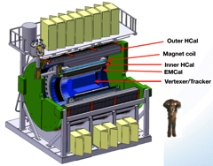
Project Tasks and Timeline
FY2016
FY2017
FY2018
FY2019
FY2020
FY2021
sPHENIX
baseline
CD-0
9/2016
CD-1
CD-2/3
8/1
Ready for
Beam
6/1
ALICE ITS/IB
Prod. ends
Readout R&D
Mech. design
@LANL/ALICE
A schedule driven project!
Key R&D
Mech. Integr.
& Prototype
@MIT/LBNL
Stave prod.&test @CERN;
C-Stru. Prod.
@LBNL
“RU” prod @CERN
“FELIX” Prod. @US
Production
MAPS Prod. & QA
@ALICE
Detector Assembly
& Test @LBNL
Det. Install.
@BNL
+2%
+50%
“MoU” w/ ALICE/ITS: 11/2016
- Produce MAPS chips and Stave Space frames for sPHENIX as part of ALICE production!
- Full staves and RU & CRU production cost & schedule → MVTX MIE

Slide 12
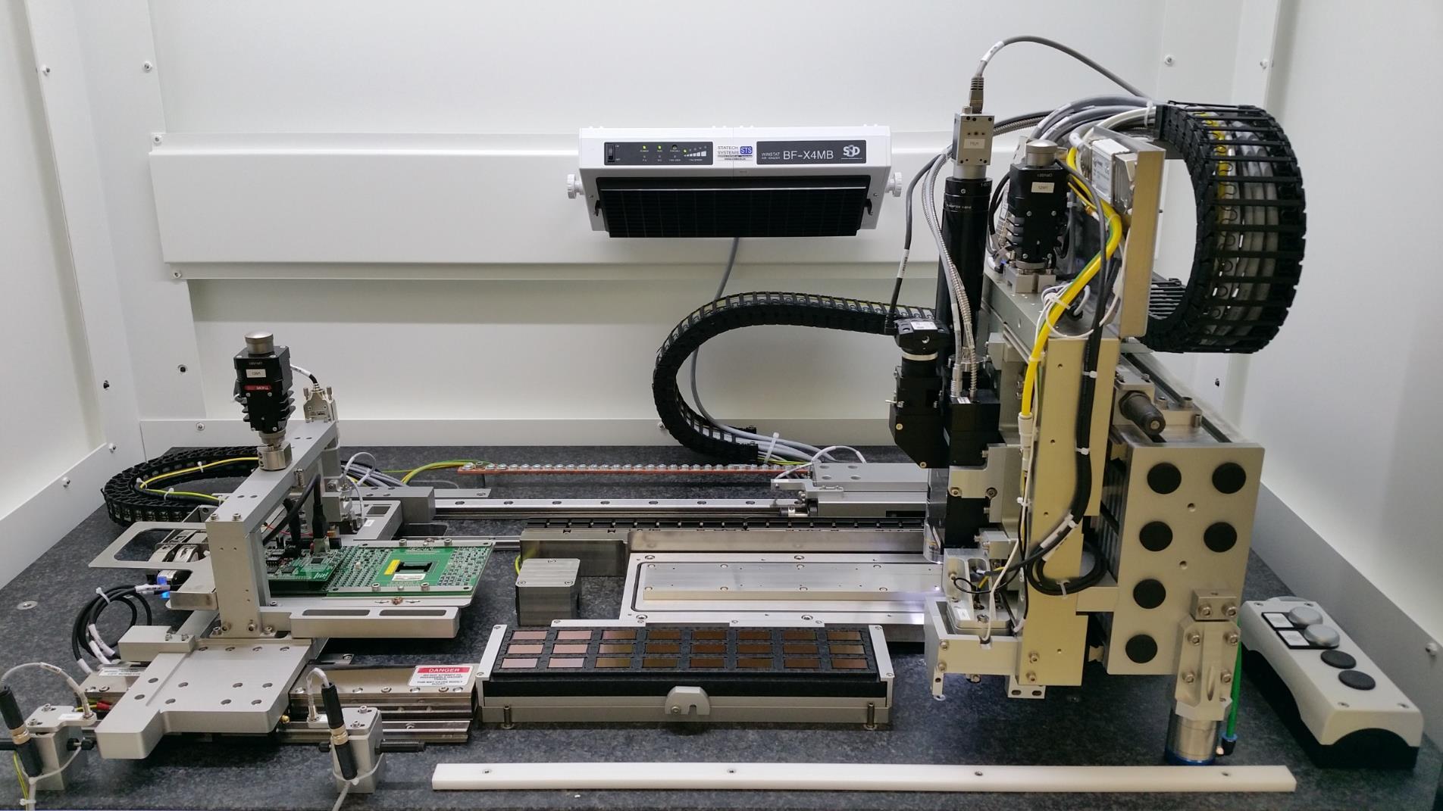
Stave Production & Test @ CERN
Cesar’s talk
Preparation for final stave production
  Successful ITS Stave production readiness review on Apr/27, 2017
  Optimization of final configuration is underway
Final stave production: July 2017 – June 2018
  One stave per day
  1st set of full staves complete in Jan. 2018
FPC
Chips
Cooling plate
Chip test and HIC assembly machine
Chip
pre-position
Chuck (PPC)
HIC assembly table
Probe-card
Chips tray
Chip gripper

Slide 13
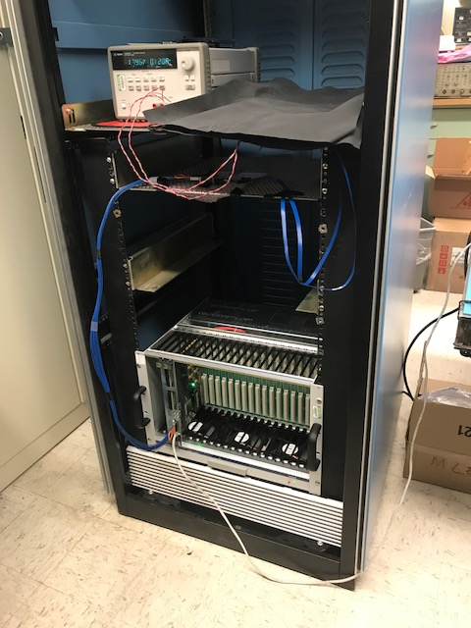
R&D @LANL on MAPS Single Chip Readout
Cesar’s talk
MAPS chip
MOSAIC test bench in operation
  Single MAPS chip with high-speed readout
  Threshold scan
  Noise scan
  External trigger
  Test data readout performance
    1.2Gb/sec
    0.6Gb/sec
    0.4Gb/sec
Test firefly cable performance
  5m (ALICE default)
  7m, 10m
  Short extension cables, +20~30cm
10m FireFly cable
MOSAIC test bench

Slide 14
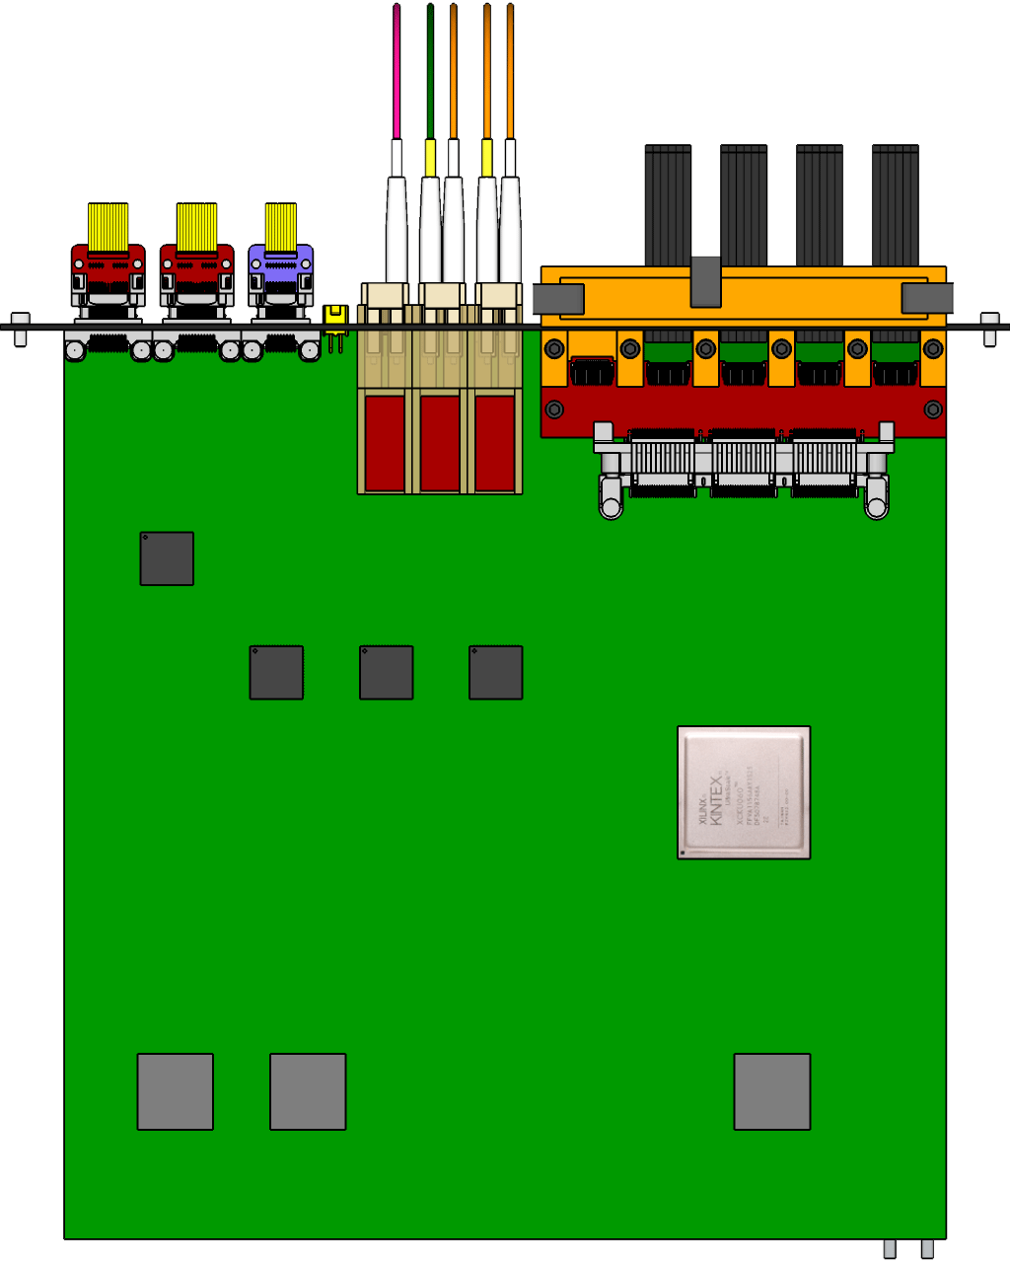
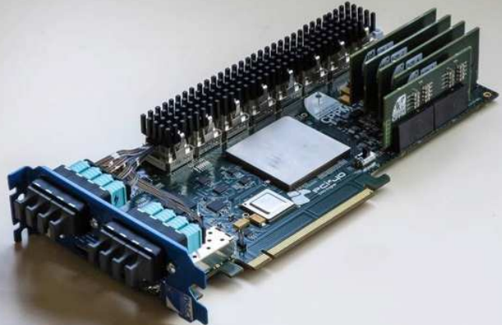

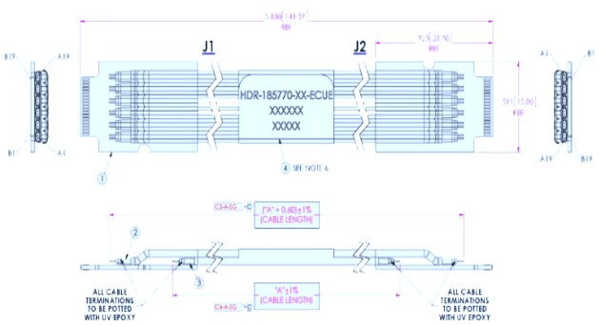

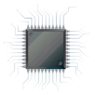
MVTX Readout and Control System: Status
Mark’s talk
RUv1 prototype:
~July
Prototype stave:
~June
5 m
Readout Unit
Optical Links
9-sensor Stave
9 Data (1.2Gbps)
1 Clock, 1 Control/Trigger
Control
Data (9.6 Gb/s max)
Trigger
Samtec Twinax “FireFly”
FELIX (or CRU)
Flex
Power
Alpide Sensors
FELIX v1.5:
~June
Filtering Board
(Capacitors)
regulators
Cold Plate
Regulated Power
Power Board
Available:
~August

Slide 15
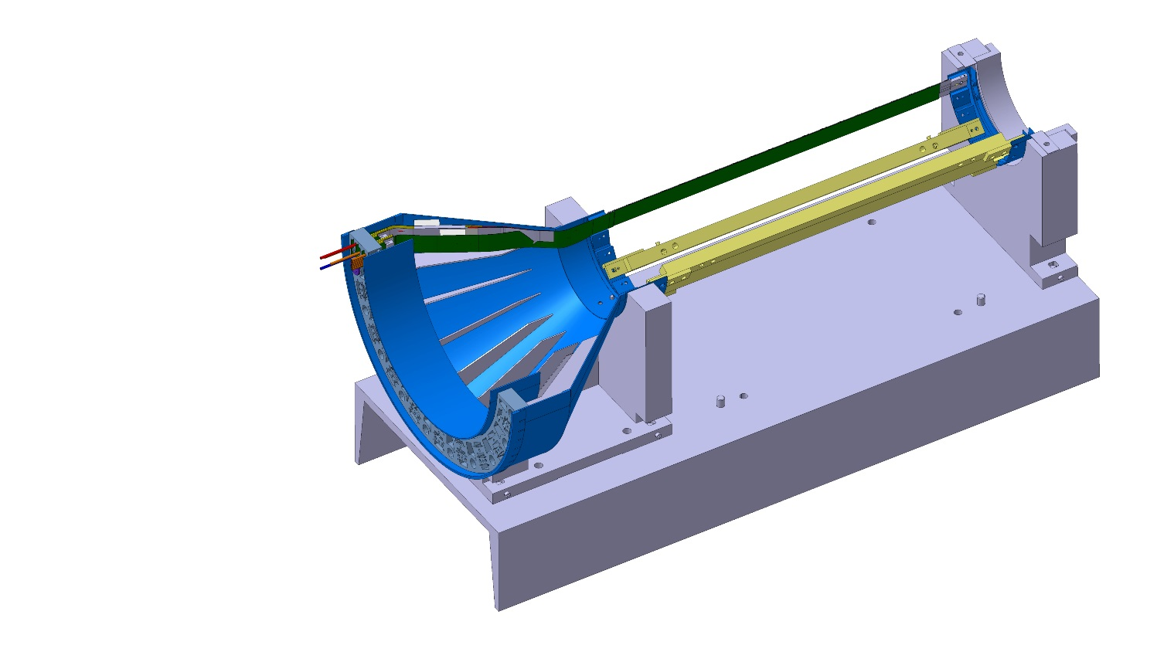
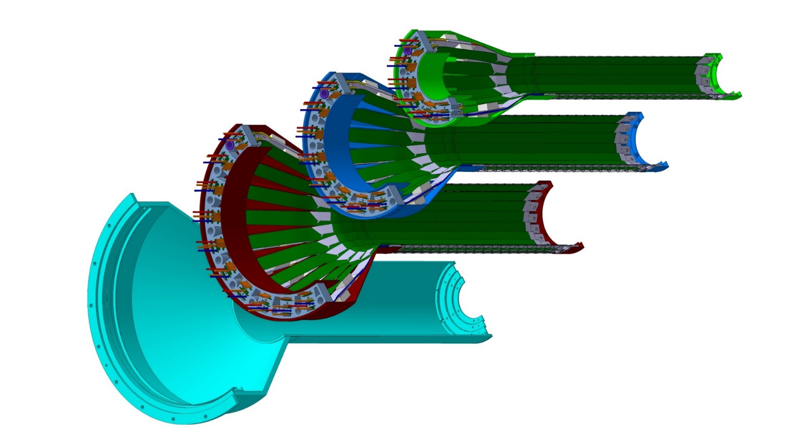
Detector Assembly
Giacomo’s talk
Precision positioning and installation of staves on end-wheels
Layer 0
Layer 1
Assembly of layers and carbon fiber structure into half-detector
Stave testing at each step
Metrology survey
Layer 2
IB CYSS

Slide 16
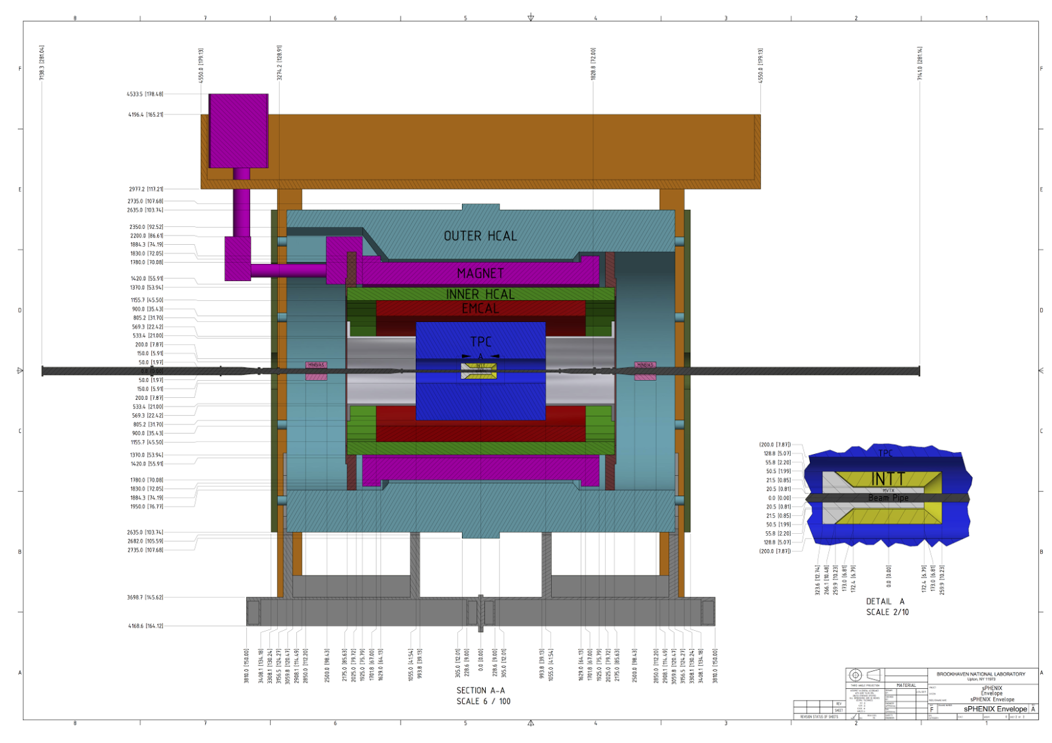
System Integration
Walt’s talk
MVTX+INTT

Slide 17
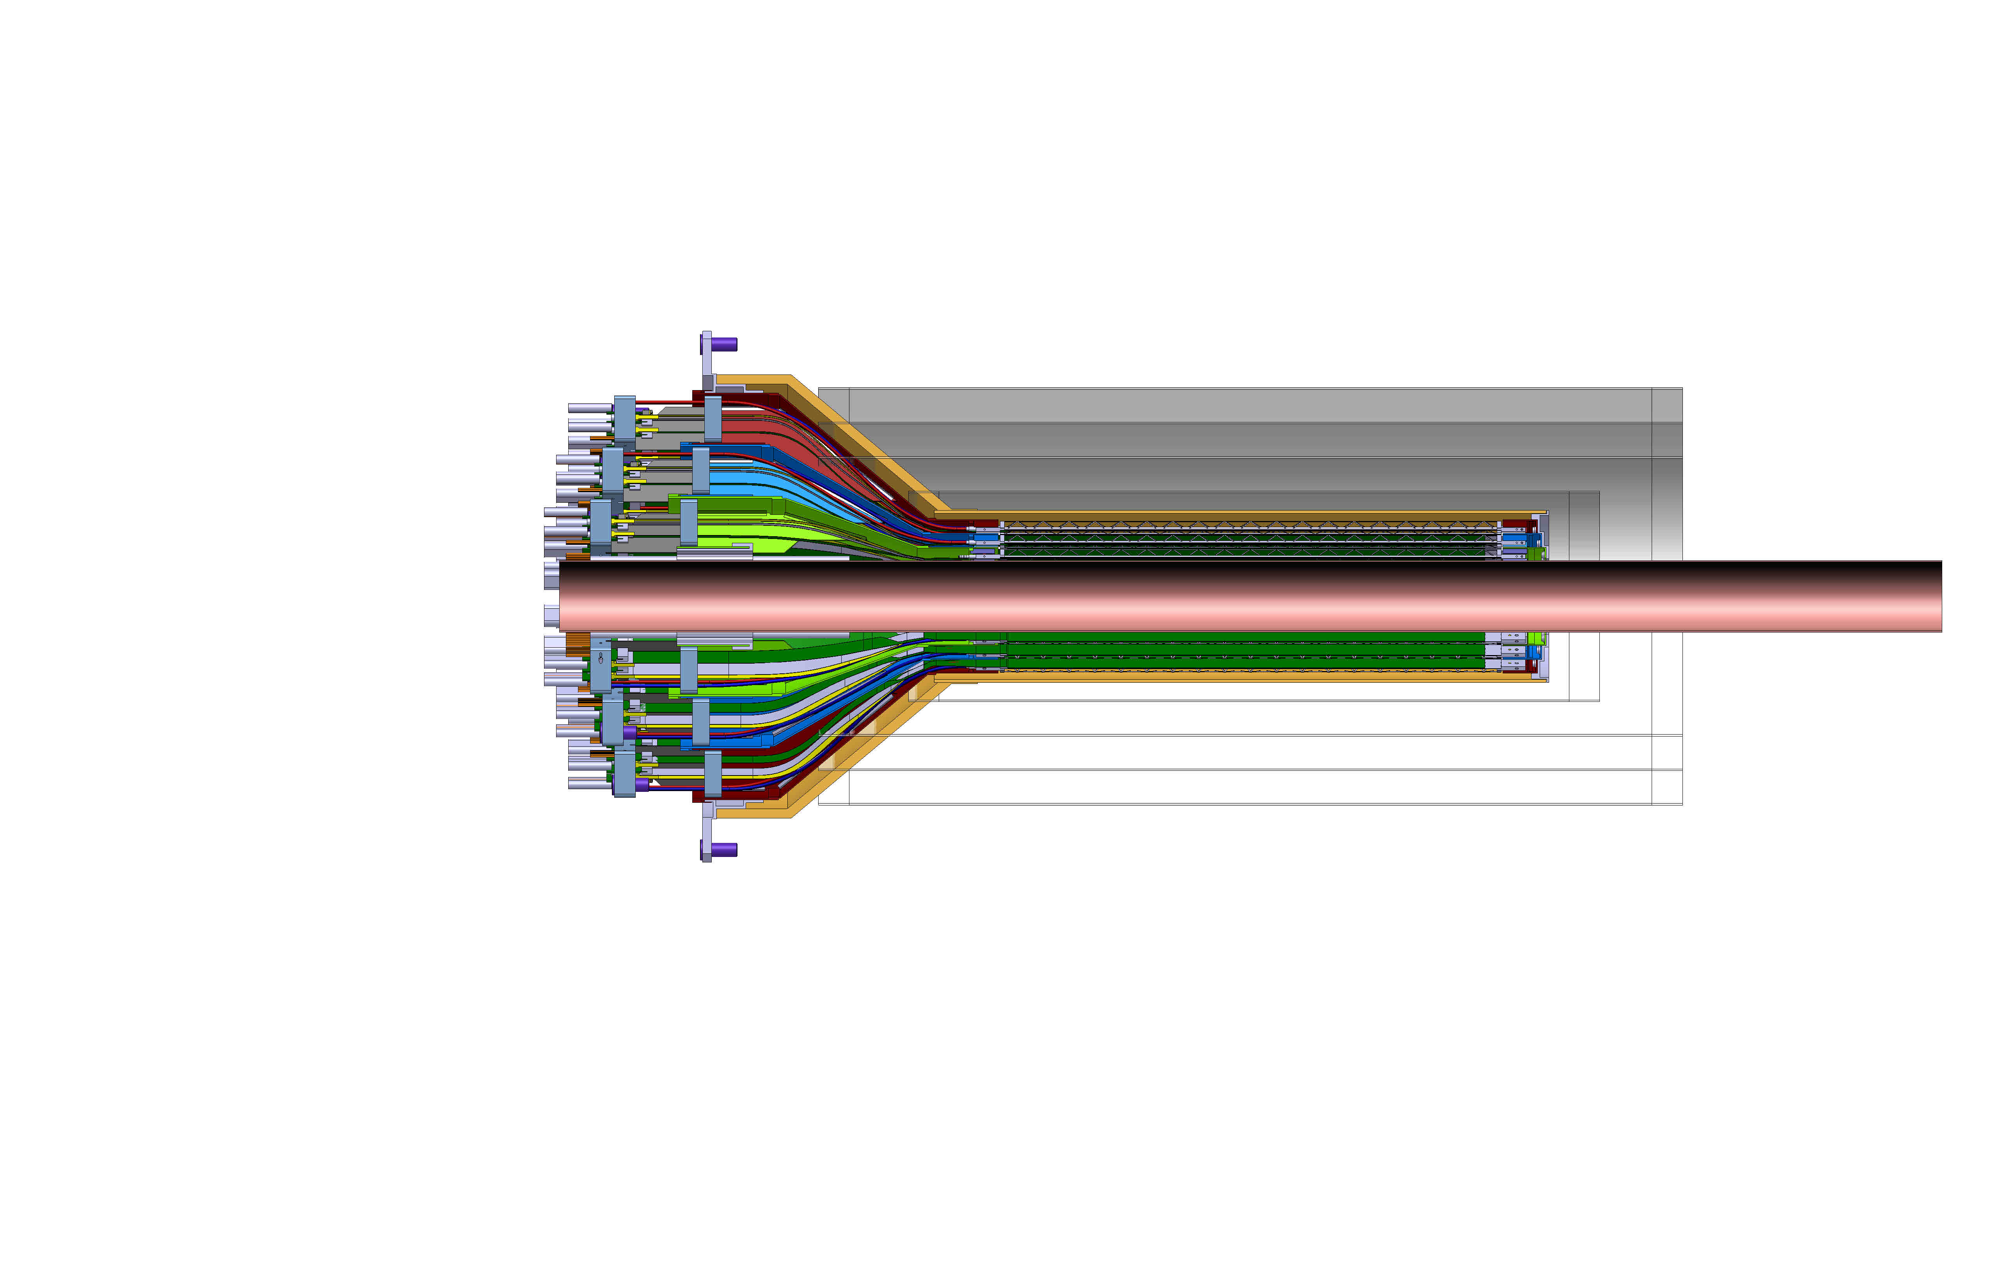
INTT-MVTX Conflict
INTT Acceptance
@ |z|=10
INTT 4-layers
|η|<0.95
|η|<1.09
|η|<1.28
|η|<1.12
Currently a clear conflict between the INTT and MVTX
  INTT only includes ladder, no connectors, cooling barbs, etc
R&D items: 1) Extend cables to move the conical structure further out in z-direction; 2) Design/optimize INTT layers to fit current MVTX geometry;
  FPC data cable is the HDI and can’t be easily extended, short “firefly” cables possible?
  Reduce angle of cone – redesign C-structures and connectors

Slide 18
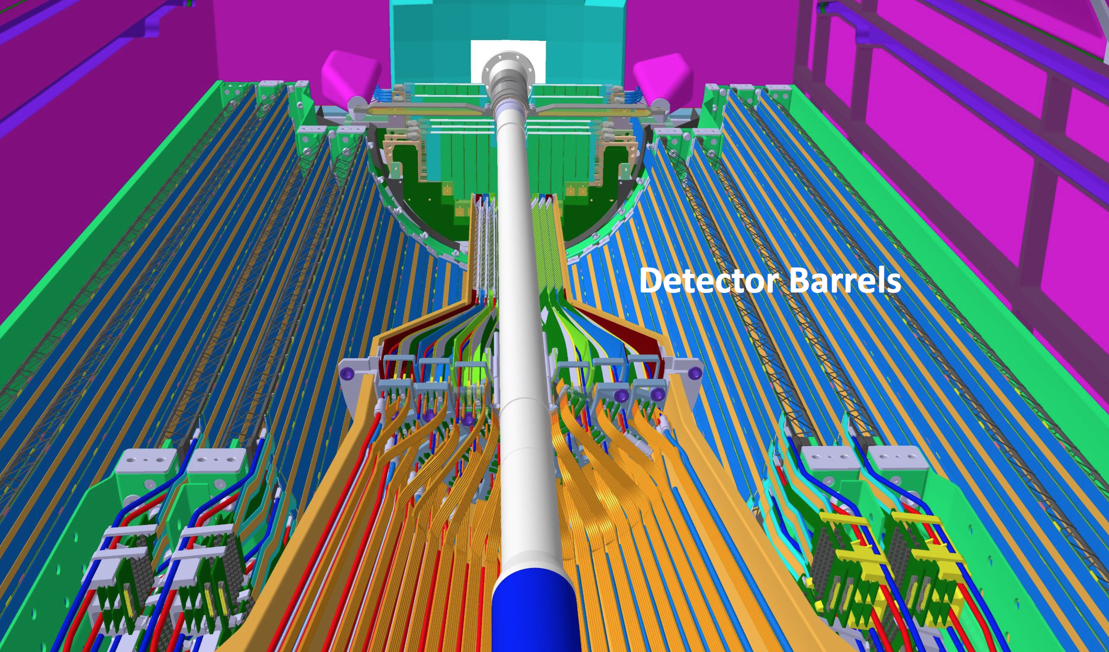
Alice ITS Cabling & Support similar for sPHENIX

Slide 19
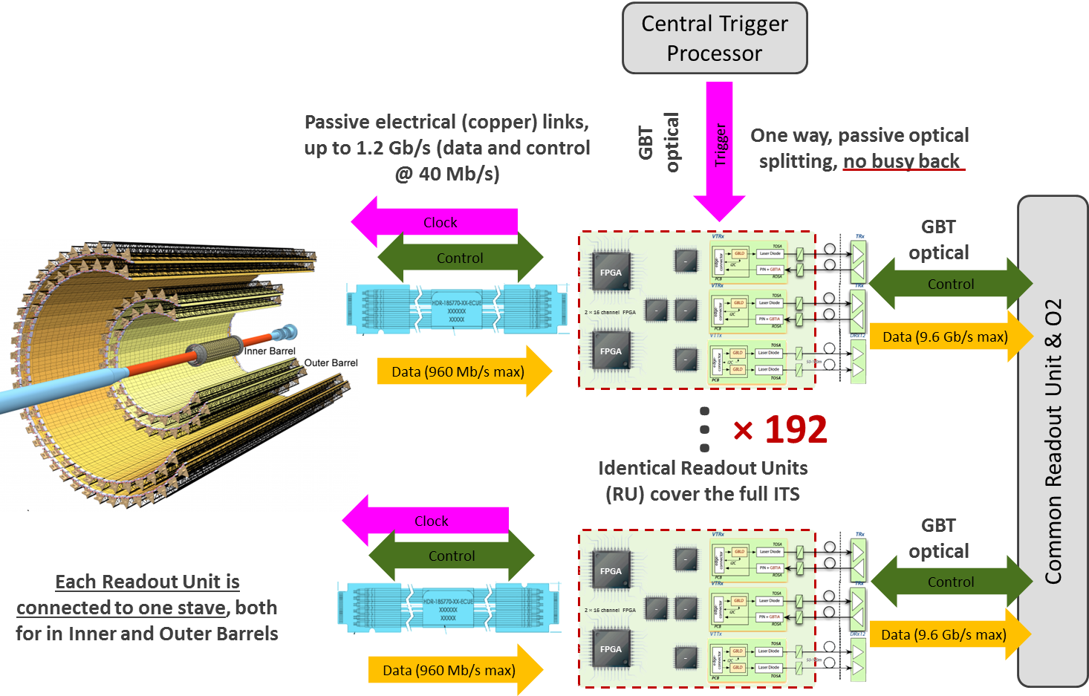
Cost Basis – Major Items
Dave Lee’s talk
MAPS and Staves: ~$xx
  ALICE ITS production
Readout: ~$xx
  ALICE ITS RDO
  ATLAS FELIX (ALICE CRU)
  FVTX/PHENIX experience
PS and slow control etc. ~$xx
  ALICE ITS design
  FVTX/PHENIX experience
Mechanical structures and cooling: $xx
  ALICE ITS inner tracker design
  FVTX/PHENIX, HFT/STAR experience
x48

Slide 20
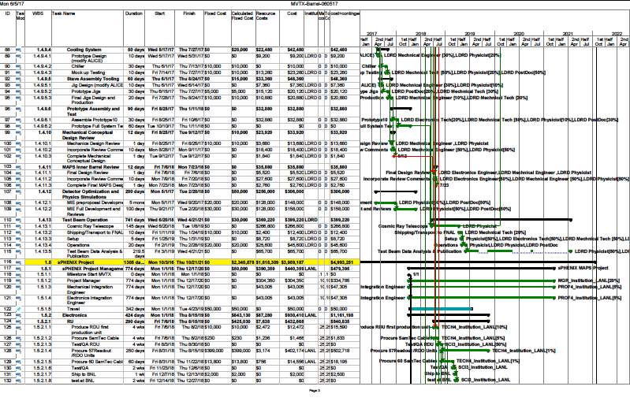
Updated Cost and Schedule WBS: 6/5/2017

Slide 21
sPHENIX Project Manager: Ed O’Brien
MVTX
Project Manager: M. Liu (LANL)
Lead Coordinator: M. Chamizo-Llatas (BNL)
Deputy Project Managers: G.Odyenic (LBNL),R.Redwine(MIT)
ES&H liason:
QA liason :
sPHENIX Office:
D. Morrison &
G. Roland
Electronics
WBS 1.1
Mechanics & Detector Assembly
WBS 1.2
Integration & Infrastructures
WBS 1.3
Readout Units
WBS 1.1.1
Staves
WBS 1.2.1
Cooling
WBS 1.3.1
Back-end
WBS 1.1.2
Carbon Structures
WBS 1.2.2
Safety System
WBS 1.3.2
Power systems
WBS 1.1.3
Barrel Assembly
WBS 1.2.3
Global Support
WBS 1.3.3
Installation & Commissioning
WBS 1.3.4

Slide 22
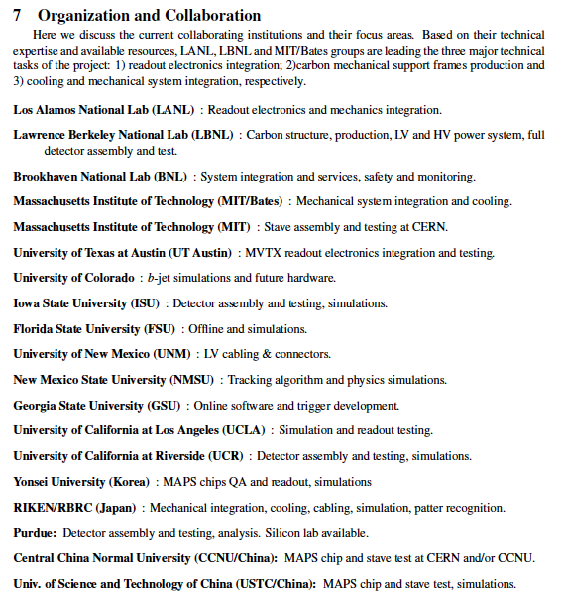
A growing collaboration!
new sPHENIX/MVTX members:
Czech groups
CCNU – lab
USTC
Peking Univ.

Slide 23
Status, Plans and Issues
Agreement with ALICE/CERN
  Obtained ALICE readout test stand, MAPS and electronics for early R&D
  Obtained design files, electronics and mechanics
  Training sPHENIX personnel
  ALICE produces MAPS and stave space frames for sPHENIX as part of the contingency
  Provide prototype and final staves
  Availability of CERN facilities after ITS/IB production
Potential schedule/funding gap of stave production
  ITS/IB production: ~7/2017 - 6/2018
  Risk Mitigation:
    Early training through LDRD effort, maintain activity at low level
    Possible mortgage for sPHENIX production from ALICE/CERN with MoU
    Seek external foreign funding
sPHENIX readout and mechanical integration R&D
  Possible delay due to unavailability of key elements like staves and readout for R&D
  MVTX/INTT integration
  Risk mitigation:
    Early joint R&D with ALICE as associate members
    Start with prototype RDO and FELIX/CRU
    Early system integration R&D and mechanical system mockup

Slide 24
Summary
Exciting science
No high risk R&D
Strong support from ALICE
LANL LDRD very important
Ready for beam summer 2021
Project has ~6 months float

Slide 25
Backup

Slide 26
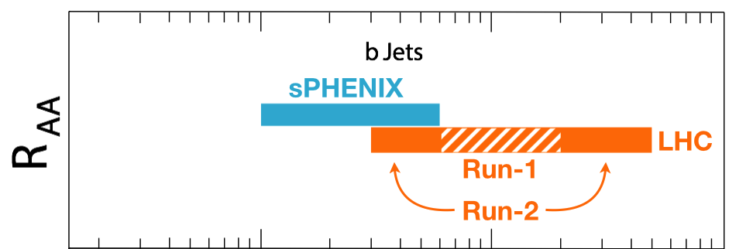
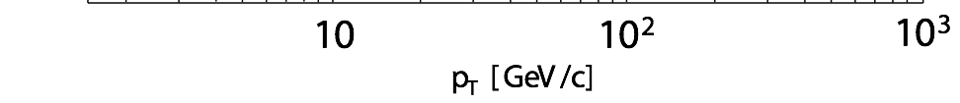
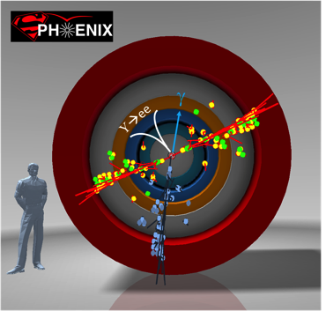
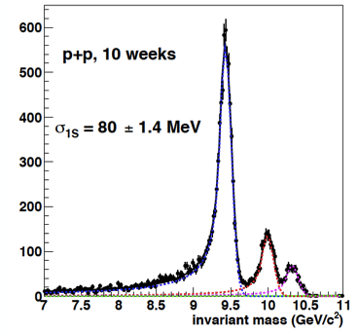
Exciting Science: Physics of the 3rd Pillar
Cannot be done at the LHC for lack of low pT reach and huge backgrounds
sPHENIX is the next flagship heavy ion physics experiment in US
  Jets
  Upsilons
  B-jets
MVTX will complete b-jet physics
sPHENIX Three Physics Pillars
Jets
Upsilons
B-Jets Physics

Slide 27

MAPS-based Vertex Detector (MVTX) for sPHENIX
|eta| < 2.0
R = 2.4; 3.2; 3.9cm;
L = 27.1cm; @Z=|10|cm, eta =(1.2,0.94,0.81)
“Adopt” ALICE ITS Upgrade Inner Barrel 3-layer MAPS detector
  Mini. risk, Max. Physics
Precision vertexing for b-jet/B-hadron tagging in HI with high efficiency and high purity
B-jet modification in QGP at low-medium pT to determine QGP properties, study mass-dependence on collisional vs radiative energy loss, flow etc.
A separate DOE MIE to build the full detector, WBS 1.12, ~$5M for construction;
Early R&D by LANL LDRD, $5M, FY17-19, readout and mechanical integration;

Slide 28

Overall ITS Planning (Simplified Global View)
ALICE ITS Upgrade
2016
2017
2018
2019
2020
PRR
Sensor Series Production
CMOS processing, thinning & dicing, test
From L. Musa, 4/27/2017
Stave PRR Presentation
Stave Develop
PRR
Stave Mechanics
HIC Production
HIC and Stave
Stave Production
Mechanical Support Structures
Dry Assembly Test
Development
Production
EDR
PRR
Readout Electronics
Global Assembly
Commissioning @ Surface
Design & Prototyping
Design & Prototyping
Production & Test
Installation
EDR
PRR
Commissioning
11 months
Commissioning in ALICE
2016
2017
2018
2019
2020

Slide 29
Project Review Milestones
ALICE ITS Upgrade
From L. Musa, 4/27/2017
  Pixel Sensor Chip - EDR (Oct’ 15)
  Stave - EDR (May’ 16)
  Detector Barrel Mechanics - EDR (Jul ’16)
  Cooling – EDR (Jul ’16)
  Pixel Sensor Chip - PRR (Nov ’16)
  Detector Barrel Mechanics - PRR (Dec ’16)
  Service Barrel Mechanics - EDR (Dec ‘16): done
  Cooling – PRR (Dec ’16): done
  Readout Electronics – EDR (Jan ‘17): done
  Stave - PRR (Apr ‘17)
  Service Barrel Mechanics – PRR (May ‘17)
  Readout Electronics – PRR (Dec ’17)
Stave Production Readiness Review:
4/27/2017
Stave production starts ~May/June;
1st set of IB by Jan 2018;
2nd set of IB by July 2018
LANL people + others/MVTX work on stave production from May 2017 at CERN, prototype available soon at LANL
Fully working staves for R&D available ~Jan 2018;
Near final readout RU/CRU: ~12/2017

Slide 30
Detector Assembly
Giacomo’s talk
Carbon supporting structures
Stave assembly & test
Side view of MVTX

Slide 31
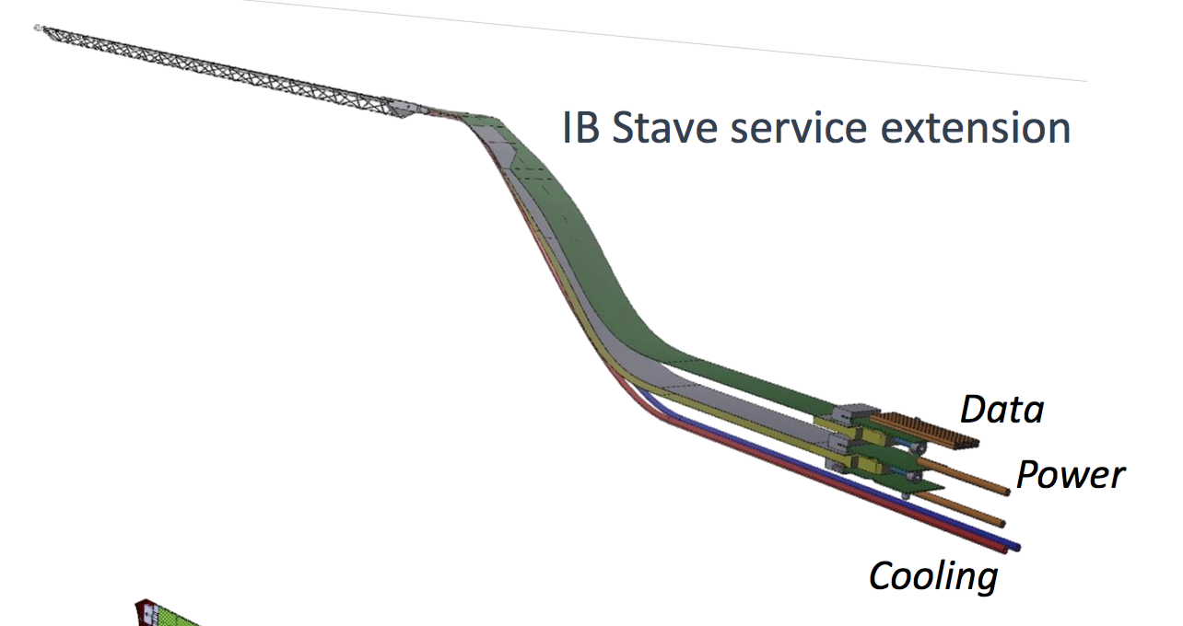
INTT-MVTX Conflict
INTT 4-layers
Extend cables to move the conical structure further out in z-direction
  FPC data cable is the HDI and can’t be easily extended
  Possibly add short “firefly” cables to hook up to patch panel, R&D needed
Reduce angle of cone – redesign

Slide 32
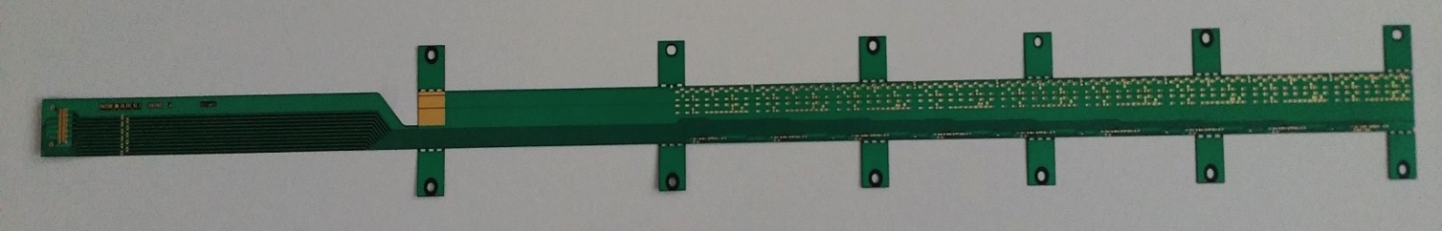
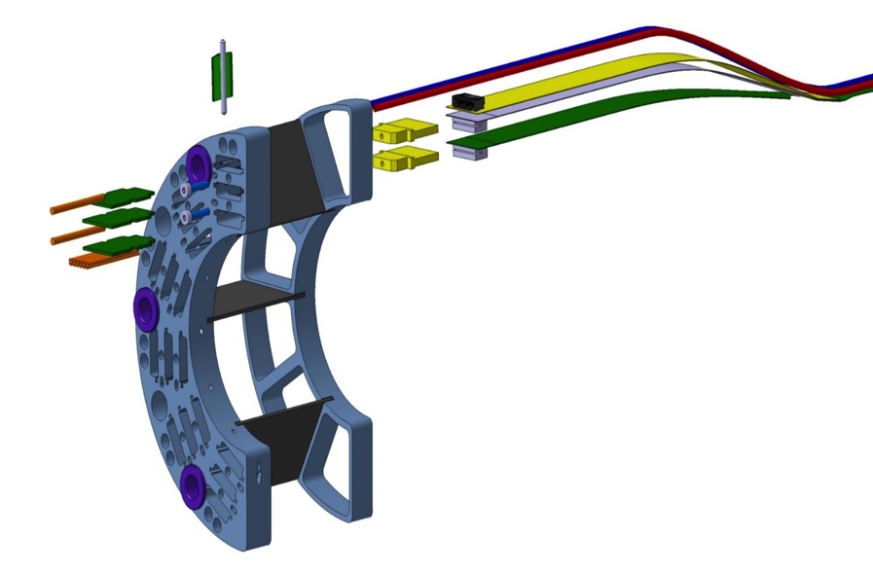
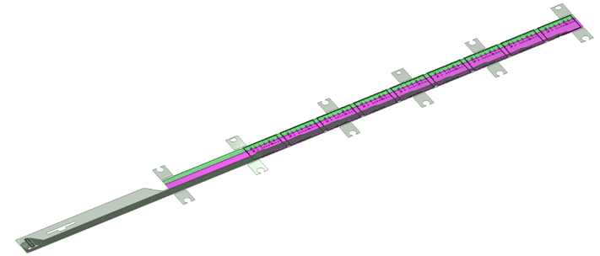
MVTX/INTT Integration
Extend MVTX Service Cables?
506.2 mm
16 mm
16.15 mm
41.9 mm
CHIP 9
……
CHIP 2
CHIP 1
The 9 silicon chips are read out in parallel: each chip sends its data stream to the end of Stave by a dedicated differential pair, 100 μm wide. Two additional differential pairs distribute the clock and configuration signals.

Slide 33
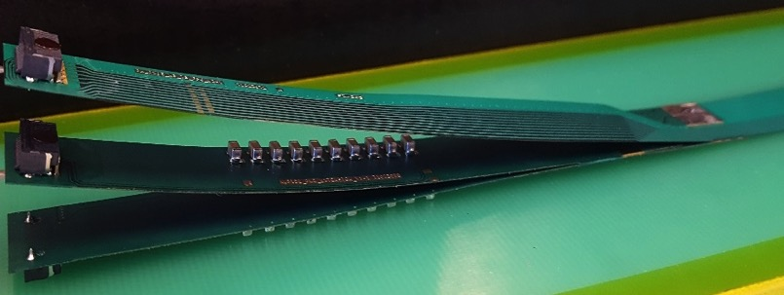
FPC Extension for Connection to Electrical Services
Antonello Di Mauro, Stave PRR 4/27/2017
The connection to the service cables is achieved by a double FPC extension which is soldered to the HIC
x-section at interconnection between FPC and extensions
AVDD
AVDD
AVDD
AVDD
DVDD
FPC
AVDD
DVDD
AGND
AGND
Flex power extension
AVDD
DVDD
AGND
FPC
AGND
DGND
DVDD
DVDD
AGND
DGND
DVDD
AGND
DGND
FPC
DGND
DGND
Flex power extension
DGND
signal lines (FPC)
digital power
analogue power

Slide 36
Cost Basis For Electronics
J. Phys. G: Nucl. Part. Phys. 41 (2014) 087002
48(+40%)
sPHENIX

Slide 37
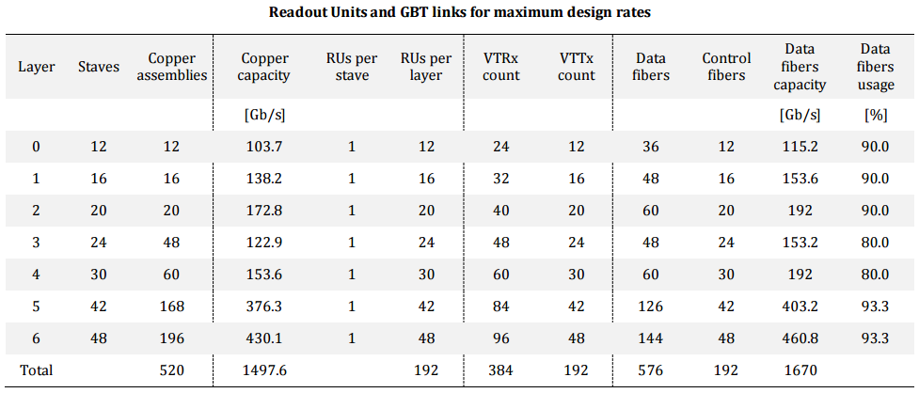
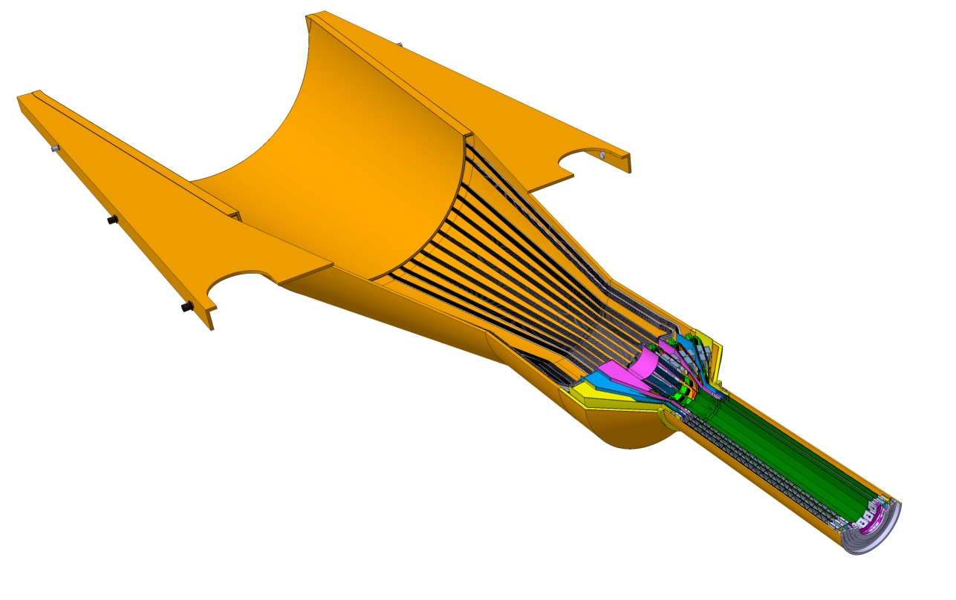
Readout Units Required for ITS & sPHENIX
ITS IB:
Produce 120 staves in one year
120% contingency
48 RDO boards
48 inner staves
sPHENIX: 48 +40% = 68

Slide 38
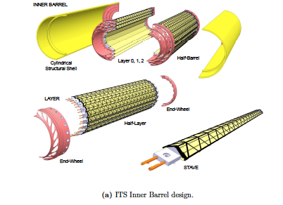
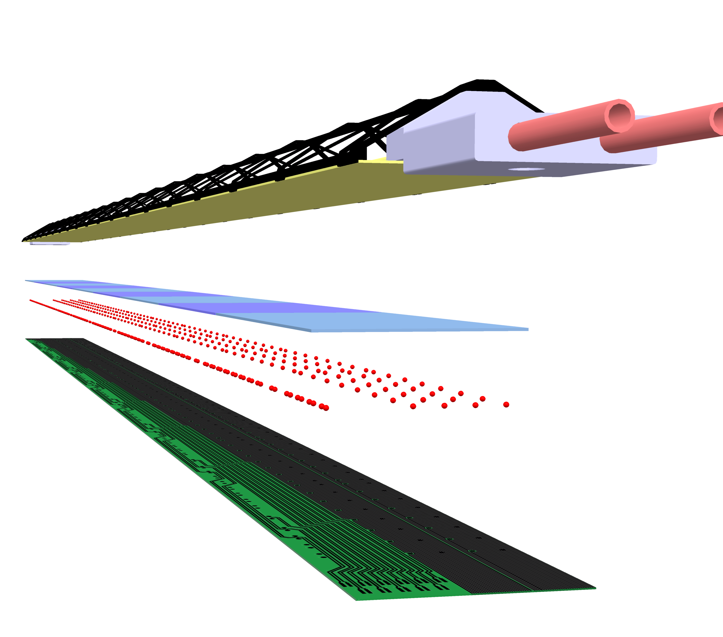
ALICE Stave and Global Support Structure
Cost and Schedule Basis
ALICE Stave
J. Phys. G: Nucl. Part. Phys. 41 (2014) 087002

Slide 39
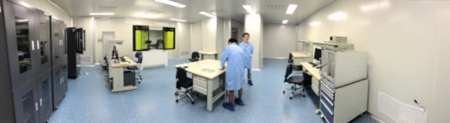
HICs Assembly Lab @CCNU space ~ 70m² (1K clean room); 20m² (10K clean room, 2.9m head room)
Chip and FPC gluing
Gluing FPC/MAPS
Chip mounting
Wire Bonding
Electrical circuit testing
Storage
Machine shop: (Sun, Daming, Tech.)
CNC etc.
Simple mechanical structures
Not Doing at present:
Stave assembly
No carbon structures
Chip mounting
Wire bonding
Test bench
storage
Gluing & assembly
tables

Slide 40
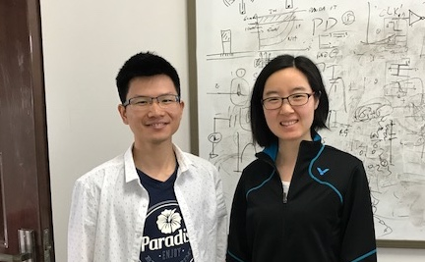
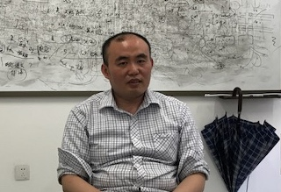
CCNU Plan – Cont.
Gao
Yang
Experts and Designers of ALICE MAPS/ALPIDE on-chip electronics
  Analogy circuit – Dr. Chaosong Gao
  Digital circuit – Dr. Ping Yang
  They will help us!
PLAC – Pixel Lab At CCNU
  Also interested in mechanical system integration
  Plan to hire a full time engineer to work on sPHENIX integration effort
    Visit LANL 6-12 months, work on preliminary conceptual design for the MVTX/INTT/TPC
Physics simulation and analysis
  Many students
PLAC Ass. Director
Dr. Xiangming Sun

Slide 41
MVTX R&D Status and Plan
Readout R&D
  5 single-chip MAPS tested at LANL
  Workfest @UT-Austin, 4/19-20
  RUv1 available in July, will be used for LDRD telescope
  BNL/ATLAS FELIX being evaluated as the default backend
    Computer arrived, fibers/cables ordered
    Obtain one FELIX in a few weeks
    “CRU” being prototyped with Altera evaluation boards, able to communicate with the RUv0 board @ UT-Austin;
  LANL MOSAIC test bench in operation!
Tracker integration task force
  MVTX + INTT + TPC mechanical system integration
  Identified the major tasks
Stave production @CERN
  ALICE Stave Production Readiness Review 4/27, prod. Starts in June/July
  LANL people do assembly and testing at CERN, May – Sept. 2017
  MVTX plan

Slide 42
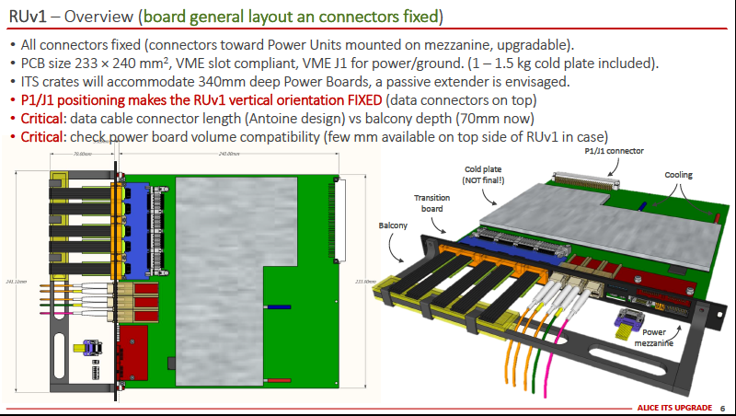
ALICE/ITS Readout R&D
5 RUv1 available for LANL R&D ~July 2017

Slide 43
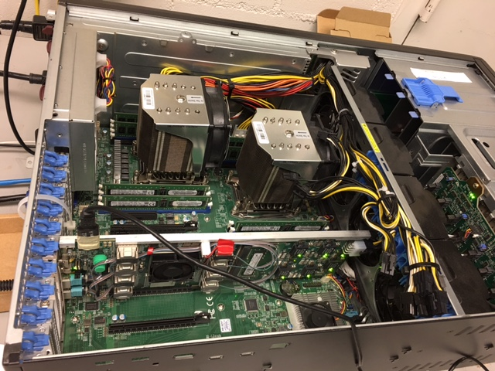
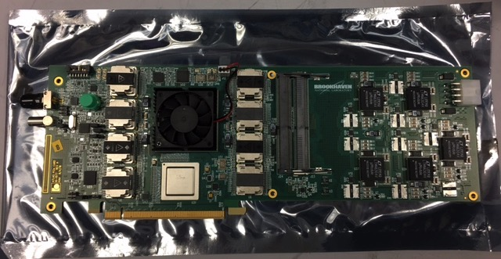
Electronics R&D – Cont.
FELIX and MVTX Power Distribution Boards
FELIX: visited BNL Labs and had FELIX system demo
  V1.5 boards, all functionalities available- data, slow control and Timing/Trigger/Busy, w/ GBT
  Multi-channel GBT links and PCIe interface code developed, with examples of user modules
  V2.0, available ~end of 2017, sPHENIX application
  A 1.5v FELIX board produced and tested, ready for shipment to LANL; Optical cables etc. to be ordered soon for LANL test bench
Power distribution boards and PS
  LBNL PS distribution board available for R&D from CERN/LBNL ~ August. Order placed, 4wks + testing
  R&D power supply and control system ordered (CAEN), available ~August
FELIX: tested @BNL
To be shipped to LANL

Slide 44
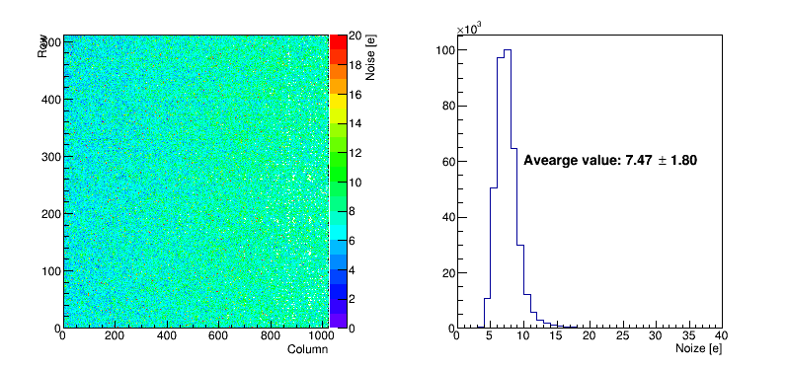
Test under internal trigger (40MHz)
From Xuan
Readout speed 1.2 Gb/s and 50 injections.
Scan the noise per pixel and the average value is 7.47±1.80 (e).

Slide 45
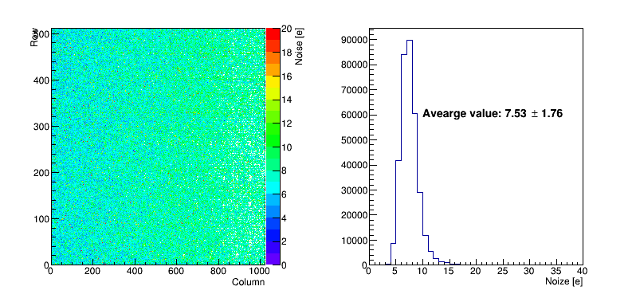
Test under internal trigger (40MHz)
Readout speed 600 Mb/s and 50 injections.
Scan the noise per pixel and the average value is 7.53±1.76 (e).

Slide 46
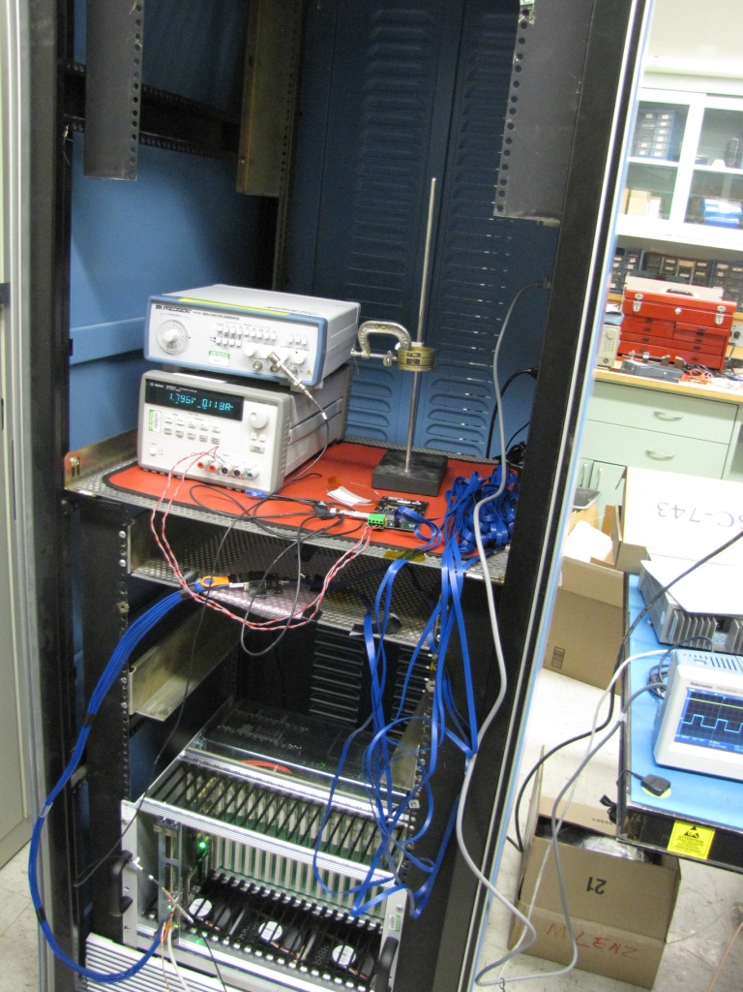
External Trigger and Source
Xuan et al
Single chip readout
Use a pulse generator as the external trigger
Use the Strontium-90 to produce beta rays.
  Vary the distance between the source and the silicon chip
Sr-90
1kHZ trigger

Slide 47
A Single-chip MAPS Telescope
Check the readout occupancy and efficiency under different internal trigger clock (10-40MHz), readout speed (400-1200Mb/s) and threshold (set up by the analog signal or the configuration file?).
Set cosmic ray triggers with scintillator bars or pads to read out single MVTX chip with the external coincidence cosmic ray trigger.
Design of single chip based telescope in progress
Efficiency tester
Simple tracker
μ⁻
μ⁻

