Slide 1
Major Tasks and Lead Institutions for sPHENIX MAPS Project (MIE Writing)
MAPS chips/stave production
LANL/ALICE (Ming Liu, Cesar da Silva)
Readout integration and testing
LANL, BNL, UT-Austin, U-Colorado (Mike McCumber. Ming, Leo etal)
Mechanical carbon structures
LBNL (Grazyna Odyneic/Eric, Walt etal)
Mechanical integration
MIT, LBNL (Bob Redwine, Walt etal)
LV/HV PS and controls
LBNL (Grazyna Odyneic/Leo)
MAPS stave assembly and testing at CERN
MIT, LANL, CCNU and others (Gunther Roland)
Full module assembly and test in US
LBNL, MIT and others (Grazyna Odyneic/Leo)
Online software and Trigger
BNL, GSU, LBNL (Xiaochun He, Chris P. etal)
Offline software - detector simulation, geometry, offline tracking
NMSU, FSU, LANL (Tony Frawley, Jin etal)
Physics simulations - to make “Money Plots”
LBNL, LANL, U-Colorado and all (Xin Dong, Haiwang, Sanghoon et al)
Cost and Schedule and Resources (Dave Lee, Ming etal )
Collaboration and Org (Cesar, Ming etal)

Slide 2
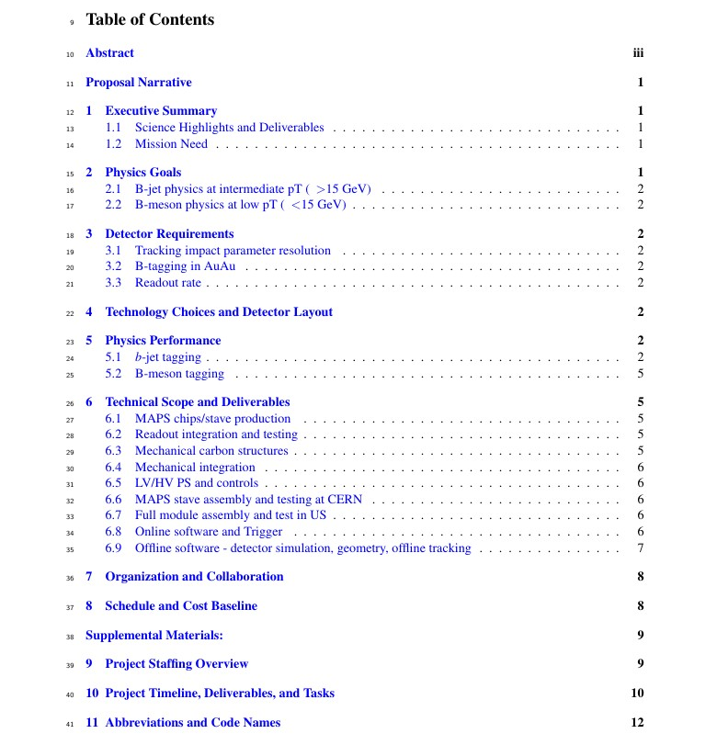
Editing/Proofreading – Dennis, Darren, Hubert et al
1. Ming, Mike, Gunther et al
2. Cesar, Xin et al
3. Jin, Darren, Haiwang et al
4. Giacomo et al
5. Tony, Haiwang, Jin et al
6.1 Cesar, Mike, Ming,
6.2 Grazyna/Leo, Ming et al
6.3 Walt, Grazyna/Eric et al
6.4 Bob, Gunther, Walt
6.5 Grazyna/Leo et al
6.6 Gunther etal
6.7 Grazyna/Leo
6.8 Xiaochun, Chris et al
6.9 Tony, Jin, Chris et al
7. Cesar, Gunther et al
8. Dave, Ming et al

