Slide 1
MAPS-based Vertex Detector
(MVTX)
WBS 1.13 (Full Detector) & 1.3 (Telescope)
Ming Liu
1/24/2017

Slide 2
Outline
Introduction
  MAPS-based Vertex Detector (MVTX)
  WBS and Baseline
Project scope and schedule
Tasks and collaboration
MIE status and plan

Slide 3

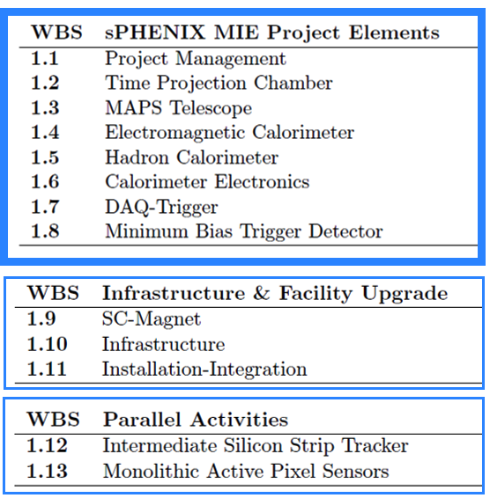
WBS of the Baseline sPHENIX MIE
A new DOE MIE to build the full MAPS-based vertex
Detector defined in the sPHENIX Reference Design

Slide 4
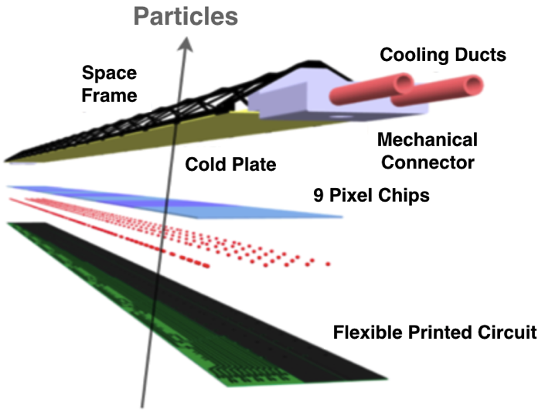

Monolithic-Active-Pixel-Sensors (MAPS)
A State of the Art Tracker
Advantages of MAPS:
  Very fine pitch (28x28 μm)
  High efficiency (>99%) and low noise (<10⁻⁶)
  Fast readout, 2~4 μS
  Ultra-thin/low mass, 50μm (~0.3% X₀)
  On-pixel digitization, low power dissipation
  15+ years of R&D at CERN for ALICE upgrade
An ideal detector for QGP b-jet physics!
A 9-chip MAPS stave, ITS/IB
ALPIDE design
50 μm
28 μm

Slide 5

sPHENIX MAPS-based Vertex Detector (MVTX)
|eta| < 2.0
R = 2.4; 3.2; 3.9cm;
L = 27.1cm
“Adopt” ALICE ITS Upgrade Inner Barrel 3-layer MAPS detector
  Mini. risk, Max. Physics
Precision vertexing for b-jet/B-hadron tagging with high efficiency and high purity
B-jet modification in QGP at low-medium pT to determine QGP properties, study mass-dependence on collisional vs radiative energy loss, flow etc.
A separate DOE MIE to build the full detector, WBS 1.13, ~$5M for construction
Early R&D by LANL/LDRD, $5M, FY17-19, readout and mechanical integration; Recycle staves and electronics for WBS 1.3 Telescope

Slide 6
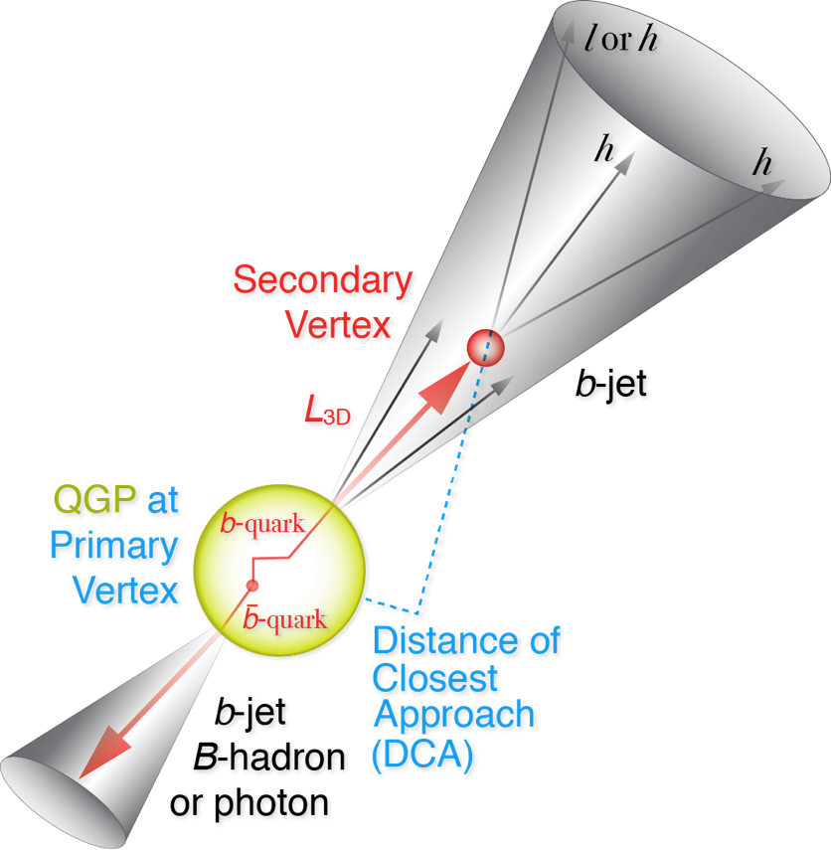
B-jet/B-hadron Tagging in sPHENIX
Goal: much improved B-jet Identification in Heavy Ion Collisions
Secondary Vertexing Possible!
A new b-jet identification with high efficiency and high purity is possible
Figure of merit is efficiency x purity. Greatly enhancing the b-jet physics program, x4 improvement in FOM (compared to alternatives)
Jin, Xin, Cesar, Haiwang et al

Slide 7
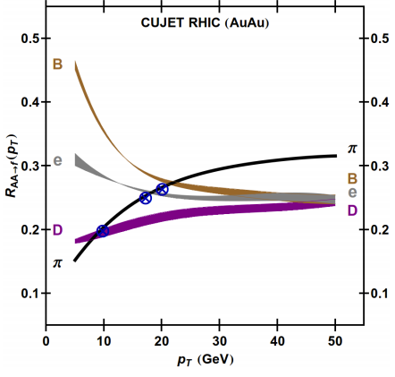

Heavy Quark and QGP Interactions
“Jet flavor tomography”
B-jet modification, collisional vs radiative dE/dX, mass-dependence etc.
Heavy quark flow, thermalization, recombination etc.
sPHENIX Proposal (2014)
Buzzatti et al., PRL 108 (2012) 022301
B-jet
B-hadron

Slide 8
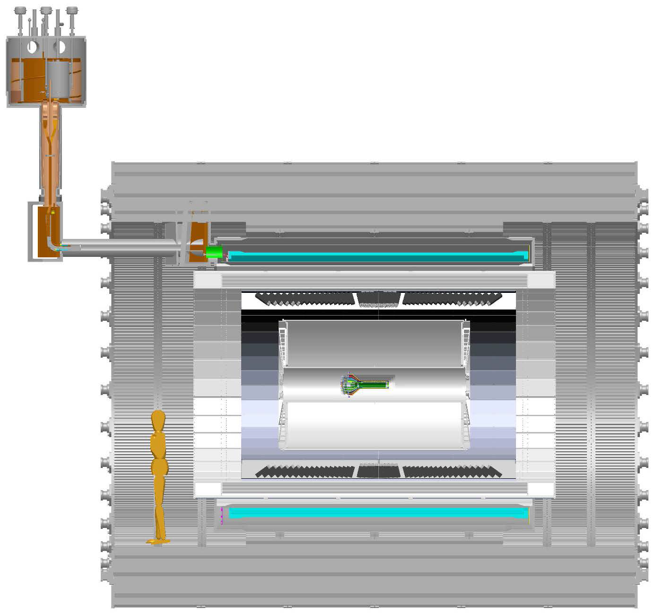
sPHENIX MVTX Project
MVTX in sPHENIX
From MVTX to Readout
Unit & Control Crates:
“5m” copper wires
Host 6U VME RUs
Services for 48 modules, monitoring
LV/HV controls
RU->CRU @CH:
sPHENIX CRU
Power supply
30+m fibers
Mechanical Integration
MVTX

Slide 9
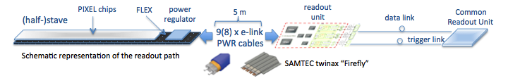
MVTX-sPHENIX Integration
Carbon structure
Global support
Cooling
Readout Chain: 48 staves – Readout Unit (IR) – Comm. Readout Unit (sPHENIX CH)

Slide 10
Scope of the MVTX Project
MAPS staves & Electronics
  MAPS Detectors
    “MoU” to build 68 ITS MAPS staves
    No modification
  Readout Electronics
    Use ALICE/ITS, RU + CRU
    Modify/reprogram CRU for sPHENIX
      Plan-B: build a custom board to convert ALICE/ITS into sPHENIX DAQ format; BNL FILEX etc.
    R&D by LANL LDRD
  Production
    Extend ALICE/ITS MAPS stave production
    sPHENIX personnel help assembly and testing staves at CERN
    Reproduce additional ALICE RU+CRU for sPHENIX
    Final assembly and test in US
  Ancillary systems, copy ALICE
    LV, cables, crates, racks etc.
    Slow control, safety and monitoring
Mechanics & Cooling
  No/(some) changes to ALICE/ITS inner tracker mechanical structures
    End Wheels
    Cylindrical structure shells
    Detector half barrels
    Service half barrels
    Detector and Service half barrels
    Half support structures
  Mechanical Integration
    Conceptual design by LANL LDRD
    Prototype by sPHENIX R&D
    Design integration frames
    Carbon frames etc.
    Installation tooling etc.
  Copy ALICE cooling plant design
    Minor modification to fit sPHENIX
    Smaller heat load than ALICE ITS
  Metrology and Survey
WBS 1.13: a new MIE fund the full MAPS Vertex Detector, ~$5M
WBS 1.3: a sPHENIX baseline 10-stave telescope demonstrator

Slide 11
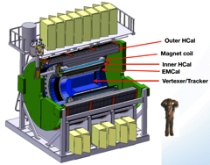
Project Tasks and Timeline
FY2016
FY2017
FY2018
FY2019
FY2020
FY2021
sPHENIX
baseline
CD-0
9/2016
CD-1
CD-2/3
8/1
Ready for
Beam
6/1
ALICE ITS/IB
Prod. ends
Readout R&D
Mech. design
@LANL/ALICE
A schedule driven project!
Key R&D
Mech. Integr.
& Prototype
@MIT/LBNL
Production
MAPS Prod. & QA
@ALICE
Stave prod.&Test @CERN;
RUs Prod. @US
Detector Assembly
& Test @LBNL
Det. Install.
@BNL
+2%
+50%
“MoU” w/ ALICE/ITS: 11/2016
- Produce MAPS chips for sPHENIX as part of ALICE production!
- Full staves, space frames and RUs production cost & schedule → MVTX MIE
More discussions:
Cesar, Gunther, Bob,
Giacomo, Grazyna et al

Slide 12
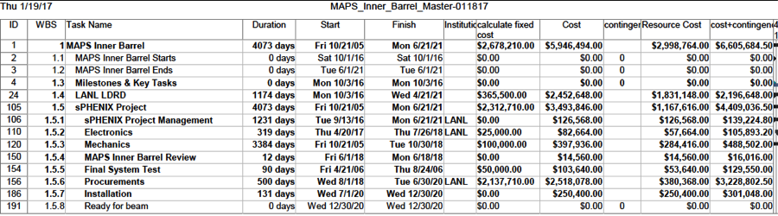
Project Cost and Schedule
To be updated: Dave Lee

Slide 13
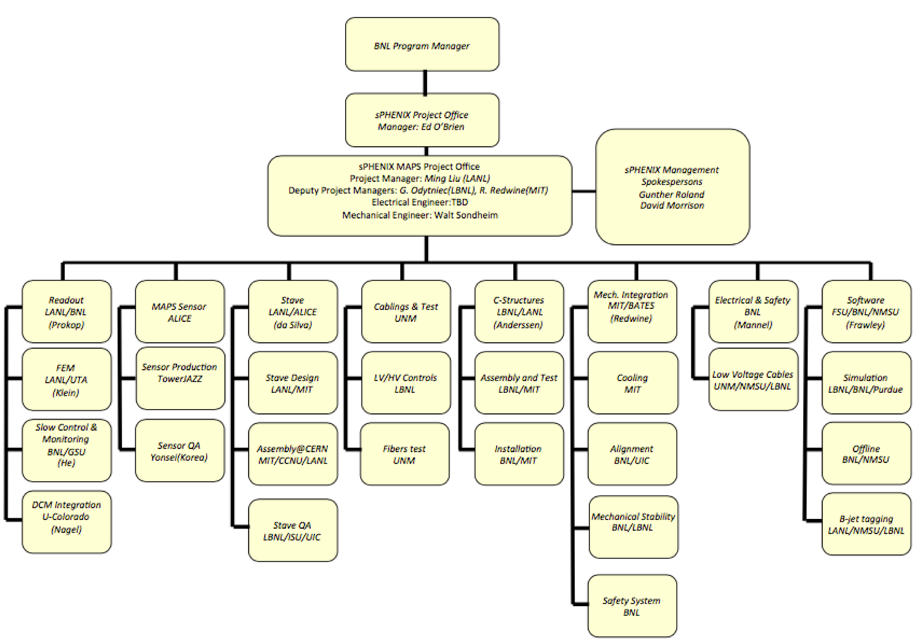
Organization
To be updated: Cesar da Silva

Slide 14
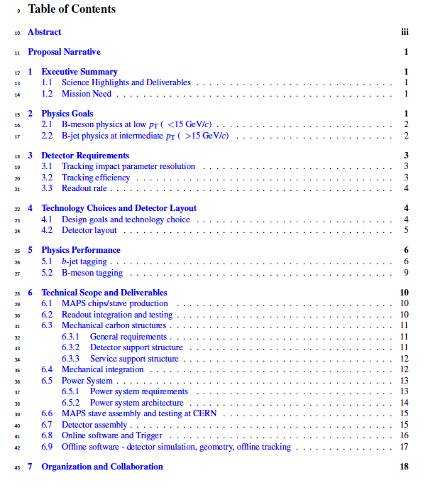
Status of MIE
Thanks for all the hard work put in by everyone!
First draft of proposal narrative available, about 21 pages
Some sessions are more complete than others
Need input from each institution
  FTE
  Labor rates
  Resource schedule
  Focus area
Further editing /polishing

Slide 15
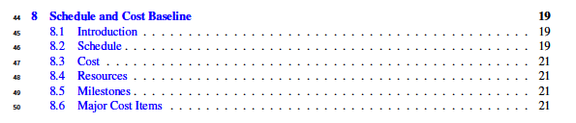

Slide 16
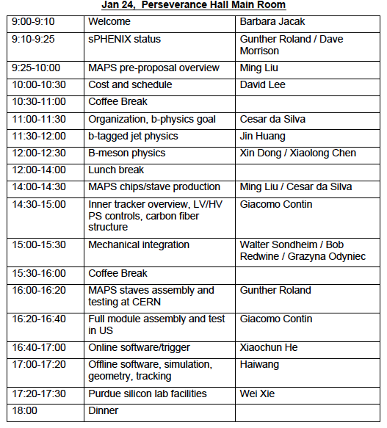
Plan for next 2 days
Presentation and discussion for each session
Update them with the latest information
Proofreading and polishing
To be ready for submission to DOE, 2 weeks before the Feb. budget meeting (2/15 for LANL)
Targeted submission date:
Feb 1, 2017 (Wed.)

Slide 17
Editing/Proofreading
– Dennis, Darren, Dave M., Hubert et al
1. Ming, Mike, Gunther, Dave et al
2. Cesar, Xin et al
3. Jin, Xin, Darren, Sanghoon et al
4. Giacomo et al
5. Tony, Haiwang, Jin et al
Happy Writing!
6.1 Cesar, Mike, Ming,
6.2 Grazyna/Leo, Ming et al
6.3 Walt, Grazyna/Eric et al
6.4 Bob, Gunther, Walt
6.5 Grazyna/Leo et al
6.6 Gunther etal
6.7 Grazyna/Leo
6.8 Xiaochun, Chris et al
6.9 Tony, Jin, Chris et al
7. Cesar, Gunther et al
8. Dave, Ming et al

Slide 18
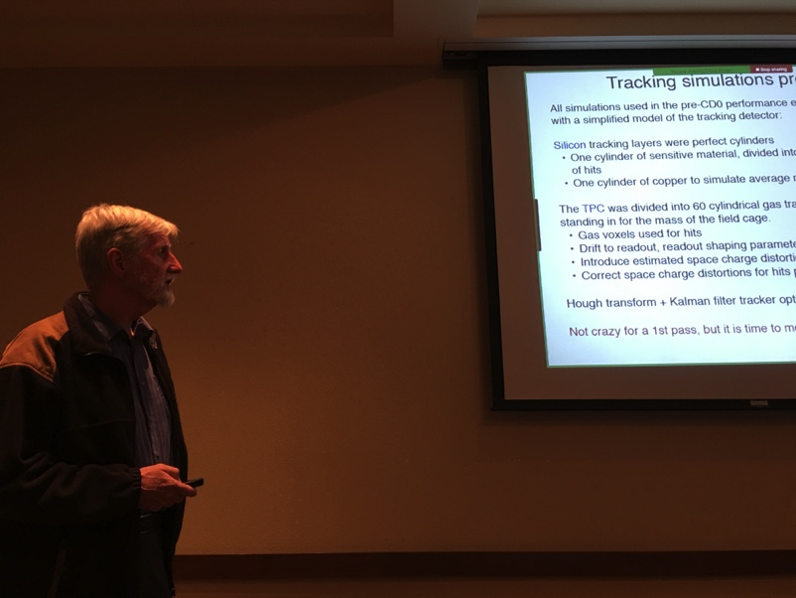
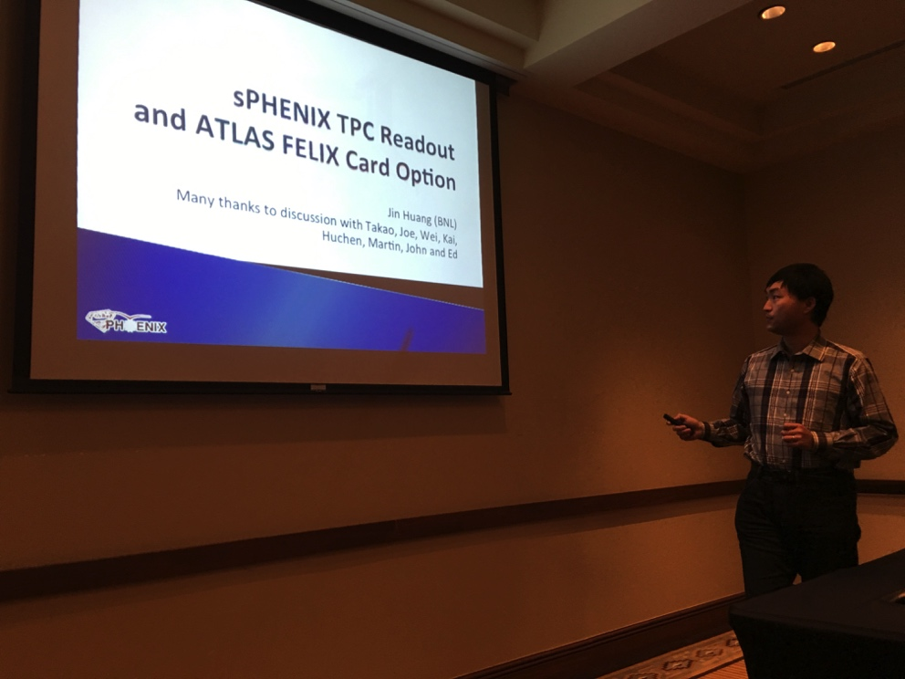
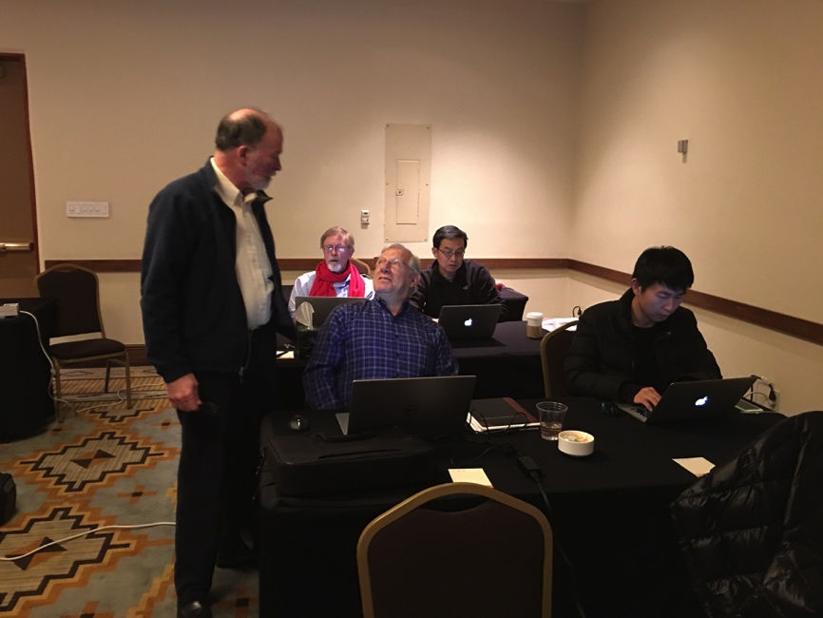
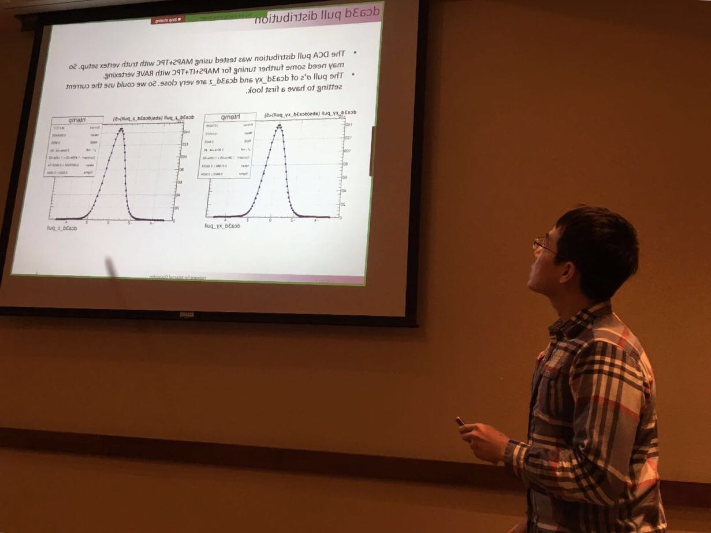
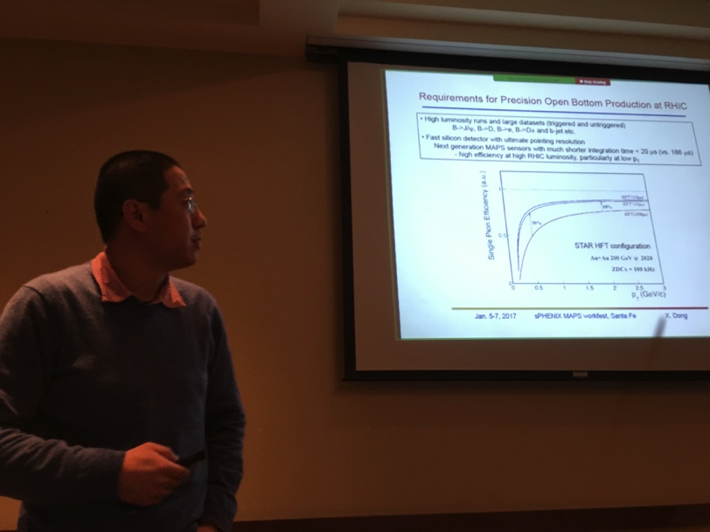
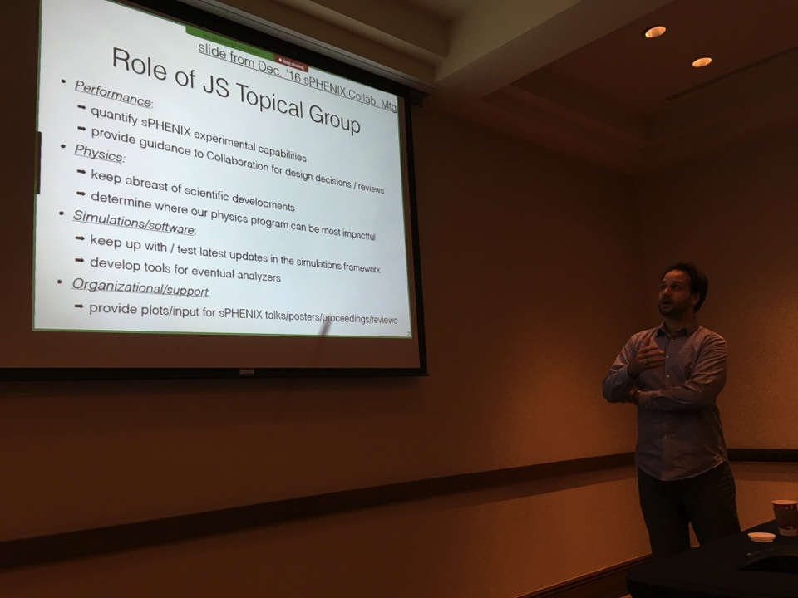
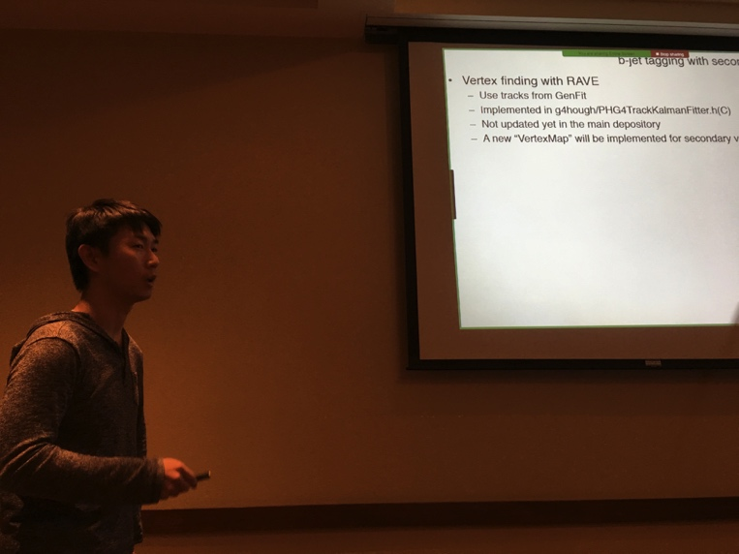

Slide 19
Backup slides

Slide 20
Vertex Detector Design Drivers
Inner Silicon tracking driven by heavy flavor jet performance
Track acceptance: -1.1<η<+1.1 and 0<φ<2π
Minimum vertex acceptance: -10 cm < zvtx < +10 cm
Meet or Exceed a 30% b-jet efficiency at 30% b-jet purity
  defined by the CMS of b-jet figure-of-merit
Minimum track efficiency: >95% of all charged particles
Minimum DCAXY resolution: < 70 microns
Resolve multiple collisions vertexes at large collider luminosities
Maintain track momentum resolution:
  Upsilon mass: dp/p <1.2% for 4 < pT < 10 GeV/c
  Jet Fragmentation: dp/p < (0.2% x p) for pT < 40 GeV/c
Maintain small rate of tracking ambiguities: fake tracks

Slide 21
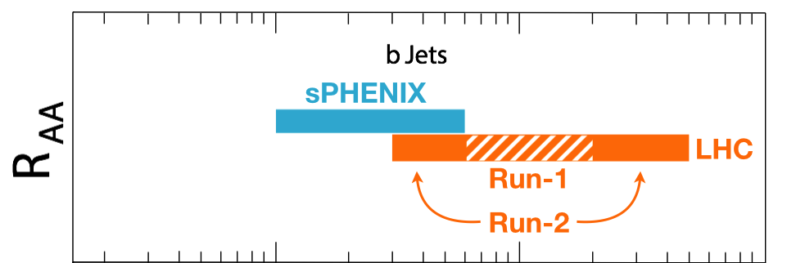
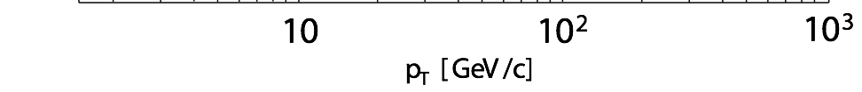
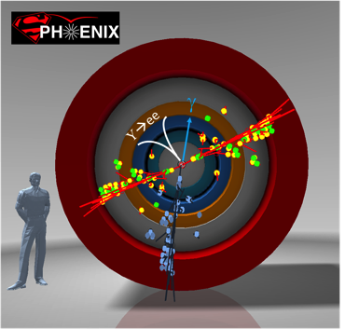
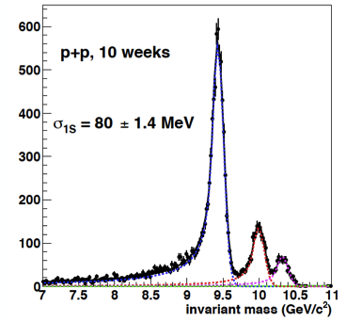
Exciting Science: Physics of the 3rd Pillar
Cannot be done at the LHC for lack of low pT reach and huge backgrounds
sPHENIX is the next flagship heavy ion physics experiment in US
  Jets
  Upsilons
  B-jets
MVTX will complete b-jet physics
sPHENIX Three Physics Pillars
Jets
Upsilons
B-Jets Physics

Slide 22


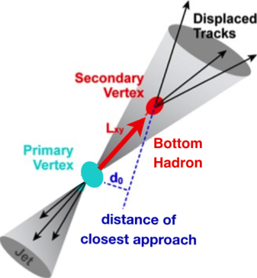
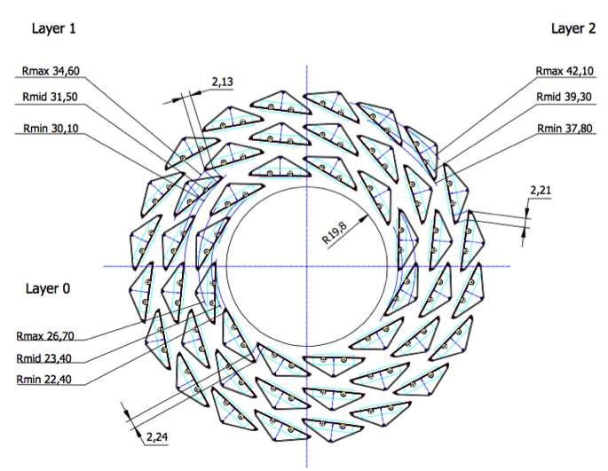
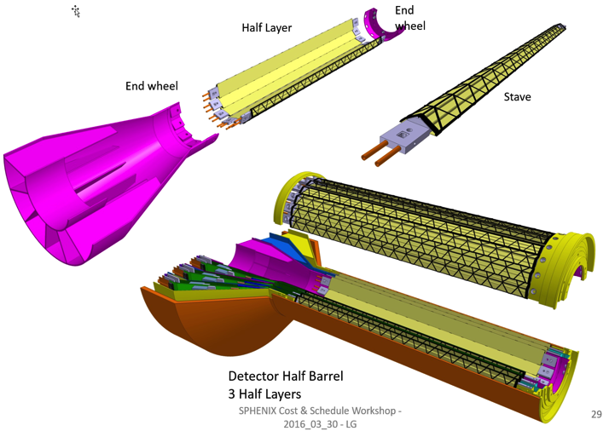
Proposed sPHENIX MAPS-based Vertex Detector (MVTX)
2022+
ALICE ITS Upgrade (2021+);
Inner Tracker System
Key issues:
- Readout
- Mechanics
sPHENIX Inner Tracking
“Adopt” ALICE/ITS
Mini. risk,
Max. physics

Slide 23
MAPS-sPHENIX Electronics Integration
Plan A:
reprogram
ALICE readout path
Plan B: sPHENIX readout path (held as contingency)
MAPS FEM
DCM2
EvB
existing ALICE design
trigger in
modified design,
starting with ALICE boards
busy out
existing design
existing sPHENIX design

Slide 24
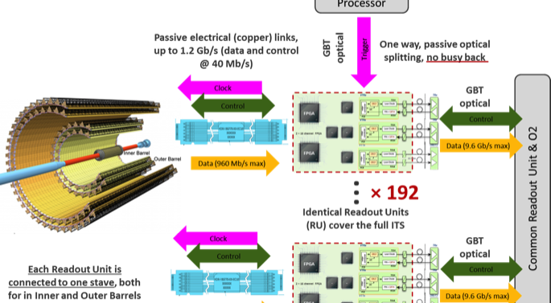

Cost Base for Major Items
From 09/2016
review
MAPS and Staves
  ALICE ITS production
Readout
  ALICE ITS RU and CRU production
Electronics Interface to sPHENIX/DAQ
  FVTX/PHENIX experience
Slow control, DCM-II etc.
  FVTX/PHENIX experience
Mechanical structures and cooling
  ALICE ITS inner tracker design
  FVTX/PHENIX and HFT/STAR experience
x48

Slide 25
CD-1 Practice Speaker Instructions
CD-1 Review Speaker Instructions:
Include the following slides:
15 slides:
1-2 slides describing the system. Include a figure of the system, performance specs, design specs, physics contribution if appropriate to the subsystem.
1 slide with a brief technical overview. List the design drivers.
1 slide defining the scope of the subsystem. Channel counts, segmentation, coverage, etc.
1 Interface slide listing the mechanical and electronics boundaries of the system. Text list of what is “inside the L2 scope ” and what is “outside the L2 scope” with an indication of what WBS contains the “outside the L2” and what is existing from PHENIX.
1 slide showing the WBS structure and the Control Accounts.
1 slide listing the L2 and CAMs by name and Institutions with a brief description of their experience
1 slide showing schedule drivers, a schedule Gantt chart and a list of milestones that include design reviews, prototype v_x complete, PRR, production starts, production ends, installation.
1 slide for the budget with OPC, EQUMIE profile (capital equipment) in AY$. Include a list of 5-10 major cost items on this slide, the cost drivers.
1 slide with the labor profile broken down by job category. Identify the labor you have, and the labor that you still need to identify.
1 slide for the status of the design (off project), generic R&D (off project) if any and OPC
1 slide showing WBS dictionary
1 slide showing BOE
1 slide showing Risk analysis
1 slide listing Issues and Concerns
No summary

