Slide 1
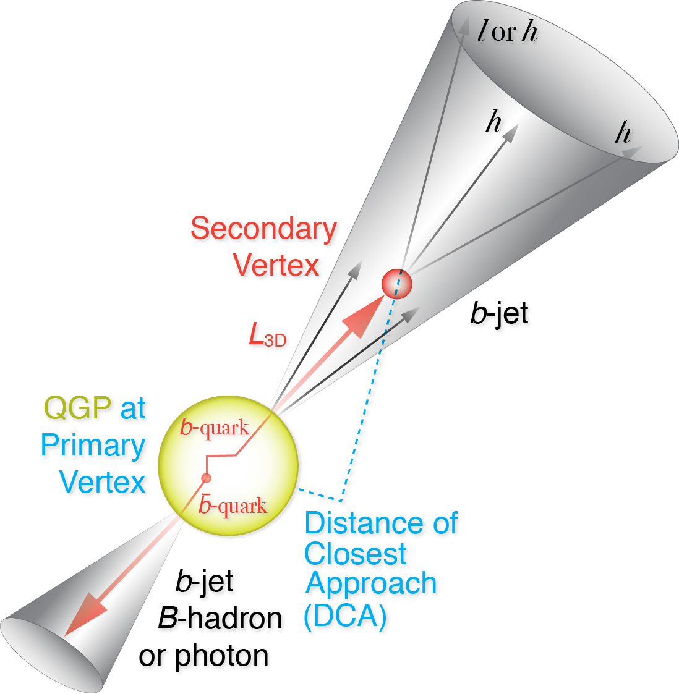
HF TG status and planned simulations for MVTX review
Ming Liu (LANL)
Jin Huang (BNL)
Mike McCumber (LANL)

Slide 2
MVTX Cost & Schedule and R&D
  A master cost & schedule project file being updated
  LBNL - manpower and technical resources, fixed cost etc.
  Will get similar updates from MIT and other institutions
  Prepare for BNL review (physics + cost & schedule)
  To update MVTX proposal later this year
MAPS R&D @LANL
  Received 5 MAPS chips + high-speed readout adaptors to build a telescope
  Setting up “MOSAIC” high-speed readout test bench @LANL
  Two RUv1 boards available ~ April/May, “CRU” w/ Altera evaluation borads
  In process of obtaining FELIX from BNL
MAPS Readout workfest scheduled @UT-Auston, 4/19-20
    UT-Austin, LANL, LBNL, BNL experts

Slide 3


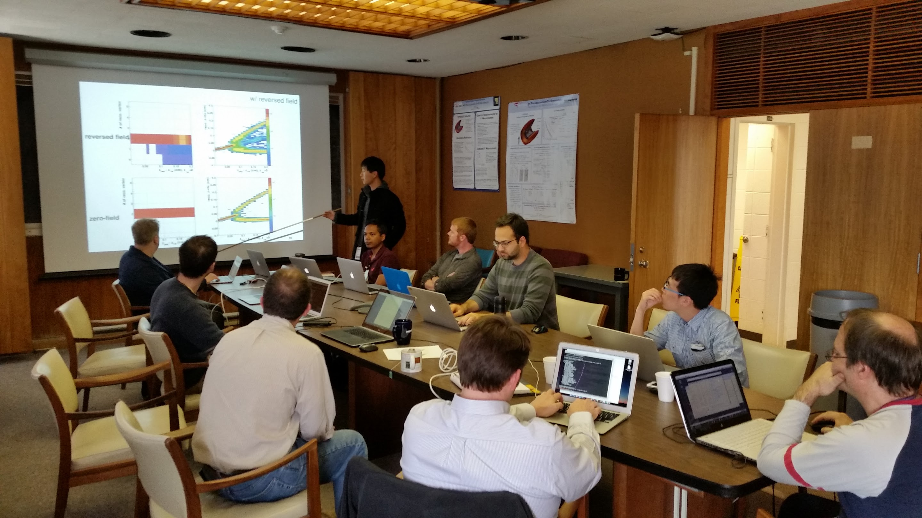
Topical group organization
Co-conveners
  Jin Huang (Brookhaven National Lab)
  <jhuang@bnl.gov>
  Mike McCumber (Los Alamos National Lab)
  <mccumber@bnl.gov>
We are very fortune to have a diligent team working on a wide spectrum of high-priority development
  More manpower are always welcomed and needed!
Communication:
  Discussion email list:
  https://lists.bnl.gov/mailman/listinfo/sphenix-hf-jets-l
  Wiki page under construction:
  https://wiki.bnl.gov/sPHENIX/index.php/Heavy_Flavor_Topical_Group
Meetings/Events
  Use weekly simulation meetings for updates, as many high-priority
  tasks involve software developments with tracking detector designs
  https://indico.bnl.gov/categoryDisplay.py?categId=88
  Goal oriented irregular events:
    MVTX brainstorming meeting, Mar 8
    MAPS+HF-jet joint workfests, e.g. Jan 5-7 2017 @ Santa Fe
    Pre-collaboration meeting work-fest on May 16-17, 2016
    Initial TG meeting on Apr 22 , 2016
MAPS workfest
HF-jet workfest

Slide 4
HF-topical group introduction
High-precision vertex
Jet capability
High rate
HF-jet: in particular b-jet, when compared with much more abundant light-parton jet, provide differentiating sensitivity to collision VS radiative energy loss. “no” FF complication, probing parton energy and higher-scale, that compliments HF-meson programs
Detection technique employed: Jet + jet structure information enhancing B-hadron fraction, i.e: displaced track, high mass secondary vertex and enhanced leptonic decay products
HF-jet topical group formed in Apr 2016 and initiated Geant4 based b-jet study in sPHENIX. Many progresses in simulation tool, b-jet tagger and studying new observables.
In the new era of MVTX program, aim to expand the program in HF-meson program (See Xin’s talk) and serve the detector consortium of MVTX (See Ming’s talk)
https://wiki.bnl.gov/sPHENIX/index.php/Heavy_Flavor_Topical_Group

Slide 5
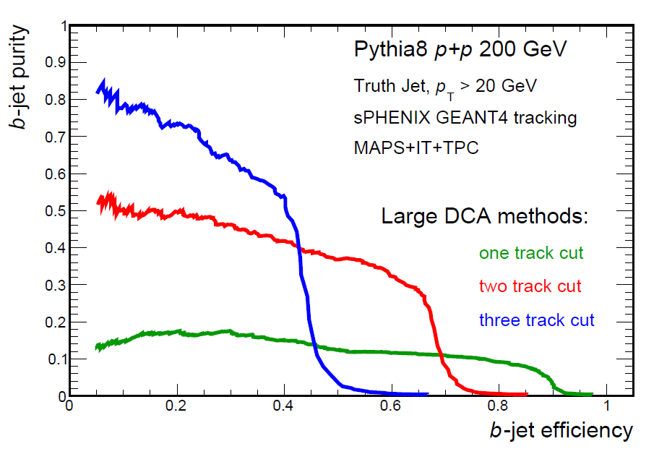
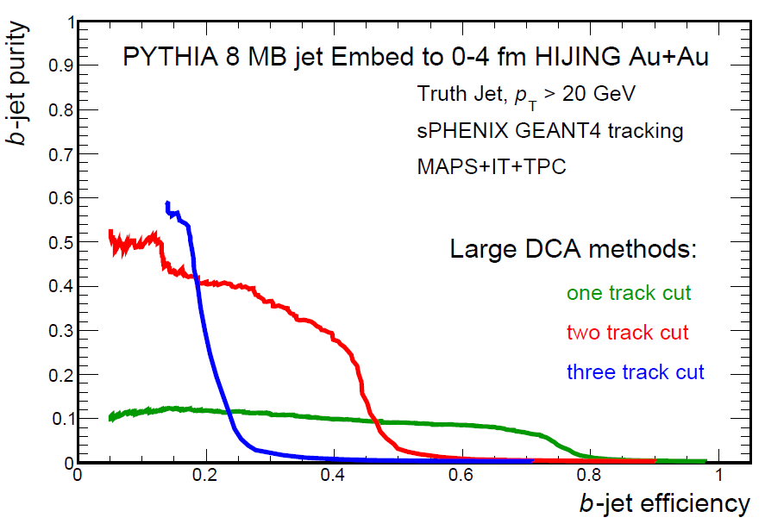
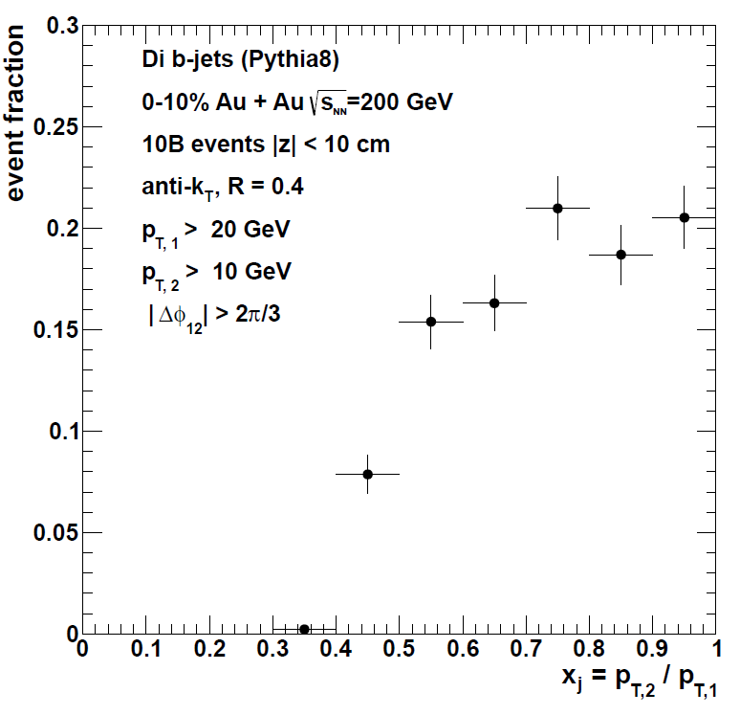
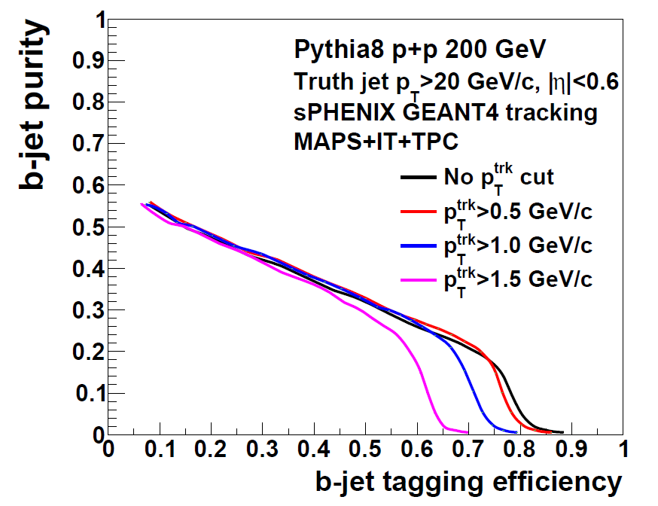
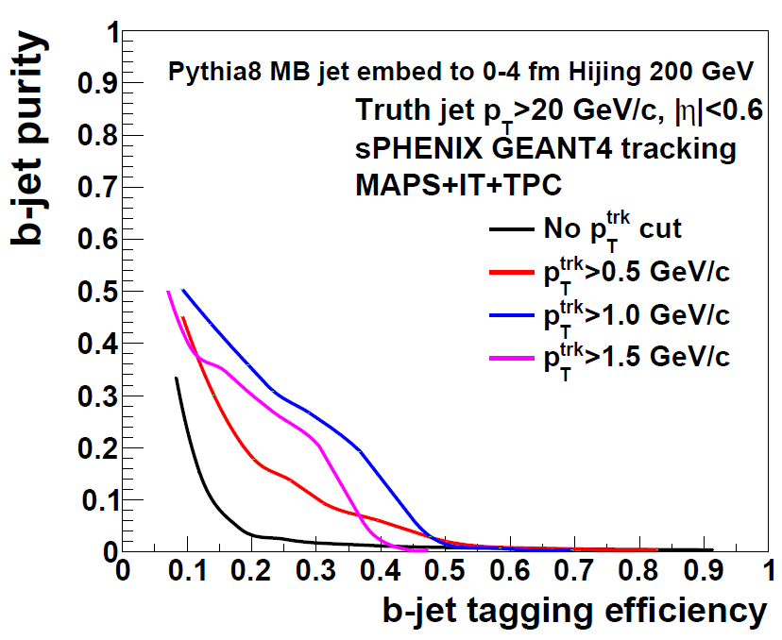
Delivered plots for Feb-2017 MAPS pre-proposal
Curve update request, not yet received
Observable Projections
B-jet tagging in p+p
B-jet tagging in 10%C Au+Au

Slide 6
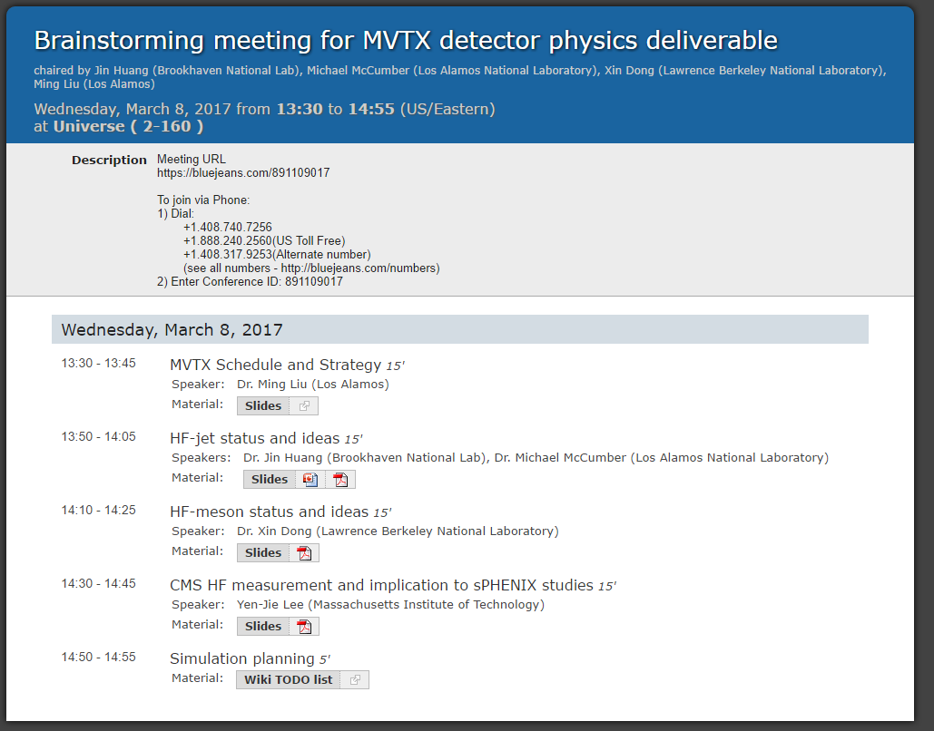
Brainstorming meeting
https://indico.bnl.gov/conferenceDisplay.py?confId=2932
About 20 collaborator called in the discussion
Next few pages

Slide 7
Technical performances:
Realistic implementation in Geant4
  In verification: implement ladder structure in simulation – Tony F., Gaku M.
  By Apr (Done): digitization of MAPS detector - Tony F.
  By Apr (?): Update tracking performance plots for MAPS, DCA and dp/p resolutiosn - Tony F.(?)
  By summer (?): complete the pile-up simulation framework – Mike M., Yorito Y.
b-jet tagging algorithm
  By summer, help needed : Investigating full-detector fast simulation for b-jet simulation. Look into general packages e.g. DELPHES.
  By summer: Full calorimetry simulation with secondary vertexing tagger – Sanghoon L.
  By summer: Full calorimetry simulation with high-DCA track counting – Haiwang Y.

Slide 8
Physics performances:
Update non-prompt D meson performance projection
  Deliverable by end Apr :update the Rcp and v2 plot with real simulations for MB and peripheral collisions - Xin D., Xiaolong C.
Explore complimentary B-hadron channels beyond non-prompt-D
  By summer: Fast simulation for exclusive channels, B->J/Psi K, B->D pi - Xin D., Xiaolong C.
  By summer, help needed: B->non-prompt J/Psi->e+/e- and p+p triggering
Inclusive b-jet R_{AA}
  By Apr (?): Update theory curve to RHIC energy – Cesar da S. contact Vitev group
  Deliverable by end Apr: Update theory curve for RHIC energy for R_{AA} plot
di-b-jet asymmetry
  By Apr: Extract di-jet purity from Geant4 simulation - Haiwang Y.
  Deliverable by end Apr: Apply di-jet purity to projection – Darren M., Haiwang Y.
b-jet-non-prompt-D asymmetry:
  Deliverable by end Apr: Produce uncertainty projection in fast simulation – Xuan L.

Slide 9
Additional topics help (always) wanted
HF-hadron chemistry: e.g. Lambda_c, to study HQ hadronization
HF-meson correlations, e.g. D-D_bar azimuthal correlations, to enhance sensitivity to HQ-medium integration.
Explore b-jet substructure tools:
  Exercise jet-grooming algorithm, FF. – in collaboration with Jet Structure group
  Tagging gluon splitting via multi-decay vertex in inclusive b-jets.
Explore Charmed-quark jet:
  charm fragmentation, completes mass hierarchy. Select D meson formed late in formation
  Try out prompt-D tagger (ALI-PREL-117896) and Corrected Secondary vertex (arXiv:1612.08972)
Explore tagged D-meson in correlation with opposite hard structure
  Tagging initial c-quark kinematics with correlations, including D-meson - jet correlation and D-meson - photon correlation
  Study D-FF and formation of D-meson
Further b-jet tagging developments
  Try different strategy: Soft-lepton tagging
  Optimize analysis methods: likelihood analysis and machine learning tool
Triggering of B-mesons in p+p collisions
  D->J/Psi ->e+/e-, EMCal trigger. Explore work by Sasha L.
  D meson calorimetry trigger, turn on.
  Large DCA triggers?

Slide 10
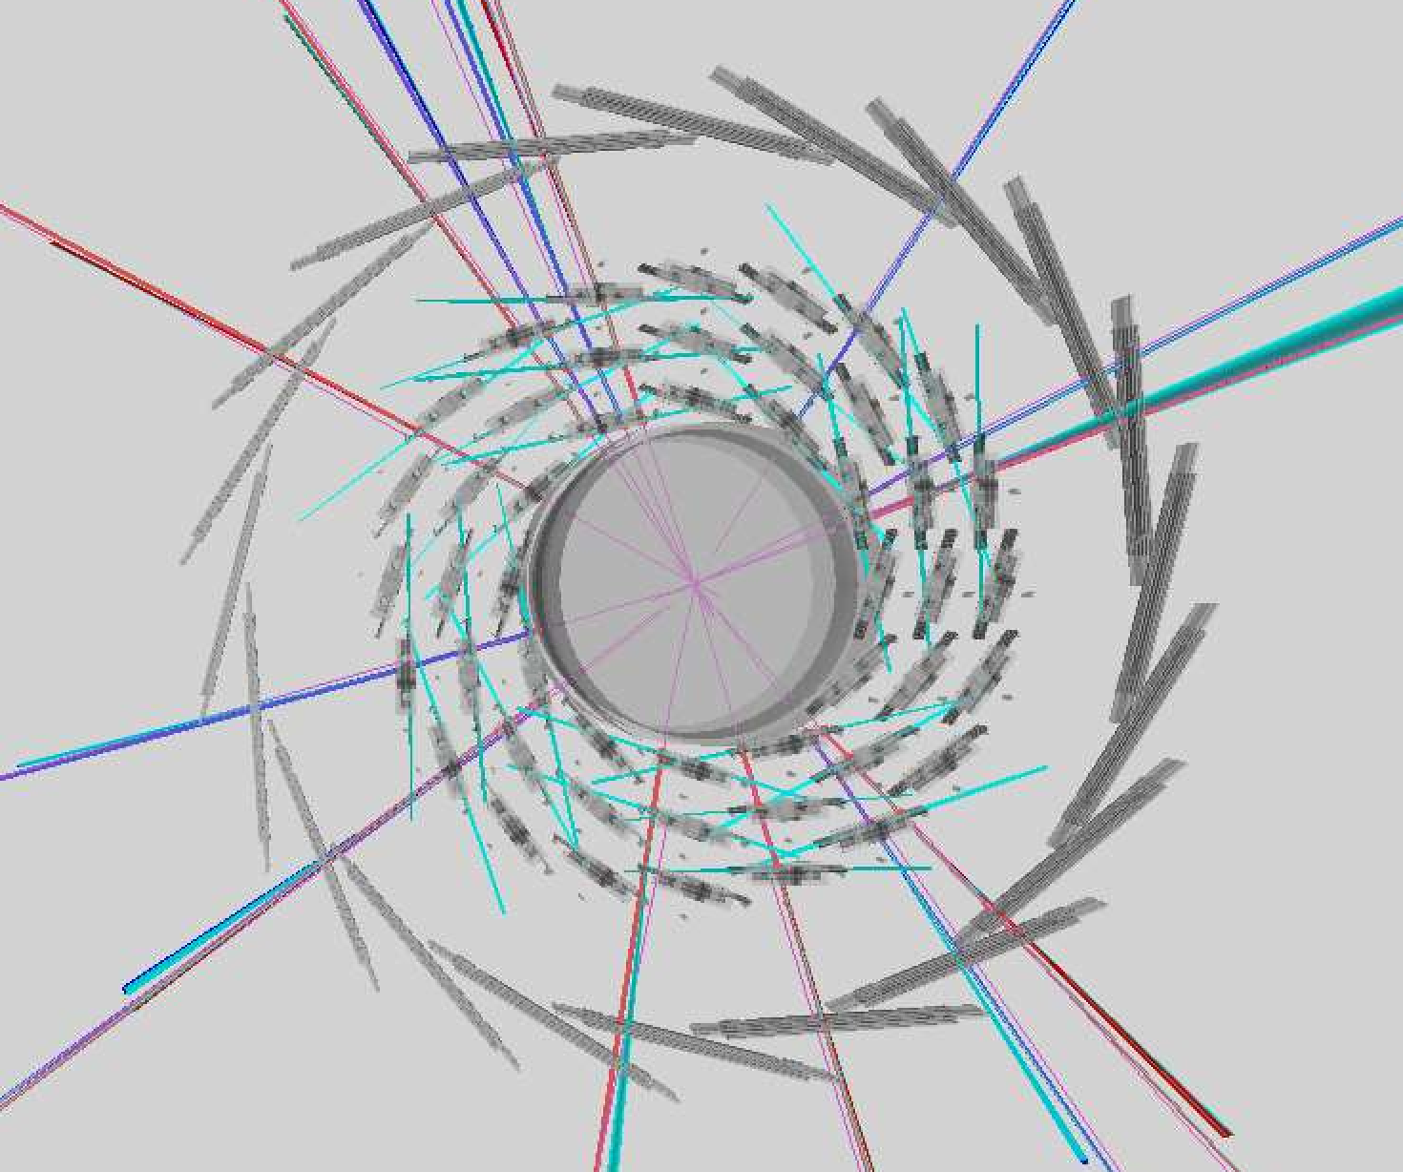


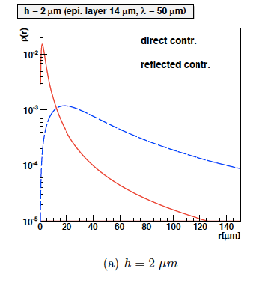
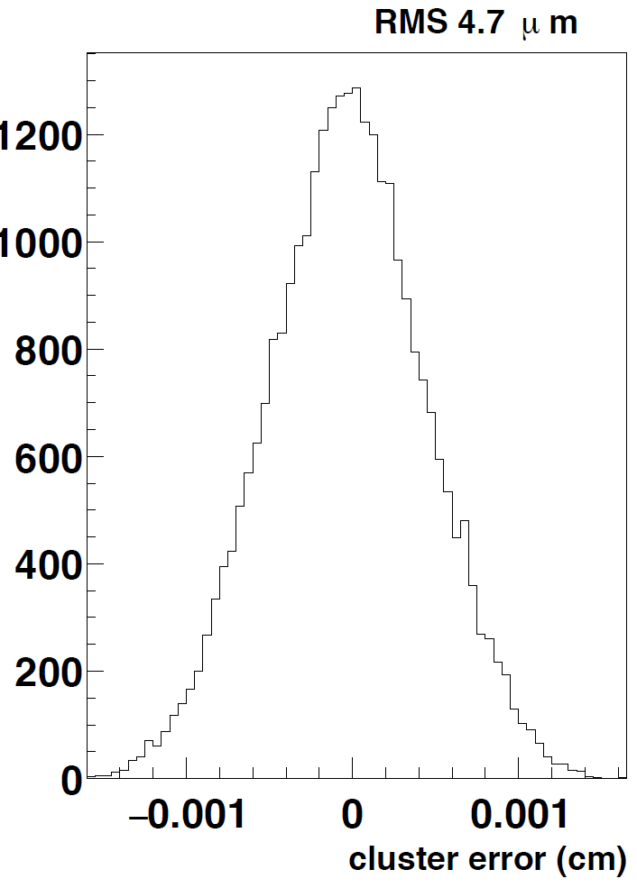
Progresses since brain storming meeting – modeling of silicon trackers
Tony Frawley:
Approximation of MAPS diffusion
parametrization [arXiv:10053.3710]
Used in MAPS digitization,
Reproduced ALICE claim of 5 um res.
https://github.com/sPHENIX-Collaboration/coresoftware/pull/255
Pipe
MAPS inner tracker
INTT-layers 1
Gaku Mitsuka :
Built INTT geometry model
Improving estimation of material budget
Debugging rφ cluster distribution

Slide 11
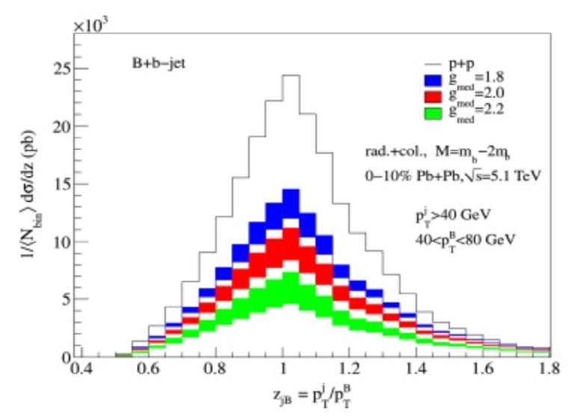
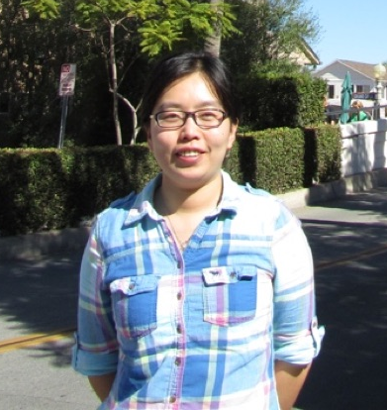
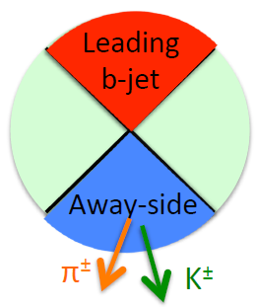
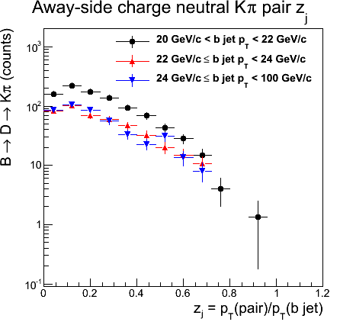
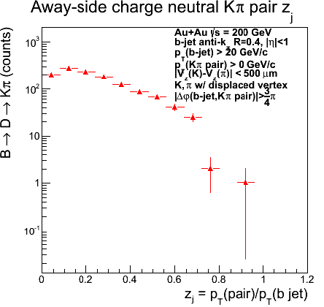
Progresses since brain storming meeting
Non-prompt D-meson correlations
Phys.Lett. B750 (2015) 287-293
Xuan Li (LANL) also started investigation of correlation of b-jet in correlation of a non-prompt D₀-meson (→pi + K)
Goal: probe b-quark energy loss and fragmentation, access to lower z_{j} cut-off comparing to di-b-jets correlation; help purity of b-quark-jet tagging
Producing fast simulation results for pre-proposal
Preliminary study
Updates in simulation meetings:
https://indico.bnl.gov/conferenceDisplay.py?confId=2684

Slide 12
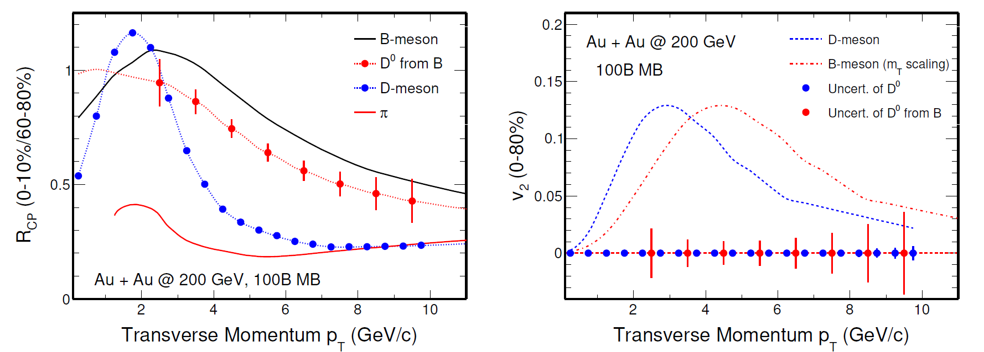
Plan summary
Apr review/preproposal: Solidifying results for already presented in pre-proposal
Summer review/full proposal:
  Expansion of selected topics: more realistic simulation, exclusive B-meson reconstruction
  Addressing BNL-charged review comments
  Many more HF capabilities need your help to develop
Expect workfest around time of May collaboration meeting

