Slide 1
MVTX Status
Ming Liu
LANL
sPHENIX HF-jet Topical Group Meeting

Slide 2
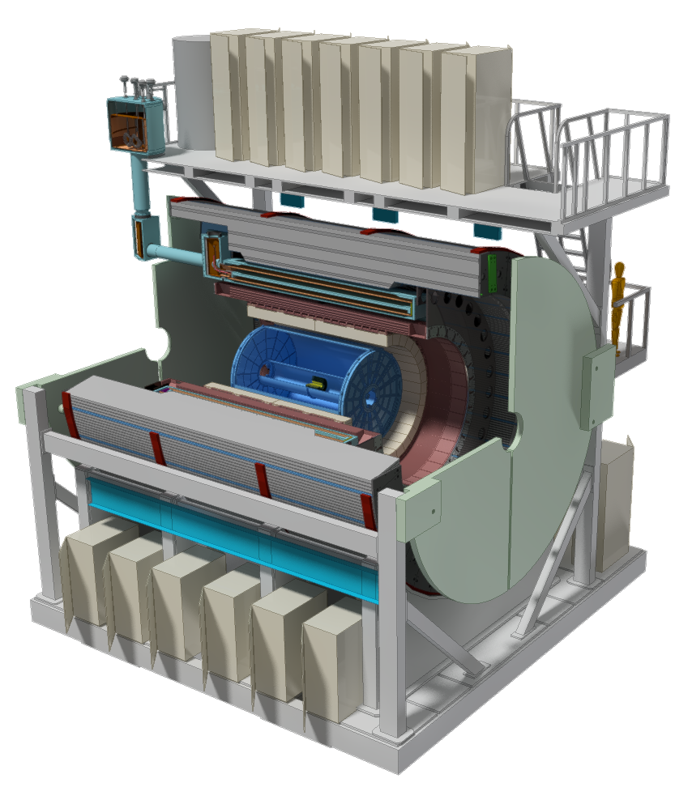
Scope of sPHENIX MIE
The MIE Cost Range 30-35M AY$ in Mission Need (CD-0) approval document

Slide 3
MVTX Progress
A separate MIE as an upgrade project
Full proposal to be submitted by BNL
Expand HF physics program, ~science case (CD-0)
BNL Director’s review later this spring/summer, science ”CD0” + C&S “CD1”
Dry run in mid/late June ? → need to complete preliminary physics case study
BNL review w/ DOE observers, July ?
MVTX project file: Cost & Schedule updated, 4/7/2017
LANL & LBNL, detailed labor profile
MIT, discussed last week.
Other institutions, in progress
DOE wants to keep the fund below $5M, possibly from some redirected $$
Project webpage:
https://p25ext.lanl.gov/maps/mvtx/mvtx.html
On-going discussion between BNL ALD/Deputy (Dr. Maria Chamizo Llatas) and LANL/LBNL/MIT
First phone meeting with Maria, Bob, Grazyna and Ming attended
Path toward BNL Directors review, C&S
R&D plan, milestones
Infrastructure needs, collaboration with ALICE etc.
A small group weekly phone meetings to discuss project planning etc on Wed.
First in person meeting/discussion 4/25 (full day) on cost and schedule and R&D plan
Maria, Bob, Grazyna and Ming, + Ed/sPHENIX Project office

Slide 4
MVTX R&D Status
Readout R&D
Workfest @UT-Austin, 4/19-20
LANL MOSAIC test bench setup in progress
RUv1 available in May, will be used for LDRD telescope
CRU being prototyped with Altera evaluation boards, able to communicate with the board;
BNL/ATLAS FELIX being evaluated as an alternative
Computer arrived, fibers/cables ordered
Like to obtain one FELIX in a few weeks
Stave production for LDRD telescope
ALICE Stave Production Readiness Review 4/27
LANL people do assembly and test at CERN, May – Sept. 2017
Project C&S – work in progress
Detailed commitment from each institutions etc
More work after BNL meeting w/ Project Office, 4/25
Tracker integration task force, led by Mickey
MVTX + INTT + TPC mechanical integration issues
Identify the major tasks, report due by the end of April
Resources will be workout later

Slide 5
Prepare for the BNL Director’s Review Physics/Detector Simulations
Produce preliminary by early June
B hadron physics
B-jet physics
Detector performance plots
To be ready for BNL Directors Review in July
Money plots for the proposal

Slide 6
sPHENIX Schedule
Test Beam at FNAL(1st round prototyping) Feb 2016
CD-0 Sep 2016
Test Beam at FNAL(2nd round prototyping) Jan 2017
CD-1 Director’s Review May-Jun 2017
OPA-CD-1/CD-3a Review Nov 2017
CD-1/CD-3a authorization Dec 2017
All Preproduction R&D and Design complete Jun 2018
OPA- CD-2/CD-3b review Jun 2018
CD-2/CD-3b authorization Aug 2018
sPHENIX installation begins in 1008 Facility Apr 2020
sPHENIX Installed, cabled, ready to commission Apr 2021
First RHIC beam for sPHENIX Jan 2022
The Resource-loaded Schedule contains 8.5 months of float to Jan 2022
From Ed’s 3/30/2017
L2 meeting

