Slide 1
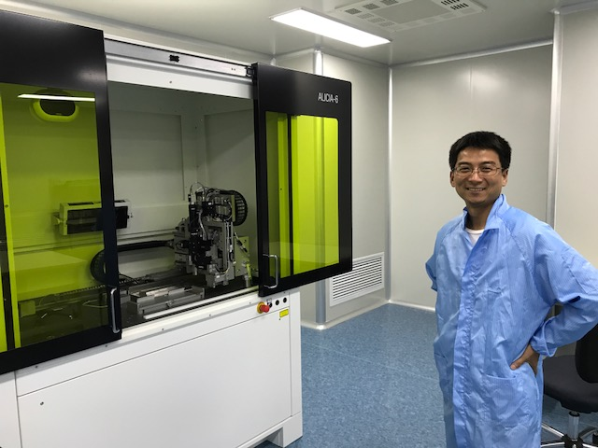
Feasibility to use CCNU Labs for MVTX HICs/Staves production 5/24/2017
CCNU ALICE/ITS HICs assembly lab
Chip assembly machine, installed and tested
2 technicians trained @Italy and also locally
Wire bonding machine, will arrive soon, a few weeks, arriveds in June
2 technicians trained @Italy
1 week local training planned
One old bonding machine in opeation
Wire bonding
machine location
Dr. Yaping Wang,
Assembly lab director

Slide 2
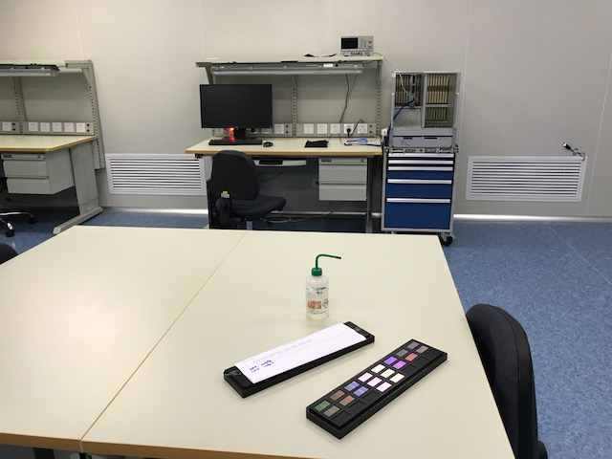
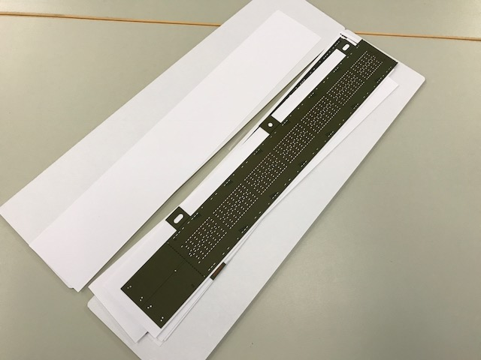
Technical Resources
Technical resources
2 mechanical technicians on MAPS chip mounting on FPCB
FPC gluing
Mount chips on FPCB
Wire bonding
Trained at CERN/Italy
1 electronics technician on testing HICs
Test and fix HICs
Trained at CERN/Italy
One Ph.D (An, Mang Mang) trained in all aspects in R&D on HICs assembly and test @CERN
PLAC – Pixel Lab At CCNU
Electronics readout design engineers,
a team led by Wang, Dong (from ALICE, readout and trigger)
Chip design engineers
A team led by Yang, Ping (participated in ALPIDE design @CERN, 2012-2015)
Staff and Students from CCNU
Staff: 15
Graduate students: 10+ Ph.D and 25+ Master students
Institute of Particle Physics
Staff: 30+
Postdocs and Students: 10+ postdocs, ~80 students

Slide 3
HICs Assembly Lab: space ~ 70m² (1K clean room); 20m2 (10K clean room, 2.9m head room)
Chip and FPC gluing
Gluing FPC/MAPS
Chip mounting
Wire Bonding
Electrical circuit testing
Storage
Not Doing:
Stave assembly
No carbon structures
Machine shop: (Sun, Daming, Tech.)
CNC etc.
Simple mechanical structures
Chip mounting
Wire bonding
Test bench
storage
Gluing & assembly
tables

Slide 4
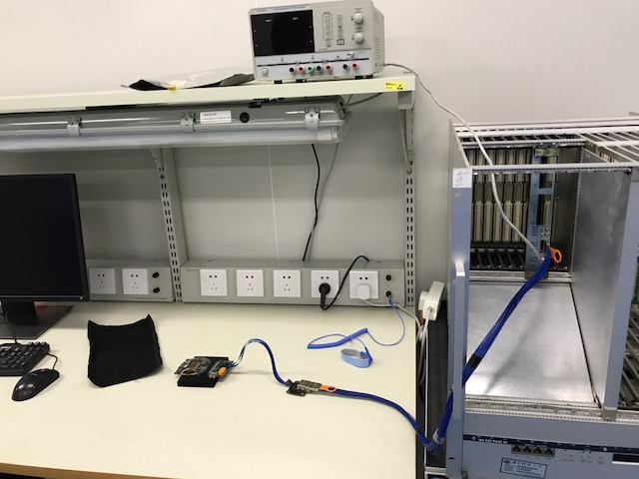
Test Bench
One MOSAIC
4 single chips
What LANL has now

Slide 5
CCNU Plan
CCNU Budget ALICE: $7.5M RMB
Pay MAPS chips
Pay toolings, jigs
Pay assembly machine
Technician salary
Traveling, student labor
To produce 500 ALICE/ITS mid-layer HICs
~2 HICs per day -> 250 days, 10+ months
starting from June 27, 20117 –> June 2018
No immediate use of the lab after June 2018
The lab can be used for MVTX HICs production
3 months replace jigs, training
Starting ~Sep. 2018, ~2 HICs per day, -> 35days -> 2 months (2~3 months)
Many students available for testing
Stave assembly sites: 68 staves
Stave space frame fabricated at CERN ( by 2017)
Assemble at US/LBNL? (replace jigs, copy from CERN ITS/IB)
China/CCNU? -> replace jigs (copy from CERN ITS/IB)
@CERN 2 staves/week, from MAPS/Spaceframe/stave
CCNU budget sPHENIX: US$100K?
toolings, jigs, training
M&S for operation, gas etc.
Technician’s salary
Traveling, student labor
Shipping MAPS/HICs/staves

Slide 6
CCNU Plan – Cont.
Gao
Yang
Experts and Designers of ALICE MAPS on-chip electronics
Analogy circuit – Dr. Chaosong Gao
Digital circuit – Dr. Ping Yang
They can help us!
PLAC – Pixel Lab At CCNU
Interested in mechanical system integration
Plan to hire a full time engineer to work on sPHENIX integration effort
Visit LANL 6-12 months on preliminary conceptual design for the MVTX/INTT/TPC
Physics simulation and analysis
Many students
PLAC Ass. Director
Dr. Xiangming Sun

Slide 7
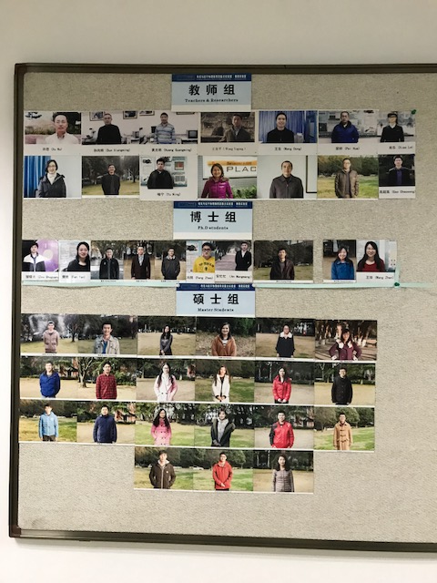
PLAC Members (Pixel Lab At CCNU)
Faculty: ~15
Ph.D students: ~10
Master students: ~25

Slide 8
Stave production plans
Plan-A
CERN production:
Assembly and test
Time: starting 08/2018, 6-9 months
Plan-B
HICs production @CCNU, Sep. 2018, 2-3 months
Stave space frame production @CERN ITS/IB, by 2017
Stave assembly: US/LBNL? Or China/CCNU, 4-6 months
DOE Budget: FY18
Delay in sPHENIX start?
CCNU option → plan A?

Slide 9
MVTX Review Presentations
Overview
Cost and Schedule
…
Impacts of new president’s FY18 budget
sPHENIX baseline
MVTX MIE

Slide 10
In the MVTX leaders meeting last week we had a few questions about the integration and installation of the MVTX in sPHENIX regarding:
installation tools
Jiggs for stave assembly … and half-barrel integration
installation process: it seems once the INTT and MVTX are installed one cannot remove independently the MVTX
Global integration issue … check with HFT design
modifications to the design of the MVTX (cables too?)
Possible to use short (~20cm) extension cables to extend the central barrel carbon structure to allow space for INTT,
R&D needed
beam pipe tolerances
There is a room to expand the radius a bit, needs engineer’s evaluation on this
We had a brief discussion at CERN last time… but didn’t draw a conclusion as we were not sure we need to do it

