Slide 1
sPHENIX MAPS Inner Tracker
Ming X. Liu
LANL

Slide 2
Outline
Motivation
MAPS Inner Tracker
Project Status
R&D status
Full MIE proposal writing
Santa Fe HF-Jet/MAPS Workfest 1/5-7, 2017
https://indico.bnl.gov/conferenceDisplay.py?ovw=True&confId=2641

Slide 3
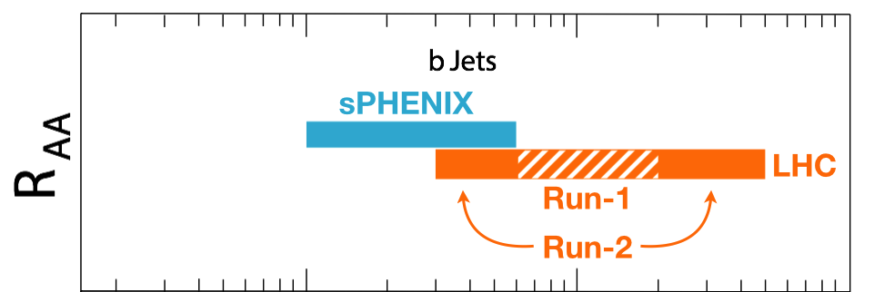
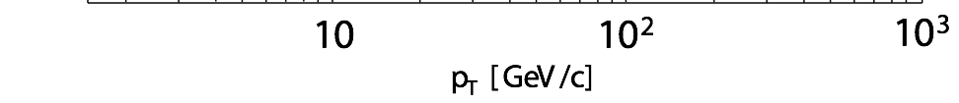
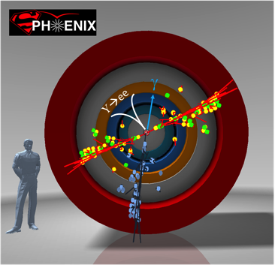
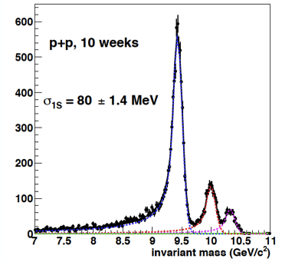
Exciting Science: Physics of the 3rd Pillar
Cannot be done at the LHC for lack of low pT reach and huge backgrounds
sPHENIX is the next flagship heavy ion physics experiment in US
  Jets
  Upsilons
  B-jets
sPHENIX Three Physics Pillars
Jets
Upsilons
B-Jets Physics
Jin’s talk

Slide 4
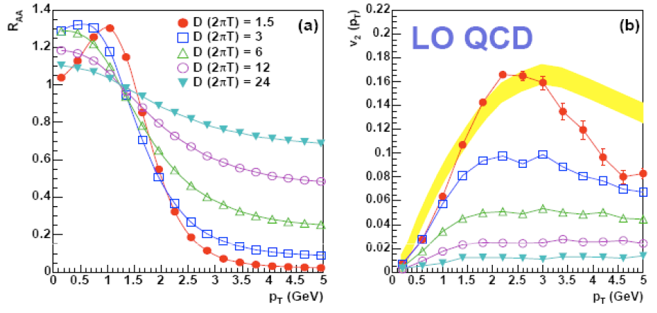
Heavy Quark: Sensitive to Medium Properties
Moore & Teaney, PRC 71 (2005) 064904
Charm quark
Xin’s talk

Slide 5
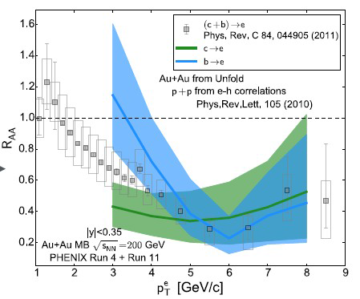
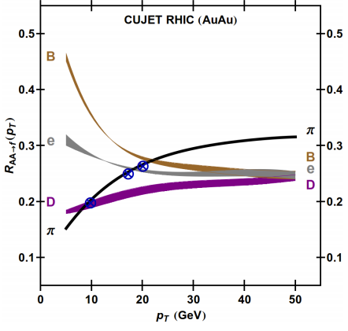

Heavy Quark Energy Loss @RHIC
“Jet flavor tomography”
PHENIX PRC 93 (2016) 034904
Buzzatti et al., PRL 108 (2012) 022301
Xin’s talk

Slide 6


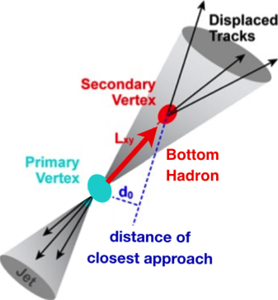
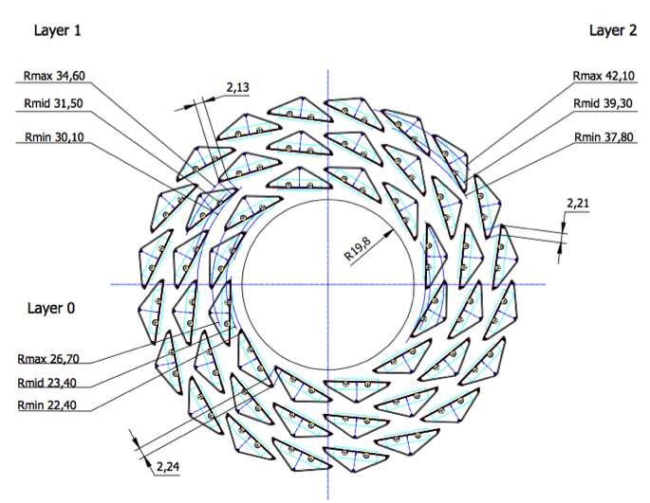
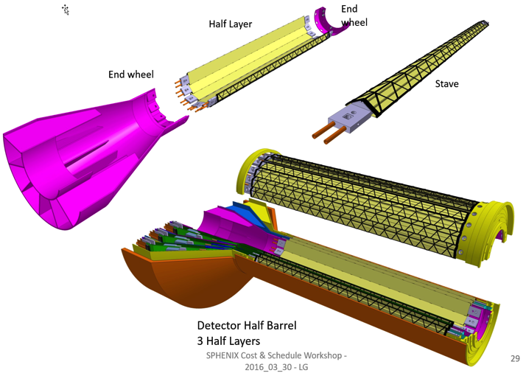
sPHENIX MAPS Inner Tracker
2022+
ALICE ITS Upgrade (2021+);
Inner Tracker System
Key integration issues:
- Readout
- Mechanics
sPHENIX Inner Tracking
“Adopt” ALICE/ITS
Mini. risk,
Max. physics

Slide 7
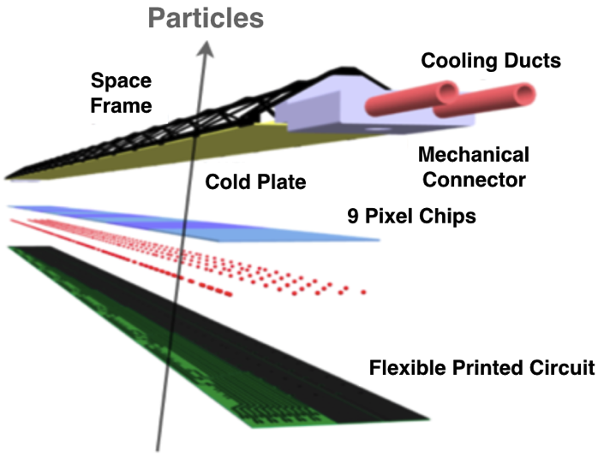

MAPS: a State of the Art Tracker
Advantages of MAPS:
  Very fine pitch (28x28 μm)
  High efficiency (>99%) and low noise (<10⁻⁶)
  High speed, 2~4 μS
  Ultra-thin/low mass, 50μm (~0.3% X₀)
  On-pixel digitization, low power dissipation
  15+ years of R&D at CERN for ALICE upgrade
An ideal detector for QGP b-jet physics!
A 9-chip MAPS stave
50 μm
28 μm

Slide 8
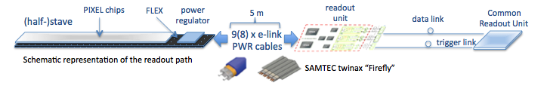
MAPS-sPHENIX Electronics Integration
Plan A:
reprogram
ALICE readout path
Plan B: sPHENIX readout path (held as contingency)
MAPS FEM
DCM2
EvB
existing ALICE design
trigger in
New:
- ATLAS FELIX Readout Unit
to replace CRU?
- TPC & MAPS
modified design,
starting with ALICE boards
busy out
existing design
existing sPHENIX design

Slide 9
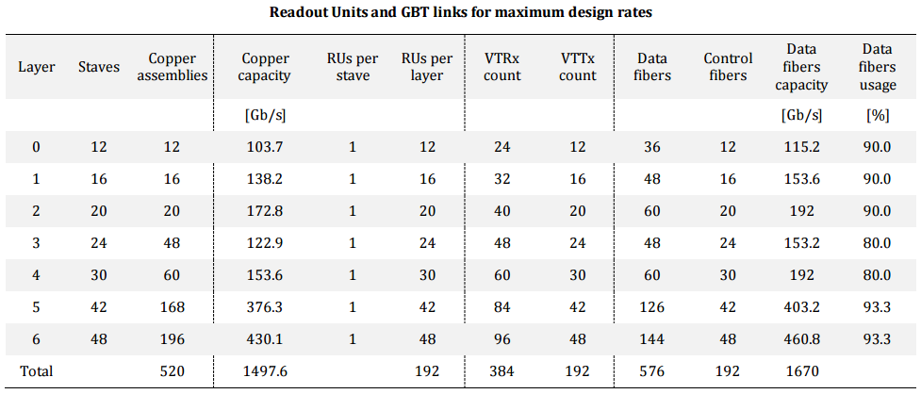
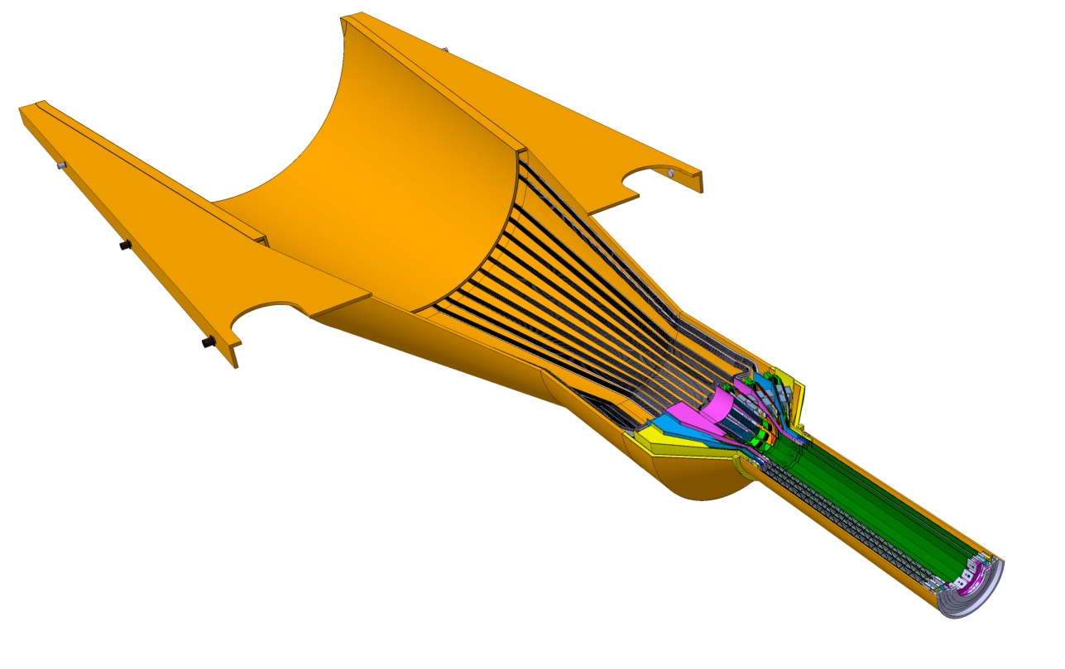
Readout Units Required for ITS & sPHENIX
ITS IB:
Produce 120 staves in one year
120% contingency
48 RU
24 CRU
48 inner staves
sPHENIX: 48 +40% = 68

Slide 10
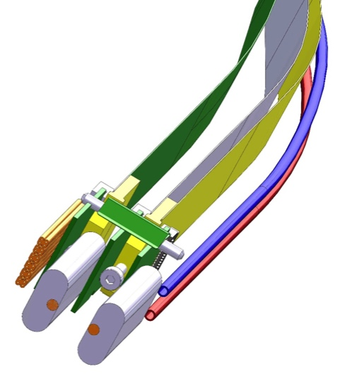
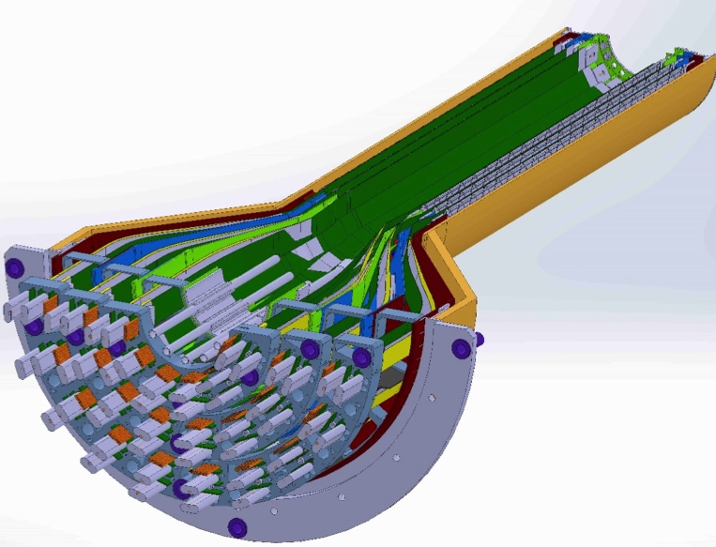
MAPS-sPHENIX Mechanical Integration
Service End Wheel
Possible modifications
High speed signal
Analogy power
Digital power
Cooling

Slide 11
Scope of the Full Project
MAPS & Electronics
  MAPS Detectors
    MoU to build 68 ITS MAPS staves
    No modification
  Readout Electronics
    Use ALICE/ITS, RDO + CRU
    Modify/reprogram CRU for sPHENIX
      Plan-B: build a custom board to convert ALICE/ITS into sPHENIX DAQ format
    R&D by LANL LDRD
  Production
    Extend ALICE/ITS MAPS stave production
    Train sPHENIX personnel for assembly and testing staves at CERN
    Reproduce additional ALICE RDO+CRU for sPHENIX
  Ancillary systems
    LV, cables, crates, racks etc.
    Slow control, safety and monitoring
Mechanics & Cooling
  No/(minor) changes to ALICE/ITS inner tracker mechanical structures
    End Wheels
    Cylindrical structure shells
    Detector half barrels
    Service half barrels
    Detector and Service half barrels
    Half support structures
  Mechanics Integration
    Conceptual design by LANL LDRD
    Prototype by sPHENIX R&D
    Design integration frames
    Cage etc.
    Installation tooling etc.
  Copy ALICE cooling plant design
    Minor modification to fit sPHENIX
    Smaller heat load than ALICE ITS
  Metrology and Survey
A new MIE to fund the full MAPS detector

Slide 12
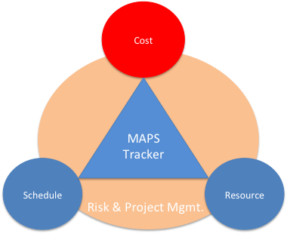
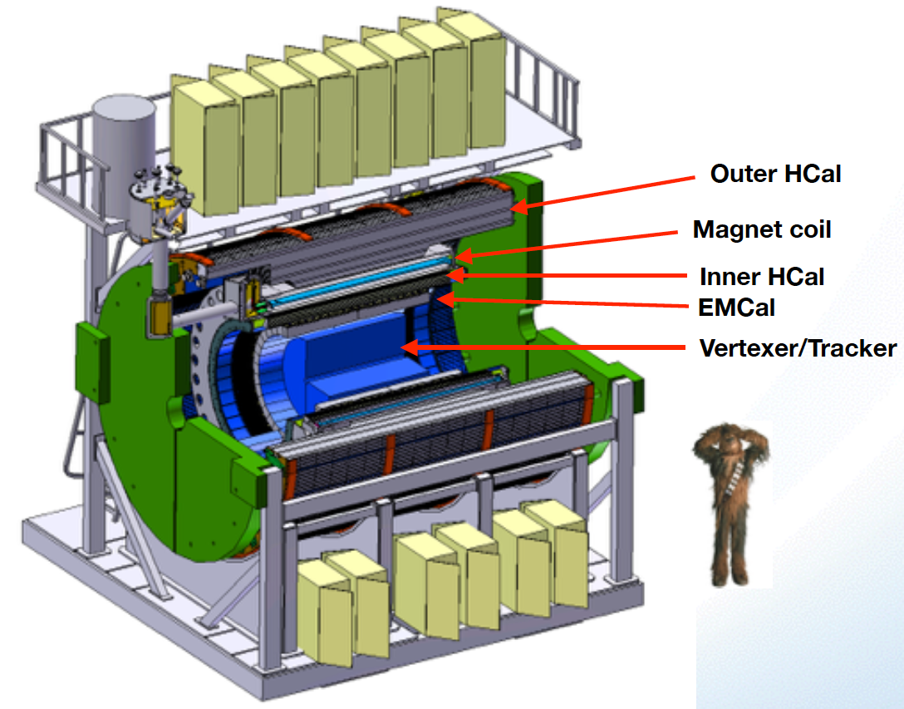
Project Task and Timeline
From 09/2016
review
FY2016
FY2017
FY2018
FY2019
FY2020
FY2021
CD-0
11/1
CD-1
11/1
CD-2/3
8/1
Ready for
Beam
6/1
Readout R&D
Mech. design
@LANL/ALICE
ALICE ITS/IB
completed
A schedule driven project!
Key R&D
Mech. Integr.
& Prototype
@MIT/LBNL
Production
MAPS Prod. & QA
@ALICE
Stave prod.&Test @CERN;
RUs Prod. @US
Detector. Assembly
& Test @BNL
Det. Install.
@BNL
+2%
+50%
“MoU” w/ ALICE/ITS: 11/2016
- Produce MAPS chips for sPHENIX as part of ALICE production!
- Full staves, space frames and RUs production cost & schedule TBD ← a new MIE

Slide 13
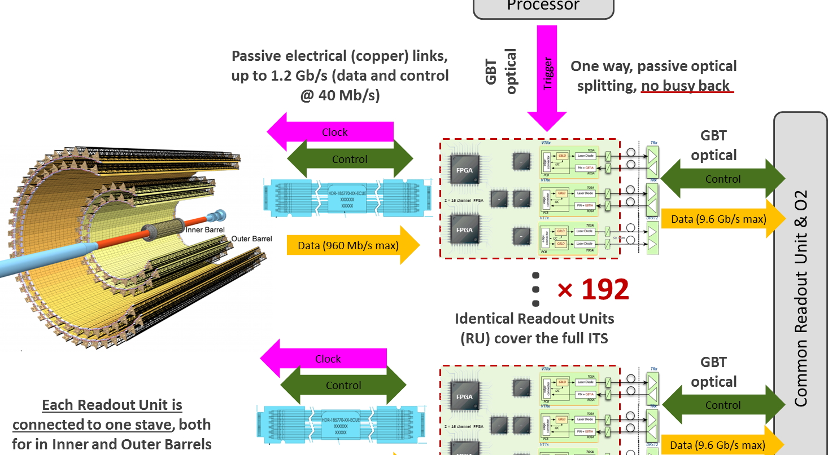
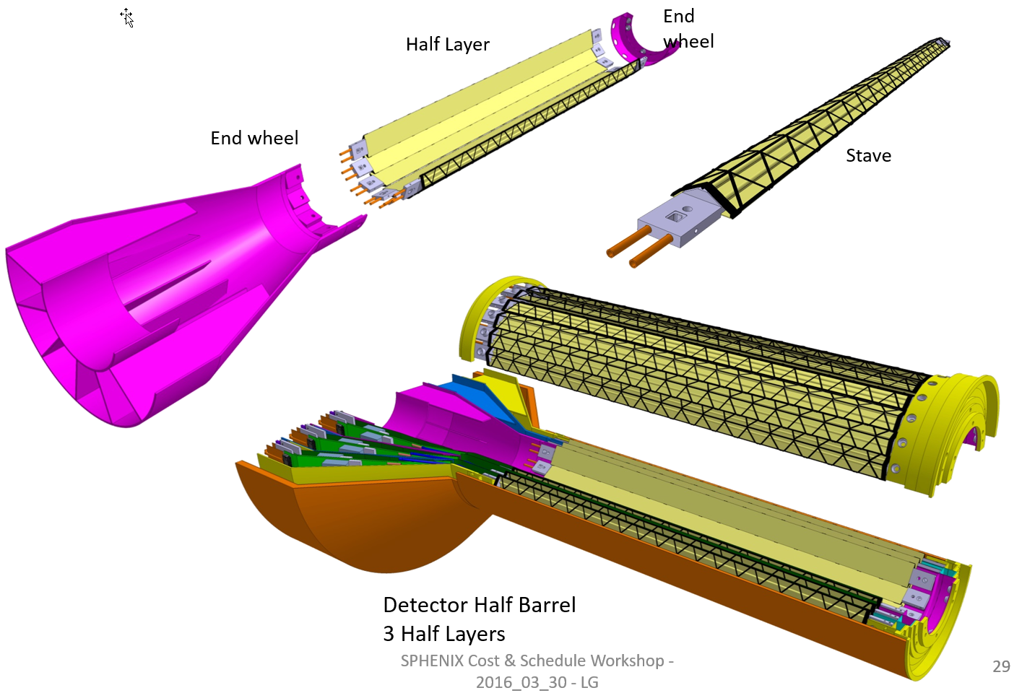
Cost Basis – Major Items
From 09/2016
review
MAPS and Staves
  ALICE ITS production
Readout
  ALICE ITS RDO and CRU production
Electronics Interface to sPHENIX/DAQ
  FVTX/PHENIX experience
Slow control, DCM-II etc.
  FVTX/PHENIX experience
Mechanical structures and cooling
  ALICE ITS inner tracker desgin
  FVTX/PHENIX experience
x48

Slide 14
Major Item Cost Estimate
From 09/2016
review
From 09/2016
review
sPHENIX MAPS Inner Tracker Cost Estimate
3 MAPS layers | Updated: 9/2/2016 |  | LANL STD Labor Rates w/o OH |  | LANL STD Labor Rates w/o OH
FY16 dollars |  |  | No Funding Profile
 | R&D | R&D |  | Construction (k$) |  | Comments | Contingency | M&S OH | Full M&S Cost with Contingengy (k$)
 | LANL (k$) | Collaboration (k$)
 |  | M&S | Labor Cost w/o Cont. & OH | M&S | Labor Cost w/o Cont.
Produce & Test MAPS Staves at CERN | 205.4 |  |  | 945.7 | 139.7 | Alice production | 0.4 | 0.25 | 1654.975
 |  |  |  |  |  |  | 0.4 | 0.25 | 0
Procure and Test RDO boards | 17.6 |  |  | 265.7 | 15.5 | Alice production | 0.4 | 0.25 | 464.975
Procure and Test CRU boards | 16.9 |  |  | 271.7 | 1.6 | Alice production | 0.4 | 0.25 | 475.475
sPHENIX readout R&D | 203.4 |  |  |  |  |  | 0.4 | 0.25 | 0
DAQ integration | 104.5 |  |  |  |  |  | 0.4 | 0.25 | 0
 |  |  |  |  |  |  | 0.4 | 0.25 | 0
Setup 2 ALICE Readout Teststand | 52.9 |  |  |  |  | Alice production | 0.4 | 0.25 | 0
Procure and Test SamTec cables | 3.2 |  |  | 27 | 0.3 | Alice production cost | 0.4 | 0.25 | 47.25
Procure and Test Optical links | 1 |  |  | 81.6 | 0.6 | Alice production cost | 0.4 | 0.25 | 142.8
 |  |  |  |  |  |  | 0.4 | 0.25 | 0
Procure and Test LV, Cables etc | 28.6 |  |  | 100 | 1.6 | Alice production cost | 0.4 | 0.25 | 175
Racks | 8.6 |  |  |  |  |  | 0.4 | 0.25 | 0
Chiller & Cooling Plant | 41.8 | 20 | 23.4 | 40 | 1.6 | Alice production; may need to modify them to fit sPHENIX | 0.4 | 0.25 | 105
Safety system | 35.4 | 20 | 36.4 |  |  |  | 0.4 | 0.25 | 35
Mechnical integration | 65.1 | 50 | 78.5 |  |  |  | 0.4 | 0.25 | 87.5
Assembly Jigs | 48.37 | 20 | 24.6 | 100 | 0.9 | Alice production; may need to modify them to fit sPHENIX | 0.4 | 0.25 | 210
Test beam | 99.6 |  |  |  |  |  | 0.4 | 0.25 | 0
 |  |  |  |  |  |  | 0.4 | 0.25 | 0
End wheels |  |  |  | 34 | 1.6 | Alice production | 0.4 | 0.25 | 59.5
Cylindrical Structure Shells |  |  |  | 11 | 1.6 | Alice production | 0.4 | 0.25 | 19.25
Detector half barrels |  |  |  | 13 | 1.6 | Alice production | 0.4 | 0.25 | 22.75
Service half barrels |  |  |  | 120 | 1.6 | Alice production | 0.4 | 0.25 | 210
Detector and Service Half Barrels |  |  |  | 21 | 1.6 | Alice production | 0.4 | 0.25 | 36.75
Two Half Support Structures |  |  |  | 50 | 1.6 | Alice production; may need to modify them to fit sPHENIX | 0.4 | 0.25 | 87.5
Total | 932.37 | 110 | 162.9 | 2080.7 | 171.4 |  |  |  | 3833.725
 | LDRD fully burdened | R&D M&S | R&D Labor | Prod. M&S | Prod. Labor |  |  |  | Pod. M&S wirh Cont. & OH

Slide 15
Major Item R&D Prototype Costs
LANL LDRD: $930K
  $1.1M/year for 3 years (FTE’s and M&S )
    DAQ Interface: $600K
    Mechanics: $230K
    Test beam: $100K
sPHENIX Mechanics System Prototype: $270K
  Mechanical design and integration: $220K
  Mechanical prototype: $50K

Slide 16
Key Schedule: ALICE and sPHENIX
ALICE Milestones
√
sPHENIX CDs
LANL R&D Milestones
sPHENIX
MAPS Tracker
About 6 months of schedule float

Slide 17

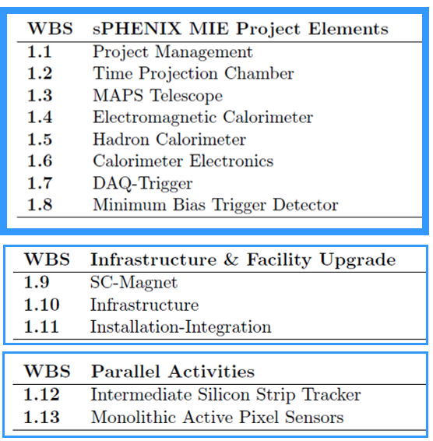
Scope of sPHENIX MIE
A new MIE to build the full MAPS detector
From Ed O’Brien

Slide 18
MAPS Inner Tracker
WBS 1.3 – A MAPS Telescope
  About 10 staves
  Optimized geometry for maximum physics, TBD
  $500K (including contingency)
  Day-1 physics for b-jet
  Commissioning MAPS detector
WBS 1.13 – The full MAPS inner tracker
  3 layers of MAPS detectors
  $5M construction fund from DOE
  A new MIE

Slide 19
MAPS Project Updates
sPHENIX/MAPS discussion at MIT, Oct. 2016
  Identified MIT’s interest and responsibility
  Major tasks to lead – Mechanical integration
  MIT Physics and Bates Engineering Group
  Resource and timeline
    Engineers and Techs
    Students and postdocs
LBNL joins sPHENIX 12/2016
  LV, HV PS and controls
  Mechanic carbon structures
  Physics simulations
A separate MIE being developed for full MAPS
  Feasibility, start communication with DOE
  Develop a plan to identify tasks, resources and timeline
  First draft/outline ~Dec 15
    First full doc by Jan 2017, to be ready for discussions with DOE in Feb.
  Timeline of MIE
    Submitted and reviewed in FY17, establish DOE “mission need”
    Federal budget request by DOE in Feb 2018,
    Fund available FY20 for construction
  Advanced fund in mid 2018 to produce full staves following the completion of ALICE/ITS production at CERN
Visited ALICE/CERN Nov. 2016
LANL-ALICE/ITS MOU achieved
Associate member on ITS
Joint R&D for sPHENIX/MAPS
Help ALICE/ITS & train sPHENIX experts
Produce MAPS chips for sPHENIX
A possible joint Readout
Unit for TPC and MAPS

Slide 20
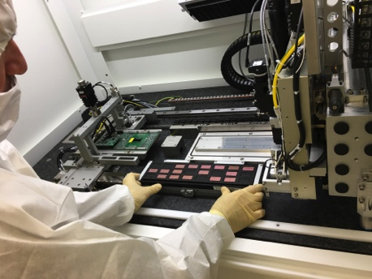
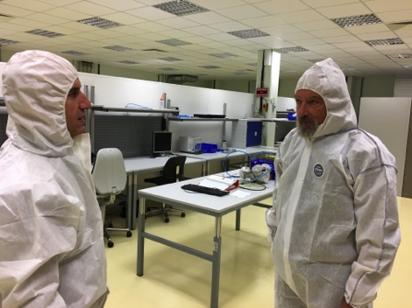
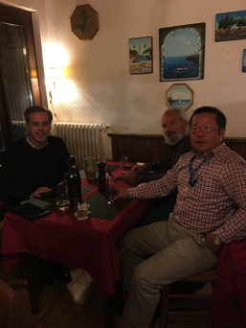
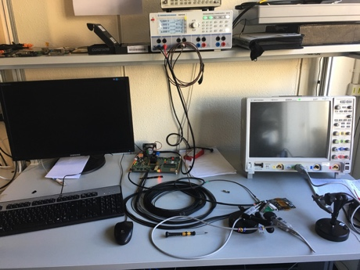

1st Milestone: MoU with ALICE/ITS
CERN Visit to discuss MoU: November 10-15, 2016
  Visited MAPS R&D and construction labs
  Agreement on MoU achieved!
LANL MoU with ALICE/ITS
  Associate member on the ALICE/ITS project at CERN
    Access all technical design files and documents
    Access other technical resources, including Engineering and Computing support, joint R&D on LDRD project
    Train LANL personnel on the job
  Procurement of critical items from CERN
    5 single-chip MAPS readout evaluation boards
    1-2 high-speed readout out test boards (MOSAIC test bench)
    4+ Readout-Unit and 2+ Common-Readout-Unit prototypes and associated electronics components, including CERN GBT optical links
    Mechanical support frame prototypes
LDRD milestones developed to match:
  ALICE R&D and production schedule
  sPHENIX proposed installation schedule
Automated chip
mounting
High speed readout test

Slide 21
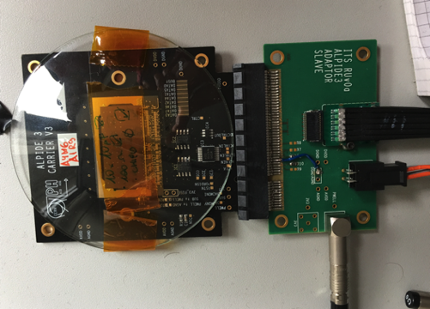
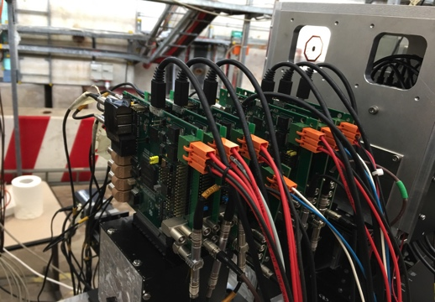
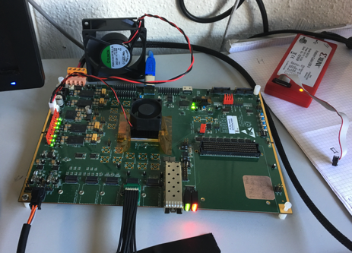
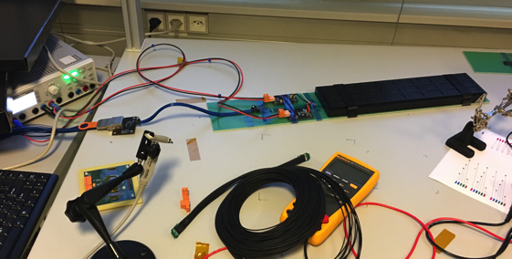
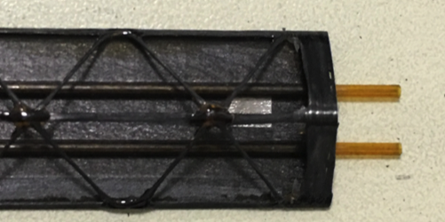
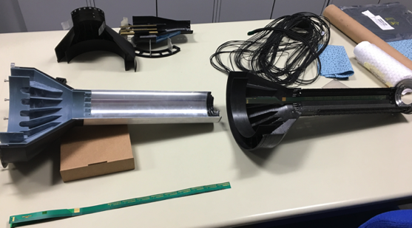
Status of MAPS R&D at ALICE/CERN
MAPS chip readout with test board
  Also tested at LANL
  Telescope
Multichip MAPS high speed readout
  with the first prototype Readout Cards (RUv0)
  MiniDAQ (MOSAIC board) test bench
RU v0 tested to readout stave with high-speed, next version spring 2017
RU fiber optics communication established with a prototype Common Readout Unit (CRU)
Stave space frame being produced
Service End Wheel being prototyped
Procurement for LANL LDRD R&D items
  Key test electronics and mechanic prototypes being produced for LANL LDRD
A 7-single-chip telescope
Single MAPS Chip
RUv0
MOSAIC Test Bench
stave
Service wheel

Slide 22


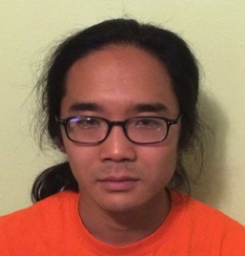





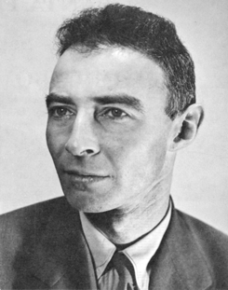
LANL LDRD Activities
LALN internal
  Simulations
  Electronics
  Mechanics
External collaboration
  CERN/ITS group
  ALICE US groups
Lead people identified for key tasks
  Team of experts
Job AD out for a new staff
  Several outstanding candidates
Mark
Prokop
(AOT)
A new
staff

Slide 23
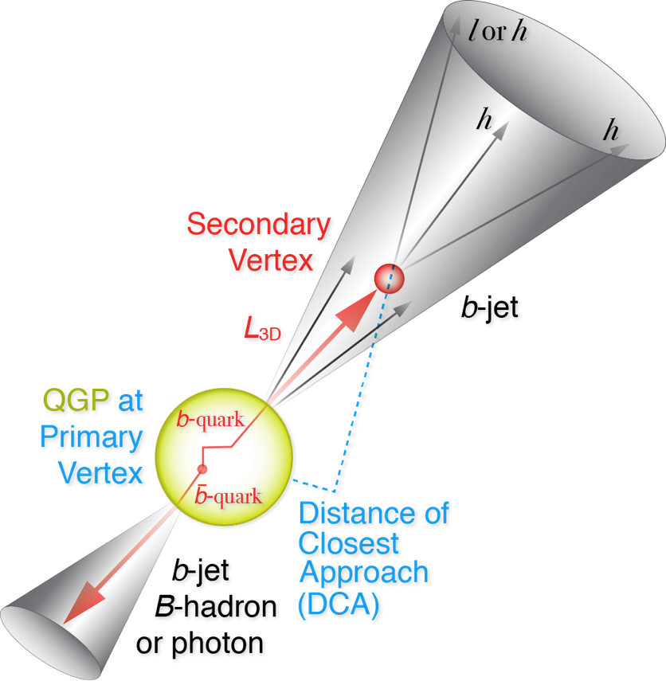
Experimental R&D Deliverables: Physics
LDRD Goal: much improved B-jet Identification in Heavy Ion Collisions
Secondary Vertexing Possible!
Sanghoon’s talk
A new b-jet identification with high efficiency and high purity is possible
Figure of merit is efficiency x purity. Greatly enhancing the b-jet physics program, x4 improvement in FOM (compared to alternatives)

Slide 24
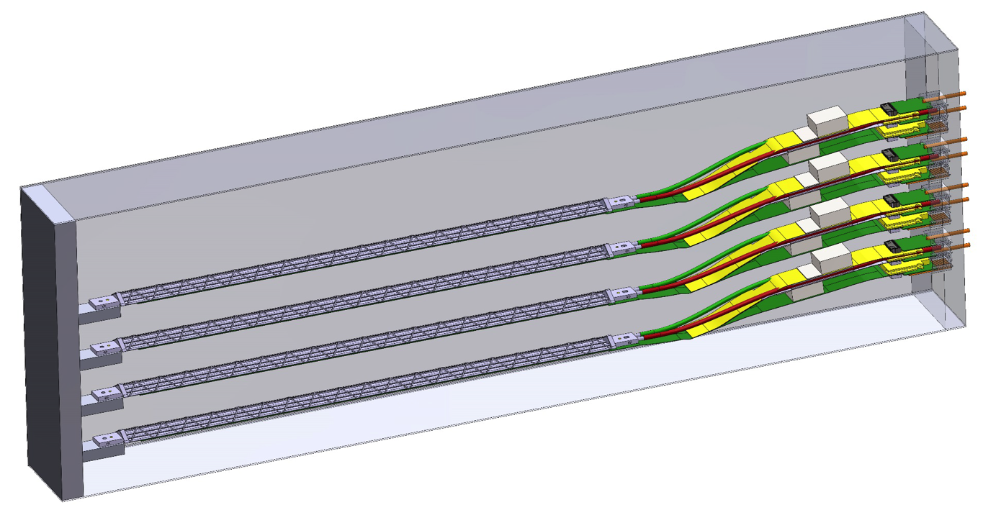

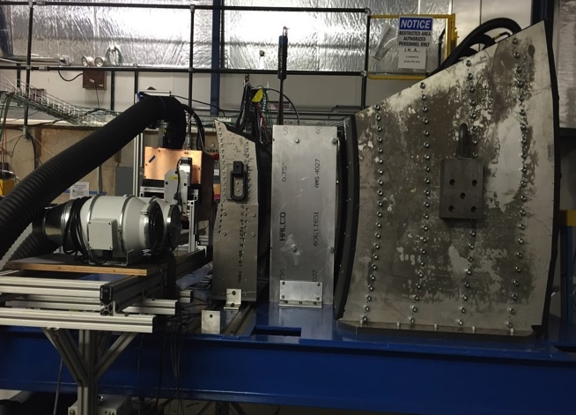
Experimental R&D Deliverables a 4-Stave Telescope
A 5-single-chip telescope
Performance of prototype tracker
  High speed readout of staves
  Spatial resolution
  Electrical and mechanical stability
  Cooling etc.
NIM paper
Cosmic ray
Beam test at Fermilab
sPHENIX
Data Format
Pat and Walt’s talks

Slide 25
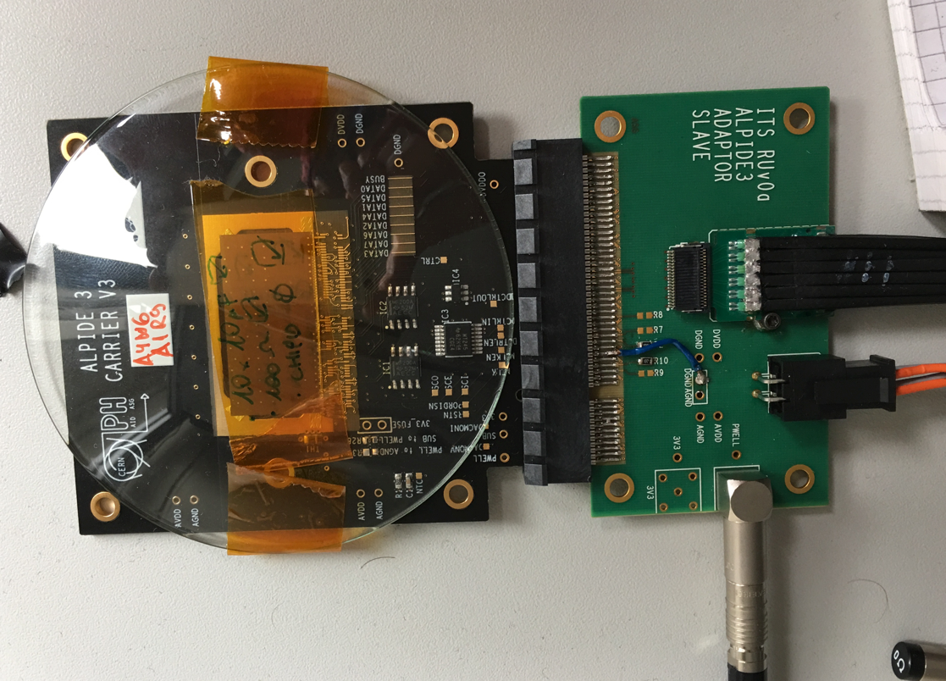
R&D at LANL:MAPS Chips
A single chip:
15 x 30 mm
active area
- Have one chip with slow readout working;
- 5 more on the way to build a telescope

Slide 26
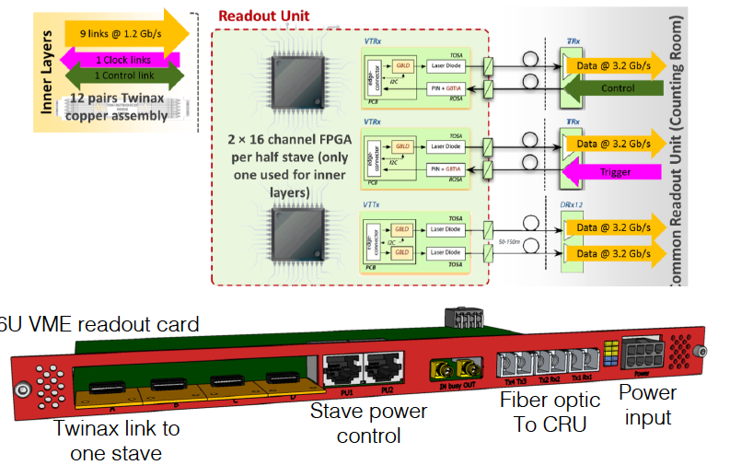
ALICE Readout Unit

Slide 27
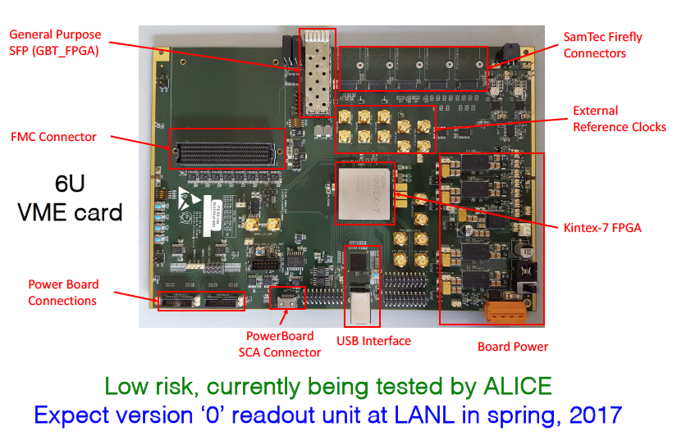
Readout Unit – Prototype 0
From Pat McGaughey

Slide 28
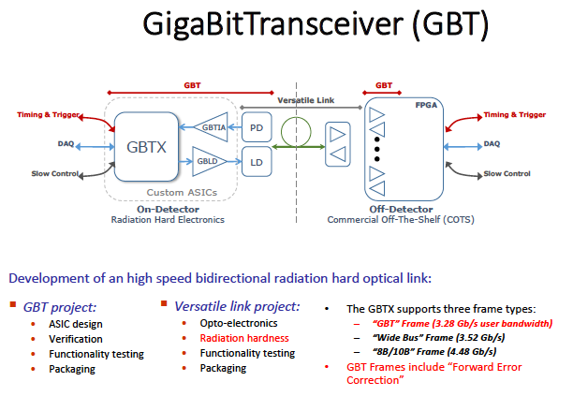
GBT
Jo Schambach

Slide 29
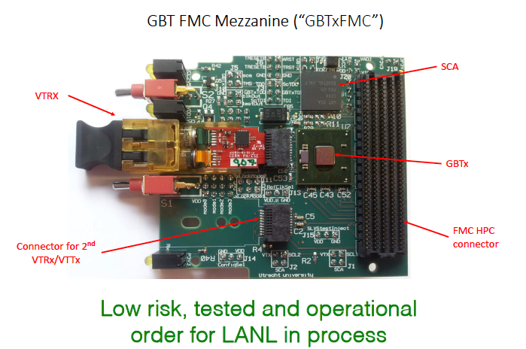
GBT Optic Transceiver Daughterboard for Readout Unit
From Pat McGaughey

Slide 30
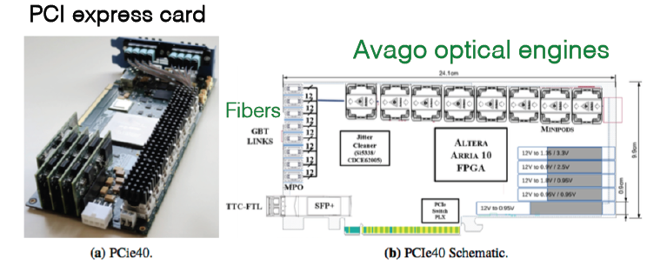
Common Readout Unit
From Pat McGaughey
Each CRU reads out 2 Rus
Expected at LANL summer 2017
Also exploring other options, ATLAS/FELIX system

Slide 31
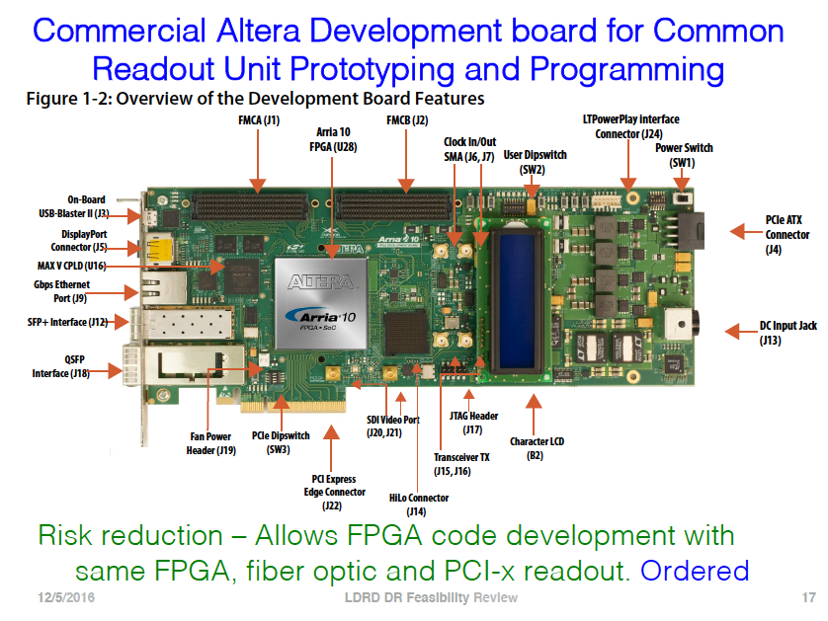
From Pat McGaughey

Slide 32
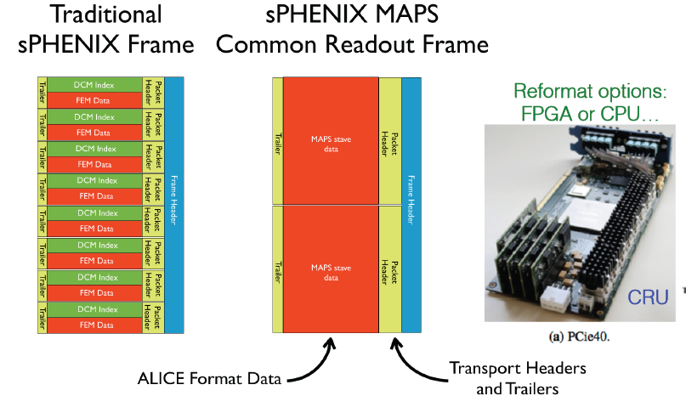
Data Formatting
From Mike McCumber

Slide 33
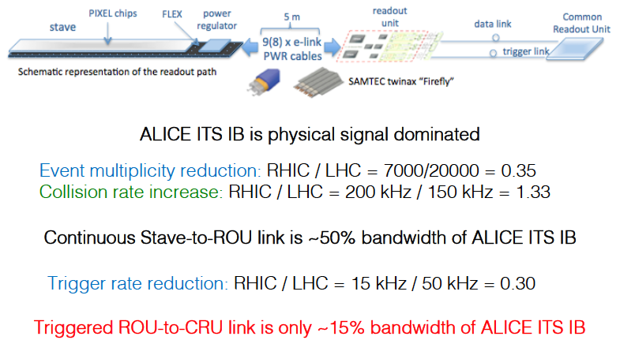
sPHENIX MAPS Data Bandwidth
From Mike McCumber

Slide 34
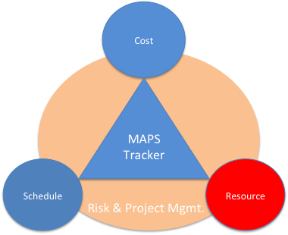
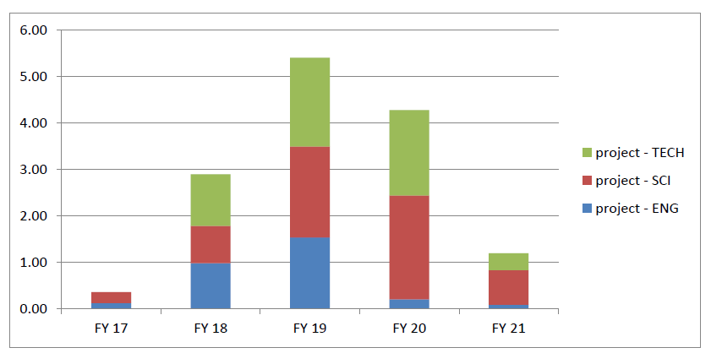
MAPS Labor Profile
MAPS Labor profile from resource – loaded schedule sorted by FY and job category

Slide 35
Participating and Interested Institutions
LANL - Readout & FEMs, Mechanics
MIT - Assembly and testing, cooling
LBNL – Mechanical carbon structures, LV/HV PS and controls
BNL – Integration and services, safety and monitoring
UT-Austin – MAPS readout electronics and testing
Univ. of Colorado – sPHENIX DAQ/DCM-II integration
Univ. of New Mexico – LV, cabling & connectors
New Mexico State University – Tracking algorithm and simulations
Univ. of IL of Chicago – Stave assembly and testing, simulation and offline analysis
Iowa State University – Assembly and testing, simulations
Georgia State University - Slow control and monitoring
Florida State University - Offline and simulations
Univ. of California, Los Angeles – Assembly and testing, simulations
Univ. of California, Riverside – Assembly and testing, simulations
RIKEN/RBRC, Japan – Assembly and testing, integration
Yonsei, Korea – MAPS QA and readout, simulations
Czech Group – Sensor and electronics testing at CERN
Potential collaboration

Slide 36
Organization Chart
From 09/2016
review
BNL Program Manager
sPHENIX Project Office
Manager: Ed O’Brien
sPHENIX Management
Spokespersons
Gunther Roland
David Morrison
sPHENIX MAPS Project Office
Project Manager: Ming Liu (LANL)
Deputy Project Manager: Mike McCumber (LANL)
Electrical Engineer:TBD
Mechanical Engineer: Walt Sondheim
Readout
UT/LANL
MAPS Sensor
ALICE
Stave
ALICE
Cabling
UNM
Mechanics
MIT/LBNL
Integration
MIT
Electrical
BNL
Software
UIC/FSU
FEM
M. Prokop LANL
Sensor Design
ALICE
Stave Design
ALICE
High density cables
UNM
Structure Design
LANL/MIT
Cooling
MIT
Low Voltage
UNM/NMSU
Simulation
ISU/GSU/
Slow Control &
Monitoring
BNL
Sensor Production
TowerJAZZ
Stave Assembly
MIT/UIC/LANL
LV
UNM/NMSU
Assembly
BNL/MIT
Alignment
BNL/UIC
Offline
NMSU/FSU
DCM Integration
Colorado
Sensor QA
Yonsei(Korea)
Stave QA
MIT/ISU
Fibers
UNM
Installation
BNL/MIT
Mechanical Stability
BNL
B-jet tagging
LANL,NMSU
Safety System
BNL

Slide 37
Full MIE Proposal Writing https://www.overleaf.com/7090105wwsnqpczbwgg#/24371042/
A MAPS detector subgroup to identify and work on
  Tasks, Resources and Responsibilities for each institution
  Agreement on each institution’s interest and available resource
  Start joint R&D on critical tasks
    LDRD, associate members and other R&D fund etc
Pre-proposal writing
  Identify required resources ($$ and manpower) and timeline
  Intended contributions from all institutions
  Electronics and readout – LANL , UT-Austin, CERN
  Mechanic system and integration – MIT
  LV, HV PS and Controls – LBNL
  Ancillary and other systems – other collaborators
  A draft by January 2017? Discussions with DOE during Feb budget meeting
More communications with DOE
  Based on updated resource loaded Cost and Schedule from pre-proposal
  Then decide on next step
    either go forward or not, work out a plan with DOE
  Get more support from ALD & DOE on CERN-SPHENIX agreement etc.

Slide 38
Major Tasks
MAPS chips production
  LANL et al
Readout integration and testing
  LANL, BNL, UT-Austin, U-Colorado?
Mechanical structures and integration
  MIT, LBNL, UC?
LV, HV PS and controls
  LBNL
MAPS chips and stave production
  LANL
  assembly and testing at CERN
  MIT and other collaborators
Detector simulation, geometry, offline tracking
  NMSU, FSU, LANL
Physics simulations to make “Money Plots”
  NMSU, LBNL

Slide 39
MIE pre-proposal writing
1. Executive Summary (1~2 pages)
-Science highlights and deliverables
-Mission Need
2. Physics Goals (~2 pages)
- B-jet physics at intermediate pT (~>15 GeV)
- B-hadron physics at low pT (<~ 15 GeV)
3. Detector Requirements (~2 pages)
-Tracking impact parameter resolutoin
-B-tagging in AuAu
-Readout rate
4. Physics Performance (~2 pages)
-B-tagging
5. Technical Scope and Deliverables (~2 pages)
-Stave assembly and testing
-Readout
-Mechanical structures
6. Organization and Collaboration (1~2pages)
7. Schedule and Cost Baseline (3~5 pages)
Outline being discussed
  A short one, 10~20 pages
  Welcome contributions
First draft for collaboration discussion
  Dec 15-17, sPHENIX meeting
Complete draft by the end of January
  DOE Feb budget meeting
  Timeline of
Joint R&D on readout and mechanics integration

Slide 40
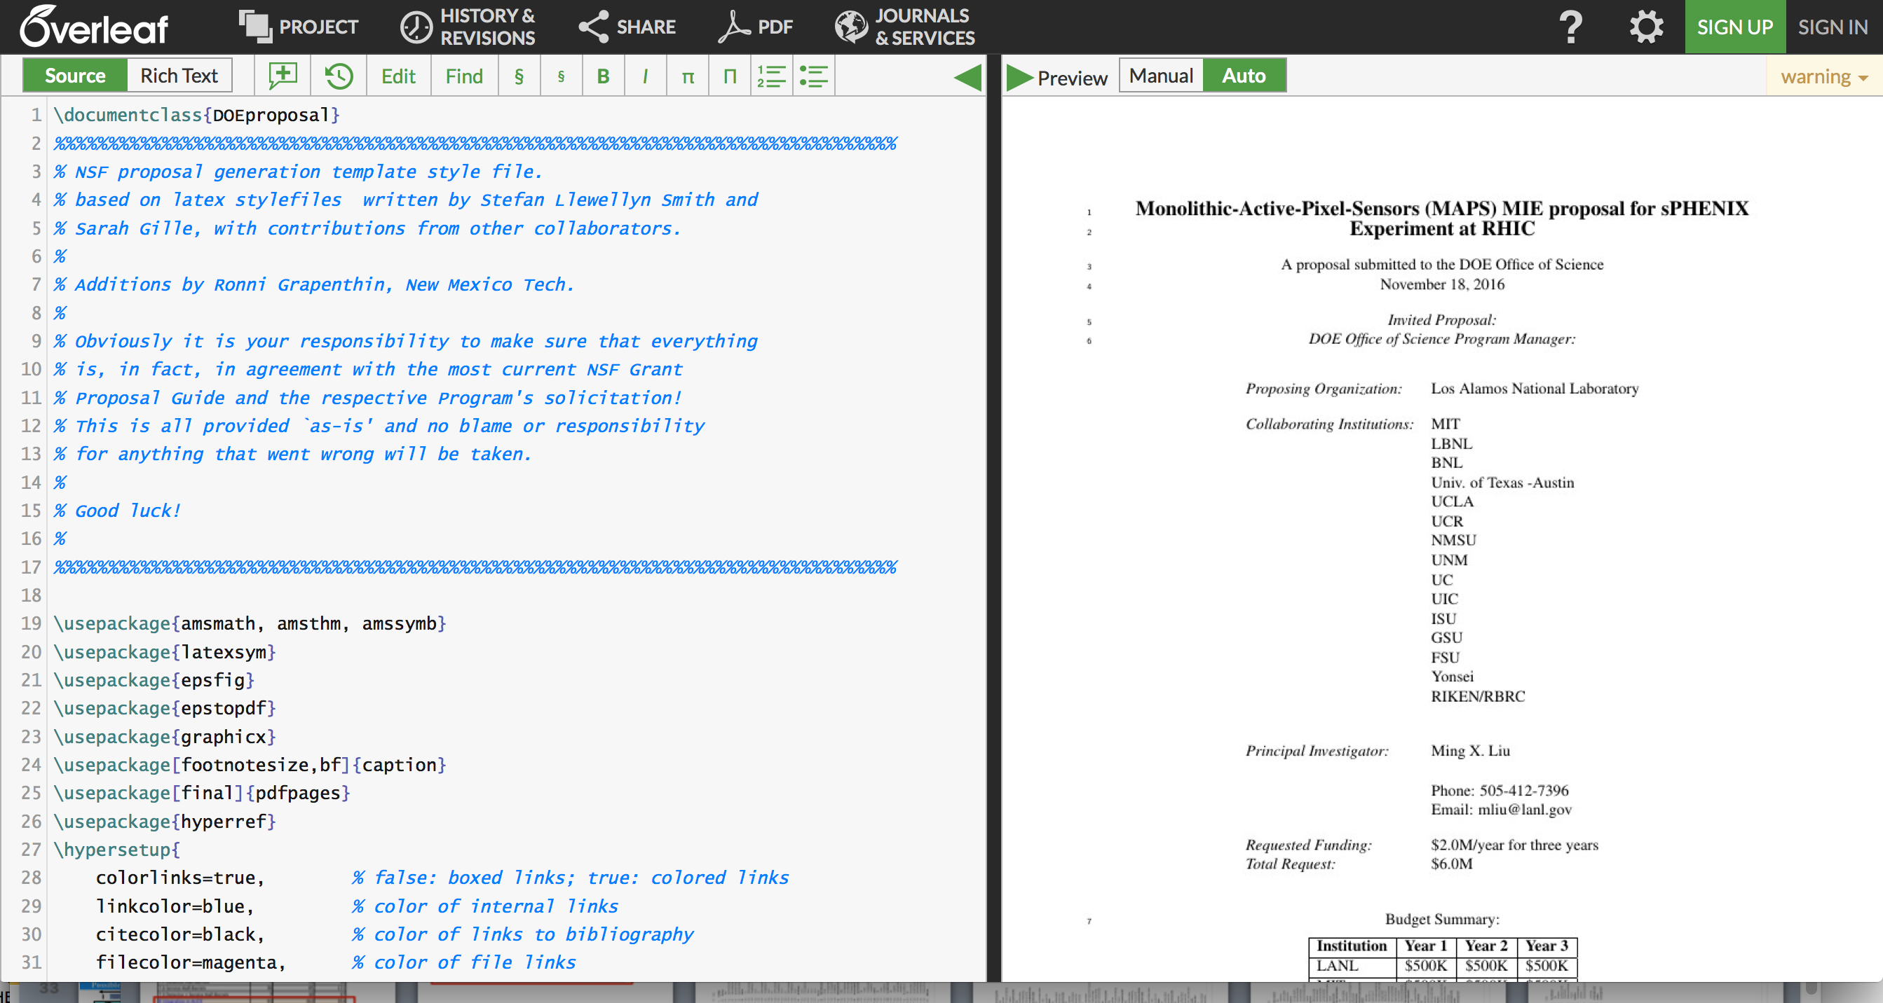
MIE Proposal Writing
https://www.overleaf.com/7090105wwsnqpczbwgg#/24371042/

Slide 41
DOE MIE Process and Challenges
Contact for new scientific proposals
  Associate Director for NP (Tim), who will then identify point of contact for the project
    Jehanne Gillo
For a project with Total Estimated Cost(TEC) < $10M
  no CD process needed: good news
  The 3-layer MAPS inner tracker fit this scope
For a project with TPC > $2M
  “includes all engineering and fabrication costs, needs to be identified individually in the federal budget as Major Item of Equipment(MIE)” - concern over timeline
  If submitted and reviewed and DOE “mission need” approved in FY17
    the earliest date to receive fund is FY20, Oct. 2019.
  Federal budget prepared 2-year in advance
  DOE budget request to Congress ~Feb 2018
  It is hard to have a complete proposal submitted, reviewed and approved for “DOE mission need” and have this MIE included in the Feb. 2017 DOE budget request (~3 months from now)
    while we are still waiting for (CD0 and) CD1 approval from DOE
  http://science.energy.gov/np/facilities/project-development/
Challenges to match ALICE/ITS production schedules
  Early fund (~$1M) needed summer 2018 to continue ALICE/ITS production line for sPHENIX MAPS staves
My Conclusion
The normal MIE process may not match current ALICE/ITS and sPHENIX installation and run schedules, need to work closely with DOE how to proceed
Some minimum fund (~$1M) must be secured for the MAPS stave production at CERN following the completion of ALICE/ITS project, such as $$ from RHIC operation savings or foreign contributions etc.
Other considerations:
  Can we defend the “BNL base line TPC only” tracking system for the sPHENIX physics program, with separate MAPS MIE?
  If MAPS delayed, with TPC only, it won’t be able to do tracking

Slide 42
Summary: MAPS Project Status
LANL/LDRD MoU with ALICE/ITS achieved
Early “Agreement” between DOE/sPHENIX with ALICE/CERN critical
sPHENIX initial cost, schedule and risk management plan developed
Key R&D item procurement in progress
Physics and detector simulation work underway
MIE pre-proposal writing in progress

Slide 43
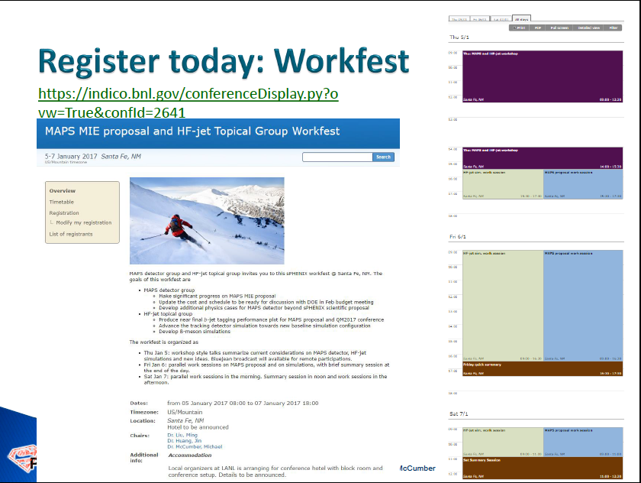
Jin’s talk

Slide 44
Backup slides

Slide 45
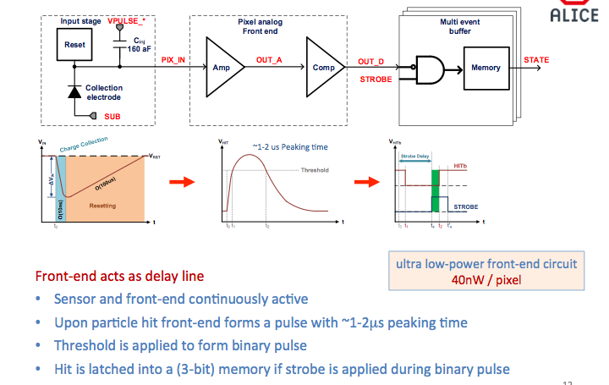
ALPIDE Operation

Slide 46

ALPIDE Readout

Slide 47

Long Term LHC Schedule
ALICE/ITS
MAPS installation

Slide 48
Possible sPHENIX Schedule
Operating* Funds
Construction
& PED
Funds
Operating Funds
OLD
Initiation
Definition
Execution
Closeout
Conceptual Design
Preliminary and Final Design
Construction
*
Assumption:
3 Months CR
Will receive 1/12 per month during CR
Critical
Decisions
CD-0
Approve Mission Need
CD-1
Approve Alternative Selection
and Cost
Range
CD-2
Approve Performance Baseline (PB)
Installation
CD-4
Approve
Start of Operations or Project Completion
CD-3
Approve Start of Construction or Execution
Request/Receive
Construction Funds
CY
2016
2017
2018
2019
2020
2021
2022
2023
Operating Funds are used for conceptual design between CD-0 and CD-1. Operating funds may also be used prior to CD-4 for R&D, NEPA, D&D, ES&H, transition, startup, and training costs. Non-federal funds from other sources that are considered capital funds and are included in the “Total line item cost” as OPC.
Good Practice—For the first year that TEC is requested, ensure that OPC is also requested for that year. The OPC will allow the project to continue in a long CR until TEC is available and new starts are allowed.
MIE funds are more flexible than Line Items. Moving OPC to TEC or vice versa is much easier than for Line-Item reprogramming since MIE funds are “batched.”
New Start is defined as the first use/appropriation of any TEC funds (including TEC PED) for both line items and MIEs project.
48

Slide 49

Musa @Santa Fe
Workshop, 4/1/16
Chips:
1k/50k = 2%
- $100K
Staves:
68/120 = 60%
-$340K
Full cost recovery
for CERN labor
-$500K
(cover in production
labor cost)
“Buy staves”
and MoU
Total ~$1M

Slide 50


Slide 51


Slide 52

sPHENIX
sPHENIX

Slide 53
Overall project delayed
~6 months as of 4/1/2016

Slide 57

Module Assembly Lab

Slide 58


FPCB and Module Assembly

Slide 59

Readout Electronics Lab

Slide 60

Readout Unit - V0 single module high-speed readout, USB or GBT fiber; no CRU yet

Slide 61

Single Chip High Speed Readout

Slide 62


9-Chip Module High Speed Readout
Test Bench: MOSAIC Card

Slide 63


Stave Production
Very good progress, ahead of schedule

Slide 64

Mechanical Frames

Slide 65

Service End Wheel

Slide 66

Staves

Slide 67

Mechanical End Wheel Design

Slide 68

Test beam setup: 7 Single Chip Modules

