Slide 1
sPHENIX/MAPS Update 11/18/2016
CERN Visit:
Walt Sondheim and Ming Liu from LANL
LANL joined ALICE/ITS project as an Associate Member
MOU discussions, LDRD and sPHENIX
Lab visit, R&D plan
New Collaboration
LBNL
Czech
Meeting at CERN this week
Excellent in sensor design and readout electronics
MIE Proposal Writing

Slide 2
MOU Discussions
LDRD R&D – full support
Single chips test boards to build a telescope
Assembled prototype modules
Test bench, high speed MOSAIC board
Readout units, CRU etc.
sPHENIX – great support
MAPS chips, to be part of the full production
Production Review next week,
Stave/space frames, to be part of the full production
Will support sPHENIX production run for module assembly etc.
sPHENIX needs to come up with a plan to build one!

Slide 3
MIE pre-proposal writing etc
1. Executive Summary (1~2 pages)
-Science highlights and deliverables
-Mission Need
2. Physics Goals (~2 pages)
- B-jet physics at intermediate pT (~>15 GeV)
- B-hadron physics at low pT (<~ 15 GeV)
3. Detector Requirements (~2 pages)
-Tracking impact parameter resolutoin
-B-tagging in AuAu
-Readout rate
4. Physics Performance (~2 pages)
-B-tagging
5. Technical Scope and Deliverables (~2 pages)
-Stave assembly and testing
-Readout
-Mechanical structures
6. Organization and Collaboration (1~2pages)
7. Schedule and Cost Baseline (3~5 pages)
Outline being discussed
A short one, 10~20 pages
Welcome contributions
First draft for collaboration discussion
Dec 15-17, sPHENIX meeting
Complete draft by January
DOE Feb budget meeting
Timeline of
Joint R&D on readout and mechanics integration

Slide 4
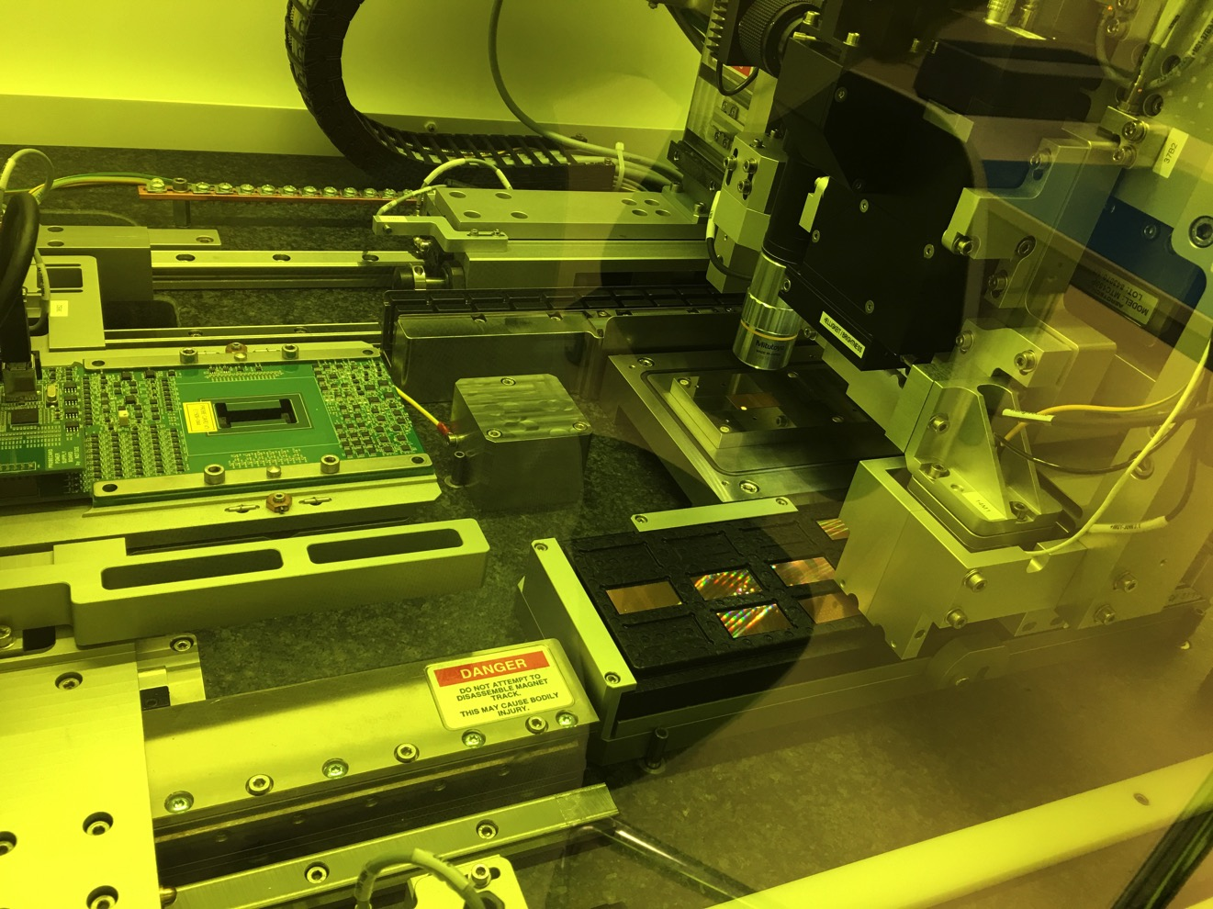
Module Assembly Lab

Slide 5
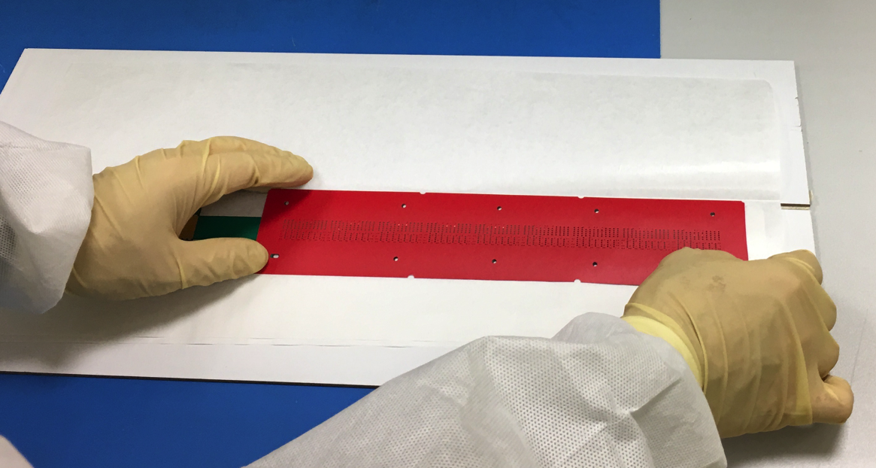
FPCB and Module Assembly

Slide 6
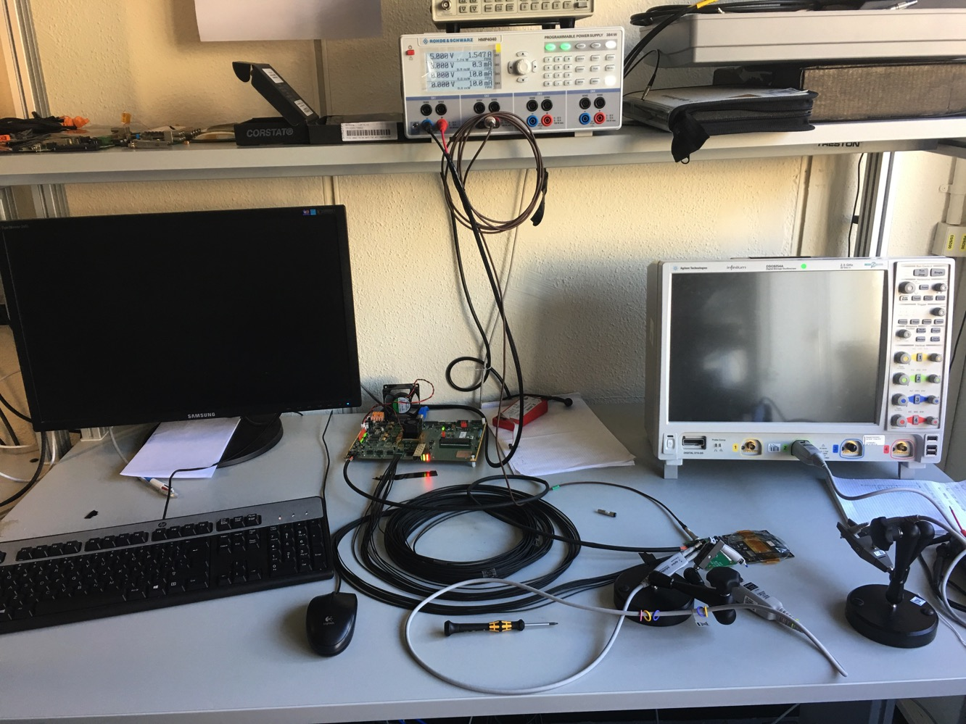
Readout Electronics Lab

Slide 7
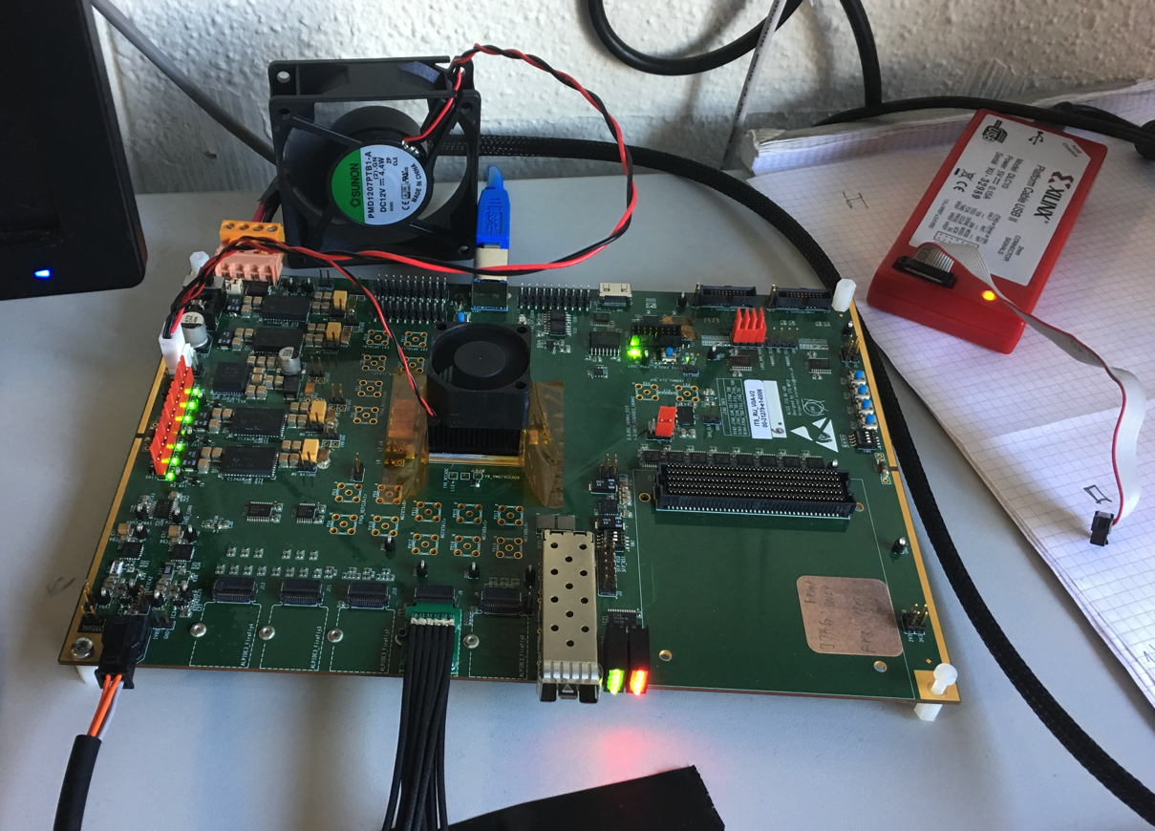
Readout Unit - V0 single module high-speed readout, USB or GBT fiber; no CRU yet

Slide 8
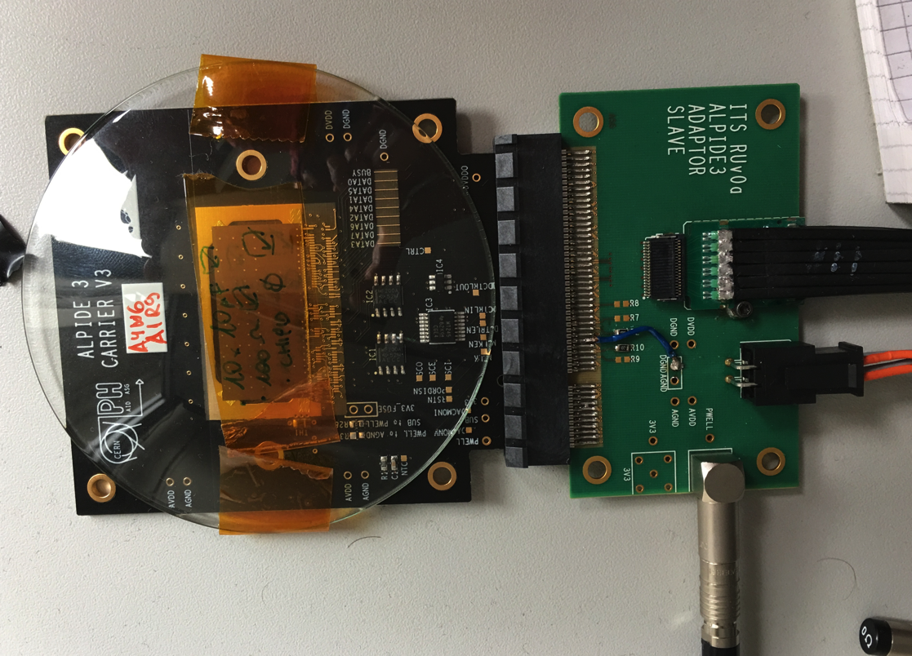
Single Chip High Speed Readout

Slide 9
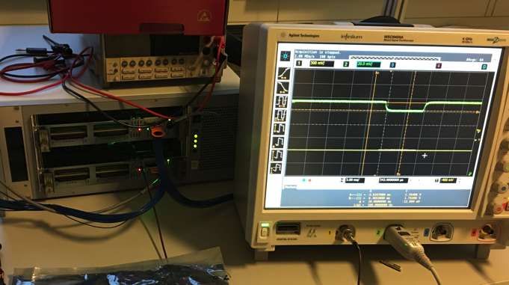
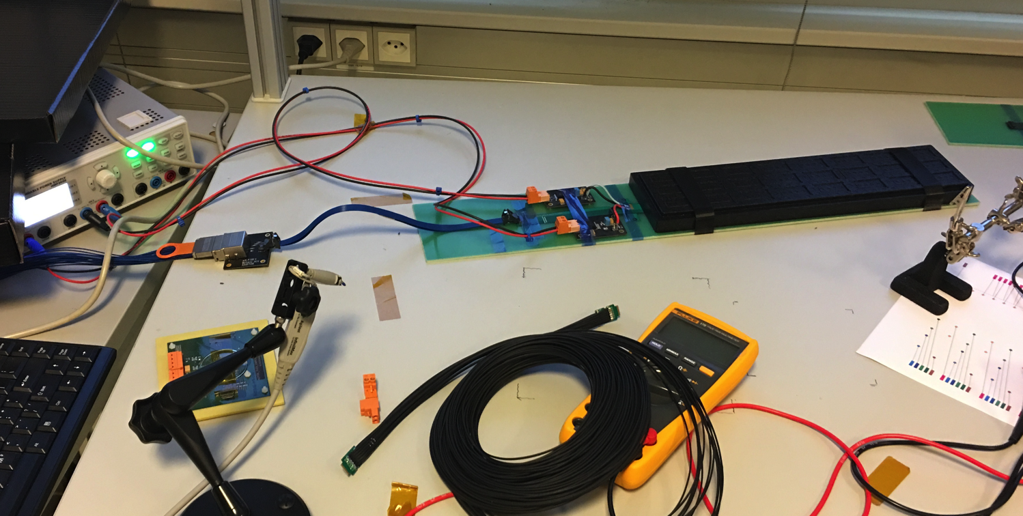
9-Chip Module High Speed Readout
Test Bench: MOSAIC Card

Slide 10
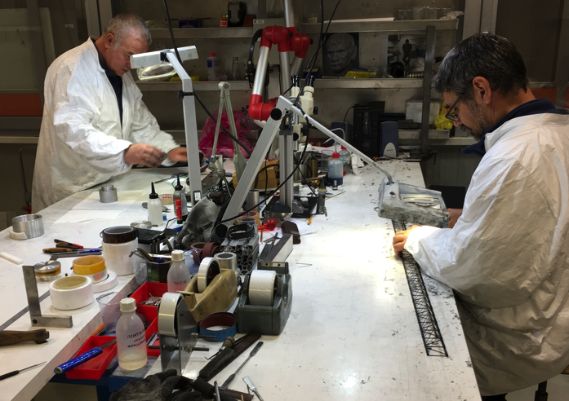
Stave Production
Very good progress, ahead of schedule

Slide 11
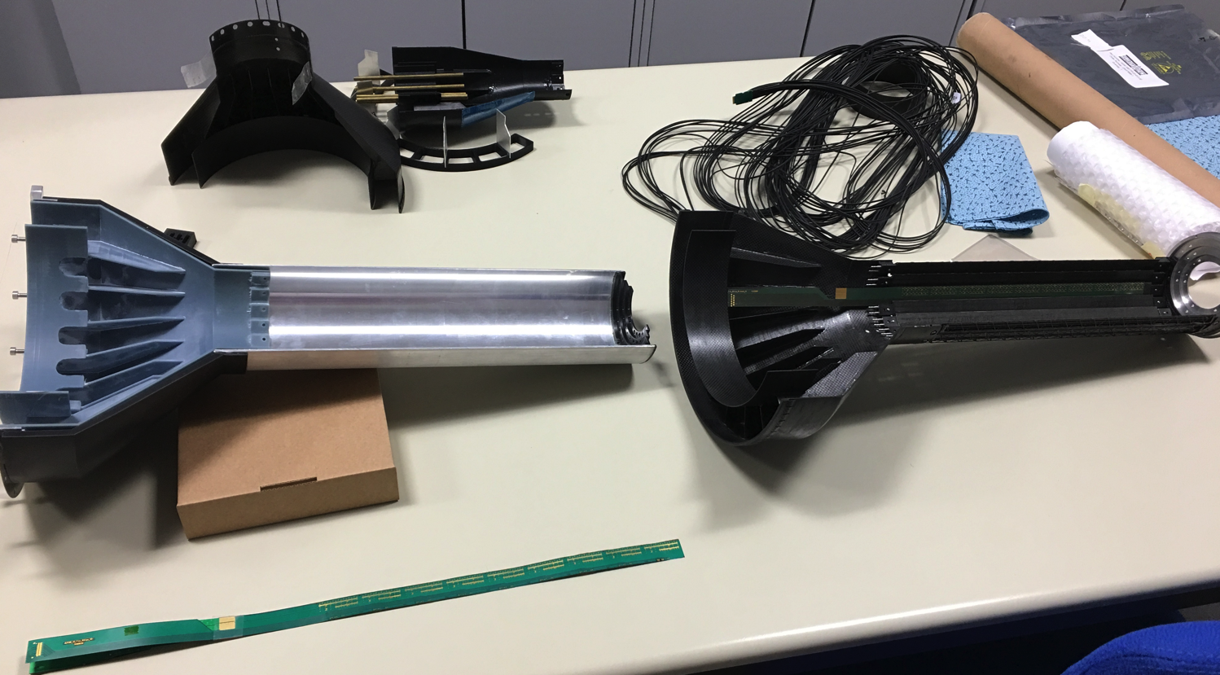
Mechanical Frames

Slide 12
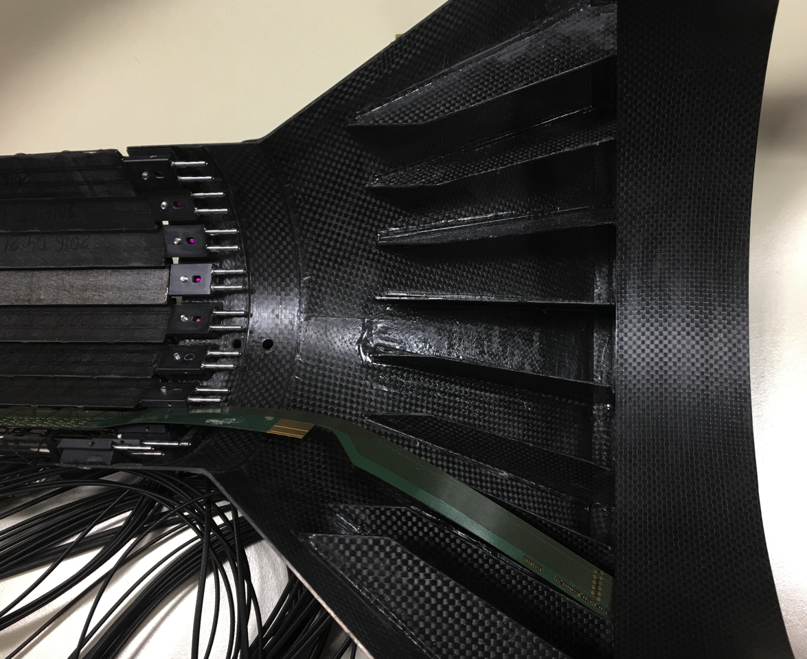
Service End Wheel

Slide 13
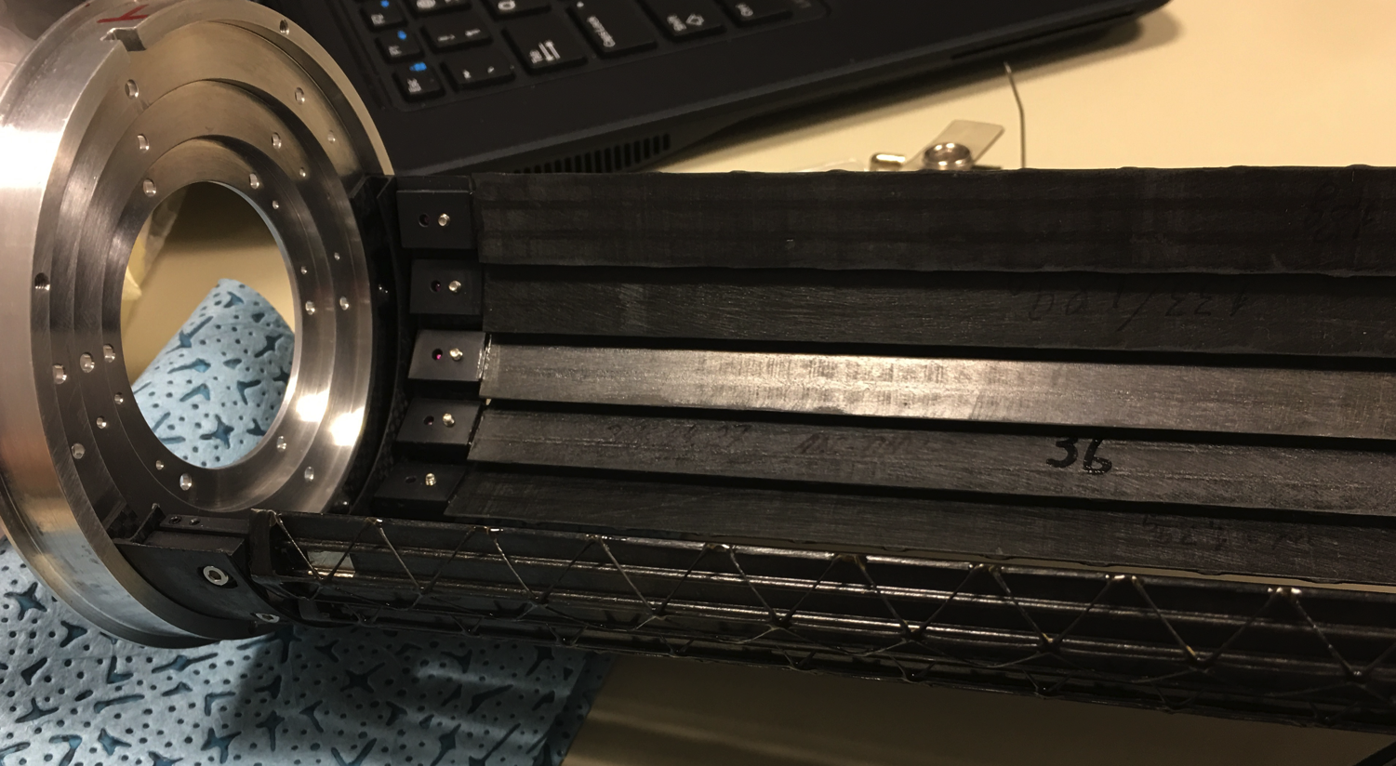
Staves

Slide 14
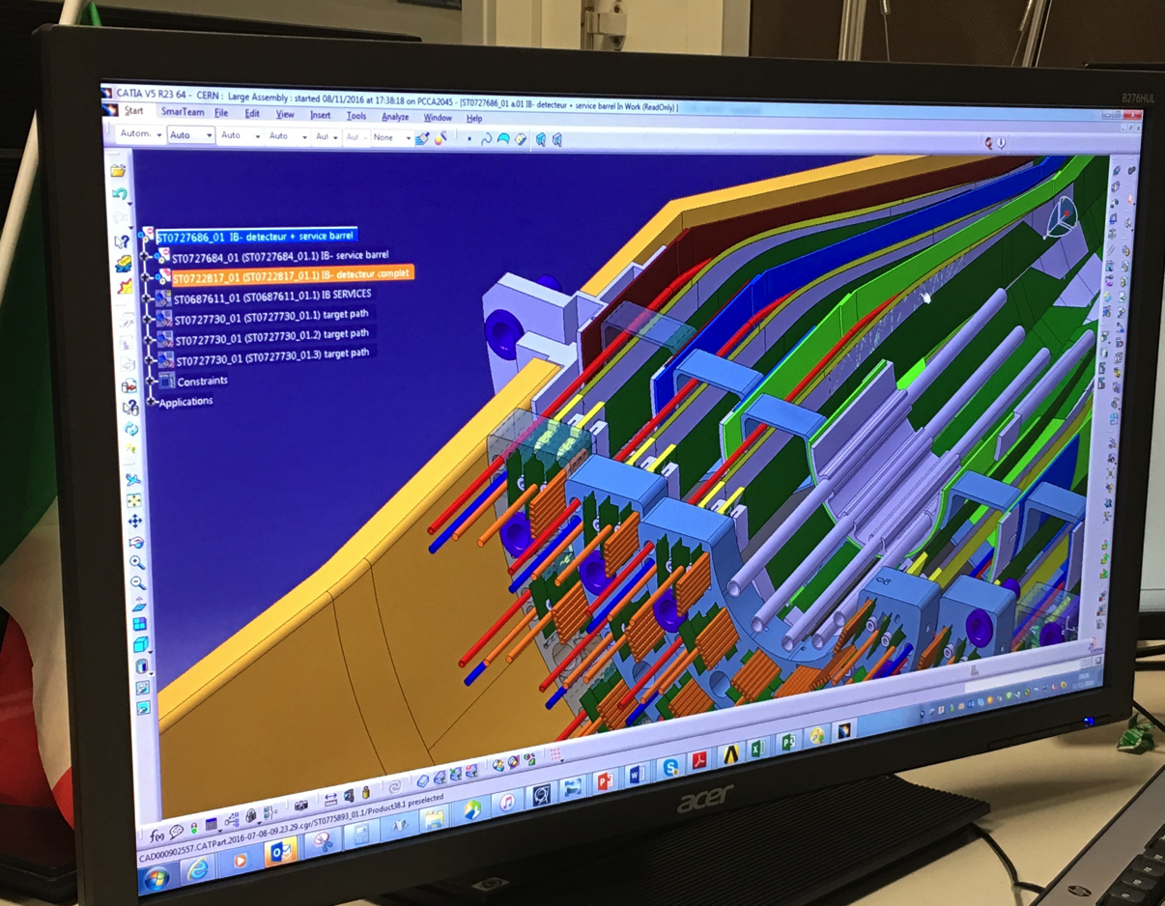
Mechanical End Wheel Design

Slide 15
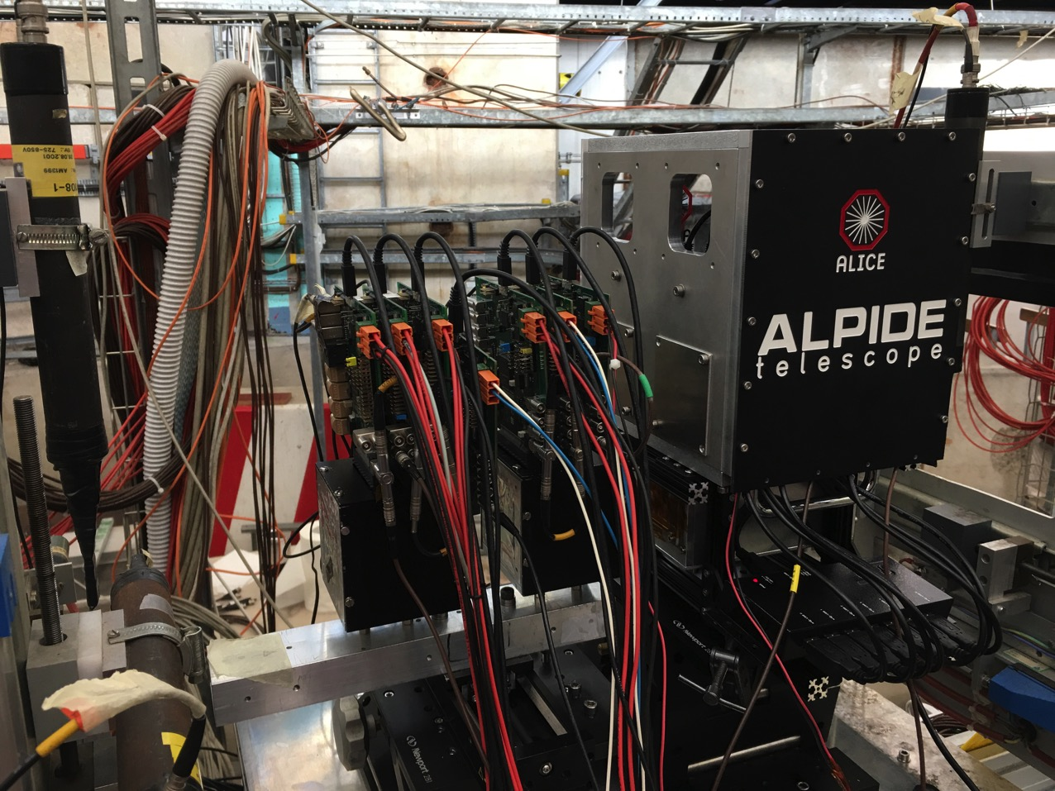
Test beam setup: 7 Single Chip Modules

