Slide 1
Progress since last Presentation 11/05/2016
MoU discussion continues with ALICE/ITS
LANL “Express of Interest” submitted in early October and reviewed by ALICE
Associate Membership expected after ALICE Collaboration Board Meeting next week (11/11)
Luciao/ALICE working on Cost & Schedule of sPHENIX “MoU”
Walt and Ming visit ALICE next week
MoU and procurements of R&D test stand etc.
Continue building collaboration
More new members
A separate MIE idea being explored
A small group meeting 10/21
Visit MIT/Bates 10/27
A near term plan developed

Slide 2
Possible Additional Collaborations
Czech Group (PHENIX, FVTX )
Expressed interest - M. Finger/Mike Finger
possible engineering and student support
A meeting w/ Ming and Walt scheduled next week at CERN, Nov. 10-15
China Central Normal Univ. (CCNU, ALICE/ITS 5th layer)
Expressed interest and possible collaboration on sPHENIX MAPS tracker - Nu Xu
Cesar visited CCNU ITS/MAPS labs
Many good students already at ALICE/CERN
Could help on assembly and testing etc.

Slide 3
A Separate MIE Proposal for the sPHENIX MAPS Inner Tracker?
This idea of a separate MIE has been brought up and discussed at several meetings recently
sPHENIX collaboration proposed “cost reduced” baseline configurations, (I) & (II).
Still waiting for decisions/inputs from ALD
In both scenarios, we need MAPS!
MAPS is considered by BNL ALD to have the best chance to get additional fund for sPHENIX:
With strong consortium of outside institutions (LANL+MIT+LBNL? + UT..), thus there is a strong push/desire from ALD/sPHENIX project office to get a separate MIE for MAPS

Slide 4
Challenges of a new MIE
What do we know from DOE?
From what ALD described, DOE (Jehanne and Tim) thought this was a good idea but it is too early to say more than that.
Not very clear DOE will be ready to provide $$ for this, and also the timeline given the 2-year Federal Budget Cycle even if “mission need” approved --- earliest MIE fund FY20
The separate MAPS MIE timeline needs to be tied to the ALICE/ITS production and also the sPHENIX schedules
ALICE/ITS production ends summer 2018
The early funding opportunity from normal MIE ~10/2019, a special case must be made to meet the ALICE/ITS production schedule
Potential high impacts on the sPHENIX-ALICE “MoU”
Resources, lab space and man power
Schedules

Slide 5
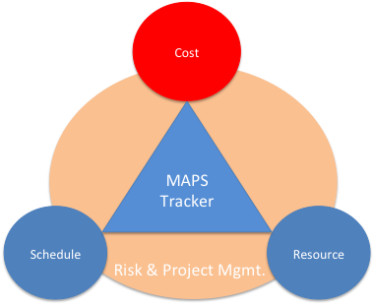

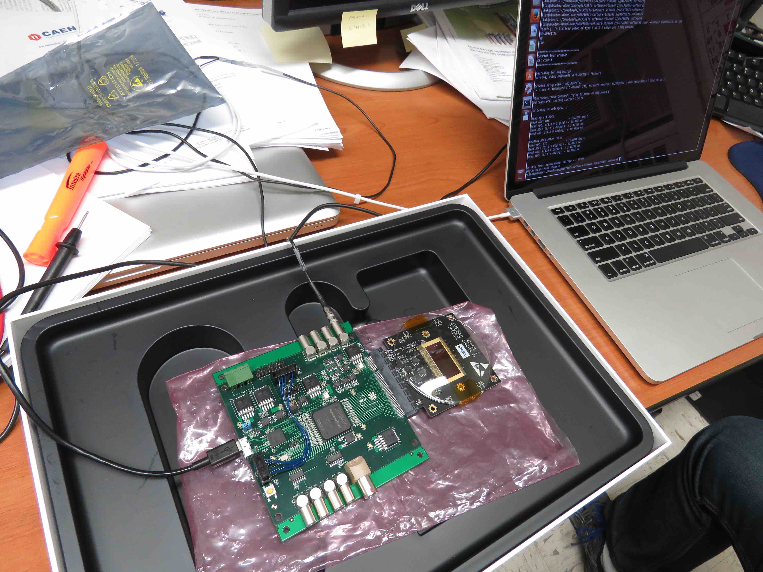
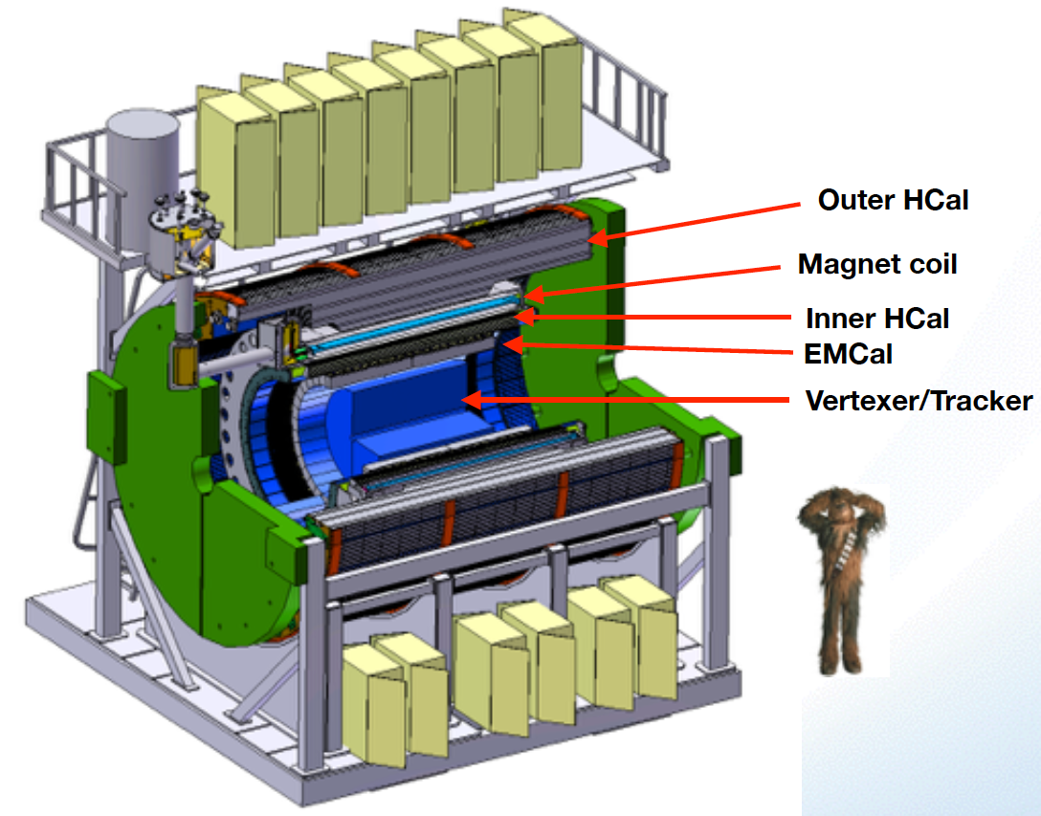
Project Task and Timeline
From Sep. 2016
Tracker Review
FY2016
FY2017
FY2018
FY2019
FY2020
FY2021
CD-0
11/1
CD-1
11/1
CD-2/3
8/1
Ready for
Beam
6/1
Readout R&D
Mech. design
@LANL/ALICE
Key R&D
Mech. Integr.
& Prototype
@BNL/LANL
Production
MAPS Prod. & QA
@ALICE
Stave Prod.&Test @CERN;
FEM Prod. @US
Det. Assembly & Test
@BNL
Det. Install.
@BNL
+2%
+50%
We need $$
here to start!
FY20:
MIE Fund available?
Some intermediate
solutions needed to
fill the gap!
MoU w/ ALICE: 12/2016
To produce staves, frames and FEMs

Slide 6
Had a Small Group Meeting on 10/21/2016
Ed, Dave M, Gunther and Ming
1. High level sPHENIX-ALICE “Agreement”:
“The document that we intend to have both CERN and DOE sign agreeing to cooperate on MAPS
development for sPHENIX, will not be a Memorandum of Understanding, but rather an
agreement to collaborate, an agreement to provide resources, or something similar. “ from Ed.
2. ALD plans to work on sPHENIX-ALICE Agreement with DOE and sPHENIX management, willing to go
to CERN for negotiation etc.
3. >$2M MIE as an individual federal budget item, there could be some flexibilities, we try to work out MAPS plan first then deal with this later
4. Develop a pre-proposal (a draft by 12/15/2016 sPHENIX collaboration meeting),
-- identify the timeline of M&S fund and manpower needs to match ALCIE/ITS and
sPHENIX schedules
--- > starting from Cost & Schedule documents we already have
5. To get all interested parties involved in the pre-proposal writing
6. Gunther will try to arrange a meeting with MIT folks on 27th to discuss MAPS involvement

Slide 7
sPHENIX/MAPS MIE Discussion (Cont.)
sPHENIX/MAPS discussion at MIT, 10/27/16, many attended
Gunther, Bolek W., Yen-Jie L, Bob R., Richard M., Bolek W. ,
Bates Engineers Jason Besuille, James Kelsey.
Dave M., John H, Ed dialed in
Cesar and Ming
Discussed MIT’s interest and responsibility
Major tasks to lead
Mechanical system integration
Assembly and system test
MIT Physics and Bates Engineering Group
excellent match to the capabilities
Resource and timeline
Engineers and Techs
Students and postdocs

Slide 8
A Near Term Plan
Consider a separate MIE proposal for MAPS
Feasibility, start communication with DOE
Have a pre-proposal soon, first draft by Dec 15
Identify tasks, resources and timeline
First full doc by Jan 2017, to be ready for discussions with DOE
Invite all interested parties to join the pre-proposal writing
A draft: ~15 pages
Update Resource, Cost and Schedules
More discussion at Dec. collaboration meeting

Slide 9
Note: a Typical MIE Timeline
Submitted and reviewed in FY17, establish DOE “mission need”
Federal budget request by DOE in Feb 2018,
Fund available FY20 for construction
Early construction fund needed by mid 2018
Produce MAPS chips and staves following ALICE/ITS production at CERN
About $1M, external funding opportunities?

