Slide 1
Goals
Formation of MAPS Detector Group
  Institutions and contacts
Prepare for the September MAPS Cost & Schedule Review
  Who: contact person, institute, expertise
  When: your plan and schedule
  What: resources, interest and tasks
Future Plan discussion
  sPHENIX cost and schedule review, ~Nov. 2016
  New collaborators and other external funding opportunities
  DOE MIE proposal writing? (needs to act fast!)

Slide 2
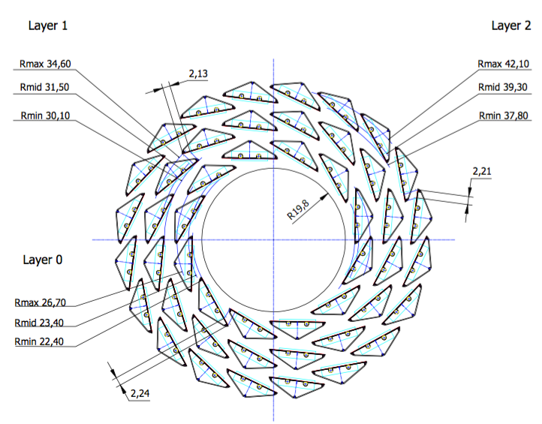
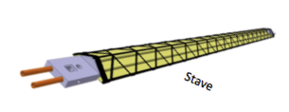
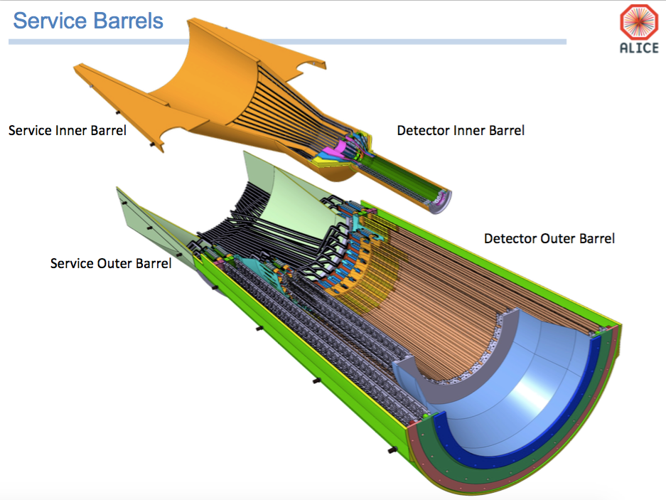
Scope of the Proposed MAPS Project
Build “a copy” of ALICE/ITS 3-layer inner MAPS detector for sPHENIX
Extend ALICE/ITS stave production
  Minimize technical risks
  “Buy” assembled and fully tested staves from CERN (48+40% =68)
  ITS produces 120 staves (2x+20%)
Modify ITS readout to match sPHENIX DAQ
Modify ITS mechanical frame to fit sPHENIX world
Physics and simulations
Work at CERN on MAPS/ITS as ALICE Associate Members
Inner Tracking Region

Slide 3
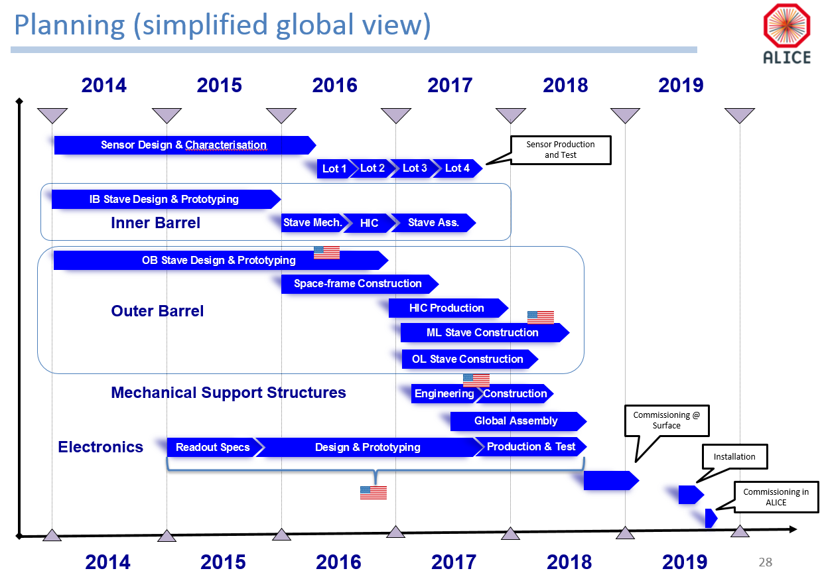
Current ITS Schedule, +6 months delay
CD1
11/2017
CD3b
8/2018
sPHENIX
installation
6/2021
sPHENIX project fund available, CD3b
Stave Assembly at CERN
1/17 - 1/18
Extend the production for sPHENIX
LANL/LDRD: 10/2016 – 9/2019
MAPS detector prototype R&D
- full readout chain into sPHENIX
- Initial mechanical design
Be ready for full MAPS production
L. Musa

Slide 4
sPHENIX MAPS Detector Questionnaire
Your institution and contact person
Expertise and interests in the sPHENIX MAPS project
Manpower
Manpower could be used for activities at CERN?
Available resources and capabilities
What of the above would you like us to include in the September tracking review presentations?

Slide 5
Backup

Slide 6
Building Collaboration
Workshops organized in Santa Fe
  MAPS experts from CERN, LBNL and BNL
Strong support from ALICE MAPS groups
  ITS project management, Musa et al
  LBNL
  Yonsei/Korean Institutions
US institutions
  UNM, NMSU, other (s)PHENIX institutions
  MIT HI/ME groups
  STAR/HFT group
  LBNL, LDRD proposal to build mechanical support
Other international collaborators
  CCNU/ALICE?

Slide 7
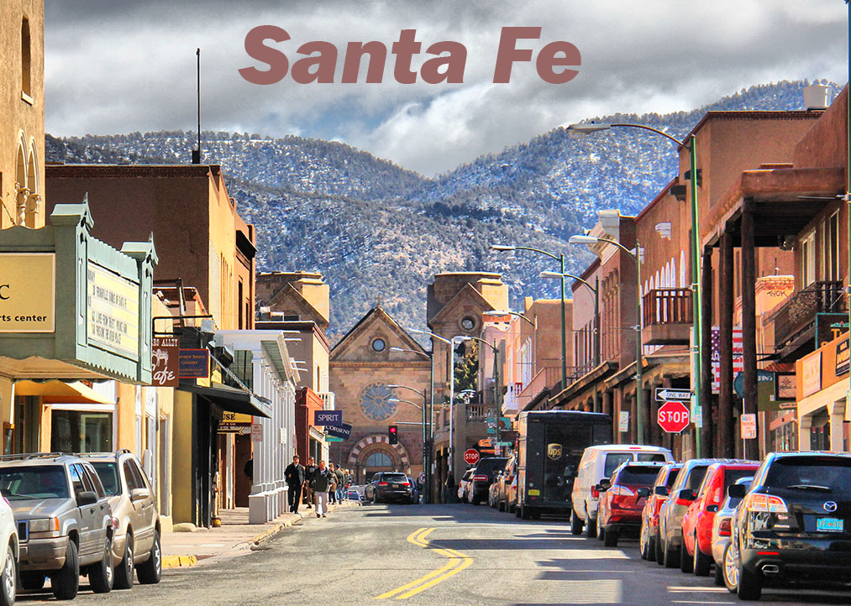

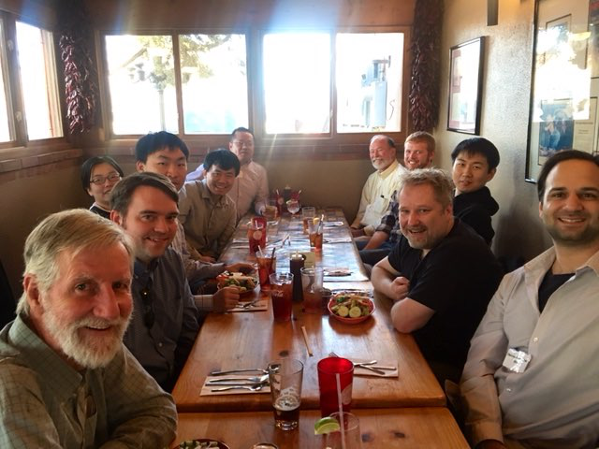

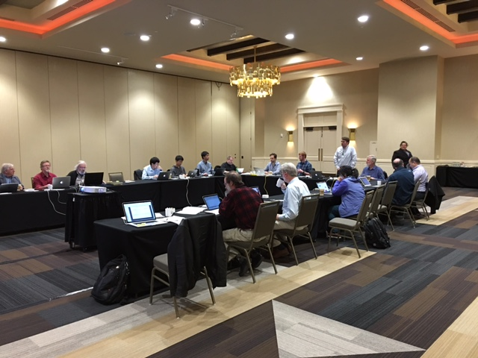
sPHENIX Tracking Workshops in Santa Fe
1st Pre-DNP sPHENIX Tracking Workshop held
in Santa Fe, Oct. 27, 2015https://indico.bnl.gov/conferenceDisplay.py?confId=1364
Discussed various options for sPHENIX Tracking needs
MAPS technology clearly stands out from others
LANL MAPS Silicon Option
was examined at Santa Fe MAPS Cost & Schedule Workshop, Mar 30-Apr. 1, 2016
Excellent turn-out from sPHENIX, ALICE, STAR/HFT, EIC experts
https://indico.bnl.gov/conferenceDisplay.py?confId=1741
Take Home:
- Extension of ALICE production possible
- Inner tracker cost <$5M inc. contingency

Slide 8
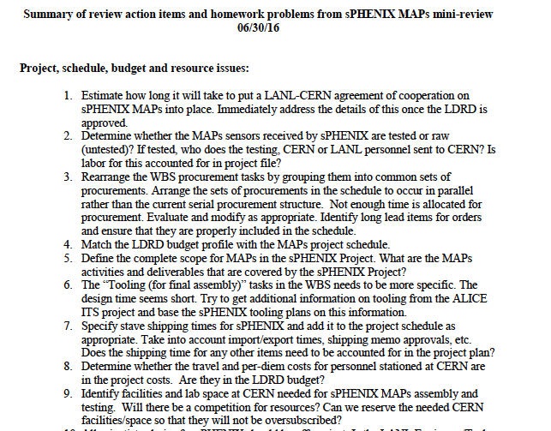
BNL MAPS mini Review 6/30/2016
Very constructive feedback, ~60 homework items

Slide 9
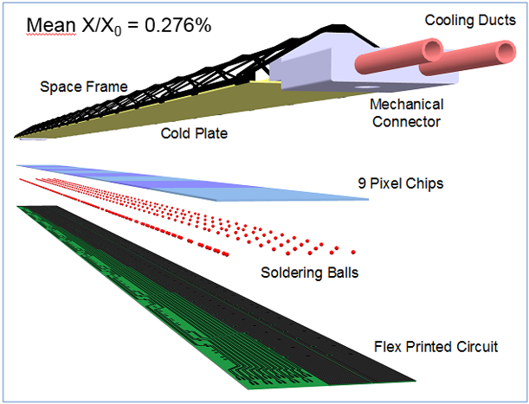
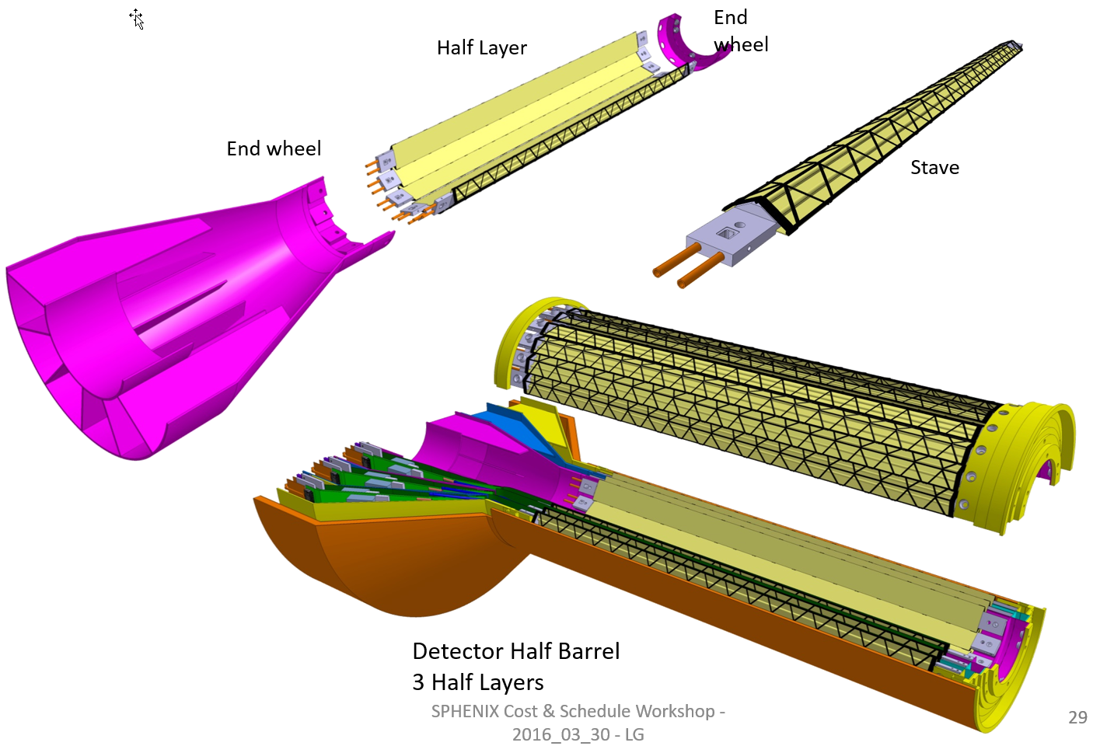
ITS Inner Layers
Leo’s talk
@Santa Fe
48 inner staves
432 Sensors
226 M pixels
0.19 m² of silicon
Readout for:
Very comparable to PXL

