Slide 1
MAPS MoU Progress
9/30/2016
Received sample documents from Luciano about MoU and Express of Interest on 9/27
  Working on LANL-ALICE/ITS EOI, draft by this weekend
  Apply for ALICE Associate Membership
  sPHENIX MoU, Luciano working on cost and schedule estimate, try to have MoU draft by mid of Oct.
Encouragement from ALICE SP Dr. Paolo Giubellino, with detailed instruction how to proceed:
  EOI to SP and ITS Management by 10/6 (MB)
  Collaboration Board Meeting for approval, 11/9(CB)
Plan to visit CERN the week 11/9, ALICE collaboration week
  Meet people, also visit lab, discuss plans
  sPHENIX MoU discussion

Slide 2
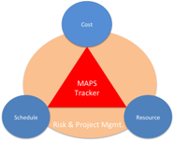
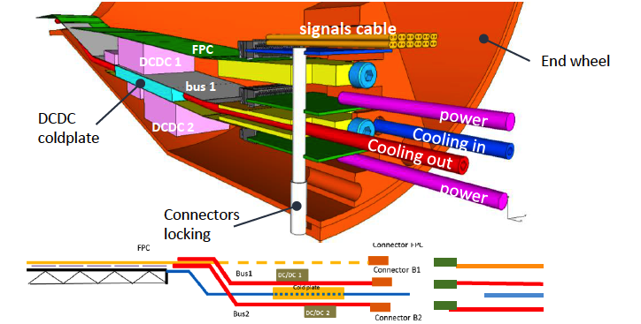
sPHENIX MAPS Inner Tracker
Sharing space:
MAPS + INTT + TPC

