Slide 1
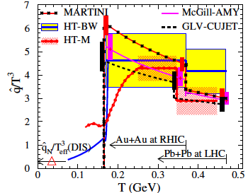
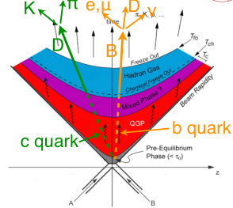
B Physics @sPHENIX
RHIC physics reach
PHENIX
STAR
D physics well covered by RHIC and LHC/ALICE
What we learned
Desires B measurements at low pT
sPHENIX opportunity
Precision B and b-jet measurements
Upsilons

Slide 2
TAMU Model heavy quark diffusion and hadronization/recombination

Slide 3
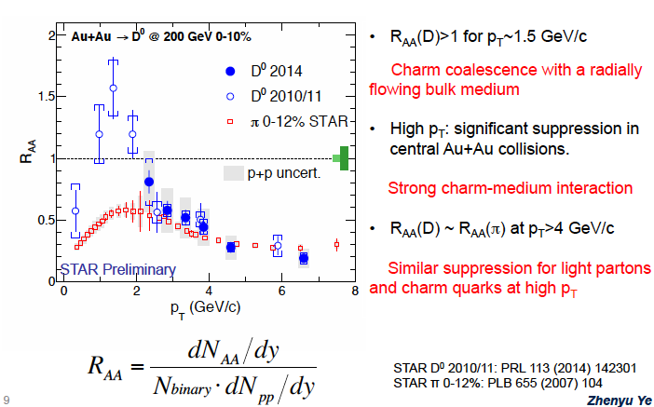
Latest D⁰ RAA from STAR
Santa Fe Jet and Heavy Quark Workshop 1/2016

Slide 4
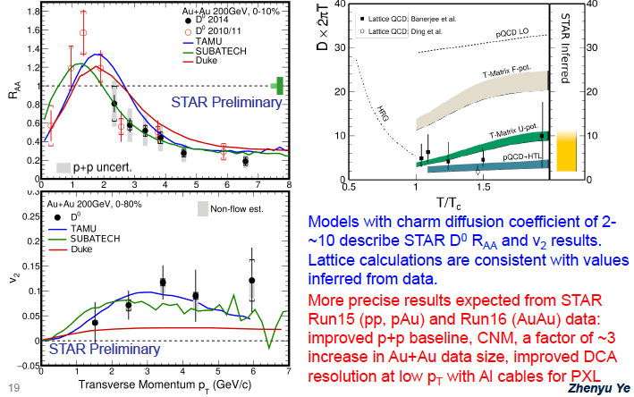
D⁰ at RHIC

Slide 7
D: pT > 8GeV
B->J/Psi: pT > 6.5GeV

Slide 8
This is what sPHENIX
can do (better) with MAPS!

Slide 9
STAR Projections: 2021-2022

Slide 10
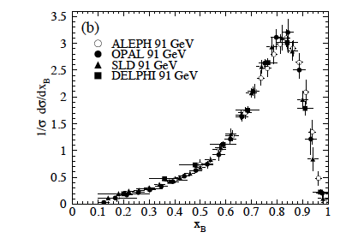
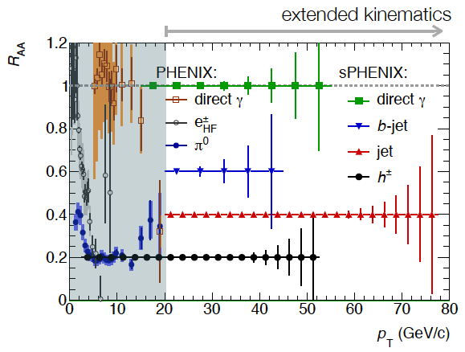
sPHENIX Coverage
Low pT B mesons?
0<pT<20GeV
Currently limited at both RHIC/LHC to
B->J/Psi + X
B->leptons + X
Inclusive B measurements
R_{AA}
V₂
Correlations
B-Jet in A+A
<Z> ~ 0.8 in p+p
pT_Jet >~20GeV

Slide 11
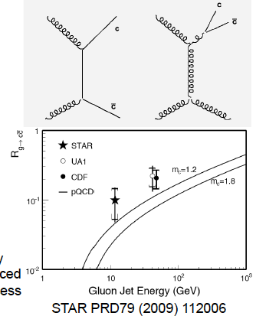
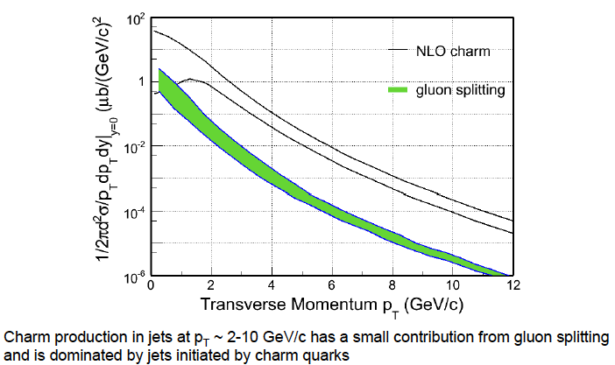
Theory Predictions

Slide 12
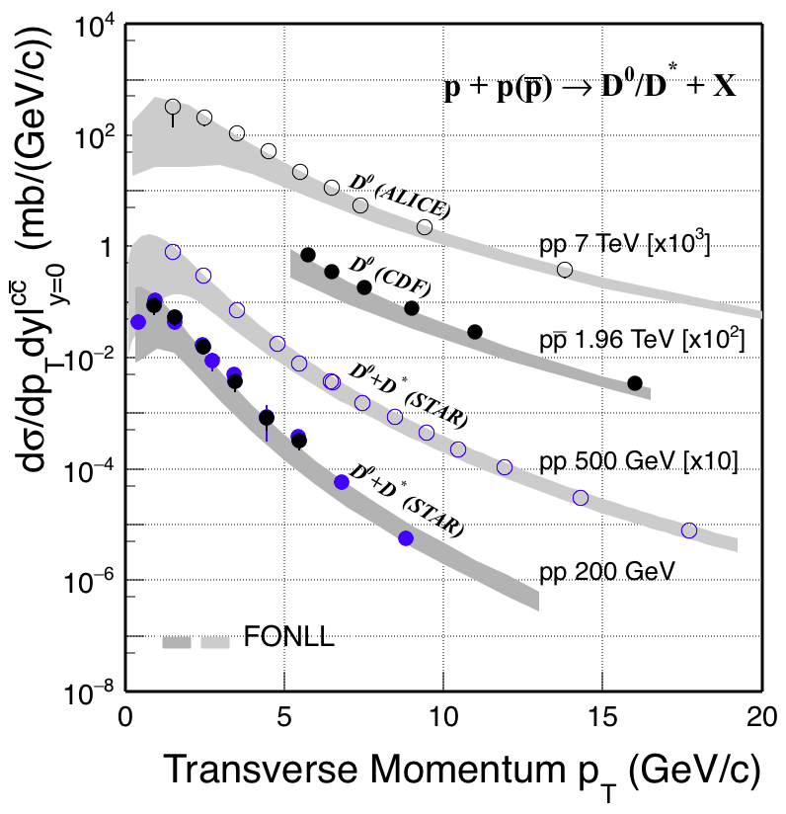
Current Expectations vs STAR Data

Slide 13
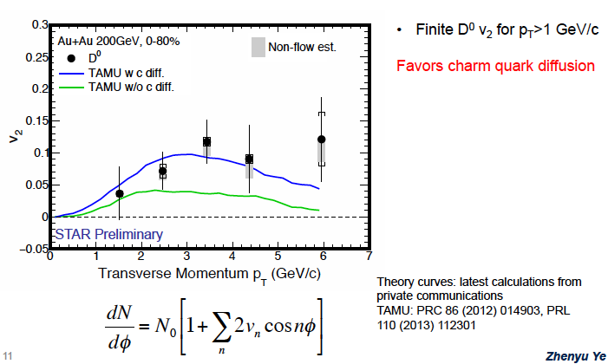
Latest D⁰ v2 from STAR

Slide 14
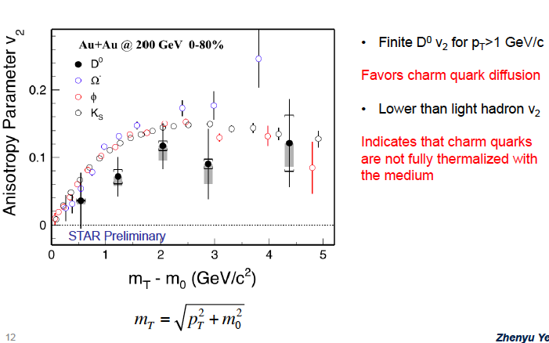
V2 and Heavy Quark Diffusions

Slide 15
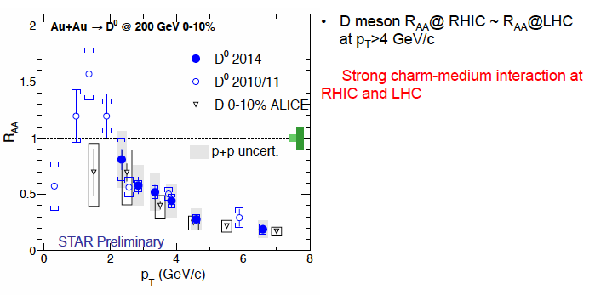
RHIC vs LHC: D⁰ R_{AA}
How about B hadorns?

Slide 16
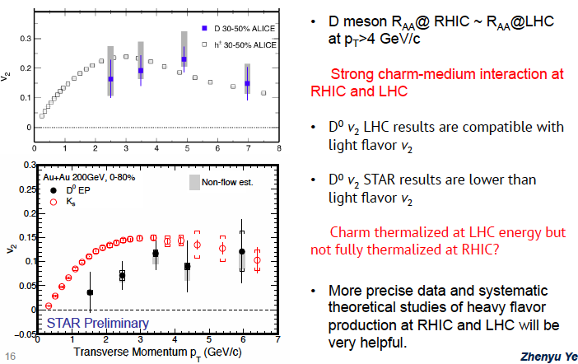
RHIC vs LHC: D⁰ v2

Slide 17
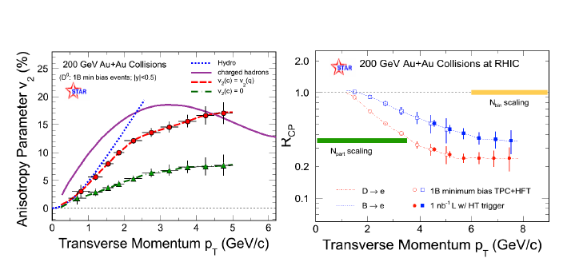
STAR HFT

Slide 19
D: pT > 8GeV
B->J/Psi: pT > 6.5GeV

