Slide 1
Intelligent Experiments Through Real-Time AI
-
Fast Data Processing and Autonomous Detector Control for sPHENIX and Future EIC Detectors
Ming Liu
Los Alamos National Laboratory
for the Fast-ML Team
DOE Fast-ML Presentations
November 30, 2022

Slide 2
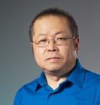
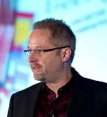
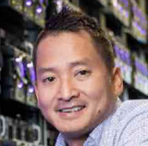

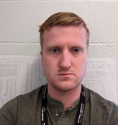
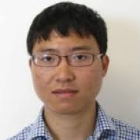

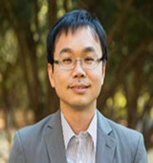
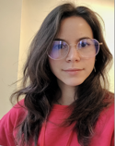

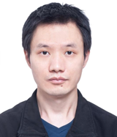


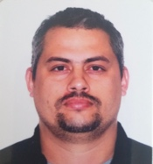


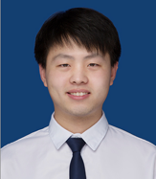
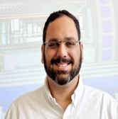
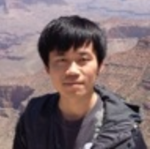
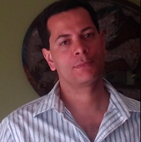
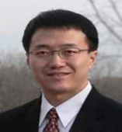
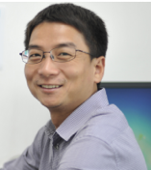
Today’s Presentations
Overview, 10’
  - Ming Liu (LANL)/Gunther Roland(MIT)/Nhan Tran(FNAL)/ Dantong Yu (NJIT)
Physics simulation and AI-ML algorithms, 10’
  - Dantong Yu (NJIT)/Cameron Dean(MIT)/Zhaozhong Shi(LANL) /Hang Qi(MIT)/Hao-Ren Jheng(MIT)/Beilei Jiang(NTU)
HLS4ML and firmware implementation, 5’
  - Micol Rigatti (FNAL)/Phil Harris(MIT)/Nhan Tran(FNAL)/
Demonstrator implementation, 5’
  Jakub Kvapil (LANL)/Yasser Corrales(MIT)/Noah Wuerfel(LANL)/Jo Schambach(ORNL)/Kai Chen(CCNU)/Lang Lei(CCNU)/Beilei Jiang(NTU)
Q & A: 5’

Slide 3
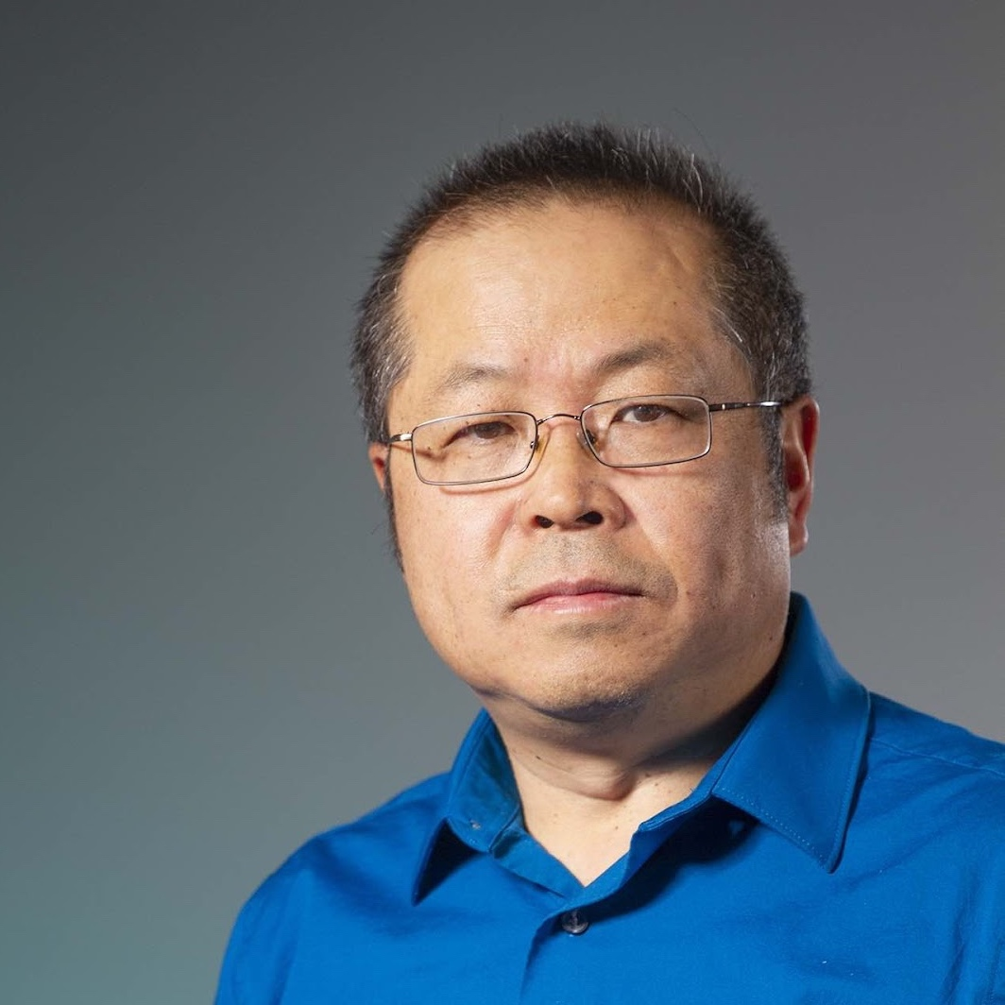
Overview
- Ming Liu

Slide 4

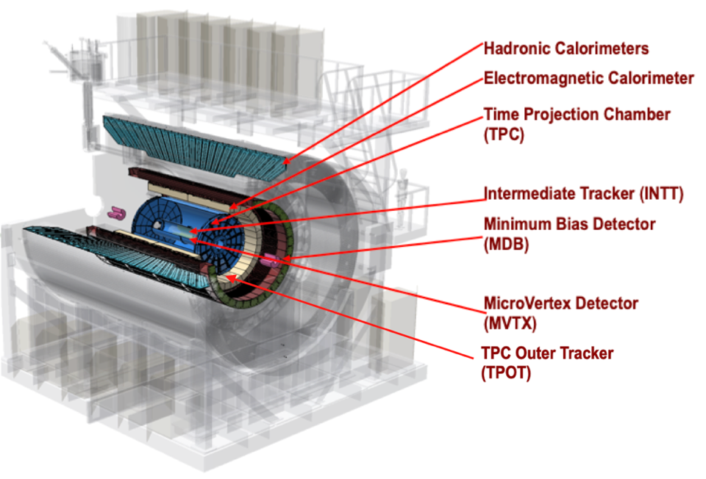
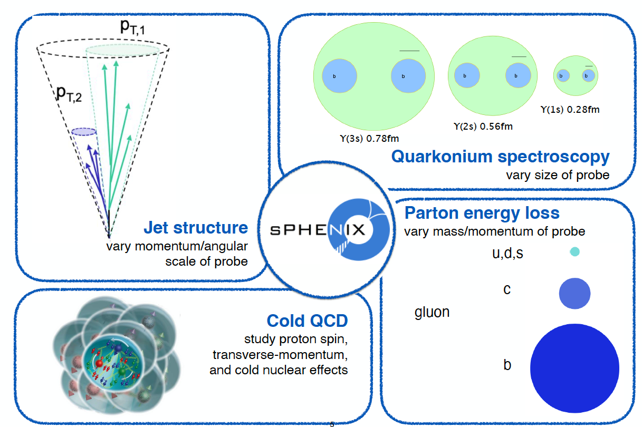
sPHENIX at RHIC
2015 NSAC Long Range Plan for Nuclear Science priority: sPHENIX Experiment at RHIC
Probe the inner workings of QGP by resolving its properties at shorter and shorter length scales
Complementary to LHC experiments to study relativistic heavy-ion collisions
Heavy Flavor physics – a key pillar of RHIC science

Slide 5
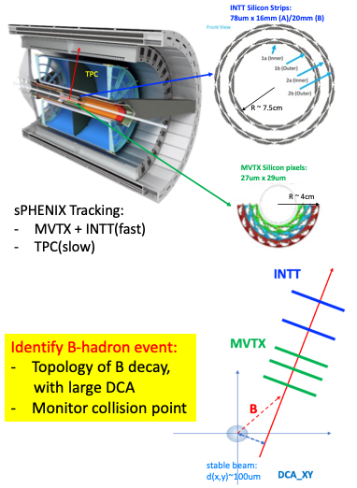
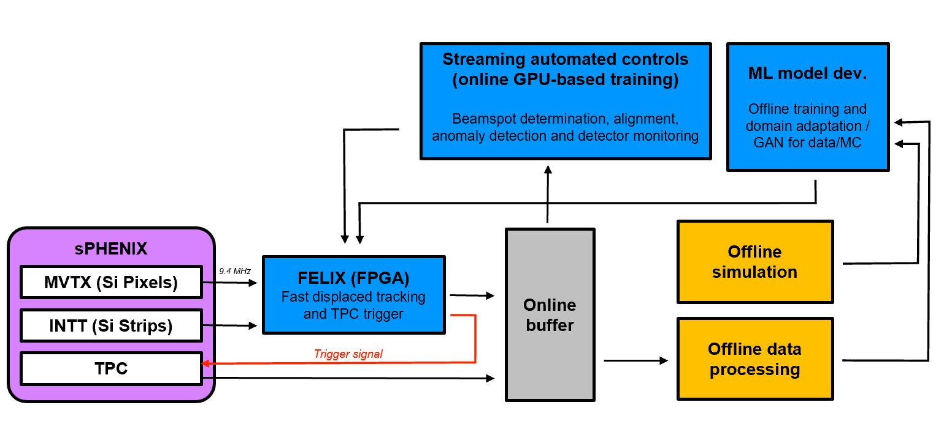
Project Goals and Deliverables
Selective streaming real-time AI and autonomous detector control:
Deliver a demonstrator for p+p and p+Au running for sPHENIX -> generalizable for applications in experiments at the EIC, improve b-hadron physics in p+p/Au by >100x
4 interconnected key tasks:
Constraints:
MVTX data rate = 300 kHz
INTT data rate = 9.4 MHz
Trigger latency = 10μs
Task 4
Task 2
Task 3
Task 1

Slide 6
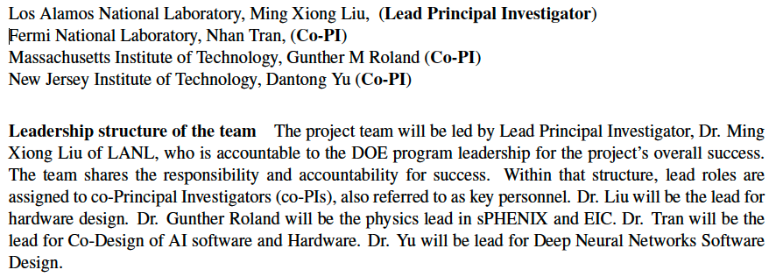
Leadership and Technical Roles
Team of NP + HEP + CS
New teams joined later in early 2022:
Dr. Jo Schambach, ORNL, sPHENIX/EIC readout integration, sPHENIX MVTX and EIC/ePIC readout lead
Dr. Kai Chen, CCNU, FELIX-AI-Trigger hardware integration, FELIX developer at BNL for ATLAS, also sPHENIX
Prof. Song Fu, NTU, data acceleration in ML

Slide 7
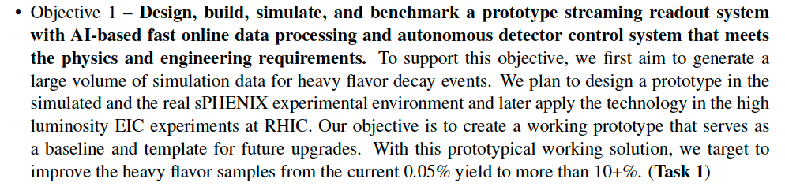
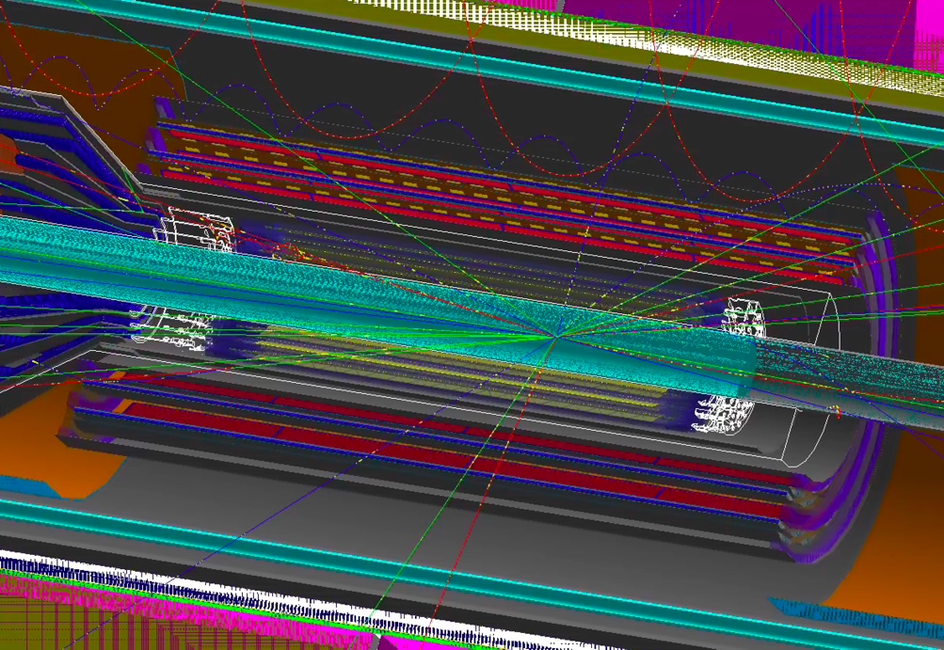
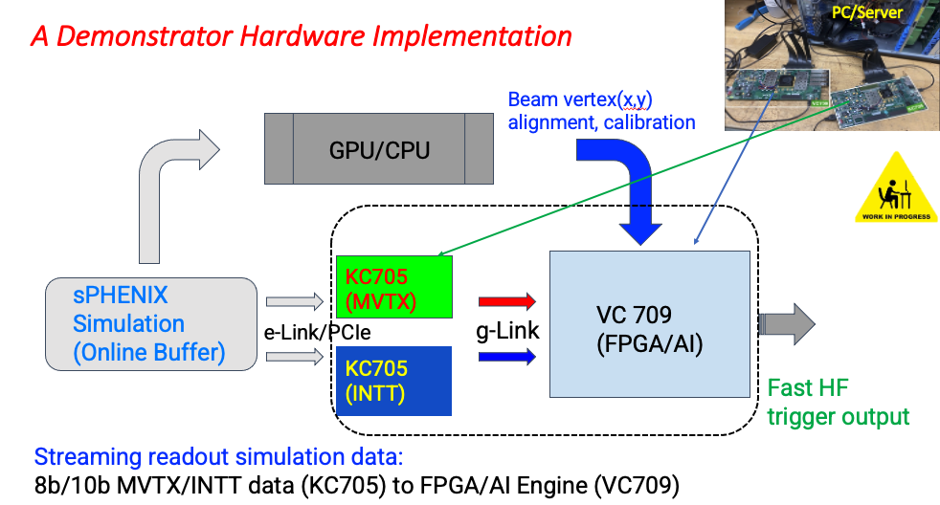
Technical Approaches and Highlights - I
Jakub
sPHENIX MVTX and INTT
full simulations of p+p collision
Convert simulated hits to sPHENIX real data like bit-stream to feed FPGA/AI

Slide 8
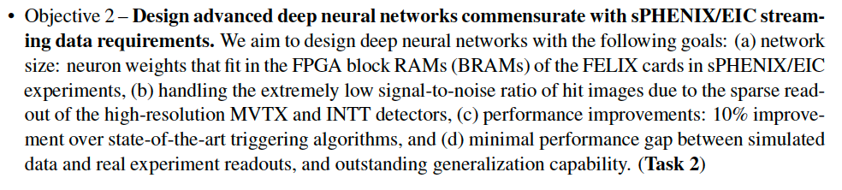
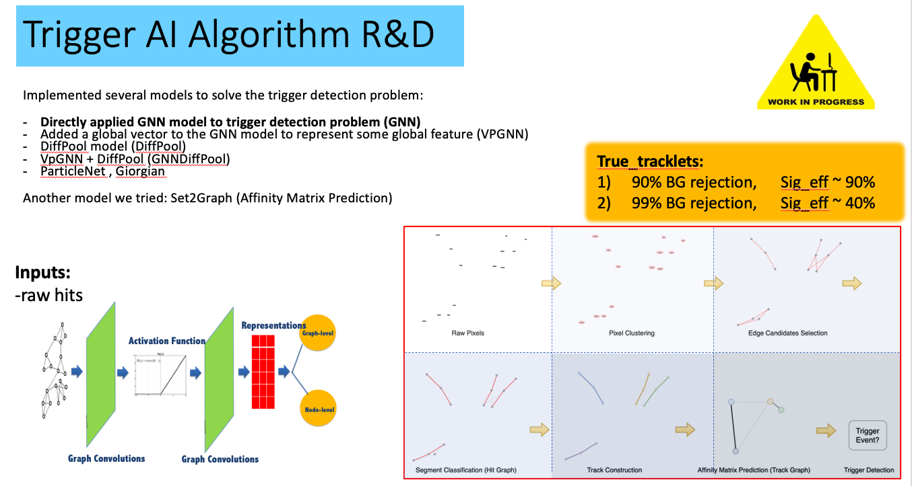
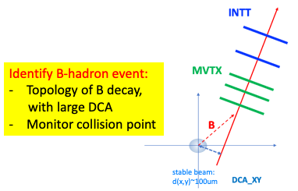
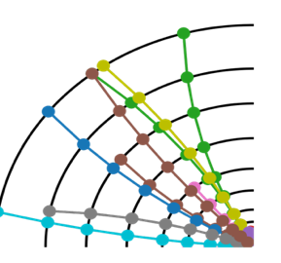
Technical Approaches and Highlights - II
Dantong

Slide 9
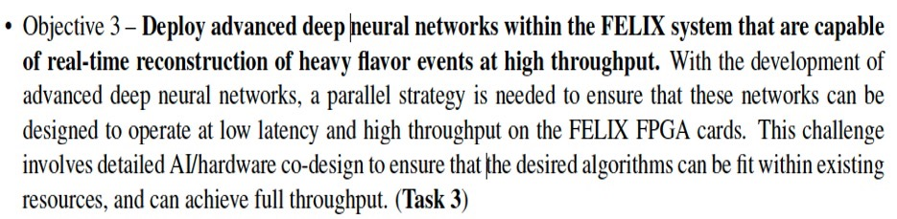
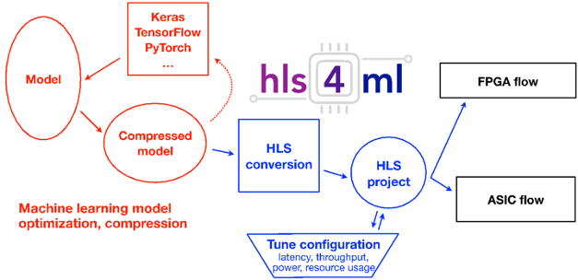
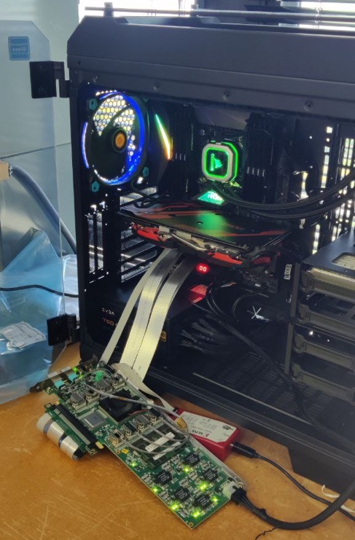
Technical Approaches and Highlights - III
Micol/Phil
Primary focus:
achieving low latency, real-time processing of data, and deployment of algorithms with high efficiency
FELIX 711@FNAL

Slide 10
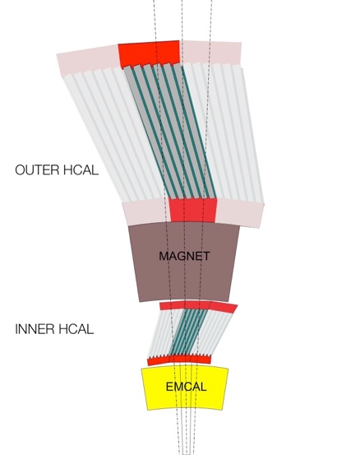
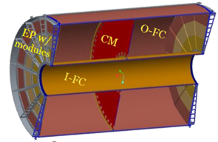
sPHENIX Readout and AI-ML HF Trigger Integration
DCM-2 receives data from digitizer, zero-suppresses and packages
SEB collects data from a DCM group (~20)
EBDC Event Buffer and Data Compressor (~40)
Buffer Box data interim storage before sending to the computing center (6)
On Detector
Rack Room
oHCal
FEM
DCM
DCM2
DCM
DCM
DCM
DCM
100+ Gigabit
Crossbar
Switch
DCM
SEB
Buffer Box
FEM
iHCal
DCM
DCM
DCM2
DCM
DCM
DCM
Buffer Box
FEM
DCM
SEB
EMCal
DCM
To
HPSS
(Computing Center)
DCM
DCM
DCM2
DCM
SEB
Buffer Box
DCM
DCM
TPC
FEE
Buffer Box
DCM
DCM
FELIX
EBDC
DCM
INTT
FEE
Buffer Box
DCM
DCM
FELIX
EBDC
DCM
FEE
Buffer Box
MVTX
DCM
FELIX
EBDC
DCM
DCM
Streaming Readout (SRO) + AI/ML

Slide 11
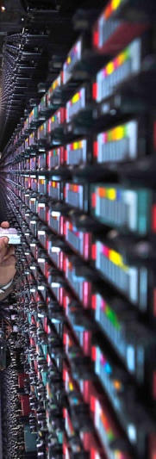
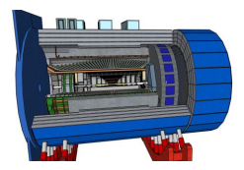
From sPHENIX to EIC/ePIC: Streaming + AI/ML DAQ
from Jo’s talk at ePIC collab. Mtg, 7/2022
Timing System
Detector Control
FEB = Front End Electronics Board
RDO = Front End Aggregation & E/O I/F
DAM = Data Aggregation Module
EBDC = Event Buffer / Data Compressor
FEB
DCM
DAM
EBDC
DCM
Network
Switch
DCM
FEB
DCM
DAM
EBDC
DCM
DCM
Online
Data Filter
Buffer Box
FEB
DCM
DAM
EBDC
DCM
DCM
Buffer Box
FEB
DCM
DAM
EBDC
DCM
To permanent storage and nearline processing
DCM
Buffer Box
FEB
Online
Data Filter
DCM
DAM
EBDC
DCM
DCM
Buffer Box
FEB
DCM
DAM
EBDC
DCM
DCM
Buffer Box
FEB
Online
Data Filter
(sPHENIX)
ePIC detector
DCM
DAM
EBDC
DCM
DCM
Buffer Box
FEB
DCM
DAM
EBDC
DCM
DCM
FEB
RDO
DCM
DAM
EBDC
DCM
DCM
Monitoring
SRO + AI/ML
O(2 Pbps)
O(10 Tbps)
O(0.5 Tbps)
O(0.1 Tbps)

Slide 12
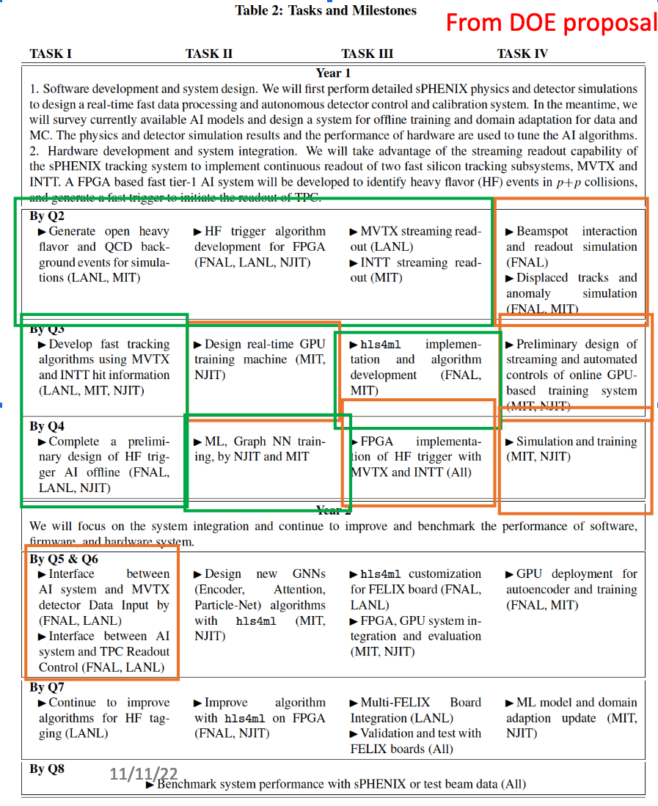
Summary and Outlook
Note: completed; in progress
Produced full sPHENIX physics and detector simulations of heavy quark and QCD backgrounds
Successfully developed preliminary AI-algorithms for sPHENIX HF triggers
Completed MVTX SRO
Demonstrated INTT SRO
Implemented a toy AI-algorithm in HLS4ML in FELIX
Work in progress to implement full sPHENIX trigger in a simplified hardware
On track to accomplish all major goals in 2023
Future plan/proposal:
Extend project by 2 years, 2024 ~ 2025
  Implement the demonstrator for sPHENIX p+p run in 2024
  Develop EIC/ePIC TDR of SRO with AI/ML for EIC CD2(2024) and CD3(2025) based on our work

Slide 13
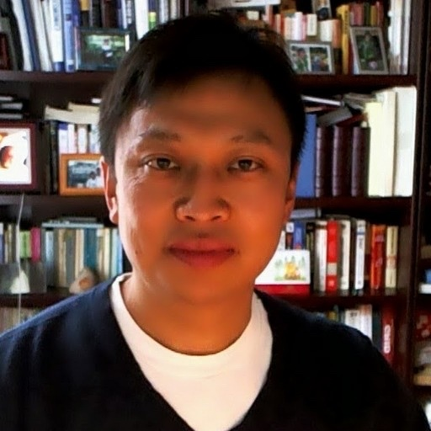
Physics simulation and AI-ML algorithms
- Dantong Yu

Slide 14
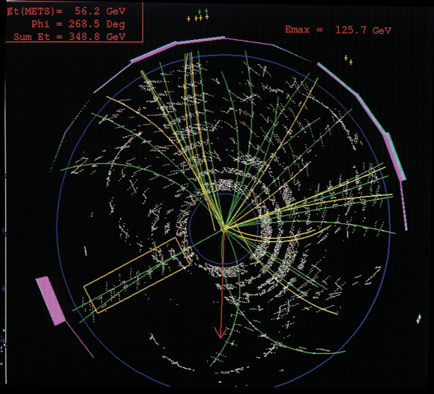
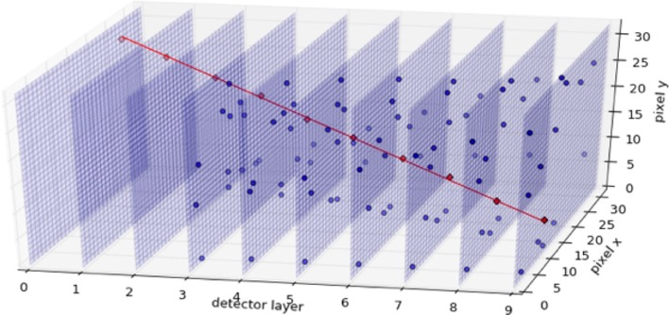
AI Trigger Pipeline
Fetch events from event buffer to Processing
Data Pre-processing Clustering
Tracking + Outlier hits Removal
Triggering
Triggers on TPC

Slide 15
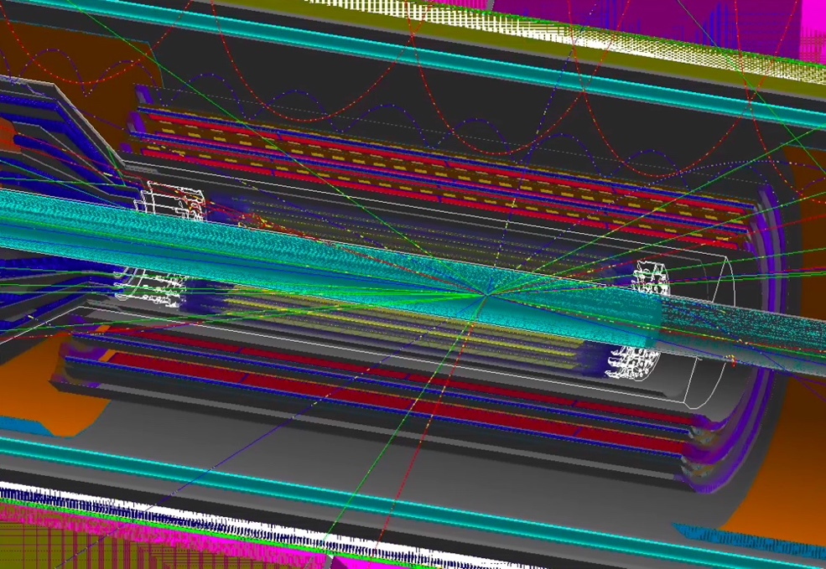
Simulations
Most simulations have focused on sPHENIX
  ePIC detector simulations for EIC are under rapid changes
We simulated 2 different physics events (all 200 GeV pp collisions)
  Minimum bias with all heavy flavor decays rejected for background
  D⁰→K⁻ π⁺ in minimum bias for signal
Simulations have been improved throughout the year
  Added full service material for MVTX
  Added realistic hit duplication in MVTX from pixel pulse length
Dataset
  8 million events - 50% signal/noise.
  8 million events - 0.1% signal/noise.
sPHENIX Sim: p+p
INTT
MVTX

Slide 16
Algorithm Flow
Strategy is to construct a large scale AI algorithm with all elements of trigger
  Algorithm is factorizable into core physics components
  Emulates the normal reconstruction workflow
  Use of core components allows for intermediate physics validation
Labelled
Track
Hits
Displaced Vertices
Silicon
Pixel
Hits
Displaced
Vertex Reconstruction
AI Algorithm Block
Graph Track reconstruction
Bipartite
Trigger Decision
(D/B Identification)
Track Momentum Regression
Graph NN
AI Algorithm Block
Reconstructed
Track Momenta
AI Algorithm Block

Slide 17
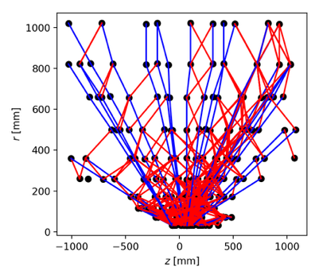
Tracking as Graph Neural Networks
See also:
https://exatrkx.github.io/
Graph neural networks are a popular way of posing tracking problems in physics
  Sparse hits in space do not fit traditional ML architectures
  Growing sub-field of geometric deep learning
Data is structured as a graph of connected hits
  Connect plausibly related hits using geometric constraints and learn best associations and parameters of connected hits (tracks)

Slide 18
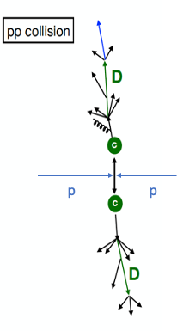
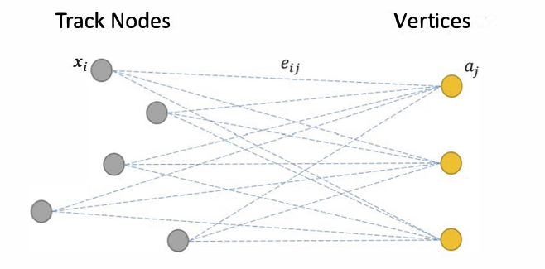
Three Types of Potential Interactions in Model Event Decay
Local track-to-track interactions, such as determining whether two tracks share the same origin vertex.
Track-to-global interactions, such as determining the collision vertex of the event and potential secondary vertices of decaying.
Global-to-track interactions, such as comparing each track's origin with the collision vertex of the event.
Pair-wise Relations (Set/Graph/Attention)
Graph Aggregation
(Bipartite Graph aggregation)
- vertexing
Graph Distribution and Bypassing (Bipartite Graph)
- parent/daughter
Notes:
This slide illustrates the main problem, it might be good to move this early
Adding high level explanation of the challenge “Find the secondary Vertex”
Vertex Parents

Slide 19
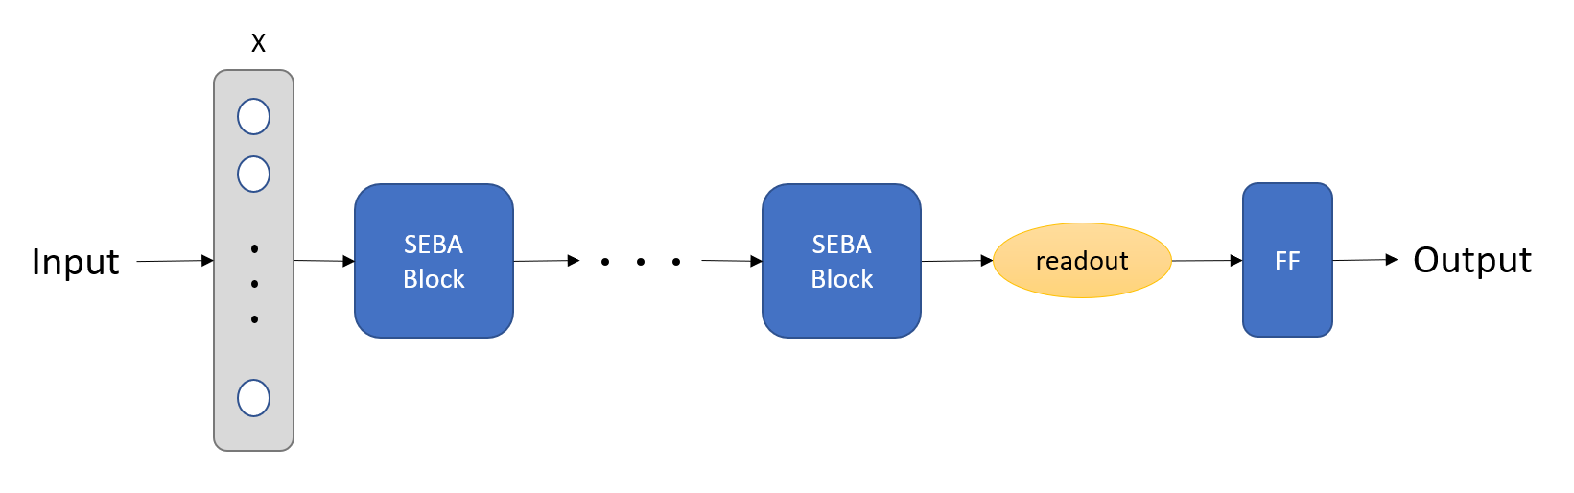
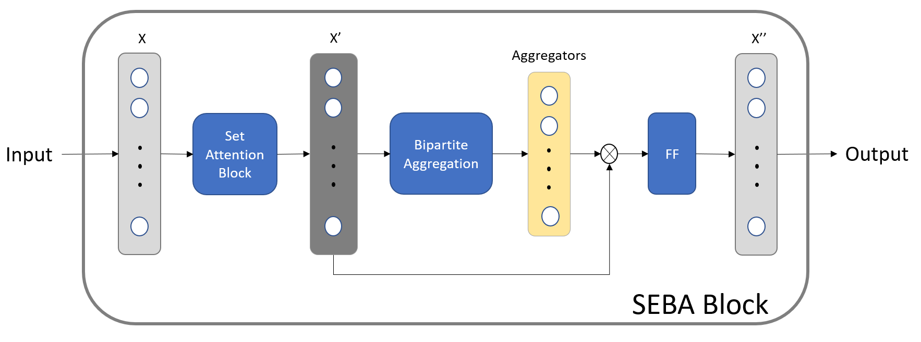
Bipartite Graph Networks with Set Transformer
(BGN-ST) Model Architectures
FF: Feed Forward Network
vertices
Set Encoder with Bipartite Aggregator (SEBA) Blocks
Notes:
difficult to understand them .. backup slide?
Put This slide in backup, its a detail of next slide

Slide 20
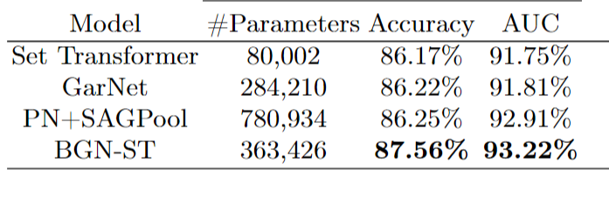
Experiments: Physics Driven BGN-ST
1% signal/background ratio
Background Rejection | Efficiency | Purity
90% | 72.5% | 7.25%
95% | 48.9% | 9.78%
99% | 15.0% | 15.0%
99.33% | 10.5% | 15.7%
Excellent physics trigger performance for charm events
Expect better results for beauty, work in progress
Notes:
Sim done for charm signal events
Can you quote the signal efficiency for a background efficiency of 1% ( a rejection of 99%);
For ref.:
MB_Trigger = 10 kHZ (15kHz)
P+p arte = 10MHz
Fraction of HF = 10^-3
If HF Trig_Eff = 10%,
gives us 100x improvement in stat.
We compare our model with the ParticleNet(PN)+SAGPool method proposed in \cite{zhu2021new}. We also use Set Transformer and GarNet as our baselines because they are also well-suited to the problem of classifying a set of tracks.
Table 2 compares the performance between BGN-ST and the baseline models. From Table 2, we observe that BGN-ST outperforms all other methods by a significant margin. It usually takes no more than one day to train the Set Transformer, GarNet and BGN-ST on a single GPU card. The baseline PN+SAGPool has more parameters than ours. It takes two to three days to train the baseline model PN+SAGPool.

Slide 21
Status and Outlook
Demonstrated BGN-ST outperforms selected state-of-the-art methods ^{[1,2]}
  Adopts the physics-aware concept and introduces explicit physics properties such as transverse momentum
  Improves the task accuracy and AUC score by about 15%
  Architecture benefits from pairwise interactions between tracks and allows a two-way scattering and gathering for effective information exchange and adaptive graph pooling
Next step: from optimal performance of state-of-the-art methods, develop firmware implementations
  Understand what is feasible and condense the model into latency and resource constraints
[1] Xuan, Y. Zhu, G. Borca-Tasciuc, M. X. Liu, Y. Sun, C. Dean, Y. C. Morales, Z. Shi, D. Yu, End-To-End Pipeline for Trigger Detection on Hit and Track Graphs in, Accepted by Thirty-Fifth Conference on Innovative Applications of Artificial Intelligence, IAAI.
[2] Xuan, G. Borca-Tasciuc, Y. Zhu, Y. Sun, C. Dean, Z. Shi, D. Yu, Trigger Detection for the sPHENIX Experiment via Bipartite Graph Networks with Set Transformer in European Conference on Machine Learning and Principles and Practice of Knowledge Discovery in Databases (ECML-PKDD 22).

Slide 22
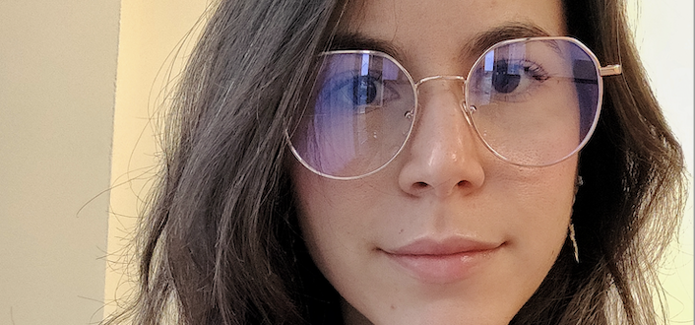

hls4ml translation and firmware implementation
- Micol Rigatti and Phil Harris

Slide 23
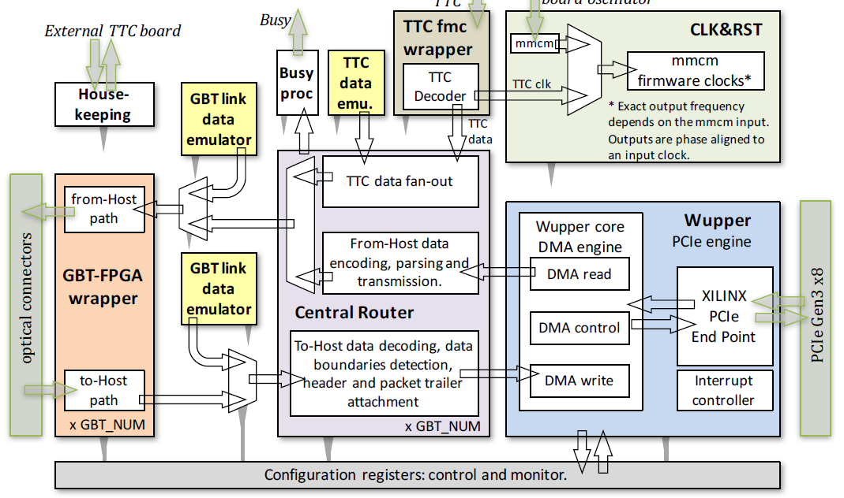
Hardware and Firmware Implementations
Selective data streaming in sPHENIX will use the FELIX board. FELIX is a 16-lane Gen-3 PCIe card with 48 transmitters and receiver optical links. The on-board FPGA is a Kintex Ultrascale XCKU115FLVF1924-2E
The FELIX Firmware implements the interface for the PCIe, the interface for the transmitters and receiver optical links, the routing of data, and the clock and resets logic.

Slide 24
Hardware Configuration
A second FELIX is connected to the first FELIX through the optical transceivers, as a dedicated FPGA hardware for smart control and real-time decision-making for TPC readout in the selective data streaming architecture.
The AI Engine will search for displaced tracks to identify tracks from heavy quark decays that are pointing away from the nominal beam center. Such a signal will initiate the readout of the TCP detector.
The firmware of the AI Engine will implement the Neural Network deployed using hls4ml, the PCIe interface, and the optical link interface.

Slide 25

Schedule – completed
1
The Fermilab test stand has been set up: the FELIX board BNL711 is set up in a Host Computer.
2
On the Host Computer, the FELIX driver and the software application is been installed.
The data movement between the BNL711 and the Host Computer is been tested. The data are emulated inside the BNL711.
3
4
The hsl4ml workflow is been tested with the Kintex Ultrascale XCKU115 as a target generating the IP of a simple NN
5
The IP of the simple NN is in the integration phase with the Wupper module (PCIe engine)
Data emulator
Wupper core
DMA engine
Wupper
PCIe engine
PCIe Gen3 x8
Simple
NN
IP
DMA read
XILINX PCIe
End Point
DMA control
DMA write
Interrupt controller

Slide 26
Schedule – next steps and challenges
1
Test the functionality of the NN and the data routing mechanism
2
Fit the NN in the FELIX Firmware complying with timing constraints.
The workflow of hls4ml generates an IP considering available the resources of the target FPGA. We need to route the NN considering the already routed FELIX Firmware.
APPLICATION
OPERATING SYSTEM
FELIX HW & FW (BNL711)
FELIX DRIVER
Meeting the timing in this condition is the real challenge
The FELIX card is a data router. It needs an application to be instructed on the data movement.
The application relies on an OS and a driver interfacing the FELIX card.
NEXT STEP: the analysis of the FELIX Firmware in terms of resources to drive the hls4ml implementation of the NN
3
Inserting the NN in the FELIX Firmware will change how the driver interfaces with the card
The testing part right now relies on the interplay of Hardware, Firmware, and Software
4
NEXT STEP: the integration of the IP of the simple NN is in with the Wupper module (PCIe engine)
Interfacing the board to test the NN is the other real challenge

Slide 27
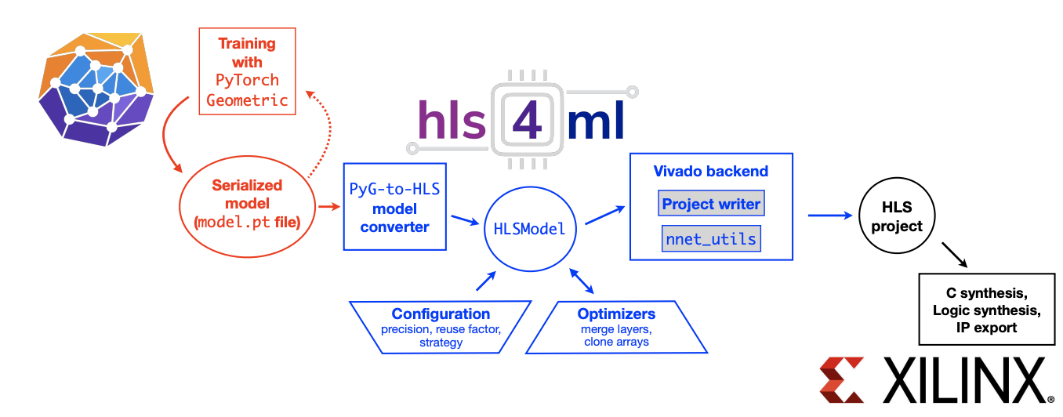
GNN Implementation in hls4ml
First version of hls4ml-based Graph encoder available
https://arxiv.org/pdf/2112.02048.pdf
Simplified Graph-based encoding to hls4ml-style interface
Critical optimization needed in construction of Graph-based mapping

Slide 28
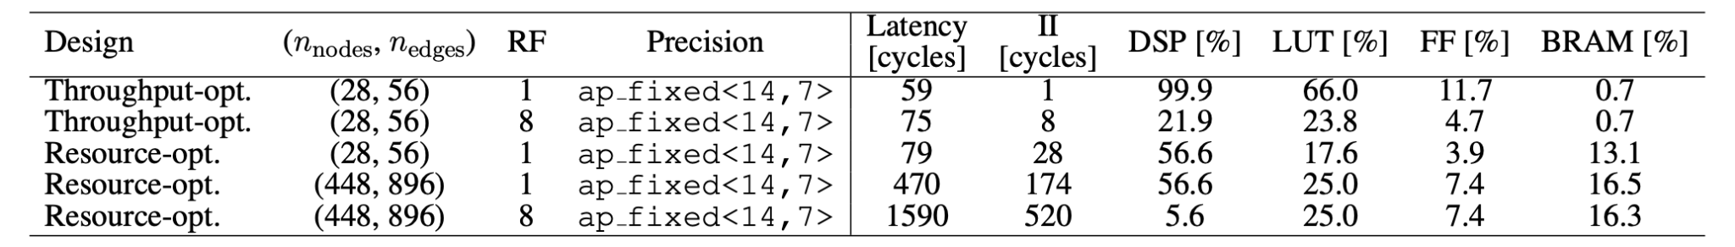
GNN Planned Upgrade in hls4ml
@200 MHz, 1590 Cycles → 7.5μs
Active work is underway to improve the GNN implementation
Base implementation has been updated twice in 2022
A third update will start in mid December, focusing on 3 examples
  Example 1: Tri-muon reconstruction with the LHC (muon endcaps)
  Example 2: Heavy flavor tracking at sPHENIX
  Example 3: Silicon strip tracking at LHC
Current Graph encoder to be optimized (adjacency matrix computation)
  Aiming to centrally rework this with core hls4ml developers
  Will be a central project across several domains
Notes:
Add text

Slide 29

Demonstrator Implementation
- Jakub Kvapil

Slide 30

Demonstrator Development @ LANL, ORNL and CCNU
Why a demonstrator?
sPHENIX technologies rapidly evolving at the time of proposal
sPHENIX DAQ will be ready in early 2023
  Parallelize development in early stage to be ready for final deployment
Fabricate more FELIX boards later
  The AI core logic will be implemented on VC709 which is the FELIX protoboard (share similar resources and is supported)
LANL Setup

Slide 31
Demonstrator Implementation
GPU/CPU processing
Beam vertex(x,y) alignment,
calibration etc.
Work in Progress
KC705
(MVTX)
sPHENIX raw data
Simulation
AI FPGA
VC709
Fast HF
trigger output
DONE
e-Link/PCIe
g-Link
KC705
(INTT)
Work in Progress
DONE
Both KC705 and VC709 will be replaced by FLX712 at deployment stage

Slide 32


sPHENIX RAW Hit Data Simulation
LANL
In order to test the full loop feedback AI system detector hits must be known
Code developed to transform MC JSON hit patterns into MVTX and INTT raw data streams
MVTX sensor
readout

Slide 33

KC705 MC Raw Data Transmission Demonstrated
CCNU
Simulated data must be streamed to the AI/FPGA, VC709/FLX712
KC705 is used to read the MC data via PCI XDMA and transmit them using g-Links
One link for MVTX and one for INTT
0x0000
0x0001
n
0xFFFF
Package ID
63:48
63:48
63:48
63:48
63:32
0x0000
0x0001
n
0xFFFF
47:32
47:32
47:32
47:32
64 bit
Head
0x0000
0x0001
…
n
…
0xFFFF
31:16
31:16
31:16
31:16
31:0
0x0000
0x0001
n
0xFFFF
15:0
15:0
15:0
15:0
payload 1
payload 2
payload 3
payload n+2
payload 2^16+1
One packet
PCIe Width: 64bit

Slide 34
FLX712 Raw MVTX Data Transmission to AI-FPGA
ORNL
Success!
FELIX input: up to 24 GBT links at 3.2 Gbps payload rate
MUX Logic: multiple GBT packets into raw data packets with header
GTH output: ~8 GTH wizard data streams (8b10b encoded) at up to 14 Gbps
KCU105 simulates the AI/FPGA board that receives the GBT data and contains the AI engine
Implemented GTH wizard example design to measure bit errors and verify received data

Slide 35
Timeline and Outlook
2021
2022
2023
2024
2025
2030+
Project funded by DOE FOA
  Dec. 2021 (Lab)
  Jan. 2022 (Univ.)
MVTX & INTT SRO
Fast tracking & trigger algorithms in place
Initial FPGA bitstream
GPU feedback machine R&D
Refine interface between system and detectors
Improve algorithms with latest data stream
Pre-commissioning
Deploy device at sPHENIX pp/pAu run
EIC preliminary TDR (CD2)
Final design for EIC TDR (CD3)
Take advantage of new technology if required
Deploy device at EIC
Great progress, on track to succeed in 2023
Future plan, 2024+

Slide 36
Backup slides

Slide 37


sPHENIX and EIC Schedules
sPHENIX Run Plan: 2023-2025
pp and pAu run in 2024
EIC Project Plan (as of 11/05/2022)
ePIC TDR for CD2/CD3A, 2024
Final design/construction, 2025

Slide 38
EIC: ePIC DAM Candidates: ATLAS “FELIX”
FELIX FLX-181 Prototype (BNL)
Current ATLAS Phase 1/ sPHENIX FELIX BNL-712v2
(Hao Xu, BNL, DAQ WG meeting 7/2021)
Assembled 24ch FLX-181 with 25 Gbps FireFly FMC+
Current Design of FELIX FLX-182

Slide 39
FELIX Status

