Slide 1
SamTec Cable Test & ALPIDE Driver Evaluation
Alex, Ming

Slide 2
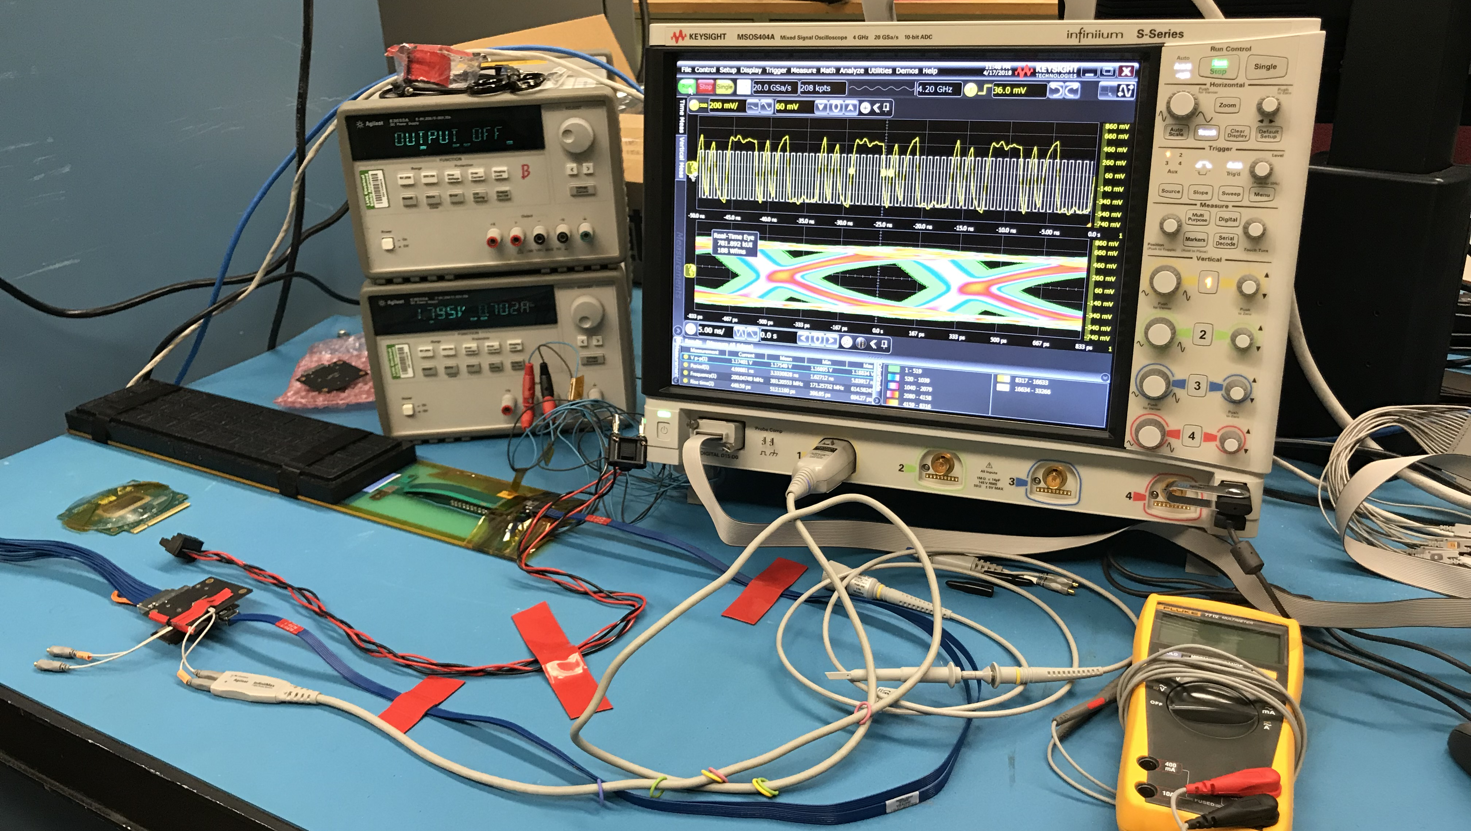
System Setup
w/ MOSAIC
9-chip IB HIC
Chip-8
Chip-0

Slide 3
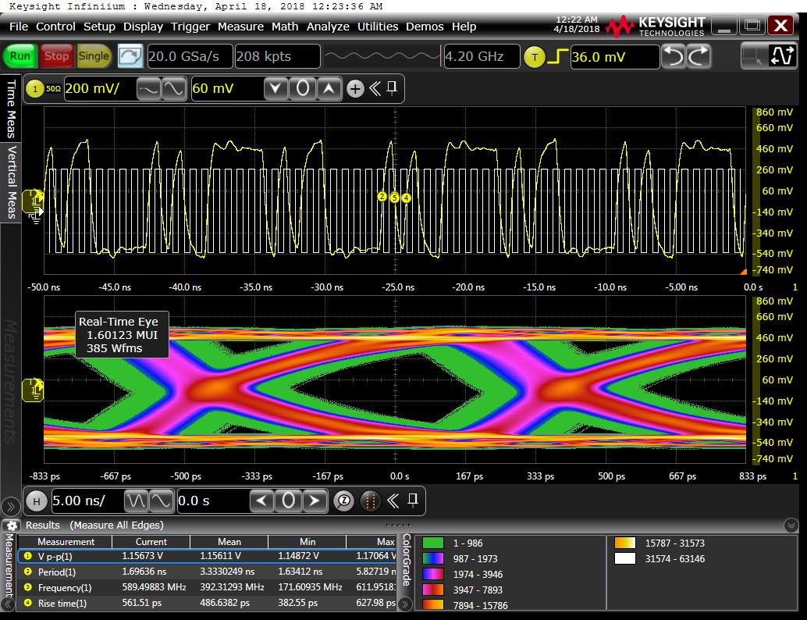
Running condition:
-1m SamTec Cable
Default ALPIDE setting
Chip0 signals
Vp-p = 1157 mV
Good signal

Slide 4
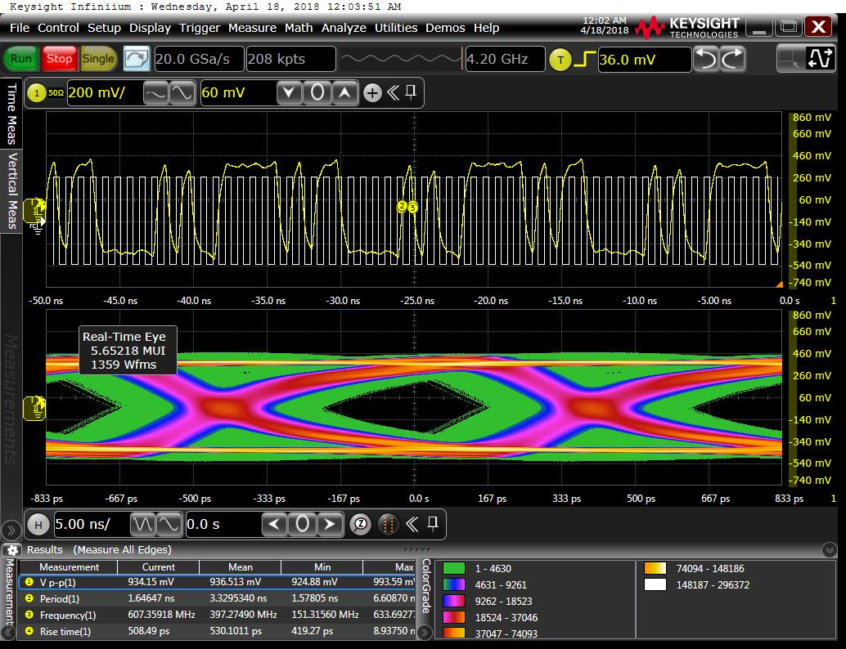
Chip-8 (furthest chip?)
-1m SamTec Cable
Default ALPIDE setting
Vp-p = 934 mV

Slide 5
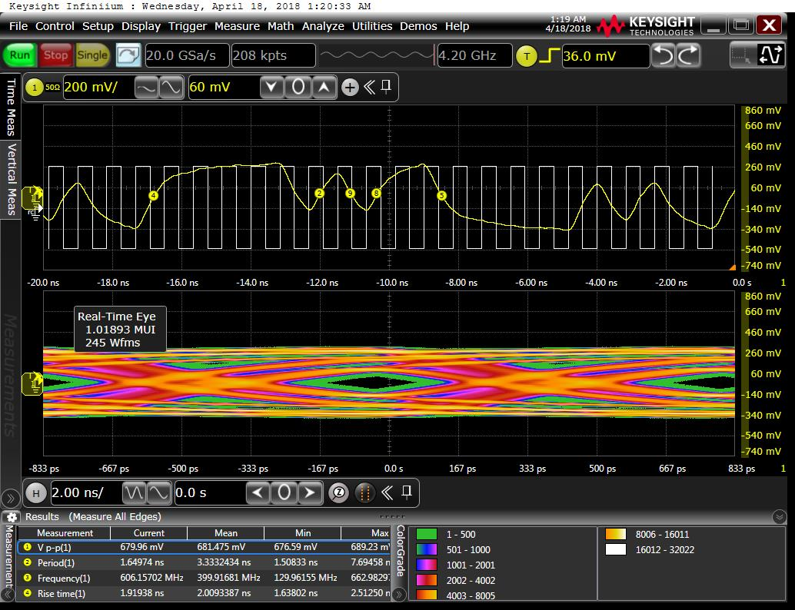
5-m cable:
Can’t see chip-0,
only 4 working chips:
Chip-8 used for evaluation
Vp-p = 679 mV
Weaker signal

Slide 6
7m and 10m cables
Can’t see signal
No chip found under “test_fifo”.
Under investigation

Slide 7
1-m cable test, different Driver Strength
DTUDriver [4-bit]: 0 -15
DTUPreEMP [4-bit]: 0-15
I (mA) | DTUDriver | DUTPreEMP | Chip-0 Vp-p (V)
825 | 15 | 15 | 1.1
815 | 15 | 1 | 0.98
796 | 1 | 15 | 0.69
780 | 1 | 1 | No signal

Slide 8
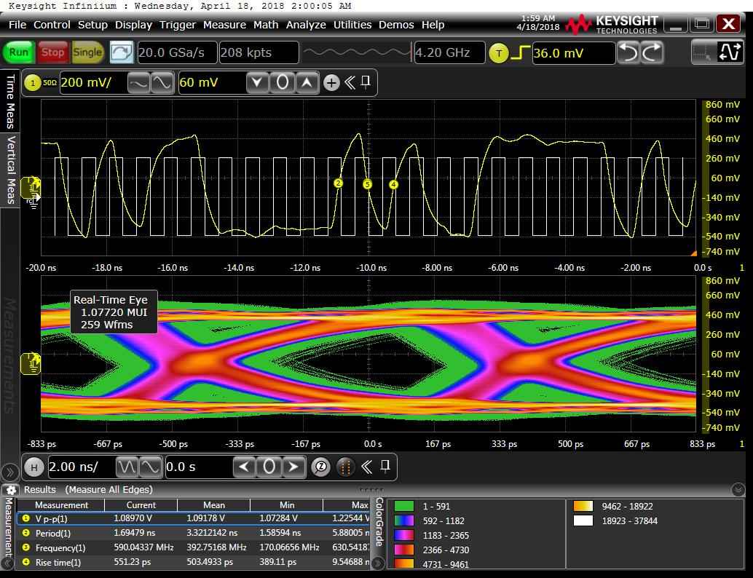
Driver = 15 & PreEMP = 15, Chip0
1-m cable
5 enabled chips
Check outputs from
chip0 and chip-8

Slide 9
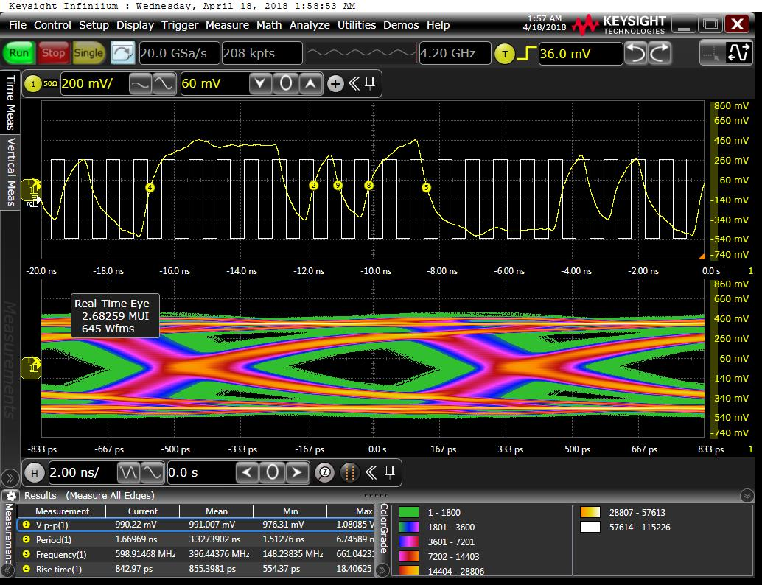
Driver = 15 & PreEMP = 1, Chip0
1-m cable
5 enabled chips
Check outputs from
chip0 and chip-8

Slide 10
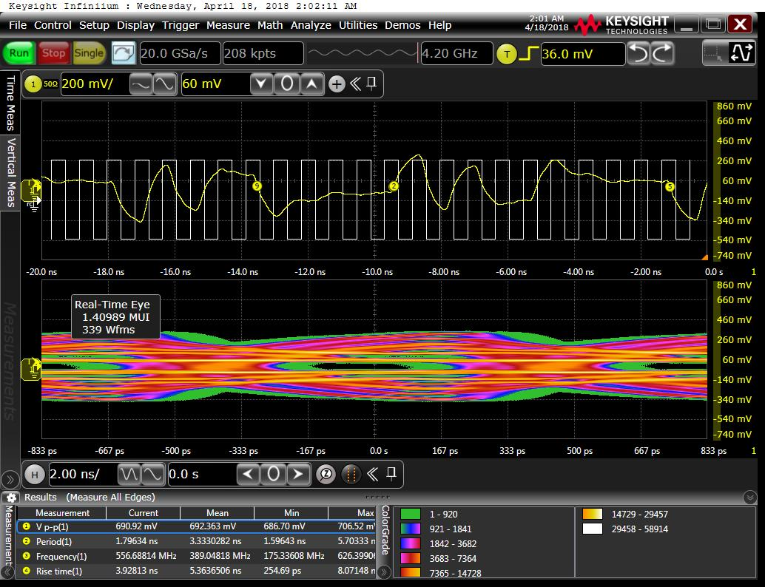
Driver = 1 & PreEMP = 15, Chip0
1-m cable
5 enabled chips
Check outputs from
chip0 and chip-8

Slide 11
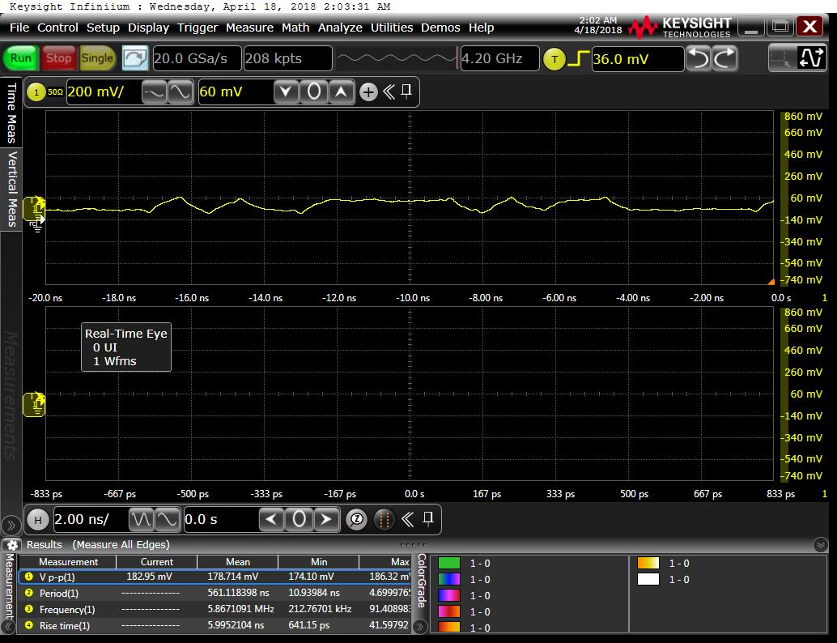
Driver = 1 & PreEMP = 1, Chip0
1-m cable
5 enabled chips
Check outputs from
chip0 and chip-8

