Slide 1
MVTX cable extension discussion March 26th, 2018
sPHENIX MVTX LDRD team

Slide 2
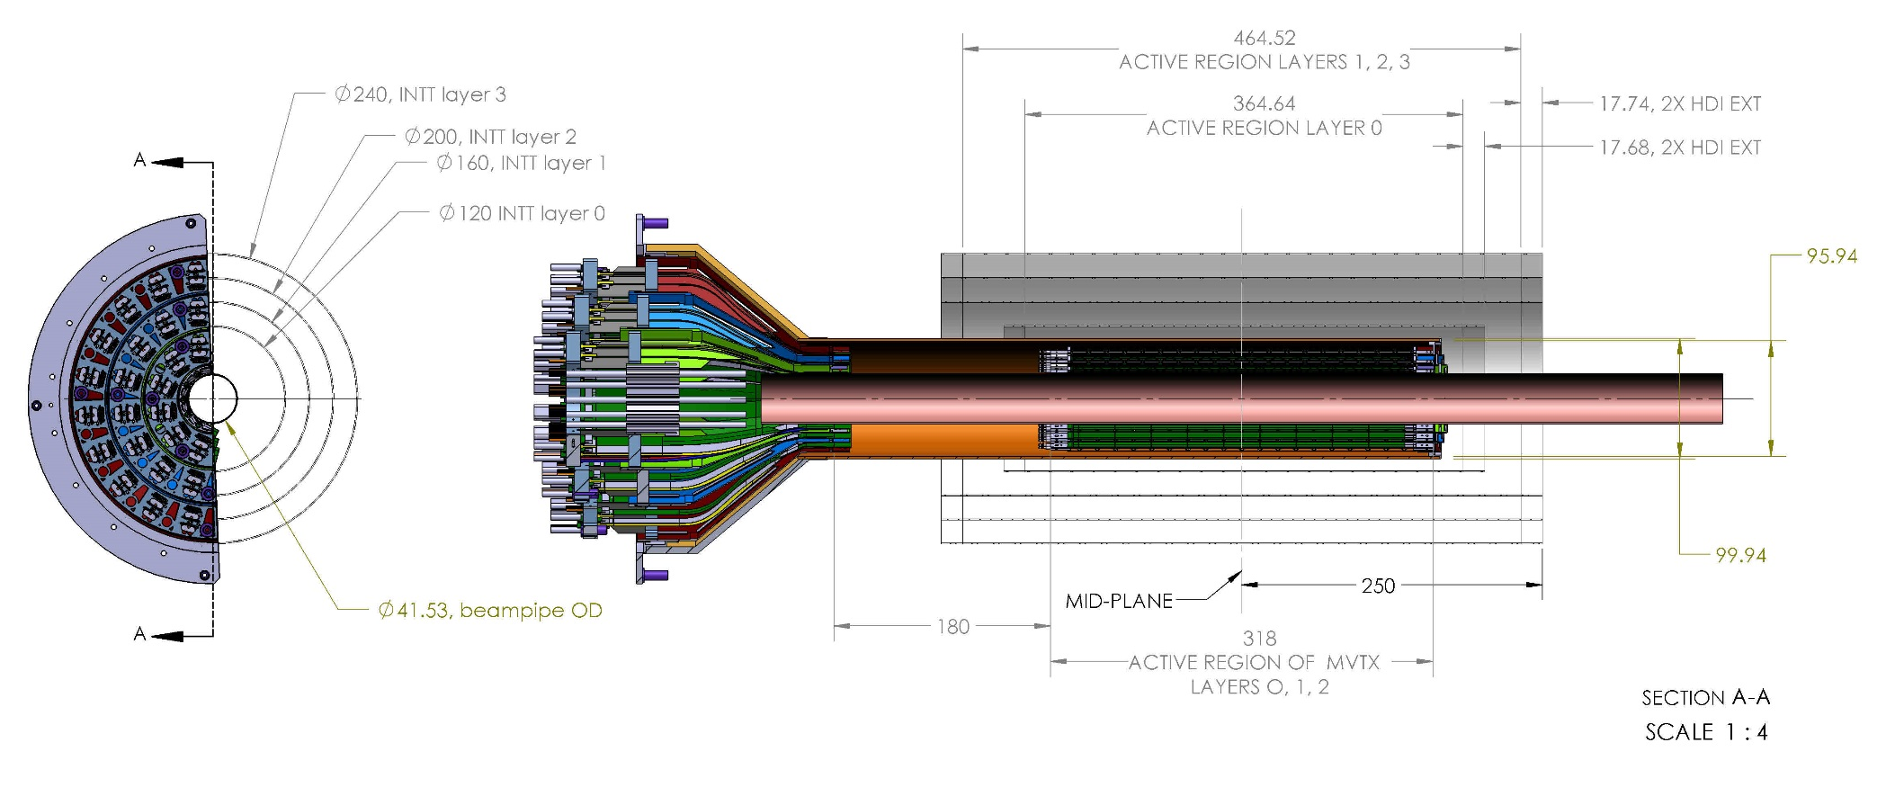
CAD model, MVTX/INTT;
Translate the conical section of MVTX by 180.0 mm along the beam axis
All dimensions in millimeters
A common integration group, combining the MVTX, INTT, TPC and sPHENIX detector representatives, has been discussing options regarding geometries and interferences to ensure that all detectors, supports, and services are compatible.

Slide 3
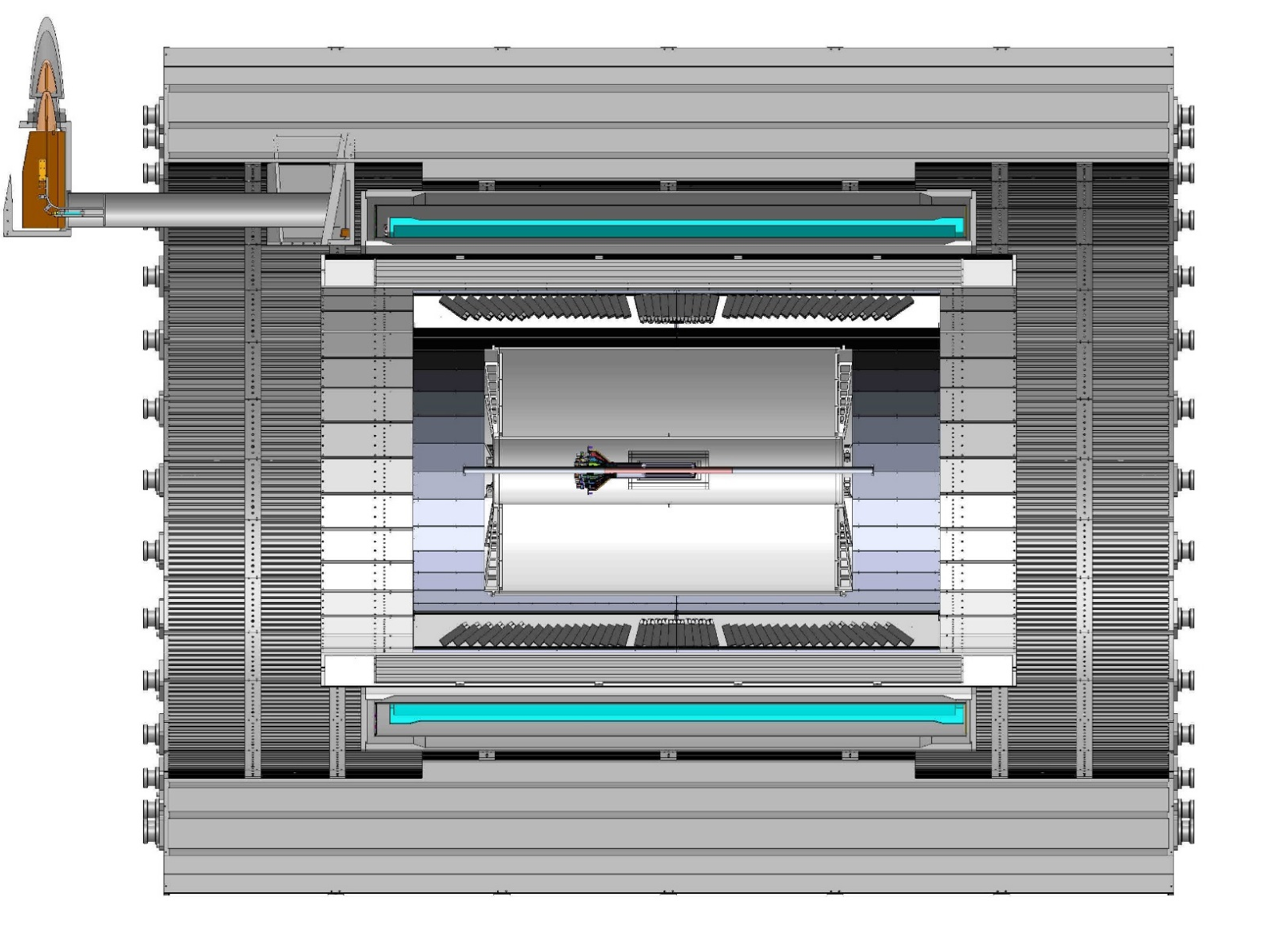
sPHENIX CAD model sectioned - view showing overall scale of sPHENIX detector; including all three tracking elements; MVTX, INTT and TPC
TPC
INTT
3,285.235 mm
NOTE; MVTX service cone and supports are not shown

Slide 4
Sheet 2, showing extension to both the composite shell and MVTX extension cables by 180.0mm

Slide 5
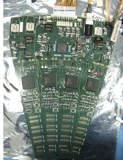
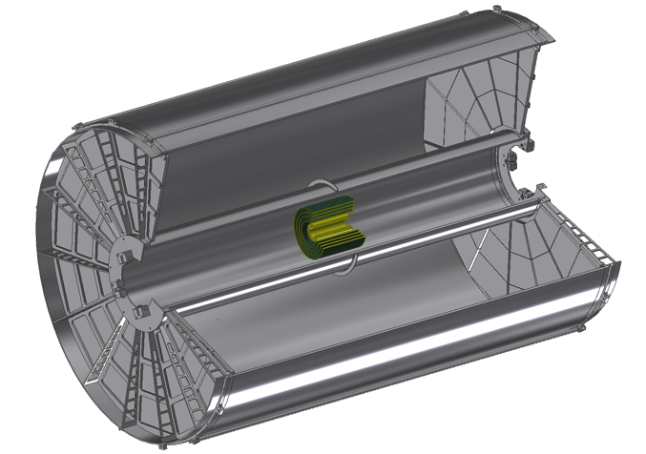
Readouts from both North and South
ROC boards mount off inner EMCAL
Identical to FVTX Big Wheel
35cm
Bus Extender
ROC
Boards
Bus Extender
105 cm
η=1
ROC
Boards
η=0
The bus extender needs to run to ROC boards (reuse FVTX ROC) outside TPC.
Minimum length is 105cm – ladder length + distance to ROC board.

Slide 6
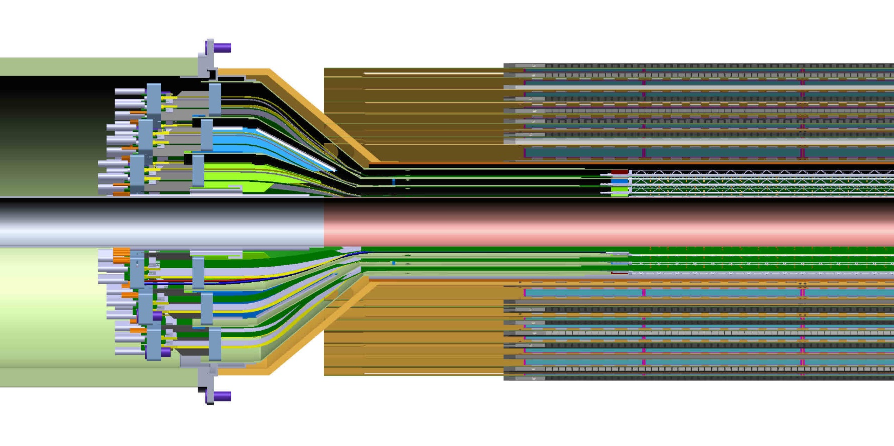
Detail from previous slide;
It is clear from this detail view the conical region of the MVTX detector barrel with the INTT that the MVTX will need to translate in Z by at least another 50.0 mm in addition to the 180.0mm that is seen in this model

Slide 7
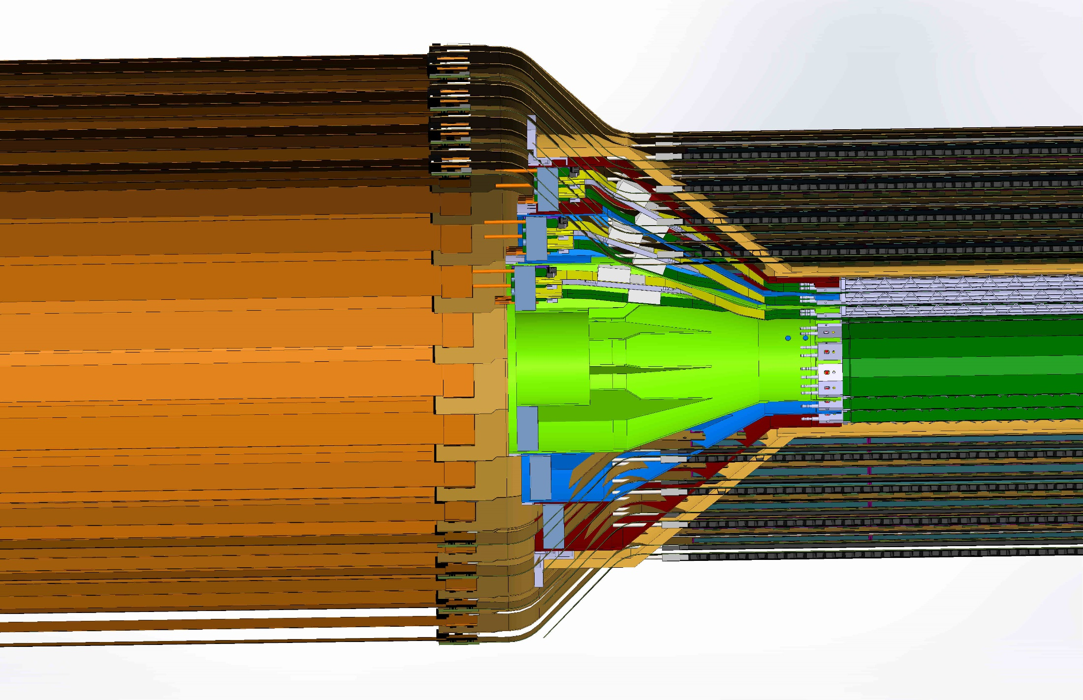
Original MVTX without 18.0cm extension and latest INTT extension cables:

Slide 8
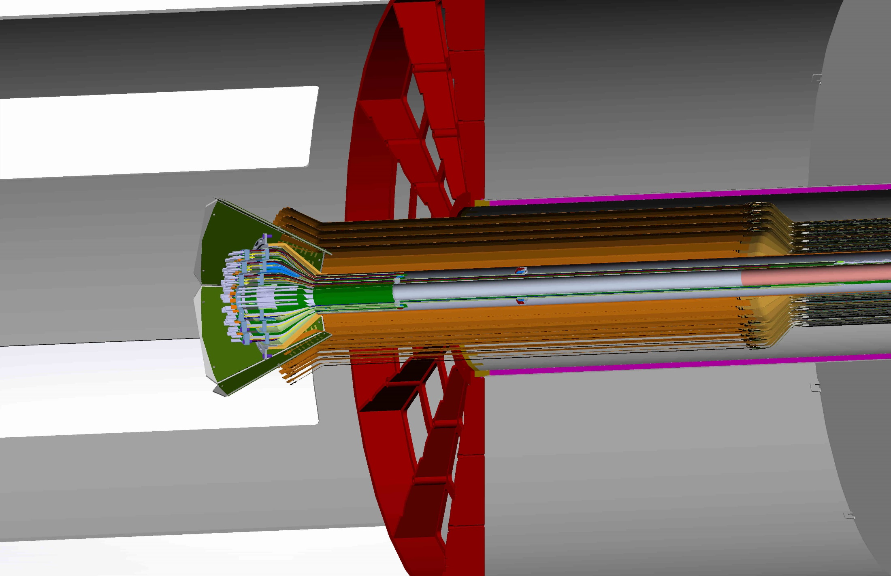
MVTX with 1308 mm extension bring conical region outside of the INTT

Slide 9
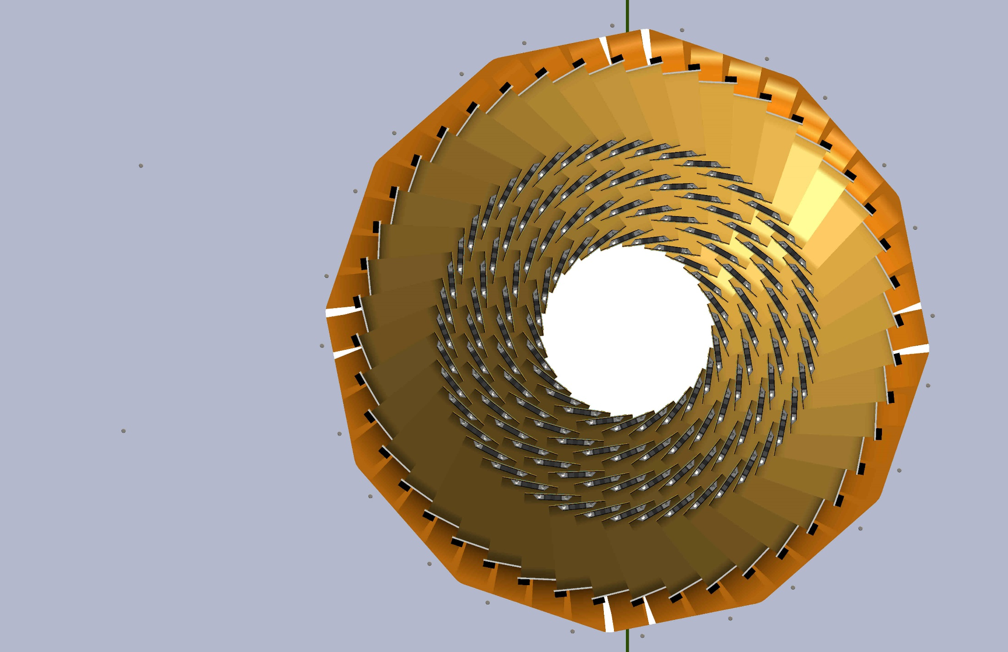
INTT extension cable cross-section;

Slide 10
Cross-section INTT extension cables;
Diameter of inner bore INTT cables in slide 9, MVTX cone would need to have a smaller diameter:

Slide 11
Aluminum Flex
Copper Flex
Bidge Flex

Slide 12
Aluminum Flex
Copper Flex

Slide 13
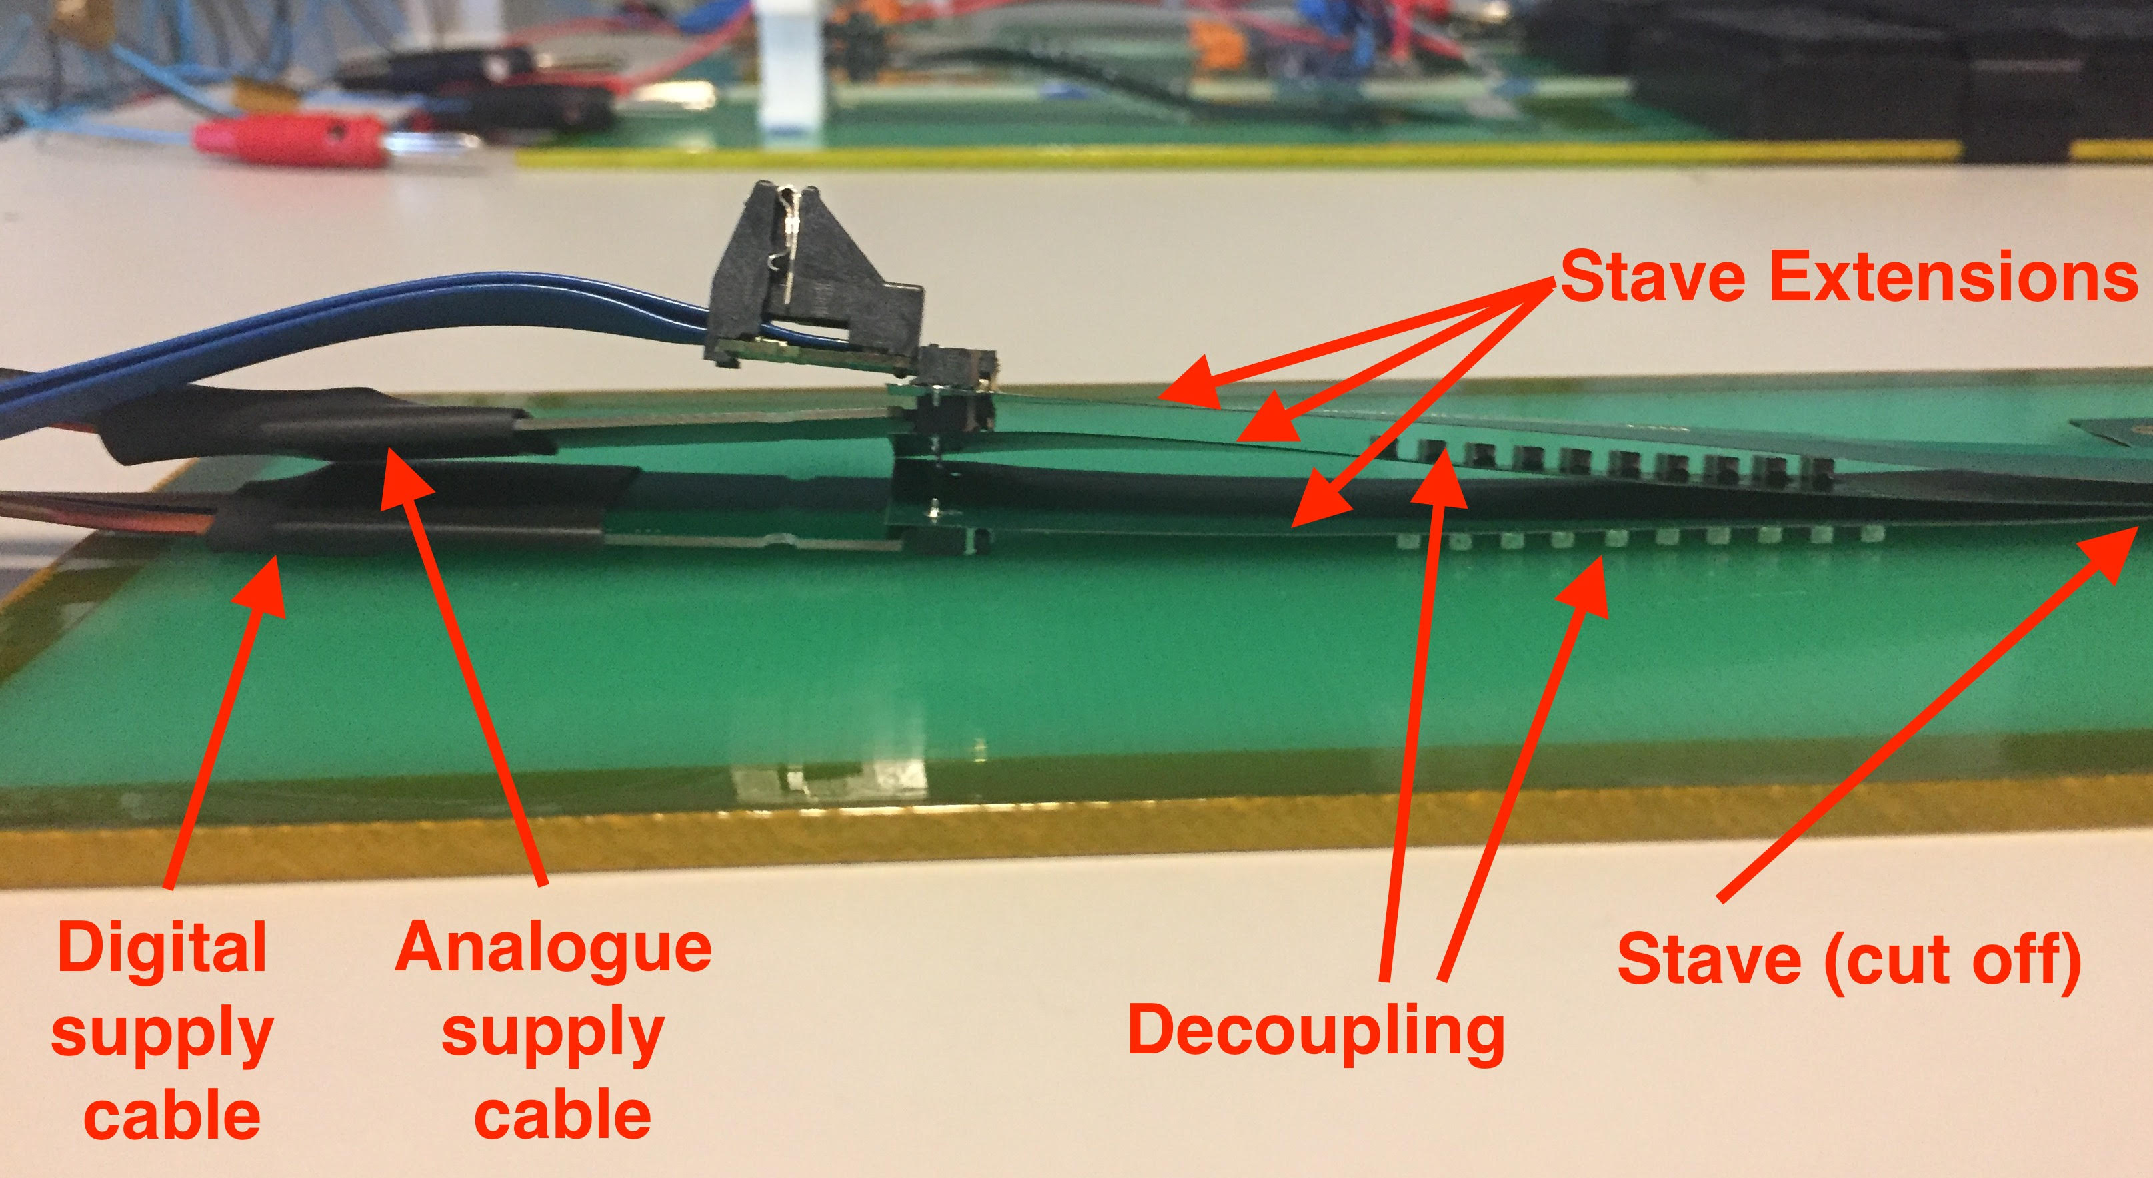

Slide 14
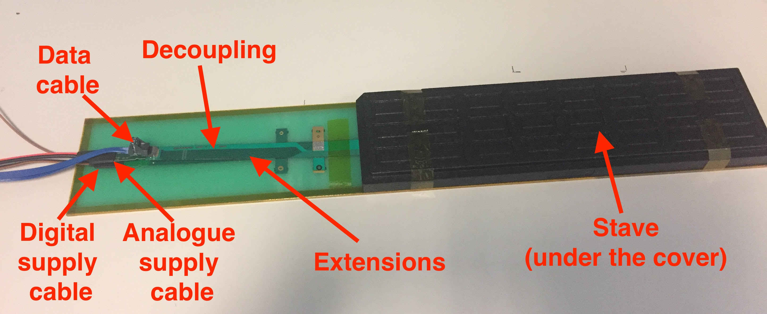

Slide 15
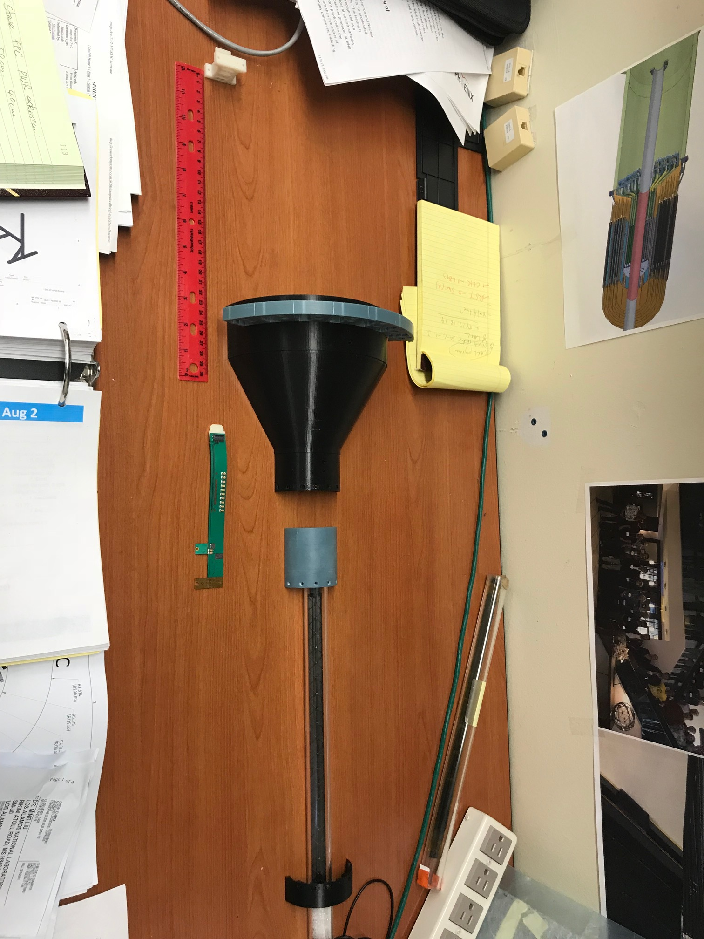
Updated 4/6/2018
- FPC PWR extension: Default = 15cm;
- 40/50/60 cm?
- 150cm?
- FPC maximum additional length <=10cm
- 60/50/40 cm PWR extension possible?
10cm
15cm
50cm

Slide 16
ITS/IB FPC, 50cm long; CERN can make upto 60cm long ones but need to be tested.
Caps, resistors, connectors, etc
Is there a CAD model that includes the surface mount components on the end of the FPC? Any other detail features -

Slide 17
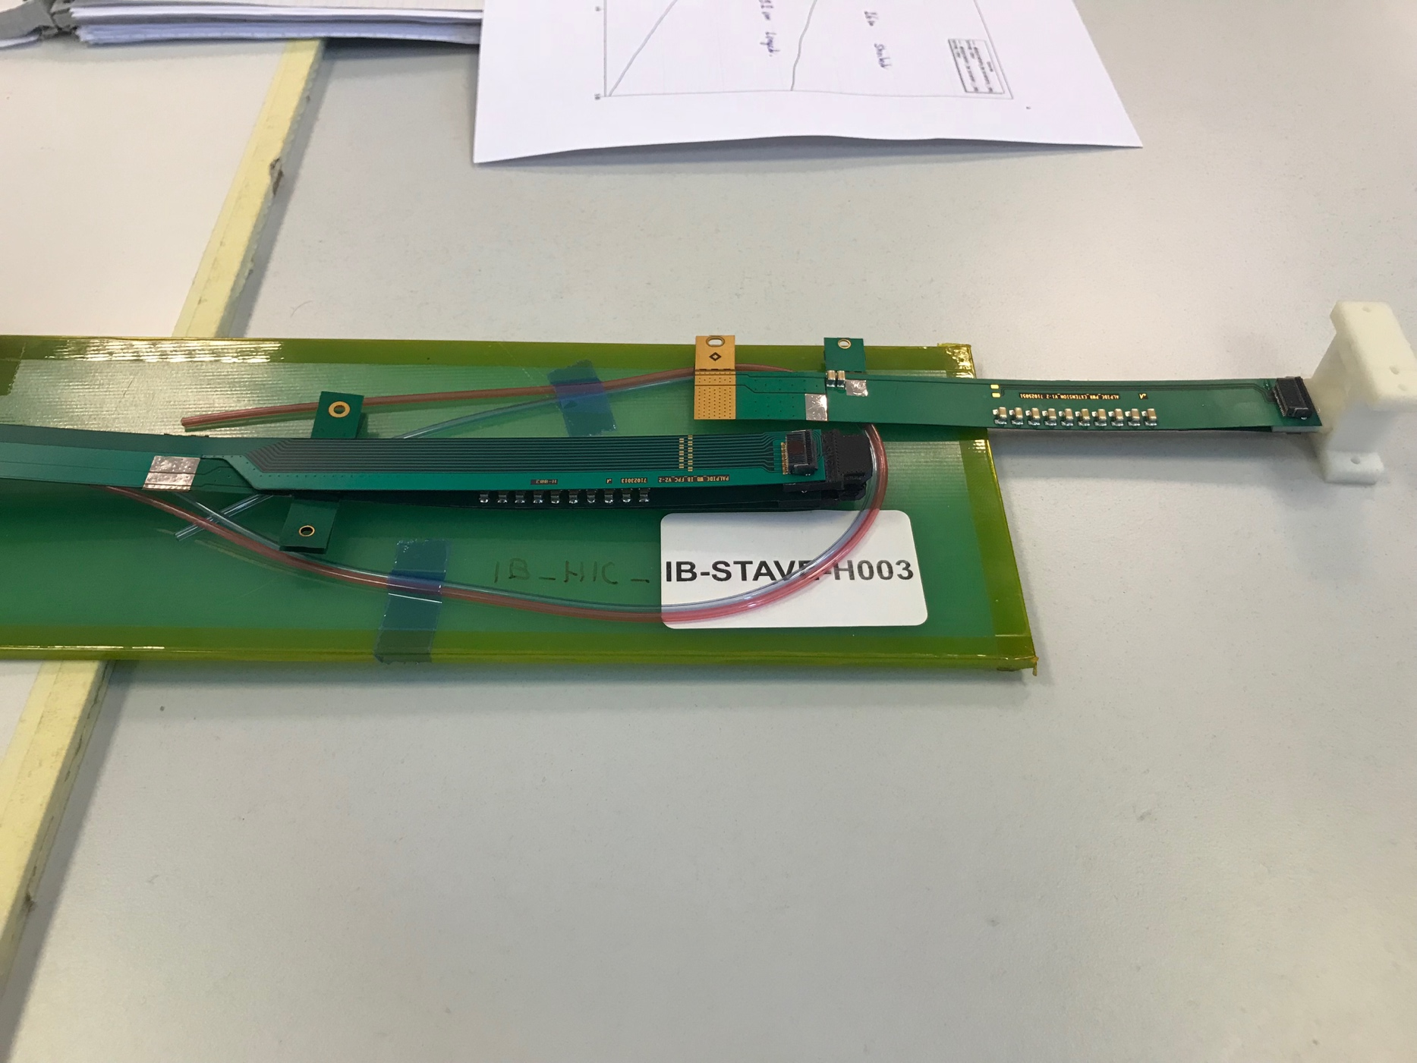
FPC R&D @CERN and LANL
Analogy and Digital Power
Extension
High-speed signal, 1.2Gbps
Try to extend high-speed portion of FPC
by 10cm @CERN, September 18
2) Try to extend AV and DV by 50+cm at LANL,
by summer 18

