Slide 1
sPHENIX Status
sPHENIX officially received CD-0 Sept 2016. BNL notification came 1.5 weeks ago.
The FPD has been identified. Lloyd Nelson BHSO.
The NP Program Manager will be Elizabeth Bartosz
Stephanie LaMontagne has submitted memo to BNL CFO requesting EPR
Setting up project accounts this week.
Lloyd would like to meet with me bi-weekly at BHSO. Elizabeth Bartosz will call in as needed.
Request from DOE for sPHENIX OPC plan by Dec 10.
Jim Sowinski has set up a monthly phone call with me on PHENIX R&R.
Preparation for full-field magnet test of sPHENIX SC-Magnet (formally the BaBar magnet) ongoing. Test scheduled for Feb.
R&D on all detector systems progressing.
FNAL test beam for calorimeter systems scheduled for Jan-Feb 2017
Full size Hadronic calorimeter mechanical module (6.3 m, 13.5 tons) to be built this year
Removal of old PHENIX experimental equipment is progressing in Building 1008.

Slide 2
Near Term Priority Items for the Project
Prepare for a CD-1 review in the June 2017 (Target date)
Revise the sPHENIX bottoms-up cost estimate and project plan.
Need to update all costs. Most, except the Tracker, are nearly 2 years old.
We will meet with the L2 managers Thursday to start revising the Project Plan.
Prepare the EMCal and HCAL for the next FNAL test beam
Jan 18 – Feb 21
Order the full size OHCal prototype
Complete the full-field magnet test early CY2017
Generate the documents for a CD-1 review
Continue progress on all sPHENIX design and R&D
All design and R&D must be completed prior to CD-3b
Identify all engineers and designers needed to meet this schedule

Slide 3
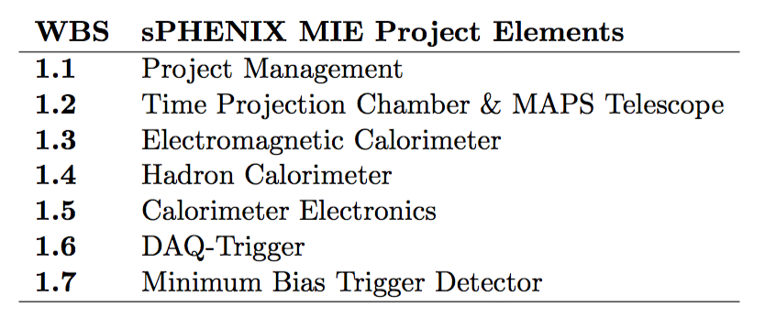
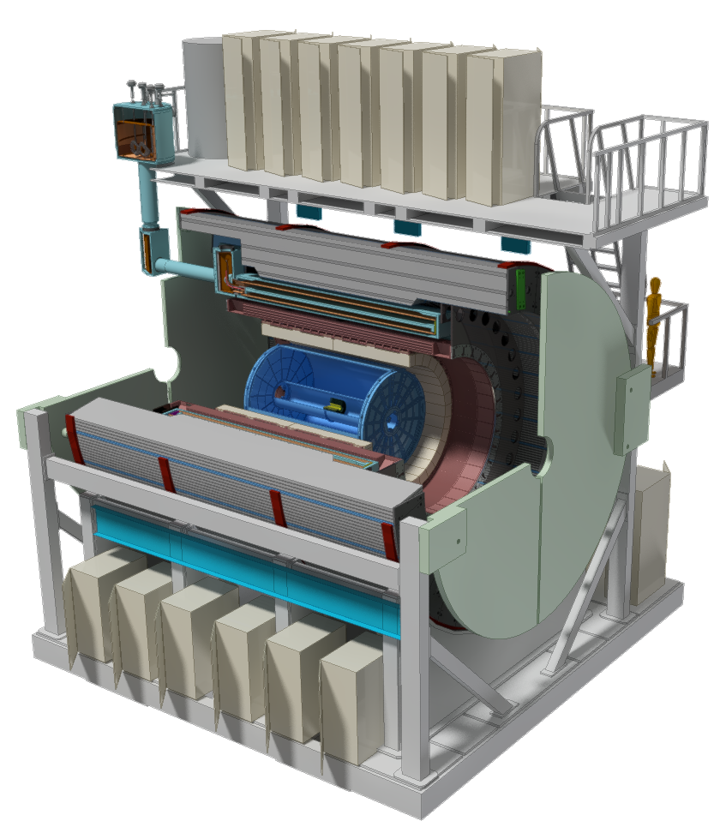
Scope of sPHENIX MIE
The MIE scope will be tracked with EVMS and reported to DOE
The Infrastructure and Facility upgrade will be managed by the Project team. Likely reported to NPP/BNL. Could require EVMS
The Ops labor supporting the MIE will also be managed by the Project team and reported to NPP.
MAPS and INTT are treated like deliverables and tracked with milestones

Slide 4
Projected sPHENIX Schedule
CD-0 Sept 2016
Test Beam at FNAL(2nd round prototyping) Jan 2017
CD-1 Practice Review – v1(sPHENIX organized) Feb 2017
CD-1 Practice Review – v2(Director organized) April 2017
OPA-CD-1/CD-3a Review Jun 2017(Target date)
CD-1/CD-3a authorization Nov-Dec 2017
All Preproduction R&D and Design complete May-Jun 2018
OPA- CD-2/CD-3b review May-Jun 2018
CD-2/CD-3b authorization Jul-Aug 2018
sPHENIX Installed, cabled, ready to commission Apr 2021
First RHIC beam for sPHENIX Jan 2022
The Resource-loaded Schedule contains 8.5 months of float to Jan 2022

Slide 5
Documents Required for CD-1
Acquisition Strategy
Conceptual Design Report
Preliminary Project Execution Plan
Preliminary Hazard analysis
Preliminary Risk Management Plan
Preliminary Risk Assessment and Risk Registry
Preliminary Security Vulnerability Assessment
Project Description
Alternate Analysis
Management Organization
Cost Range (Cost Books)
Proposed Funding Profile
WBS (WBS Dictionary)
Critical Milestones
Project Schedule
Contingency Risk/Analysis
ESH&Q
Many documents accessible at https://docdb.sphenix.bnl.gov/

Slide 6
WBS Instructions for the L2 Managers
We are doing the Project plan revision in MS-Project. All L2 managers should have access to MS-project 2010.
We are redoing the bottoms-up cost estimate. All costs should be updated with revised best estimates.
Revise all M&S costs, all labor, all durations in MS-Project
All schedules must be consistent with latest sPHENIX CD-0, CD-1/3a, CD-2/3b , subsystem install and sPHENIX completion dates.
Add contingency based on our standardized formula (LBNL-formula)
Add EDIA code: (Design, Prototype, Production, Management)
Add EVM code: (LOE, Percent complete, Planning package, 0 - 100)
Add procurement delays in schedule for duration to establish contracts
Contracts < $100k 1 mo
Contracts >$100k but < $1M 3 mo
Contracts > $1M 6 mo

Slide 7
WBS Instructions - continued
WBS
The L2 managers need to take ownership of the Project files.
Feel free to delegate the work to a deputy but let us know who that is.
The Project team will provide the sPHENIX schedule template for MS-Project
The Project team will provide the standard resource table
The Project team will provide the contingency calculation rules.
We will use MS-Project up until the CD-1 review and then switch to Primavera-6. Irina will be our P-6 operator.
Other documents
We will also need WBS dictionaries and Cost Book entries with more details than for the Nov 2015 review
These will also be the responsibility of the L2 Manager
Examples are in the sPHENIX docdb

Slide 8
Reporting to DOE
Pre CD-0 sPHENIX will report technical progress and budget expenditures quarterly
We will need the L2 managers’ input for those reports
Post-CD-1 sPHENIX will report to DOE monthly in a prescribed format.
The L2 Managers will send Irina the monthly reports that the Project team will compile and send to DOE.
The reports will be a combination of WBS L3 and L4 tasks that we will establish with DOE ahead of time as the standard monthly reporting levels (e.g Inner HCal sector production, Calorimeter digitizer board production, MAPS telescope stave production…)

Slide 9
One More CD-1 Issue
At the DOE CD-1 review expect that the L2 all have to do drill–downs of their Project files. Similar but more detailed than what was done at the Nov 2015 Cost and Schedule review.
David Lissauer would like to start these practices for the L2 Managers soon. I am trying to negotiate how soon this is. I would like to finish the new bottoms-up first.

Slide 10
Sample ATLAS Phase-2 Report

Slide 11
Sample ATLAS Phase-2 Report

Slide 12
Sample ATLAS Phase-2 Report

Slide 13
Sample ATLAS Phase-2 Report

Slide 14
Sample ATLAS Phase-2 Report

Slide 15
Sample ATLAS Phase-2 Report

Slide 16
Sample ATLAS Phase-2 Report
This document is posted on the Indico page for this meeting

Slide 17
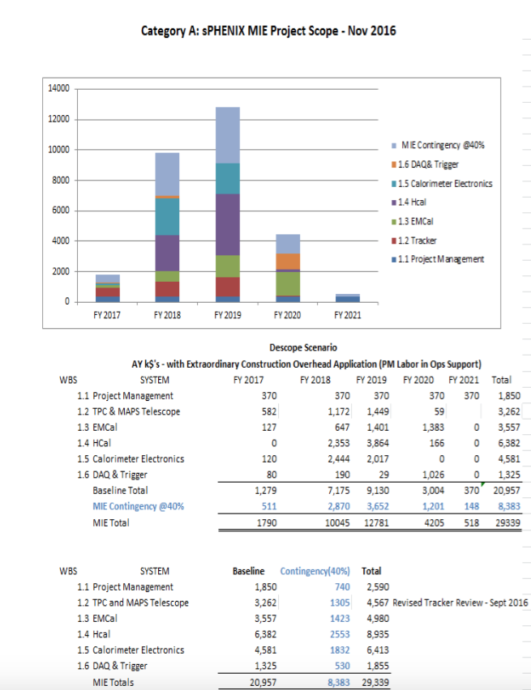
MIE Budget Estimate – Nov 2016
AY k$ with escalation and EPR and 40% contingency
FY17 is 100% OPC
FY18 is a combination of OPC and TEC

Slide 18
Engineering Needs
7.4, 2.75

Slide 19
Engineering Needs
4.7, 2.15

Slide 20
Summary
The Project’s #1 Issue is schedule and the #1a Issue is budget
We have 18 months to complete all engineering and design detailing
The Conceptual Design has started to be shortly followed by the Technical Design. Need to maintain level of engineering and design effort to make the schedule.
Will use MS-Project up until CD-1 review. Transition to P6 will happen immediately after the review. We already have a parallel Project file in P6.
We need to generate a great deal of documentation for the CD-1 review. This has to begin now if we are to be ready by next spring.

